Slide 1
Chapter 11: Opinion Mining

Slide 2
Introduction – facts and opinions
Two main types of textual information on the Web.
  Facts and Opinions
Current search engines search for facts (assume they are true)
  Facts can be expressed with topic keywords.
Search engines do not search for opinions
  Opinions are hard to express with a few keywords
    How do people think of Motorola Cell phones?
  Current search ranking strategy is not appropriate for opinion retrieval/search.
CS583, UIC

Slide 3
Introduction – user generated content
Word-of-mouth on the Web
  One can express personal experiences and opinions on almost anything, at review sites, forums, discussion groups, blogs ... (called the user generated content.)
  They contain valuable information
  Web/global scale: No longer – one’s circle of friends
Our interest: to mine opinions (sentiments) expressed in the user-generated content
  An intellectually very challenging problem.
  Practically very useful.
CS583, UIC

Slide 4
Introduction – Applications
Businesses and organizations: product and service benchmarking. Market intelligence.
  Business spends a huge amount of money to find consumer sentiments and opinions.
    Consultants, surveys and focus groups, etc
Individuals: interested in other’s opinions when
  Purchasing a product or using a service,
  Finding opinions on political topics,
Ads placements: Placing ads in the user-generated content
  Place an ad when one praises a product.
  Place an ad from a competitor if one criticizes a product.
Opinion retrieval/search: providing general search for opinions.
CS583, UIC

Slide 5
An Interesting Problem!
Intellectually challenging & major applications.
  A very popular research topic in recent years in NLP and Web data mining.
  20-60 companies in USA alone
It touches everything aspect of NLP and yet is restricted and confined.
  Little research in NLP/Linguistics in the past.
Potentially a major technology from NLP.
  But it is not easy!
CS583, UIC

Slide 6
Two types of evaluation
Regular Opinions: sentiment expressions on some entities, e.g., products, events, topics, persons.
  E.g., “the picture quality of this camera is great”
  Subjective
Comparisons: relations expressing similarities or differences of more than one entity. Usually expressing an ordering.
  E.g., “car x is cheaper than car y.”
  Objective or subjective.
CS583, UIC

Slide 7
Opinion search (Liu, Web Data Mining book, 2007)
Can you search for opinions as conveniently as general Web search?
Whenever you need to make a decision, you may want some opinions from others,
  Wouldn’t it be nice? you can find them on a search system instantly, by issuing queries such as
    Opinions: “Motorola cell phones”
    Comparisons: “Motorola vs. Nokia”
Cannot be done yet! (but could be soon …)
CS583, UIC

Slide 8
Typical opinion search queries
Find the opinion of a person or organization (opinion holder) on a particular entity or an aspect of the entity.
  E.g., what is Bill Clinton’s opinion on abortion?
Find positive and/or negative opinions on a particular entity (or some aspects of the entity), e.g.,
  customer opinions on a digital camera.
  public opinions on a political topic.
Find how opinions on an entity change over time.
How entity A compares with entity B?
  Gmail vs. Hotmail
CS583, UIC

Slide 9
Find the opinion of a person on X
In some cases, the general search engine can handle it, i.e., using suitable keywords.
  Bill Clinton’s opinion on abortion
Reason:
  One person or organization usually has only one opinion on a particular topic.
  The opinion is likely contained in a single document.
  Thus, a good keyword query may be sufficient.
CS583, UIC

Slide 10
Find opinions on an entity
We use product reviews as an example:
Searching for opinions in product reviews is different from general Web search.
  E.g., search for opinions on “Motorola RAZR V3”
General Web search (for a fact): rank pages according to some authority and relevance scores.
  The user views the first page (if the search is perfect).
  One fact = Multiple facts
Opinion search: rank is desirable, however
  reading only the review ranked at the top is not appropriate because it is only the opinion of one person.
  One opinion ≠ Multiple opinions
CS583, UIC

Slide 11
Search opinions (contd)
Ranking:
  produce two rankings
    Positive opinions and negative opinions
    Some kind of summary of both, e.g., # of each
  Or, one ranking but
    The top (say 30) reviews should reflect the natural distribution of all reviews (assume that there is no spam), i.e., with the right balance of positive and negative reviews.
Questions:
  Should the user reads all the top reviews? OR
  Should the system prepare a summary of the reviews?
CS583, UIC

Slide 12
Reviews are similar to surveys
Reviews can be regarded as traditional surveys.
  In traditional survey, returned survey forms are treated as raw data.
  Analysis is performed to summarize the survey results.
    E.g., % against or for a particular issue, etc.
In opinion search,
  Can a summary be produced?
  What should the summary be?
CS583, UIC

Slide 13
Roadmap
Opinion mining – problem definition
Document level sentiment classification
Sentence level sentiment classification
Opinion lexicon generation
Aspect-based opinion mining
Opinion mining of comparative sentences
Opinion spam detection
Summary
CS583, UIC

Slide 14
An Example Review
“I bought an iPhone a few days ago. It was such a nice phone. The touch screen was really cool. The voice quality was clear too. Although the battery life was not long, that is ok for me. However, my mother was mad with me as I did not tell her before I bought the phone. She also thought the phone was too expensive, and wanted me to return it to the shop. …”
What do we see?
  Opinions, targets of opinions, and opinion holders
SMUC-2010 @ CIKM-2010, Toronto, Canada. Bing Liu

Slide 15
Opinion mining – the abstraction
(Hu and Liu, KDD-04; Liu, Web Data Mining book 2007)
Basic components of an opinion
  Opinion holder: The person or organization that holds a specific opinion on a particular entity.
  Entity: on which an opinion is expressed
  Opinion: a view, attitude, or appraisal on an entity from an opinion holder.
Objectives of opinion mining: many ...
Let us abstract the problem
  put existing research into a common framework
We use consumer reviews of products to develop the ideas. Other opinionated contexts are similar.
CS583, UIC

Slide 16
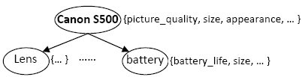
Target entity (Liu, Web Data Mining book, 2006)
Definition (entity): An entity e is a product, person, event, organization, or topic. o is represented as
  a hierarchy of components, sub-components, and so on.
  Each node represents a component and is associated with a set of attributes of the component.
An opinion can be expressed on any node or attribute of the node.
To simplify our discussion, we use the term aspect (features) to represent both components & attributes.
CS583, UIC

Slide 17
Model of an entity
An entity e_{i} is represented with a finite set of aspects, A = {a₁, a₂, …, a_{n}}.
  The entity can be expressed with any one of a final set of entity expressions EE_{i} = {oe_{i1}, oe_{i2}, …, oe_{ik}}.
  Each aspect a_{ij} ∈ A_{i} of the entity can be expressed by any one of a finite set of aspect expressions AE_{ij} = {ae_{ij1}, ae_{ij2}, …, ae_{ijm}}.
CS583, UIC

Slide 18
Model of a review
Model of a review: An opinion holder j comments on a subset of the aspects S_{j} ⊆ A of entity e.
  For each aspect a_{k} ∈ S_{j} that j comments on, he/she
    chooses a word or phrase from EE_{i} to describe the entity, and
    chooses a word or phrase from AE_{ij} to describe the aspect, and
    expresses a positive, negative or neutral opinion on a_{k}.
CS583, UIC

Slide 19
What is an Opinion? (Liu, Ch. in NLP handbook)
An opinion is a quintuple
(e_{j}, a_{jk}, so_{ijkl}, h_{i}, t_{l}),
where
  e_{j} is a target entity.
  a_{k} is a aspect of the entity e_{j}.
  so_{ijkl} is the sentiment value of the opinion of the opinion holder h_{i} on aspect a_{jk} of entity e_{j} at time t_{l}. so_{ijkl} is +ve, -ve, or neu, or a more granular rating.
  h_{i} is an opinion holder.
  t_{l} is the time when the opinion is expressed.
CS583, UIC

Slide 20
Objective – structure the unstructured
Objective: Given an opinionated document,
  Discover all quintuples (e_{j}, a_{k}, so_{ijkl}, h_{i}, t_{l}),
    i.e., mine the five corresponding pieces of information in each quintuple, and
  Or, solve some simpler problems
With the quintuples,
  Unstructured Text → Structured Data
    Traditional data and visualization tools can be used to slice, dice and visualize the results in all kinds of ways
    Enable qualitative and quantitative analysis.
CS583, UIC

Slide 21
Aspect-Based Opinion Summary
(Hu & Liu, KDD-2004)
“I bought an iPhone a few days ago. It was such a nice phone. The touch screen was really cool. The voice quality was clear too. Although the battery life was not long, that is ok for me. However, my mother was mad with me as I did not tell her before I bought the phone. She also thought the phone was too expensive, and wanted me to return it to the shop. …”
….
aspect Based Summary:
aspect1: Touch screen
Positive: 212
The touch screen was really cool.
The touch screen was so easy to use and can do amazing things.
…
Negative: 6
The screen is easily scratched.
I have a lot of difficulty in removing finger marks from the touch screen.
…
aspect2: battery life
…
Note: We omit opinion holders
CS583, UIC

Slide 22
Visual Comparison (Liu et al. WWW-2005)
+
Summary of reviews of Cell Phone 1
_
Voice
Screen
Battery
Size
Weight
+
Comparison of reviews of
Cell Phone 1
Cell Phone 2
_
CS583, UIC

Slide 23
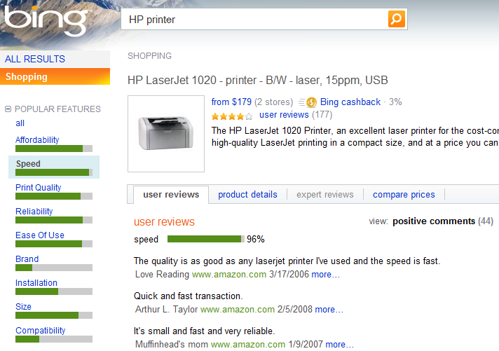
Feat.-based opinion summary in Bing
CS583, UIC

Slide 24
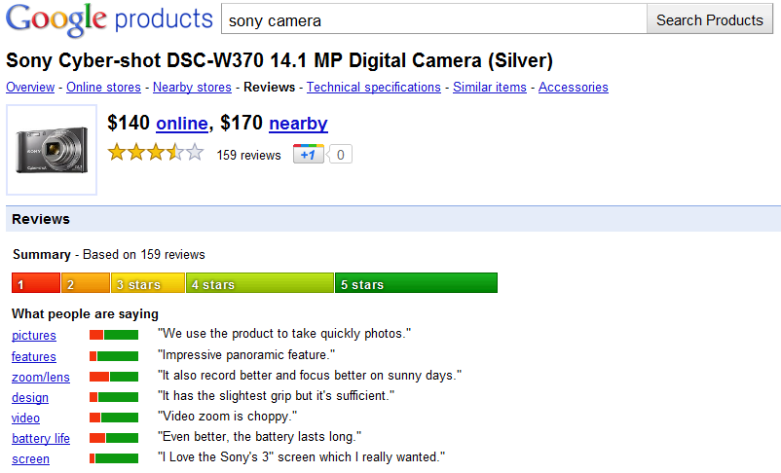

Google Product Search (Blair-Goldensohn et al 2008 ?)
Bing Liu @ AAAI-2011, Aug. 8, 2011, San Francisco, USA

Slide 25
Opinion Mining is Hard!
“This past Saturday, I bought a Nokia phone and my girlfriend bought a Motorola phone with Bluetooth. We called each other when we got home. The voice on my phone was not so clear, worse than my previous phone. The battery life was long. My girlfriend was quite happy with her phone. I wanted a phone with good sound quality. So my purchase was a real disappointment. I returned the phone yesterday.”
CS583, UIC

Slide 26
It is not Just ONE Problem
(e_{j}, a_{k}, so_{ijkl}, h_{i}, t_{l}),
  e_{j} - a target entity: Named Entity Extraction (more)
  a_{jk} - a aspect of e_{j}: Information Extraction
  so_{ijkl} is sentiment: Sentiment determination
  h_{i} is an opinion holder: Information/Data Extraction
  t_{l} is the time: Data Extraction
Co-reference resolution
Synonym match (voice = sound quality) …
None of them is a solved problem!
CS583, UIC

Slide 27
Opinion mining tasks
At the document (or review) level:
  Task: sentiment classification of reviews
    Classes: positive, negative, and neutral
    Assumption: each document (or review) focuses on a single entity (not true in many discussion posts) and contains opinion from a single opinion holder.
At the sentence level:
  Task 1: identifying subjective/opinionated sentences
    Classes: objective and subjective (opinionated)
  Task 2: sentiment classification of sentences
    Classes: positive, negative and neutral.
    Assumption: a sentence contains only one opinion
      not true in many cases.
    Then we can also consider clauses or phrases.
CS583, UIC

Slide 28
Opinion mining tasks (contd)
At the aspect level:
  Task 1 (entity extraction and grouping): Extract all entity expressions, and group synonymous entity expressions into entity clusters. Each cluster indicates a unique entity e_{i}.
  Task 2 (aspect extraction and grouping): Extract all aspect expressions of the entities, and group synonymous aspect expressions into clusters. Each aspect expression cluster of entity e_{i} indicates a unique aspect a_{ij}.
CS583, UIC

Slide 29
Opinion mining tasks (contd)
  Task 3 (opinion holder and time extraction): Extract these pieces of information from the text or structured data.
  Task 4 (aspect sentiment classification): Determine whether each opinion on an aspect is positive, negative or neutral.
  Task 5 (opinion quintuple generation): Produce all opinion quintuples (e_{i}, a_{ij}, oo_{ijkl}, h_{k}, t_{l}) expressed in D.
CS583, UIC

Slide 30
Roadmap
Opinion mining – problem definition
Document level sentiment classification
Sentence level sentiment classification
Opinion lexicon generation
Aspect-based opinion mining
Opinion mining of comparative sentences
Opinion spam detection
Summary
CS583, UIC

Slide 31
Sentiment classification
Classify documents (e.g., reviews) based on the overall sentiments expressed by opinion holders (authors),
  Positive, negative, and (possibly) neutral
  Since in our model an entity e itself is also a aspect, then sentiment classification essentially determines the opinion expressed on e in each document (e.g., review).
Similar but different from topic-based text classification.
  In topic-based text classification, topic words are important.
  In sentiment classification, sentiment words are more important, e.g., great, excellent, horrible, bad, worst, etc.
CS583, UIC

Slide 32
Unsupervised review classification
(Turney, ACL-02)
Data: reviews from epinions.com on automobiles, banks, movies, and travel destinations.
The approach: Three steps
Step 1:
  Part-of-speech tagging
  Extracting two consecutive words (two-word phrases) from reviews if their tags conform to some given patterns, e.g., (1) JJ, (2) NN.
CS583, UIC

Slide 33
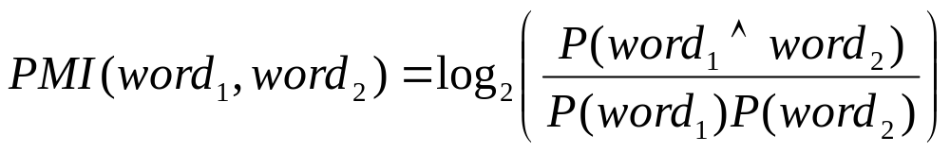
Step 2: Estimate the semantic orientation (SO) of the extracted phrases
  Use Pointwise mutual information
  Semantic orientation (SO):
SO(phrase) = PMI(phrase, “excellent”)
- PMI(phrase, “poor”)
  Using AltaVista near operator to do search to find the number of hits to compute PMI and SO.
CS583, UIC

Slide 34
Step 3: Compute the average SO of all phrases
  classify the review as recommended if average SO is positive, not recommended otherwise.
Final classification accuracy:
  automobiles - 84%
  banks - 80%
  movies - 65.83
  travel destinations - 70.53%
CS583, UIC

Slide 35
Sentiment classification using machine learning methods (Pang et al, EMNLP-02)
This paper directly applied several machine learning techniques to classify movie reviews into positive and negative.
Three classification techniques were tried:
  Naïve Bayes
  Maximum entropy
  Support vector machine
Pre-processing settings: negation tag, unigram (single words), bigram, POS tag, position.
SVM: the best accuracy 83% (unigram)
CS583, UIC

Slide 36
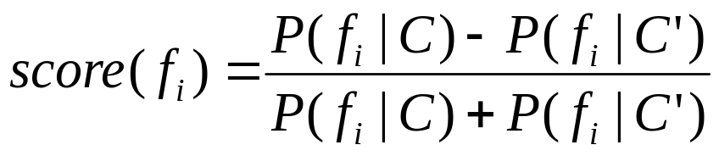
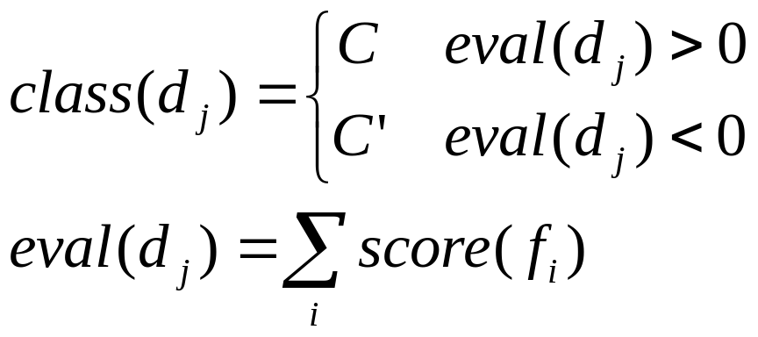
Review classification by scoring features (Dave, Lawrence and Pennock, WWW-03)
It first selects a set of features F = f₁, f₂, ……
  Note: machine learning features, not product features.
Score the features
  C and C’ are classes
Classification of a
review d_{j} (using sign):
Accuracy of 84-88%.
CS583, UIC

Slide 37
Roadmap
Opinion mining – problem definition
Document level sentiment classification
Sentence level sentiment classification
Opinion lexicon generation
Aspect-based opinion mining
Opinion mining of comparative sentences
Opinion spam detection
Summary
CS583, UIC

Slide 38
Sentence-level sentiment analysis
Document-level sentiment classification is too coarse for most applications.
Let us move to the sentence level.
Much of the work on sentence level sentiment analysis focuses on identifying subjective sentences in news articles.
  Classification: objective and subjective.
  All techniques use some forms of machine learning.
  E.g., using a naïve Bayesian classifier with a set of data features/attributes extracted from training sentences (Wiebe et al. ACL-99).
CS583, UIC

Slide 39
Using learnt patterns (Rilloff and Wiebe, EMNLP-03)
A bootstrapping approach.
  A high precision classifier is first used to automatically identify some subjective and objective sentences.
    Two high precision (but low recall) classifiers are used,
      a high precision subjective classifier
      A high precision objective classifier
      Based on manually collected lexical items, single words and n-grams, which are good subjective clues.
  A set of patterns are then learned from these identified subjective and objective sentences.
    Syntactic templates are provided to restrict the kinds of patterns to be discovered, e.g., <subj> passive-verb.
  The learned patterns are then used to extract more subject and objective sentences (the process can be repeated).
CS583, UIC

Slide 40
Subjectivity and polarity (orientation)
(Yu and Hazivassiloglou, EMNLP-03)
For subjective or opinion sentence identification, three methods are tried:
  Sentence similarity.
  Naïve Bayesian classification.
  Multiple naïve Bayesian (NB) classifiers.
For opinion orientation (positive, negative or neutral) (also called polarity) classification, it uses a similar method to (Turney, ACL-02), but
  with more seed words (rather than two) and based on log-likelihood ratio (LLR).
  For classification of each word, it takes the average of LLR scores of words in the sentence and use cutoffs to decide positive, negative or neutral.
CS583, UIC

Slide 41
Let us go further?
Sentiment classification at both document and sentence (or clause) levels are useful, but
  They do not find what the opinion holder liked and disliked.
An negative sentiment on an entity
  does not mean that the opinion holder dislikes everything about the entity.
A positive sentiment on an entity
  does not mean that the opinion holder likes everything about the entity.
We need to go to the entity level.
CS583, UIC

Slide 42
Roadmap
Opinion mining – problem definition
Document level sentiment classification
Sentence level sentiment classification
Opinion lexicon generation
Aspect-based opinion mining
Opinion mining of comparative sentences
Opinion spam detection
Summary
CS583, UIC

Slide 43
But before we go further
Let us discuss Opinion Words or Phrases (also called polar words, opinion bearing words, etc). E.g.,
  Positive: beautiful, wonderful, good, amazing,
  Negative: bad, poor, terrible, cost someone an arm and a leg (idiom).
They are instrumental for opinion mining (obviously)
Three main ways to compile such a list:
  Manual approach: not a bad idea, only an one-time effort
  Corpus-based approaches
  Dictionary-based approaches
Important to note:
  Some opinion words are context independent (e.g., good).
  Some are context dependent (e.g., long).
CS583, UIC

Slide 44
Corpus-based approaches
Rely on syntactic or co-occurrence patterns in large corpora. (Hazivassiloglou and McKeown, ACL-97; Turney, ACL-02; Yu and Hazivassiloglou, EMNLP-03; Kanayama and Nasukawa, EMNLP-06; Ding and Liu SIGIR-07)
  Can find domain (not context!) dependent orientations (positive, negative, or neutral).
(Turney, ACL-02) and (Yu and Hazivassiloglou, EMNLP-03) are similar.
  Assign opinion orientations (polarities) to words/phrases.
  (Yu and Hazivassiloglou, EMNLP-03) is different from (Turney, ACL-02)
    use more seed words (rather than two) and use log-likelihood ratio (rather than PMI).
CS583, UIC

Slide 45
Corpus-based approaches (contd)
Use constraints (or conventions) on connectives to identify opinion words (Hazivassiloglou and McKeown, ACL-97; Kanayama and Nasukawa, EMNLP-06; Ding and Liu, 2007). E.g.,
Conjunction: conjoined adjectives usually have the same orientation (Hazivassiloglou and McKeown, ACL-97).
    E.g., “This car is beautiful and spacious.” (conjunction)
  AND, OR, BUT, EITHER-OR, and NEITHER-NOR have similar constraints.
  Learning using
    log-linear model: determine if two conjoined adjectives are of the same or different orientations.
    Clustering: produce two sets of words: positive and negative
  Corpus: 21 million word 1987 Wall Street Journal corpus.
CS583, UIC

Slide 46
Corpus-based approaches (contd)
(Kanayama and Nasukawa, EMNLP-06) takes a similar approach to (Hazivassiloglou and McKeown, ACL-97) but for Japanese words:
  Instead of using learning, it uses two criteria to determine whether to add a word to positive or negative lexicon.
  Have an initial seed lexicon of positive and negative words.
(Ding and Liu, 2007) also exploits constraints on connectives, but with two differences
  It uses them to assign opinion orientations to product aspects (more on this later).
    One word may indicate different opinions in the same domain.
      “The battery life is long” (+) and “It takes a long time to focus” (-).
    Find domain opinion words is insufficient.
  It can be used without a large corpus.
CS583, UIC

Slide 47
Corpus-based approaches (contd)
A double propagation method is proposed in [Qiu et al. IJCAI-2009]
It exploits dependency relations of opinions and aspects to extract opinion words.
  Opinion words modify entity aspects/features, e.g.,
  “This camera has long battery life”
The algorithm essentially bootstraps using a set of seed opinion words
  With the help of some dependency relations.
CS583, UIC

Slide 48
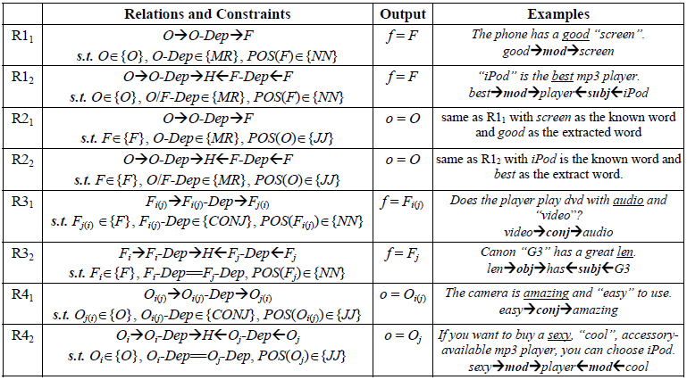
Rules from dependency grammar
CS583, UIC

Slide 49
Dictionary-based approaches
Typically use WordNet’s synsets and hierarchies to acquire opinion words
  Start with a small seed set of opinion words.
  Use the set to search for synonyms and antonyms in WordNet (Hu and Liu, KDD-04; Kim and Hovy, COLING-04).
  Manual inspection may be used afterward.
Use additional information (e.g., glosses) from WordNet (Andreevskaia and Bergler, EACL-06) and learning (Esuti and Sebastiani, CIKM-05).
Weakness of the approach: Do not find context dependent opinion words, e.g., small, long, fast.
CS583, UIC

Slide 50
Roadmap
Opinion mining – problem definition
Document level sentiment classification
Sentence level sentiment classification
Opinion lexicon generation
Aspect-based opinion mining
Opinion mining of comparative sentences
Opinion spam detection
Summary
CS583, UIC

Slide 51
Aspect-based opinion mining and summarization (Hu and Liu, KDD-04)
Again focus on reviews (easier to work in a concrete domain!)
Objective: find what reviewers (opinion holders) liked and disliked
  Product aspects and opinions on the aspects
Since the number of reviews on an entity can be large, an opinion summary should be produced.
  Desirable to be a structured summary.
  Easy to visualize and to compare.
  Analogous to but different from multi-document summarization.
CS583, UIC

Slide 52
The tasks
We have 5 tasks, but only focus on two.
  Task 2 (aspect extraction and grouping): Extract all aspect expressions of the entities, and group synonymous aspect expressions into clusters. Each aspect expression cluster of entity e_{i} indicates a unique aspect a_{ij}.
  Task 4 (aspect sentiment classification): Determine whether each opinion on an aspect is positive, negative or neutral.
CS583, UIC

Slide 53
Aspect extraction(Hu and Liu, KDD-04; Liu, Web Data Mining book 2007)
Frequent aspects (called features before): those aspects that have been talked about by many reviewers.
Use sequential pattern mining
Why the frequency based approach?
  Different reviewers tell different stories (irrelevant)
  When product aspects are discussed, the words that they use converge.
  They are main aspects.
Sequential pattern mining finds frequent phrases.
Many companies implemented the approach (no POS restriction).
CS583, UIC

Slide 54
Using part-of relationship and the Web
(Popescu and Etzioni, EMNLP-05)
Improved (Hu and Liu, KDD-04) by removing those frequent noun phrases that may not be aspects: better precision (a small drop in recall).
It identifies part-of relationship
  Each noun phrase is given a pointwise mutual information score between the phrase and part discriminators associated with the product class, e.g., a scanner class.
  The part discriminators for the scanner class are, “of scanner”, “scanner has”, “scanner comes with”, etc, which are used to find components or parts of scanners by searching on the Web: the KnowItAll approach, (Etzioni et al, WWW-04).
CS583, UIC

Slide 55
Infrequent aspects extraction
How to find the infrequent aspects?
Observation: the same opinion word can be used to describe different aspects and entities.
  “The pictures are absolutely amazing.”
  “The software that comes with it is amazing.”
Frequent aspects
Infrequent aspects
Opinion words
CS583, UIC

Slide 56
Using dependency relations
A same double propagation approach in (Qiu et al. IJCAI-2009) is applicable here.
It exploits the dependency relations of opinions and aspects to extract aspects.
  Opinions words modify entity/aspect, e.g.,
  “This camera has long battery life”
The algorithm bootstraps using a set of seed opinion words (no aspect input).
  To extract aspects (and also opinion words)
CS583, UIC

Slide 57
Rules from dependency grammar
CS583, UIC

Slide 58
Identify aspect synonyms (grouping)
Liu et al (WWW-05) made an attempt using only WordNet.
Carenini et al (K-CAP-05) proposed a more sophisticated method based on similarity metrics, but it requires a taxonomy of aspects to be given.
  The system merges each discovered aspect to a aspect node in the taxonomy.
  The similarity metrics are defined based on string similarity, synonyms and other distances measured using WordNet.
(Zhai et al Coling-2010; Zhai et al WSDM-2011) proposed a semi-supervised learning method and a unsupervised learning method together with linguistic constraints.
CS583, UIC

Slide 59
Aspect sentiment classification
For each aspect, we identify the sentiment or opinion orientation expressed by a reviewer.
We work based on sentences, but also consider,
  A sentence can contain multiple aspects.
  Different aspects may have different opinions.
  E.g., The battery life and picture quality are great (+), but the view founder is small (-).
Almost all approaches make use of opinion words and phrases. But notice again:
  Some opinion words have context independent orientations, e.g., “great”.
  Some other opinion words have context dependent orientations, e.g., “small”
Many ways to use them.
CS583, UIC

Slide 60
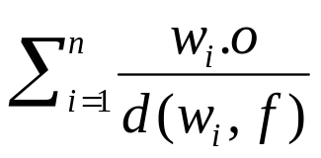
Aggregation of opinion words
(Hu and Liu, KDD-04; Ding and Liu, 2008)
Input: a pair (f, s), where f is a product feature (aspect) and s is a sentence that contains f.
Output: whether the opinion on f in s is positive, negative, or neutral.
Two steps:
  Step 1: split the sentence if needed based on BUT words (but, except that, etc).
  Step 2: work on the segment s_{f} containing f. Let the set of opinion words in s_{f} be w₁, .., w_{n}. Sum up their orientations (1, -1, 0), and assign the orientation to (f, s) accordingly.
In (Ding and Liu, SIGIR-07), step 2 is changed to
with better results. w_{i}.o is the opinion orientation of w_{i}. d(w_{i}, f) is the distance from f to w_{i}.
CS583, UIC

Slide 61
Context dependent opinions
Popescu and Etzioni (EMNLP-05) used
  constraints of connectives in (Hazivassiloglou and McKeown, ACL-97), and some additional constraints, e.g., morphological relationships, synonymy and antonymy, and
  relaxation labeling to propagate opinion orientations to words and features.
Ding and Liu (2008) used
  constraints of connectives both at intra-sentence and inter-sentence levels, and
  additional constraints of, e.g., TOO, BUT, NEGATION, ….
to directly assign opinions to (f, s) with good results (> 0.85 of F-score).
CS583, UIC

Slide 62
Basic Opinion Rules (Liu, Ch. in NLP handbook)
Opinions are governed by some rules, e.g.,
Neg → Negative
Pos → Positive
Negation Neg → Positive
Negation Pos → Negative
Desired value range → Positive
Below or above the desired value range → Negative
CS583, UIC

Slide 63
Basic Opinion Rules (Liu, Ch. in NLP handbook)
Decreased Neg → Positive
Decreased Pos → Negative
Increased Neg → Negative
Increased Pos → Positive
Consume resource → Negative
Produce resource → Positive
Consume waste → Positive
Produce waste → Negative
CS583, UIC

Slide 64
Divide and Conquer
Most current techniques seem to assume one-technique-fit-all solution. Unlikely??
  “The picture quality of this camera is great.”
  “Sony cameras take better pictures than Nikon”.
  “If you are looking for a camera with great picture quality, buy Sony.”
  “If Sony makes good cameras, I will buy one.”
Narayanan, et al (2009) took a divide and conquer approach to study conditional sentences
CS583, UIC

Slide 65
Roadmap
Opinion mining – problem definition
Document level sentiment classification
Sentence level sentiment classification
Opinion lexicon generation
Aspect-based opinion mining
Opinion mining of comparative sentences
Opinion spam detection
Summary
CS583, UIC

Slide 66
Extraction of Comparatives
(Jinal and Liu, SIGIR-06, AAAI-06; Liu’s Web Data Mining book)
Recall: Two types of evaluation
  regular opinions: “This car is bad”
  Comparisons: “Car X is not as good as car Y”
They use different language constructs.
Direct expression of sentiments are good. Comparison may be better.
  Good or bad, compared to what?
Comparative Sentence Mining
  Identify comparative sentences, and
  extract comparative relations from them.
CS583, UIC

Slide 67
Two Main Types of Opinions
Regular Opinions: direct sentiment expressions on some target entities, e.g., products, events, topics, persons.
  E.g., “the picture quality of this camera is great.”
Comparative Opinions: Comparisons expressing similarities or differences of more than one entity. Usually stating an ordering or preference.
  E.g., “car x is cheaper than car y.”
CS583, UIC

Slide 68
Comparative Opinions (Jindal and Liu, 2006)
Gradable
  Non-Equal Gradable: Relations of the type greater or less than
    Ex: “optics of camera A is better than that of camera B”
  Equative: Relations of the type equal to
    Ex: “camera A and camera B both come in 7MP”
  Superlative: Relations of the type greater or less than all others
    Ex: “camera A is the cheapest camera available in market”
CS583, UIC

Slide 69
Types of comparatives: non-gradable
Non-Gradable: Sentences that compare aspects of two or more entities, but do not grade them. Sentences which imply:
  Entity A is similar to or different from entity B with regard to some aspects.
  Entity A has aspect F₁, entity B has aspect F₂ (F₁ and F₂ are usually substitutable).
  Entity A has aspect F, but entity B does not have.
CS583, UIC

Slide 70
Mining Comparative Opinions
Objective: Given an opinionated document d,. Extract comparative opinions:
(E₁, E₂, A, po, h, t),
  where E₁ and E₂ are the entity sets being compared based on their shared aspects A, po is the preferred entity set of the opinion holder h, and t is the time when the comparative opinion is expressed.
Note: not positive or negative opinions.
CS583, UIC

Slide 71
Roadmap
Opinion mining – problem definition
Document level sentiment classification
Sentence level sentiment classification
Opinion lexicon generation
Aspect-based opinion mining
Opinion mining of comparative sentences
Opinion spam detection
Summary
CS583, UIC

Slide 72
Opinion Spam Detection (Jindal and Liu, 2007)
Fake/untruthful reviews:
  Write undeserving positive reviews for some target entities in order to promote them.
  Write unfair or malicious negative reviews for some target entities to damage their reputations.
Increasing number of customers wary of fake reviews (biased reviews, paid reviews)
CS583, UIC

Slide 73
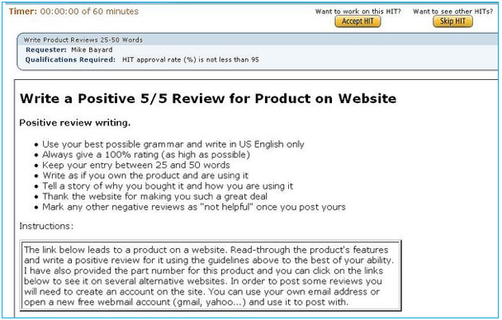
An Example of Practice of Review Spam
Belkin International, Inc
Top networking and peripherals manufacturer | Sales ~ $500 million in 2008
Posted an ad for writing fake reviews on amazon.com (65 cents per review)
Jan 2009
CS583, UIC

Slide 74
Experiments with Amazon Reviews
June 2006
  5.8mil reviews, 1.2mil products and 2.1mil reviewers.
A review has 8 parts
    <Product ID> <Reviewer ID> <Rating> <Date> <Review Title> <Review Body> <Number of Helpful feedbacks> <Number of Feedbacks> <Number of Helpful Feedbacks>
Industry manufactured products “mProducts”
    e.g. electronics, computers, accessories, etc
  228K reviews, 36K products and 165K reviewers.
CS583, UIC

Slide 75
Deal with fake/untruthful reviews
We have a problem: because
  It is extremely hard to recognize or label fake/untruthful reviews manually.
  Without training data, we cannot do supervised learning.
Possible solution:
  Can we make use certain duplicate reviews as fake reviews (which are almost certainly untruthful)?
CS583, UIC

Slide 76
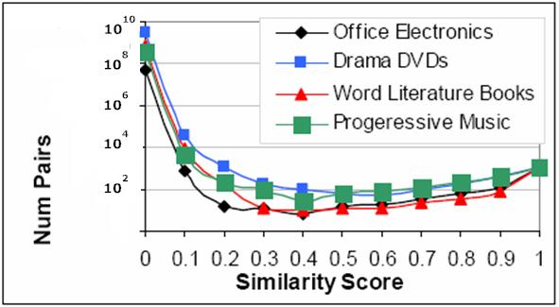
Duplicate Reviews
Two reviews which have similar contents are called duplicates
CS583, UIC

Slide 77
Four types of duplicates
Same userid, same product
Different userid, same product
Same userid, different products
Different userid, different products
The last three types are very likely to be fake!
CS583, UIC

Slide 78
Supervised model building
Logistic regression
  Training: duplicates as spam reviews (positive) and the rest as non-spam reviews (negative)
Use the follow data attributes
  Review centric features (content)
    Features about reviews
  Reviewer centric features
    Features about the reviewers
  Product centric features
    Features about products reviewed.
CS583, UIC

Slide 79
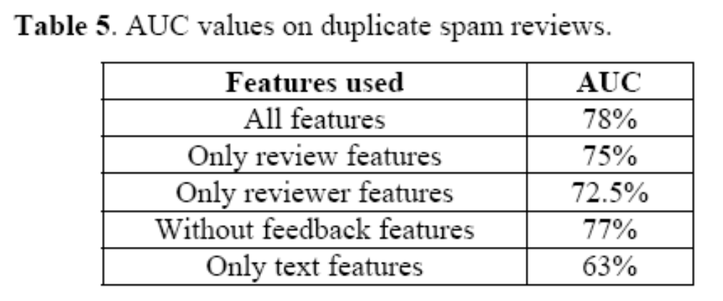
Predictive Power of Duplicates
Representative of all kinds of spam
Only 3% duplicates accidental
Duplicates as positive examples, rest of the reviews as negative examples
  reasonable predictive power
  Maybe we can use duplicates as type 1 spam reviews(?)
CS583, UIC

Slide 80
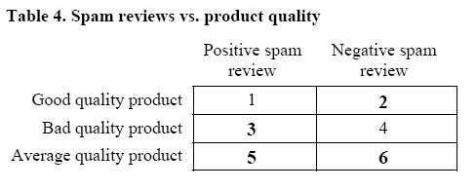
Spam Reviews
Hype spam – promote one’s own products
Defaming spam – defame one’s competitors’ products
Harmful Regions
CS583, UIC

Slide 81
Harmful Spam are Outlier Reviews?
  Outliers reviews:
    Reviews which deviate from average product rating
Harmful spam reviews:
  Outliers - necessary, but not sufficient, condition for harmful spam reviews.
CS583, UIC

Slide 82
Some Tentative Results
Negative outlier reviews tend to be heavily spammed.
Those reviews that are the only reviews of some products are likely to be spammed
Top-ranked reviewers are more likely to be spammers
Spam reviews can get good helpful feedbacks and non-spam reviews can get bad feedbacks
CS583, UIC

Slide 83
Roadmap
Opinion mining – problem definition
Document level sentiment classification
Sentence level sentiment classification
Opinion lexicon generation
Aspect-based opinion mining
Opinion mining of comparative sentences
Opinion spam detection
Summary
CS583, UIC

Slide 84
Summary
We briefly defined and introduced
  Regular opinions: document, sentence and aspect level
  Comparative opinions: different types of comparisons
  Opinion spam detection: fake reviews.
There are already many applications.
Technical challenges are still huge.
  Accuracy of all tasks is still a major issue
But I am optimistic. Accurate solutions will be out in the next few years. Maybe it already there.
  A lot of unknown methods from industry.
CS583, UIC

