Slide 1


Warehouse Options
for Gimi Michi
Gurugram · 2 Properties
Prepared by WareOnGo | Dated 20/05/2026 | Confidential

Slide 2
INDEX
S.No | WH ID | Location | Quoted Monthly Rental (INR/Sq.ft) | Offered Area (Sq.ft) | Availability
1 | 1700 | Sihi Village, Gurugram | 26/- | 7,000 | Immediate
2 | 1701 | Kherki Dhaula | 40/- (negotiable) | 5,000 | Immediate
Prepared by WareOnGo | Dated 20/05/2026 | Confidential

Slide 3
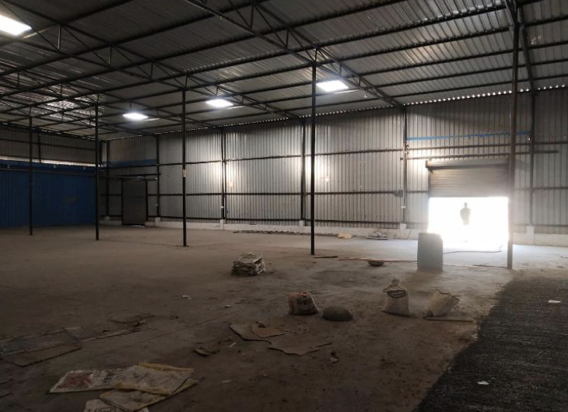
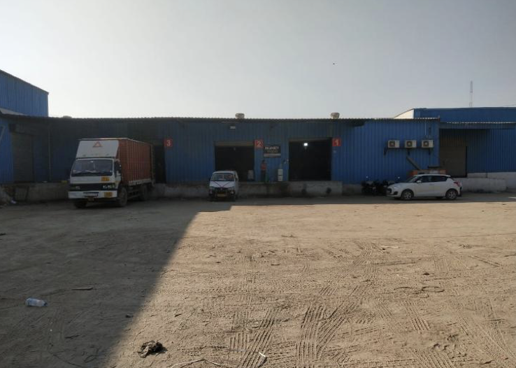
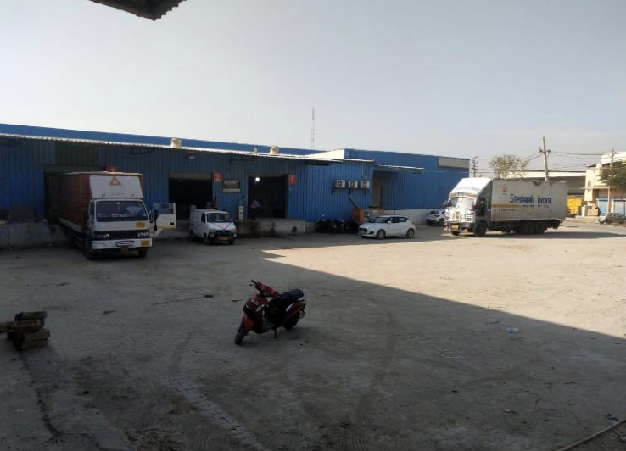
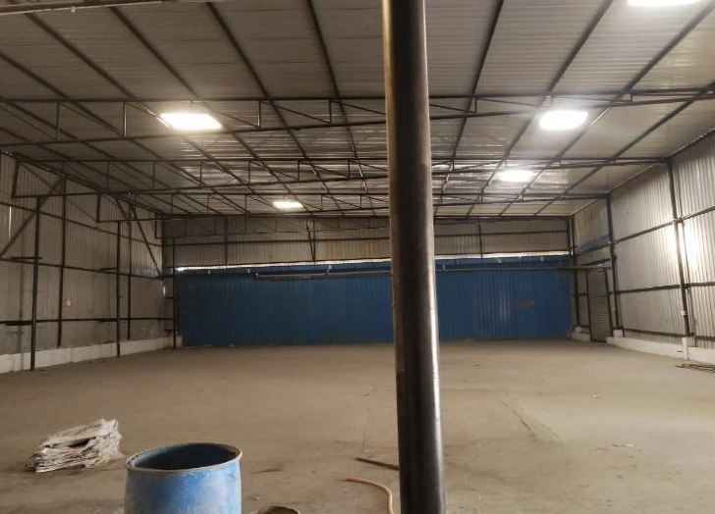
Option 1 - ID 1700
Location Details
Option 1
Address | Sihi Village, Gurgaon
Google Maps | Awaited
Property Information
Specifications
Offered Area | 7000 sqft
Building | Shed
Docks | 3 Nos. | 4ft plinth height
Height | 18ft eaves | 20ft centre
Flooring | VDF type | 4-5 mtr/sqm
Fire Safety | Hydrants - N | Sprinklers - N
Compliances | CLU - Y | Fire NOC - N
Handover | Immediate
Specifications
Commercials
Commercials
Rent per sq.ft (INR) | 26
Prepared by WareOnGo | Dated 20/05/2026 | Confidential
Notes:
Optional rows:
maps location
Rent per sqft

Slide 4
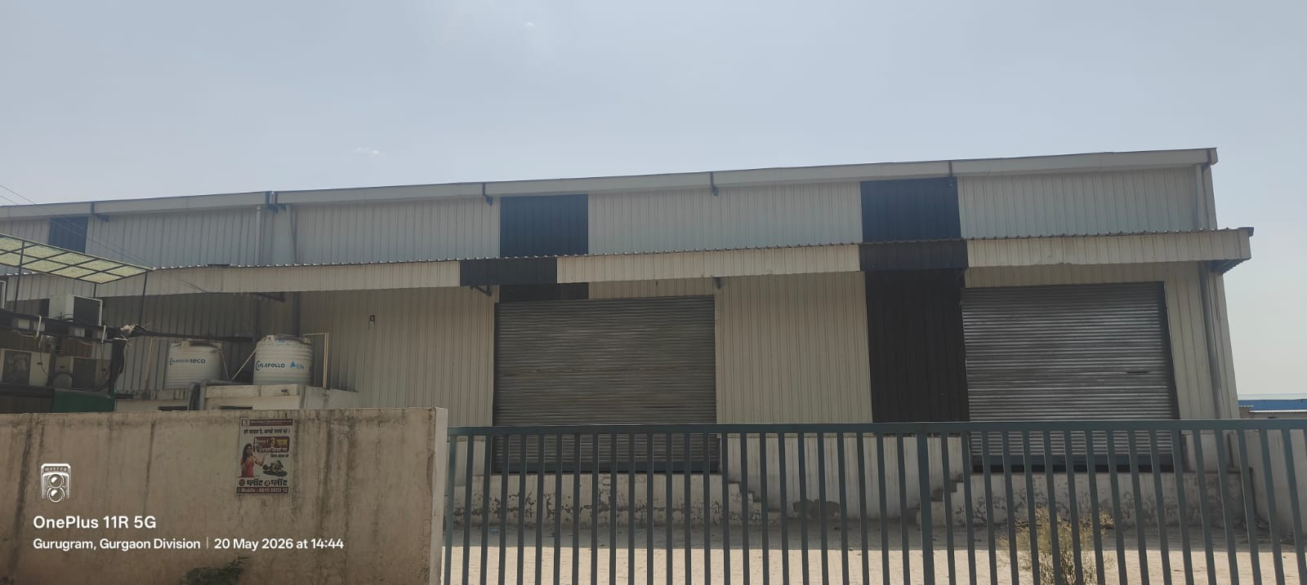
Option 2 - ID 1701
Location Details
Option 1
Address | Kherki Dhaula
Google Maps | Awaited
Property Information
Specifications
Offered Area | 5000 sqft
Building | PEB
Docks | 2 Nos. | 4ft plinth height
Height | 23ft eaves | 25ft centre
Flooring | Concrete
Fire Safety | Hydrants - N | Sprinklers - N
Compliances | CLU - N | Fire NOC - N
Handover | Immediate
Specifications
Commercials
Commercials
Rent per sq.ft (INR) | 40 (negotiable)
Prepared by WareOnGo | Dated 20/05/2026 | Confidential
Notes:
Optional rows:
maps location
Rent per sqft

Slide 5
For more details (or) to schedule a site visit, please contact –
Dhaval Gupta | +918318825478
www.wareongo.com
Prepared by WareOnGo | Dated 20/05/2026 | Confidential

