Slide 1
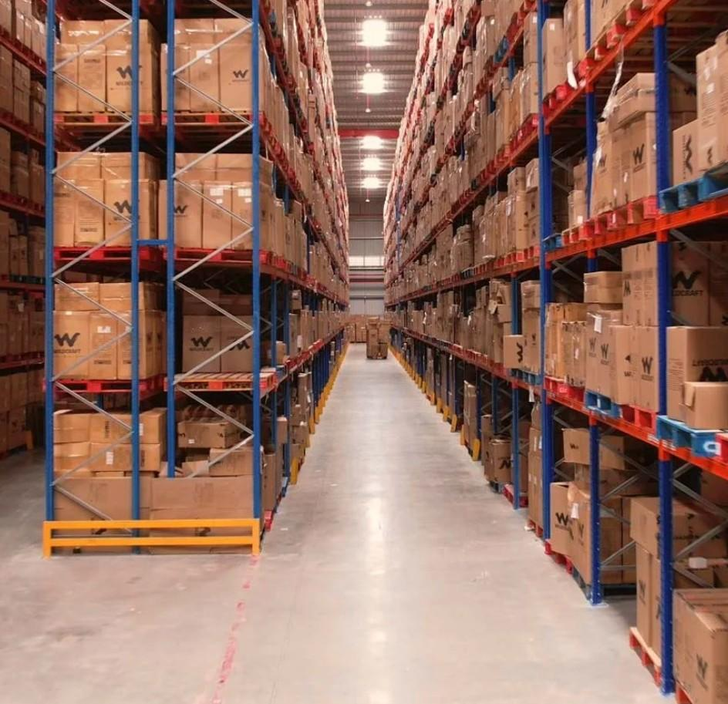

Warehouse Options
for Demo Client
Delhi · 5 Properties
Prepared by WareOnGo | Dated 04/06/2026 | Confidential

Slide 2
INDEX
S.No | WH ID | Location | Quoted Monthly Rental (INR/Sq.ft) | Offered Area (Sq.ft) | Availability
1 | 1811 | Moti Bagh industrial Area | 41/- | 2700 | Immediate
2 | 1812 | Avalahalli, Old Madras Road, near Whitefield | 25/- | 40000 | Yes
3 | 1813 | Balaji nagar kadachanendhal | 33/- | 680 | Immediate
4 | 1814 | Whitefield, | 115 sft negotiable/- | 7200 | Yes
5 | 1815 | New Udupi krishna Naivedhya Bomasandra | 40 negotiable/- | 10000, 9000 | Yes
Prepared by WareOnGo | Dated 04/06/2026 | Confidential

Slide 3
Option 1 - ID 1811
Location Details
Photos not available.
Can be provided upon request.
Address | Delhi, New Delhi
Google Maps | 28.668056, 77.180885
Specifications
Offered Area | 2700 sqft
Building | RCC
Docks | N/A
Height | 22 eaves | N/A
Flooring | Unverified | Unverified
Fire Safety | N/A
Compliances | Industrial CLU CLU | Fire NOC - N
Handover | Immediate
Commercials
Rent per sq.ft (INR) | 41
Prepared by WareOnGo | Dated 04/06/2026 | Confidential

Slide 4
Option 2 - ID 1812
Location Details
Photos not available.
Can be provided upon request.
Address | Bangalore, Karnataka
Google Maps | See link
Specifications
Offered Area | 40000 sqft
Building | Shed
Docks | 2 | 3ft plinth height
Height | 25ft eaves | 30ft centre
Flooring | VDF | Unverified
Fire Safety | N/A
Compliances | Warehouse CLU CLU | Fire NOC - N
Handover | Yes
Commercials
Rent per sq.ft (INR) | 25
Prepared by WareOnGo | Dated 04/06/2026 | Confidential

Slide 5
Option 3 - ID 1813
Location Details
Photos not available.
Can be provided upon request.
Address | Madurai, Tamilnadu
Google Maps | 9.9739699, 78.1673481
Specifications
Offered Area | 680 sqft
Building | RCC
Docks | Not verified | N/A
Height | 11 eaves | N/A
Flooring | Unverified | Unverified
Fire Safety | N/A
Compliances | Unverified CLU | Fire NOC - N
Handover | Immediate
Commercials
Rent per sq.ft (INR) | 33
Prepared by WareOnGo | Dated 04/06/2026 | Confidential

Slide 6
Option 4 - ID 1814
Location Details
Photos not available.
Can be provided upon request.
Address | Bangalore, Karnataka
Google Maps | See link
Specifications
Offered Area | 7200 sqft
Building | RCC
Docks | N/A
Height | N/A | 10 feet centre
Flooring | FM2 | Unverified
Fire Safety | N/A
Compliances | Commercial CLU CLU | Fire NOC - N
Handover | Yes
Commercials
Rent per sq.ft (INR) | 115 sft negotiable
Prepared by WareOnGo | Dated 04/06/2026 | Confidential

Slide 7
Option 5 - ID 1815
Location Details
Photos not available.
Can be provided upon request.
Address | Bangalore, Karnataka
Google Maps | See link
Specifications
Offered Area | 10000, 9000 sqft
Building | Shed
Docks | 1 | N/A
Height | N/A | 25 ft centre
Flooring | VDF | Unverified
Fire Safety | N/A
Compliances | Warehouse CLU CLU | Fire NOC - N
Handover | Yes
Commercials
Rent per sq.ft (INR) | 40 negotiable
Prepared by WareOnGo | Dated 04/06/2026 | Confidential

Slide 8
For more details (or) to schedule a site visit, please contact –
Dhaval Gupta | +91 8318825478
www.wareongo.com
Prepared by WareOnGo | Dated 04/06/2026 | Confidential

