Slide 1

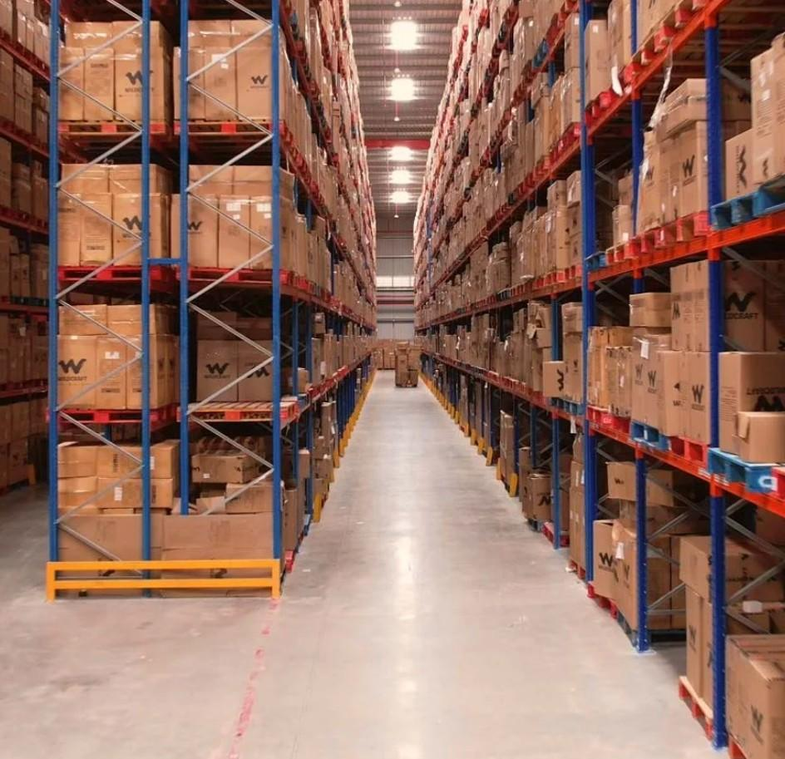

TM
Warehouse Options
for Acme Logistics
Bengaluru · 4 Properties

Slide 2
INDEX
S.No | WH ID | Location | Quoted Monthly Rental (INR/Sq.ft) | Offered Area (Sq.ft) | Availability
1 | 108 | Bengaluru, Karnataka | 23/- | 51000 | Yes
2 | 253 | Bengaluru, Karnataka | 26/- | 72000 | Yes
3 | 304 | Vishakapatnam, Andhra Pradesh | 25/- | 43000 | Yes
4 | 313 | Bangalore, Karnataka | 21/- | 15000, 10000 | Yes

Slide 3
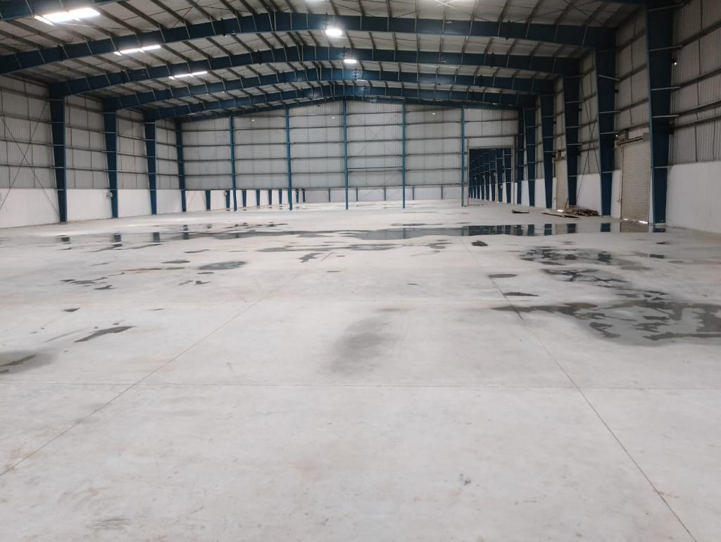
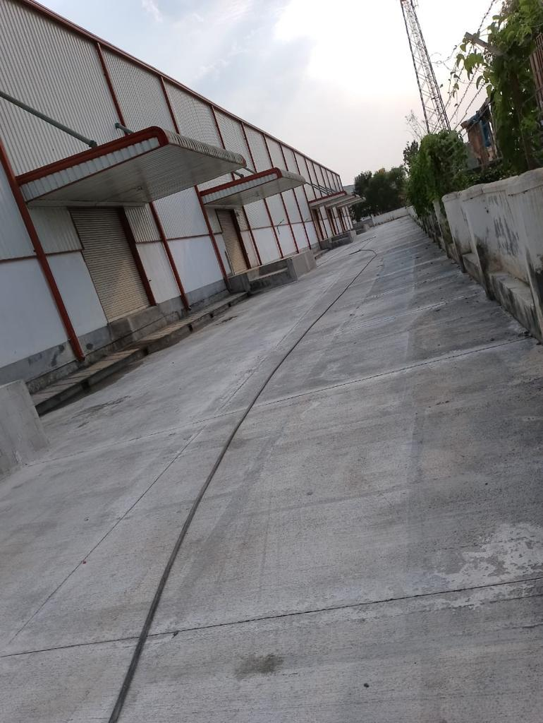
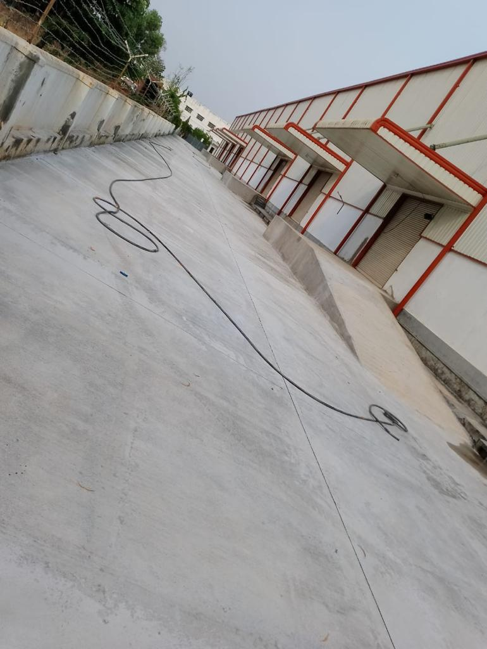
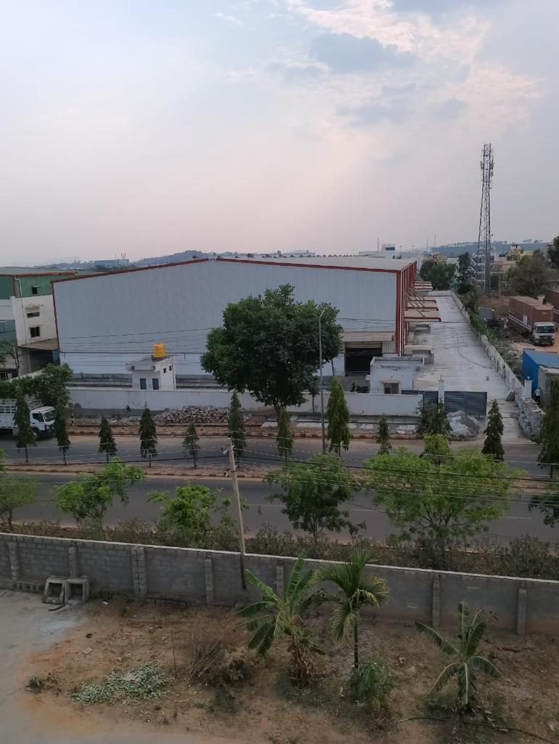
Option 1 - ID 108
Location Details
Address | Bengaluru, Karnataka
Google Maps | Available on demand
Specifications
Offered Area | 51000 sqft
Building | PEB
Docks | 5 | N/A
Height | 30 eaves | N/A
Flooring | N/A
Fire Safety | N/A
Compliances | Unverified CLU | Fire NOC - N
Handover | Yes
Commercials
Rent per sq.ft (INR) | 23

Slide 4
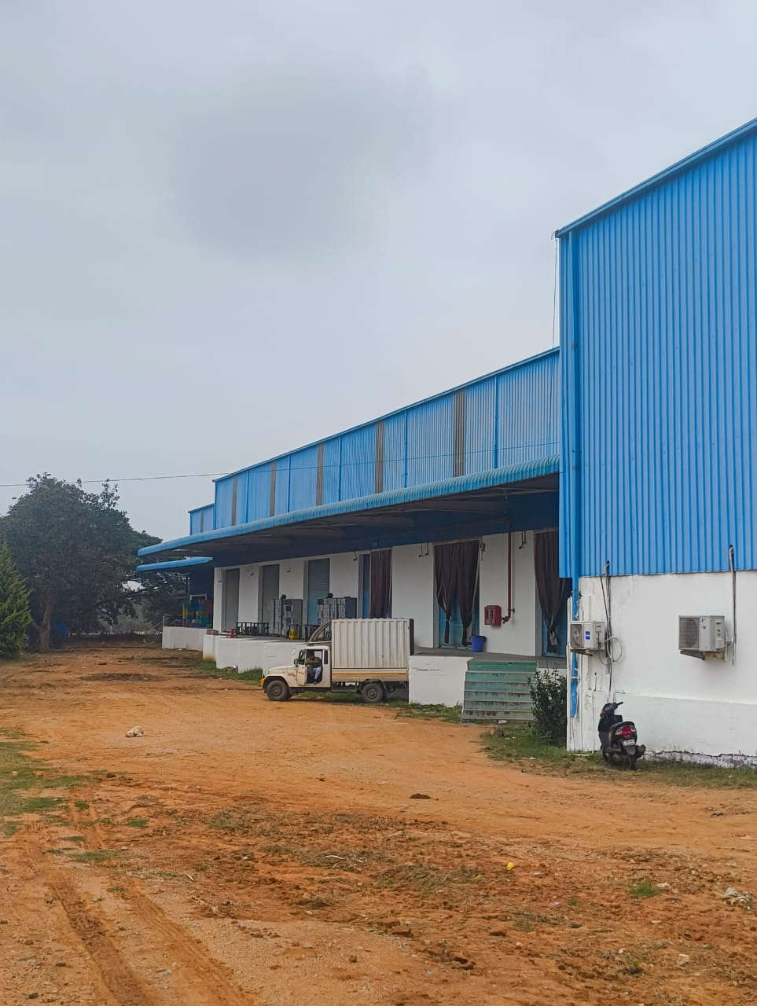
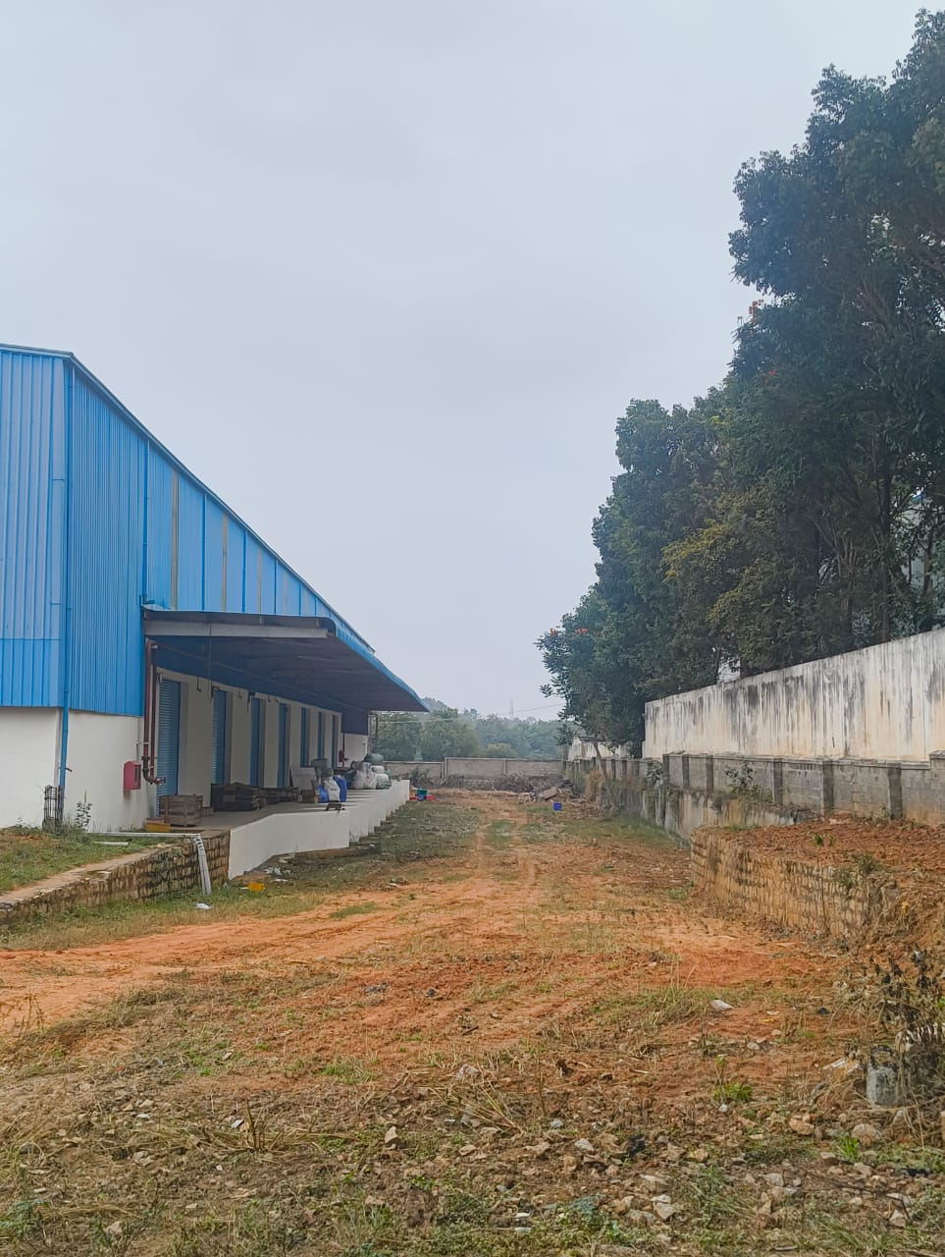
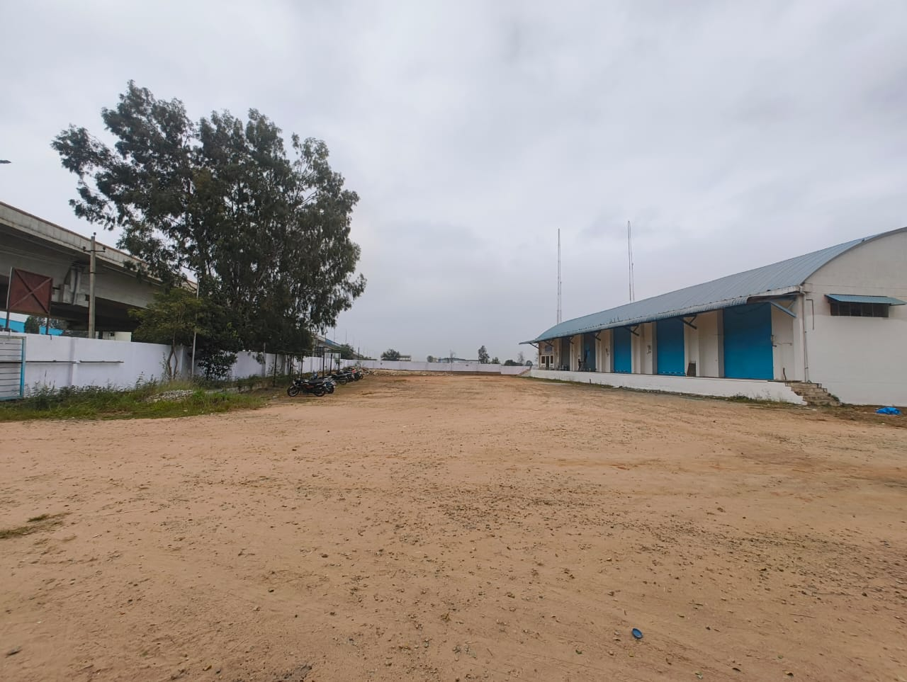
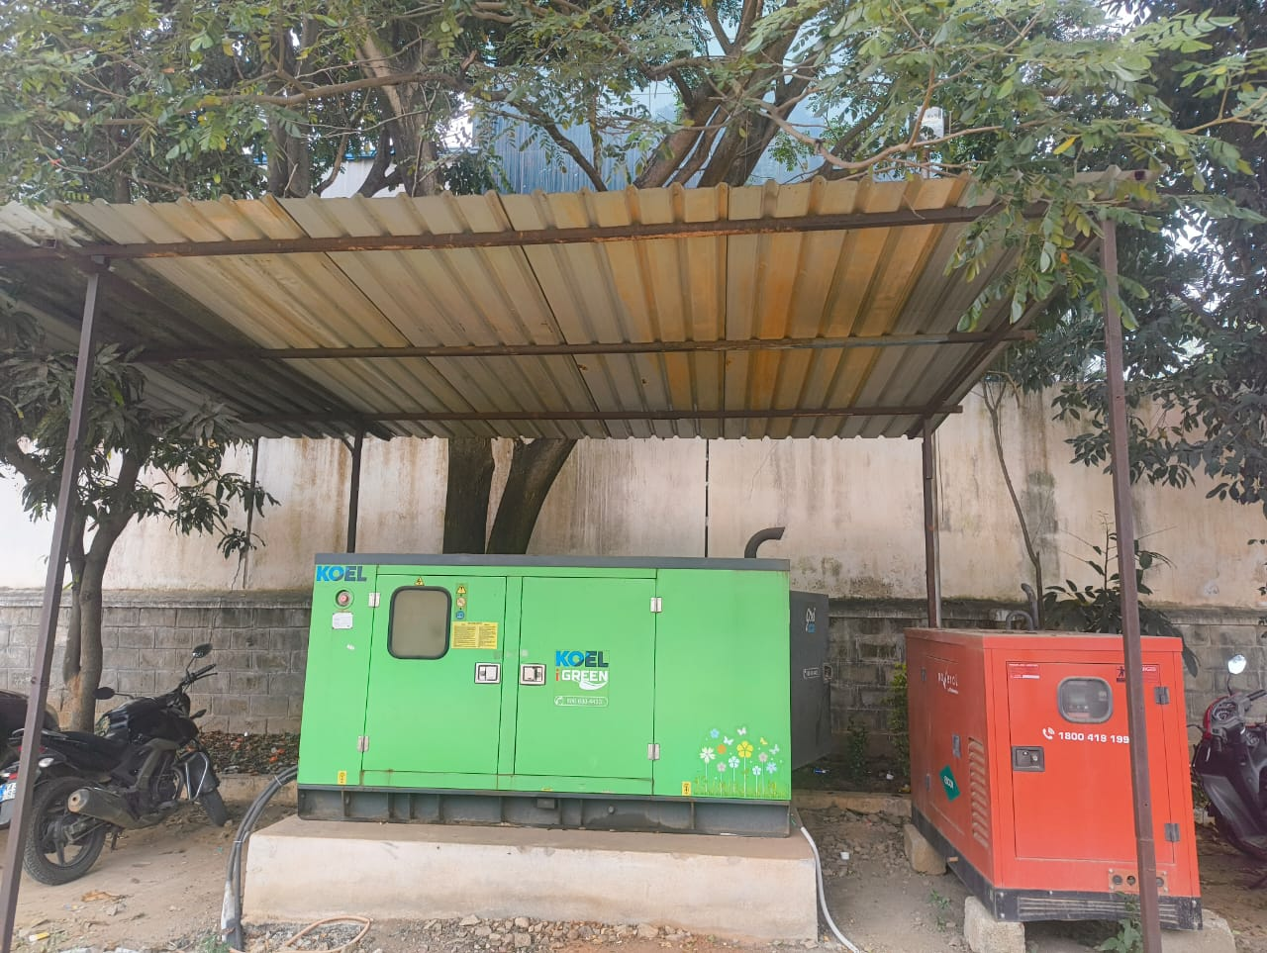
Option 2 - ID 253
Location Details
Address | Bengaluru, Karnataka
Google Maps | Available on demand
Specifications
Offered Area | 72000 sqft
Building | PEB
Docks | 10 | N/A
Height | 35 eaves | N/A
Flooring | N/A
Fire Safety | N/A
Compliances | Unverified CLU | Fire NOC - N
Handover | Yes
Commercials
Rent per sq.ft (INR) | 26

Slide 5
Option 3 - ID 304
Photos not available.
Can be provided upon request.
Location Details
Address | Vishakapatnam, Andhra Pradesh
Google Maps | 17.651217, 83.222063
Specifications
Offered Area | 43000 sqft
Building | PEB
Docks | 4 | N/A
Height | 24ft eaves | N/A
Flooring | Custom clearances also available
Fire Safety | N/A
Compliances | Unverified CLU | Fire NOC - N
Handover | Yes
Commercials
Rent per sq.ft (INR) | 25

Slide 6
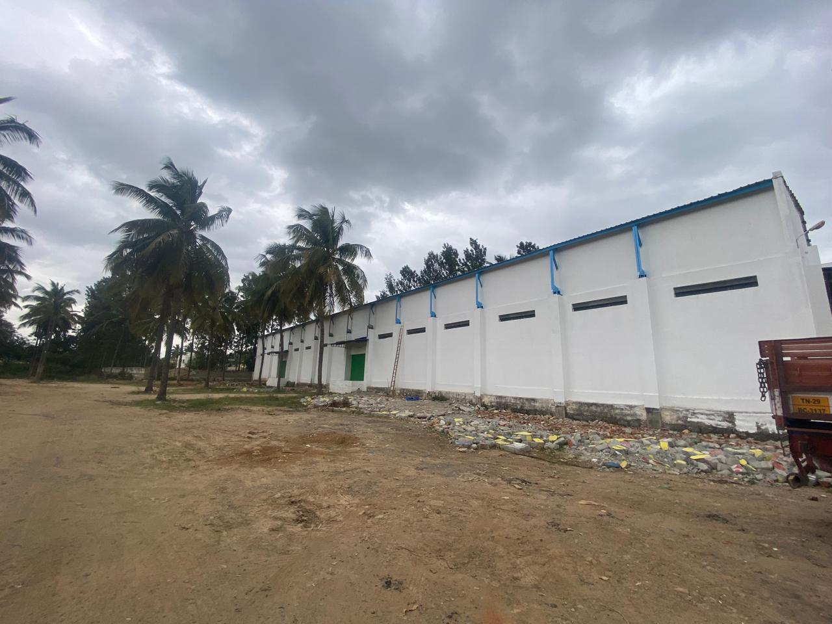
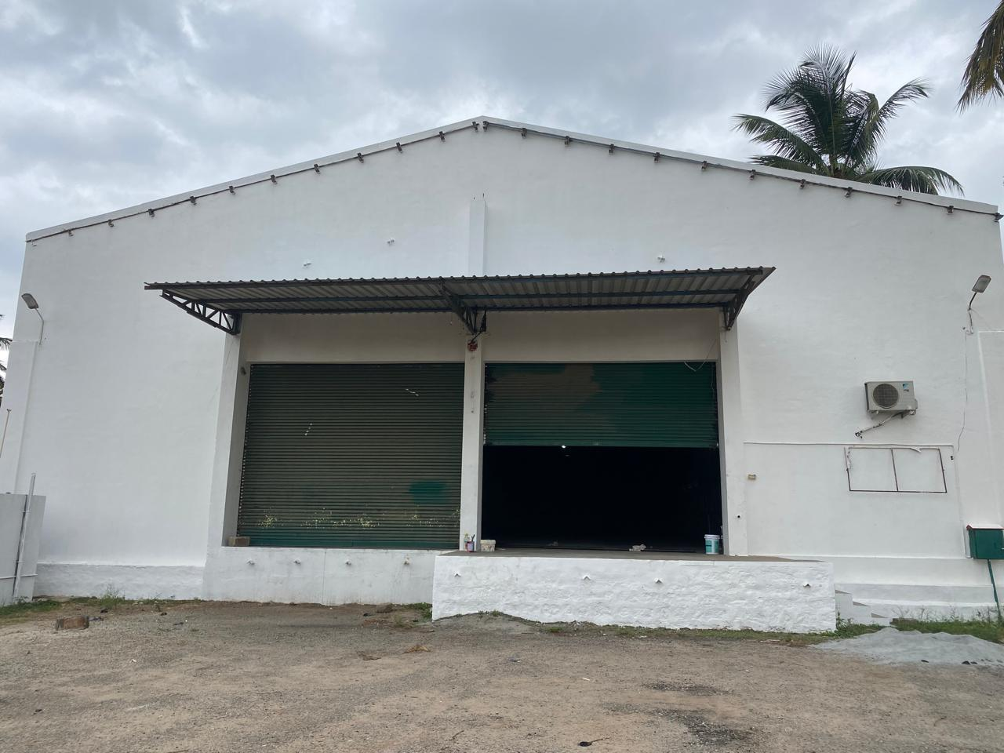
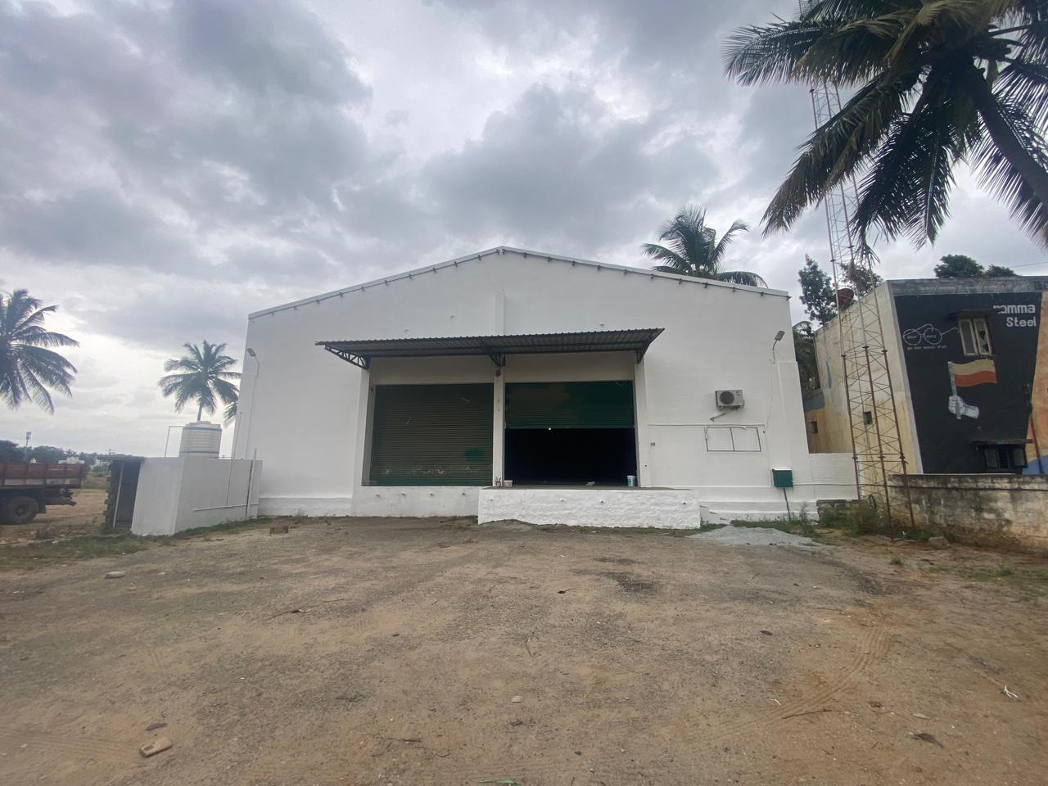
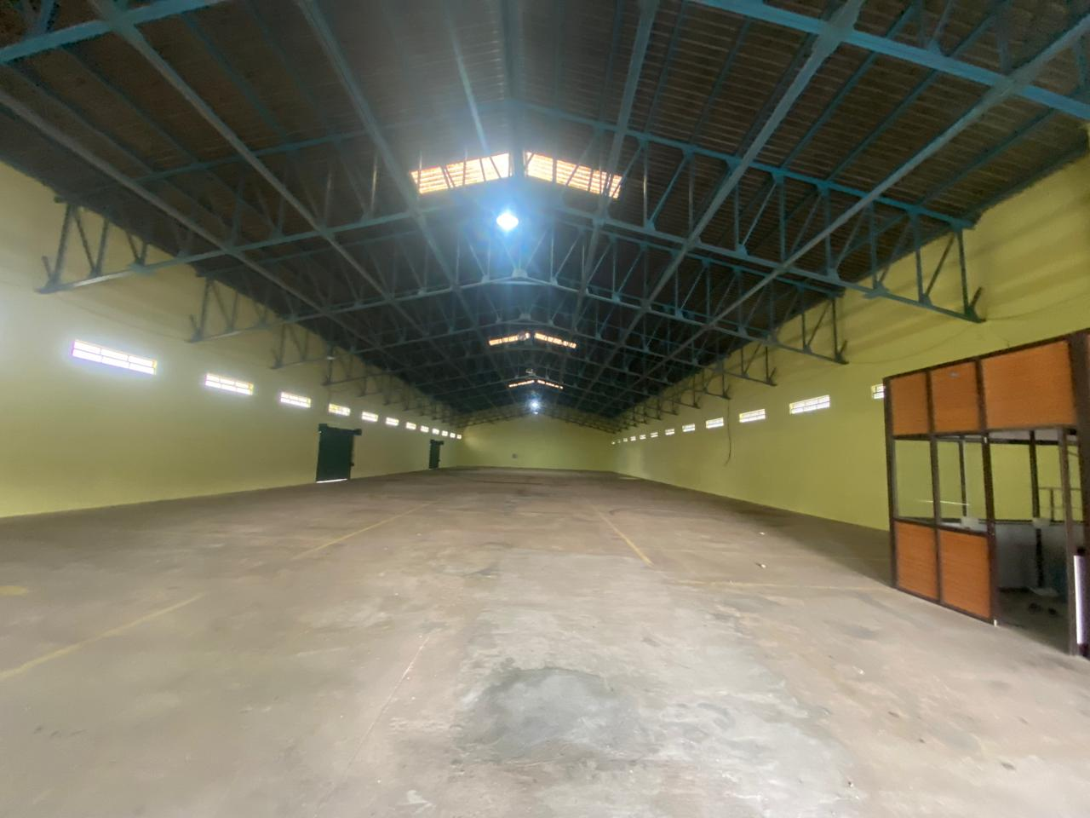
Option 4 - ID 313
Location Details
Address | Bangalore, Karnataka
Google Maps | 13.0823497, 77.4212214
Specifications
Offered Area | 15000, 10000 sqft
Building | RCC
Docks | 4 | N/A
Height | 25ft eaves | N/A
Flooring | Main highway access | partition possible
Fire Safety | NA
Compliances | Commercial CLU | Fire NOC - N
Handover | Yes
Commercials
Rent per sq.ft (INR) | 21

Slide 7
For more details (or) to schedule a site visit, please contact –
Dhaval Gupta | +91 8318825478
www.wareongo.com

