Slide 1
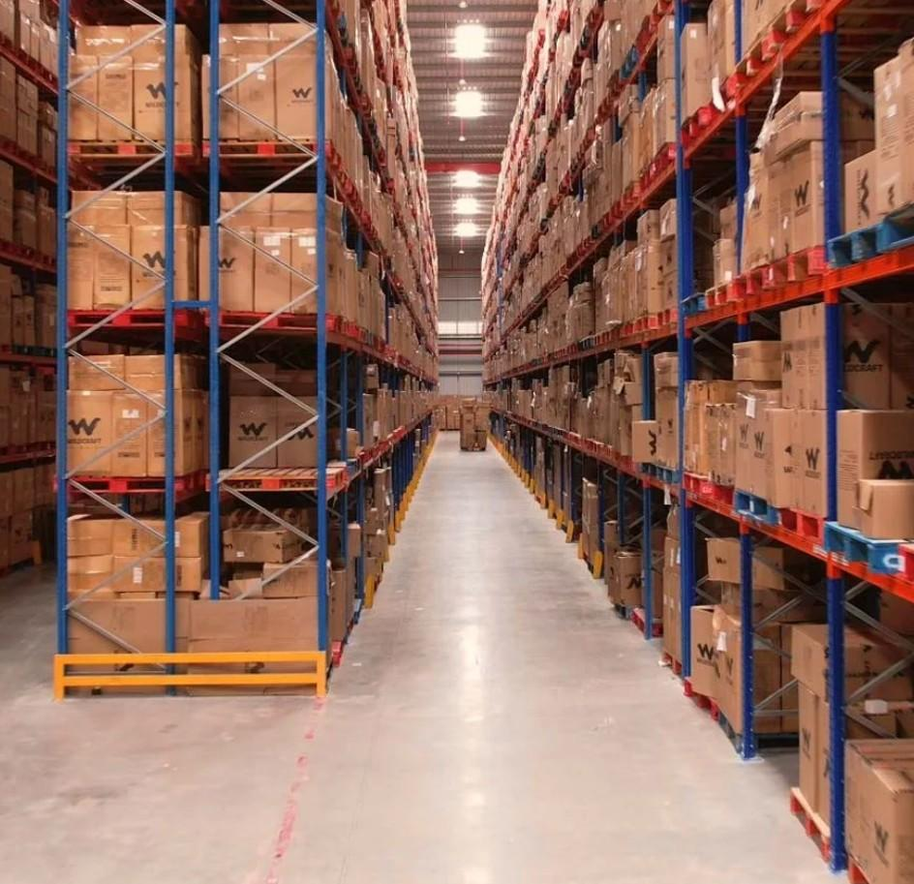

Warehouse Options
for Preview Client
Bangalore · 3 Properties
Prepared by WareOnGo | Dated 25/05/2026 | Confidential

Slide 2
INDEX
S.No | WH ID | Location | Quoted Monthly Rental (INR/Sq.ft) | Offered Area (Sq.ft) | Availability
1 | 1512 | Bangalore, Karnataka | 28/- | 25000 | Immediate
2 | 325 | Bangalore, Karnataka | 24/- | 15000, 65000 | 3 months post LOI
3 | 893 | Bangalore, Karnataka | 27+1/- | 235060 | Immediate
Prepared by WareOnGo | Dated 25/05/2026 | Confidential

Slide 3
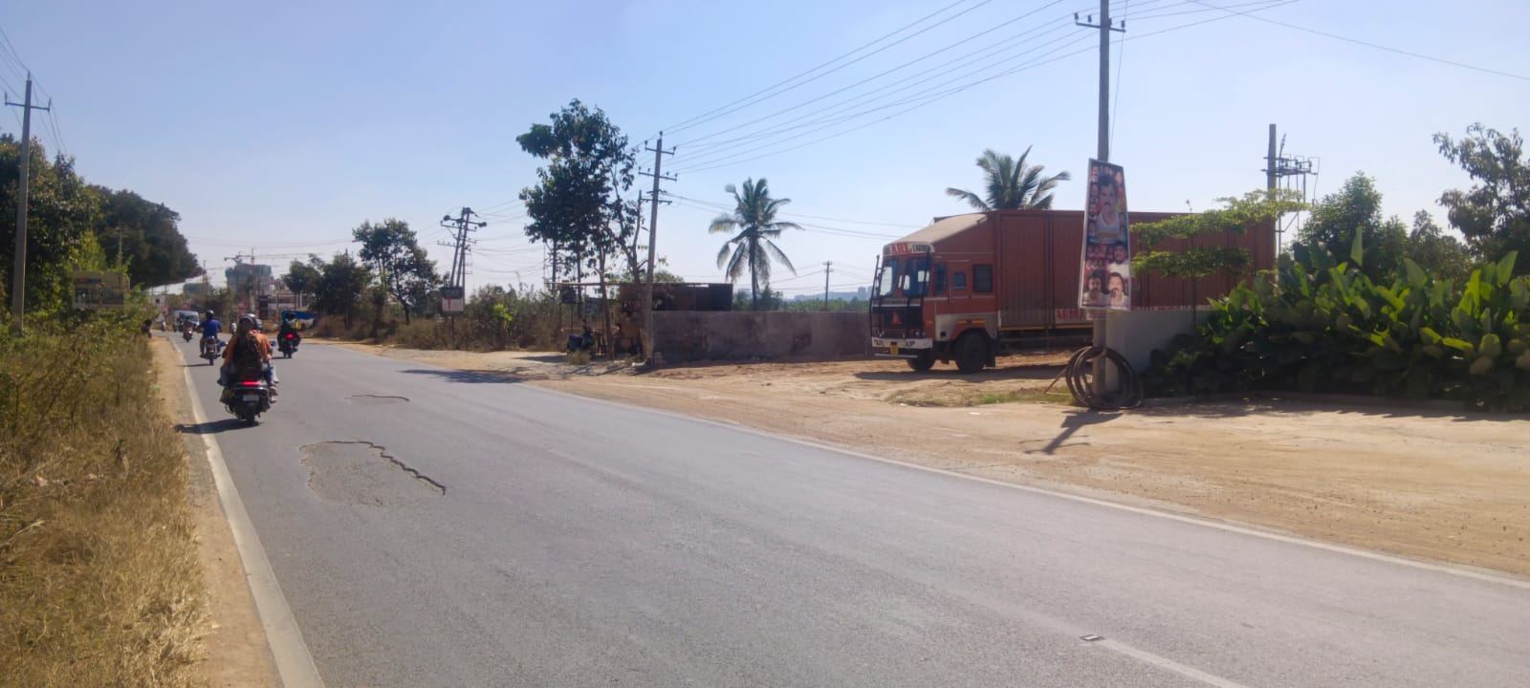
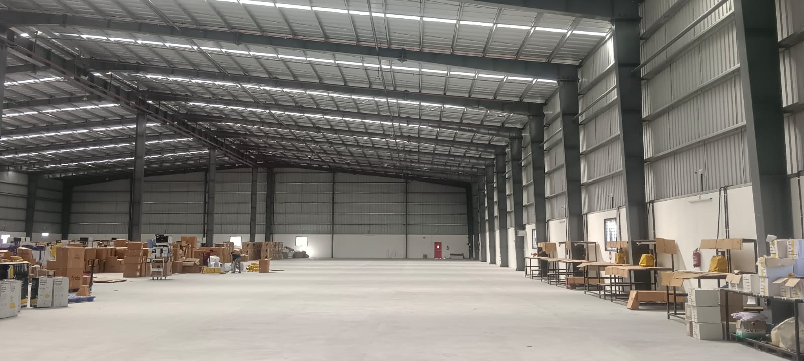
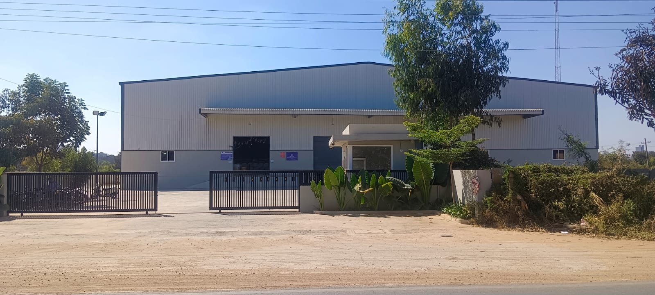
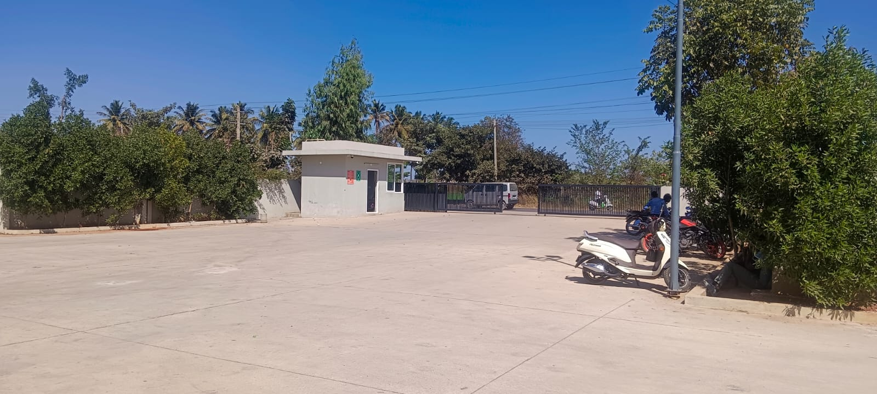
Option 1 - ID 1512
Location Details
Address | Bangalore, Karnataka
Google Maps | 13.0365264, 77.7850696
Specifications
Offered Area | 25000 sqft
Building | PEB
Docks | 3 | 4ft plinth height
Height | 35ft eaves | 40ft centre
Flooring | VDF | 5 mtr/sqm
Fire Safety | Hydrants + Sprinklers
Compliances | Commercial CLU | Fire NOC - Y
Handover | Immediate
Commercials
Rent per sq.ft (INR) | 28
Prepared by WareOnGo | Dated 25/05/2026 | Confidential

Slide 4
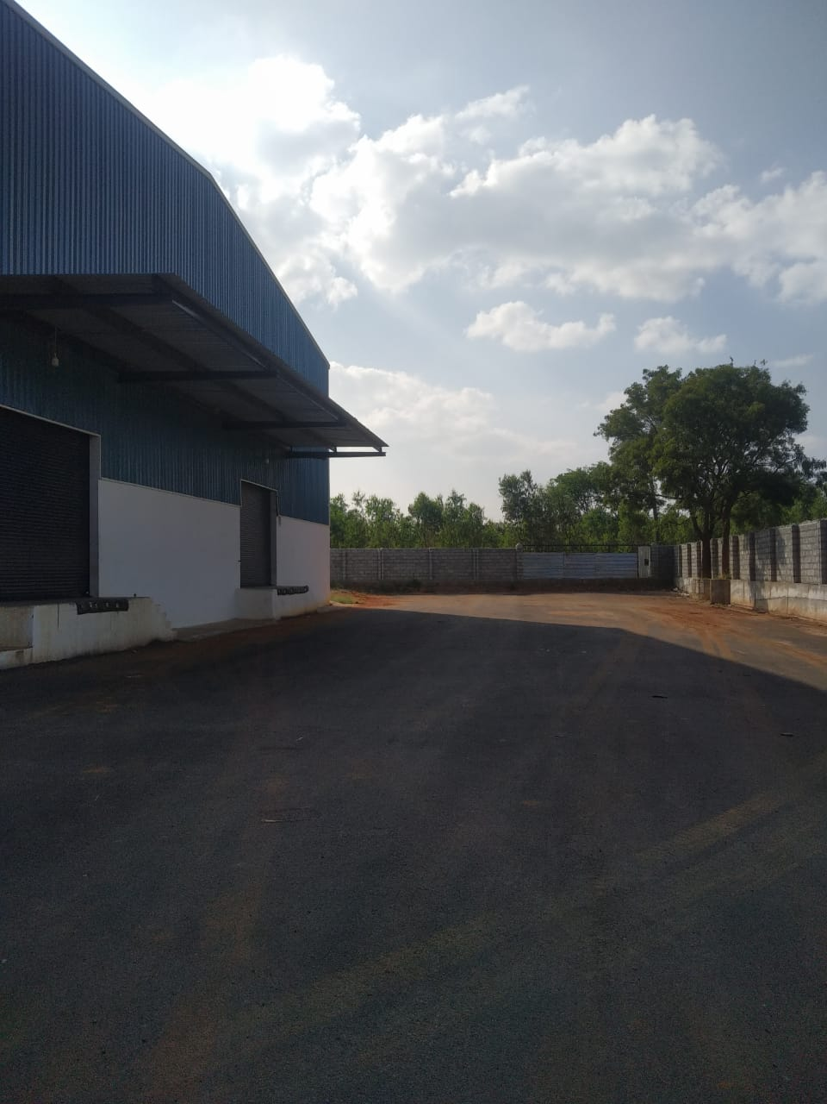
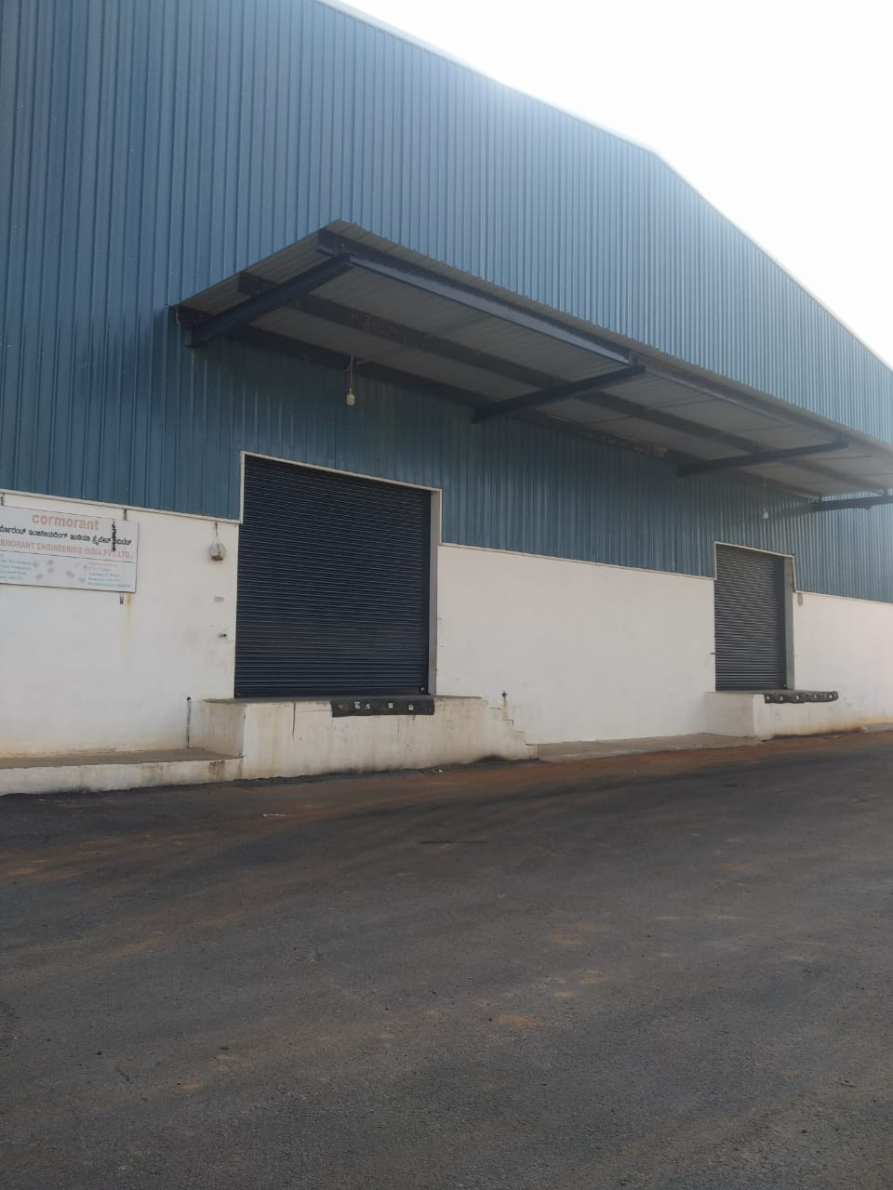
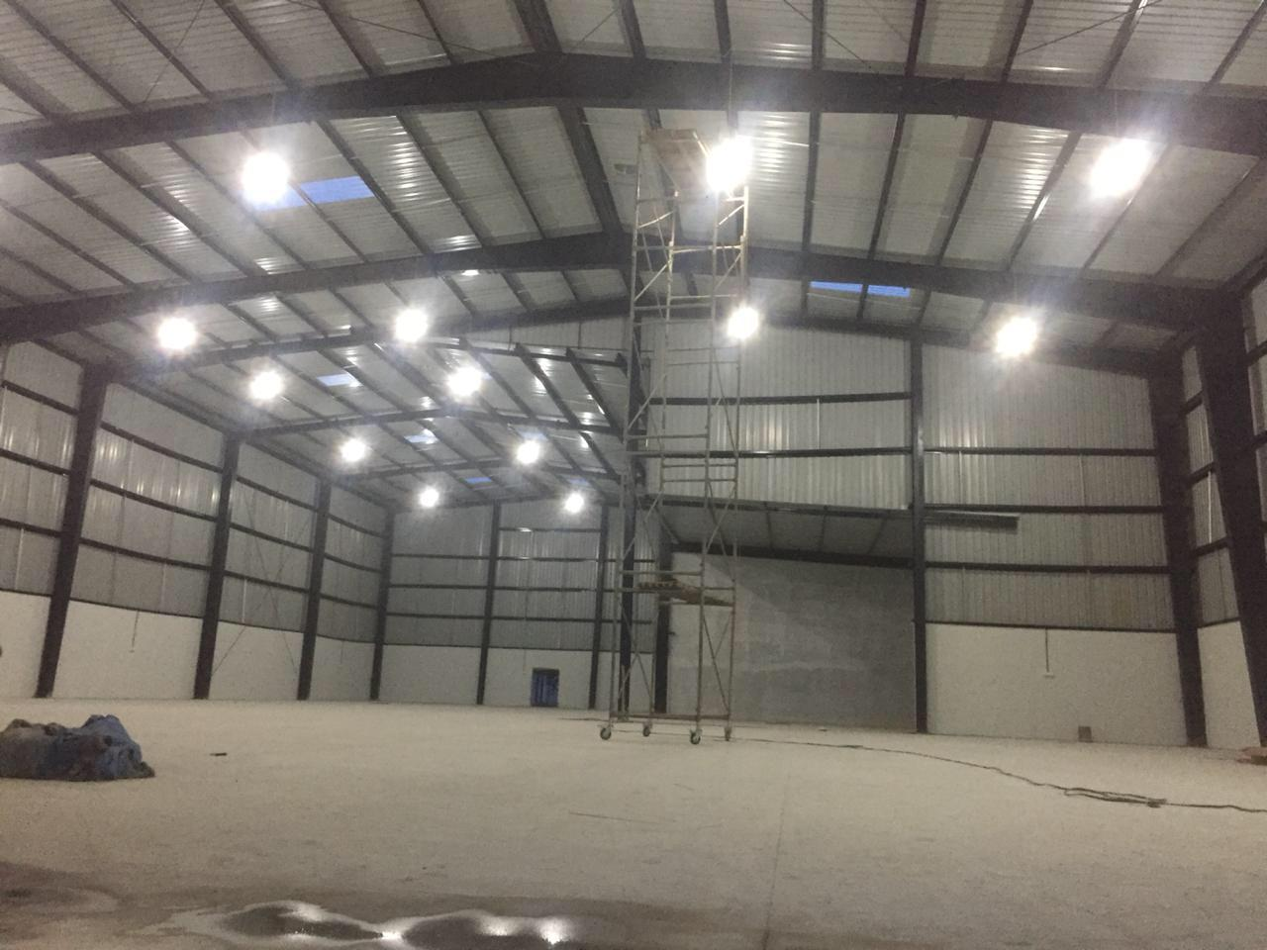
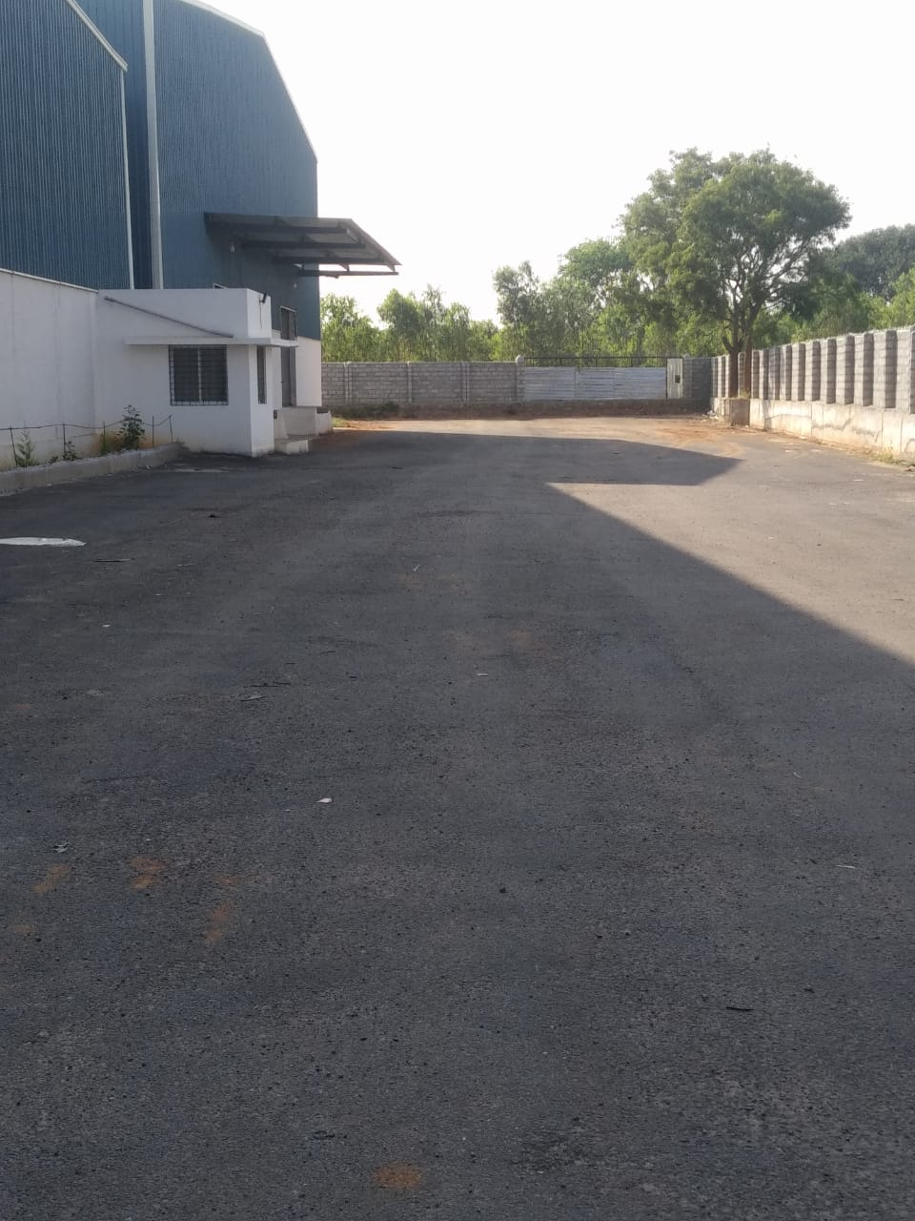
Option 2 - ID 325
Location Details
Address | Bangalore, Karnataka
Google Maps | 13.1170278, 77.4254722
Specifications
Offered Area | 15000, 65000 sqft
Building | PEB
Docks | 6 | 3ft plinth height
Height | 30ft eaves | 36ft centre
Flooring | VDF | N/A
Fire Safety | N/A
Compliances | Unverified CLU | Fire NOC - N
Handover | 3 months post LOI
Commercials
Rent per sq.ft (INR) | 24
Prepared by WareOnGo | Dated 25/05/2026 | Confidential

Slide 5
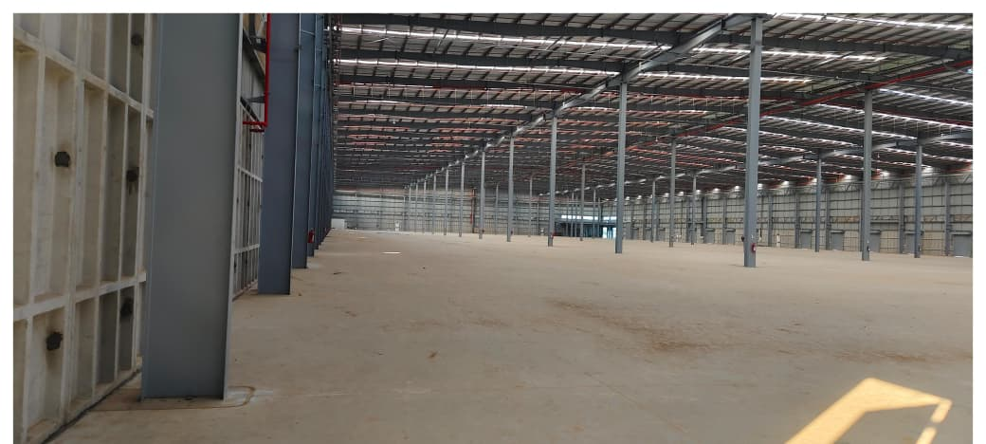
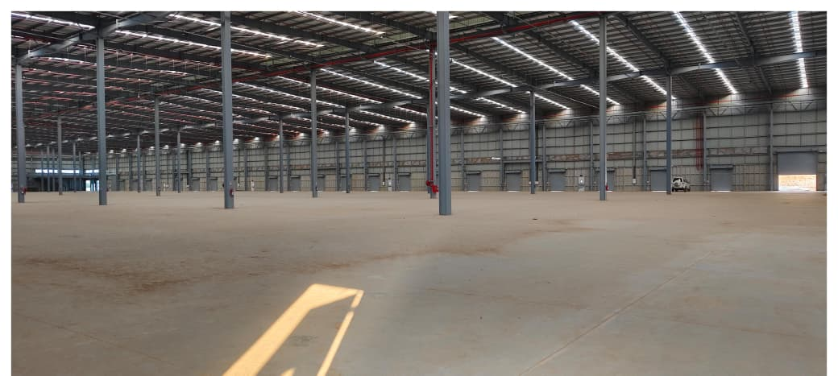
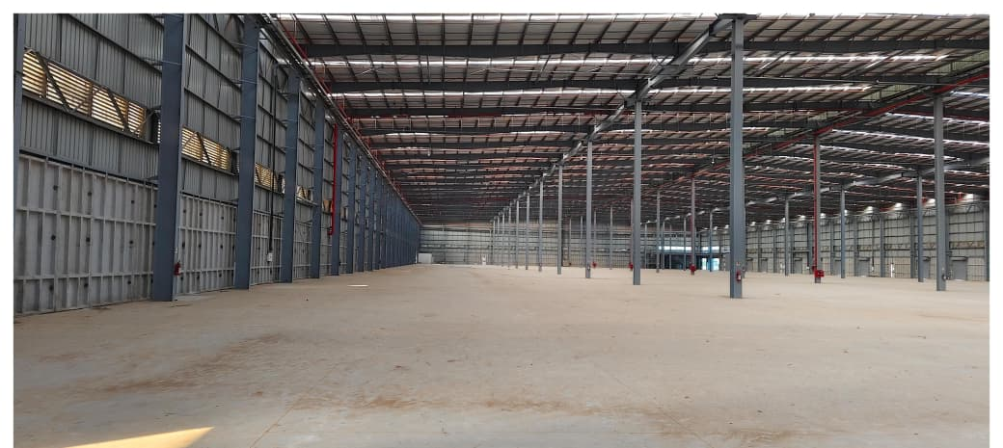
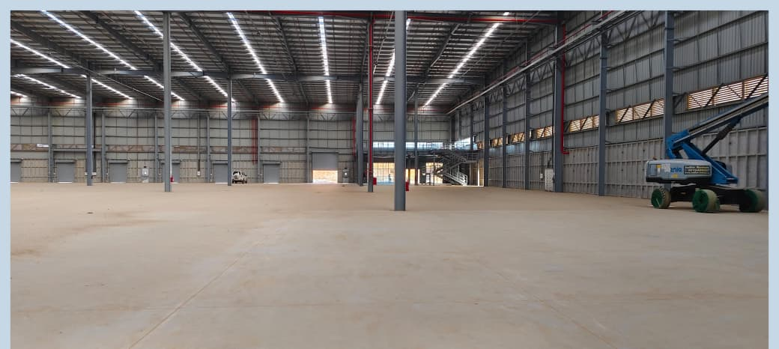
Option 3 - ID 893
Location Details
Address | Bangalore, Karnataka
Google Maps | 13.1975389, 77.2400936
Specifications
Offered Area | 235060 sqft
Building | PEB
Docks | 20 | 4ft plinth height
Height | 40ft eaves | 48ft centre
Flooring | FM2 | N/A
Fire Safety | Hydrants+Sprinklers
Compliances | Unverified CLU | Fire NOC - Y
Handover | Immediate
Commercials
Rent per sq.ft (INR) | 27+1
Prepared by WareOnGo | Dated 25/05/2026 | Confidential

Slide 6
For more details (or) to schedule a site visit, please contact –
POC | +91 9999999999
www.wareongo.com
Prepared by WareOnGo | Dated 25/05/2026 | Confidential

