Slide 1
Real-Time Radar (Features and Design)

Slide 2
High-Level Requirements
The Radar must be able to maintain real-time performance
And the radar should be able to run in a non-real time mode as well
An operator will have the ability to interact with the radar systems and view the raw video and plots (i.e., virtual mode)
And the radar must be able to operate without operator interaction as well (i.e., constructive mode)
A single simulation application will need be able to run multiple, independent radars
Hybrid applications must be able to contain radars that are operating as either constructive or virtual radars
The operator's graphical interface and the radar model will need be able to run in separate applications

Slide 3
High-Level Requirements
The level of fidelity of the radar will need be scalable from a virtual radar station to a simple ‘spinner’
The radar will need to interact with locally generated players
The radar will need to interact with players generated by remote simulation applications
The radar will need to filter players by type, range, and aspect angles

Slide 4
Example (Out of the Box Fidelity)

Slide 5
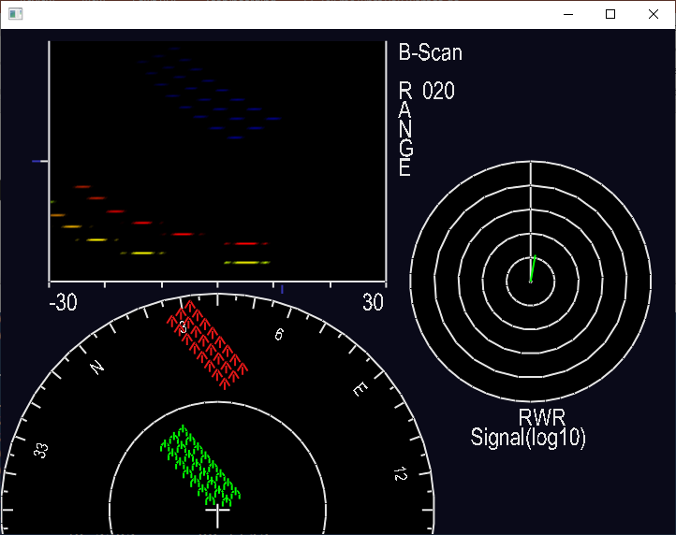
Graphical View (testRadar)

Slide 6
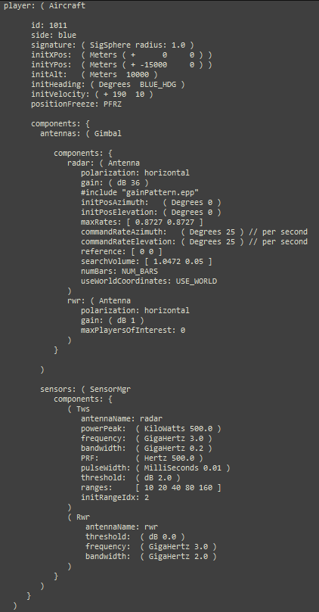
Example Inputs
Player definition consists of defining initial position, direction, velocity, etc... and the various components attached/associated with it.
Components consist of a collection of antennas and sensors
There are two antennas, both steered by a gimbal: one is used by radar system (“radar”), the other for a radar warning receiver (“rwr”)
There are two sensors: a track while scan (Tws) and a radar warning receiver (Rwr) – both reference the antenna components that are being steered by the gimbal

Slide 7
A Comment About Inheritance
Class inheritance can lead to not only highly coupled code, but also relationships that make no sense
We have some of this.... (e.g., an Antenna IS a Gimbal)
Example, antennas don’t have a search volume or commanded rates – our scan gimbal does
The subclassing of an Antenna from Gimbal creates this mixture – our Antennas act like both “an antenna” –AND- “a scan gimbal”

Slide 8
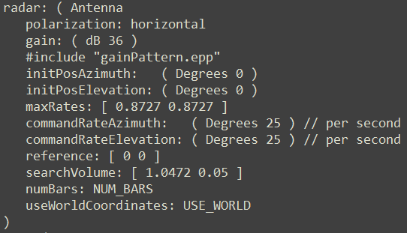
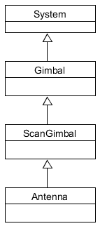
Example of Confounded Parameters
When parameters from one class are inherited by another conceptually unrelated class
The adjustable parameters associated with an Antenna include those defined & by a scan gimbal

Slide 9
Adjustable Parameters

Slide 10
Architecture & Implementation

Slide 11
Application Pattern
OTW interfaces
Dynamics Model
Environments
Weapons
Station
StoresMgr
PVIs
External
Stores
Linkage
Simulation
(Auto) Pilot
Control
Loading
Navigation
Routes
Player List
GUIs
Datalink
Waypoints
Player
Radios
DIS
Player
Onboard Computers
Track
Managers
HLA
…
Gimbals, Antennas and Seekers
TENA
Tracks
…
IPlayer
R/F and IR Sensors
R/F & IR Signatures
IPlayer

Slide 12
Application Pattern (Sim Exec, Environments & Player Lists)
OTW interfaces
Dynamics Model
Environments
Weapons
Station
StoresMgr
PVIs
External
Stores
Linkage
Simulation
(Auto) Pilot
Control
Loading
Navigation
Routes
Player List
GUIs
Datalink
Waypoints
Player
Radios
DIS
Player
Onboard Computers
Track
Managers
HLA
…
Gimbals, Antennas and Seekers
TENA
Tracks
…
IPlayer
R/F and IR Sensors
R/F & IR Signatures
IPlayer

Slide 13
Simulation Class
Manages the player list
Manages the environment databases (e.g., Terrain Elevations)
Can be used to embed the simulation (library) into other simulation systems
Supports multiple time critical and background threads when processing the player list
Manages the frame, cycle and phase timing
Phases
P0 Dynamics
P1 Transmitter Processing
P2 Receiver Processing
P3 Guidance And Management

Slide 14
Frames & Phases
Frames, Phases and Cycles
Frame rate is master clock rate:
50 frames per seconds
Frame time (i.e., delta time): frameTime = 1/frameRate
20 Ms per frame
Frame can be partitioned into phases
4 phases per frame
Frames can be grouped into cycles (usually a power of 2)
16 frames per cycle
One Cycle (16 Frames)
F
F
F
F
F
F
F
F
F
F
F
F
F
F
F
F
F
F
F
F
F
F
F
F
F
F
F
F
F
F
F
F
F
F
F
F
F
F
F
F
F
F
F
F
F
F
F
F
Time
Time
Time
Phase 1
Phase 1
Phase 1
Phase 2
Phase 3
Phase 3
Phase 3
Phase 4
Phase 4
Phase 4

Slide 15
Application Pattern (Players & Major Components)
OTW interfaces
Dynamics Model
Environments
Weapons
Station
StoresMgr
PVIs
External
Stores
Linkage
Simulation
(Auto) Pilot
Control
Loading
Navigation
Routes
Player List
GUIs
Datalink
Waypoints
Player
Radios
DIS
Player
Onboard Computers
Track
Managers
HLA
…
Gimbals, Antennas, Beams and Seekers
TENA
Tracks
…
IPlayer
R/F and IR Systems
R/F & IR Signatures
IPlayer

Slide 16
Player Class
Purpose: provide a common interface for player ID, type, status, state vector, control flags, sub-systems, event handling, etc.
Player types (derived classes)
Air vehicles
Ground vehicles
Ships
Space vehicles
Weapons
Decoys
Major components
Signatures (R/F and IR)
Gimbals, Antennas and IR Seekers
R/F systems
IR systems
On-board computer models & track managers
Navigation models
Datalinks
Dynamics models
Autopilot model
Store management systems

Slide 17
Application Pattern (Distributed Simulations)
OTW interfaces
Dynamics Model
Environments
Weapons
Station
StoresMgr
PVIs
External
Stores
Linkage
Simulation
(Auto) Pilot
Control
Loading
Navigation
Routes
Player List
GUIs
Datalink
Waypoints
Player
Radios
DIS
Player
Onboard Computers
Track
Managers
HLA
…
Gimbals, Antennas and Seekers
TENA
Tracks
…
IPlayer
R/F and IR Sensors
R/F & IR Signatures
IPlayer

Slide 18
Application Pattern (Controls & Displays)
OTW interfaces
Dynamics Model
Environments
Weapons
Station
StoresMgr
PVIs
External
Stores
Linkage
Simulation
(Auto) Pilot
Control
Loading
Navigation
Routes
Player List
Ownship
Datalink
GUIs
Player
Waypoints
Radios
DIS
Player
Onboard Computers
Track
Managers
HLA
…
Gimbals, Antennas and Seekers
TENA
Tracks
…
IPlayer
R/F and IR Sensors
R/F & IR Signatures
IPlayer

Slide 19
EW Radar Test Application
Environments
Station
User Interface
Simulation
Navigation
Player List
(Plots)
Ownship
Datalink
EW
Players
Antennas and Beams
Radars and
Channels
DIS
Target
Players
R/F Signatures
Target
IPlayers

Slide 20
EW Radar
Radar Pulse
Beam Center
ECM Xmit
SOJ

Slide 21
RF – Emission Path
EW Radar Player
Target Player
Sensor Manager
Radar
RWR
Transmitter
Antenna
Antenna
Receiver
Track Mgr
Receiver
Jammer
Antenna
Transmitter
Target #2
EW Player
Radar with transmitter and receiver functions
Antenna assigned to the Radar
Target Player
RWR and Jammer controlled by a Sensor Manager
Antennas assigned to each
Player #2
Requested emissions reflected from Player 2

Slide 22
RF– Emission Path (cont)
EW Radar Player
Target Player
(2)
Sensor Manager
Radar
(1)
RWR
Transmitter
Antenna
Antenna
Receiver
Track Mgr
Receiver
(2)
Jammer
Antenna
Transmitter
Target #2
(1) EW Radar transmitter creates an RF emission packet, which contains the waveform parameters, and passes the packet to its antenna
(2) For each player of interest, the antenna clones the emission packet, added target player specific geometry and gain data, and sends emission packets to the target player

Slide 23
RF– Emission Path (cont)
EW Radar Player
Target Player
(2)
Sensor Manager
Radar
(4)
(1)
RWR
Transmitter
(3)
Antenna
Antenna
Receiver
Track Mgr
Receiver
(2)
Jammer
(3a)
Antenna
Transmitter
Target #2
(3) Using the waveform parameters and geometry from the emission packets, the target players compute their radar cross section (RCS) and send the modified packets back to the EW antenna
(3a) And the packets are passed to any other player that requested them
(4) The target players can send the emission packets to their own onboard antennas for processing

Slide 24
RF– Emission Path (cont)
EW Radar Player
Target Player
Sensor Manager
Radar
(4)
RWR
(7)
Transmitter
(3)
(6)
(6)
(5)
Antenna
Antenna
(5)
Receiver
Track Mgr
Plots
Receiver
Jammer
(3a)
Antenna
Transmitter
Target #2
(5) Antennas that are assigned to receivers will apply gains and pass the emission packets to their receivers
(6) The receivers apply any final effects (e.g., noise, ECM). Emissions that exceed a given threshold are sent as plot reports
(7) Track managers will generate tracks

Slide 25
RF– Emission Path (cont)
EW Radar Player
Target Player
(9)
Sensor Manager
Radar
(10)
RWR
(7)
Transmitter
(6)
(5)
Antenna
Antenna
(5)
Receiver
Track Mgr
(6)
(11)
Plots
Receiver
Jammer
(8)
Antenna
Transmitter
Target #2
(9)
(8) The jammer transmitter creates an ECM emission packet and sends it to its assigned antenna
(9) The jammer antenna after computing geometry and gains, sends ECM packets to other players
(10) Players pass the ECM packets to their own onboard antennas
(11) The antennas, which are assigned to receivers, will apply gains and pass the ECM packets to the receivers for processing

Slide 26
Emission Packets
SensorMsg Class
Used to pass data and requests between sensors and players
Used by R/F systems (via Emission class) and IR systems (via IrQueryMsg class)
Contains standard geometry data between the ownship and target player
Normalized ownship to target and target to ownship LOS vectors
Angles to target in gimbal coordinates
Range and range rate
Target's Angle Of Incidence (AOI)
Pointers to the players and systems
SensorMsg
Class
Emission
Class

Slide 27
Emission Packets
Emission Class
Used as the emission packet by RF systems and sensors (Radars, Radios, Jammers, etc.)
Extends the SensorMsg with R/F waveform parameters
Peak power, center frequency, PRF, pulse width, antenna gains, polarization, loses and the RCS from the target player
Unique packet is generated for each transmitting antenna to target player pair
SensorMsg
Class
Emission
Class

Slide 28
Target Signatures (RCS)
Signature Class
Base class for all R/F signatures
Is attached to the target players
i.e., it’s not part of the radar system
Defines a standard interface (virtual function) used to compute the RCS based on the waveform and geometry data in the emission packet
rcs = getRCS(p);
Where ‘p’ points to an instance of an Emission class (i.e., the emission packet received by the target player from a transmitting antenna)
Where ‘rcs’ is the computed radar cross section in meters squared.
Signature
Class
Specific Signatures

Slide 29
Target Signatures (RCS)
Specific Signature Classes
Derived classes implement the specific signatures
RCS is computed based on the geometry data and waveform parameters from the emission packet
Can be simple or complex, as needed
Several test Signature classes
SigConstant – Constant RCS value
SigSphere – Computes RCS for a sphere of a given radius
SigPlate – Computes RCS for a plate with a given width and height, and always normal to the transmitter SigDihedralCR
SigDihedralCR – Dihedral Corner Reflector based on edge length, and always facing the transmitter
Signature
Class
Specific Signatures

Slide 30
R/F Static Class Structure
Component
*
System
Player
*
*
*
RfSystem
Gimbal
Tdb
RfSensor
ScanGimbal
Radar
1
Antenna
0 .. 1
Gain Functions

Slide 31
Target Data Blocks
List of players of interest, with associated geometry data, used by an IR seeker, R/F antenna or beam
Created and managed by the Gimbal class
Filters players by type, range and aspect angles
Performs terrain occulting checks
Performs horizon masking checks
Computes radar to target geometry for each player of interest
Player
*
Gimbal
*
Tdb
ScanGimbal
Antenna
0 .. 1
Gain Functions

Slide 32
Gimbal Class
Base class for all gimbals, RF antennas, IR seekers, etc
Position or Rate servo
Mechanical or Electronic
Parameters
Location of the gimbal in its parent’s coordinate system
Angles (azimuth, elevation and roll)
Can contain other Gimbals as sub-components
Transformation matrix
gimbal coordinates to/from ownship’s body coordinates
Includes all parent gimbals
Player
*
Gimbal
*
Tdb
ScanGimbal
Antenna
0 .. 1
Gain Functions

Slide 33
ScanGimbal Class
Implements a standard set of scan (search) patterns
Horizontal bar scan
Vertical bar scan
Conical scan
Circular scan
Pseudo random scan
Spiral scan
Player
*
Gimbal
*
Tdb
ScanGimbal
Antenna
0 .. 1
Gain Functions

Slide 34
Antenna Class
Transmit
Receives emission requests from its assigned transmitter
Uses the current Tdb to compute geometry
Applies antenna gain using an attached function
Emissions that exceed a given threshold are sent to the target players
Receive
Receives incoming emission packets
Returns from own transmissions
Emissions received by own Player that originated from other players
Applies the antenna gain using an attached function
Emissions that exceed a given threshold are passed to the receiver
Player
*
Gimbal
*
Tdb
ScanGimbal
Antenna
0 .. 1
Gain Functions

Slide 35
Gain Functions
The antenna gain functions are implemented using standard Function and Table classes, which are part of the ‘basic’ library
One dimensional gain functions
The dependent variable is the angle off the beam center to the target
Two dimensional gain functions
First dependent variable is the azimuth angle off the beam center to the target
Second dependent variable is the elevation angle off the beam center to the target
Player
*
Gimbal
*
Tdb
ScanGimbal
Antenna
0 .. 1
Gain Functions

Slide 36
RfSystem Class
Generic class for all R/F type systems
Radars
Jammers
Radio: Datalink, Comm, NAV and SATCOM
Contains basic waveform parameters
Frequency
Bandwidth
Peak Power
Antennas are attached to R/F systems
Can contain other R/F systems as sub-systems
Player
RfSystem
RfSensor
Radar
1
Antenna

Slide 37
RfSensor Class
Base class for R/F Sensor Models
Radars
Radar Warning Receivers
Jammers
Parameters
Pulse Rate Frequency (PRF)
Pulse Width
Ranges
Modes
Assigned an optional track manager
Can contain other R/F sensors as sub-systems (e.g., submodes)
Player
RfSystem
RfSensor
Radar
1
Antenna

Slide 38
Radar Class
Brings together the various R/F components to function as a Radar systems
Synchronizes the transmission of the emission packets
Determines target detection and generates plots
Player
RfSystem
RfSensor
Radar
1
Antenna

Slide 39
Multi-Beam Radar
Multi-beam
Radar and Antenna

Slide 40
High-Level Requirements
The radar model will need to generate multiple R/F beams, each with its own waveform parameters
The waveform parameters will include the frequency, peak power, pulse width, and pulse rate frequency
Each of the R/F beams will have the ability to sequence through multiple waveform definitions
The beam gain patterns will be defined from an input file

Slide 41
Multi-Beam Radar
Multi-beam is like a single antenna with additional antennas attached
Each additional antenna controls its own beam
Each additional antenna is controlled by its own R/F Channel within the multi-beam Radar
Multi-Beam Radar
R/F Channel
Multi-Beam Antenna
R/F Channel
R/F Channel

Slide 42
Multi-Beam Radar System
The multi-beam radar system is a composite of one or more sub-radars, each of which consists of a R/F channel/beam pair
The R/F channels are managed by their container multi-beam radar, which synchronizes their modes and operations
The R/F beams are slaved to their container multi-beam antenna, which control the overall azimuth and elevation angles of the search radar
Multi-Beam
Radar
Multi-Beam
Antenna
R/F Channel
R/F Beam
R/F Channel
R/F Beam
R/F Channel
R/F Beam
R/F Channel
R/F Beam

Slide 43
Multi-Beam Radar
System
Player
*
*
*
RfSystem
Gimbal
Tdb
RfSensor
ScanGimbal
Radar
1
Antenna
0 .. 1
Gain Function
MultiBeam
Radar
*
RfChannel
MultiBeam
Antenna
*
RfBeam

Slide 44
TPS-43 Side Lobe Rejection
“A sidelobe reference antenna is mounted on the antenna assembly. The pattern coverage of this antenna approximately encompresses the sidelobe structure of the radar antenna and is use to minimize the detection of targets in the radar antenna sidelobes.” (ref)
An additional, auxiliary R/F channel and beam will be used to simulate this antenna
The aux channel is receive only and will process the emissions sent by the main beams
The Aux and main receiver signals are compared and if the aux signal is stronger, then the main signal is rejected

Slide 45
Design approach for adding Aux Beam to the EW Radar
(8)
EW Radar
Multi-Beam
Antenna
(3)
Return Emissions
R/F Channel
RfBeam 1
R/F Channel
RfBeam 2
Out Emissions
R/F Channel
RfBeam 3
(1)
R/F Channel
RfBeam 4
Target
R/F Channel
RfBeam 5
R/F Channel
RfBeam 6
(7)
Emission Reports from RfBeams
(2)
Return Emissions
(4)
Return Emissions
(6)
Emission Reports from Aux RfBeam
Aux
R/F Channel
Aux
RfBeam
(5)
Return Emissions
Emission packets from each of the 6 beams being sent to target player
Target player sends emission packets back to the source antenna beam
Each RfBeam then pass along the same emission packet to the parent Multi-Beam antenna
Multi-Beam Antenna then pass the emission packets to the Aux RfBeam

Slide 46
Design approach for adding Aux Beam to the EW Radar
(8)
EW Radar
Multi-Beam
Antenna
(3)
Return Emissions
R/F Channel
RfBeam 1
R/F Channel
RfBeam 2
Out Emissions
R/F Channel
RfBeam 3
(1)
R/F Channel
RfBeam 4
Target
R/F Channel
RfBeam 5
R/F Channel
RfBeam 6
(7)
Emission Reports from RfBeams
(2)
Return Emissions
(4)
Return Emissions
(6)
Emission Reports from Aux RfBeam
Aux
R/F Channel
Aux
RfBeam
(5)
Return Emissions
Aux RfChannel receives and process the emissions and generates reports
Aux RfChannel pass the emission reports to EWRadar
RfChannel pass the emission reports to EWRadar
EW Radar then compares the reports from 6 beams with reports from Aux beam and rejects signals that’s greater than signals from Aux Beam

Slide 47
Basic Horizon Masking
A target is not horizon masked if …
The distance to the target is less than the distance to the horizon
Or, the local angle (up+) to the target is greater than the angle to the horizon
∴ The tangent of the local angle to the target is greater than the tangent of the angle to the horizon
P_{a}
Local tangent plane
horizon
r
P_{t}
P_{a} => Antenna Position
P_{t} => Target Position
r = local earth radius

Slide 48
Basic Horizon Masking Distance & Angle to Horizon
P_{a}
h_{a}
θ_{h}
d_{h}
d_{h} => distance to horizon
θ_{h} => Angle to horizon
r = earth radius
h_{a} = antenna height
a = r + h_{a}
d_{h} = sqrt (a² – r²)
tan θ_{h} = d_{h} / r
r
θ_{h}

Slide 49
Basic Horizon Masking Distance & Angle to Target
P_{a}
d_{xy}
d_{t} => distance to target
θ_{t} => Angle to target
T_{los} => TGT LOS vector (NED)
d_{x} => T_{los} X Component
d_{y} => T_{los} Y Component
d_{z} => T_{los} Z Component
d_{xy}² = (d_{x}² + d_{y}²)
d_{t} = sqrt (d_{xy}² + d_{z}²)
d_{xy} = sqrt (d_{xy}²)
tan θ_{t} = d_{z} / d_{xy}
θ_{t}
d_{t}
d_{z}
T_{los}

Slide 50
Over the Horizon Radars
Some radars have the ability to detection targets at very long ranges
These radars make use of the refraction of the R/F beam by the earth’s atmosphere, which gives them the ability to detect targets over the horizon
This in effect creates a new horizon called the “radio horizon”
P_{a}
h_{a}
r
d_{t}
P_{a} => Antenna Position
h_{a} => Antenna Height (HAE)
P_{t} => Target Position
h_{t} => Target Height (HAE)
d_{t} => Distance to target
r => local earth radius
P_{t}
h_{t}

Slide 51
Over the Horizon Radars
The radio horizon can be simulated by expanding the earth’s radius, r’, while keeping the antenna and target heights and the distance to the target constant
As before, a target is not radio horizon masked if …
The true distance to the target is less than the distance to the radio horizon
Or, the new, expanded angle to the target is greater than the angle to the radio horizon
P_{a}
h_{a}
d_{t}
r’
Radio horizon
P_{t}
h_{t}
r

Slide 52
Over the Horizon Radars Distance & Angle to Radio Horizon
P_{a}
d_{h} => Distance to horizon
θ_{h} => Angle to horizon
r’ = expanded earth radius
h_{a} = antenna height
a = r’ + h_{a}
d_{h} = sqrt (a² – r’²)
θ_{h} = acos( r’ / a )
h_{a}
θ_{h}
d_{h}
r’
r’

Slide 53
Over the Horizon Radars
New Angle to Target
d_{t} => True distance to tgt
θ_{t}’ => Angle to target
P_{a}
h_{a}
θ_{t}’
b = d_{t}
r’
Radio horizon
P_{t}
The angle to the target is computed using the law of cosines:
a² = b² + c² - 2bc cos(θ_{t}’)
or
θ_{t}’ = acos( (b2 + c2 - a2) / 2bc )
h_{t}
r’
c = r’ + h_{a}
a = r’ + h_{t}

Slide 54
Elevation Posts
Radar
Altitude
= ALT₀
Terrain
Altitude =
ALT[1]
ALT[2]
ALT[3]
ALT[N]
1*Max/N
2*Max/N
3*Max/N
N*Max/N
N = number of points in the array
Max = Maximum distance of array
For each azimuth ray, we generate an array of N terrain elevation samples, or posts, from the radar’s position to the maximum distance, Max.
The posts are evenly spaced with a spacing of Max/N.
Each post has a ground range, r_{g}, equal to it’s index * Max/N
Although not shown, the elevation post values are modified to account for earth curvature.

Slide 55
Terrain Shadow Areas
Pmax
Radar
Altitude
= ALT₀
Terrain
Altitude =
ALT[1]
ALT[2]
ALT[3]
ALT[N]
1*Max/N
2*Max/N
3*Max/N
N*Max/N
N = number of points in the array
Max = Maximum distance of array
For each elevation post, starting with the closest, the point is visible if the angle to the point is greater than all previous points.
A point is hidden, or in shadow, if the angle to the point is less than the angle to any previous point, Pmax. (see red dashed lines)

Slide 56
Terrain Tangents
r_{g}
α
Δh
Radar
Altitude
= ALT₀
Terrain
Altitude =
ALT[1]
ALT[2]
ALT[3]
ALT[N]
1*Max/N
2*Max/N
3*Max/N
N*Max/N
N = number of points in the array
Max = Maximum distance of array
To increase performance, the tangent of the angle to each post can be used to compared with the previous posts.
Δh => Height of the antenna minus the elevation post, ALT[i]
r_{g} => Ground range to the elevation post
tan α = Δh / r_{g}

Slide 57
Target/Terrain Occulting
Pmax
Radar
Altitude
= ALT₀
Terrain
Altitude =
ALT[1]
ALT[2]
ALT[3]
ALT[N]
1*Max/N
2*Max/N
3*Max/N
N*Max/N
As defined by terrain shadows, a point is occulted, or hidden, when it has a smaller angle than an elevation post that is closer to the radar.
That is, for each elevation post with a range less than the target, the target is occulted if any post has an angle greater than the angle to the target.
To increase performance, the tangent of the angle to the target can be used to compare to the closer elevation posts.

Slide 58
Clutter Equivalent Cross Section (σ) Equation using DTED Terrain Data
Radar
Calculate DTED intersection point. If no intersection within max range then σ = 0
Check if it is in shadow. If yes then σ = 0
Calculate COSθ. If COSθ ≤ 0 then σ = 0 (This also indicates it is in shadow)
Otherwise calculate σ = σ₀ A
Where:
σ₀ = Clutter Coefficient predefined from table
A = Patch Area = 2π[R*tan(Φ /2)]² / COS θ
Φ = Beam Width
R = Vector from Terrain Intersection to Radar
R = Magnitude of R = |R| , r = unit vector = R / R
n = normal to ground unit vector
COS θ = r ∙ n (unit vector dot product)
Beam Width (Φ)
Normal to Ground Vector (n)
Elevation View
Ө
Beam Width (Φ)
Radar
Patch
Area
Plan View
Note – These calculations assume constant surface normal over the patch area. A more accurate approach would evaluate each DTED facet across the patch area with the contribution from each facet added separately. This is not implemented due to processing speed considerations.

Slide 59
Clutter Computations
Beam Elevation Angle
Radar
Altitude
= ALT₀
Terrain
Altitude =
ALT[1]
ALT[2]
ALT[3]
ALT[N]
Occulting
Flag =
1*Max/N
2*Max/N
3*Max/N
N*Max/N
Surface
Normal =
OCC[1]
OCC[2]
OCC[3]
OCC[N]
AAC[1]
AAC[2]
AAC[3]
AAC[N]
Loop through the Terrain Altitude Array from [i] = 1 to N,
IF OCC[i] = 0 (False) or if (i * Max/N) ≥ Maximum Clutter Distance,
Then
Equivalent Cross Section (σ) = 0.
Else,
Range to terrain element (R) = SQRT[ (i * Max/N)² + (ALT[i] – ALT₀) ² ]
Off-Axis Elevation Angle from Antenna = ASIN[(ALT[i] – ALT₀) / R] – Beam Elevation (Use for Antenna Gain Calculation)
Surface Normal = AAC[i] (array of terrain normals) = COS θ of Terrain for cross section calculation

Slide 60
Clutter Processing Integrated into the Radar Framework
Radar memory (Range bins)
(4)
EW Radar
Multi-Beam
Antenna
(3)
Clutter Emission packet
R/F Channel
RfBeam 1
R/F Channel
RfBeam 2
R/F Channel
RfBeam 3
R/F Channel
RfBeam 4
R/F Channel
RfBeam 5
(1)
R/F Channel
RfBeam 6
Clutter Emission packet
Emission Reports from RfBeams
(2)
Emission Reports from Aux RfBeam
Clutter Emission packet
Aux
R/F Channel
Aux
RfBeam
In rfTransmit() method, add calculations to calculate clutter equivalent cross section for the DTED intersection point for the beam
Create the Emission packet with the clutter equivalent cross section and send the packet to the RfChannel. (call onRfEmissionReturnEventAntenna() method. The packet will have a null pointer for the target player

Slide 61
Clutter Processing Integrated into the Radar Framework
Radar memory (Range bins)
(4)
EW Radar
Multi-Beam
Antenna
(3)
Clutter Emission packet
R/F Channel
RfBeam 1
R/F Channel
RfBeam 2
R/F Channel
RfBeam 3
R/F Channel
RfBeam 4
R/F Channel
RfBeam 5
(1)
R/F Channel
RfBeam 6
Clutter Emission packet
Emission Reports from RfBeams
(2)
Emission Reports from Aux RfBeam
Clutter Emission packet
Aux
R/F Channel
Aux
RfBeam
The packet will go though the same flow as other emission packets
The clutter emission data will then be written to the radar memory (range bins). To save CPU time, if radar is ground based, once the clutter data is written to memory, they won’t get erased, and RfBeams won’t generate new clutter emission packets once the radar completes 1 full sweep

Slide 62
Design approach for EW Radar Range Bin
Each bin contains a single RangeBinObj
4 rays / degree
512 bins / ray
Radar memory
RangeBinObj contains multiple RangeBinData objects
Radar memory is partitioned into 360 degree with 4 rays per degree, 512 range bins per ray, with each bin contains a single RangeBinObj which contains multiple RangeBinData objects. The data objects are created once and new data are copied to into these objects to reduce processing time.
Attributes included in RangeBinData object:
Signal to noise ratio value at the time of detection
Latitude, Longitude, Altitude of the detected target or clutter
Range of the target or clutter
Azimuth
Range rate (Closure)
Pointer to signal characteristics (emission packet)
Pointer to the target

Slide 63
Design approach for EW Radar Range Bin
Each bin contains a single RangeBinObj
4 rays / degree
512 bins / ray
Radar memory
RangeBinObj contains multiple RangeBinData objects
After detection reports generated from 6 main beams and evaluated against the reports from the Aux beam, a new RangeBinData object is created for each of the updated detection reports
The RangeBinData object is then written (stored) in the radar memory object based on the azimuth and range of the detected target/clutter
The range bins in each ray will be cleared after each sweep
The memory object can be retrieved by the radar scope for display
Currently we are assuming radar scope will handle the aging of the signal

