Slide 1

Airline information system
Group 19, Svetoslav, Rajinder, Jason, Jasper

Slide 2
Table of contents
Introduction
Use case diagram
Activity diagram
Domain model
Class diagram
Test cases
Application(So far)
Conclusion

Slide 3
Introduction
Why
Purpose
Expected outcome

Slide 4
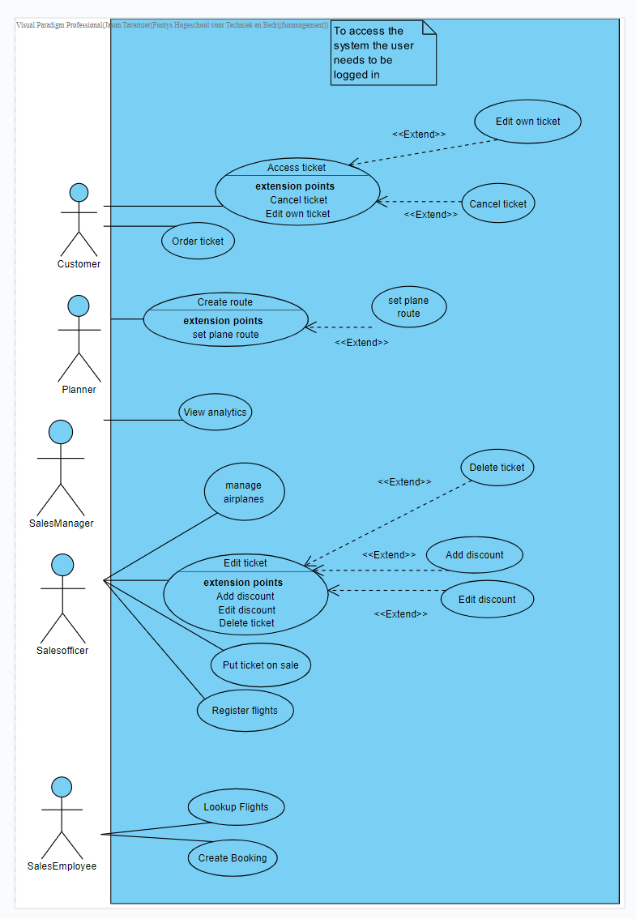
Use case diagram

Slide 5
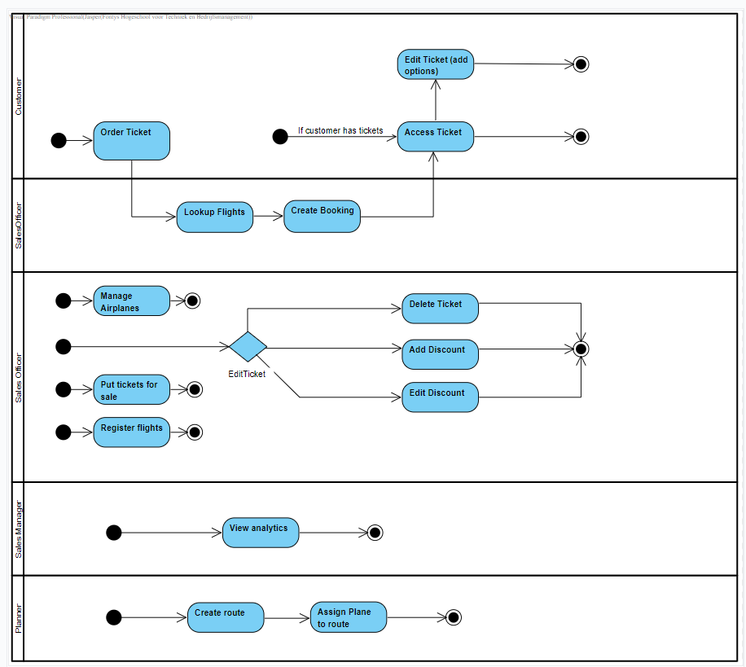
Activity Diagram

Slide 6
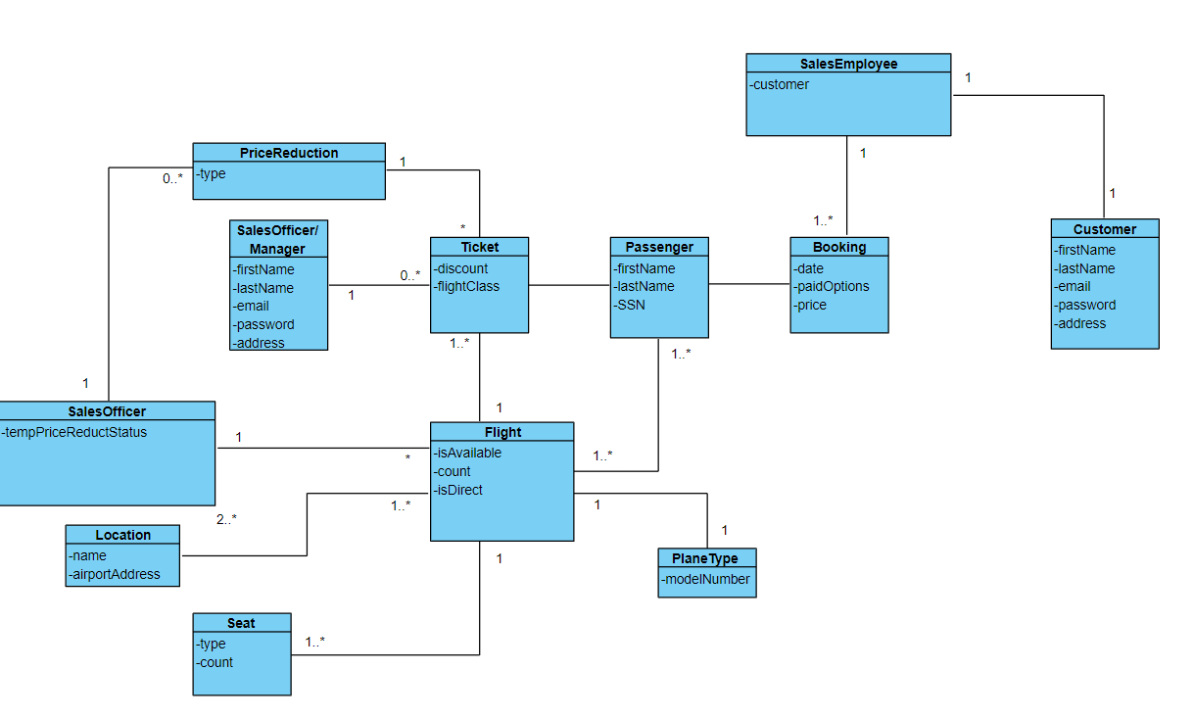
Domain model

Slide 7
Class diagram
View in visual paradigm
https://raw.githubusercontent.com/FontysVenlo/prj2-2021-prj2-2021-g19/master/design/ClassDiagram/ClassDiagram.svg?token=ALUAK4R3MP6YLHX4C3HH5LTAOWHMU

Slide 8
Test cases
Lookup in Github
https://github.com/FontysVenlo/prj2-2021-prj2-2021-g19/blob/master/analysis/TestScenarios.md

Slide 9

Application demo

Slide 10

Conclusion

