Slide 1

Reddit
Software Engineering, FEUP 2015/2016
Work by:
Daniel Couceiro
Diogo Cardoso
Pedro Albano
Pedro Faria

Slide 2
Software Development Process
What is Reddit?
An entertainment and social networking website where registered user’s can post and share their content, founded by Steve Huffman.
Programming Language Used
It was originally written in Lisp but was rewritten in Python some months later, after becoming open source.
Development Process
Unfortunately we didn't find any info about what process reddit follows, or if it follows a determined one or not.
FEUP 2015/2016
Software Engineering

Slide 3
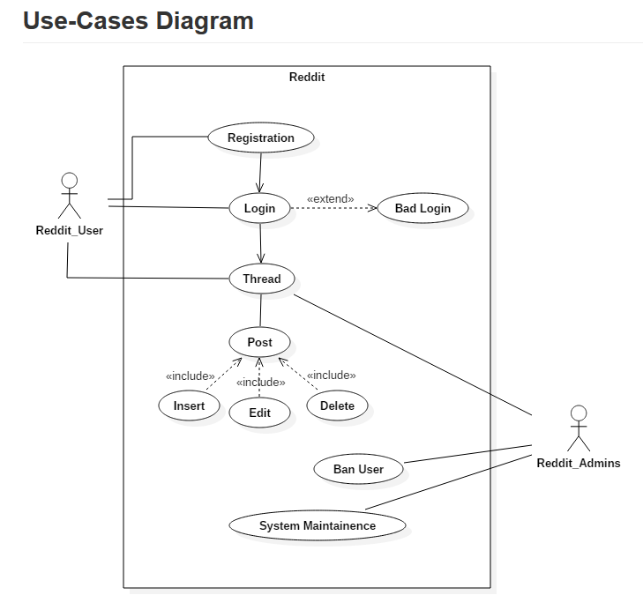
Requirement Elicitation
Contributing to reddit
Anyone can contribute to reddit, as long as the rules and code standards used by the software are followed.
Users are also able to share new ideas or features directly on reddit via the “ideasfortheadmins” subreddit.
Use-Cases
It’s mainly a system where the user authenticates and publishes and comments content, where some users may be promoted to perform tasks of administration and moderation.
FEUP 2015/2016
Software Engineering

Slide 4
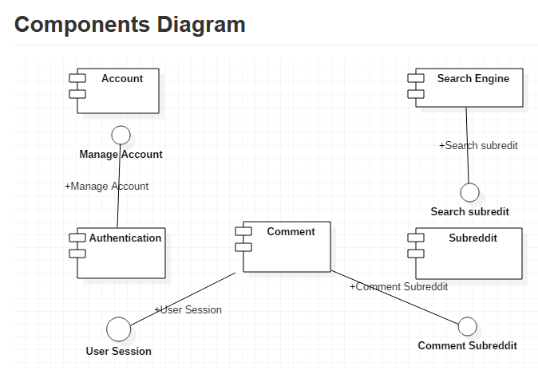
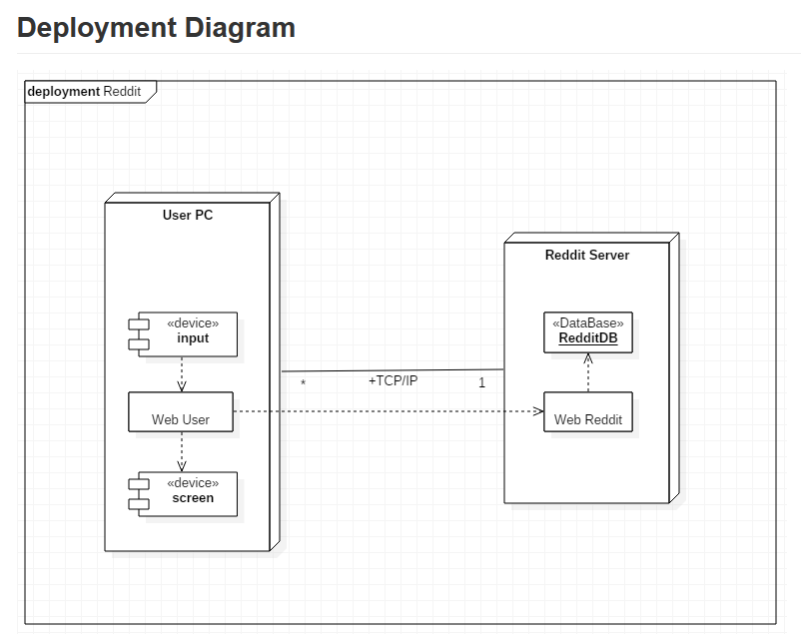
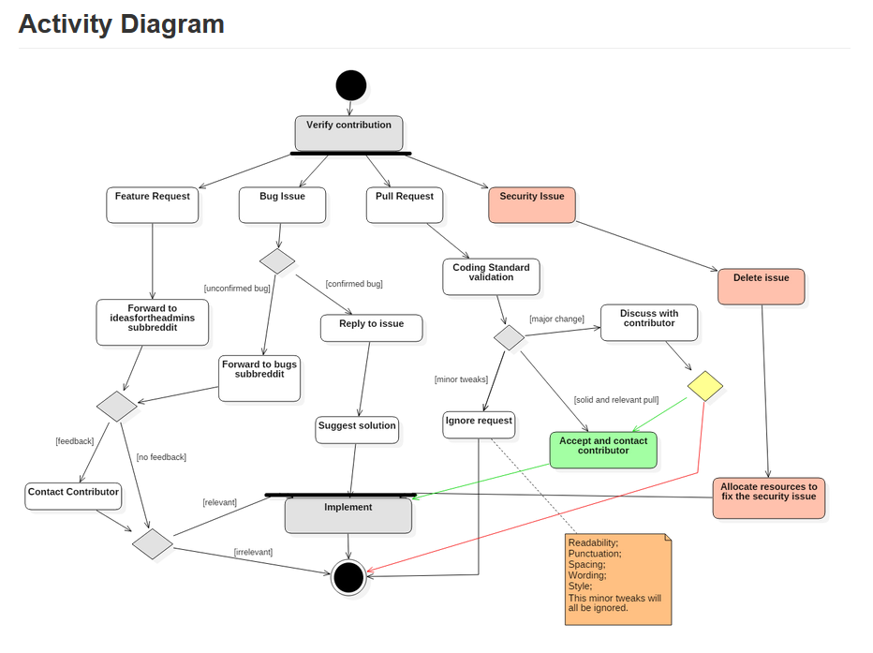
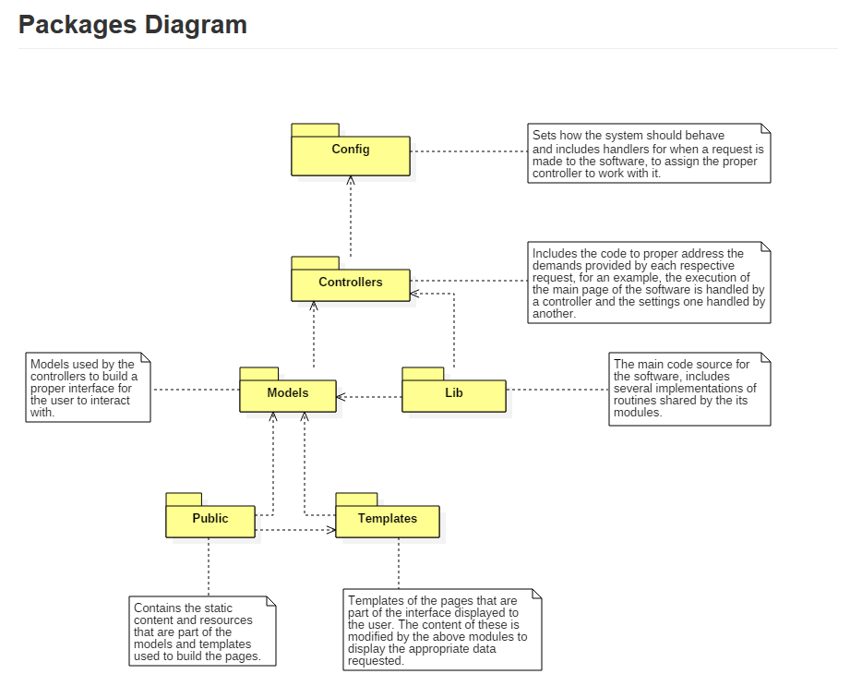
Software Design
The design of the software can be split into two groups,
The reddit software itself, the core that manages and implements the application and its services, allowing users to submit their content and the administration to review and moderate it.
A secondary group of software services that are used primarely to store information and manage it, mostly database servers.
FEUP 2015/2016
Software Engineering

Slide 5
Software Tests
The reddit software uses a set of basic unit tests
These tests allow to identify severe and critical software issues, but lack the depth necessary to locate lesser problems
Although the lack of an advanced set of tests, the main usage of the software provides feedback on the system actively, making these not a crucial functionality to have present
FEUP 2015/2016
Software Engineering

Slide 6
The End Thank you for watching

