Slide 1

FIRE ALARM SYSTEM
DIVYA P HATHWAR 1DS17CS035
CHANDANA VIJAYAKUMAR 1DS17CS033
GAURI PANDIT 1DS17CS038

Slide 2
INTRODUCTION
Flame Sensors, Smoke Sensors, Fire Alarms etc. are part of a safety equipment that help us in keeping our homes, offices and stores safe from fire accidents.
Almost all modern houses, apartments, malls, cinema halls, theatres, office buildings and shops are equipped with such safety equipment and it is mandatory in some regions to fire safety devices.
A flame detector is a sensor designed to detect and respond to the presence of a flame or fire. Responses to a detected flame depend on the installation, but can include sounding an alarm, deactivating a fuel line (such as a propane or a natural gas line), and activating a fire suppression system.
DOMAIN :
IOT

Slide 3
OBJECTIVE
The main objective is to develop an web-based application for the user to detect a fire which will be detected by the flame sensor. Also, to alarm to user with the help of a buzzer incase a fire is around.
A Flame Sensor is a device that can be used to detect presence of a fire source or any other bright light sources.
NodeMCU is an open source IoT platform.It includes firmware which runs on the ESP8266 Wi-Fi SoC from Espressif Systems, and hardware which is based on the ESP-12 module.
We have integrated nodemcu as well as the flame sensor into our model.

Slide 4
FLAME SENSOR AND ITS WORKING
A flame detector is a sensor designed to detect and respond to the presence of a flame or fire. Responses to a detected flame depend on the installation, but can include sounding an alarm.
There are different types of flame detection methods. Some of them are: Ultraviolet detector, near IR array detector, infrared (IR) detector, Infrared thermal cameras, UV/IR detector etc.
When fire burns it emits a small amount of Infra-red light, this light will be received by the Photodiode (IR receiver) on the sensor module.
Then we use an Op-Amp to check for change in voltage across the IR Receiver, so that if a fire is detected the output pin (DO) will give 0V(LOW) and if the is no fire the output pin will be 5V(HIGH).
In this project we are using an IR based flame sensor. It is based on the YG1006 sensor which is a high speed and high sensitive NPN silicon phototransistor. It can detect infrared light with a wavelength ranging from 700nm to 1000nm and its detection angle is about 60°.
Working voltage is between 3.3v and 5v DC, with a digital output. Logic high on the output indicates presence of flame or fire. Logic low on output indicates absence of flame or fire.

Slide 5
NODEMCU SPECIFICATIONS
Developer : ESP8266 Opensource Community Type : Single-board microcontroller CPU : ESP8266 Memory : 128kBytes Storage : 4MBytes Power By : USB Power Voltage : 3v ,5v (used with 3.3v Regulator which inbuilt on Board using Pin VIN) IDE Used : Arduino IDE
GPIO : 10

Slide 6
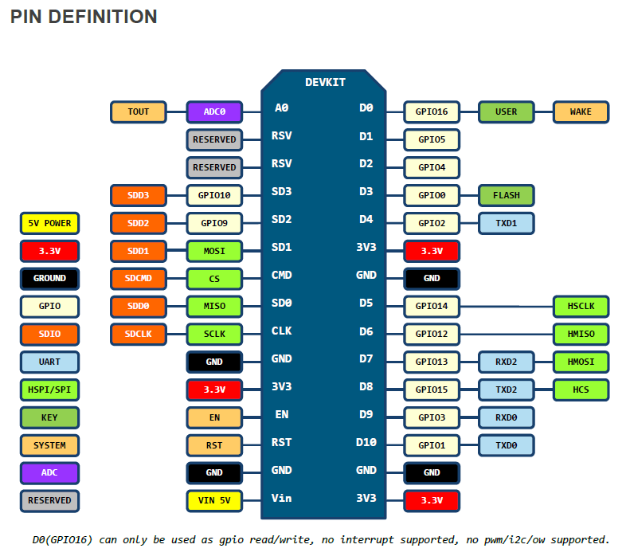

Slide 7
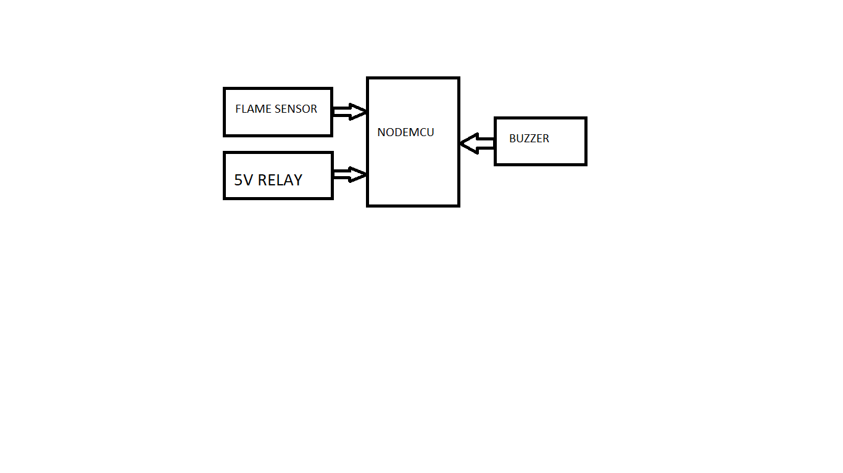
DESIGN AND IMPLEMENTATION

Slide 8
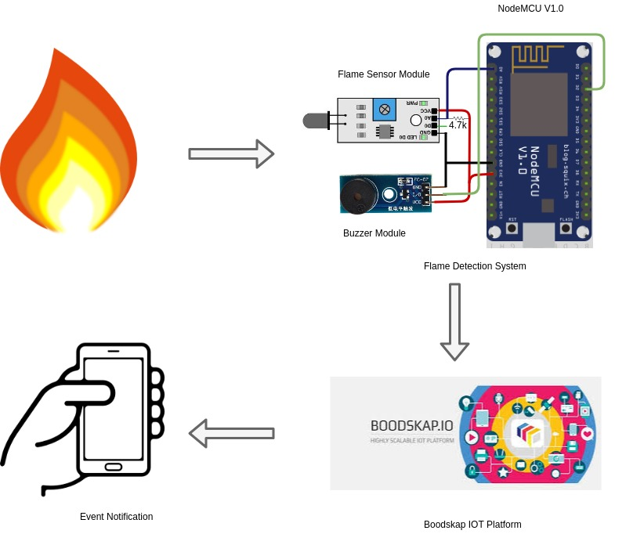
CIRCUIT DIAGRAM

Slide 9
We are going to define pins for Flame sensor, and buzzer which are connected to Nodemcu.
Based on analog value we will detect the presence of flame. Based on the value stored in “threshold”, we have to turn on the buzzer.
If the value of threshold is high then under normal conditions, the output from the Flame Sensor is HIGH.
When the sensor detects any fire, its output becomes LOW.
Arduino detects this LOW signal on its input pin and activates the Buzzer. compare the value with 0 or 1.If its equal to 1, it indicates that flame has been detected.
We have to turn on buzzer and then send value to the web page.
If its equal to 0, then it indicates that no flame has been detected. This process is repeated.

Slide 10

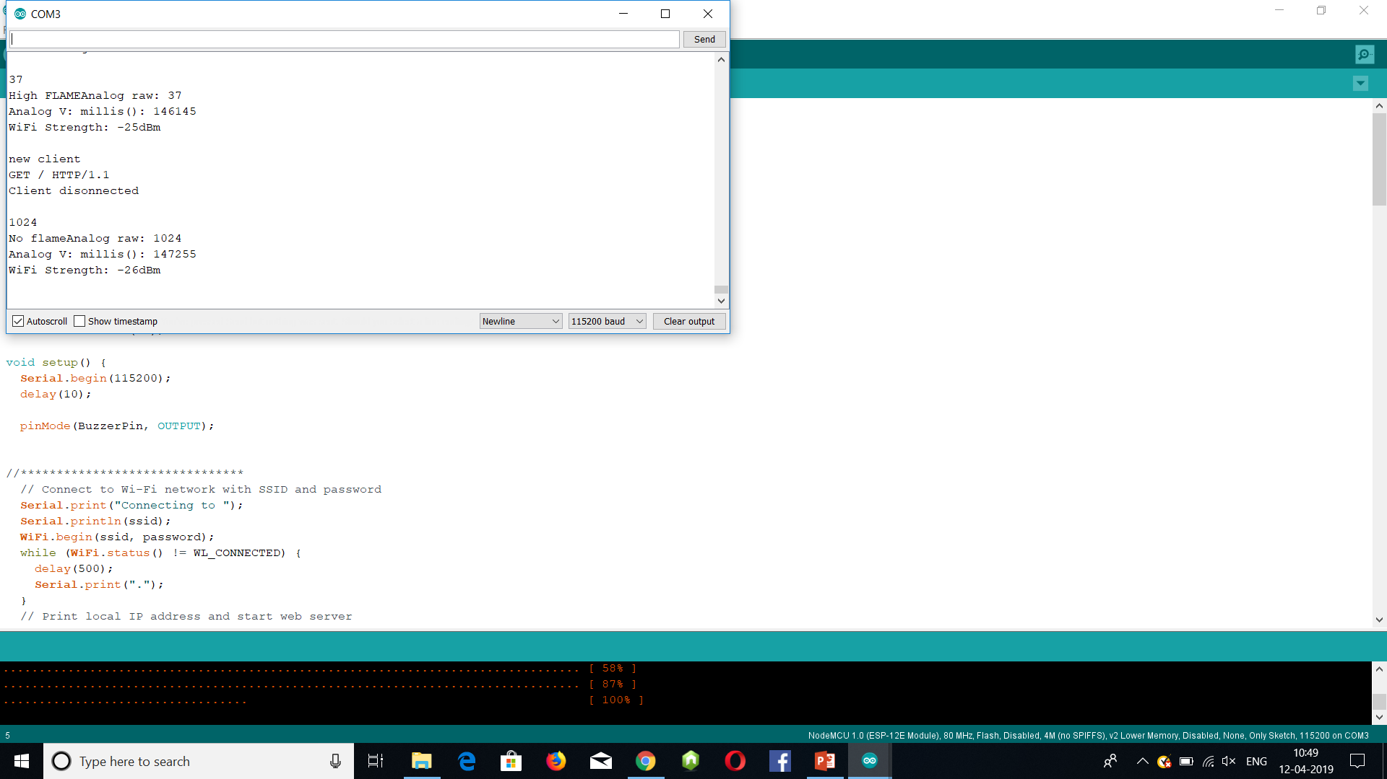
RESULTS SNAPSHOT
.

Slide 11
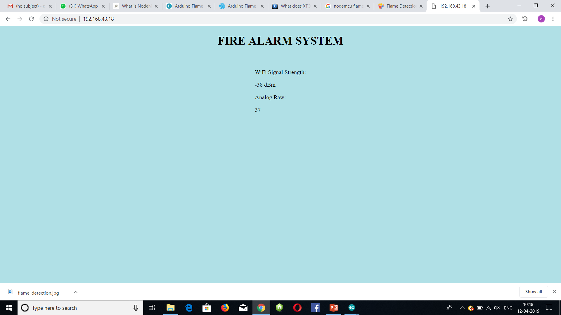
WEB INTERFACE

Slide 12
FUTURE UPDATES
In the future updates there will be notifications sent to the user on phone incase of any fire
A water sprinkler can be added to decrease or put out the fire.

