Slide 1

Spyro Game Project
Java / Greenfoot 2D Game Development
Courtney McGuinness

Slide 2
Project Overview
A 2D Spyro-inspired game developed in Java using Greenfoot.
  Created as an introduction to object-oriented programming and game logic.
  Includes interactive gameplay, collectibles, and enemy mechanics.

Slide 3
Key Features
Player-controlled character (Spyro)
  Gem collection system
  Enemy characters (Gnorc)
  Fire attack mechanic
  Score tracking and counter system
  Collision detection and world interaction

Slide 4
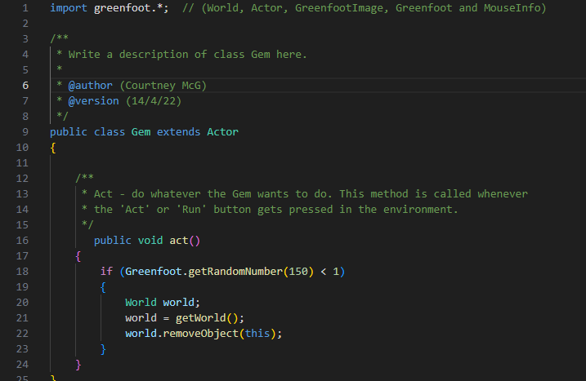
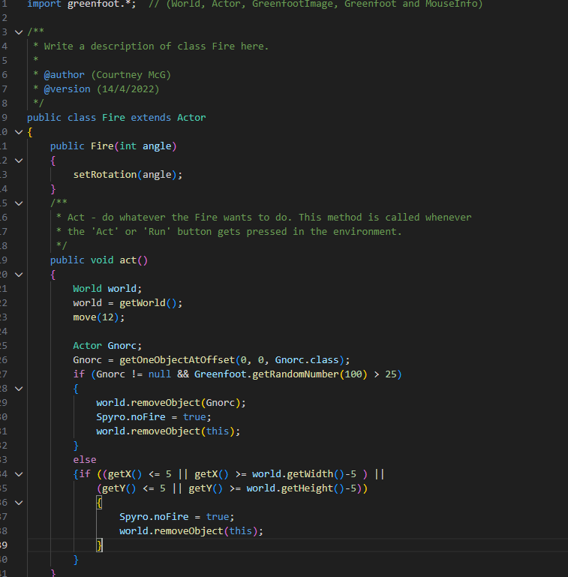
Code Structure
Gem Class
Fire Class

Slide 5
Technical Implementation
Object-Oriented class design.
Designed using modular class architecture:
• Player (Spyro)
• Enemy (Gnorc)
• Collectibles (Gem)
• World Controller (MyWorld)
Event-driven input handling
  Game loop and world state management
  Collision detection between actors
  Asset and sound integration

Slide 6
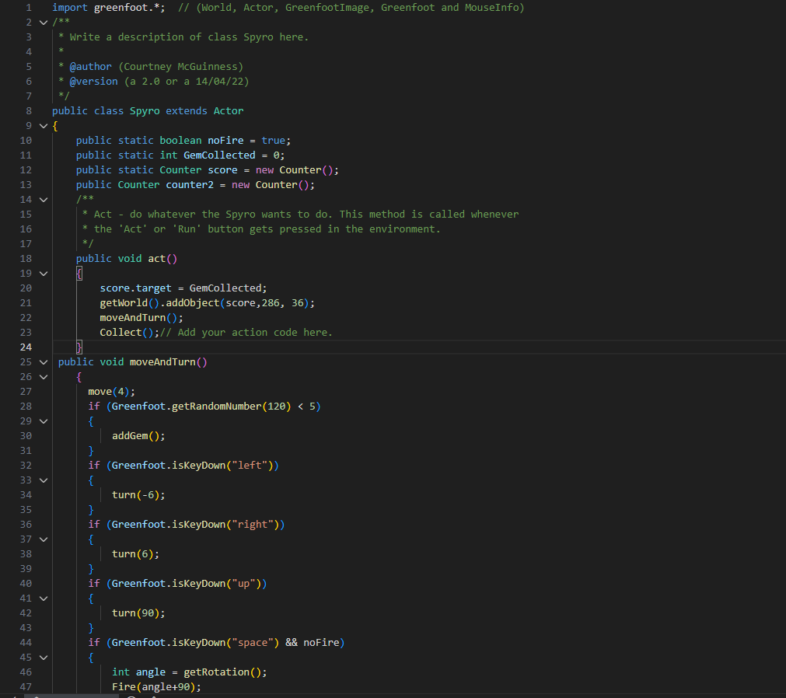
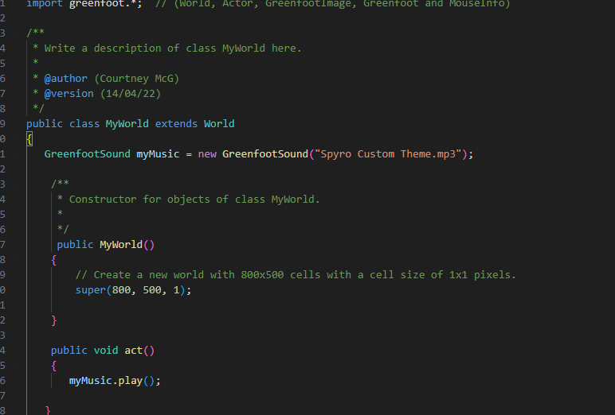
Code Structure
Character Logic
Music

Slide 7
Game Architecture
MyWorld → Controls game environment
  Spyro → Player logic and movement
  Gem → Collectible objects
  Gnorc → Enemy behavior
  Fire → Attack mechanism
  Counter → Score tracking system

Slide 8
Learning Outcomes
Applied foundational object-oriented programming principles
  Managed multiple interacting classes
  Handled input, collisions, and game state updates
  Developed early understanding of game architecture

Slide 9
Project Significance
First complete game development project
  Established foundational programming skills
  Demonstrates growth prior to mobile and AI-based projects

Slide 10
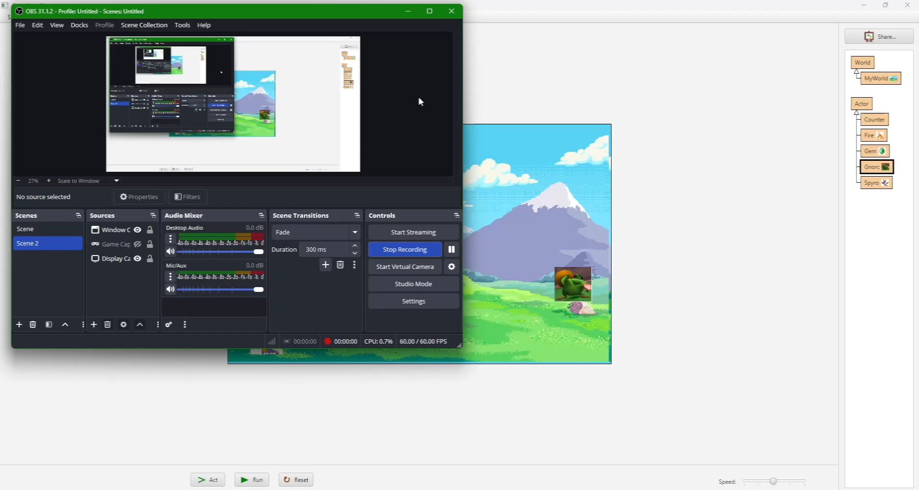
Demo

