Slide 1
Sharit
Kenneth Liang, Allen Zheng, Warlon Zeng, Hui Huang

Slide 2
Overview
What’s the Problem?
Story
A solution
Problems with the Current Solution
Our solution: Sharit
Use Case Diagrams
Advantages
Future Work
Post Implementation Review
What Would we Change
Questions & Answers

Slide 3

What’s the Problem?
NYU Poly had a four year graduation rate of 41%¹
Students are not adequately prepared for exams
Students are not doing well
¹http://catalog.poly.edu/content.php?catoid=7&navoid=606

Slide 4

Story
Midterms and Finals
Rush to find past exams
Generic: Past homeworks and solutions
Generic: Lecture notes

Slide 5

A Solution
Allow students to share notes and old exams
Encourage collaboration on topics that they don’t understand

Slide 6

Problems with Current Solution
File sharing is highly disorganized
Difficult to locate the correct file that you are looking for
Students would have to ask on Facebook and sometimes not get a reply

Slide 7
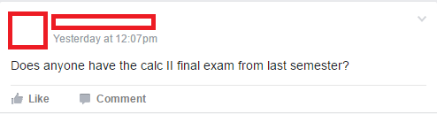



Slide 8

Our solution: Sharit
Sharit is a web-based forum that allow students to collaborate by sharing files, e.g., exams, homeworks, and notes
Feedback system
Central point of access for all files

Slide 11

Advantages
Dedicated file sharing/collaboration forum
Organized by utilizing domains and subdomains
Professional, simple, and clean interface

Slide 12

Future Work
Expand to multiple schools
Go enterprise

Slide 13
Post implementation review
What we did right:
Documents completed in a timely manner
Evenly distributed work
What we did wrong:
Not enough team meetings
Some incorrect documentation

Slide 14
Post implementation review
What we would change:
More team meetings
Frequent document inspections by all team members

Slide 15
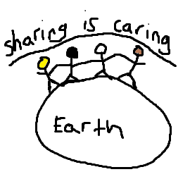
Questions & Answers
???

