Slide 1
Sharit
Kenneth Liang, Allen Zheng, Warlon Zeng, Hui Huang

Slide 2
Overview
What’s the Problem?
Roles
Story
A solution
Problems with the Current Solution
Our solution: Sharit
Advantages
Use Case Diagrams
Future Work
Post Implementation Review
What Would we Change
Questions & Answers

Slide 3
Roles
Hui Huang - Chief Engineer/Frontend
Kenneth Liang - Database Engineer
Warlon Zeng - Backend Engineer/SRE
Allen Zheng - Backend Engineer

Slide 4

What’s the Problem?
NYU Poly had a four year graduation rate of 41%¹
Students are not adequately prepared for exams
Students are not doing well
¹http://catalog.poly.edu/content.php?catoid=7&navoid=606

Slide 5

Story
Midterms and Finals
Rush to find past exams
Generic: Past homeworks and solutions
Generic: Lecture notes

Slide 6

A Solution
Allow students to share notes and old exams
Encourage collaboration on topics that they don’t understand

Slide 7

Problems with Current Solution
File sharing is highly disorganized
Difficult to locate the correct file that you are looking for
Students would have to ask on Facebook and sometimes not get a reply

Slide 8
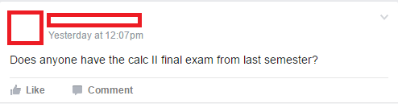
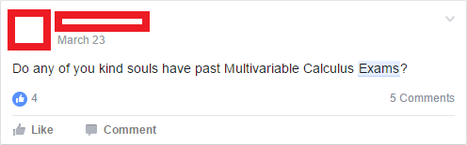
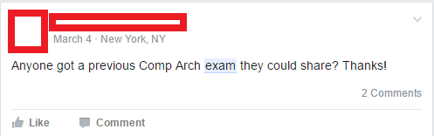

Slide 9

Our solution: Sharit
Sharit is a web-based forum that allow students to collaborate by sharing files, e.g., exams, homeworks, and notes
Feedback system
Central point of access for all files

Slide 10

Advantages
Dedicated file sharing/collaboration forum
Organized by utilizing domains and subdomains
Professional, simple, and clean interface

Slide 13
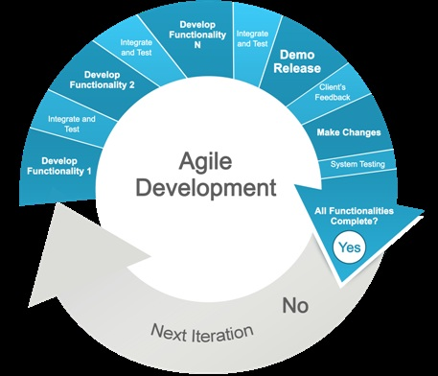
Development Cycle
Developed using the agile development cycle.

Slide 14
User Process

Slide 15

Future Work
Expand to multiple schools
Go enterprise
Implement user email validation
Comment replies
Sort threads by user’s specification

Slide 16
Post implementation review
What we did right:
Evenly distributed work
Implemented all our basic features
Weekly team discussions
What we did wrong:
Using technologies that we were not familiar with consumed too much time
Started coding for the project late

Slide 17
Post implementation review
What we would change:
Using technologies that we are already familiar with to ensure no delays in building the product
More in person team meetings

Slide 18
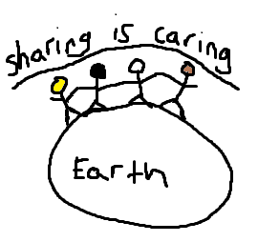
Questions & Answers
???

