Slide 1
Overview of Web Database Applications with Flask
CS 3083

Slide 2
Quick guide on how to install Flask
Make sure you have python and MySQL installed
Go to the terminal or command prompt (for windows, make sure python is added to your path environment variables) and run:
pip install flask
pip install pymysql (used to connect to database)
If you don’t have pip you can get it in the following link:
https://pypi.python.org/pypi/pip
Run: python get-pip.py
More information:
http://flask.pocoo.org/

Slide 3
Flask
Flask is a micro-framework for python
Easy to code
Flexible
Good documentation
RESTful

Slide 4
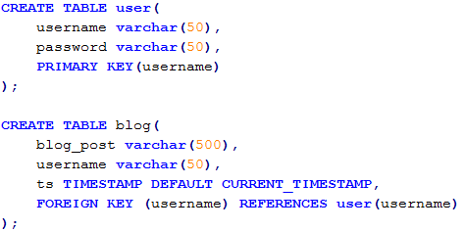
Table definitions

Slide 5
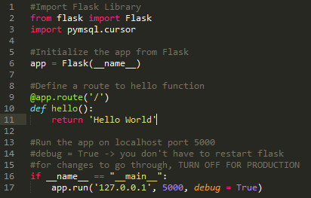
Basic Flask App
@app.route(‘/’) is saying that if the user goes to the root level of your application (e.g 127.0.0.1:5000/) the hello function will be called
If you go to localhost:5000
You should see Hello World being printed out

Slide 6
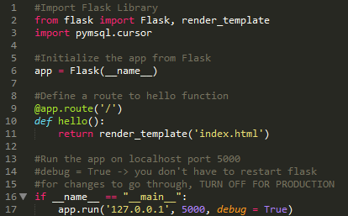

Rendering html files
If you want to send back hml files, import render_template and use it to send back html files.
***The html files should be in a directory called templates

Slide 7


Creating a simple login/register form
This would be in a login.html file, this makes a POST request to /loginAuth, we’ll talk more about /loginAuth later
This would be in a register.html file, this makes a POST request to /registerAuth, we’ll talk more about /registerAuth later

Slide 8
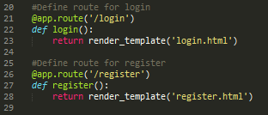
Creating flask code to serve the files

Slide 9
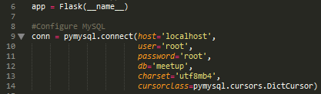

Configuring to connect to MySQL
This sets the configuration to connect to your MySQL database
Import session, requests, url_for, and redirect for the next part
In order to use session, you must create a secret key

Slide 10
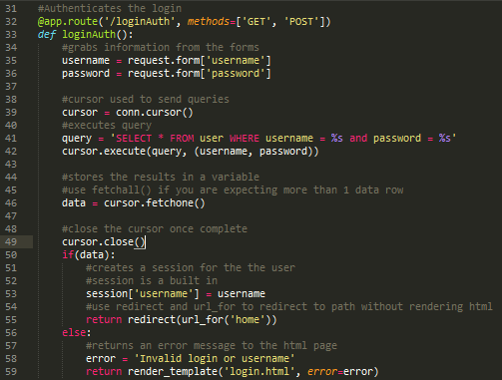
Authenticating the login
Need to add this for GET and POST requests to work
We can send a query to the database by calling the execute method of cursor. Cursor is just an object that is used to interface with the database. If the query is successful, call fetchone() to get a single data row or fetchall() to get multiple rows.
If the login is successful, it will redirect to the home page

Slide 11
Redirect(url_for(…)) vs Render_template(…)
Render_template gives back the html page
Redirect(url_for(…)) calls the function given

Slide 12
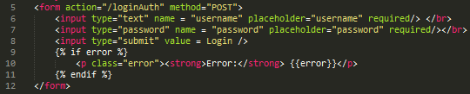
Updating the login form
In the previous slide, we passed in an extra argument to render_template:
error = error. Error corresponds to the error that was passed in by the render_template call. Flask uses jinja templating and we can pass variables from flask to the html page using this. If there was an error message, we passed it in and the message is displayed. {{}} denotes a variable.

Slide 13
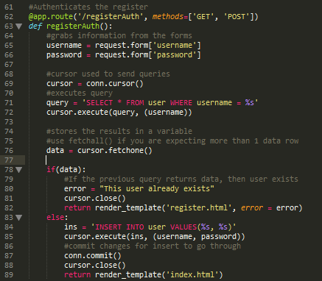
Authenticating register
NOTE: You don’t want to store your passwords in your database as plain text, you probably want to hash it
Notice in line 87, we have to commit if the query modifies the database

Slide 14
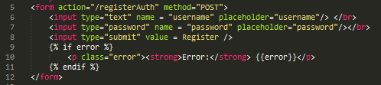
Updating register form

Slide 15

The home page
In our home page, we want to display a welcome message to the user and allow the user to post something.

Slide 16
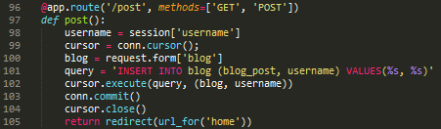
Posting
Notice in the insert that we only insert into blog_post, and username.
We don’t want to insert into the timestamp because MySQL automatically
updates it for us.

Slide 17
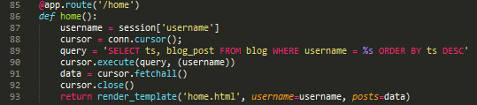
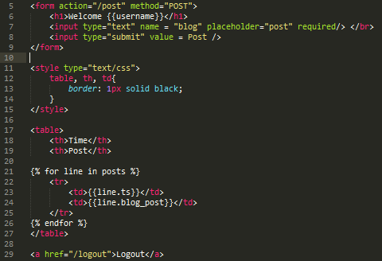
Home page
We want to allow the user to be able to post and see their posts on the front page. We call fetchall() and pass it into the home.html page.
Update the home.html page and use jinja’s for loop to iterate through the data given and display it.

Slide 18

Logout
To log out of the application, simply pop ‘username’ from the session store.
Note that if the user presses the back button on the browser or manually types in
a path that requires the user to be logged in, bad things will happen. In all the routes
add a check to see if ‘username’ is in session before doing any other operations.

Slide 19
Some notes
In the previous example, you can choose to sort the result of the search query either in python or MySQL.

Slide 20
Issues that you may have with connecting to MySQL
Run “mysqld” in the command line to start the mysql daemon
If you are unable to run mysql do the following:
Mac – Add the path to mysqld using the following:
export PATH=${PATH}:/usr/local/mamp/mysql/bin/
You will have to modify the path to match how it’s installed in your system
Windows – Add mysqld to environment variables
C:\wamp\bin\mysql\mysql5.6.17\bin
This needs to be added to PATH in environment variables
Once again, the path might be different on your machine

