Slide 1

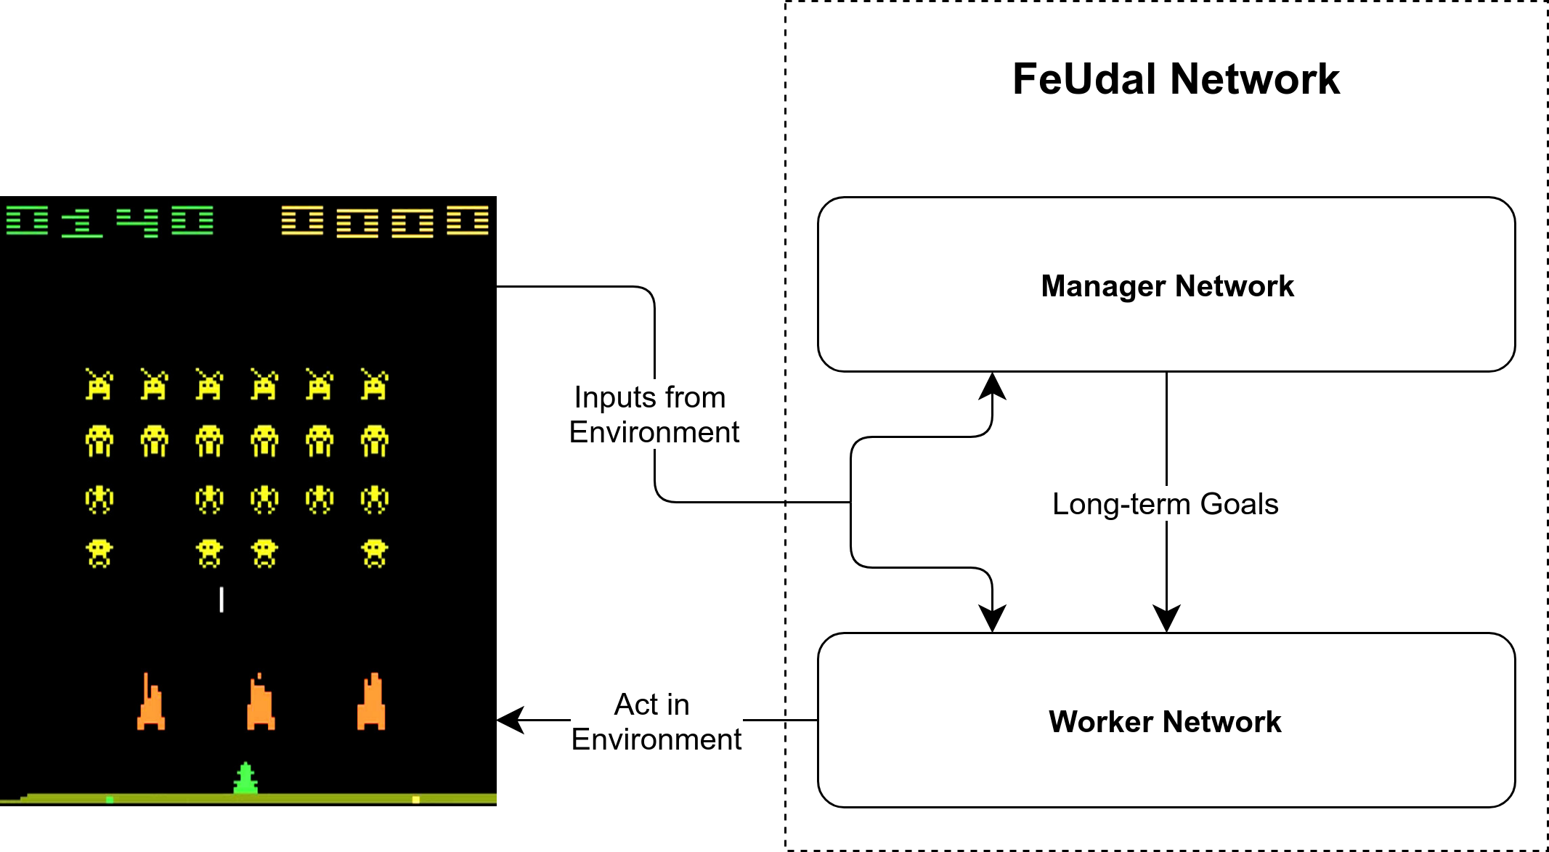
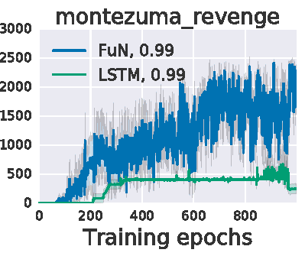
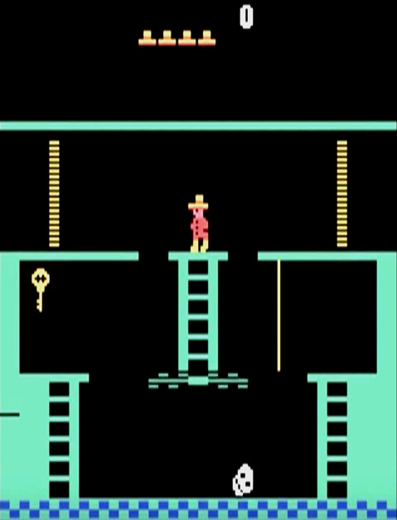
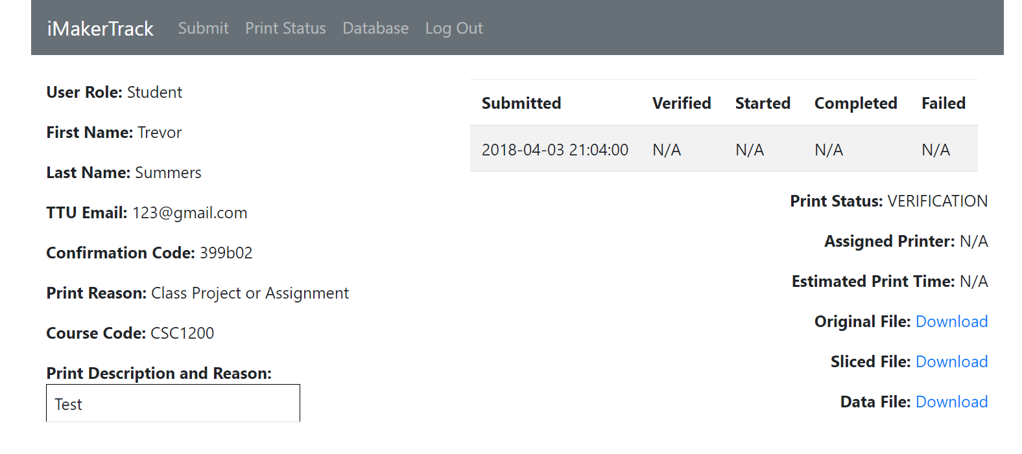
FeUdal Networks for Hierarchical
Reinforcement Learning
Reinforcement Learning
Summary
The concept of FeUdal Networks comes from a paper by DeepMind. This technique involves running multiple deep reinforcement learning algorithms at different levels of spatial or temporal resolution. In DeepMind’s architecture, there are two layers – a “manager” network that runs on a longer overarching timescale, which provides goals to a “worker” network. The worker network in turn takes actions in the environment to try to align with those goals. The manager network is then optimized to try to maximize reward from the environment, and the worker network is optimized to follow the goals specified from the manager network.
Design and Methodology
Future Work
Concept
In Artificial Intelligence, Reinforcement Learning is finding an optimal strategy – using input from the environment, taking actions in that environment, and using reward feedback in order to improve its strategy.
Technologies used to replicate study:
Python (primary language used for implementation)
Tensorflow (Google’s machine learning library)
Gym (OpenAI’s interface for game emulators)
Universal Starter Agent (OpenAI’s base A3C Implementation)
Methodology
Compare base A3C with FuN on Space Invaders
Compare base A3C with FuN on Montezuma’s Revenge
Attempt to replicate original study’s results in Figure 1.)
Applications
Due to the fact that Reinforcement Learning is, at its core, an agent learning how to act optimally through trial and error, it has the potential to work in a great diversity of domains. In particular, it sees applications in robotics, natural language processing, dialogue systems, healthcare, and computer vision [2].
Architecture and Interaction with Atari Game Environment
Feudal Reinforcement Learning
Video Games as Benchmarks
Instead of physically going to the iMakerSpace, students and faculty can submit a 3D print job online (Figure 2) and will receive a code once they submit a print which they use to view their print’s status (Figure 3)
The Challenge – Montezuma’s Revenge
Of all the games in the Atari suite, Montezuma’s Revenge is traditionally one of the hardest for reinforcement algorithms to learn.This is due to “sparse rewards.” The algorithm can play for a long time without receiving any rewards, meaning it doesn’t know whether it’s doing the right thing or not.
Problems like this require “temporally extended planning strategies” [1]. The algorithm needs to have the capability to analyse larger spans of time in order to find correlations between the rewards it earns and its sequence of actions prior.
Figure 1: Scores on Montezuma’s Revenge (from DeepMind’s study)
Foundational Work
Staff login page, provided access to a database (Figure 4) with all print submissions on it, can view and edit these print jobs as well as update the print’s status (Figure 5).
[1] V. Mnih, “Human-level control through deep reinforcement learning,” Nature, vol 518, pp. 529-533, Feb. 2015.
[2] Y. Li, “Deep Reinforcement Learning: An Overview,” arXiv:1701.07274, Sep. 2017.
[3] A. Vezhnevets, “FeUdal Networks for Hierarchical Reinforcement Learning,” arXiv:1703:01161v2, Mar. 2017
Figure 5: Staff’s Print Status Page
Acknowledgments go to Dr. Doug Talbert

