Slide 1

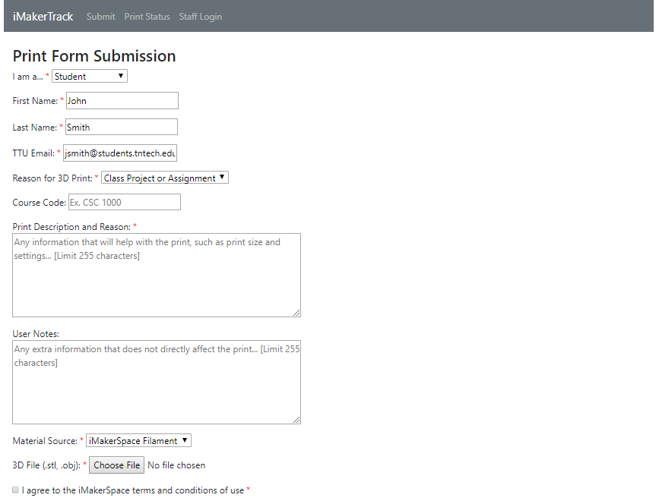
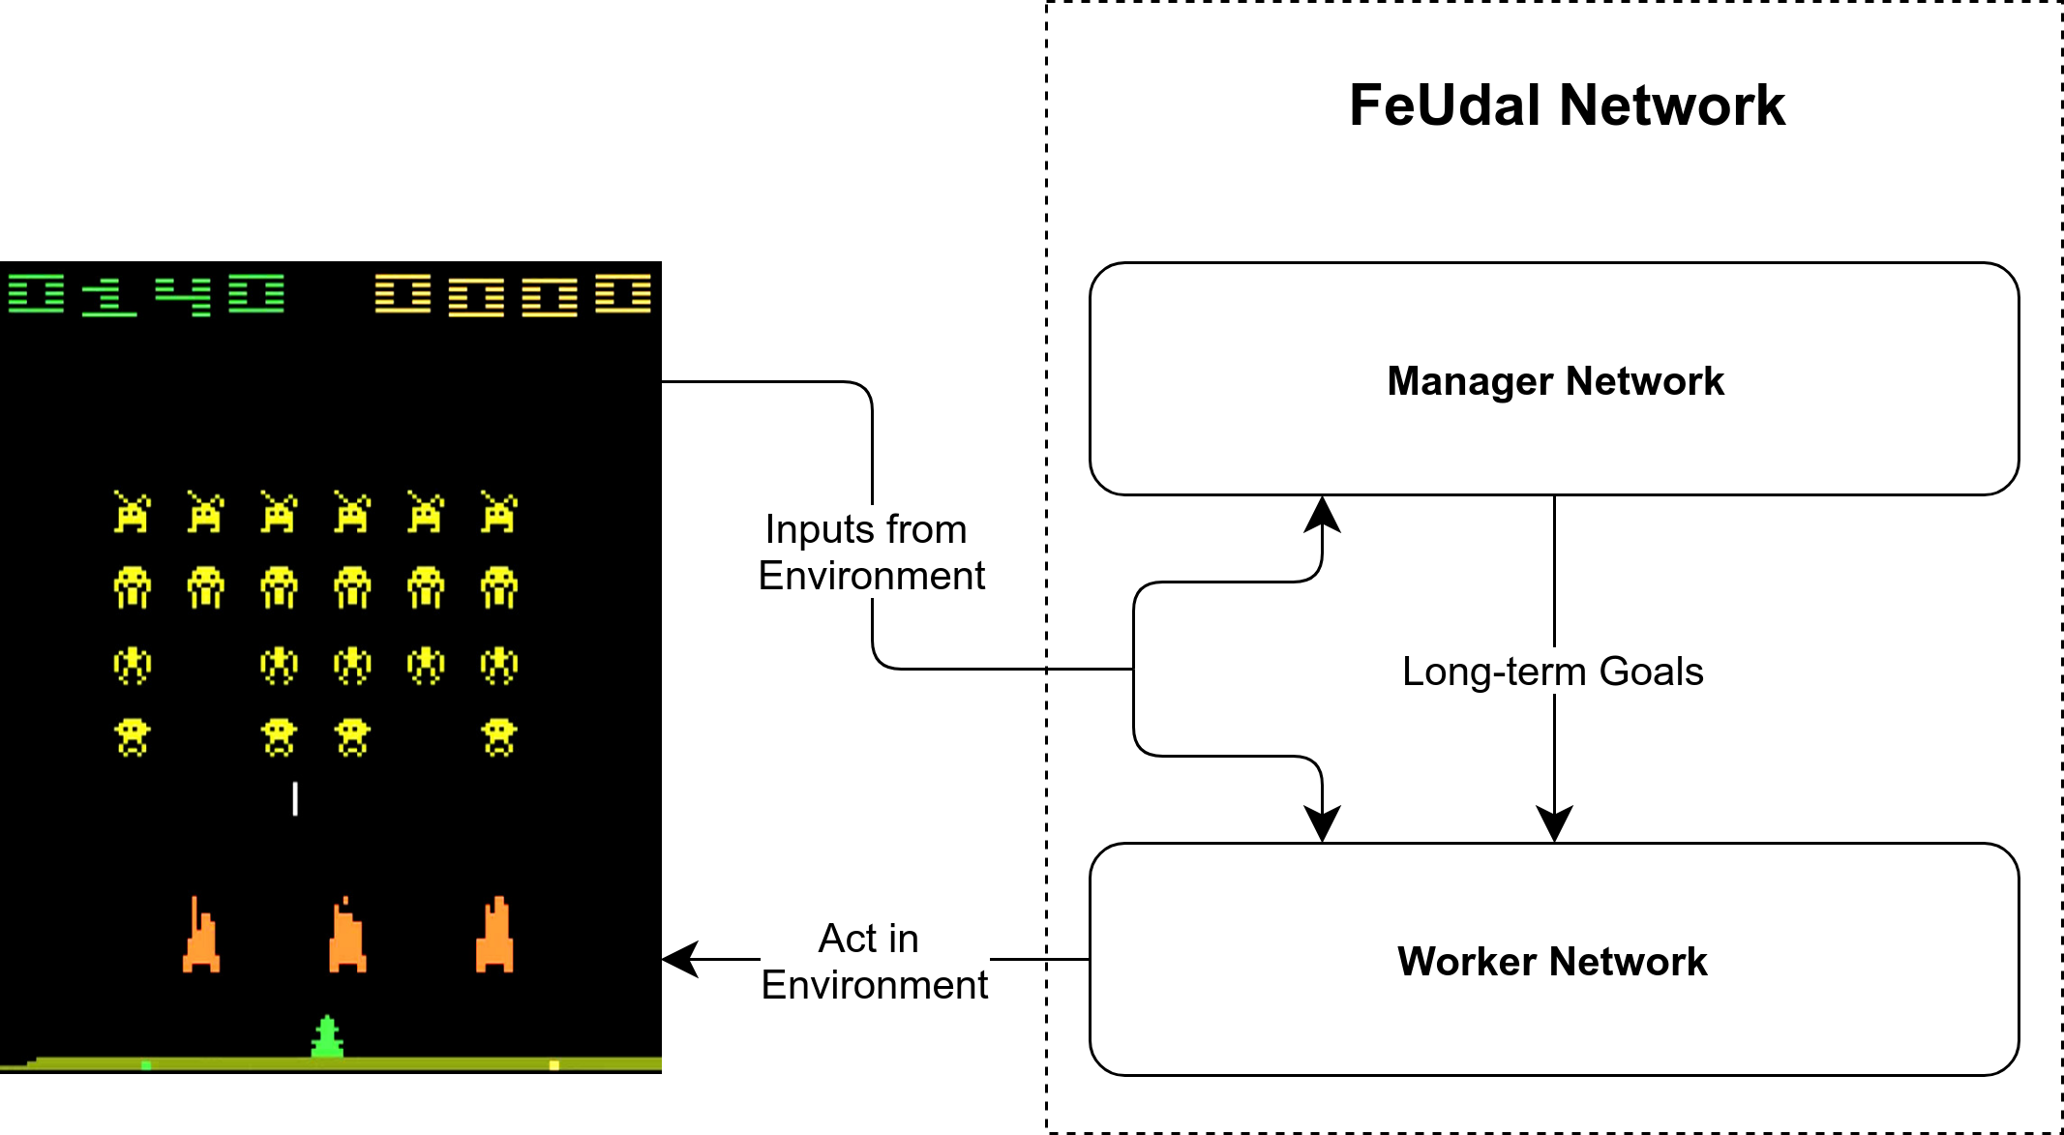

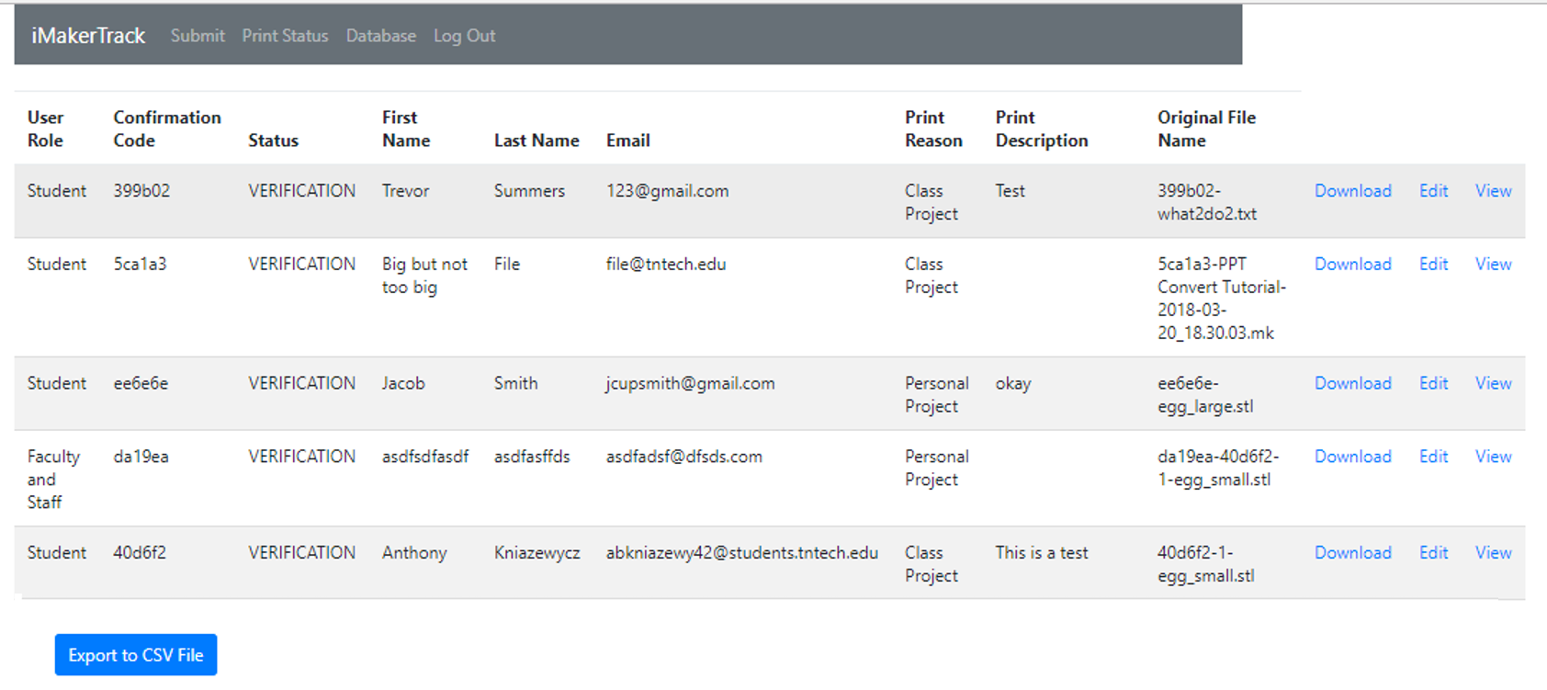
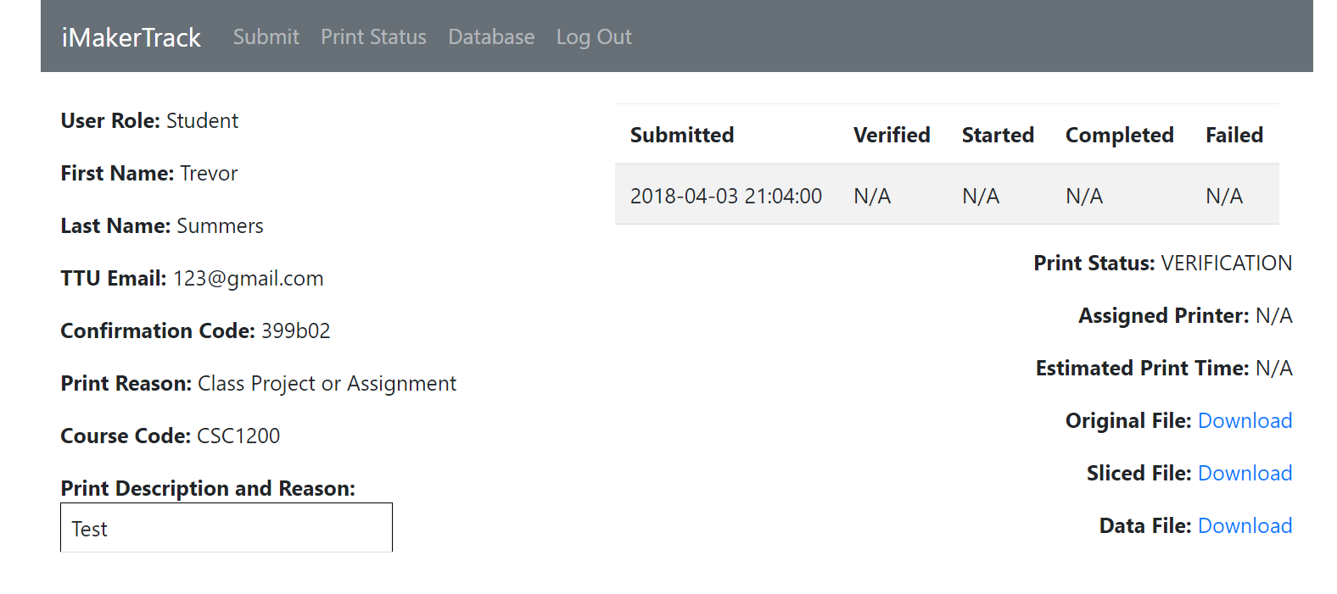
FeUdal Networks for Hierarchical
Reinforcement Learning
Development
Summary
The concept of FeUdal Networks comes from a paper by DeepMind. This technique involves running multiple deep reinforcement learning algorithms at different levels of spatial or temporal resolution. In DeepMind’s architecture, there are two layers – a “manager” network that runs on a longer “overarching” timescale, which provides goals to a “worker” network, which takes actions in the environment to try to align with those goals. The manager network is optimized to try to maximize reward from the environment, and the worker network is optimized to follow the goals specified from manager network.
iMakerTrack Website
Design
Agile development using story cards and developing the project through five iterations to create a Minimal Viable Product.
Platforms
Cloud9, the coding language of the website was written in PHP. The website will be migrated from Cloud9 to Heroku which will host the website with its custom URL.
Figure 2: Print Form Submission Page
Users of iMakerTrack
TTU Students and Faculty
Instead of physically going to the iMakerSpace, students and faculty can submit a 3D print job online (Figure 2) and will receive a code once they submit a print which they use to view their print’s status (Figure 3)
Figure 3: User’s Print Status Page
Figure 4: Print Submissions Database for Staff
iMakerSpace Staff
Staff login page, provided access to a database (Figure 4) with all print submissions on it, can view and edit these print jobs as well as update the print’s status (Figure 5).
Team Members
Jonah Aberle (Scrum Master/Business Analyst)
Jacob Smith (Business Analyst)
Anthony Kniazewycz (Technical Lead)
Kimberlyn Dunn (Tester)
Trevor Summers (Developer)
Figure 5: Staff’s Print Status Page
Acknowledgments go to Dr. Gerald Gannod, Josh Tinker, Dr. Nan Guo of the iMakerSpace, and iMakerSpace staff.

