Slide 1
Caterpillar
Exploratory Data Analysis

Slide 2
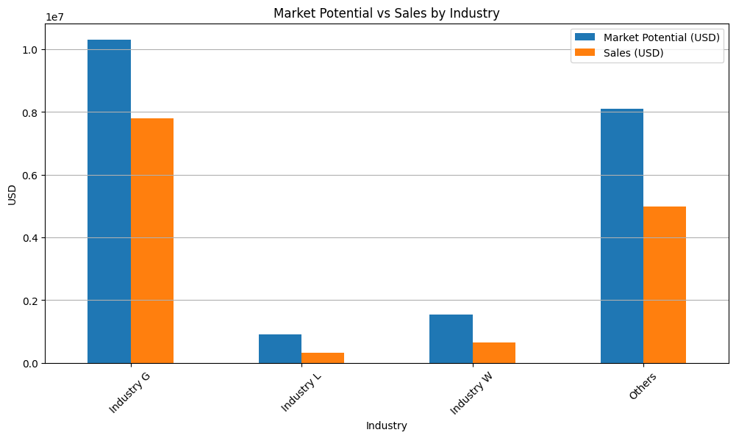
Market Overview
Notes:
Industry G represents the largest market potential and sales, but the gap suggests there’s room to improve sales performance further. The "Others" category has high market potential, second only to Industry G, but there remains a notable gap between potential and sales.

Slide 3
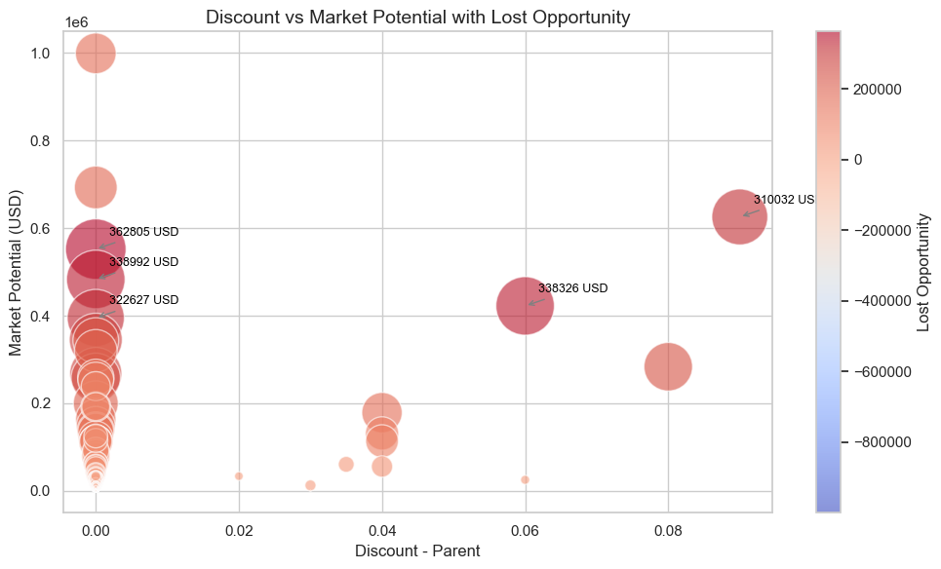
Lost Opportunities Analysis
Notes:
High market potential is clustered around low discounts, suggesting that offering smaller discounts correlates with better market opportunities.

Slide 4
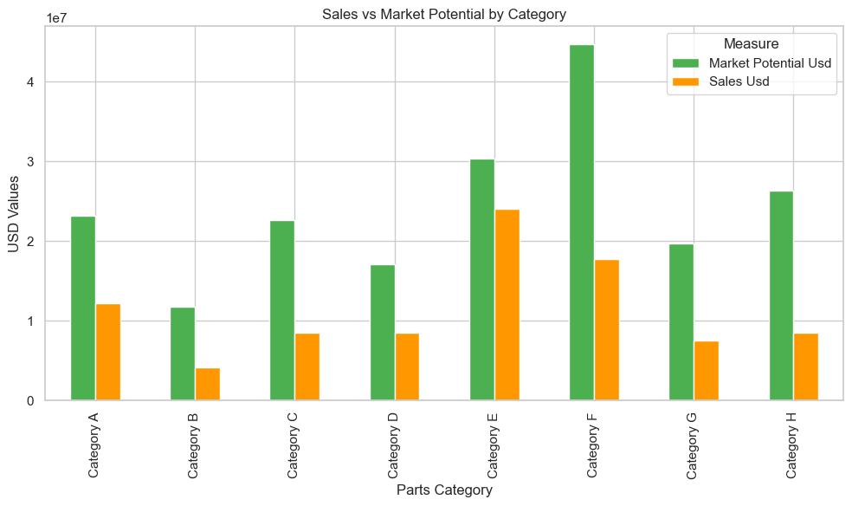
Parts Category Performance
Notes:
Categories E and F have the highest market potential. However, Category F has a significant gap between sales and market potential, highlighting a need for strategies to increase sales in this category. Investigate why sales are lagging behind market potential and implement strategies to capture more of the market

