Slide 1
Network Security - Project
Yujia Huo 372538125@sjtu.edu.cn
2025.5.30

Slide 2
Contents
1
Introduction
2
Task 1: Textbook-RSA
3
Task 2: CCA2 Attack
4
Task 3: OAEP
5
Submission and Standard

Slide 3
Contents
1
Introduction
2
Task 1: Textbook-RSA
3
Task 2: CCA2 Attack
4
Task 3: OAEP
5
Submission and Standard

Slide 4
Introduction
DDL: 23:59 June 22 (Last Day of Week 18)
Submit Format:
Project_${Name}.{tar.gz/rar/zip}
Task 1
Your code/data for task 1 (15/100)
Task 2
Your code/data for task 2 (25/100)
Task 3
Your code/data for task 3 (15/100)
Report_${Name}.pdf (45/100)
Notes:
课程结束后的两周以内

Slide 5
Contents
1
Introduction
2
Task 1: Textbook-RSA
3
Task 2: CCA2 Attack
4
Task 3: OAEP
5
Submission and Standard
Notes:
实现 textbook RSA 算法

Slide 6
Project – Task 1
Goal: Implement the textbook RSA algorithm (without any padding)
Your code should be able to:
Generate a random RSA key pair with a given key size (e.g., 1024-bit)
Encrypt a plaintext with the public key.
Decrypt a ciphertext with the private key.
Notes:
也就是需要实现一个生成大素数的方法

Slide 7
Contents
1
Introduction
2
Task 1: Textbook-RSA
3
Task 2: CCA2 Attack
4
Task 3: OAEP
5
Submission and Standard
Notes:
实现对textbook RSA的 CCA2攻击

Slide 8
Project - Task 2
Goal : Perform a CCA2 attack on textbook RSA
Textbook RSA is elegant, but has no semantic security.
An adaptive chosen-ciphertext attack (abbreviated as CCA2) is an interactive form of chosen-ciphertext attack in which an attacker sends a number of ciphertexts to be decrypted, then uses the results of these decryptions to select subsequent ciphertexts.
The goal of this attack is to gradually reveal information about an encrypted message, or about the decryption key itself.
Notes:
Semantic security: 给m0和m1的c0与c1，攻击者无法区分哪个是哪个的加密结果
RSA加密的同态性

Slide 9
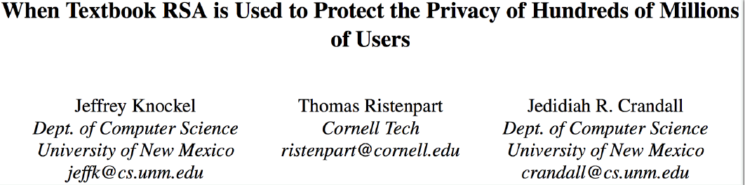
Project - Task 2
Refer an existing work for the implementation
Details of this attack can be found in Chap 4.
Knockel J, Ristenpart T, Crandall J. When textbook RSA is used to protect the privacy of hundreds of millions of users[J]. arXiv preprint arXiv:1802.03367, 2018.

Slide 10
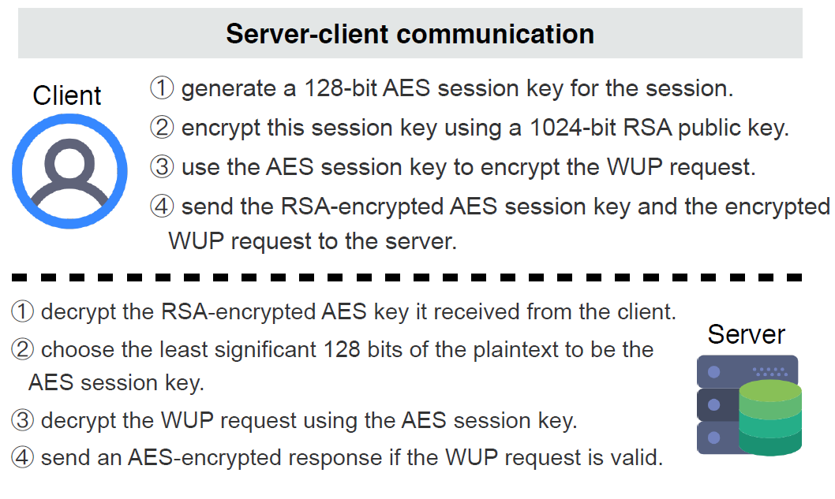
Project - Task 2
Notes:
WUP Wake Up Pattern

Slide 11
Project - Task 2
In this attack, the server knows
RSA key pair
AES key
The adversary knows
RSA public key
a RSA-encrypted AES key
an AES-encrypted WUP request
The adversary wants to know
AES key

Slide 12
Project - Task 2
In this part, you are supposed to
Properly design your own WUP request format, server-client communication model, etc.
Generate a history message by yourself, it should includes a RSA-encrypted AES key and an AES-encrypted request.
Present the attack process to obtain the AES key (and further decrypt the encrypted request) from the history message.
You can use third-party library to implement AES encryption and decryption.

Slide 13
Contents
1
Introduction
2
Task 1: Textbook-RSA
3
Task 2: CCA2 Attack
4
Task 3: OAEP
5
Submission and Standard

Slide 14
Project - Task 3
Goal: defend the attack
Implement RSA-OAEP algorithm and discuss why it can defend such kind of attacks.
Since textbook RSA is vulnerable to attacks, in this paper, the authors give a solution: using OAEP key padding algorithm.
In cryptography, Optimal Asymmetric Encryption Padding (OAEP) is a padding scheme often used together with RSA encryption. OAEP satisfies the following two goals:
Add an element of randomness which can be used to convert a deterministic encryption scheme (e.g., traditional RSA) into a probabilistic scheme.
Prevent partial decryption of ciphertexts (or other information leakage) by ensuring that an adversary cannot recover any portion of the plaintext without being able to invert the trapdoor one-way permutation.

Slide 15
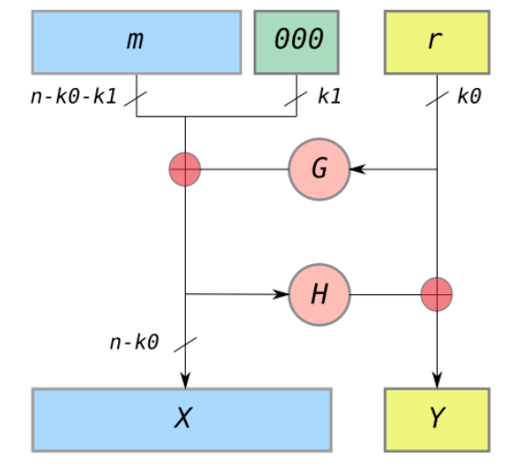
Project - Task 3: OAEP
n is the number of bits in the RSA modulus.
k0 and k1 are integers fixed by the protocol.
m is the plaintext message, an (n−k0−k1) bit string
G and H are typically some cryptographic hash functions fixed by the protocol.
⊕ is an xor operation

Slide 16
Project - Task 3: OAEP encoding
messages are padded with k1 zeros to be n−k0 bits in length.
r is a randomly generated k0 bit string
G expands the k0 bits of r to n−k0 bits.
X = m00..0 ⊕ G(r)
H reduces the n−k0 bits of X to k0 bits.
Y = r ⊕ H(X)
The output is X || Y where X is shown in the diagram as the leftmost block and Y as the rightmost block

Slide 17
Project - Task 3: OAEP decoding
recover the random string as r = Y ⊕ H(X)
recover the message as m00..0 = X ⊕ G(r)
The "all-or-nothing" security is from the fact that to recover m, you must recover the entire X and the entire Y; X is required to recover r from Y, and r is required to recover m from X. Since any changed bit of a cryptographic hash completely changes the result, the entire X and the entire Y must both be completely recovered.
Notes:
OAEP padding避免了partial decryption，也就是让攻击者拥有的CCA能力失效。

Slide 18
Project - Task 3
In this part, you are supposed to
Add the OAEP padding module to the textbook RSA implementation.
Give a discussion on the advantages of RSA-OAEP compared to the textbook RSA.
As a bonus, you can further try to present CCA2 attack to RSA-OAEP to see whether it can thwart the CCA2 attack you have implemented in part 2.

Slide 19
Contents
1
Introduction
2
Task 1: Textbook-RSA
3
Task 2: CCA2 Attack
4
Task 3: OAEP
5
Submission and Standard

Slide 20
Task 1
Files to be Submitted and Standard of Grading:
Code : 6 points
RSA parameters (Decimal, 1024bits):
RSA_Moduler.txt 1 point
RSA_p.txt 1 point
RSA_q.txt 1 point
RSA key (Decimal, 1024bits):
RSA_Secret_Key.txt 1 point
RSA_Public_Key.txt 1 point
Encryption:
Raw_Message.txt 1 point
Encrypted_Message.txt (hexadecimal) 1 point
Pass Decryption (TA) 2 points

Slide 21
Task 2
Files to be Submitted and Standard of Grading:
Code : 10 points
CCA2 (Use RSA parameters in task 1):
History_Message.txt 1 point
AES_Key.txt (hexadecimal, 128bits) 1 point
WUP_Request.txt (hexadecimal) 1 point
AES_Encrypted_WUP.txt (hexadecimal) 2 points
Attack Process to Obtain the AES key: 10 points
Both Screenshot and Log Files are OK

Slide 22
Task 3
Files to be Submitted and Standard of Grading:
Code : 10 points
Encryption (Use RSA parameters and Message in task 1):
Random_Number.txt 1 point
Message_After_Padding.txt (hexadecimal) 1 point
Encrypted_Message.txt (hexadecimal) 1 point
Pass Decryption (TA) 2 points
(Recommended using n=1024, k0=512, hash: sha512 )
Any extra file added is OK but need to be explained in report!

Slide 23
Thank You

