Slide 1

Forecasting District-Level Paddy Yield in Sri Lanka at Sowing Time
Applied Machine Learning – Final Assignment
Buddhika K H W · 269086V
Notes:
Hello, I am Buddhika K H W. My project forecasts the paddy yield of every Sri Lankan district for the coming Maha or Yala season, at the moment the season is sown, using Department of Census and Statistics data from 1979 to 2023.

Slide 2



Planners must decide before the harvest is known
Two seasons, 25 districts
Decisions at sowing time
2022 showed the risk
Maha (Oct–Mar) and Yala (Apr–Sep) differ in rainfall and tank water, and dry-zone irrigated districts out-yield wet-zone rain-fed ones.
Fertilizer allocation, Paddy Marketing Board purchasing, storage and rice imports are all planned months before harvest.
The 2021/22 chemical fertilizer ban cut national yield by about a third. Early, explainable yield signals matter.
Goal: predict each district's average paddy yield (kg/ha) for the coming season, using only information available at sowing. This is a regression problem on tabular, local data.
Notes:
Rice is our staple. Fertilizer, purchasing and imports are planned before the harvest. The 2022 fertilizer ban showed how costly a surprise can be. So the goal is to predict each district's yield at sowing time. That makes it a regression problem on local tabular data.

Slide 3

The DCS data needed real cleaning first
1979–2023
100 duplicate rows
2010–2012 were entered twice, so they were removed
45 years, Maha & Yala
4 aggregate regions
Mahaweli, Udawalawe, Highland and North & East overlap real districts, so they were dropped
2,612 → 2,174
raw rows → model rows
Unit error
the yield column says “MT/Ha”, but its values are kg/ha (checked: production = harvest × yield)
25
Text numbers & gaps
commas and “-” were converted; war-year gaps in the North became missing values for imputation
administrative districts
Notes:
The data is the DCS district paddy statistics, 1979 to 2023. Before modelling I found four problems: 100 duplicated rows, four regions that overlap real districts, a unit error where yields labelled tonnes are really kilograms per hectare, and text-formatted numbers. Fixing these needed domain knowledge, not just code.

Slide 4
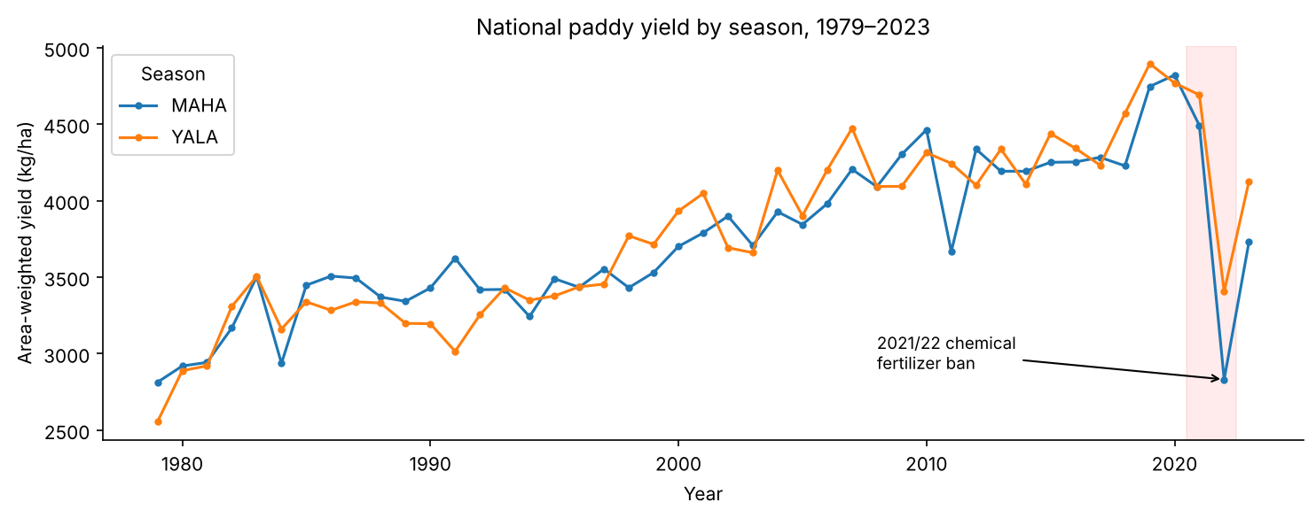
Yields doubled since 1980, then collapsed in 2022
Leakage-free features (known at sowing)
District, season, year (trend)
Sown area and its major / minor / rain-fed shares
Change in sown area vs last year
Last season, same season last year and 4-season average yield
Last season's harvested ÷ sown
Rain-fed share correlates −0.56 with yield; the 4-season average +0.79.
Excluded: this season's harvested area and production, because they would leak the answer.
Notes:
EDA shows a strong upward trend and the 2022 collapse. Irrigation matters: rain-fed share is strongly negative. I only use features known at sowing: district, season, year, sown area by irrigation type and past yields. Harvest and production columns are excluded because they would leak the answer.

Slide 5




Time-aware validation and self-designed hyperparameters
Split by time
Baselines
Tune ensembles
Stack
Explain
Train 1979–2015, test 2016–2023; one held-out sample
Persistence, moving average, linear regression
RF, XGBoost, LightGBM, CatBoost with TimeSeriesSplit CV
Four models combined by a Ridge meta-learner
SHAP global and local; LIME
Model | Design choices (tuned, not defaults)
LightGBM | num_leaves 21, min_child_samples 34, learning_rate 0.010, 615 trees, λ = 7.2: small leaves for under 2k rows
XGBoost | max_depth 2, learning_rate 0.017, 1019 trees, subsample 0.83, L1 1.5 / L2 1.7
Random Forest | 428 trees, min_samples_leaf 8, max_features 0.34 to decorrelate the lag features
CatBoost | depth 6, l2_leaf_reg 14.3, native categorical handling of district and season
Notes:
I split by time, not randomly, so the model never learns from the future. Hyperparameters were not left at defaults. For example, LightGBM uses few leaves and large minimum leaf sizes because there are under two thousand training rows. Tuning used forward-chaining time-series cross-validation.

Slide 6
Ensembles beat every existing approach
−17 %
CV error vs linear regression
−16 %
test error vs persistence (−22 % outside 2022)
60 %
of forecasts within ±10 %
LightGBM selected on CV RMSE (425). Stacking is the best on test but more complex.
Notes:
Grey bars are existing approaches, green are the ensembles. LightGBM was selected on cross-validation error: 17 percent lower than linear regression. On the unseen 2016 to 2023 seasons it is 16 percent better than persistence, and 60 percent of forecasts are within plus or minus 10 percent. Stacking scored best on the test set, but I select on validation, not on test.

Slide 7
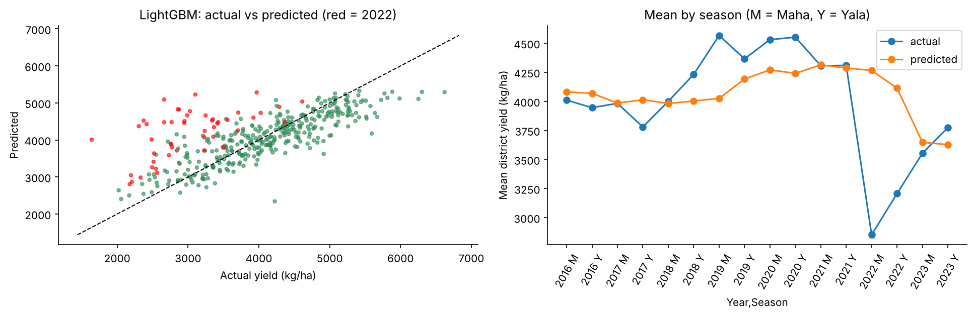
Where every model struggles: trends and shocks
No extrapolation
Trees can't exceed past yields, so the 2019–21 records are under-predicted. Linear regression catches up on test. The fix: retrain on recent data.
2022 fertilizer ban
Red points: errors are 2.5–4 times larger and every model over-predicts. The shock is not in any sowing-time feature.
Notes:
Two honest limitations. Tree models cannot extrapolate above the yields they have seen, so the record years are under-predicted; that is why the final model is retrained on data up to 2023. And the 2022 fertilizer ban, the red points, could not be predicted by any model.

Slide 8
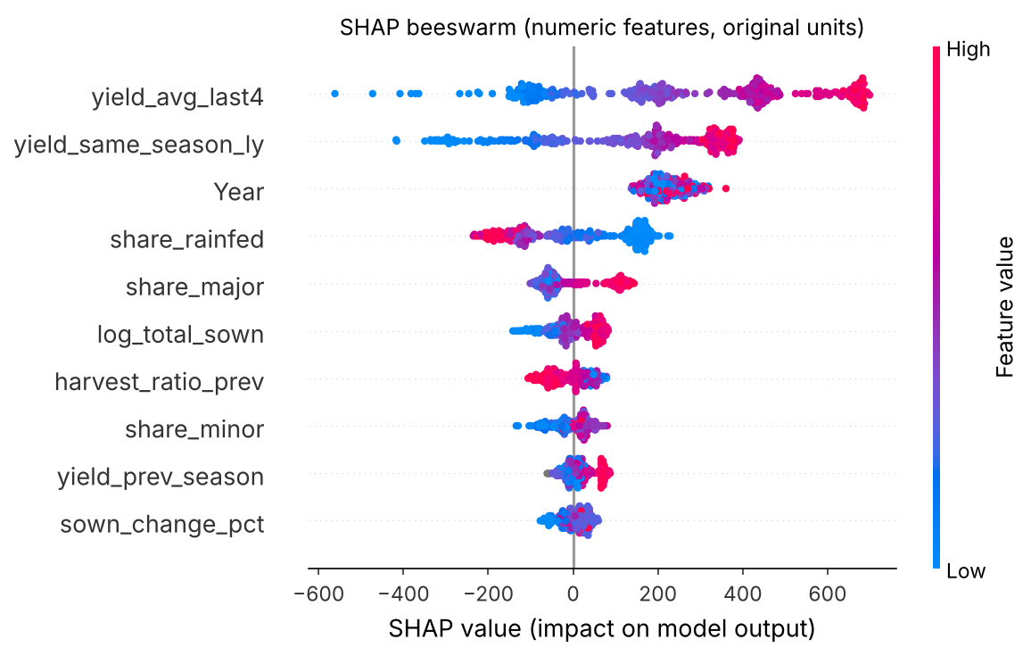

SHAP: the model reasons like an agronomist
History drives it
A high 4-season and last-year yield raises the forecast.
Irrigation matters
Rain-fed share lowers the forecast; a major-scheme share raises it.
Long-term trend
Year captures better varieties and inputs.
District adds ~0
Location is already explained by history and irrigation, not memorised.
Notes:
SHAP shows the model's reasoning. Recent yield history is the main driver. A higher rain-fed share lowers the forecast, while major irrigation raises it. Year captures the technology trend. Interestingly, the district name adds almost nothing, because its effect is already explained by history and irrigation. This matches agronomy, so we can trust it.

Slide 9
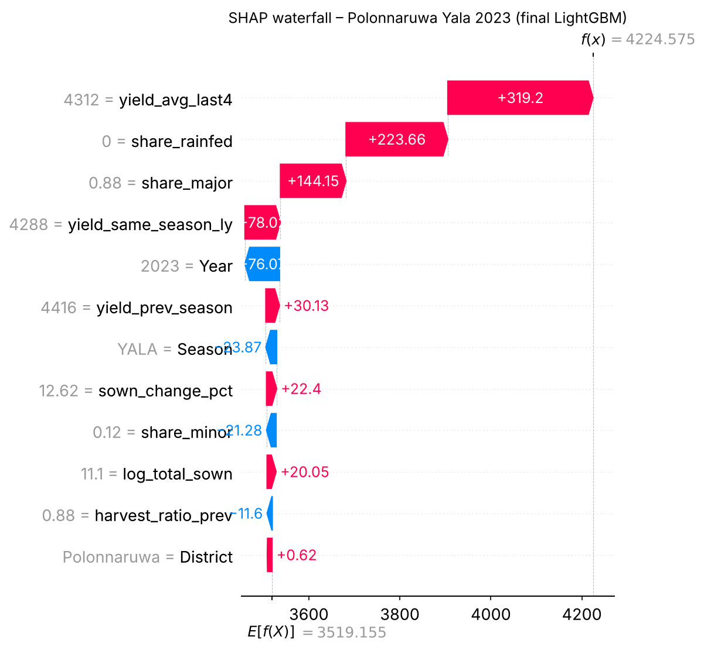
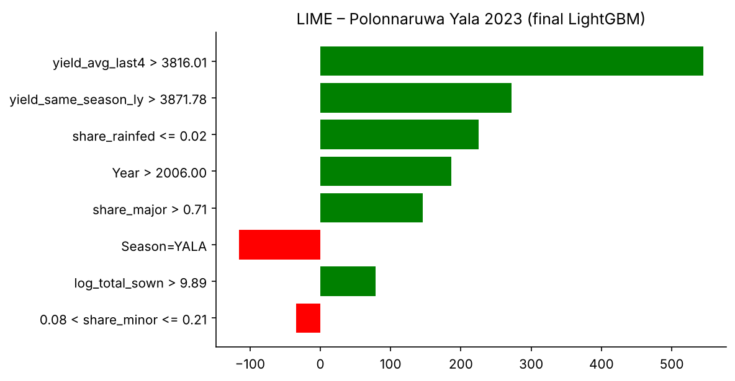
One unseen sample: Polonnaruwa, Yala 2023
4,225
predicted kg/ha (from the .pkl)
4,918
actual kg/ha (−14 %)
Why the gap? SHAP shows Year = 2023 pulling the forecast down: the model learned the 2022 collapse, but yields recovered in 2023.
SHAP vs LIME: they agree on history and irrigation. LIME's coarse “Year > 2006” bin hides the 2022 dip, so the two methods are a useful cross-check.
Notes:
For inference I held out Polonnaruwa Yala 2023. The pickled model predicts 4,225 kg/ha against an actual 4,918. The SHAP waterfall explains why: Year 2023 pulls the forecast down because the model learned the 2022 collapse, but yields recovered. LIME agrees on the main drivers but misses this, because it uses coarse bins.

Slide 10
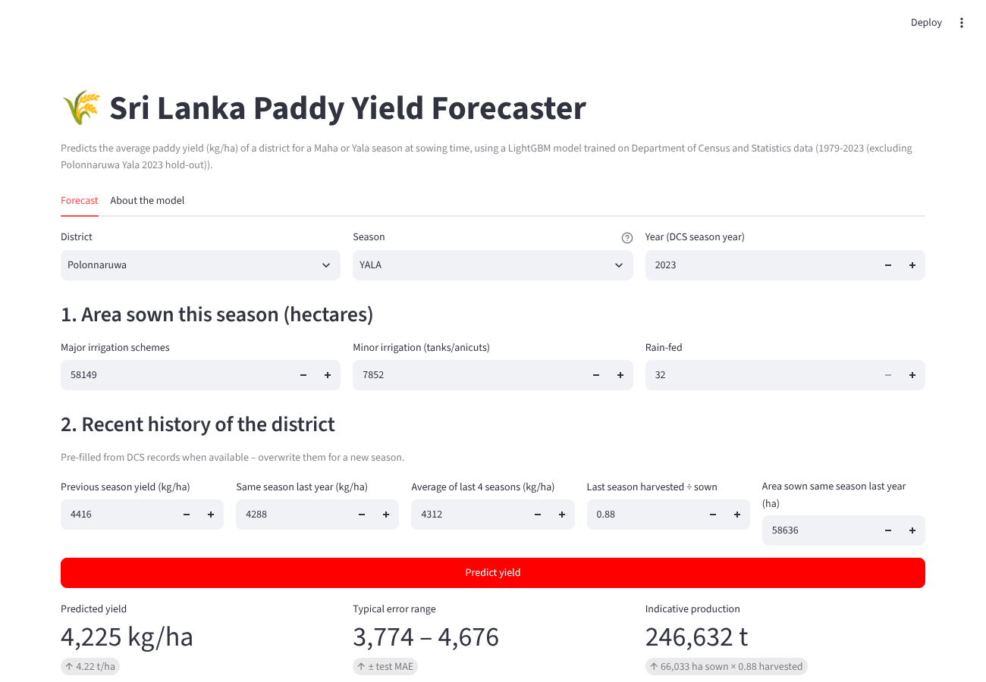

A GenAI-built front end that explains each forecast
Streamlit + pickle
Loads paddy_yield_model.pkl, pre-fills district history and shows yield, error range and production
Explains itself
A SHAP bar chart for every prediction
Bonus: MLOps
Dockerfile, plus GitHub Actions CI that tests the pickle and builds the image. Ready for Streamlit Cloud or Azure Container Apps
Notes:
The front end was generated with GenAI prompts, which are in the repository, then tested against the notebook. It loads the pickle file, pre-fills district history, and shows the forecast with a SHAP explanation. For the bonus, there is a Dockerfile and a CI pipeline that tests the model and builds the container. [Show a live demo here.]

Slide 11
Explainable yield forecasts from local data
LightGBM: 16–22 % lower error than the persistence baseline, with reasoning that matches agronomy
Next: add rainfall, tank storage and fertilizer data; monitor drift and retrain every season
Notes:
To conclude: careful cleaning, leakage-free features and tuned ensembles give forecasts 16 to 22 percent better than the persistence baseline, with explanations that make sense. Next steps are weather and fertilizer data, and drift monitoring. Thank you.

