Slide 1

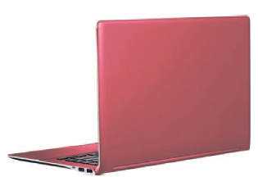
Can AI agents see what people see?
Vivid
Colour saturation and perceived product size: Hagtvedt and Brasel (2017), Study 3, replicated with 77 AI agents
Muted
Krishna Soni · Michael Toner · Dale Warner
MBAN 5640 Visualization & Data Mining · Group Project 4 · November 28, 2026
Notes:
Krishna Soni (about 0:24)
Good morning. We are Group 1: Krishna Soni, Michael Toner and Dale Warner. Our question is simple: can AI agents see what people see? We took a published sensory marketing experiment and ran it again, with AI agents in place of people.

Slide 2
Does a more vivid colour make a product look bigger?
High saturation (vivid)
Low saturation (muted)
Same laptop, same size. Only the colour saturation differs.
Cheap lever
Colour costs almost nothing to change
Where it matters
Packaging, product design, online photos
What we measure
Perceived screen size (inches)
MBAN 5640 · Group Project 4 · Group 1: Soni, Toner, Warner
2
Notes:
Krishna Soni (about 0:49)
Colour is one of the cheapest things a marketer controls. Changing the colour of a product, a package or an online photo costs almost nothing. Hagtvedt and Brasel asked whether colour saturation, meaning how vivid a colour is, changes how big a product looks. These are the two images from their study: the same red laptop, exactly the same size, once vivid and once muted. If vivid colour makes a product look bigger, that is a lever for packaging and online product photos, and a risk when you want something to look compact. What we measure is perceived size: how big people think the screen is.

Slide 3
The theory: saturation, arousal, attention, size
Colour saturation
Arousal
Attention
Perceived size
Proposed mechanism, confirmed by serial mediation in the original (indirect effect B = .53, 95% CI [.16, 1.01])
Measure | Scale
Screen-size estimate | 10 to 20 inches, whole numbers
Attention (2 items, averaged) | 1 to 7
Arousal | 1 to 9
Mood (control: should not change) | 1 to 9
Study 3 design
77 undergraduates
Between-subjects: each person sees one image
Random assignment to vivid or muted
MBAN 5640 · Group Project 4 · Group 1: Soni, Toner, Warner
3
Notes:
Krishna Soni (about 0:47)
Their explanation is a chain of three steps. Saturated colours are more arousing. Arousal draws attention. And things that hold our attention are judged to be larger. The authors confirmed this chain statistically. In Study 3, the one we replicated, 77 undergraduates each saw only one of the two images, a between-subjects design. They estimated the screen size from 10 to 20 inches, rated attention on two seven-point items, and reported arousal and mood on nine-point scales. Mood is a useful control: it is not part of the theory, so it should not change. Keep that in mind; it matters later.

Slide 4
Two human studies, two different answers on size
Original study
Hagtvedt and Brasel (2017) · n = 77 students
Replication
Motoki and Iseki (2022) · n = 823 adults, Japan
+.30
Size
15.3 vs 14.4 in
+.01
Size
15.5 vs 15.4 in, no effect
+.25
Attention
effect (r)
+.24
Attention
effect (r)
+.30
Arousal
effect (r)
+.18
Arousal
effect (r)
r = effect size of high vs low saturation (0 = none, .3 = moderate). Mood did not differ in the original (p > .87). The replication used a 7-point arousal scale, so arousal is compared by r only.
MBAN 5640 · Group Project 4 · Group 1: Soni, Toner, Warner
4
Notes:
Krishna Soni (about 0:49)
Here is what people did. In the original study, the vivid laptop was judged almost an inch larger: 15.3 versus 14.4 inches. Attention and arousal rose too, each with an effect size of about 0.3, a moderate effect. Mood did not move. But a 2022 replication with 823 adults in Japan found the attention and arousal effects again, and no size effect at all: an r of 0.01. So the two human benchmarks disagree on the headline result, which is why we compare our agents with both. Michael will now explain how we built the agents.

Slide 5
Our AI-agent system
1
2
3
4
5
Roster
77 agents
39 vivid / 38 muted
fixed random seed
49% male student persona
One fresh call
OpenAI GPT-4o mini
sees ONE real image
no memory between agents
Fixed format
Answers forced into
a JSON structure:
five whole numbers
Validate
Whole number,
inside its scale?
Retry up to 3 times
Log everything
Prompt and image
fingerprints, settings,
tokens, raw answer
All settings were signed off before the first real run and never tuned to make the AI look more human.
MBAN 5640 · Group Project 4 · Group 1: Soni, Toner, Warner
5
Notes:
Michael Toner (about 1:27)
Thanks, Krishna. Each AI agent is one simulated participant: a single, separate call to OpenAI's GPT-4o mini, a vision model, so it actually looks at the image. We created 77 agents, the same as the original study, and randomly assigned 39 to the vivid image and 38 to the muted one, using a fixed seed so anyone can reproduce the assignment. Each agent gets a one-line persona, a male or female undergraduate student, 49 percent male like the original sample. Every call is fresh, with no memory of other agents, which reproduces the between-subjects design. The model must answer in a fixed format, and Python checks that every answer is a whole number inside its scale, retrying up to three times. Everything is logged. And one rule was non-negotiable: all settings were fixed and signed off before the first real run, so we could not tune the model to look more human. For every agent we record the model, the settings, a fingerprint of the prompt and of the image, the tokens, timestamps and the raw answer, so every number in this talk traces back to a single call.

Slide 6
What each agent sees, and what it never sees
Never sent to the model
1. The image
One image per agent, sent as it is. No file name.
×
The word colour or saturation
×
Which condition it is in
2. The original questions
"Estimate the laptop's screen size. Choose a whole number of inches from 10 to 20."
"The laptop is attention-getting." "The laptop captures my attention." (1 to 7)
"Arousal: 1 = low, 9 = high." "Mood: 1 = displeasure, 9 = pleasure."
3. Answer format: five whole numbers, nothing else
×
The hypothesis or the paper
×
Image file names
×
Other agents' answers
Not reproduced: small on-screen image, no snack incentive, no real eyes or arousal. All listed in DEVIATIONS.md.
MBAN 5640 · Group Project 4 · Group 1: Soni, Toner, Warner
6
Notes:
Michael Toner (about 1:12)
This is what an agent actually receives: the image, then the original questions, almost word for word. Estimate the screen size in whole inches from 10 to 20; rate two attention statements from one to seven; report arousal and mood from one to nine. Just as important is what the agent never gets. The prompt never mentions colour, saturation, the conditions or the hypothesis, and the image files have neutral names. Our code checks for forbidden words before any call. Some things we could not reproduce: the image is small and on screen rather than projected, there is no snack incentive, and a language model has no real eyes, attention or arousal. Every deviation is listed in our repository. We also ran 20 extra agents who were asked to explain their answers. That run is used only to interpret the results, never in the main analysis. Dale will now show you what the agents said.

Slide 7
The agents saw a big difference, almost like a switch
14.7 vs 13.3 in
average estimate, vivid vs muted
r = +.70
very large effect (original: +.30)
77 of 77
valid on the first try, about US$0.04
86%
of agents gave identical answer sets
MBAN 5640 · Group Project 4 · Group 1: Soni, Toner, Warner
7
Notes:
Dale Warner (about 1:02)
Thanks, Michael. All 77 agents gave valid answers on the first try, and the whole run cost about four cents. Here is the headline. Agents who saw the vivid laptop estimated 14.7 inches; agents who saw the muted one estimated 13.3. That is a very large effect, an r of 0.70. But look at how they answered. Almost four out of five agents in the vivid group said exactly 15 inches, and more than four out of five in the muted group said exactly 13. People give a spread of answers. The agents behave almost like a switch. The spread tells the same story. The AI's standard deviation for size is about half of the humans', and for attention about a tenth. 86 percent of agents gave a set of answers identical to another agent's.

Slide 8
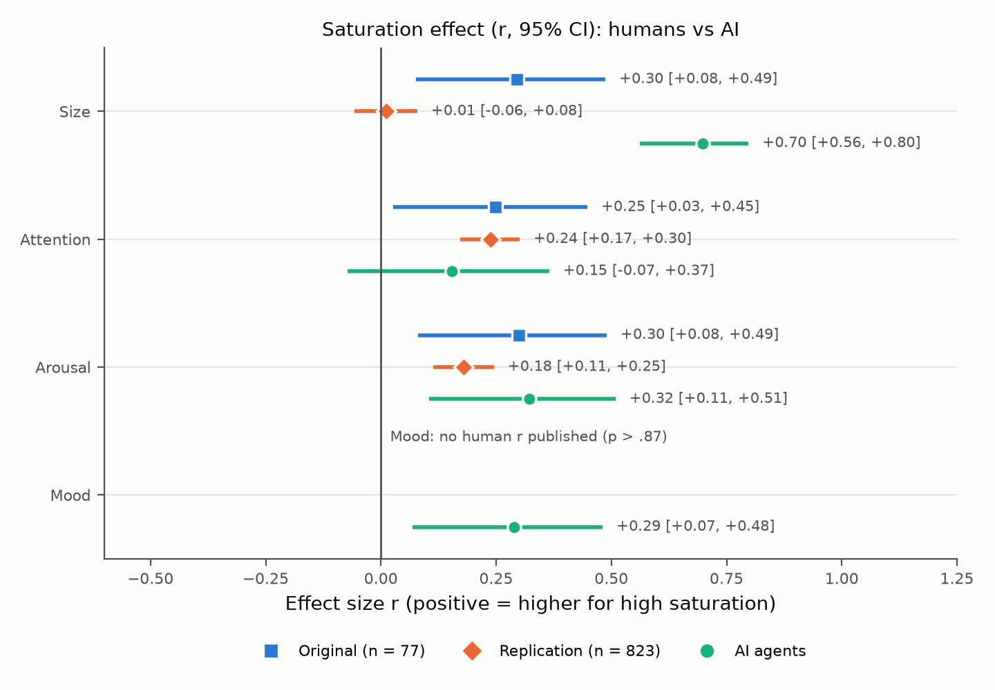
Right direction, wrong pattern
Exaggerated
Size
+.70 vs +.30 original; Fisher z p < .001
Not significant
Attention
+.15, same sign as people
Reproduced
Arousal
+.32 vs +.30 original
Halo
Mood (control)
+.29 where people showed none
Size difference 1.35 in, 90% CI [1.08, 1.62]: far outside a plus or minus 0.5 in band. Repeat run: r = +.63.
MBAN 5640 · Group Project 4 · Group 1: Soni, Toner, Warner
8
Notes:
Dale Warner (about 1:25)
This chart is the core of our comparison. Each row is a measure. Blue squares are the original study, orange diamonds the replication, and green circles our AI agents, each with a 95 percent confidence interval. On size, the AI effect is more than twice the original's, and nowhere near the replication's zero. On attention, the AI points the same way but the effect is small and not significant. Arousal is the real match, almost identical to the original. And mood, our control, moved for the AI when it did not move for people. Right direction, wrong pattern. The supposed mechanism through attention is not there. The statistics back this up. A Fisher z test shows the AI size effect is significantly larger than the original's. An equivalence test rules out the replication's no-effect result: the AI difference is 1.35 inches, far outside a half-inch band. And an accidental repeat run gave almost the same size effect, an r of 0.63, so this is stable, not a fluke. Let me show you this live.

Slide 9
Live demo: the dashboard
gp4-saturation.streamlit.app
Human vs AI
Hover for the exact effect sizes
Explore data
Every agent's answers; filter by condition
Open to anyone
Code, data and dashboard are public
No internet? Slides 7 and 8 show the same results.
MBAN 5640 · Group Project 4 · Group 1: Soni, Toner, Warner
9
Notes:
Dale Warner (about 1:01)
[Switch to the browser tab with the dashboard (already open, see the checklist).]
[Click 5. Human vs AI. Hover over the green Size circle to show the exact numbers.]
[Click 6. Explore data. Set Condition to high only: point at the column of 15s.]
[Switch back to PowerPoint, slide 10.]
This is our dashboard, public at gp4 saturation dot streamlit dot app. Everything we just showed is here and interactive. On the Human versus AI page, hovering shows the exact effect sizes. On the Explore data page you can see every agent's answers. Filter to the vivid condition and look at the screen sizes: fifteen, fifteen, fifteen.

Slide 10
Why would AI agents behave like this?
1
2
3
No eyes, no arousal
A language model has no visual system or nervous system to be aroused.
Learned associations
Vivid looks premium, premium looks bigger: patterns from text and images it was trained on.
The most typical answer
It returns the modal answer almost every time, so the human spread disappears.
20 of 20
diagnostic agents explained their answer by colour and style.
None mentioned size. The model never says the vivid laptop looks bigger, yet it answers as if it does.
MBAN 5640 · Group Project 4 · Group 1: Soni, Toner, Warner
10
Notes:
Dale Warner (about 0:34)
Why would AI behave like this? The model has no eyes and no nervous system. Our best explanation is that it maps a vivid image onto learned associations, vivid, premium, bigger, and then gives the single most typical answer, which removes the natural spread that people show. We checked this with 20 extra agents who explained their answers: all 20 talked about colour and style, and not one mentioned size. Krishna will wrap up.

Slide 11
What we learned
Reproduced
· Direction of every effect
· Arousal effect (+.32 vs +.30)
Not reproduced
· Size of the size effect (2x)
· Attention mechanism
· Mood control (halo)
· Human spread of answers
AI agents: a fast, cheap first look at a visual cue. Not a substitute for people, and not a source of effect sizes.
Limitations: one model and one prompt; published summary statistics, no raw human data; small on-screen image; an AI has no real attention or arousal.
MBAN 5640 · Group Project 4 · Group 1: Soni, Toner, Warner
11
Notes:
Krishna Soni (about 1:10)
Thanks, Dale. So, can AI agents see what people see? Partly. They pick up the direction of the colour effect and they match human arousal. But they exaggerate the size effect, miss the attention mechanism, react on mood when they should not, and give nearly identical answers. Our advice to researchers: AI agents are a fast, cheap first look at whether a visual cue matters, not a substitute for people, and their effect sizes should not be trusted. What should researchers be careful about? Fix the settings before looking at results, never reveal the hypothesis, send the real stimulus, and compare effects, not just averages, because a similar average can hide a very different pattern. Our main limitations are one model, one prompt, and published summary statistics instead of raw human data. Thank you. We are happy to take questions.

Slide 12
Questions?
Dashboard https://gp4-saturation.streamlit.app/
Code and data https://github.com/WarnerMBAN/gp4-sensory-marketing
Built with AI assistance from Claude (Anthropic): code, analysis and drafts were produced with Claude and reviewed by the team. Simulated participants: OpenAI GPT-4o mini.
MBAN 5640 · Group Project 4 · Group 1: Soni, Toner, Warner
12
Notes:
Krishna Soni (about 0:00)
[Leave this slide up for Q&A.]

