Slide 1
SUPERMARKET ANALYSIS

Slide 2
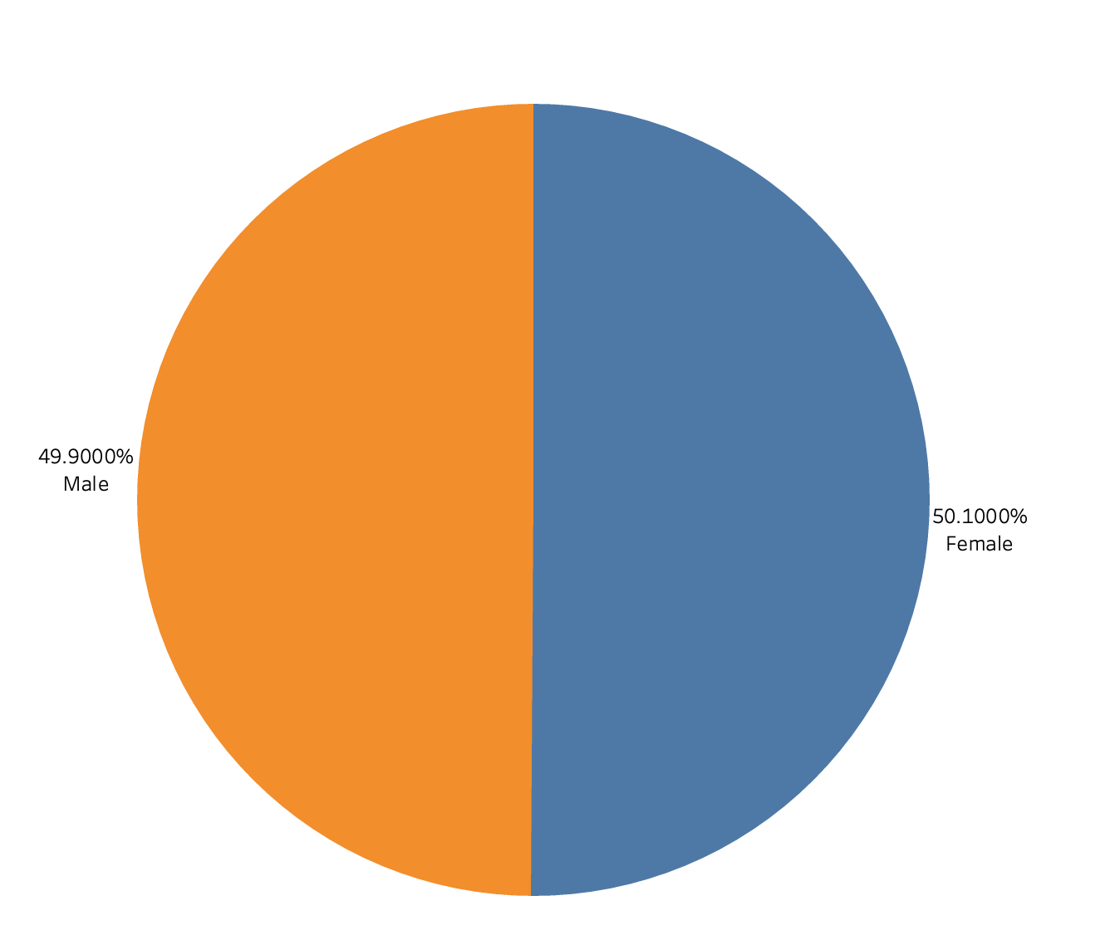
Distrubution of Male to Female Customers

Slide 3
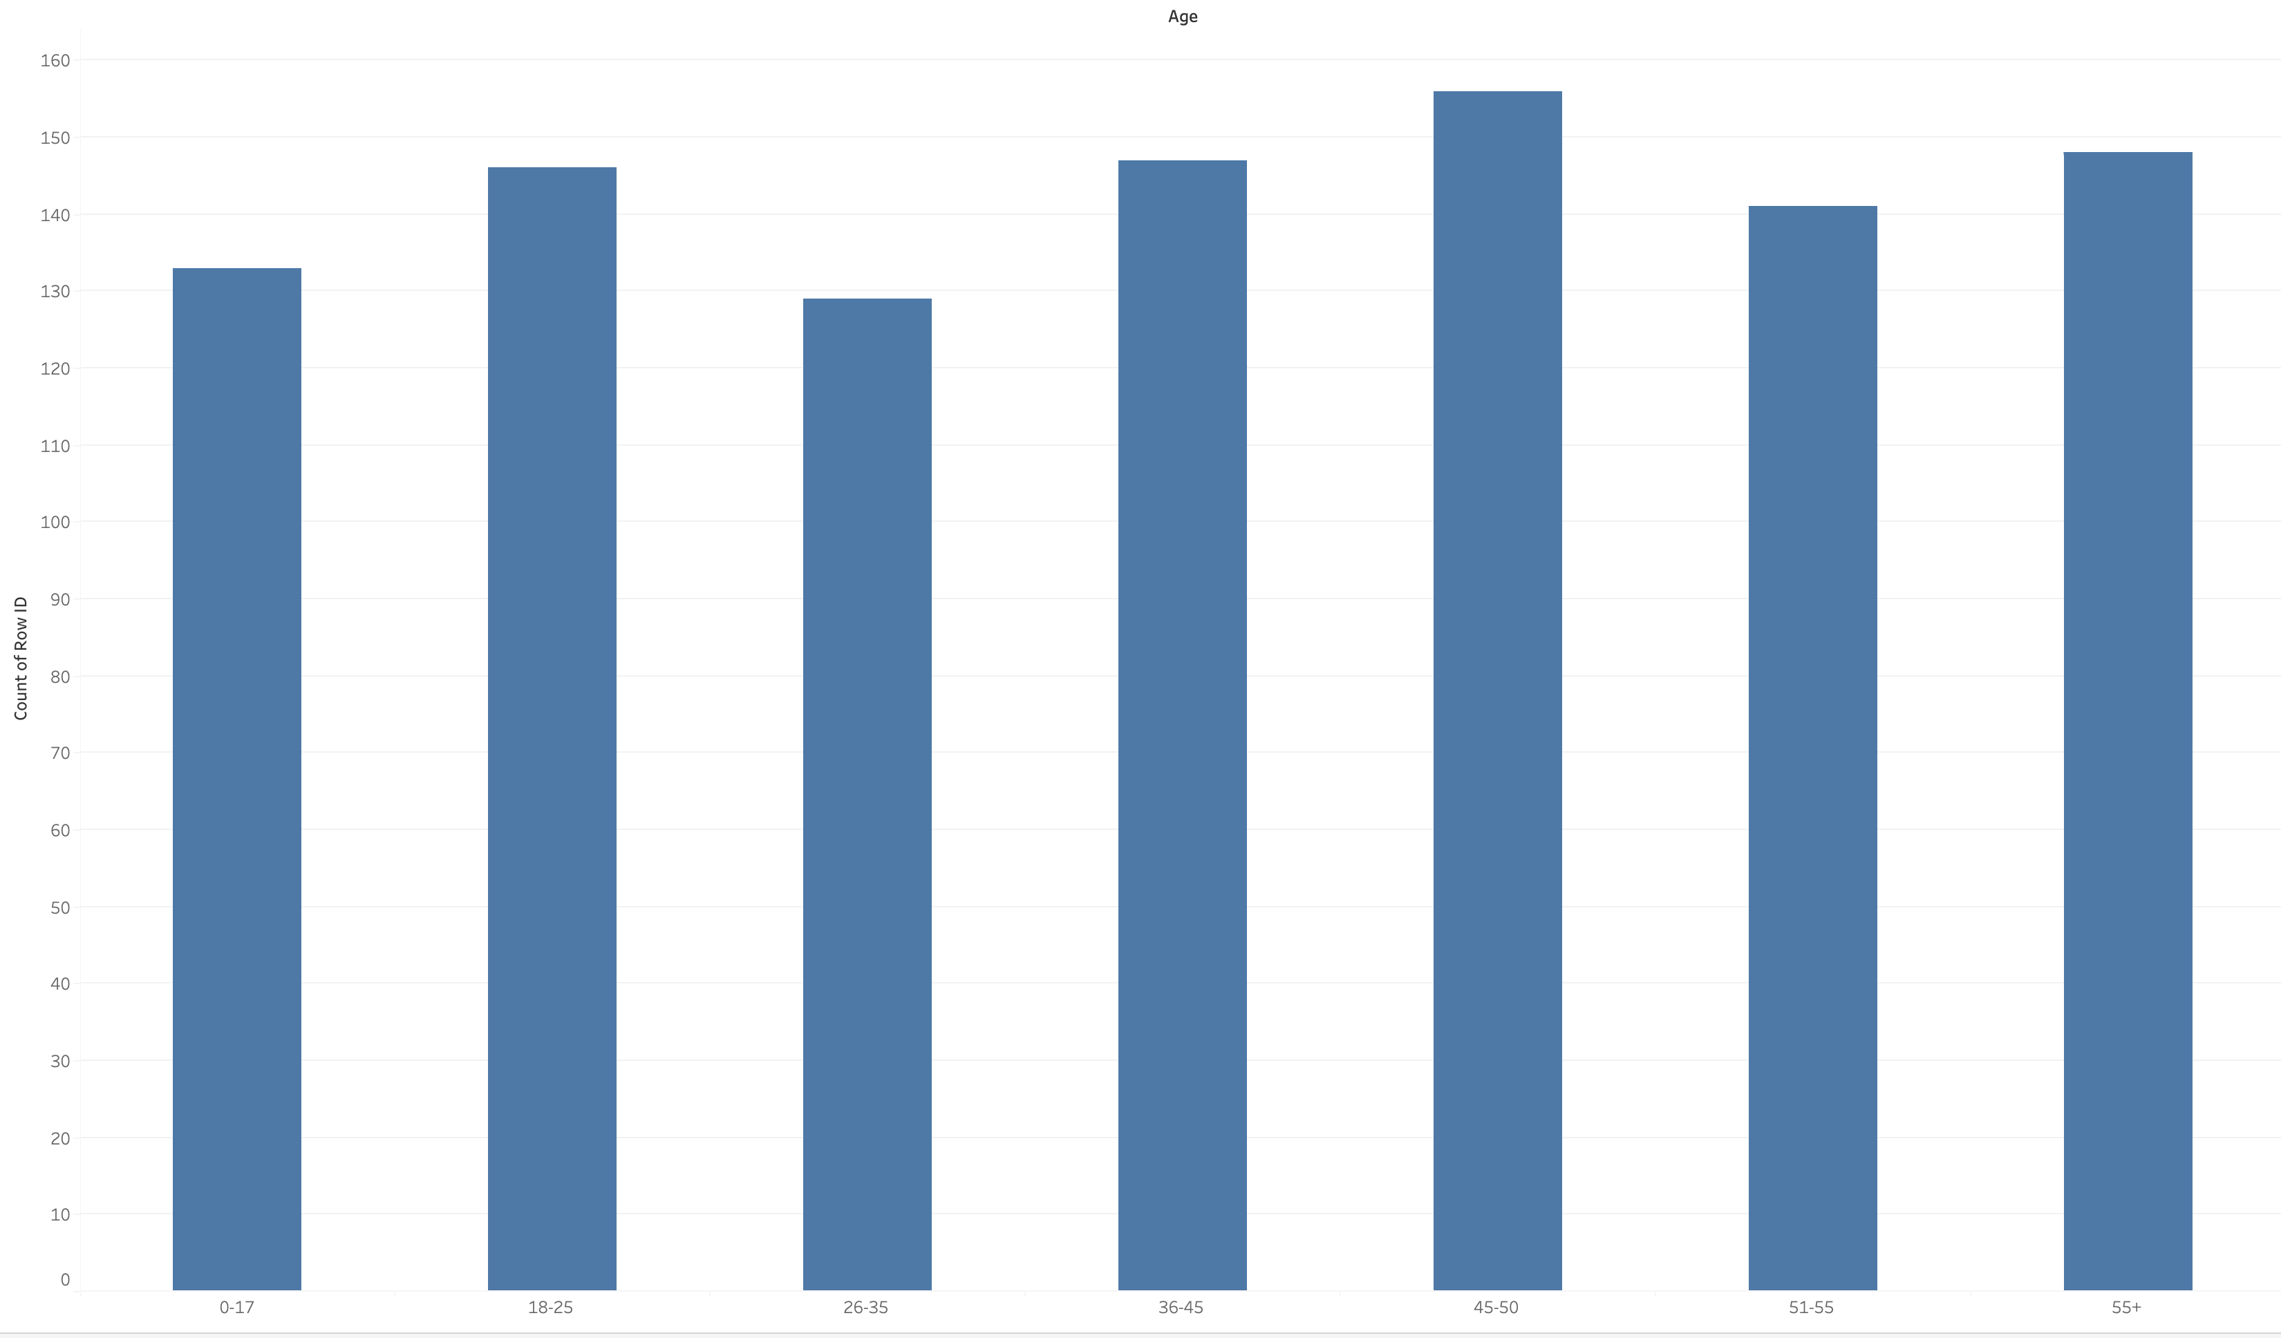
Age Distribution of Customers

Slide 4
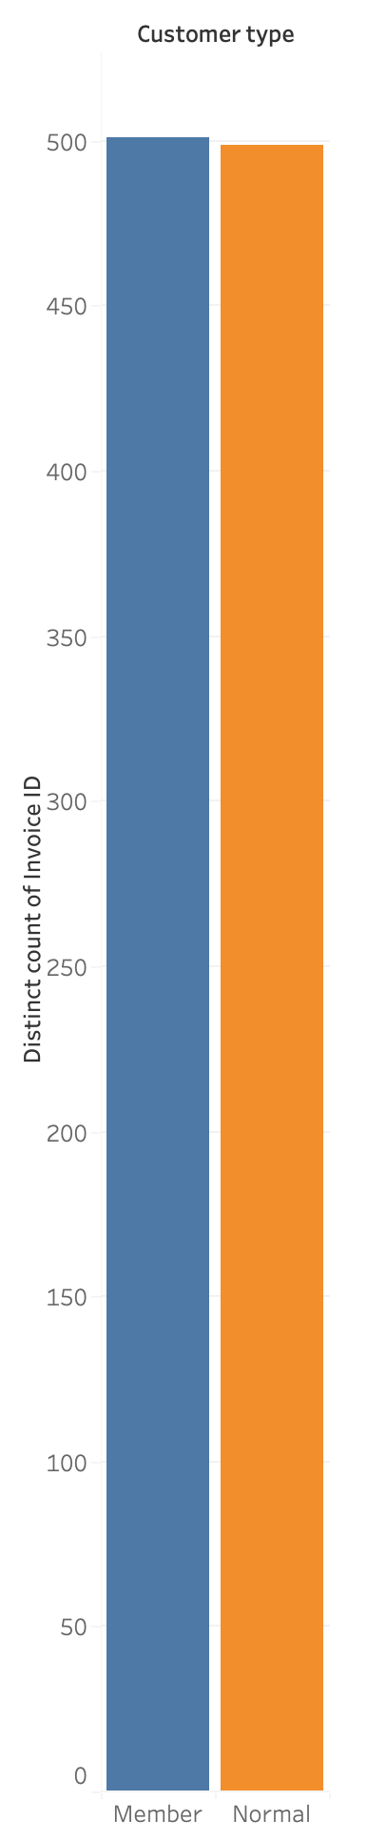
Membership count
There are 501 membership customers while 499 are normal customers

Slide 5
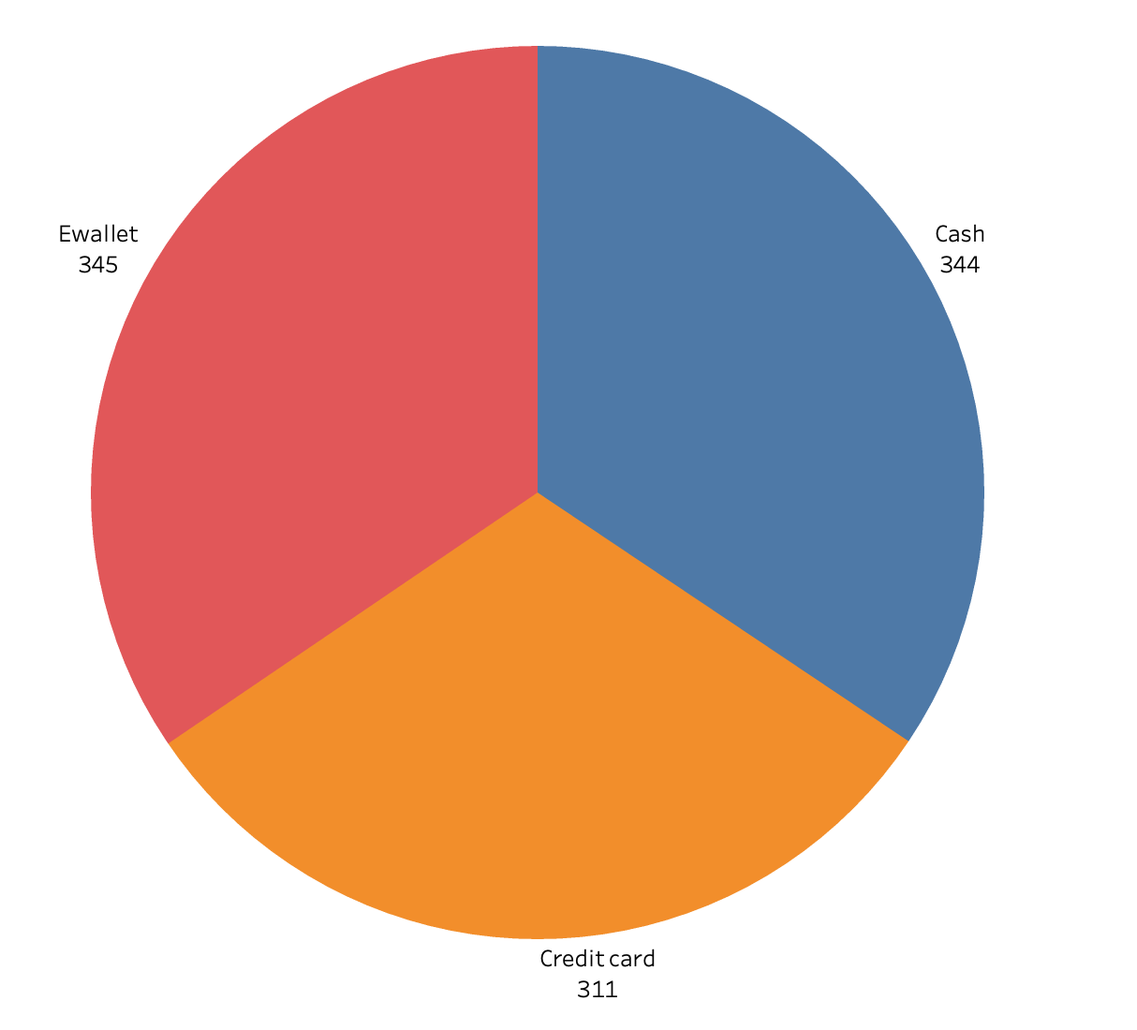
Most common method of payment
Ewallet payment is mostly used

Slide 6
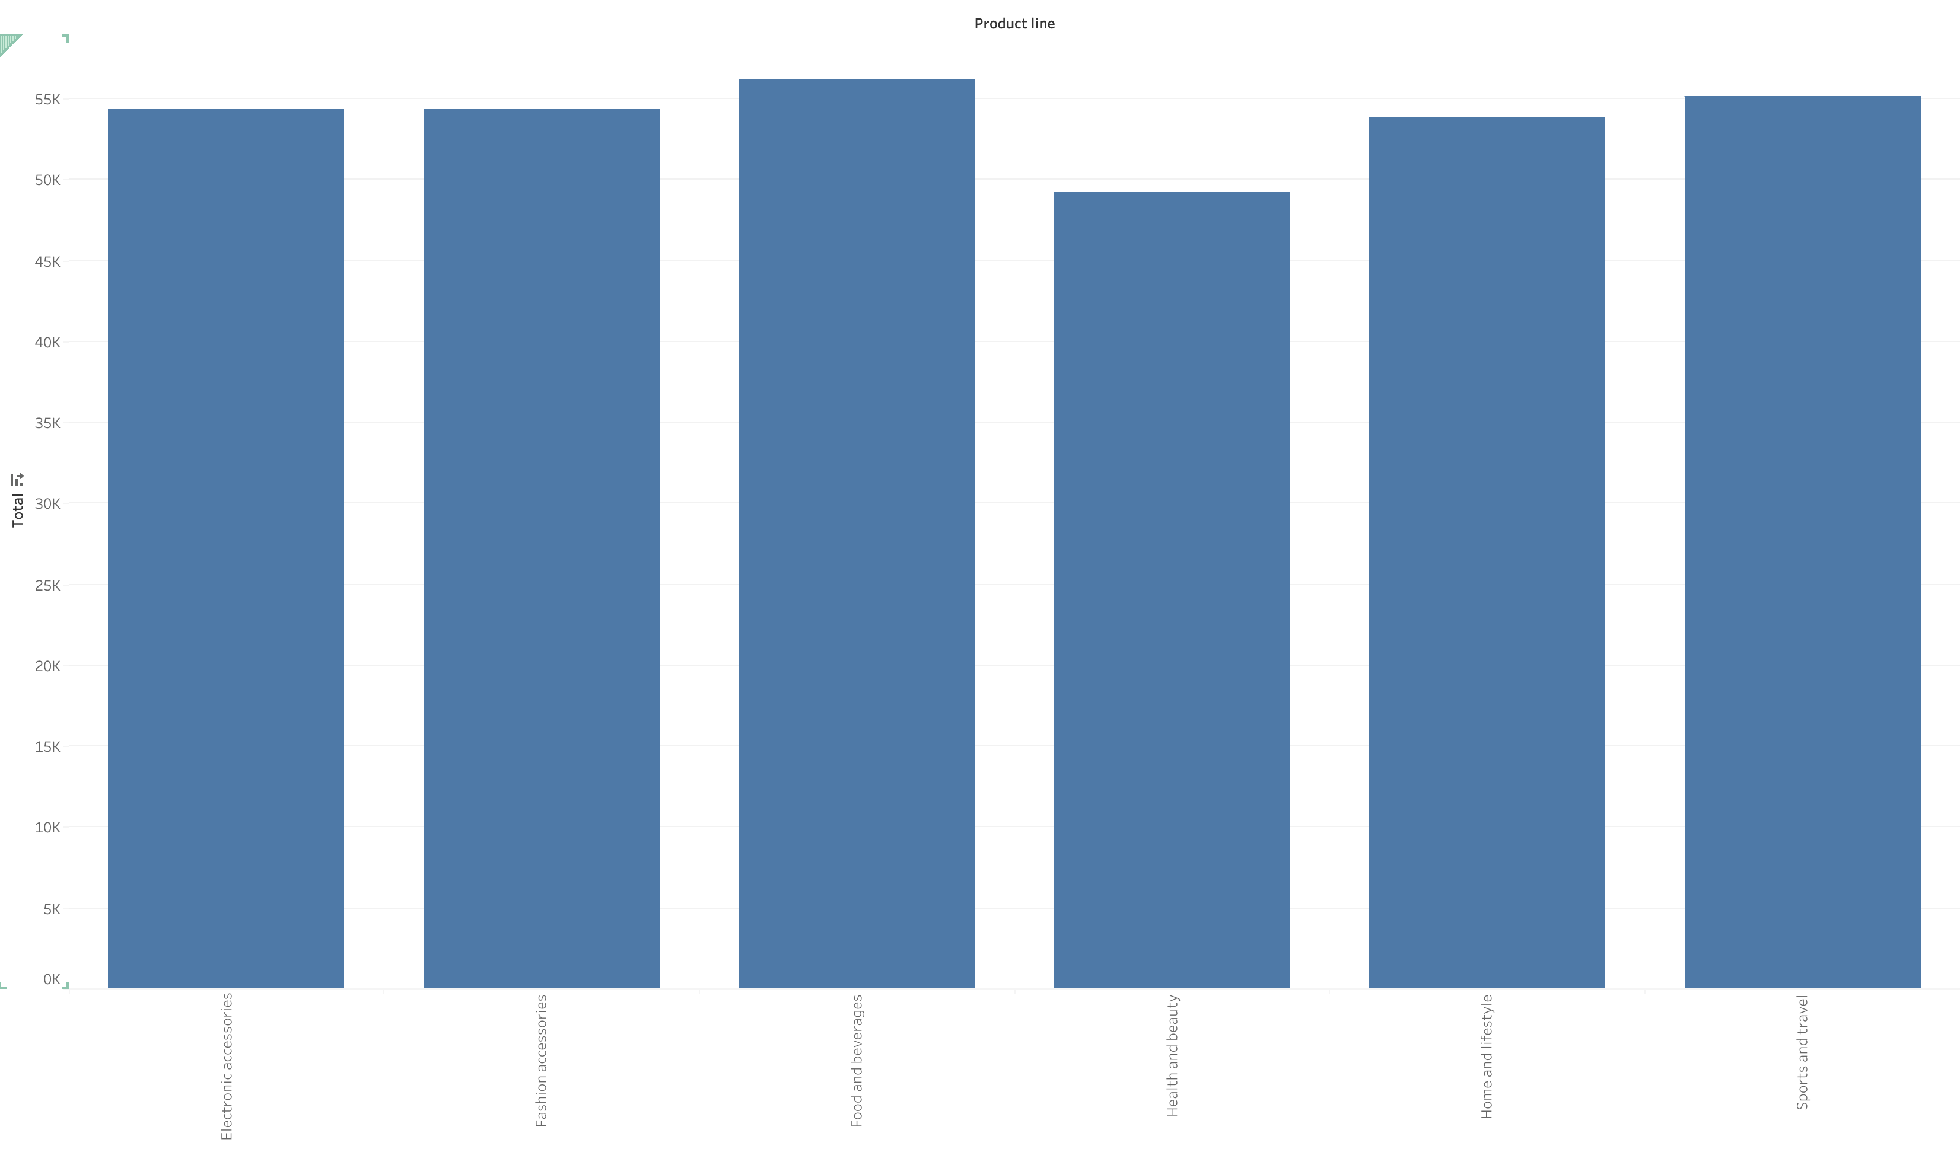
Sales of Products

Slide 7
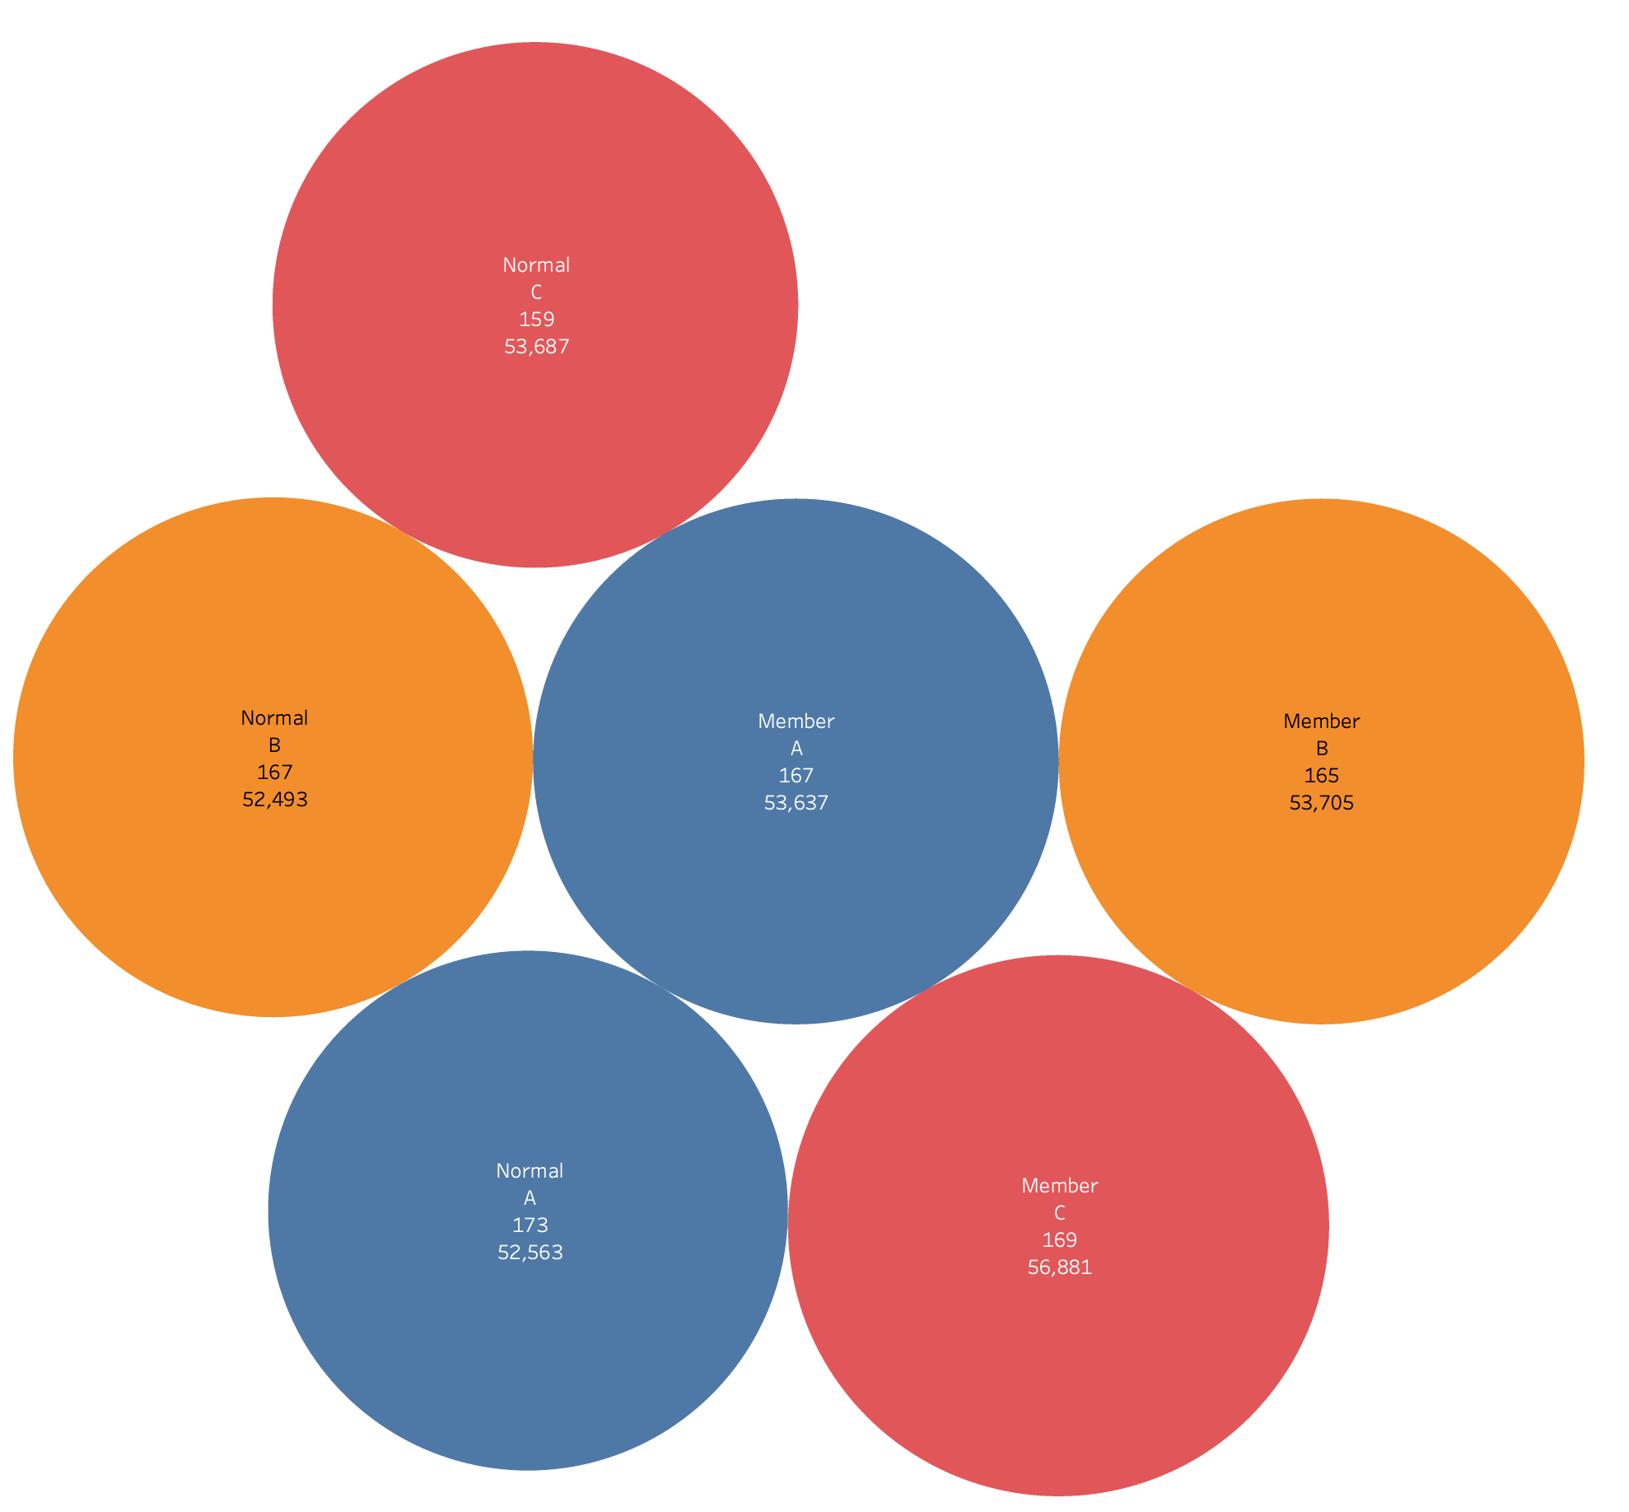
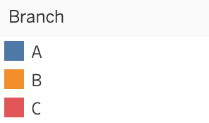
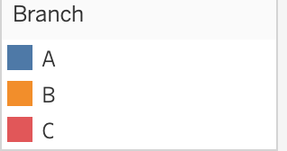
Branch sales per customer type patronage
Branch C has the most sales
Members had the most patronage in C

Slide 8
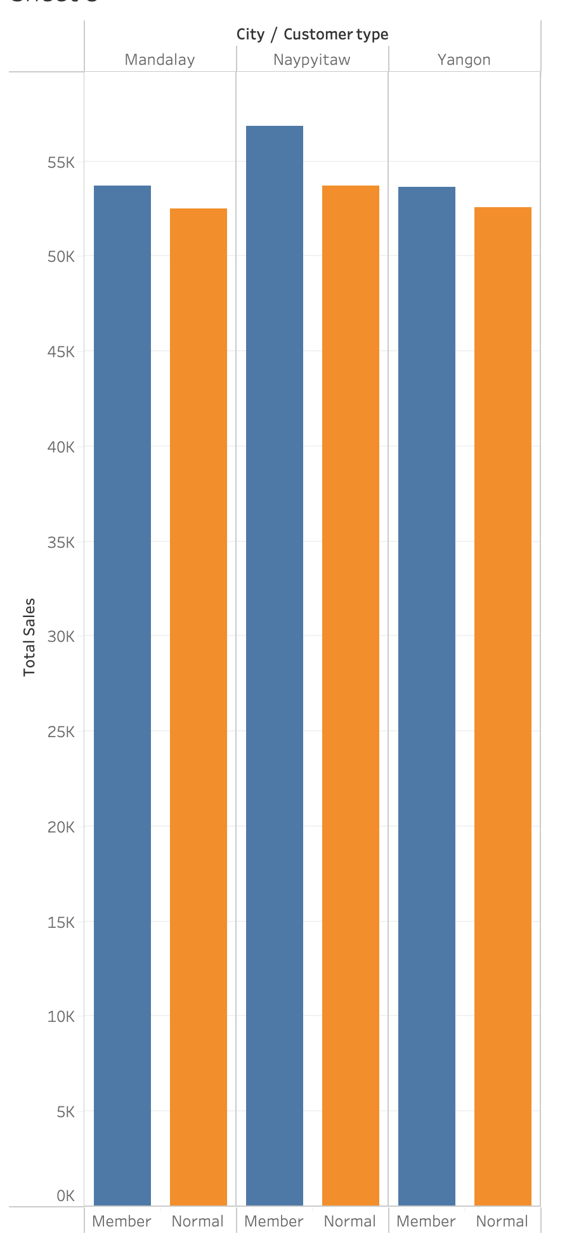
Naypyitaw generates the most sales
Members in Naypyitaw has the most contribution

Slide 9
Analysis
Discount on credit card purchases should be encouraged
More adverts on our health and beauty products
There is room for improvement in Mandalay and Yangon city, more investment on advertisement for branches in the two cities

Slide 10
The loyalty card(members) made a little more sales in comparison to the normal customers. The total purchases made by members is $164,223 compared to $158,743 purchases made by normal customers, hence I can conclude that there’s a little differences in customers turnover.

