Slide 1
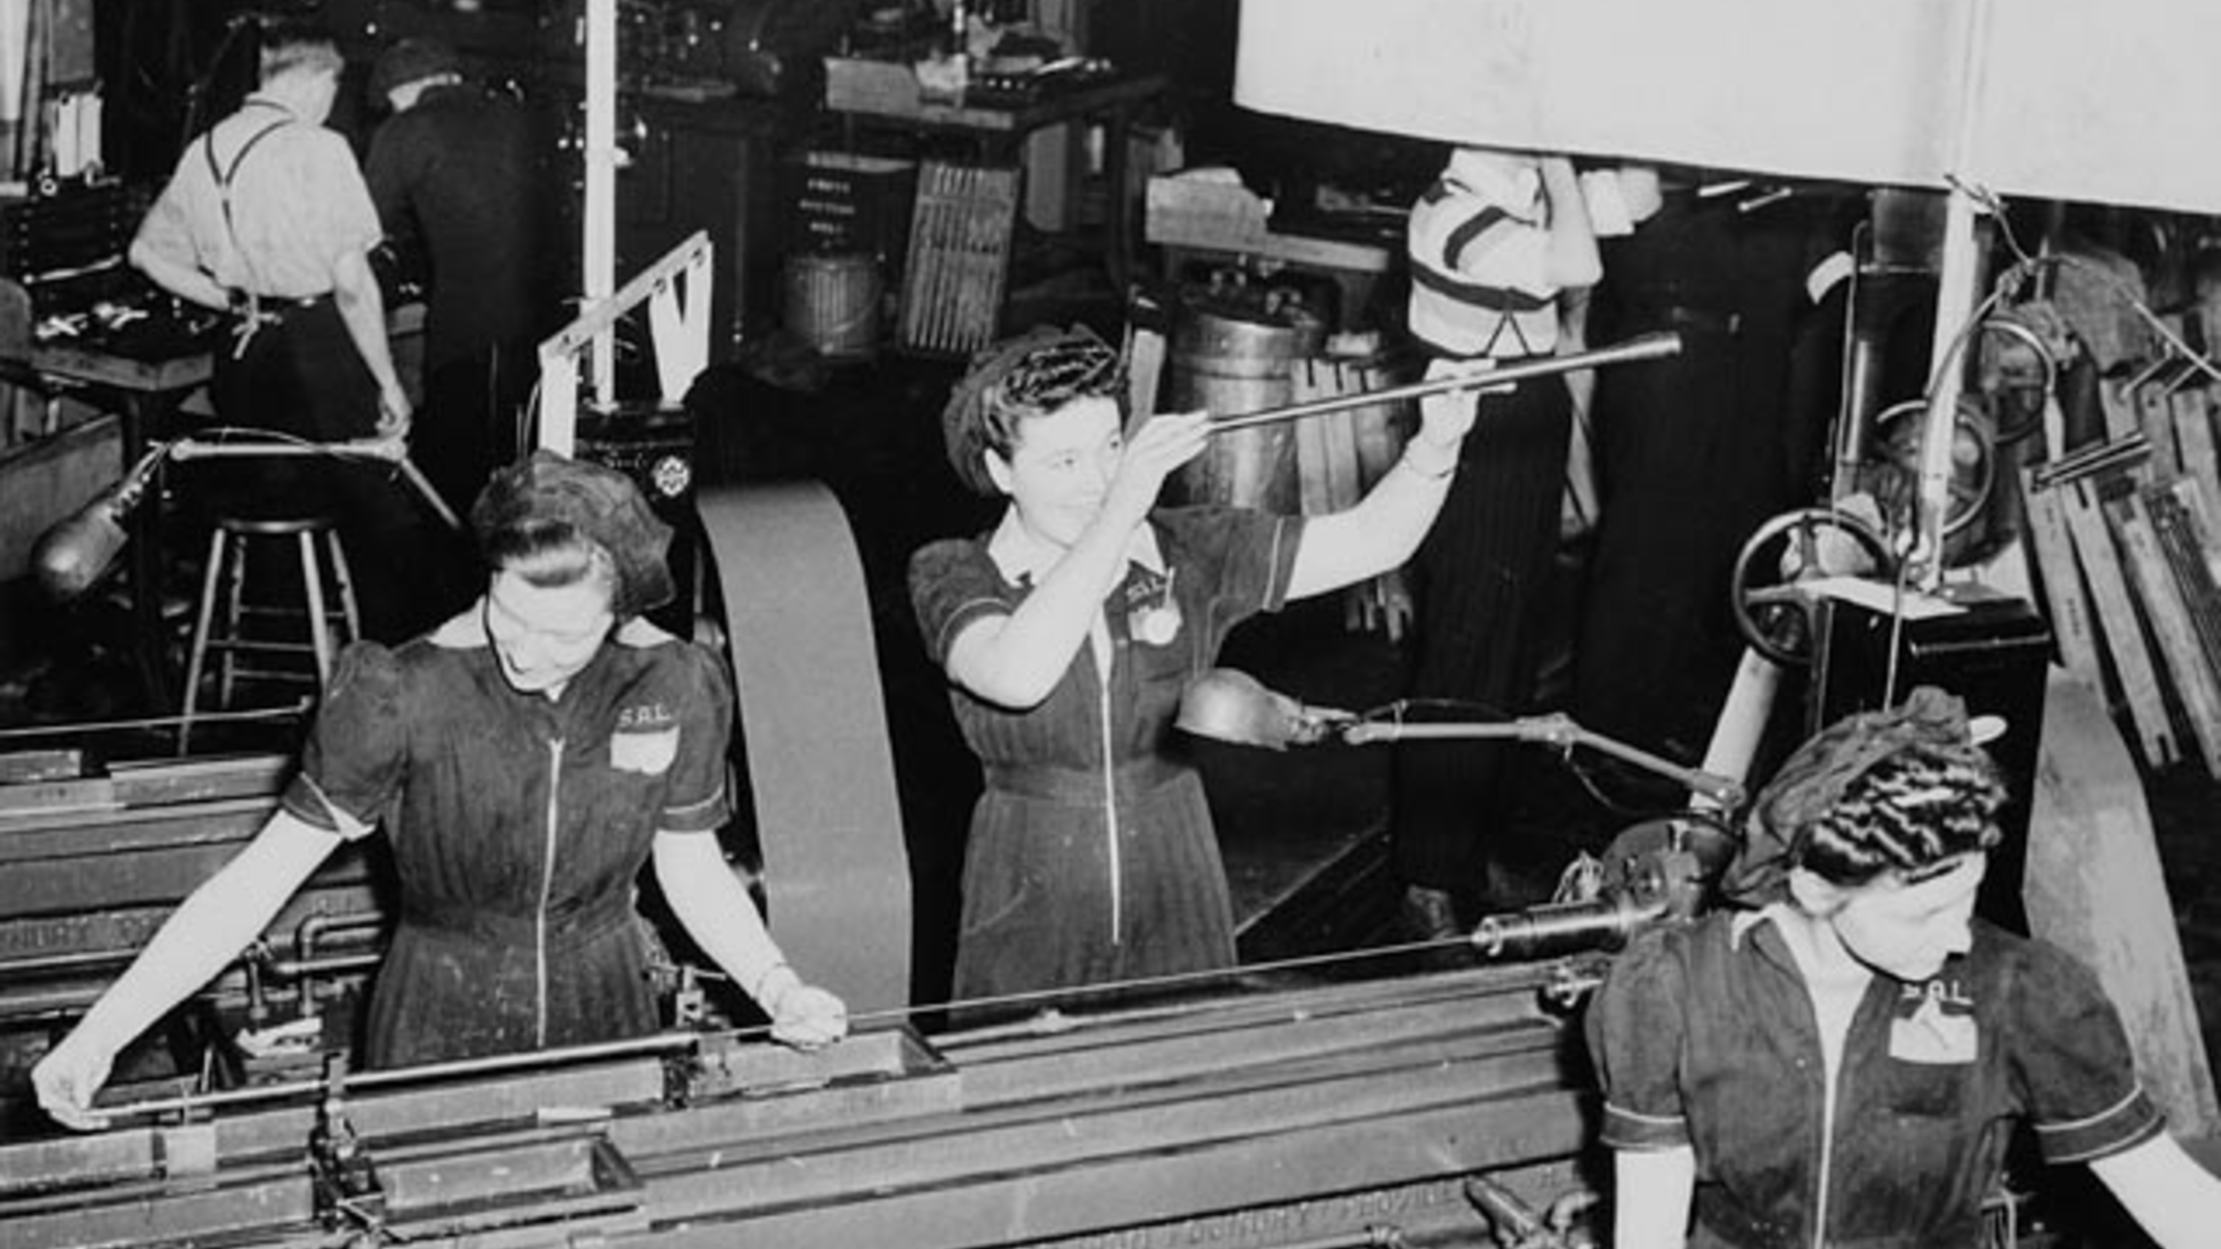
WARRE & VAVASOUR · AN AI LABORATORY
BOW VALLEY, ALBERTA · 2026
Welcome to Work, Alberta.
WorkspaceAlberta — live government demand, wired directly to the people who can do the work.
PRODUCT BRIEF · THE FIRST OFFERING IS OPEN AND FREE
Canadian industrial war production · Library and Archives Canada

Slide 2
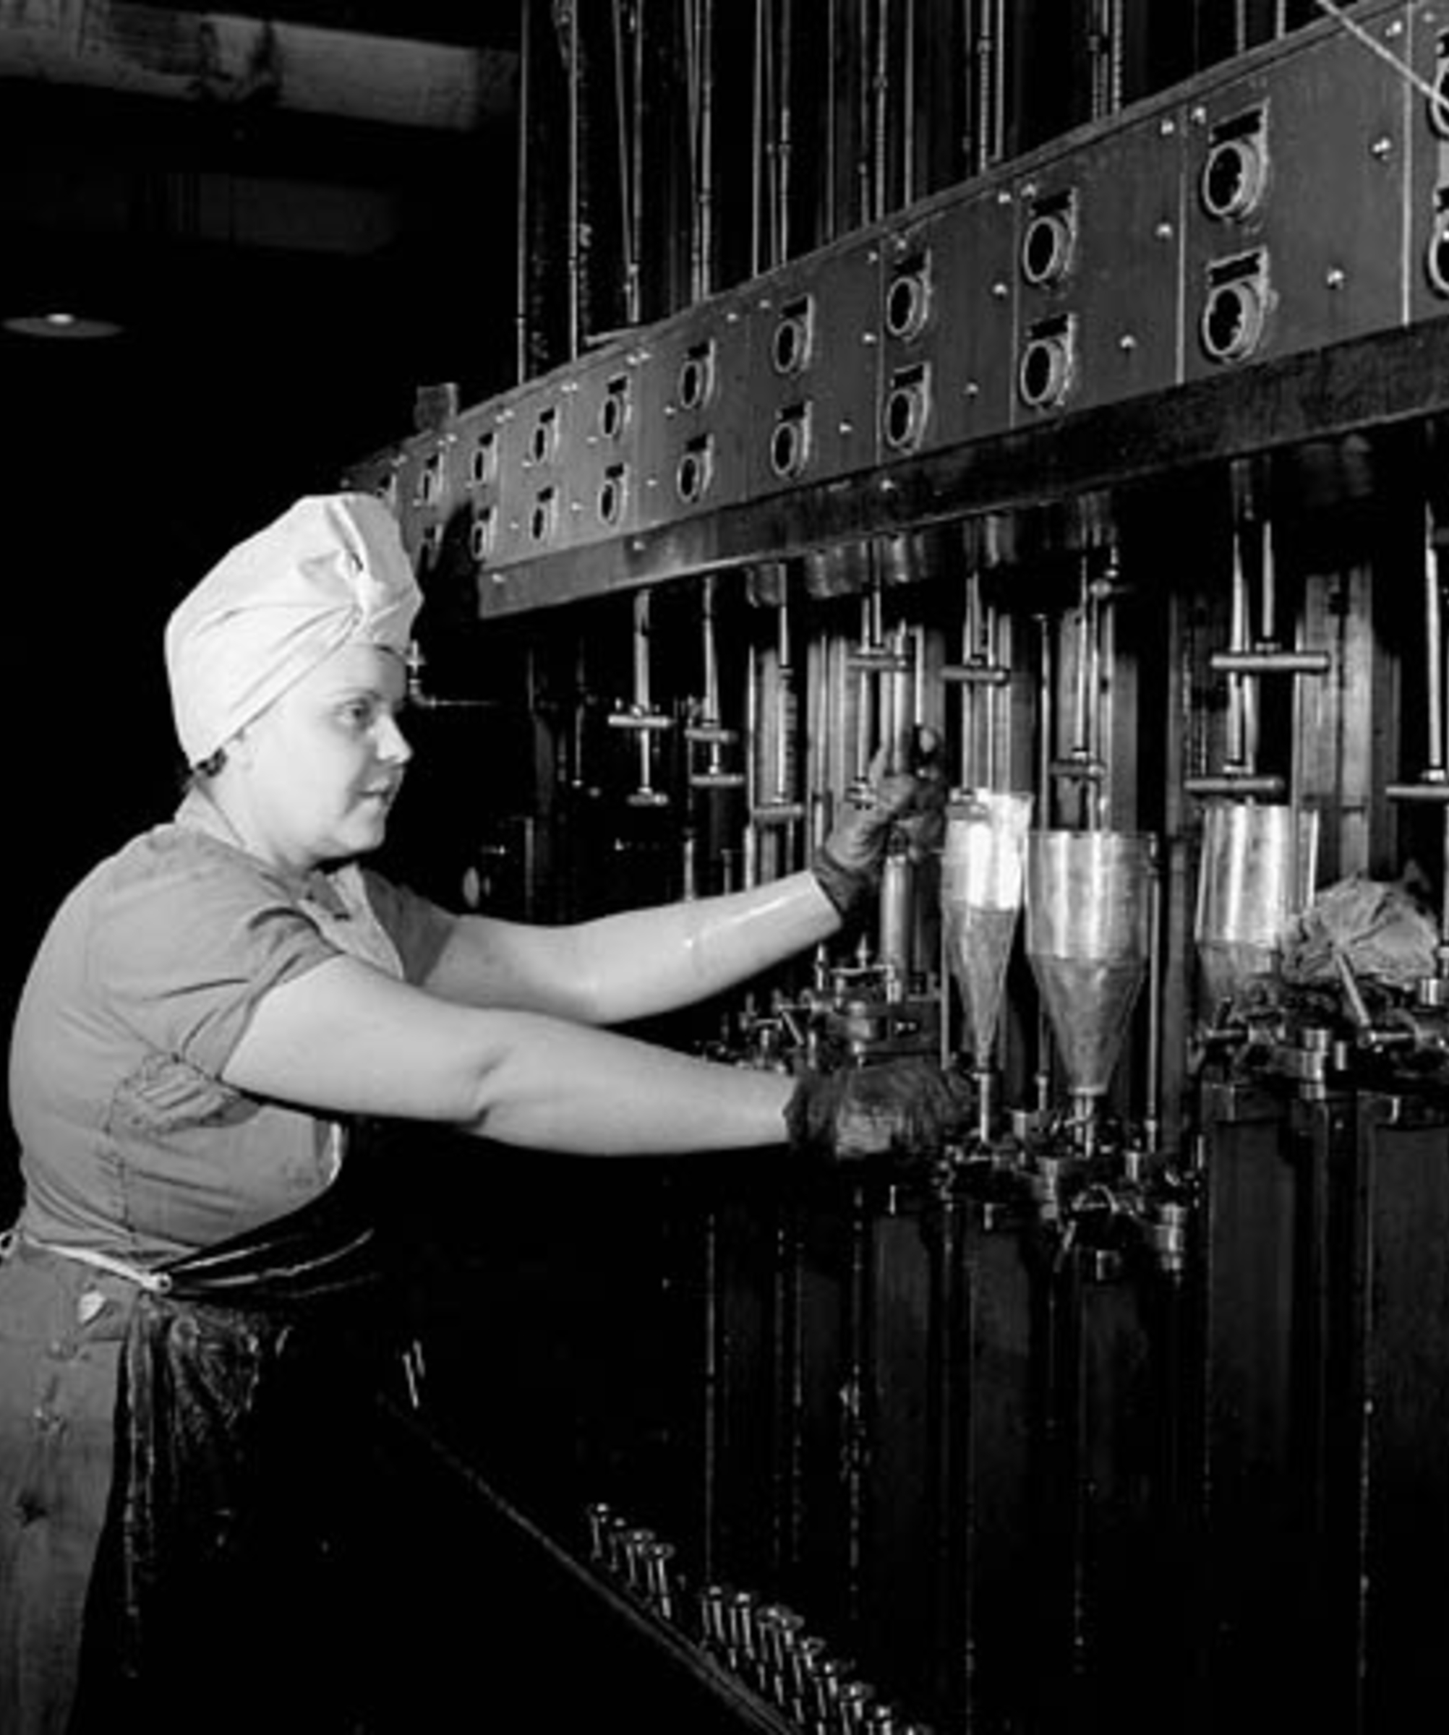
01 · THE LAST MILE
W&V · WORKSPACEALBERTA
AI promised 5X productivity.
Most small businesses got a chatbot that writes mediocre marketing copy.
The model is not the bottleneck. The connection is. Government tender databases are the perfect example: the work is public, the demand is real, but the discovery process is still awkward enough that good companies miss good opportunities.
Sophie O'Kowinski, John Inglis Co., 1943 · Library and Archives Canada

Slide 3
02 · THE SENTENCE THAT STARTS EVERYTHING
W&V · WORKSPACEALBERTA
Wouldn't it be great if…
— a fabricator saw the right tender before the deadline was already too close
— a contractor could ask one question across federal and Alberta postings
— a shop owner got a daily bid brief without learning another portal
— a good bid/no-bid decision took minutes instead of a lost afternoon
This is not a prompt library. It is the bottleneck, stated plainly.

Slide 4
03 · THE PRODUCT
W&V · WORKSPACEALBERTA
The custom MCP server is the product.
A deployed, working endpoint that knows the live public procurement pipeline — CanadaBuys and Alberta Purchasing Connection — and serves it back through any AI assistant, ranked by what you do, where you work, and what deadlines matter. No new portal to babysit.
CANADABUYS · FEDERAL
WORKSPACEALBERTA MCP
ANY AI ASSISTANT
MCP / REST
21 TOOLS
ALBERTA PURCHASING CONNECTION
Pure Python procurement core. The model layer is added only where judgment helps. Same core exposed as REST/OpenAPI.

Slide 5
04 · LIVE TEST · JULY 18, 2026
W&V · WORKSPACEALBERTA
One sentence about your shop. A ranked tender list in 30 seconds.
THE INPUT — ONE SENTENCE
THE OUTPUT — RANKED MATCH
"Custom metal fabrication shop: structural steel, stairs, railings, platforms, CWB-certified welding. 12 employees, Edmonton."
91
Alberta Transportation & Economic Corridors — ITB TND0012201
Structural steel girder bridge · Hwy 2 interchange, Morinville AB
MATCH SCORE
Closes 2026-07-30 · 11 days remaining
WHY IT MATCHES
steel · structural steel · fabrication · supply · delivers to Alberta
Ironline Fabrication Ltd. · test persona
REAL DATA · ALBERTA PURCHASING CONNECTION · REF AB-2026-04073 · RETRIEVED LIVE VIA MCP

Slide 6
05 · THE HABIT
W&V · WORKSPACEALBERTA
The market, before coffee.
LIVE COUNTS · JULY 18, 2026
850
1,523
FEDERAL OPEN NOTICES · CANADABUYS
ALBERTA OPEN OPPORTUNITIES · APC
BEST FITS
CLOSING SOON
SUGGESTED ACTION
Ranked against your profile
Closing-date countdowns
The next move, stated plainly
The daily bid brief is free. Permanently. The habit stays free while it forms — and after.

Slide 7
06 · THE DETAILS THAT DECIDE
W&V · WORKSPACEALBERTA
The three numbers that matter, out of the 140-page RFP.
ARTIFACT · TENDER AB-2026-04073
MANDATORY
BID BOND
Certificate of Recognition (CoR)
Digital format, required with every tender
SUBMISSION
PRE-TENDER MEETING
Email only — hard copy refused
June 10, 2026 · MS Teams
CONTACT
SCALE
Named procurement officer, gov.ab.ca
279,400 m³ excavation · 57,000 t asphalt · HP 310×110 steel piling
GET_OPPORTUNITY_DETAILS · VERBATIM TOOL OUTPUT · REF AB-2026-04073

Slide 8
07 · FREE BRIEF, PAID BID WORK
W&V · WORKSPACEALBERTA
Free to look. $85/month to bid.
FREE FOREVER
PRO · $85 CAD/MONTH
— Search both governments in one question
— Daily bid brief
— Full tender details
— Closing-soon deadlines
+ Bid rooms: sandboxed E2B analysis of full tender packages
+ Cohere Command A+ review: risks, requirements, fit score
+ Watchlist with closing-date countdowns
+ Bid/no-bid scorecards on demand
"WorkspaceAlberta Pro required. A WorkspaceAlberta Pro API key is required for this tool."
THE ACTUAL PAYWALL, VERBATIM · THE METER STARTS AT THE MOMENT OF INTENT

Slide 9
08 · TESTED, NOT PROMISED
W&V · WORKSPACEALBERTA
We ran the user tests before we made this deck.
5.4 s
49 s
7/7
FRESH CLONE
DEPENDENCY INSTALL · CLEAN ON WINDOWS
SMOKE TESTS PASSING
21
~2 s
30 s
MCP TOOLS LIVE
FIRST LIVE SEARCH
ONE SENTENCE TO RANKED MATCHES
What broke: the README has no setup path, naming is inconsistent, and the AI review tool dead-ends on Alberta references. All logged with fixes ranked in docs/user-tests/. We show the seams.

Slide 10
09 · WHO THIS IS FOR
W&V · WORKSPACEALBERTA
2,500 companies. $37 billion. One search box away.
SECTOR | COMPANIES | IMPACT | JOBS
Forestry & wood products | 676+ businesses, 40 major mills | $14B | 41,400
Fabricated metal products | 1,871 establishments | $23.4B sector | 16,600
Primary & machinery mfg. | 200+ facilities | included above | 12,000+
$4B FOREST EXPORTS
70 COMMUNITIES DEPEND ON THESE INDUSTRIES
$988M TAX REVENUE
STATISTICS CANADA · INNOVATION CANADA · ALBERTA FOREST PRODUCTS ASSOCIATION

Slide 11
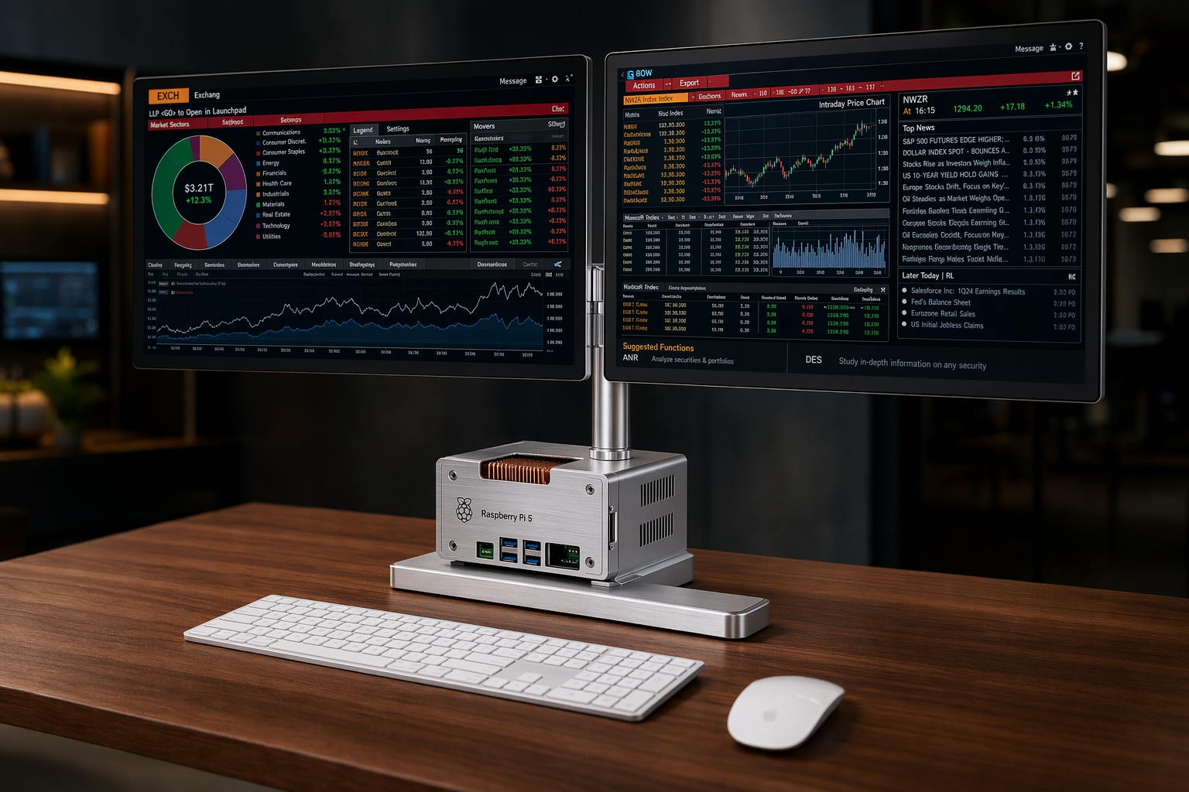
10 · THE SOVEREIGN PATH
W&V · WORKSPACEALBERTA
Canadian AI security is Canadian national security.
DEMAND
CanadaBuys + Alberta APC
MODEL
Cohere Command A+ (open, W4A4 on Hugging Face)
TOOLS
this MCP server, open and free
COMPUTE
managed terminals now; Canadian-built Linux devices on the long path
The point is not nationalism as decoration. The point is operational independence.
THE WORKSPACEALBERTA TERMINAL · ASSEMBLED NOW, CANADIAN-BUILT ON THE LONG PATH

Slide 12
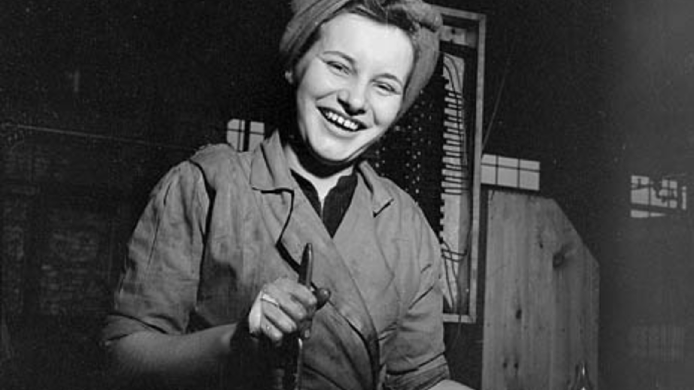
WARRE & VAVASOUR · AN AI LABORATORY
W&V · WORKSPACEALBERTA
Canada is going to work.
More contracts won. More jobs kept. More skill developed. More value staying here at home.
READ THE BRIEF TOMORROW — FREE
READY TO BID — $85 CAD/MONTH
github.com/HarleyCoops/WorkspaceAlberta
buy.stripe.com/14AfZieZmcb2eYB5v1g7e0a
WARRE & VAVASOUR · AN AI LABORATORY · BOW VALLEY, ALBERTA
BUILT FOR TRADES, NOT TECH

Slide 13
APPENDIX · ONE FAMILY, TWO REGISTERS
W&V · WORKSPACEALBERTA
Should the product have a separate brand? No — a register, not a divorce.
WARRE & VAVASOUR — THE LAB
WORKSPACEALBERTA — THE PRODUCT
#0a0807
#d9a441
#c2542a
#f3ede1
#f7f5ef
#b87333
#79a9d8
#111111
Dark, editorial, conviction. Fraunces → Oranienbaum in this deck.
Porcelain, industrial, daylight. The product the lab stands behind.
Dark slides make the argument. Light slides do the work.
Library and Archives Canada industrial photography, duotone treatment. No stock gloss, no fake stats, no fake testimonials.

