Slide 1

Recursive trees merge sort algorithm
Warren Peterson Gregory Duffley
CST-201 12/10/2021
Notes:
Slide created by Warren Peterson & Gregory Duffley on 12/11/2021

Slide 2
Lets Examine the tree to figure out the recurrence relationship
Merge Sort would be:
T(1) = 1 T(n) = 2T(n/2) + O(n)
T(n) ignore recursive call look at what is left over
Recursive Tree
Notes:
Slide created by Warren Peterson on 12/11/2021

Slide 3
Lets Examine the tree to figure out the recurrence relationship
Merge Sort would be:
Recursive Call T(n) = 2T(n/2) + O(n)
TREE
T(n) 1n
Two Recursive Calls
T(n/2) n/2 n/2
Recursive Tree
Notes:
Slide created by Warren Peterson on 12/11/2021

Slide 4





Lets Examine the tree to figure out the recurrence relationship
Merge Sort would be:
Recursive Call T(n) = 2T(n/2) + O(n)
TREE
T(n) 1n
Two Recursive Calls
T(n/2) n/2 n/2
T(n/2^2) n/2^2 n/2^2 n/2^2 n/2^2
Recursive Tree
Notes:
Slide created by Warren Peterson on 12/11/2021

Slide 5







Lets Examine the tree to figure out the recurrence relationship
Merge Sort would be:
Recursive Call T(n) = 2T(n/2) + O(n)
TREE
T(n) 1n
Two Recursive Calls
T(n/2) n/2 n/2
T(n/2^2) n/2^2 n/2^2 n/2^2 n/2^2
T(n/2^3) n/2^3 n/2^3 n/2^3 n/2^3 n/2^3 n/2^3 n/2^3 n/2^3
Recursive Tree
Notes:
Slide created by Warren Peterson on 12/11/2021

Slide 6



Lets Examine the tree to figure out the recurrence relationship
Merge Sort would be:
Recursive Call T(n) = 2T(n/2) + O(n)
TREE
T(n) 1n
Two Recursive Calls
T(n/2) n/2 n/2
T(n/2^2) n/2^2 n/2^2 n/2^2 n/2^2
T(n/2^3) n/2^3 n/2^3 n/2^3 n/2^3 n/2^3 n/2^3 n/2^3 n/2^3
n/2^k
Recursive Tree
Nodes:
1
2
4
8
k
O0(n)
O1(n)
O2(n)
O3(n)
Ok=lg n(n)
O(n log n)
Notes:
Slide created by Warren Peterson on 12/11/2021

Slide 7
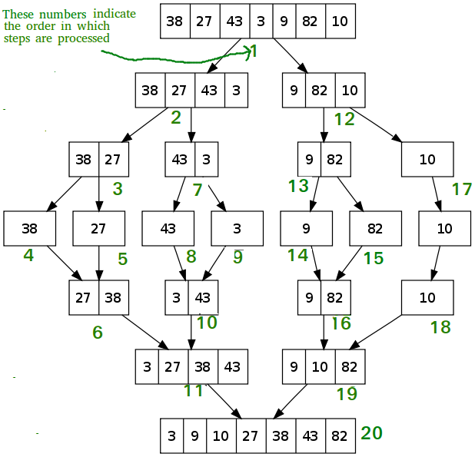
eXAMPLE
Merge Sort
Merge Sort
Notes:
Slide created by Gregory Duffley on 12/11/2021

Slide 8

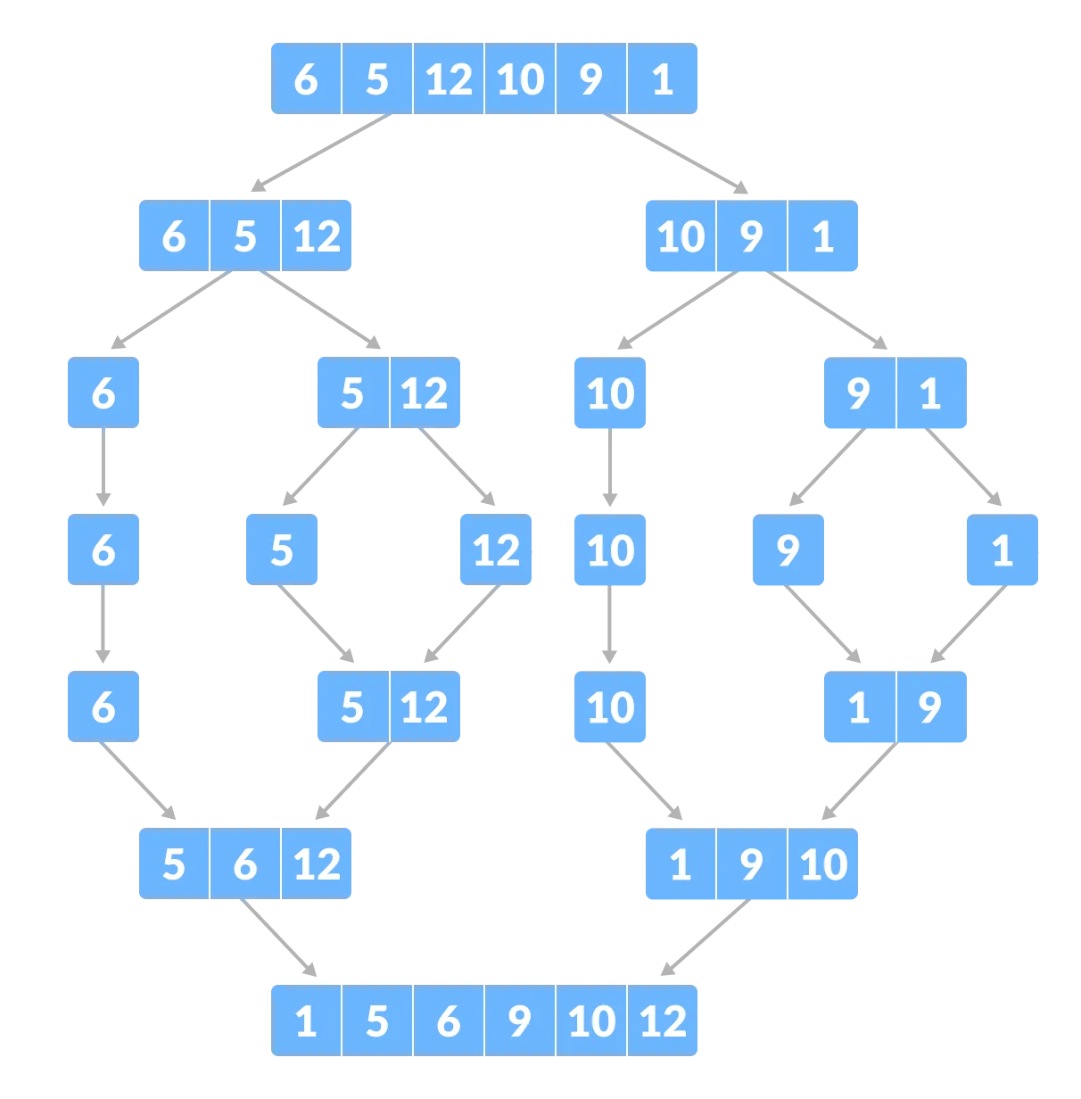
Merge Sort is classified as a divide and conquer algorithm:
Divide and conquer algorithms uses a three step approach.
1.) Divide the problem into smaller pieces.
2.) Use recursion to solve the smaller problems that make up the larger problem.
3.) Combine the answers of the smaller problems to solve a larger problem.
Merge Sort Applied:
1.) Divide the problem into what is in this case two halves but can be later represented as n sublists as the algorithm progresses.
2.) Conquer those first two sublists by sorting n sublists
3.) Merge the two first sorted sublists to output a fully sorted array
Notes:
Slide Created by Gregory Duffley on 12/11/2021

Slide 9
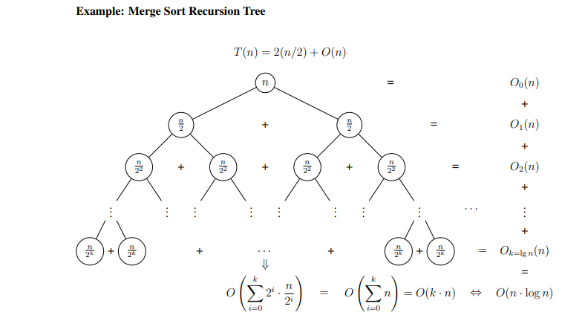
Recursive Tree
Merge Sort
Notes:
Slide created by Gregory Duffley on 12/11/2021

Slide 10
What does it really mean to divide the two halves?
Dividing the n sublists uses what is called recursion:
To apply recursion is to break the problem into smaller parts or “conquer”. The challenge of doing so is best represented via a recursion tree when working with merge sort.
We will: 1.) Represent each node in the tree structure as subproblem x where f(n) is the amount of time spent on the sublists and have the head node be represented as n while each level of the tree will be f(x/b) where b=2 and a=2
2.) The divided sub-problems will be more more time complex f(n) based on the level of n sublists.
3.) a will change based on how many times we divide the problem in the first step of the divide portion and b will change based on how many times how we divide the problem in the sublists. In the case of merge sort we have 2 for each.
3.) The problem as a whole will represented as T(n) = a(n/b) + f(n) where T(n) will be the result of the two sorted halves or the “merge” part of the algorithm.
Notes:
Slide Created by Gregory Duffley on 12/11/2021

Slide 11

Thank You
Warren Peterson
Gregory Duffley

