Slide 1

Red-Black Balanced Trees
Warren Peterson Gregory Duffley
CST-201 12/17/2021
Notes:
Slide was Created by Gregory Duffley & Warren Peterson on 12/17/2021

Slide 2
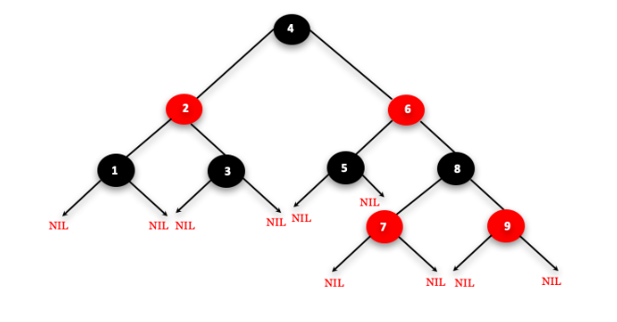
Red Black Tree
A red-black tree is a self-balancing binary search tree where each node is interpreted in a different color differing from red to black.
The balance of the tree should maintain a time complexity around O(log n) time.
The balance is maintained with the “balance factor”
Balance factor = height of left subtree-height of right subtree
Notes:
Slide was Created by Gregory Duffley & Warren Peterson on 12/17/2021

Slide 3
Rules of a Red-Black Tree
A Red-Black tree will follow a certain pattern of rules to maintain its balance factor and those rules are as follows
The node in a Red-Black tree is either red or black in color.
The color of the root node should be black.
The adjacent nodes should not be red. In other words, we can say that the red node cannot have red children, but the black node can have black children.
There should be the same number of black nodes in every path; then, only a tree can be considered a Red-Black tree.
The external nodes are the nil nodes, which are always black in color.
Notes:
Slide was Created by Gregory Duffley & Warren Peterson on 12/17/2021

Slide 4
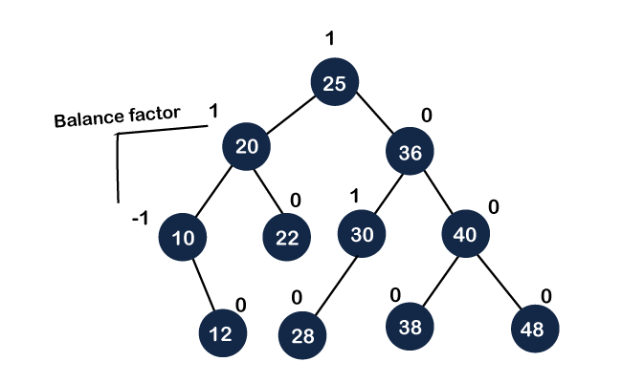
Rules of a Red-Black Tree Applied
How to balance a tree if we do not have a red-black tree
Recoloring
Rotation
insertion, deletion, and searching is O(logn).
Notes:
Slide was Created by Gregory Duffley & Warren Peterson on 12/17/2021

Slide 5
Why is a Balanced Tree Desirable?
Efficient Computational Time O(log n) Logarithmic Time
Standard Binary Search Trees use O(n) Linear Time
Skewed Binary Search Trees are O(n)
Red black trees are useful when we need insertion and deletion relatively frequent.
A balanced tree automatically keeps its height small
A balanced tree guarantees time complexity
They have relatively low constants in a wide variety of scenarios
This structure provides efficient implementation for abstract data structures such as associative arrays.
Notes:
Slide was Created by Gregory Duffley & Warren Peterson on 12/17/2021

Slide 6
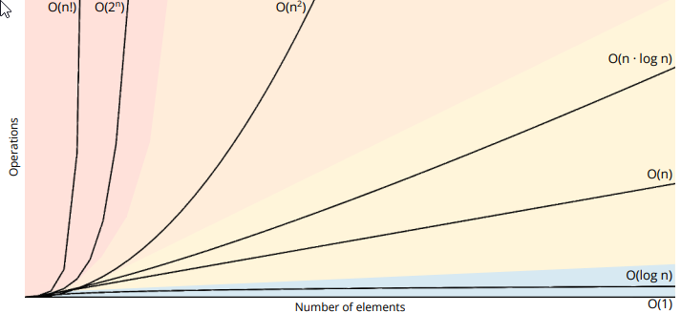
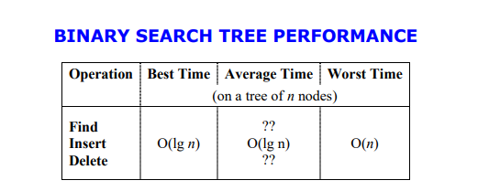
Time Complexity Red-Black Tree Functions
Search() - O(log n)
Insert() - O(log n)
Delete() - O(log n)
AnythingElse() - O(log n)
Notes:
Slide was Created by Gregory Duffley & Warren Peterson on 12/17/2021

Slide 7

Thank You
Warren Peterson
Gregory Duffley
Notes:
Slide was Created by Gregory Duffley & Warren Peterson on 12/17/2021

