Slide 1
Causal Models for Regression Modeling Strategies
Drew Griffin Levy
May, 2019

Slide 2
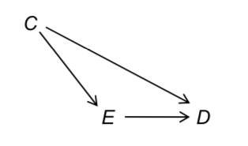
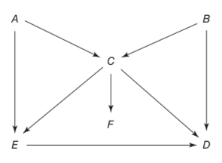
Takeaways: Reasons to consider causal models for regression modeling in observational studies
Alternative approaches to variable selection
Deeper insight re. how causal inferences from associational models can be questionable
Identifying the minimum (and various) set of adjustments necessary for unbiased estimation of effects
Risk of inducing bias with statistical adjustment (collider stratification bias)
Clearly and explicitly communicating assumptions about justifications for model specification
Notes:
Going to talk about one approach to how to select variables for regression model.
This topic involves causal modeling, in general; and Structural Causal Models and Directed Acyclic Graphs, in particular.
My call to action: consider causal modeling as part of your technical repertoire.

Slide 3
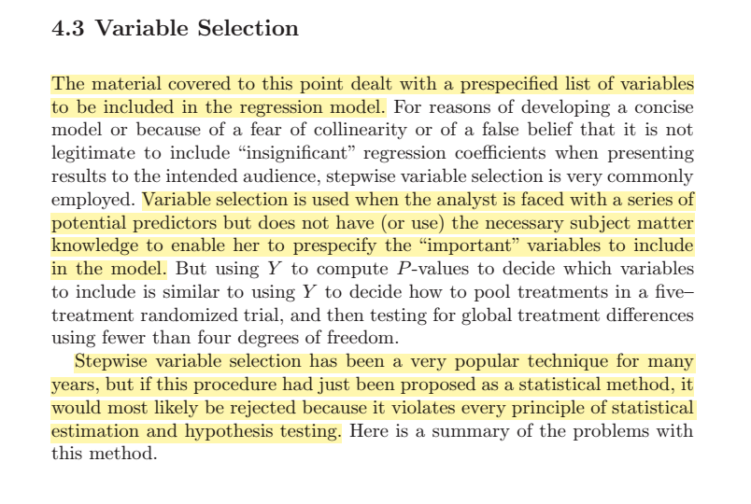
Notes:
From RMS, 2nd Ed., 2015; page 72.
RMS does a wonderful job of helping us avoid disasters due to all too prevalent abuses of statistical tools (e.g., univariable screening and stepwise selection).
RMS does a wonderful job of helping us think about how to use information effectively: N:predictor df’s, ; and avoid overfitting, and overconfidence.
RMS does not directly address how to choose variables for the purpose of mitigating bias due to confounding to obtain an unbiased estimate of effect for a particular Y~X relationship.
RMS does not address how to leverage subject matter knowledge in modeling.

Slide 4
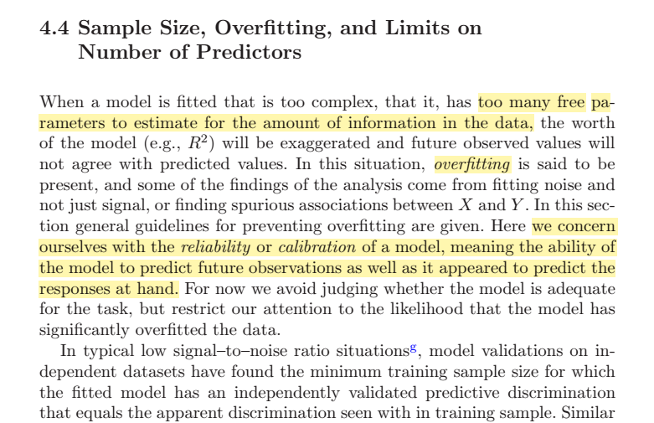
Notes:
RMS does an excellent job of providing guidance on how to minimize the damage from not pre-specifying prediction models based on subject matter knowledge.
RMS does not address how to best use subject matter knowledge in modeling.

Slide 5
We can & will be fooled by data!
It is a prevalent mistake to believe that “all the answers [information] are in the data”
Observations are not objective; Nature is indifferent to furnishing noise vs. signal; the computer cannot divine causes; good faith science requires humility
Relying on statistical approaches to identifying variables for adjustment and control of confounding can be problematic
Notes:
There is a prevalent view that the data contain all the information needed; e.g., ML,
Much of FHs RMS is about how to minimize the risks: “Using the data to guide the analysis is almost as dangerous as not using it!”

Slide 6
Alternative PoV: how to identify variables for unbiased estimation
How to estimate a 1° effect (e.g., Tx) without bias.
Confounding is a causal phenomenon
Confounding: P(Y|X) ≠ P(Y|do(X))
Causal models also elucidate
Adjustments that induce bias!
Selection bias
Much else
Identifying the set(s) of adjustments necessary for unbiased estimation of specific effects
Notes:
An alternative approach—not in conflict. Positive vs. subtractive
P(Y|X) ≠ P(Y|do(X)) [associational vs causal]

Slide 7
“What causes say about data”
Causal diagrams show how causal relations are expected to translate into associations & independencies
The associations & independencies posited are derived from subject matter knowledge
With data you can compute the associations & independencies observed
The causal model will be reconciled with the observed pattern of associations & independencies
Notes:
All causes result in associations, but not all associations are causal.
I will leave aside for the moment why and when you want to differentiate between associational prediction and causal prediction.
Briefest overview of causal models:

Slide 8
Basic structures in causal models
Causal relationship
Chains
Mediation
Confounder
Collider
Notes:
A very basic introduction to basic structures in causal models.

Slide 9
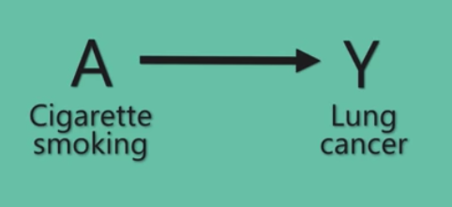

Cause-effect
Causal effects imply associations
Lack of causal effects imply independencies: e.g., P(Y|X) ≠ P(Y)
DAGs are both causal models and statistical models (i.e., models that represent associations and independencies)
Notes:
No arrow indicates that A and Y are independent.
Graph theory gives us a rule: we can only exclude an association between A and Y if there is no arrow from A to Y.
Our causal knowledge is represented where we omit arrows.
Causation: we say that X affects Y in a population of units if and only if there is at least one unit for which changing X will change Y.

Slide 10

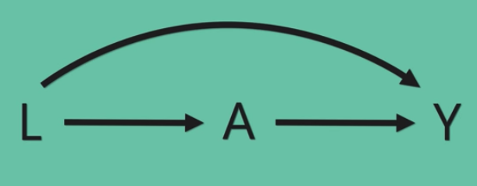

Causal structures: Chains, Junctions and Paths
Mediation
Direct vs. indirect effects
Total effect
Conditional independence:
In general: Pr(Y=y|X=x) = Pr(Y=y)
Pr(Y=y|A=a, B=b) = Pr(Y=y|B=b)
Notes:
If there is no direct arrow from A to Y, we say that there is no association between A and Y conditional on B, even though A has a causal effect on Y.
The box around B indicates conditioning; and blocks the association between A and Y. The mediator B “screens off” information about A from Y.
The flow of association between A and Y is interrupted when we condition on the mediator, B. We say that A and Y are “conditionally independent”, given the value of B.

Slide 11
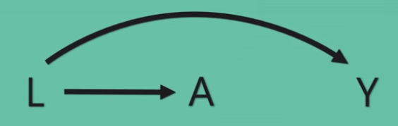
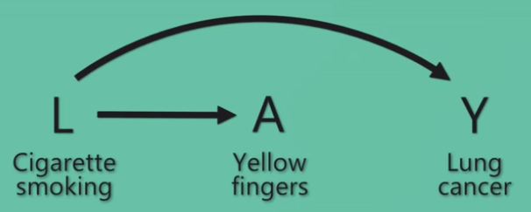
Confounders
Causal structure with common causes
Bias: A and Y are not expected to be independent
Bias: estimation of magnitude of association of A and Y
Notes:
Association due to common causes.
Often illustrated and referred to as a “fork” structure.
An open path, closed by conditioning on the confounder.

Slide 12
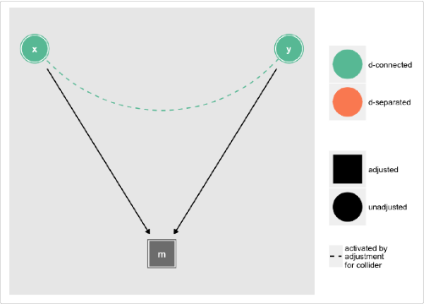
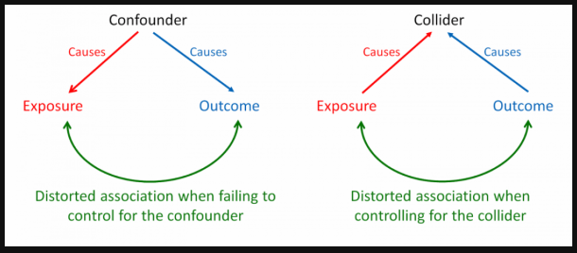
Colliders & Collider-stratification bias
Paths with convergent arrows
When colliders are not conditioned on they block pathways.
When colliders are conditioned on they open pathways
Thus adjustment can inadvertently induce bias!
The prevalence of these collider structures is likely under appreciated.
Notes:
Colliders behave the opposite of other causal structures
Two variables Z and W (e.g., A and Y, or E and D, etc.) are independent, unless the collider is controlled for.

Slide 13
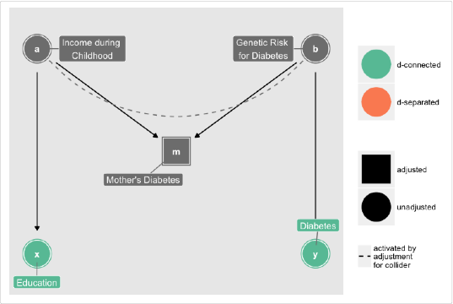
Stratifying on a collider is a major culprit in systematic bias
Notes:
Stratifying on a collider is a major culprit in systematic bias.
Here, controlling for a collider–a node where two or more arrow heads meet–induces an association between its parents, through which confounding can flow:

Slide 14
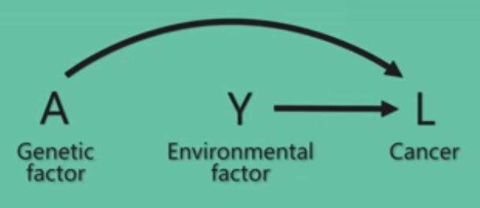
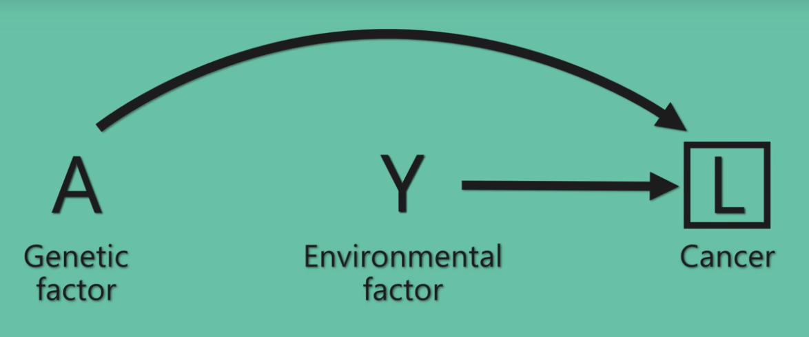
Selection Bias and collider-stratification bias
Common effects do not create an association, unless conditioned on.
When there is a component of the association due to selecting a subset of the population, we say that there is selection bias.
Notes:
Selection bias can be understood as a collider structure.
Conditioning on the outcome of interest, e.g. through selection induces an association between antecedents.

Slide 15
Deconfounding → P(Y|do(X))
Distinguish concepts: confounding, confounder, and “deconfounding”
“d-separation”: for any given pattern of paths in the causal model, what pattern of dependencies and independencies we should expect in the data
“Back-door criterion” for bias evaluation indicates possible sets of variables for unbiased estimation
Identify the set of adjustments necessary for unbiased estimation of effects

Slide 16
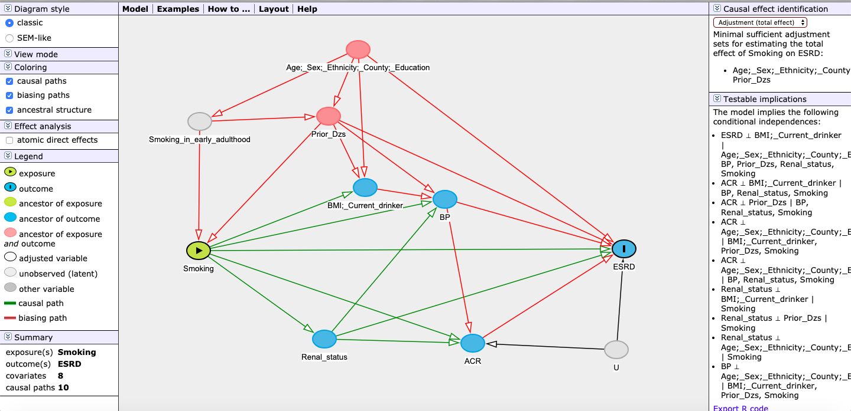
Daggity: - drawing and analyzing causal diagrams (DAGs) (www.dagitty.net/)
Staplin N, Herrington WG, Judge PK, Reith CA, Haynes R, Landray MJ, Baigent C, Emberson J. Use of Causal Diagrams to Inform the Design and Interpretation of Observational Studies: An Example from the Study of Heart and Renal Protection (SHARP). Clin J Am
Notes:
Complex, but managable.

Slide 17
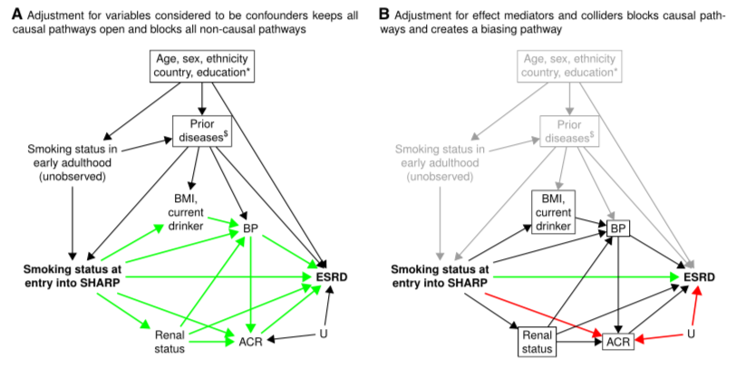
Notes:
The scientific goals need to be articulated; e.g., estimating direct vs. total effects.
Over-adjustment can occur with indiscriminate approaches to controlling for bias.

Slide 18
“Draw your assumptions before your conclusions.” —M. Hernan
Causal diagrams help us summarize what we know about a problem and communicate our assumptions about its causal structure.
Causal diagrams help us diagnose biases in causal inference
Causal diagrams help you organize your expert knowledge visually; and therefore, they help you draw your assumptions before your conclusions.
Notes:
There is a choice between the locus of uncertainties: (a) statistical model uncertainty that FH talks about and RMS is largely about, vs. (b) causal model uncertainty which is ultimately why you are doing research.

Slide 19
Resources
DAGitty - drawing and analyzing causal diagrams (DAGs) (www.dagitty.net/)
Judea Pearl
Causal Inference in Statistics: A Primer, 2016
Causality: Models, Reasoning and Inference, 2009
The Book of Why: The New Science of Cause and Effect, 2018.
Miguel Hernan
Causal Inference Book
edX MOOC: Causal Diagrams: Draw Your Assumptions Before Your Conclusions
Modern Epidemiology, 3rd Ed. Rothman, Greenland, Lash: Chapter 12–Causal Diagrams
Causal Diagrams for Epidemiologic Research. S. Greenland, J. Pearl, J. Robins. Epidemiology 1999;10:37-48.
Catalogue of Bias, Oxford University

Slide 20
Proposed process for using SCMs and DAGs
Think hard about the research question and problem of effect identification
Develop DAGs based on subject matter knowledge without looking at data: do not contort the DAG based on data availability
Do the causal calculus in Daggity to identify the set of minimum necessary adjustment meant for unbiased effect estimation
Do analysis and reconcile observations with causal model (this is science)
Publish the DAG with the research report.
Notes:
There is still much to be developed and understood for routine use in practice. Much to be worked out for how incorporate causal models into rigorous analytic practice.

Slide 21
Takeaways: Reasons to consider causal models for regression modeling in non-randomized studies
Better approaches to variable selection
Deeper insight re. how causal inferences from associational models can be questionable
Identifying the minimum set of adjustments necessary for unbiased (unconfounded) estimation of effects
Risk of collider stratification bias
Clearly and explicitly communicating assumptions about justifications for model specification.

