Slide 1
Financial Analysis of Tesco PLC
Evaluating Financial Performance and Investment Potential Through Ratio Analysis
Notes:
Welcome!

Slide 2
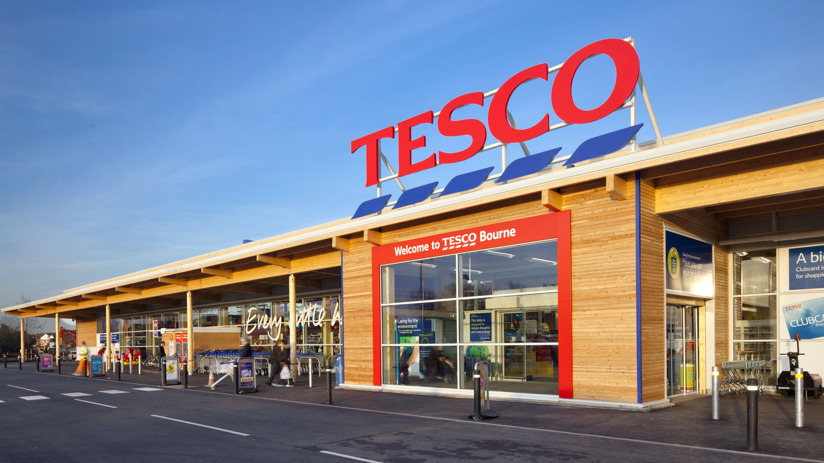
Tesco PLC: Business Overview
Tesco PLC is one of the UK's greatest multinationals whose business is dominated by retailing, grocery, convenience, online shopping and wholesale services offered via its various business units.
As a company listed on the London Stock Exchange FTSE 100, its performance is important for existing and prospective shareholders.
Tesco has a large network of stores, online platforms and Booker wholesale operations with millions of customers (Tesco, 2025).
Such competitive advantages can be derived from the company's size as well as its brand and customers' preferences.
Notes:
Tesco PLC is a big and diversified retailer in the UK. Financial Evaluation is crucial for investors due to its listing on the FTSE 100 (Tesco, 2025). A review is made to determine whether Tesco's strength is reflected in its sustainable profitability or value creation for shareholders.

Slide 3
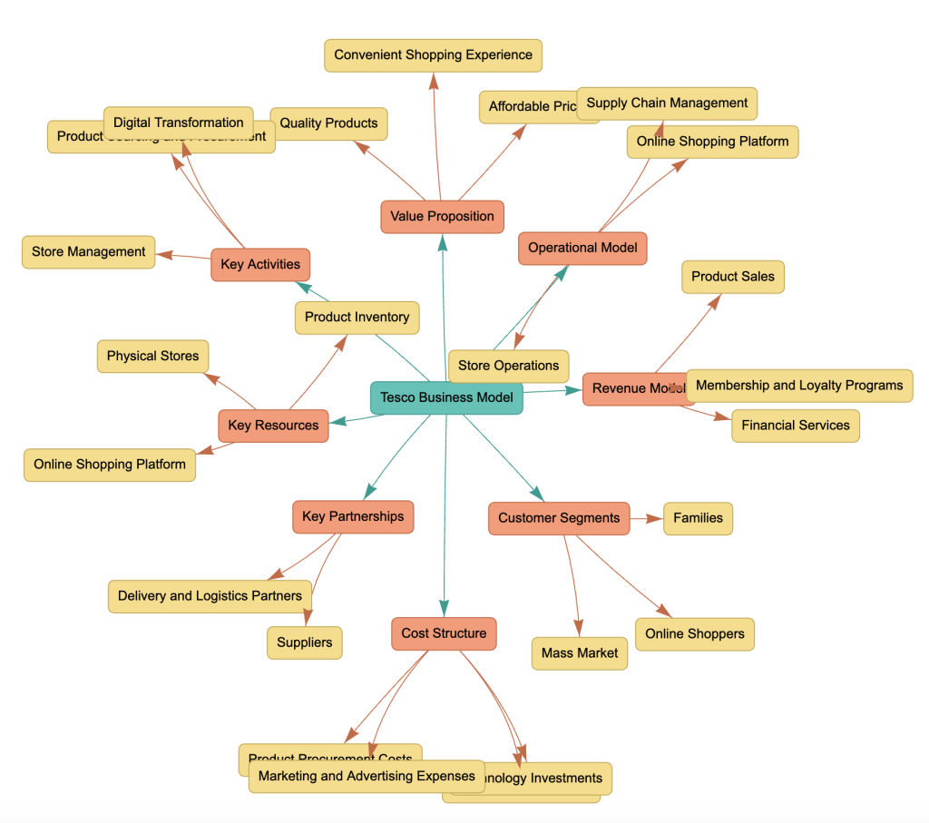
Tesco Business Model and Strategic Position
The company Tesco makes most of its revenue from grocery sales, which rely mostly on its supermarkets, convenience stores and online shopping platforms.
The overall Clubcard ecosystem enhances the customer relationship and improves purchasing decisions through the use of data analytics to personalise offers.
The Booker wholesale section is an extension of Tesco's business lines in the independent segment and food service sector.
Physical and digital operations contribute to resilience against shifts in customer behaviour (Broekhuizen et al., 2024).
Notes:
Tesco replaces old-style retail and adds digital technologies. To meet revenue growth, customer data, online services and wholesale operations are used (Broekhuizen et al., 2024). There is constant pressure on price and profit margins as discount stores provide a challenge.

Slide 4
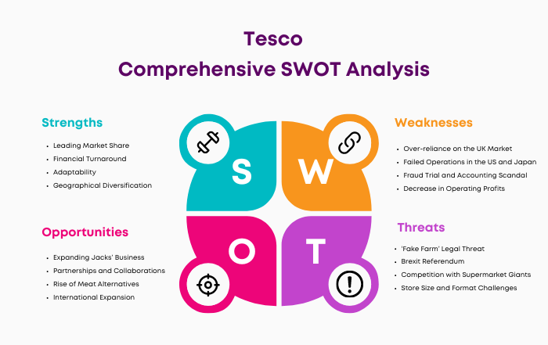
Tesco Strategic Strengths
These are the two key assets of Tesco that give the company a very strong position in the market, namely retailing infrastructure and brand image and customer loyalty.
Data-driven decision-making with Clubcard insights enables Tesco to optimise its customer targeting and operational efficiency.
Good supply chain management is associated with inventory control and competitive pricing strategies (Dymitrowski and Szillat, 2026).
Digital transformation investment creates a more sustainable future for Tesco.
Notes:
This is because of Tesco's strategic strengths that enable it to operate in a fierce retail market. The company makes use of operational efficiency, customer intelligence and digital capabilities to provide sustainable competitive advantages for investors (Dymitrowski and Szillat, 2026).

Slide 5
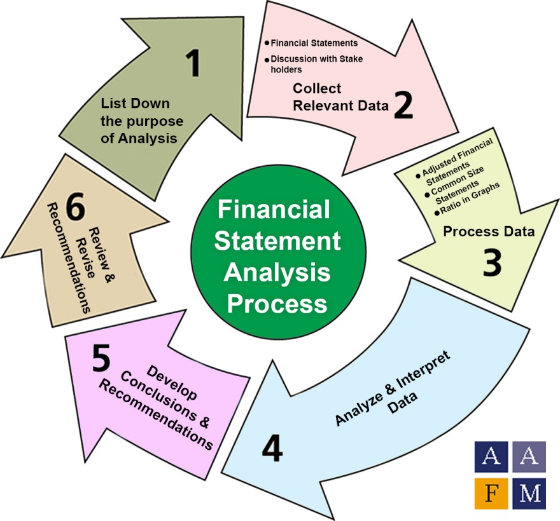
Financial Ratio Analysis Framework
Financial ratio analysis is used to gauge Tesco's financial strength, which is derived from annual report data.
Profitability ratios measure Tesco's profit-generating capacity from sales and invested capital.
Liquidity ratios assess the company's ability to meet its short-term debt obligations (Nasution and Yusleny, 2023).
Efficiency and market ratios offer clues to business performance and returns to shareholders.
Notes:
Using ratio analysis, it is possible to have a structured approach to analyse the financial performance of Tesco. It enables investors to compare trends over a period of time, knowing the profitability, financial stability, operational efficiency and investment attractiveness (Nasution and Yusleny, 2023).

Slide 6
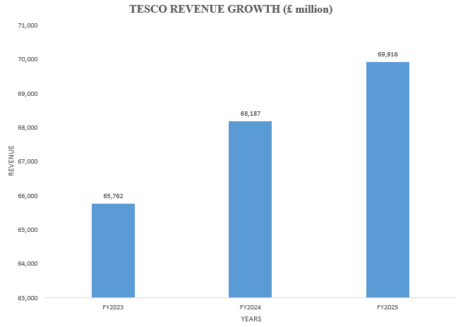
Revenue Growth Performance
The consistent growth of Tesco's business is reflected in its revenue, which rises from £65.76 billion in FY 2023 to £69.92 billion in FY 2025.
The revenue increase is about a 6.3% improvement over the three-year analysis period.
This growth is due to robust customer demand, market share and ongoing growth of digital retail modalities.
Future sales avenues may need to be assessed since greater sales may not contribute to greater revenue.
Notes:
Tesco has positive revenue growth throughout the period analysed. While higher sales are a sign of good market performance, the key for investors is whether sales growth ultimately translates into higher margins and better return per share.

Slide 7
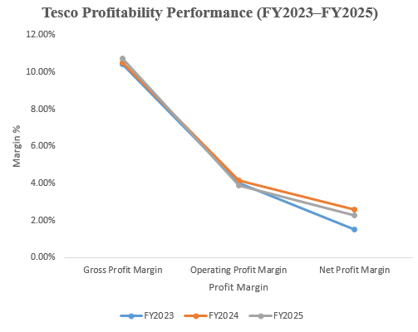
Profitability Analysis
Gross profit margin is on an improving trend from 10.41% for FY 2023 to 10.71% in FY 2025, reflecting better adeptness in controlling product profitability.
There has been a slight decline in the operating profit margin from 4.14% to 3.88%, reflecting the squeeze on operating costs and competition.
In comparison with previous years, the net profit margin is relatively stable, and this boosts investor confidence in Tesco's earning power (Hasidi et al., 2024).
Tesco's profitability was suggested by the results, but it is in a low-margin environment as a retailer.
Notes:
Tesco is still profitable in the current competitive marketplace (Hasidi et al., 2024). Final profitability is impacted by operating pressures, but gross margins are improving, while cost management is key.

Slide 8
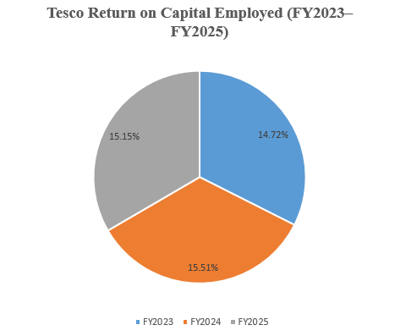
Return on Capital Employed (ROCE)
In every analysis year, Tesco’s ROCE has been above 14%, as the business is using its invested capital efficiently.
ROCE increased from 14.72% in FY 2023 to 15.51% in FY 2024 before slightly declining to 15.15% in FY 2025.
If the level is similar every time, the allocation of shareholder and business resources is effective (Pal et al., 2025).
A consistent ROCE demonstrates the ability of that business to be operationally efficient over time - an indicator that investors look for when they consider investing.
Notes:
ROCE gauges Tesco's profit made on the invested capital. The ratio is very stable, meaning that Tesco maintains the value of its resources even with fluctuations in economic activity (Pal et al., 2025).

Slide 9
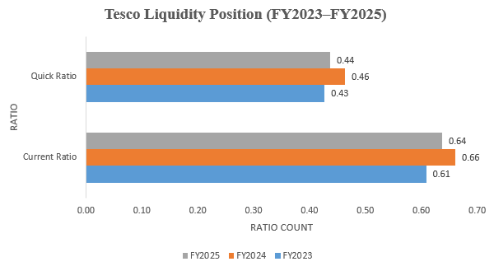
Liquidity Analysis
Tesco's current ratio is below 1 throughout the period, and it reduces the liquidity of assets in the current ratio, as seen from the reduction in current assets compared to current liabilities.
The current ratio has improved, as it was 0.61 in FY 2023 but increased to 0.66 in FY 2024 and further reduced to 0.64 in FY 2025.
This is similar to the trend of the quick ratio, which has fluctuated between 0.43 and 0.46 for the past 3 years.
The liquidity position corresponds to the operational nature of the grocery retail industry, with high liquidity as a result of decreased existing resources (Li, 2024).
Notes:
Tesco's liquidity ratios are fairly low as compared to traditional industries (Li, 2024). This is typical in the context of grocery retail as companies try to turn over their stock and take advantage of credit arrangements from suppliers. So, liquidity risk is still controllable.

Slide 10
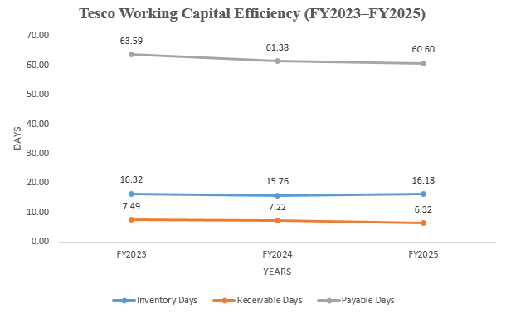
Efficiency Analysis
Tesco has stable inventory management, the inventory days during the analysed period have been around 16 days.
The receivable days reduced from 7.49 days in FY 2023 to 6.32 days in FY 2025, favouring the collection process.
The days' sales outstanding is above 60 days, indicating that Tesco has sufficient ability in handling the credit of its suppliers.
The efficiency ratios point towards good working capital management and effective operational control (Salah et al., 2023).
Notes:
Tesco has been proved having the ability to manage its operational resources efficiently and effectively by way of efficiency analysis. Cash generation is supported by stable inventory turnover and better receivables management, whilst working capital is further enhanced by suppliers' credit (Salah et al., 2023).

Slide 11

Overall Financial Performance Summary
Revenue shows sustained growth for the company as it went from £65.76 billion to £69.92 billion.
Profitability has been kept steady notwithstanding the fact that it is operating in an exceptionally competitive grocery retail scene.
Stock levels are controlled effectively, with the level of efficiency in managing inventory as well as supplier relationships.
Efficiency and return to shareholders are relatively good, suggesting Tesco is strong financially.
Notes:
The whole financial analysis reveals that the financial condition of Tesco is strong. Profits are under competitive pressure, but operations are shown to be good, while revenue growth and returns to shareholders are continuing well.

Slide 12
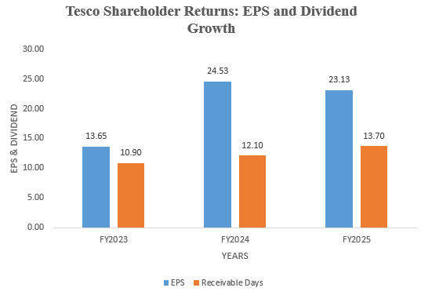
Earnings Per Share (EPS) Analysis
Tesco's EPS is projected to rise strongly from 13.65p in FY 2023 to 24.53p in FY 2024.
Although the EPS has declined slightly from the previous year, it is still strong, remaining at 23.13p in FY 2025.
The improvement reflects an improved ability for ordinary shareholders to generate earnings.
EPS performance, thus, has created favourable investor confidence towards Tesco's financial recovery and financial stability.
Notes:
EPS gives investors an idea of how much each share of stock earns. The rise in Tesco's EPS shows a superior reduction in the cost of maintaining shareholders' interests, investors would need to take note of the sustainability of the gains.

Slide 13
Dividend Performance
Tesco has pledged to raise the dividend amount steadily from 10.9p in FY 2023 to 13.7p in FY 2025.
The dividend growth can be a sign of management's faith in cash generation.
One salient fact is that Tesco's dividend is rising, making it more appealing to those looking for income investment opportunities (Abdullah and Muchran, 2026).
A dividend is a symbol of the company's intention to create shareholder value.
Notes:
Tesco's dividend payment is found to be increasing, which measures the company's efforts to reward its shareholders with higher payouts (Abdullah and Muchran, 2026). Continuous dividend growth indicates that the company will have an excellent capacity for cash generation, and sometimes it will make the company more attractive as a long-term investment vehicle.

Slide 14
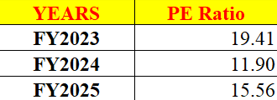
Price Earnings Ratio (PE Ratio)
Tesco's PE ratio decreases from 19.41 in FY2023 to 11.90 in FY 2024 before increasing to 15.56 in FY 2025.
The fluctuation of the PE ratio indicates differences in market expectations about growth in the company's earnings.
The boost for FY 2025 indicates that the market is more confident about Tesco's future performance.
Investors may want to refer to some of Tesco's competitors' valuations before making investment decisions.
Notes:
The PE ratio signals the price investors are willing to pay to receive earnings from Tesco. The valuation difference is caused by market expectations and confidence with regard to future profitability.

Slide 15

Investment Evaluation
Financial Strengths:
An ordinary level of revenue growth and a proven or established market position provide for business stability.
The increase in dividends shows that it has been able to consistently return to shareholders.
Investment Risks:
Competition among grocery stores remains to be a source of margin pressure.
There is some possible downside risk in terms of inflation and changes in operating costs being applied to profitability.
Notes:
Tesco has several appealing investment traits, such as a robust presence in the market with stable earnings growth and a dividend. But potential investors must take into account the competitive pressures and cost challenges in the retail industry.

Slide 16

Annual Report Evaluation
The annual report of Tesco offers information in detail about financial performance, strategy and business risks.
Annual reports help investors decipher the profitability of a company, its operational efficiency and future prospects.
The report makes it easier for management to be transparent about its operations to stakeholders.
The primary purpose of an annual report is to release historical data and possibly contain interpretations by management (Kim et al., 2024).
Notes:
Annual reports are crucial for investors to make informed decisions, as they contain vital financial and strategic details (Kim et al., 2024). Reported information will be in respect of what has transpired, and the stakeholders need to evaluate this information critically.

Slide 17
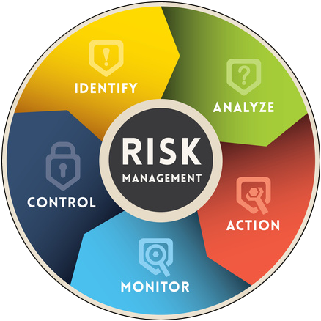
Risk Management Strengths
Tesco's control and management of supply chain risk is accomplished through the company's networks and supplier relationships.
Cost management is a tool to be resilient in times of inflation and economic pressures.
Digital security and investment in technology safeguard data related to customers and operations (Wibowo et al., 2024).
Enhanced investor confidence in long-term stability through effective risk management.
Notes:
Tesco's Risk Management Strategy helps in maintaining continuity of business and financial stability. Operational controls, supplier relationships, and investment in technology help reduce uncertainty prevailing for the investors (Wibowo et al., 2024).

Slide 18

Future Growth Opportunities
To meet the evolving consumer preferences, Tesco is continuing to grow digital grocery services.
Customer information analytics provides opportunities for personalised marketing and superior customer retention.
Operational efficiency initiatives can help contribute to future margin improvement (Tran et al., 2025).
Sustainability strategies enhance long term partnerships with stakeholders.
Notes:
Digital transformation, customer analytics and operational improvements sustain the growth potential looking ahead (Tran et al., 2025). These strategies could improve Tesco's competitive position and help to achieve a sustainable value increase for the company in the longer term.

Slide 19
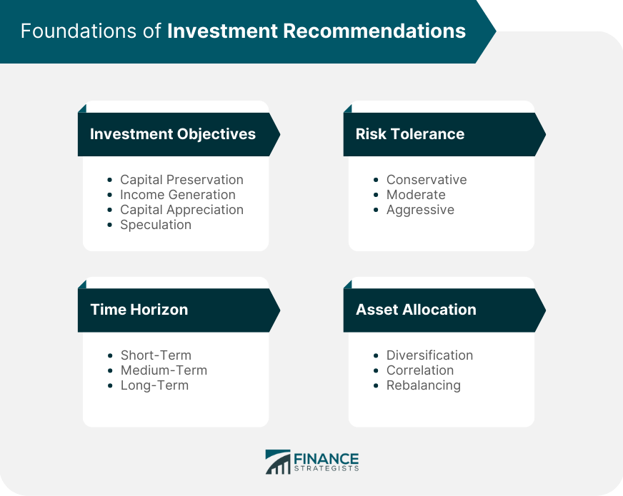
Investment Recommendation
Recommendation: HOLD / LONG-TERM BUY
Tesco has good financial strength and steady revenue growth.
Competitive retail conditions are not impacting profitability.
Dividend growth makes a company more attractive to shareholders.
It is advisable for investors to watch the risks of margins and competition (Grewal et al., 2025).
Notes:
From the financial analysis, Tesco is a relatively stable investment opportunity. The long-term prospects for the retail sector can be considered positive due to the strong fundamentals, but potential investors should be aware of the risks associated with the retail sector (Grewal et al., 2025).

Slide 20

Conclusion
Tesco has shown steady growth in its revenues and a sound market position.
According to ratio analysis, profitability has been stable, and operations and liquidity are still good.
Rising dividends and favourable EPS performance help in delivering shareholder value.
Tesco continues to be a financially sound organisation with a long project lifespan.
Notes:
The study expands on Tesco's financial standing, for them to be able to operate effectively and provide good returns to shareholders and a meaningful advantage. As for challenges, there are many, but the company is able to stay resilient and seems impressive in terms of future growth.

Slide 21
Reference
Abdullah, A. and Muchran, M., 2026. Dividend policy and its impact on financial performance and corporate social responsibility: A literature study. Journal Social Society, 6(1), pp.519-528.https://pusdig.my.id/jss/article/view/1025
Broekhuizen, T., Nguyen, D.K. and Fabian, N.E., 2024. A strategic innovation perspective on digital transformation: the example of small and medium enterprises. In A Research Agenda for Digital Transformation (pp. 11-44). Edward Elgar Publishing.https://www.elgaronline.com/edcollchap/book/9781035306435/book-part-9781035306435-7.xml
Dymitrowski, A. and Szillat, P., 2026. 2 Defining the Business Model. Strategic Inter-Organizational Relationships: The Impact of the Relational Business Model on Resilience and Sustainability, p.2.https://books.google.com/books?hl=en&lr=&id=uxrHEQAAQBAJ&oi=fnd&pg=RA1-PA1991&dq=Teece,+D.J.+(2022)+%E2%80%98Business+models,+business+strategy+and+innovation%E2%80%99,+Long+R&ots=oypEH7A7hU&sig=vJ0X0tQxGfnxS_7rCHP1A_geHc8
Grewal, D., Guha, A., Beccacece Satornino, C. and Becker, M., 2025. The future of marketing and marketing education. Journal of Marketing Education, 47(1), pp.61-77.https://journals.sagepub.com/doi/pdf/10.1177/02734753241269838
Hasidi, M.H., Baheri, J. and Hajar, K.I., 2024. Financial performance evaluation using profitability and liquidity ratio analysis. Jurnal Ilmiah Manajemen Kesatuan, 12(4), pp.1347-1358.https://pdfs.semanticscholar.org/b6db/13d72f9e39e0d2030f6d9613c7165cb8adc4.pdf
Kim, A., Muhn, M. and Nikolaev, V., 2024. Financial statement analysis with large language models. arXiv preprint arXiv:2407.17866.https://rotmandigital.ca/wp-content/uploads/2025/01/Financial-Statement-Analysis-with-Large-Language-Models.pdf
Li, K., 2024. Liquidity ratios and corporate failures. Accounting & Finance, 64(1), pp.1111-1134.https://onlinelibrary.wiley.com/doi/abs/10.1111/acfi.13174
Moolkham, M., Petchchedchoo, P., Kumsuprom, S. and Panmanee, P., 2025. Digital transformation, financial efficiency, financial effectiveness and firm values. KKBS Journal of Business Administration and Accountancy, 9(3), pp.21-38.https://so04.tci-thaijo.org/index.php/kkbsjournal/article/download/278963/190886
Nasution, Y.A. and Yusleny, Y., 2023, February. Financial Performance Measurement Using Profitability Ratios And Liquidity Ratios. In Proceeding Medan International Conference on Economic and Business (Vol. 1, pp. 1730-1741).https://proceeding.umsu.ac.id/index.php/Miceb/article/download/282/303
Oh, K., Jeong, E. and Yoo, H., 2023. Effects of working capital management on small and medium-sized enterprises' profitability from the continuity of supply chain relationships. Global Business & Finance Review (GBFR), 28(5), pp.51-66.https://www.econstor.eu/bitstream/10419/305917/1/id554.pdf
Notes:
Abdullah, A. and Muchran, M., 2026. Dividend policy and its impact on financial performance and corporate social responsibility: A literature study. Journal Social Society, 6(1), pp.519-528.https://pusdig.my.id/jss/article/view/1025
Broekhuizen, T., Nguyen, D.K. and Fabian, N.E., 2024. A strategic innovation perspective on digital transformation: the example of small and medium enterprises. In A Research Agenda for Digital Transformation (pp. 11-44). Edward Elgar Publishing.https://www.elgaronline.com/edcollchap/book/9781035306435/book-part-9781035306435-7.xml
Dymitrowski, A. and Szillat, P., 2026. 2 Defining the Business Model. Strategic Inter-Organizational Relationships: The Impact of the Relational Business Model on Resilience and Sustainability, p.2.https://books.google.com/books?hl=en&lr=&id=uxrHEQAAQBAJ&oi=fnd&pg=RA1-PA1991&dq=Teece,+D.J.+(2022)+%E2%80%98Business+models,+business+strategy+and+innovation%E2%80%99,+Long+R&ots=oypEH7A7hU&sig=vJ0X0tQxGfnxS_7rCHP1A_geHc8
Grewal, D., Guha, A., Beccacece Satornino, C. and Becker, M., 2025. The future of marketing and marketing education. Journal of Marketing Education, 47(1), pp.61-77.https://journals.sagepub.com/doi/pdf/10.1177/02734753241269838
Hasidi, M.H., Baheri, J. and Hajar, K.I., 2024. Financial performance evaluation using profitability and liquidity ratio analysis. Jurnal Ilmiah Manajemen Kesatuan, 12(4), pp.1347-1358.https://pdfs.semanticscholar.org/b6db/13d72f9e39e0d2030f6d9613c7165cb8adc4.pdf
Kim, A., Muhn, M. and Nikolaev, V., 2024. Financial statement analysis with large language models. arXiv preprint arXiv:2407.17866.https://rotmandigital.ca/wp-content/uploads/2025/01/Financial-Statement-Analysis-with-Large-Language-Models.pdf
Li, K., 2024. Liquidity ratios and corporate failures. Accounting & Finance, 64(1), pp.1111-1134.https://onlinelibrary.wiley.com/doi/abs/10.1111/acfi.13174
Moolkham, M., Petchchedchoo, P., Kumsuprom, S. and Panmanee, P., 2025. Digital transformation, financial efficiency, financial effectiveness and firm values. KKBS Journal of Business Administration and Accountancy, 9(3), pp.21-38.https://so04.tci-thaijo.org/index.php/kkbsjournal/article/download/278963/190886
Nasution, Y.A. and Yusleny, Y., 2023, February. Financial Performance Measurement Using Profitability Ratios And Liquidity Ratios. In Proceeding Medan International Conference on Economic and Business (Vol. 1, pp. 1730-1741).https://proceeding.umsu.ac.id/index.php/Miceb/article/download/282/303
Oh, K., Jeong, E. and Yoo, H., 2023. Effects of working capital management on small and medium-sized enterprises' profitability from the continuity of supply chain relationships. Global Business & Finance Review (GBFR), 28(5), pp.51-66.https://www.econstor.eu/bitstream/10419/305917/1/id554.pdf

Slide 22
Reference
Ortner, T., Hautz, J., Stadler, C. and Matzler, K., 2025. Open strategy and digital transformation: A framework and future research agenda. International Journal of Management Reviews, 27(3), pp.324-345.https://onlinelibrary.wiley.com/doi/pdf/10.1111/ijmr.12379
Pal, A. and Ukil, A., 2025. An Empirical Study on the Relationship of Profitability and Liquidity Management of some select Listed Oil Companies in India. Journal of Academic Advancement, 4(02), pp.41-46.https://jaa.kbsaa.org/index.php/j/article/download/84/72
Putri, B.M. and Ardiyani, K., 2026. The Effect Of Good Corporate Governance On Financial Performance With Intellectual Capital As A Moderator (An Empirical Study Of Banking Subsector Companies Listed On The Indonesia Stock Exchange From 2021 To 2024). Citizen: Jurnal Ilmiah Multidisiplin Indonesia, 6, pp.22-39.https://journal.das-institute.com/index.php/citizen-journal/article/download/1447/909
Salah, A., Çağlar, D. and Zoubi, K., 2023. The impact of production and operations management practices in improving organizational performance: The mediating role of supply chain integration. Sustainability, 15(20), p.15140.https://www.mdpi.com/2071-1050/15/20/15140
Sany, S. and Yonatan, N., 2023. Liquidity and Profitability of Retail Companies: Evidence from Indonesia. International Journal of Organizational Behavior and Policy, 2(2), pp.77-86.https://ijobp.petra.ac.id/index.php/ijobp/article/download/115/108
Tesco PLC., 2025. Annual Report and Financial Statements 2025.https://www.tescoplc.com/investors/reports-results-and-presentations/annual-report-2025
Tran, N.T., Le, N.T. and Nguyen, T.D., 2025. Corporate Social Responsibility Disclosure and Financial Performance: Empirical Evidence From Vietnam. Economic and Business Review, 27(3), pp.141-159.https://www.ebrjournal.net/cgi/viewcontent.cgi?article=1357&context=home
Tran, T.T.H. and Dang, N.H., 2026. A META-ANALYTIC REVIEW OF THE IMPACT OF FINANCIAL REPORTING QUALITY ON FIRM VALUE AND PERFORMANCE: EVIDENCE FROM SYSTEMATIC LITERATURE SYNTHESIS.https://www.researchgate.net/profile/Dang-Hung-2/publication/404322807_A_META-ANALYTIC_REVIEW_OF_THE_IMPACT_OF_FINANCIAL_REPORTING_QUALITY_ON_FIRM_VALUE_AND_PERFORMANCE_EVIDENCE_FROM_SYSTEMATIC_LITERATURE_SYNTHESIS/links/69f3f3f9b1dace04f143c712/A-meta-analytic-review-of-the-impact-of-financial-reporting-quality-on-firm-value-and-performance-Evidence-from-systematic-literature-synthesis.pdf
Umam, F. and Damayanti, S.M., 2023. The Role of Financial Ratios on Optimizing Company Performance At PT Angkasa Pura Retail. Journal of Economics and Business UBS, 12(2), pp.689-707.https://jurnal.ubs-usg.ac.id/index.php/joeb/article/download/137/369
Wibowo, F.A., Satria, A., Gaol, S.L. and Indrawan, D., 2024. Uncovering Financial Performance and Efficiency: A Glimpse into Indonesia's State-Owned Enterprises (SOEs) Construction Industry Debt and Financial Risk.https://www.preprints.org/frontend/manuscript/68ae6c3c0a1ab7cfabf33a93c5fb4da7/download_pub
Notes:
Ortner, T., Hautz, J., Stadler, C. and Matzler, K., 2025. Open strategy and digital transformation: A framework and future research agenda. International Journal of Management Reviews, 27(3), pp.324-345.https://onlinelibrary.wiley.com/doi/pdf/10.1111/ijmr.12379
Pal, A. and Ukil, A., 2025. An Empirical Study on the Relationship of Profitability and Liquidity Management of some select Listed Oil Companies in India. Journal of Academic Advancement, 4(02), pp.41-46.https://jaa.kbsaa.org/index.php/j/article/download/84/72
Putri, B.M. and Ardiyani, K., 2026. The Effect Of Good Corporate Governance On Financial Performance With Intellectual Capital As A Moderator (An Empirical Study Of Banking Subsector Companies Listed On The Indonesia Stock Exchange From 2021 To 2024). Citizen: Jurnal Ilmiah Multidisiplin Indonesia, 6, pp.22-39.https://journal.das-institute.com/index.php/citizen-journal/article/download/1447/909
Salah, A., Çağlar, D. and Zoubi, K., 2023. The impact of production and operations management practices in improving organizational performance: The mediating role of supply chain integration. Sustainability, 15(20), p.15140.https://www.mdpi.com/2071-1050/15/20/15140
Sany, S. and Yonatan, N., 2023. Liquidity and Profitability of Retail Companies: Evidence from Indonesia. International Journal of Organizational Behavior and Policy, 2(2), pp.77-86.https://ijobp.petra.ac.id/index.php/ijobp/article/download/115/108
Tesco PLC., 2025. Annual Report and Financial Statements 2025.https://www.tescoplc.com/investors/reports-results-and-presentations/annual-report-2025
Tran, N.T., Le, N.T. and Nguyen, T.D., 2025. Corporate Social Responsibility Disclosure and Financial Performance: Empirical Evidence From Vietnam. Economic and Business Review, 27(3), pp.141-159.https://www.ebrjournal.net/cgi/viewcontent.cgi?article=1357&context=home
Tran, T.T.H. and Dang, N.H., 2026. A META-ANALYTIC REVIEW OF THE IMPACT OF FINANCIAL REPORTING QUALITY ON FIRM VALUE AND PERFORMANCE: EVIDENCE FROM SYSTEMATIC LITERATURE SYNTHESIS.https://www.researchgate.net/profile/Dang-Hung-2/publication/404322807_A_META-ANALYTIC_REVIEW_OF_THE_IMPACT_OF_FINANCIAL_REPORTING_QUALITY_ON_FIRM_VALUE_AND_PERFORMANCE_EVIDENCE_FROM_SYSTEMATIC_LITERATURE_SYNTHESIS/links/69f3f3f9b1dace04f143c712/A-meta-analytic-review-of-the-impact-of-financial-reporting-quality-on-firm-value-and-performance-Evidence-from-systematic-literature-synthesis.pdf
Umam, F. and Damayanti, S.M., 2023. The Role of Financial Ratios on Optimizing Company Performance At PT Angkasa Pura Retail. Journal of Economics and Business UBS, 12(2), pp.689-707.https://jurnal.ubs-usg.ac.id/index.php/joeb/article/download/137/369
Wibowo, F.A., Satria, A., Gaol, S.L. and Indrawan, D., 2024. Uncovering Financial Performance and Efficiency: A Glimpse into Indonesia's State-Owned Enterprises (SOEs) Construction Industry Debt and Financial Risk.https://www.preprints.org/frontend/manuscript/68ae6c3c0a1ab7cfabf33a93c5fb4da7/download_pub

Slide 23
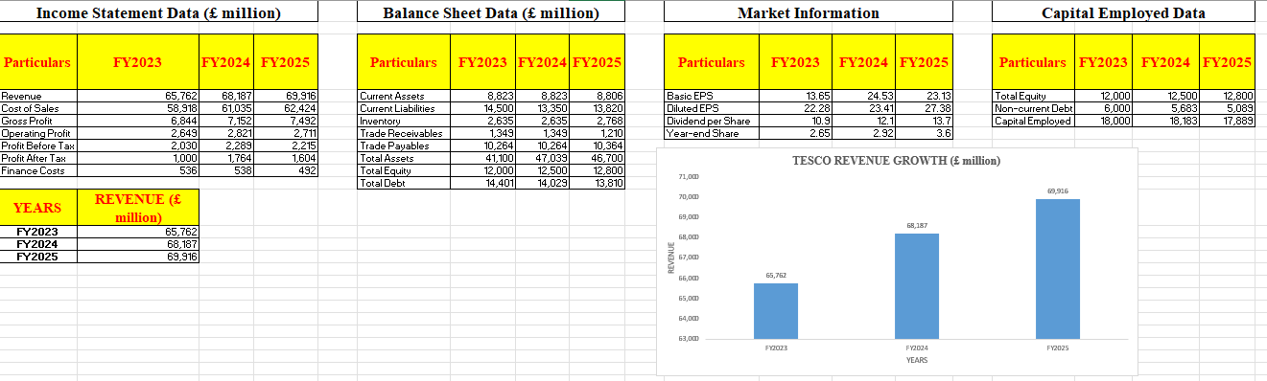
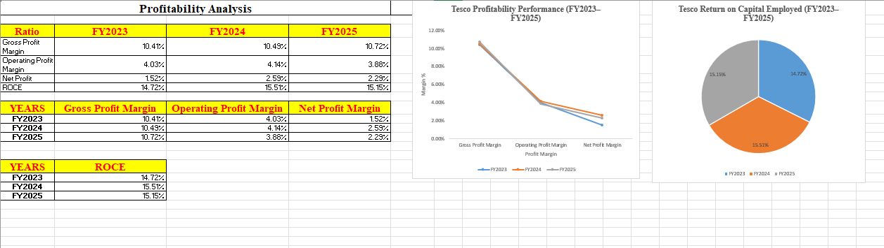
Appendix

Slide 24
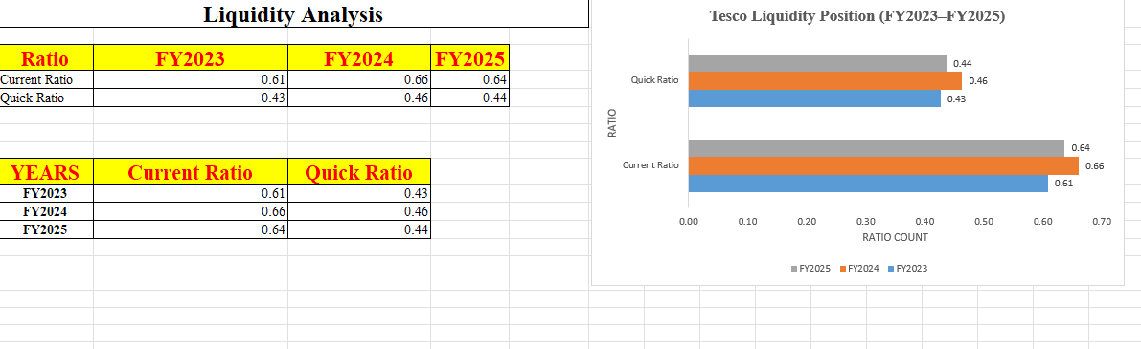
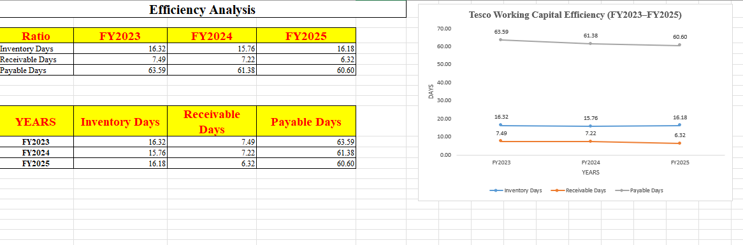
Appendix

Slide 25
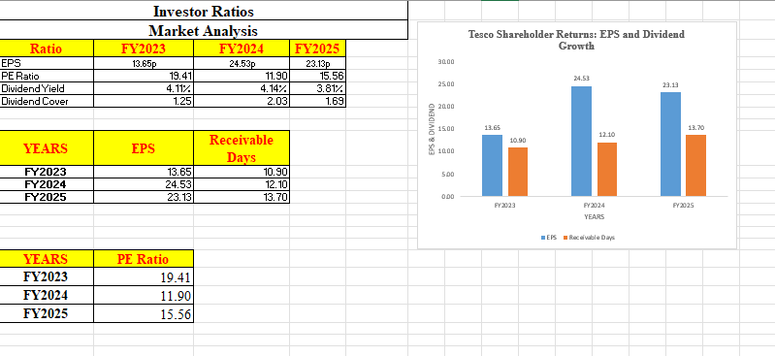
Appendix

Slide 26
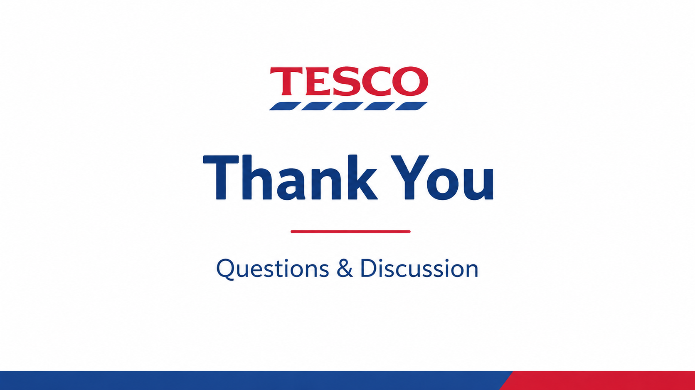
Notes:
Thank You!!!

