Slide 1
Bath Spa University London
BMAF010-20 Assessment Submission Form
Name | Elaine Silva
Student ID | 618549
Date of Submission
Word Count
Ethics Statements In completing this section and submitting this assignment to TURNITIN you are confirming that you have read and understood the regulations regarding ethics and assessment and are aware of the seriousness with which the University regards unfair practice.
I have anonymised student names in evidence/writing | Yes
I understand my ethical responsibilities regarding my assignments | Yes
I have read and understood BSU’s policy on Academic Misconduct www.bathspa.ac.uk/about-us/governance/policies/academic-misconduct/ | Yes
I have used AI tools in assignments If yes, please mention which part: | No

Slide 2
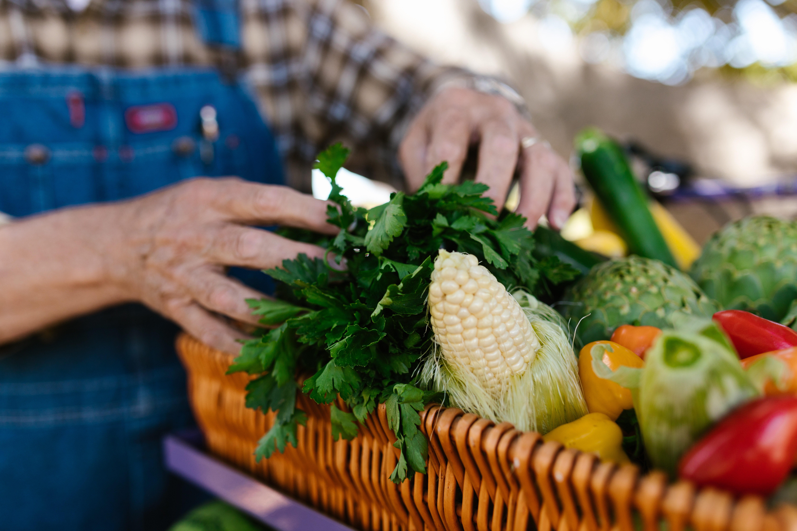
Designing a Circular Food Waste Solution for a Sustainable Bath

Slide 3
Agenda
Introduction
Empathy: Stakeholder Needs
Problem Definition Along with HMW
Ideation: From One Problem to Multiple Solutions
Solution Selection: Bath Food Circular Network
Prototype
Model Testing and Lessons Learned
Iteration: Prototype 1 → Prototype 2
Better Future State
Conclusion
References

Slide 4

Introduction
Bath Foodbank has serious food wastage in households, hospitality, retail, universities and community organisations (Bath and North East Somerset Council, 2026).
The difficulty creates environmental, economic, social, and operational impacts for stakeholders.
The Bath Food Circular Network suggests organising prevention, redistribution and community involvement.
Bath Foodbank needs an integrated solution that links suppliers to communities, decreases unnecessary fridge food waste, and promotes sustainable consumption and local resilience.

Slide 5
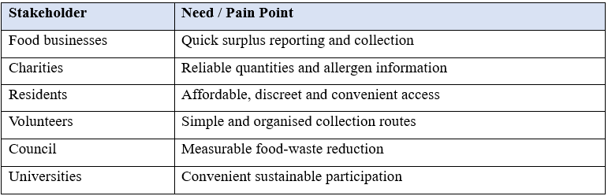
Empathy: Stakeholder Needs
Empathy determines various needs among the stakeholders in the food system of Bath. This includes speed among businesses, reliability among charities, accessibility among residents, and handy collection infrastructure among volunteers (Hess, 2024). Councils need tangible performance, and colleges need easy involvement. These variations imply that effective design will need to synchronise the needs of stakeholders and not provide a single generic intervention.

Slide 6
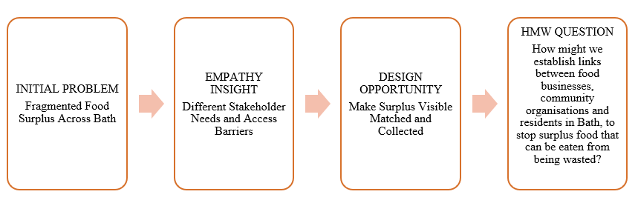
Problem Definition Along with HMW
Fragmented food surplus was identified throughout Bath stakeholders and locations during the initial analysis (Kauppinen, and Silvasti, 2026).
Empathy brought out various needs that would demand redistribution arrangements (the need to be coordinated and made available in the local area).
The design opportunity focuses on aligning excess to the right beneficiaries.
The first issue established itself in the form of widespread food waste in various places and among stakeholders. Operational and access needs were identified in empathy analysis (Koutsofta, Dimitriadou, and Karanikola, 2025). The design opportunity is thus concerned with visibility, quick matching and coordinated collection. The HMW question gives a local-centric, human, and prototype-focused guidance in favour of prevention, redistribution and quantifiable future results.
HMW: How might we establish links between food businesses, community organisations and residents in Bath, to stop surplus food that can be eaten from being wasted?

Slide 7
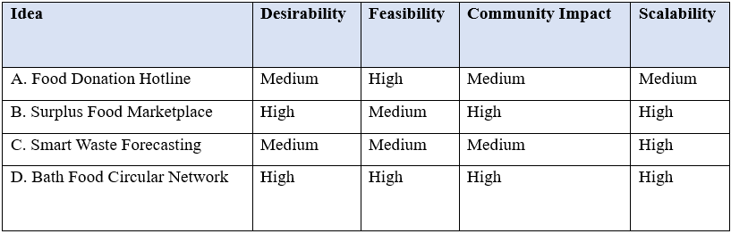
Ideation: From One Problem to Multiple Solutions
Idea Comparison Table
Four alternatives were derived and evaluated on the basis of desirability, feasibility, communal impact and scalability criteria.
Best overall alignment was Bath Food Circular Network.
The comparison provided systematic selection balancing between the needs of stakeholders, realistic implementation, benefits to the community, the prospects of long-term growth, and measurable results.
Uniform criteria evaluated the four options; the Bath Food Circular Network presented the best balance between practical implementation, stakeholder value, benefits to the community and the possibility of being widely adopted (Gandhi et al., 2026).

Slide 8
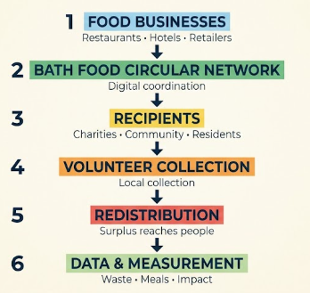
Solution Selection: Bath Food Circular Network
The network incorporates prevention, redistribution, community involvement, and visible results in a single organised local network.
It involves different stakeholders as opposed to commercial surplus transactions, unlike marketplaces (Wu et al., 2024).
This combined method enhances access, builds on partnerships, fosters inclusive involvement, and allows tracking the environmental, social and economic benefits continuously.
The network was chosen due to its focus on a solution to food waste prior to discarding, redistributing it, engaging communities, and measuring outcomes. It has broader coordination than commercial surplus marketplaces like Too Good To Go.

Slide 9
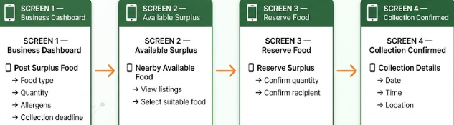
Prototype
Its prototype develops a simple digital-first, provider-to-recipients system that bridges surplus providers and recipients.
Food type and quantity, allergens, and collection deadlines are recorded in business dashboards.
There is a list of available surplus food so that appropriate recipients can book available food.
Collection confirmation offers specified destinations, dates and collection arrangements.
There is inclusive access by community hubs, telephone help, and volunteers.
The prototype converts the network suggested into a service journey to practice (Hyvärinen, 2025). Businesses upload excess information, and the recipients find appropriate food and make reservations. Collection information links up the recipients and volunteers. The issue of digital exclusion is solved by community hubs and telephone support, so that users who have a limited connection, language barrier or lower digital confidence can also participate. This develops a digital-first and not digital-only model.
Wider service: Digital Platform + Community Hubs + Telephone Support + Volunteers

Slide 10
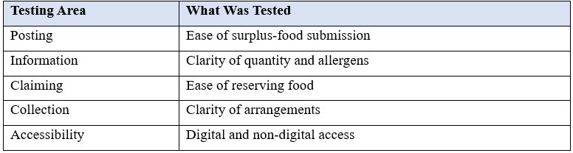
Model Testing and Lessons Learned
The students, residents, hospitality workers, volunteers, and representatives of the community were tested.
Participants rated posting, information readability, food claiming, collection and access (Lee et al., 2024).
Testing established the clarity of allergen information and the deadlines for collection as the priorities.
The physical presence was necessary to ensure that all stakeholders take part.
Only actual findings of participants should be reported in terms of testing. The participants evaluated the prototype journey and found out the usability requirements.
The major findings will be how well information was comprehended, how convenient the reservation was, and how feasible the collection process was. Accessibility barriers need to be identified and incorporated directly into the response of a later prototype and iteration decision.

Slide 11
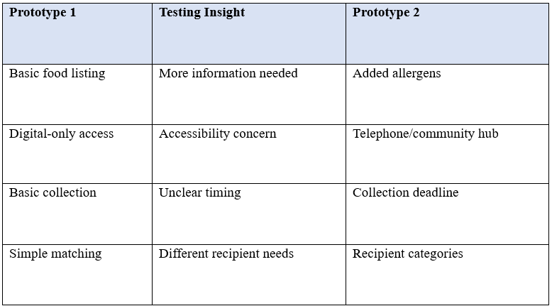
Iteration: Prototype 1 → Prototype 2
The prototype offered simple listings, basic matching, details of collections and digital access (Zhou, and Wang, 2024).
The information gaps, access issues, time uncertainty, and recipient differences were identified through testing.
In the second prototype, we included allergens that are dead, recipient types, telephone support, and community hubs.
Directly informing particular design changes in the prototype was based on testing.
The second prototype was a direct result of testing findings. Further information on allergens made things clearer, the collection deadline minimised uncertainty, recipient type met various needs, and it was available in non-digital format, making it more accessible.
As these changes show, there has been a distinct process of moving past initial assumptions to a more inclusive and coordinated design of services.
Comparison Table

Slide 12
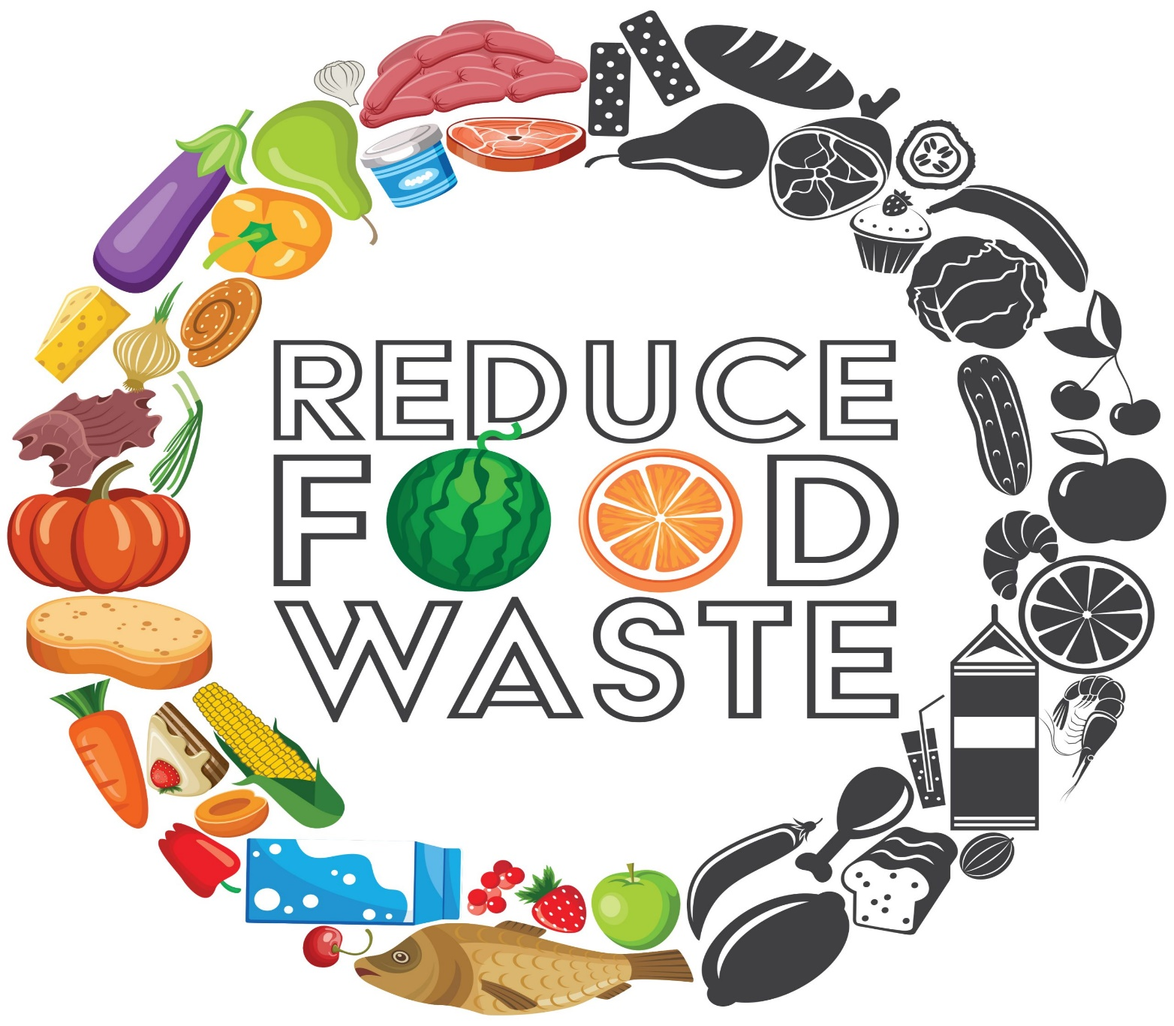
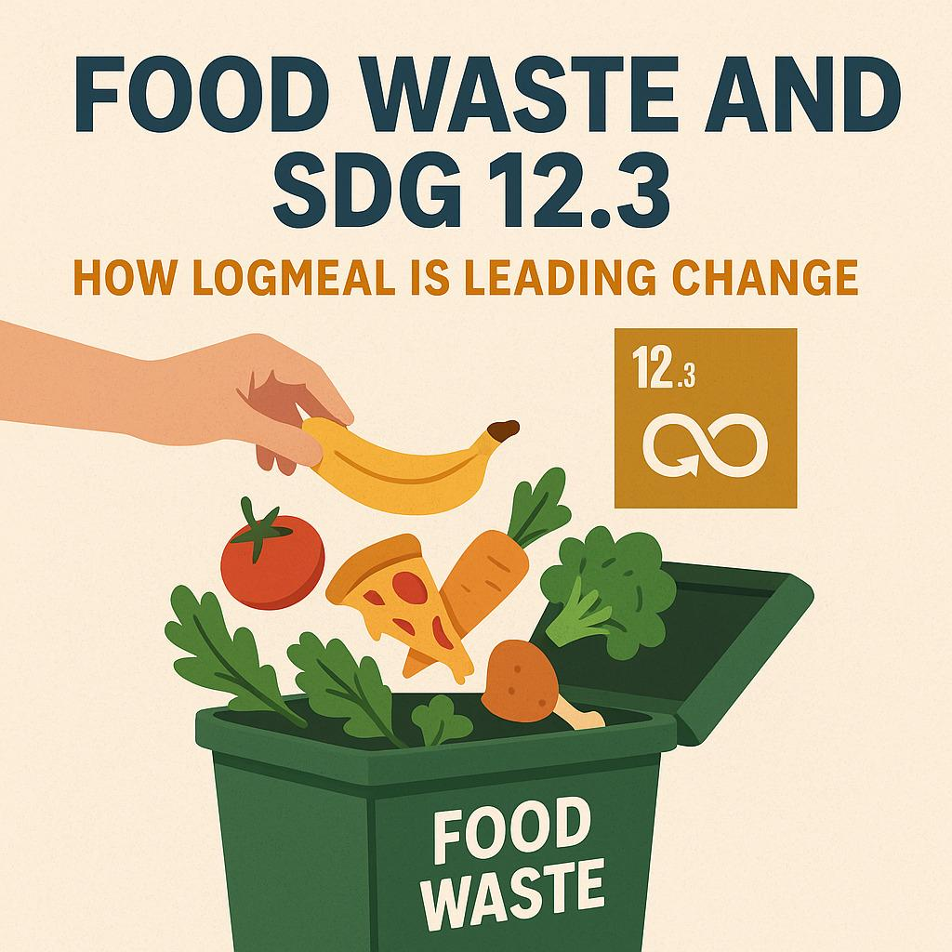
Better Future State
The present state: Excess to disaster, fragmented communication, lack of redistribution, waste.
Future state: Excess was found, matched, collected, repurchased, and measured.
The network builds coordinated prevention, redistribution, alignment, and quantifiable value, which promotes SDG 12.3 (Kontaki et al., 2026).
The future condition makes the uncoordinated, undiluted food-waste activity a harmonised act. Overabundance comes to view, appropriate beneficiaries are located, collections are arranged, food is re-circulated, and results are measured through environmental, social and economic domains.

Slide 13
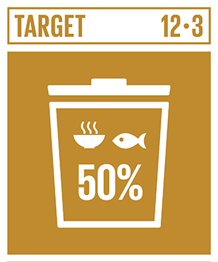
Conclusion
The food waste in Bath needs to be prevented, redistributed, made accessible, and stakeholders' input should be assessed.
The network creates a viable avenue towards sustainable local food management.
The network proposed will have stakeholders connected, surplus redistribution enhanced, avoidable waste lowered, facilitated inclusion, and a sustainable food future for Bath.

Slide 14
References
Bath and North East Somerset Council (2026). Every home in B&NES offered food waste collection. Available at: https://newsroom.bathnes.gov.uk/news/every-home-bnes- offered-food-waste-collection (Accessed on: 20th August 2026).
Gandhi, M., Pizzo, A., Schmid, A., Froes, I., Jaeger‐Erben, M., Altsitsiadis, E. and Reisch, L.A. (2026) Food System Through the Lens of a Circular Society: A Transdisciplinary Approach to Integrating Literature and Practice. Business Strategy and the Environment. https://doi.org/10.1002/bse.71087
Hess, J.L. (2024) Empathy’s role in engineering ethics: Empathizing with one’s self to others across the globe. Science and Engineering Ethics, 30(6), p.57. https://doi.org/10.1007/s11948-024-00512-1
Hyvärinen, J. (2025) Prototyping for service. Collaborative, transformative and translational practice. https://aaltodoc.aalto.fi/bitstreams/cb141154-a9e3-4c2d-9dad-1d04e2202504/download
Kauppinen, V. and Silvasti, T. (2026) Role of food waste as a resource of power: an ethnographic case study of food aid restructuring. Journal of Organizational Ethnography, 15(1), pp.25-39. https://doi.org/10.1108/JOE-01-2025-0002

Slide 15
References (Continue…)
Kontaki, I., Garefalakis, A., Passas, I. and Samaras, I. (2026) Implementing a Circular Economy Approach to Prevent Food Waste: A Comprehensive Synthesis of Strategies, Metrics, and Systemic Deficiencies. Journal of Sustainability Research, 8(3). https://doi.org/10.20900/jsr20260071
Koutsofta, C., Dimitriadou, M. and Karanikola, M., 2025, May. “Divergent needs and the empathy gap”: exploring the experience of workplace violence against nurses employed in the emergency department. In Healthcare (Vol. 13, No. 10, p. 1118). MDPI. https://doi.org/10.3390/healthcare13101118
Lee, S., Jang, J., Niehm, L. and Kim, M. (2024) The role of festival volunteers in supporting rural community development: a psychological ownership perspective. Current Issues in Tourism, 27(23), pp.4220-4241. https://doi.org/10.1080/13683500.2023.2280163
Wu, J., Wang, X., Ramkissoon, H., Wu, M.Y., Guo, Y. and Morrison, A.M. (2024) Resource mobilization and power redistribution: The role of local governments in shaping residents’ pro-environmental behavior in rural tourism destinations. Journal of Travel Research, 63(6), pp.1442-1458. https://doi.org/10.1177/00472875231191983
Zhou, T. and Wang, W. (2024) Prototype-based semantic segmentation. IEEE Transactions on Pattern Analysis and Machine Intelligence, 46(10), pp.6858-6872. https://doi.org/10.1109/TPAMI.2024.3387116

Slide 16


