Slide 1
People Analytics and Value Creation: A Case Study of Tesco plc
Analysing How Workforce Data Supports Strategic HR Decision-Making, Organisational Agility and Stakeholder Value
Notes:
Welcome!
The aim of this presentation is to analyse the situation of people analytics for better workforce management to add value to Tesco plc. It examines the role employee information plays in HR functions and decision-making, as well as in organisational agility and competitiveness. Stakeholder benefits, as well as any ethical risks of workforce information use, are also taken into account.

Slide 2
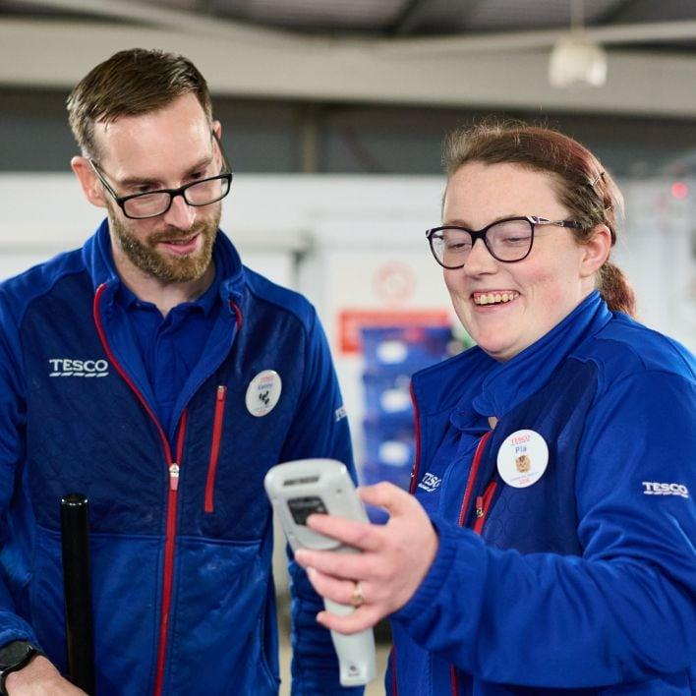
Introduction: Tesco and People Analytics
One of the largest retail organisations in the UK is Tesco plc (Tesco plc, 2025).
They have a varied staff structure at various stores and within logistics and corporate operations.
The skill of the employees directly affects customer experiences and the performance of operations.
People analytics is about turning workforce data into action.
HR decision-making is supported by data.
Notes:
As a Highly Competitive Retail Sector, Tesco needs effective workforce management. Using people analytics, Tesco can gain insight into employee behaviour, trends in the workforce and refine HR practices. The organisation makes informed choices about their workforce, informed by employee data, to help meet business goals and improve employee experiences (Tesco plc, 2025).

Slide 3
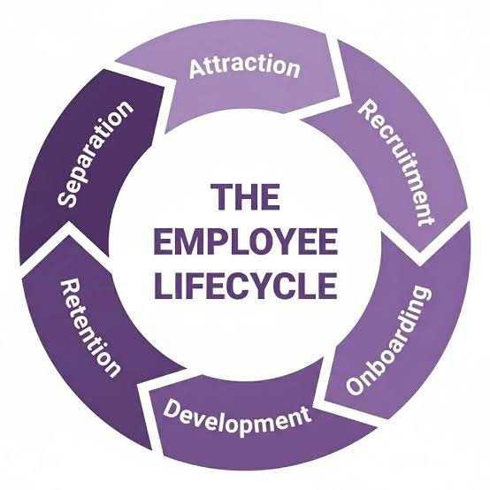
People Analytics Across the Employee Lifecycle
There are a number of different employee lifecycle stages that analytics can support.
Recruitment data enhances talent acquisition decisions.
Engagement insights make it easier to determine how satisfied employees are.
Learning Data helps strengthen employees.
Retention analytics is a strategy for determining risks in your workforce (Suri and Lakhanpal, 2024).
Notes:
Tesco uses people analytics in every phase of a person's career, from hiring to staying on board. Human resource information can help HR managers to identify employee needs and design appropriate interventions (Suri and Lakhanpal, 2024). The importance of analytics lies in the fact that it enables Tesco to shift from traditional to proactive HR practice from traditional practice and ensures that it is able to find the issues that can impact the organisation's performance beforehand.

Slide 4
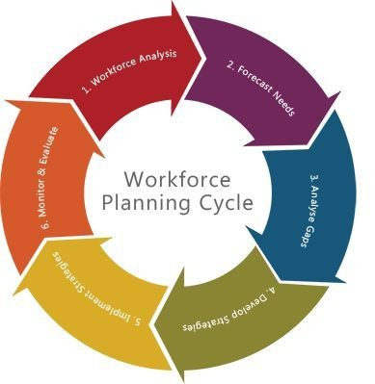
Recruitment and Workforce Planning Analytics
Information about the workforce is used to determine staffing needs.
With recruitment analytics, you are able to assess the success of hiring.
Seasonal workforce plans Data to support.
Using skill analysis to determine future workforce needs (Goswami and Mansi, 2025).
Insights help better allocate staff among operations.
Notes:
With workforce analytics supporting recruitment and workforce planning decisions, Tesco is prepared to handle the future workforce. Data offers insight on staffing needs, staff availability and, of course, varying demands on operations (Goswami and Mansi, 2025). This will help HR to refine their recruitment approach and better reuse their staff. But workforce planning needs to be ongoing as retail needs change regularly.

Slide 5
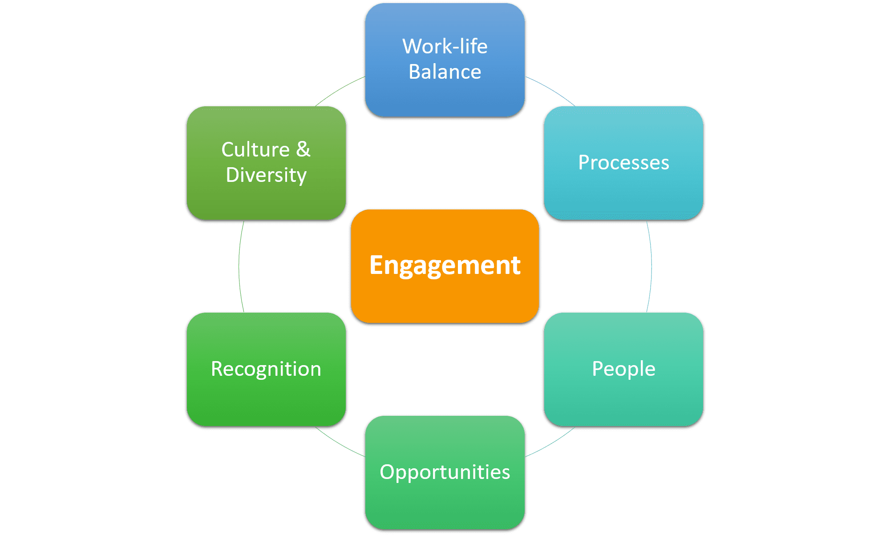
Employee Engagement and Performance Analytics
Employee surveys are one way to gain data regarding the engagement of employees.
Development opportunities are identified using performance data.
Learning analytics is the assessment of the effectiveness of training (Yoon et al., 2024).
Employee retention is supported with workforce insights.
The data is used to enhance the employee experience by managers.
Notes:
Tesco uses employee engagement and performance analytics to gain insight into employee experience and development needs. Employees can give feedback, and this information is helpful for understanding employee motivation, satisfaction with working at the company, and its culture (Yoon et al., 2024). While analytics may enhance decision-making, the behaviour of the employee is complex and numerical indications need to be mixed with managerial judgments.

Slide 6
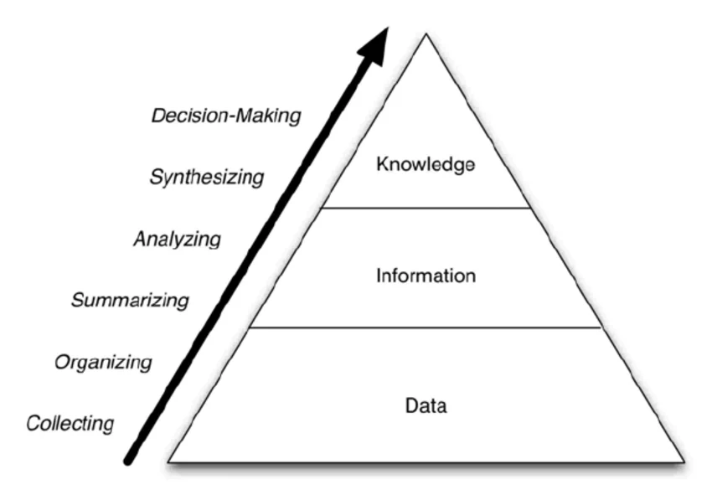
Transforming Data into Information and Knowledge
Employee Data
Engagement scores
Turnover information
Attendance records
Training participation
↓
Information
The nature or trends of employment
↓
Knowledge
Understanding employee issues
↓
Decision
Improved HR strategies
Notes:
The added value of people analytics lies in converting the raw employee data into knowledge. Tesco gathers information about the workforce and the patterns to identify key issues. These insights enable managers to gain a sense of employee issues and construct proper resolutions. Thus, analytics helps to make evidence-based decisions instead of merely making assumptions.

Slide 7
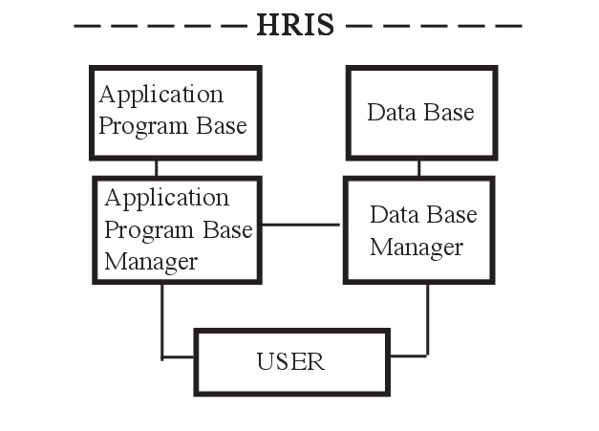
HR Information Systems and Decision Support
HR systems gather and build out employee data.
Digital platforms help to enhance reporting accuracy (Soares et al., 2022).
Use dashboards to gain visibility into your workforce.
Based on data, HR is able to make educated decisions.
Information systems are aligned with HR activities and business goals.
Notes:
Tesco's people analytics function is crucial for HR information systems to be effective. These systems enable data on employees to be gathered, evaluated and displayed in valuable ways. Force workforce dashboards can be used by managers for identifying trends and making decisions (Soares et al., 2022). But the analytical advantage stems from quality information and the ability to do responsible analysis.

Slide 8
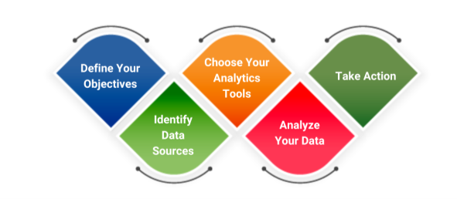
People Analytics and Value Creation
Recognises the challenges and opportunities of the workforce.
Helps with retaining employees.
Enhances workforce productivity.
Links work behaviours to organisational goals.
A solution for effective workforce management to enhance customer service (Bonilla-Chaves and Palos-Sánchez, 2023).
Notes:
People analytics makes an impact when connecting employee data with organisational outcomes. Tesco leverages workforce data to enhance retention, productivity and the quality of their service (Bonilla-Chaves and Palos-Sánchez, 2023). Having employees under management is directly related to the performance of the business, as they are the ones influencing the satisfaction of the customer and their motivation and capacity. But only when analytics drives tangible human resources activities.

Slide 9
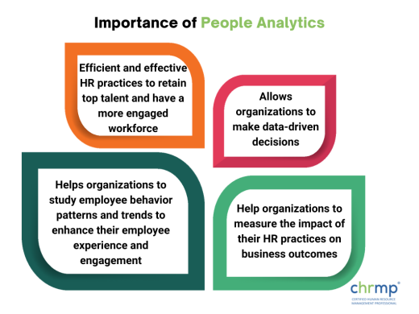
Organisational Agility Through People Analytics
Facilitates quicker provision of workforce decisions.
Recognises employees' changing needs.
Improves workforce flexibility.
Supports change in the marketplace.
Facilitates efficient resource utilisation (Vadithe and Kesari, 2025).
Notes:
Retail organisations have to be reactive towards the customers' expectations and market dynamics. People analytics helps Tesco to be more agile as an organisation by giving insights on workforce capability and availability (Vadithe and Kesari, 2025). The data provides managers with valuable insights to make effective workforce adjustments. Analytics must complement and not supersede human decision-making.

Slide 10
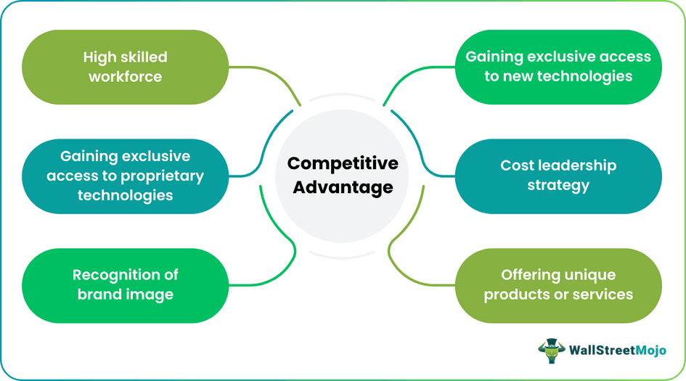
Competitive Advantage Through People Analytics
Improves talent management practices.
Increases staff retention and engagement.
Implements innovation through workforce capability.
Enhances operational effectiveness.
Makes strategic use of human resources (Suri and Lakhanpal, 2024).
Notes:
Without a doubt, people analytics, it helps Tesco improve how human resources manage and increase the competitiveness of the company. Knowing what employees want can help organisations make better hiring choices and help build employee skills (Suri and Lakhanpal, 2024). People practices that impact the customer experience and the way people work are important levers of organisational advantage.

Slide 11
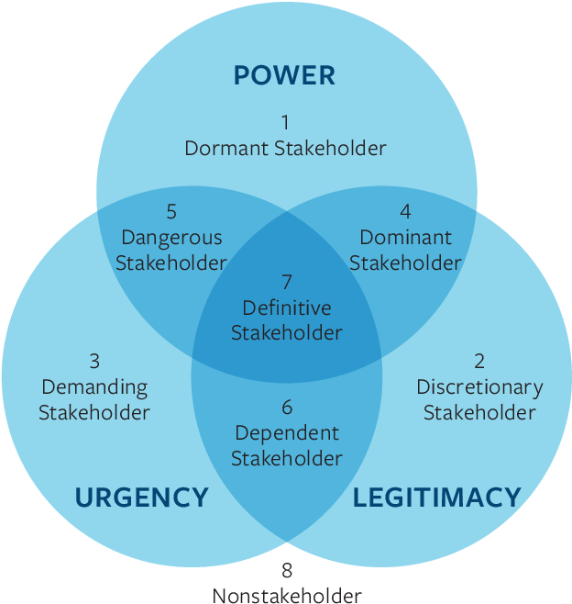
Stakeholder Value Creation
Stakeholder | Value Created
Employees | Development and improved experience
Managers | Better workforce decisions
Customers | Improved service quality
Organisation | Productivity and retention
Investors | Sustainable performance
Notes:
People analytics adds value to various stakeholders in Tesco. Staff enjoy better opportunities for training and work practices, managers get better assistance in making decisions. Effective management of the workforce leads to better customer service (Margherita, 2022). Enhanced organisational performance for investors. But this requires the use of data to be responsible, meaning that stakeholders must trust it.

Slide 12

Risks and Mitigation
Risks
Employee privacy concerns
Data security challenges
Algorithmic bias
Overdependence on analytics
Mitigation
Strong data governance
Transparent processes
Ethical HR practices
Human oversight
Notes:
While there is immense value in people analytics, Tesco will need to address challenges for ethical use. To ensure trust and compliance, employee information must be protected. If data is not of a high level of quality, analytical systems can be the source of disparate results (Edwards et al., 2024). Thus, a set of governance mechanisms, with a high level of transparency and the inclusion of people, is required to make informed decisions.

Slide 13

Critical Evaluation
Using analytics can make HR decisions more evidence-based.
Data has a lot of benefits when it comes to workforce insights.
People's judgment is still decisively important.
Not everything that an employee does can be quantified.
Sustainable values are shaped by balanced approaches.
Notes:
People analytics helps Tesco to understand their staff performance and behaviour. But limiting the analysis to numbers can fail to account for individual situations and organisational complexity. By adopting a balanced approach that involves an analysis of the evidence and professional HR judgement practices, Tesco can ensure that people are managed in an effective and responsible way.

Slide 14

Conclusion
Tesco is implementing the use of people analytics to enhance decisions about the workforce.
The data on staff aids in recruitment, staff development and retention.
Competitiveness and agility through Analytics.
Workforce data still needs to be handled ethically (Tursunbayeva et al., 2022).
Notes:
The analysis illustrates how people analytics can be used to create workforce data to help Tesco make strategic decisions. It enables management of the employee lifecycle, the organisation's performance and the value created for the stakeholders (Tursunbayeva et al., 2022). For the implementation to be successful, responsible data practices have to be put in place, which must include transparency and human evaluation to make sure that analytics can be used robustly to benefit employees and the organisation.

Slide 15

Reference
Suri, N. and Lakhanpal, P., 2024. People analytics enabling HR strategic partnership: a review. South Asian Journal of Human Resources Management, 11(1), pp.130-164.https://journals.sagepub.com/doi/abs/10.1177/23220937221119599
Goswami, T.G. and Mansi, 2025. Human resource analytics: A hybrid review. South Asian Journal of Human Resources Management, p.23220937251322236.https://journals.sagepub.com/doi/abs/10.1177/23220937251322236
Yoon, S.W., Han, S.H. and Chae, C., 2024. People analytics and human resource development–research landscape and future needs based on bibliometrics and scoping review. Human Resource Development Review, 23(1), pp.30-57.https://journals.sagepub.com/doi/abs/10.1177/15344843231209362
Margherita, A., 2022. Human resources analytics: A systematization of research topics and directions for future research. Human Resource Management Review, 32(2), p.100795.https://www.sciencedirect.com/science/article/pii/S1053482220300681
Soares, V.G., Álcazar, J.J.P. and Ludena, M.E., 2022. Analytical Approaches in Human Resources-A Systematic Review. JISTEM-Journal of Information Systems and Technology Management, 19, p.e202219014.https://www.scielo.br/j/jistm/a/9xN7Sd5SSdBSphzmfZ78zqC/?format=pdf&lang=en
Bonilla-Chaves, E.F. and Palos-Sánchez, P.R., 2023. Exploring the evolution of human resource analytics: a bibliometric study. Behavioral sciences, 13(3), p.244.https://www.mdpi.com/2076-328X/13/3/244
Edwards, M.R., Charlwood, A., Guenole, N. and Marler, J., 2024. HR analytics: An emerging field finding its place in the world alongside simmering ethical challenges. Human Resource Management Journal, 34(2), pp.326-336.https://eprints.whiterose.ac.uk/id/eprint/182675/3/Intro%20to%20Special%20Issue%20Jan%202021%20Manuscript.pdf
Tesco plc, 2025. Annual Report and Financial Statements 2025.https://www.tescoplc.com/investors/reports-results-and-presentations/annual-report-2025
Tursunbayeva, A., Pagliari, C., Di Lauro, S. and Antonelli, G., 2022. The ethics of people analytics: risks, opportunities and recommendations. Personnel Review, 51(3), pp.900-921.https://www.emerald.com/pr/article-pdf/51/3/900/2154147/pr-12-2019-0680.pdf
Vadithe, R.N. and Kesari, B., 2025. Bridging the gap: how HR analytics integrates with business intelligence and integrated reporting for organizational agility. Benchmarking: An International Journal, pp.1-25.https://www.researchgate.net/profile/Rakesh-Vadithe/publication/394086567_Bridging_the_gap_how_HR_analytics_integrates_with_business_intelligence_and_integrated_reporting_for_organizational_agility/links/6888b290253dcb78df88f974/Bridging-the-gap-how-HR-analytics-integrates-with-business-intelligence-and-integrated-reporting-for-organizational-agility.pdf
Notes:
Suri, N. and Lakhanpal, P., 2024. People analytics enabling HR strategic partnership: a review. South Asian Journal of Human Resources Management, 11(1), pp.130-164.https://journals.sagepub.com/doi/abs/10.1177/23220937221119599
Goswami, T.G. and Mansi, 2025. Human resource analytics: A hybrid review. South Asian Journal of Human Resources Management, p.23220937251322236.https://journals.sagepub.com/doi/abs/10.1177/23220937251322236
Yoon, S.W., Han, S.H. and Chae, C., 2024. People analytics and human resource development–research landscape and future needs based on bibliometrics and scoping review. Human Resource Development Review, 23(1), pp.30-57.https://journals.sagepub.com/doi/abs/10.1177/15344843231209362
Margherita, A., 2022. Human resources analytics: A systematization of research topics and directions for future research. Human Resource Management Review, 32(2), p.100795.https://www.sciencedirect.com/science/article/pii/S1053482220300681
Soares, V.G., Álcazar, J.J.P. and Ludena, M.E., 2022. Analytical Approaches in Human Resources-A Systematic Review. JISTEM-Journal of Information Systems and Technology Management, 19, p.e202219014.https://www.scielo.br/j/jistm/a/9xN7Sd5SSdBSphzmfZ78zqC/?format=pdf&lang=en
Bonilla-Chaves, E.F. and Palos-Sánchez, P.R., 2023. Exploring the evolution of human resource analytics: a bibliometric study. Behavioral sciences, 13(3), p.244.https://www.mdpi.com/2076-328X/13/3/244
Edwards, M.R., Charlwood, A., Guenole, N. and Marler, J., 2024. HR analytics: An emerging field finding its place in the world alongside simmering ethical challenges. Human Resource Management Journal, 34(2), pp.326-336.https://eprints.whiterose.ac.uk/id/eprint/182675/3/Intro%20to%20Special%20Issue%20Jan%202021%20Manuscript.pdf
Tesco plc, 2025. Annual Report and Financial Statements 2025.https://www.tescoplc.com/investors/reports-results-and-presentations/annual-report-2025
Tursunbayeva, A., Pagliari, C., Di Lauro, S. and Antonelli, G., 2022. The ethics of people analytics: risks, opportunities and recommendations. Personnel Review, 51(3), pp.900-921.https://www.emerald.com/pr/article-pdf/51/3/900/2154147/pr-12-2019-0680.pdf
Vadithe, R.N. and Kesari, B., 2025. Bridging the gap: how HR analytics integrates with business intelligence and integrated reporting for organizational agility. Benchmarking: An International Journal, pp.1-25.https://www.researchgate.net/profile/Rakesh-Vadithe/publication/394086567_Bridging_the_gap_how_HR_analytics_integrates_with_business_intelligence_and_integrated_reporting_for_organizational_agility/links/6888b290253dcb78df88f974/Bridging-the-gap-how-HR-analytics-integrates-with-business-intelligence-and-integrated-reporting-for-organizational-agility.pdf

Slide 16

Notes:
Thank You!

