Slide 1

HYDRATRACK SMART WATER BOTTLE
AN INTELLIGENT HYDRATION SOLUTION FOR HEALTHIER DAILY HABITS AND SUSTAINABLE GROWTH

Slide 2

Contents
1. HydraTrack Investment Pitch
2. Customer Problem
3. HydraTrack Solution and Value Proposition
4. Target Market and Market Opportunity
5. Competitor Positioning
6. Strategic Analysis
7. Business and Revenue Model
8. Marketing and Sales Strategy
9. Operations and Scalability
10. Three-Year Financial Forecast
11. Break-Even KPIs and Growth Potential
12. Investment Implementation and Team

Slide 3
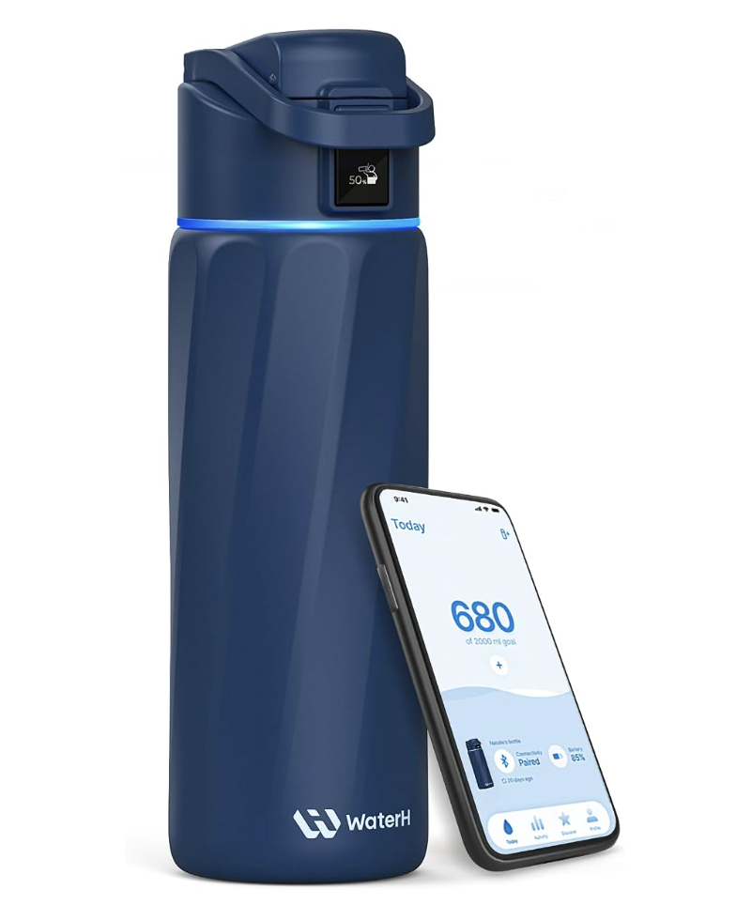
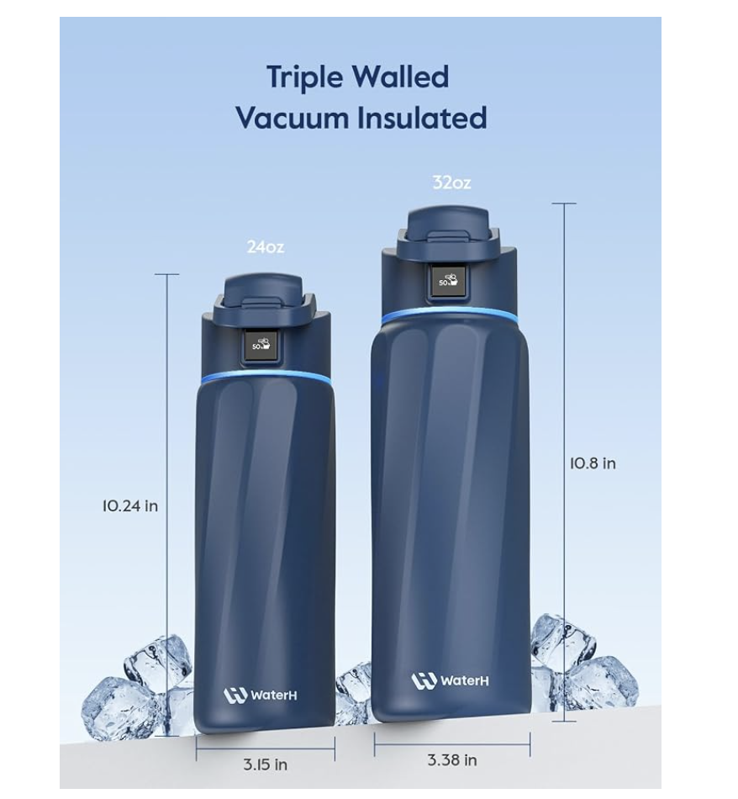
1: HydraTrack Investment Pitch
HydraTrack Ltd offers a £69 Smart Water Bottle connected to a mobile hydration application.
The venture seeks £100,000 in equity investment alongside £10,000 of founder funding.
The investment case consists of a clear customer need, a scalable sales process and measurable financial goals (OECD, 2022).
Notes:
HydraTrack tackles water scarcity with a bottle that records water consumption and reminds users to drink on time. The pitch is looking for £100,000 to enhance the application, order inventory and get customers. Research in the field of hydration helps satisfy the need, whereas a commercial case requires turning the need into repeatable demand (Nishi et al., 2023).

Slide 4
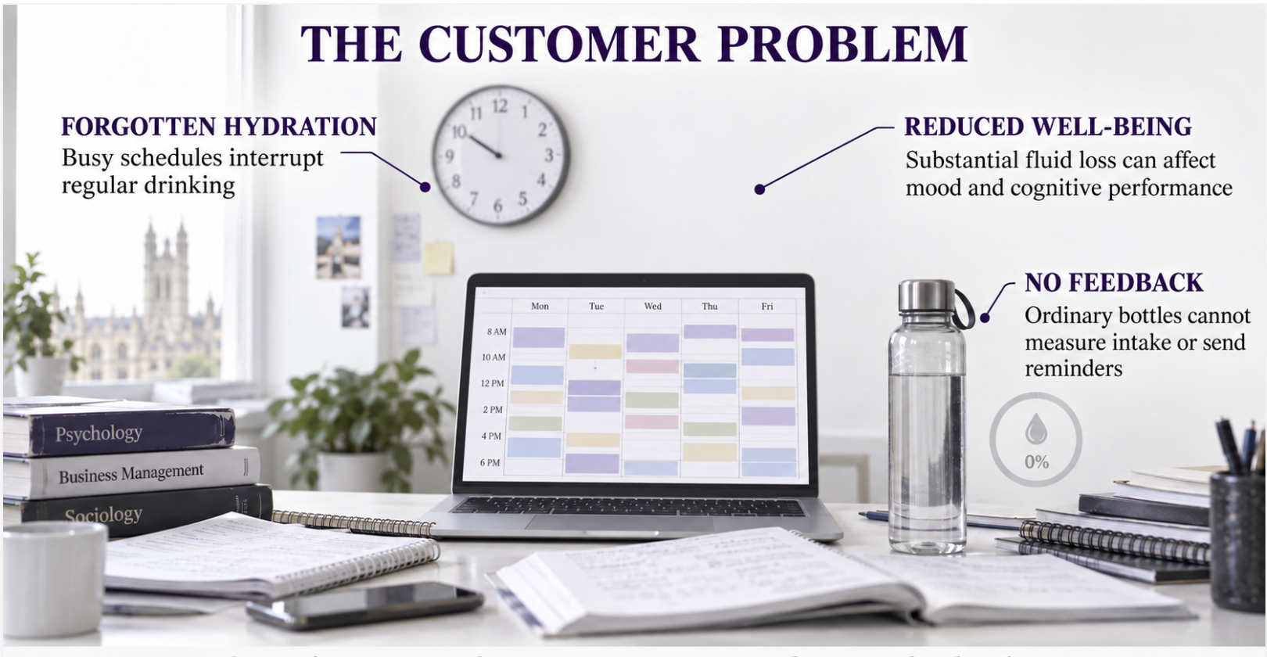
2: Customer Problem
It's easy for busy professionals, students, or fitness enthusiasts to forget to drink water regularly during a hectic work or school schedule.
Ordinary reusable bottles store water but provide no intake measurement or reminder mechanism.
Hypohydration can impair mood and cognitive performance when fluid loss becomes substantial (Dube et al., 2022).
Notes:
It's not just a water shortage issue; it's a behaviour issue. The user can carry a bottle and drink very little since there is no feedback. Studies on reuse packaging also indicate that convenience plays a role in the willingness to adopt sustainable options, and that making monitoring simple is a key component of HydraTrack's offering (Patreau et al., 2023).

Slide 5
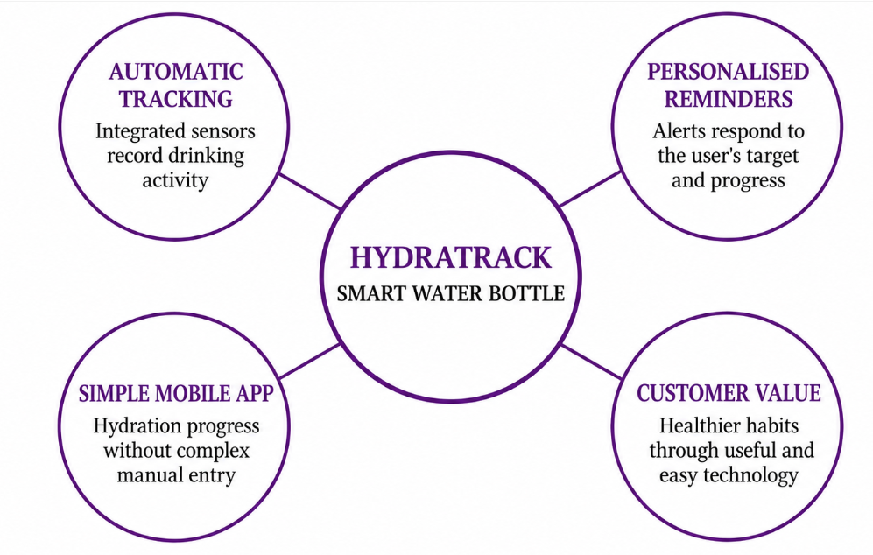
3: HydraTrack Solution and Value Proposition
The drinking activity is logged and recorded by integrated sensors, which then upload the data to the HydraTrack application (Calegari et al., 2023).
Personalised alerts prompt users according to their selected daily target and recorded progress.
The acceptance of mobile health technology is significantly affected by perceived usefulness and ease of use.
Notes:
The bottle is a single-day product, with an insulated reusable container and intake tracking and visible reminders (Alaslani et al., 2024). The application does not require any complex manual entry and shows progress. New research has shown that smartphones can aid in monitoring hydration non-invasively, suggesting a viable future trajectory in product development that goes beyond volume monitoring.

Slide 6
4: Target Market and Market Opportunity
The primary consumer market is UK students, professionals and fitness users aged 18-45.
Secondary buyers include gyms, universities and employers seeking branded wellbeing products (Li et al., 2023).
Adjustable reminders recognise that hydration requirements differ between users and circumstances.
Notes:
HydraTrack will be aimed at consumers who are already using reusable bottles and are digitally savvy, but require behavioural support. Organisational sales offer more sizeable orders and product usage in communities (Hussain et al., 2022). When the information offered in interactive social advertisements is helpful and trustworthy, it can enhance engagement and electronic word of mouth.

Slide 7
5: Competitor Positioning
Common insulated bottles can be had for under £30 and do not have connected reminder or intake tracking features (Naem et al., 2022).
Premium smart bottles offer digital functions but often require a higher purchase commitment.
IoT buyers evaluate functionality, sensor information, privacy risk and price when comparing connected products.
Notes:
HydraTrack sits between the inexpensive, reusable bottle and the connected, more costly bottle. Its £69 price requires reliable sensing, uncomplicated onboarding and responsive customer support. Marketing should highlight a real-world benefit that is sustained without making the bottle the sole option to treat dehydration (Rosinger et al., 2024).

Slide 8
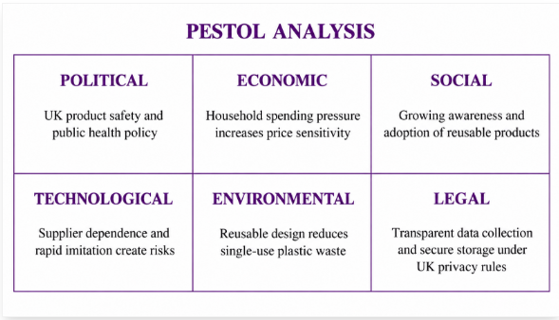
6: Strategic Analysis
The awareness and adoption of reusable products and the price sensitivity from household spending pressure drive the demand.
Supplier dependence and rapid imitation create operational and competitive risks for a small entrant (Shahid et al., 2022).
The data collection and secure storage of connected health products must be transparent and comply with privacy requirements.
Notes:
The strategic approach is to have affordable pricing, low data collection, and supplier quality controls. HydraTrack should trademark the brand, secure testing of application code and establish testing standards for documents. Reminders should be flexible and not be standardised for all users, as hydration requirements vary between different ages and physiologies (Li et al., 2023).

Slide 9
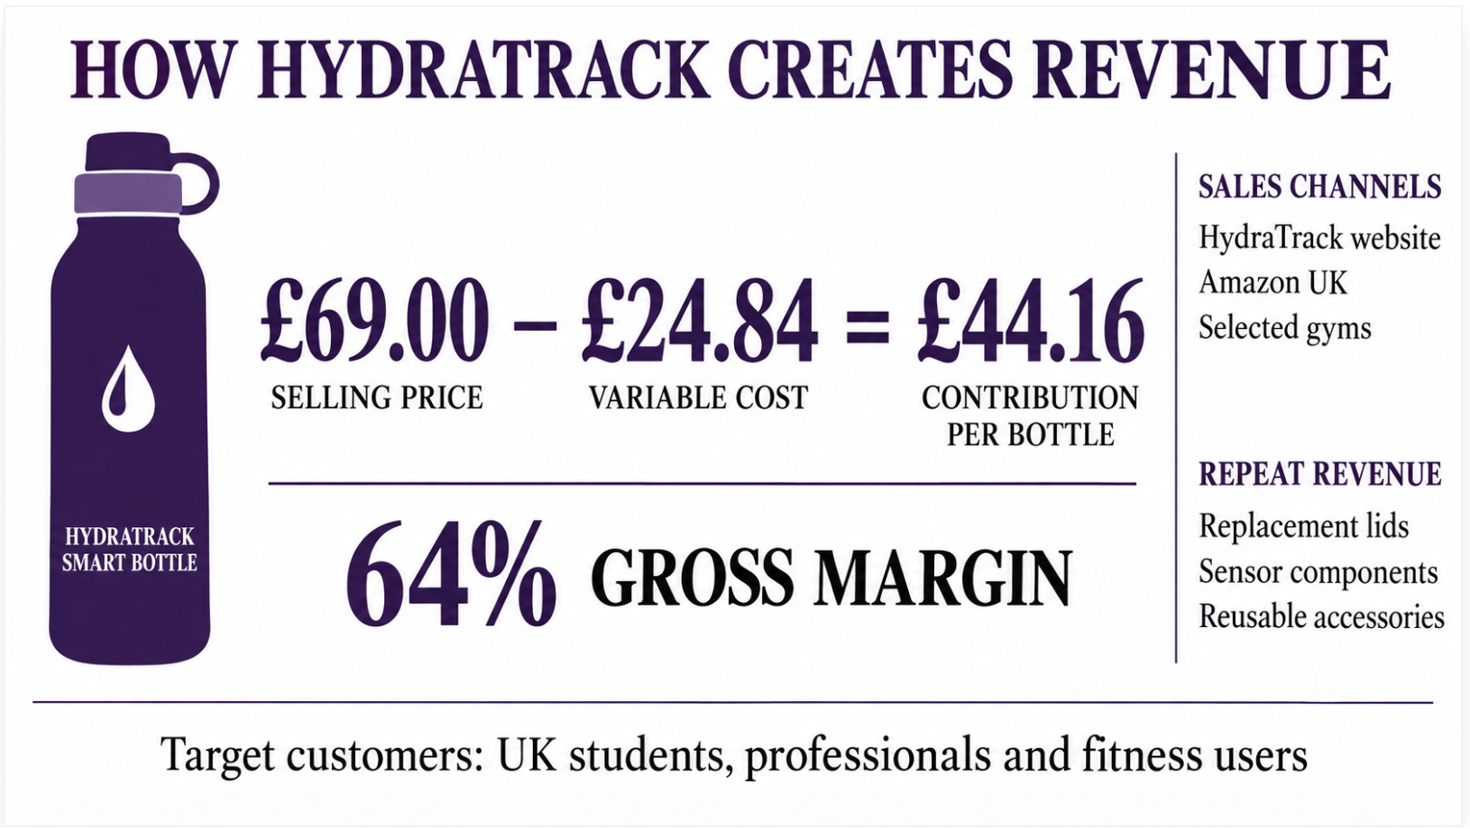
7: Business and Revenue Model
Online sales of direct bottles create £69 per order and offer insight into customer feedback.
Accessories and optional application services increase projected annual customer spending to £89.
Connected monitoring can help sustain attention by preventing user dehydration.
Notes:
The first revenue stream is the bottle, and the other revenue streams come from the replacement lids, cleaning accessories, and additional digital functionality. Direct sales ensure customer relationships are maintained, and organisational orders provide greater volume predictability. The financial assumptions in HydraTrack must be clear, verifiable and consistent with the assessment of the markets, and the assessment of the management and forecasts (OECD, 2022).

Slide 10
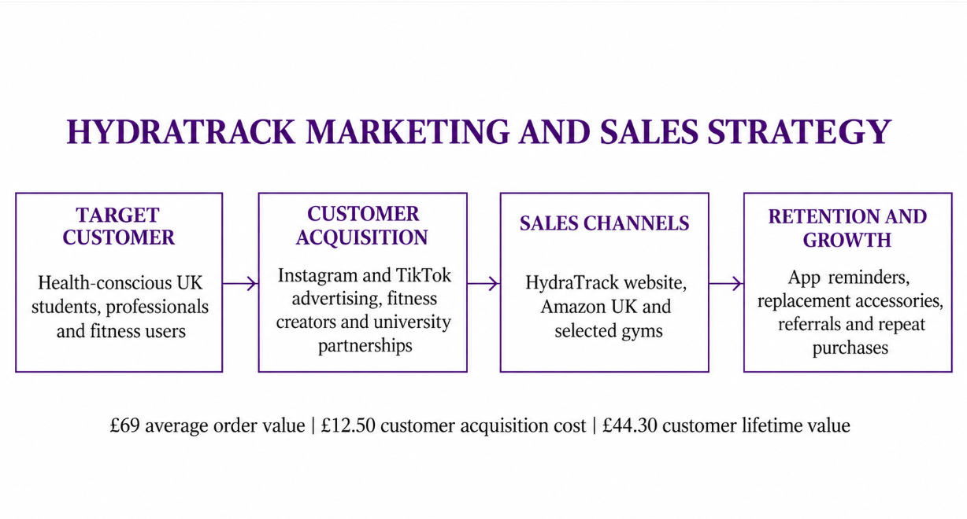
8: Marketing and Sales Strategy
The Year 1 plan allocates £4,500 monthly to paid social media, search and retargeting.
Gym and University partnerships offer demonstrations, referral codes and focused user groups (Patreau et al., 2023).
Convenience and environmental attitudes influence willingness to adopt reusable-product systems.
Notes:
Marketing focuses on quantifiable campaigns in the digital space, not on general awareness marketing spending. Each channel will monitor acquisition cost based on CAC £12.50 assumption, conversion, and repeat purchasing. Material on fitness will include reminders and real-world effects of fitness habits throughout the day, and evidence illustrating how significant hypohydration affects cognition and mood (Dube et al., 2022).

Slide 11
9: Operations and Scalability
External manufacturing minimises fixed investment in manufacturing, and HydraTrack maintains specification and quality approval (Alaslani et al., 2024).
The £30,000 initial inventory allocation supports the forecast of 400 monthly Year 1 orders.
Smartphone-based hydration research demonstrates continuing innovation in low-cost monitoring methods.
Notes:
HydraTrack has a system of authorising suppliers by samples, sensor testing and pre-shipment inspections prior to releasing inventory. If additional capacity and support are required, the operating model will be scaled up. When users believe that apps are useful and require little effort, application reliability takes priority over being an optional addition for mobile health adoption (Calegari et al., 2023).

Slide 12
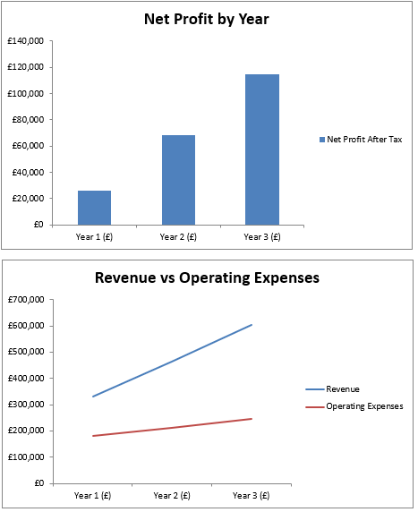
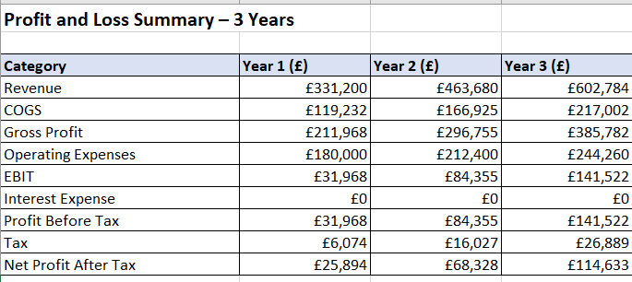
10: Three-Year Financial Forecast
Revenue increases from £331,200 in Year 1 to £463,680 in Year 2 and £602,784 in Year 3.
Net profit rises from £25,894 to £68,328 and £114,633 as revenue grows faster than operating expenditure.
Startup forecasting should integrate profitability, growth, cash requirements and market conditions.
Notes:
The model assumes a £69 selling price, 400 monthly Year 1 orders, 40% Year 2 growth and 30% Year 3 growth. Gross margin remains 64%, while projected net margin improves from 7.8% to 19.0%. Customer demand must therefore be reviewed monthly and never treated as guaranteed.

Slide 13
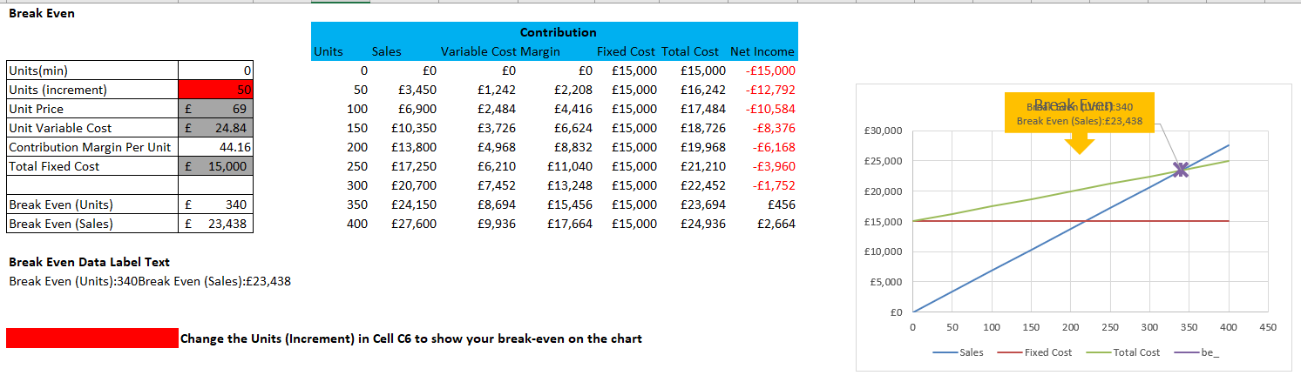
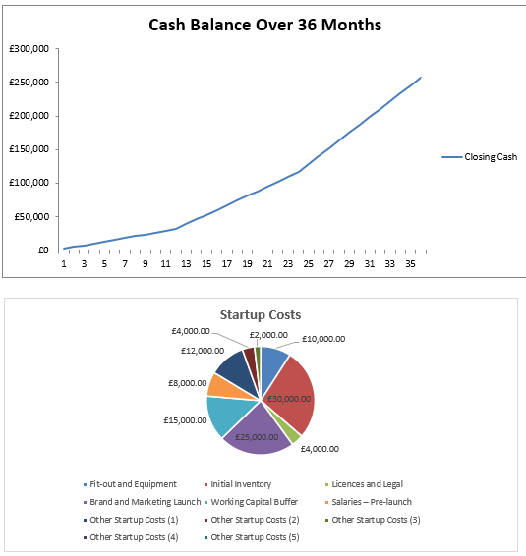
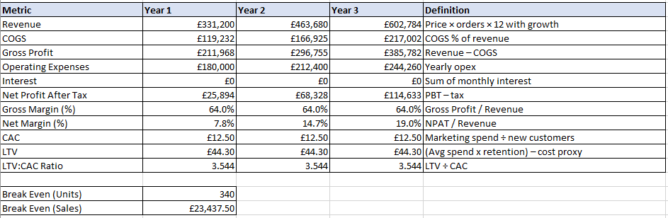
11: Break-Even KPIs and Growth Potential
Monthly break-even equals approximately 340 bottles or £23,438 in sales, against a 400-order forecast.
Customer acquisition cost is £12.50, estimated lifetime value is £44.30 and LTV:CAC equals 3.54:1.
Connected-product quality assessment should incorporate consumer needs and measurable product performance.
Notes:
With the Year 1 target being just 60 orders per month above breakeven, conversion performance is crucial. The £257,845 Month 36 cash forecast suggests that there is capacity for reinvestment if the forecast sales are realised. The financial projections, burn rate, market conditions, and ability of the team are all key factors in startup sustainability (Takas et al., 2024).

Slide 14
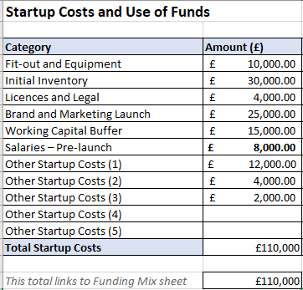
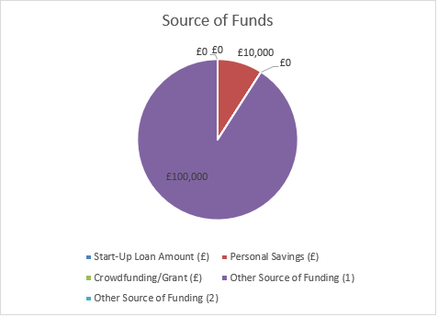
12: Investment Implementation and Team
HydraTrack seeks £100,000 equity investment, complemented by £10,000 of founder capital.
Funding covers £30,000 inventory, £25,000 launch marketing and £55,000 product, staffing and operating requirements.
Privacy controls must develop alongside the application because connected health devices process sensitive user information (Shahid et al., 2022).
Notes:
The team goes through product improvement, supplier orders and application testing from months 1 to 3. In month four, marketing commences and partnering begins, with KPI reviews every month thereafter (Hussain et al., 2022). Clear accountability is provided by founder oversight, operations management, marketing execution and technical support, while the advertising evidence helps to inform customer engagement decisions.

Slide 15
Reference List
Alaslani, R., Perzhilla, L., Rahman, M.M.U., Laleg-Kirati, T.M. and Al-Naffouri, T.Y., 2025. You can monitor your hydration level using your smartphone camera. IEEE Transactions on Instrumentation and Measurement, 74, pp.1-14. https://ieeexplore.ieee.org/abstract/document/11062629/
Calegari, L.P., Tortorella, G.L. and Fettermann, D.C., 2023. Getting connected to m-health technologies through a meta-analysis. International journal of environmental research and public health, 20(5), p.4369. https://www.mdpi.com/1660-4601/20/5/4369
Dube, A., Gouws, C. and Breukelman, G., 2022. Effects of hypohydration and fluid balance in athletes' cognitive performance: a systematic review. African health sciences, 22(1), p.367. https://pmc.ncbi.nlm.nih.gov/articles/PMC9382508/
Hussain, A., Ting, D.H. and Mazhar, M., 2022. Driving consumer value co-creation and purchase intention by social media advertising value. Frontiers in psychology, 13, p.800206. https://www.frontiersin.org/journals/psychology/articles/10.3389/fpsyg.2022.800206/full
Li, S., Xiao, X. and Zhang, X., 2023. Hydration status in older adults: current knowledge and future challenges. Nutrients, 15(11), p.2609. https://www.mdpi.com/2072-6643/15/11/2609
Naem, M.S.A., Koudil, M. and Ouldimam, Z., 2022. Product quality assessment in the internet of things: a consumer-oriented approach. Sensors, 22(6), p.2215. https://www.mdpi.com/1424-8220/22/6/2215
Nishi, S.K., Babio, N., Paz-Graniel, I., Serra-Majem, L., Vioque, J., Fitó, M., Corella, D., Pintó, X., Bueno-Cavanillas, A., Tur, J.A. and Diez-Ricote, L., 2023. Water intake, hydration status and 2-year changes in cognitive performance: a prospective cohort study. BMC medicine, 21(1), p.82. https://link.springer.com/article/10.1186/s12916-023-02771-4
OECD (2022) Financing SMEs and Entrepreneurs 2022: An OECD Scoreboard. Paris: OECD Publishing. https://doi.org/10.1787/e9073a0f-en.
Patreau, V., Bernard, S., Leroux, J., Bellemare, M. and Morissette, J., 2023. Consumer interest and willingness to pay for in-bulk products with reusable packaging options. Frontiers in Sustainability, 4, p.1228917. https://www.frontiersin.org/journals/sustainability/articles/10.3389/frsus.2023.1228917/full
Rosinger, A.Y., John, J.D. and Murdock, K.W., 2024. Ad libitum dehydration is associated with poorer performance on a sustained attention task but not other measures of cognitive performance among middle‐to‐older aged community‐dwelling adults: A short‐term longitudinal study. American Journal of Human Biology, 36(6), p.e24051. https://onlinelibrary.wiley.com/doi/abs/10.1002/ajhb.24051
Shahid, J., Ahmad, R., Kiani, A.K., Ahmad, T., Saeed, S. and Almuhaideb, A.M., 2022. Data protection and privacy of the internet of healthcare things (IoHTs). Applied Sciences, 12(4), p.1927. https://www.mdpi.com/2076-3417/12/4/1927
Takas, N., Kouloumpris, E., Moutsianas, K., Liapis, G., Vlahavas, I. and Kousenidis, D., 2024. Startup sustainability forecasting with artificial intelligence. Applied Sciences, 14(19), p.8925. https://www.mdpi.com/2076-3417/14/19/8925
Notes:
Alaslani, R., Perzhilla, L., Rahman, M.M.U., Laleg-Kirati, T.M. and Al-Naffouri, T.Y., 2025. You can monitor your hydration level using your smartphone camera. IEEE Transactions on Instrumentation and Measurement, 74, pp.1-14. https://ieeexplore.ieee.org/abstract/document/11062629/
Calegari, L.P., Tortorella, G.L. and Fettermann, D.C., 2023. Getting connected to m-health technologies through a meta-analysis. International journal of environmental research and public health, 20(5), p.4369. https://www.mdpi.com/1660-4601/20/5/4369
Dube, A., Gouws, C. and Breukelman, G., 2022. Effects of hypohydration and fluid balance in athletes' cognitive performance: a systematic review. African health sciences, 22(1), p.367. https://pmc.ncbi.nlm.nih.gov/articles/PMC9382508/
Hussain, A., Ting, D.H. and Mazhar, M., 2022. Driving consumer value co-creation and purchase intention by social media advertising value. Frontiers in psychology, 13, p.800206. https://www.frontiersin.org/journals/psychology/articles/10.3389/fpsyg.2022.800206/full
Li, S., Xiao, X. and Zhang, X., 2023. Hydration status in older adults: current knowledge and future challenges. Nutrients, 15(11), p.2609. https://www.mdpi.com/2072-6643/15/11/2609
Naem, M.S.A., Koudil, M. and Ouldimam, Z., 2022. Product quality assessment in the internet of things: a consumer-oriented approach. Sensors, 22(6), p.2215. https://www.mdpi.com/1424-8220/22/6/2215
Nishi, S.K., Babio, N., Paz-Graniel, I., Serra-Majem, L., Vioque, J., Fitó, M., Corella, D., Pintó, X., Bueno-Cavanillas, A., Tur, J.A. and Diez-Ricote, L., 2023. Water intake, hydration status and 2-year changes in cognitive performance: a prospective cohort study. BMC medicine, 21(1), p.82. https://link.springer.com/article/10.1186/s12916-023-02771-4
OECD (2022) Financing SMEs and Entrepreneurs 2022: An OECD Scoreboard. Paris: OECD Publishing. https://doi.org/10.1787/e9073a0f-en.
Patreau, V., Bernard, S., Leroux, J., Bellemare, M. and Morissette, J., 2023. Consumer interest and willingness to pay for in-bulk products with reusable packaging options. Frontiers in Sustainability, 4, p.1228917. https://www.frontiersin.org/journals/sustainability/articles/10.3389/frsus.2023.1228917/full
Rosinger, A.Y., John, J.D. and Murdock, K.W., 2024. Ad libitum dehydration is associated with poorer performance on a sustained attention task but not other measures of cognitive performance among middle‐to‐older aged community‐dwelling adults: A short‐term longitudinal study. American Journal of Human Biology, 36(6), p.e24051. https://onlinelibrary.wiley.com/doi/abs/10.1002/ajhb.24051
Shahid, J., Ahmad, R., Kiani, A.K., Ahmad, T., Saeed, S. and Almuhaideb, A.M., 2022. Data protection and privacy of the internet of healthcare things (IoHTs). Applied Sciences, 12(4), p.1927. https://www.mdpi.com/2076-3417/12/4/1927
Takas, N., Kouloumpris, E., Moutsianas, K., Liapis, G., Vlahavas, I. and Kousenidis, D., 2024. Startup sustainability forecasting with artificial intelligence. Applied Sciences, 14(19), p.8925. https://www.mdpi.com/2076-3417/14/19/8925

Slide 16
Thank You!

