Slide 1

MSc MAJOR PROJECT · PROPOSAL DEFENCE
A Privacy-Preserving Agentic AI
Assistant for Parametric CAD
Locally-hosted, human-in-the-loop design automation built on FreeCAD and the Model Context Protocol
40-day timeline
Fully local & private
FreeCAD + MCP + local LLMs
Presented to the Project Supervisor
Notes:
Open by framing the one-sentence pitch: an AI design partner that works entirely on the user's own machine, proposes a plan you approve before it touches your model, and gets better the more you use it. Stress the three pillars: privacy, human-in-the-loop, and self-improvement. Set expectation that I'll end with a self-assessment against the MSc suitability criteria.

Slide 2




MOTIVATION
Three obstacles block AI-assisted CAD today
Reliability
Data privacy
Local-model limits
LLMs hallucinate dimensions and mis-order features. In exact geometry, one silent error corrupts the whole model. Published work confirms LLMs deviate badly under spatial reasoning.
Engineering designs are commercially sensitive. Routing drawings and design chat through cloud APIs is unacceptable in most industrial settings.
My early experiments confirmed it: end-to-end multimodal CAD generation with local models alone simply does not work well enough.
This project answers all three with an architectural position — not a bigger model.
Agentic CAD Assistant · MSc Major Project
2
Notes:
These three obstacles are the spine of the whole proposal. Reliability -> solved by the human checkpoint. Privacy -> solved by a fully local pipeline. Capability limits -> solved by honest routing: deterministic parsers do exact geometry, local LLMs do reasoning, and impossible requests get a structured explanation instead of a fake answer.

Slide 3




THE IDEA
An AI design partner that lives inside your CAD tool
The engineer states intent in plain language or uploads a file. The agent proposes a verifiable, editable modelling plan. Nothing is built until the user approves — and every action runs locally.
Design together
Describe a part or upload a sketch / PDF / STEP / STL — the agent drafts a step-by-step plan and builds it with you.
Edit by conversation
Ask for changes to an existing model — “enlarge the corner holes to M6” — and the agent edits parametrically.
Validate physically
Run linear-static FEA or steady-state thermal checks as agent-callable tools, with results explained in plain language.
Extend itself
Give it a method and equations; it writes, sandbox-tests, and registers a new analysis tool for future use.
Agentic CAD Assistant · MSc Major Project
3
Notes:
Four headline capabilities. Emphasise that the user keeps full manual control of FreeCAD at all times — the agent is a collaborator, not a replacement. The fourth, self-extension, is the most novel and I'll return to it.

Slide 4




THE CORE CONTRIBUTION
Plan → Confirm → Execute
A mandatory human checkpoint turns LLM unreliability from a correctness risk into a cheap review step.
1
2
3
PLAN
CONFIRM
EXECUTE
The agent drafts a numbered, fully-parameterised feature plan with a one-line rationale per step — schema-enforced, so it is never malformed.
The plan runs in a throwaway document; a preview is shown beside the editable plan. The user tweaks any parameter or rejects with feedback. Nothing touches the real model yet.
Approved steps replay one-by-one in the live model. After each, the kernel is validated; errors feed back for a bounded retry. The whole action is one undo.
Why it matters: literature shows autonomous LLM-CAD fails on spatial reasoning. The checkpoint is what makes a local model usable.
4
Notes:
This is the slide to slow down on. The key insight: I am not trying to make the model perfect. I am inserting a review step so that when the model is wrong, fixing it is a single edit, not a corrupted file. Per-step kernel validation plus a bounded retry loop is where most of my engineering effort goes.

Slide 5

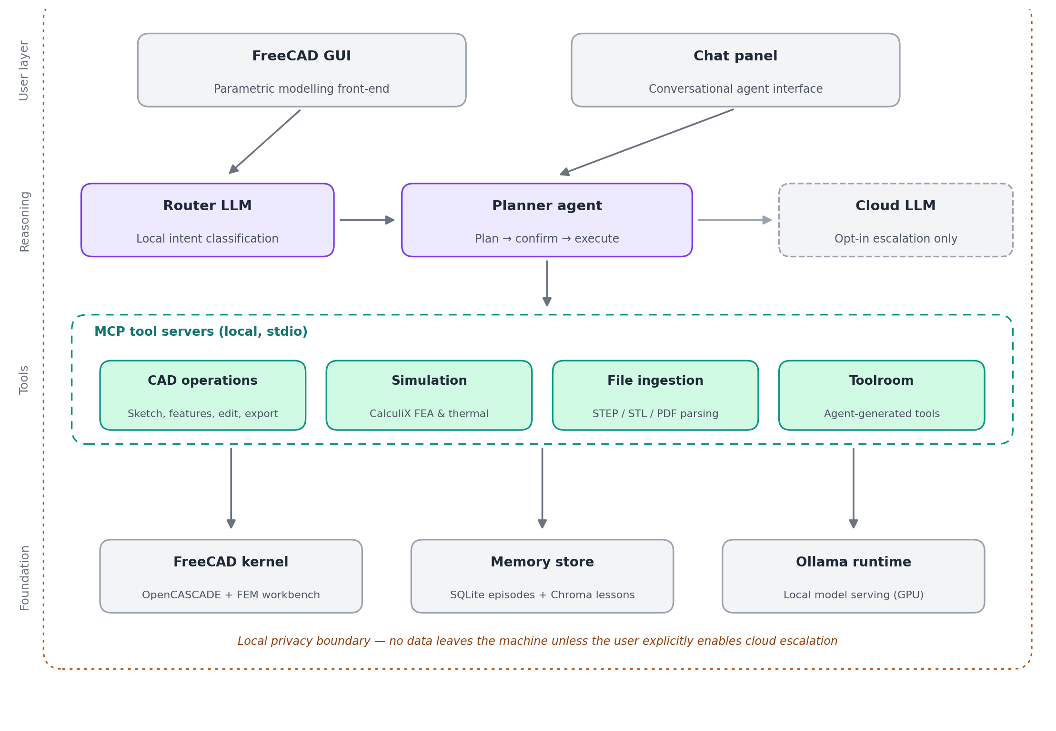
SYSTEM ARCHITECTURE
Four layers inside one local privacy boundary
Reasoning
Router + planner, run locally
MCP tools
CAD, simulation, ingest, toolroom
Foundation
FreeCAD, memory, Ollama
Key decision
Don't build a CAD kernel. Reuse FreeCAD; spend all effort on the agent layer.
Agentic CAD Assistant · MSc Major Project
5
Notes:
Walk top to bottom: user works in FreeCAD or the chat panel; the router decides where each query goes; the planner orchestrates tools; the tools wrap FreeCAD, memory, and the local model server. Everything sits inside the dashed privacy boundary. The single most important decision is reusing FreeCAD — that is what makes 40 days realistic.

Slide 6





CAPABILITIES
Four MCP tool servers — all local, all auditable
CAD operations
Simulation
~22 atomic tools: sketch, pad / pocket / revolve / loft, fillet, chamfer, boolean, patterns, parametric edits, export to STEP / STL / IGES — plus inspection tools so the agent can read the model state.
Wraps FreeCAD's FEM workbench (CalculiX): material, constraints, loads, meshing, solve, and a plain-language result summary with safety factor and stated assumptions.
File ingestion
Toolroom
Deterministic STEP / STL parsing for exact geometry (no hallucination); assistive PDF + drawing reading via a local vision-language model, marked “unverified.”
The agent's self-extension registry — synthesises, sandbox-tests, and persists new calculation tools, or returns a structured capability report when infeasible.
MCP gives process isolation (vital for the sandboxed toolroom), dynamic tool discovery, and model-vendor independence.
Agentic CAD Assistant · MSc Major Project
6
Notes:
Why MCP rather than ad-hoc function calling: three reasons on the slide. Stress inspection tools under CAD operations — an agent that can read the feature tree and take screenshots can ground itself in reality instead of its own assumptions, which is what makes per-step validation work.

Slide 7
NOVEL MECHANISM
The Toolroom: safe self-extension
When a needed analysis doesn't exist, the agent can build it — under strict guardrails and a human gate.
Feasibility
Synthesis
Static check
1
Check against an explicit capability model. If impossible → structured report.
2
Generate a typed Python function citing the user's method.
3
AST allowlist: reject file / network / exec access.
Sandbox test
Approval
Register
4
Run in an isolated subprocess vs. analytical test cases.
5
Show code + results; nothing registers without a yes.
6
Persist as a new MCP tool, reusable in future sessions.
Demo scope: closed-form & 1-D numerical calculations (beam deflection, hoop stress, 1-D heat) — honest about what local code-synthesis can verifiably achieve.
Agentic CAD Assistant · MSc Major Project
7
Notes:
This is inspired by Voyager's skill library. The crucial differences from a chatbot writing code: a static-analysis gate, a no-network sandbox, mandatory human approval, and analytical test cases. The capability report for infeasible requests is a designed response type, not a failure — it satisfies the supervisor's expectation that the system knows its own limits.

Slide 8


SELF-IMPROVEMENT
Reflective memory — learning without fine-tuning
Episodic log
Consolidate
Lesson store
Retrieve
Every action, error & user correction stored in SQLite.
An LLM distils episodes into short “lesson cards” with triggers.
Cards embedded in a local vector DB (Chroma) with provenance.
Top-k relevant lessons injected per query — a few hundred tokens.
Bounded by design
Once consolidated, raw episodes are pruned, so context never grows without bound (your “vanishing trail”). Contradicted cards are superseded; the card cap uses least-recently-retrieved eviction, and cards stay user-inspectable.
Agentic CAD Assistant · MSc Major Project
8
Notes:
This directly answers the memory-growth concern from my original idea. It is NOT fine-tuning — no weight updates, fully local, auditable. The episodic->semantic consolidation is adapted from Generative Agents and Reflexion. The on/off ablation of this subsystem is a headline result for the thesis.

Slide 9

DESIGN COMMITMENT
Privacy is architectural, not contractual
Local by default: models (Ollama), tools, memory and files never leave the machine.
VERIFIABLE
The whole benchmark is run with networking disabled.
Cloud escalation is OFF by default — a configurable trust boundary, not an absolute claim.
When enabled, every escalation shows a consent dialog stating exactly what would be sent.
If it still works offline, the privacy claim is proven — not promised. This is also the differentiator vs. every commercial tool, which offers only zero-retention policies.
A persistent header indicator shows the current mode; all escalations are logged locally.
9
Notes:
Frame this as more rigorous than the industry. Commercial copilots promise zero-retention contractually; I prove privacy by running fully offline. That offline test is part of my evaluation, so the claim is demonstrable in the demo.

Slide 10


TECHNOLOGY
A pragmatic, fully open & local stack
CAD & geometry
AI & reasoning
Agent & data
FreeCAD 1.0 (Python API)
Ollama (local serving)
MCP Python SDK (stdio)
OpenCASCADE kernel
Qwen2.5 7B router
SQLite episodic log
CalculiX FEM solver
Qwen2.5 14-32B planner
ChromaDB lessons
STEP / STL / IGES I/O
Qwen2.5-VL vision
PySide6 dock UI
Python throughout · every component is free & open-source · no paid API required for the core system.
Agentic CAD Assistant · MSc Major Project
10
Notes:
Stress that nothing here is behind a paywall. The planner-model size flexes to whatever GPU I have — I will validate the largest model on day 1. The optional cloud API is the only paid component and it is off by default.

Slide 11

PLAN
40-day roadmap with hard weekly checkpoints
Days 1–4
Foundation
Master FreeCAD scripting; validate models on GPU
Days 5–10
MCP CAD core
~22 tools; basic agent loop modifies live geometry
Days 11–16
Plan-confirm-execute
Preview, edit, approve, step-wise validated execution
Days 17–21
Ingest & edit
STEP / STL Q&A; description-driven edits; PDF assistive
Days 22–25
Simulation
FEA + thermal tools; agent runs a cantilever case
Days 26–30
Toolroom & memory
Synthesis + sandbox; consolidation + retrieval
Days 31–34
Router & privacy
Intent router; opt-in consent; offline verification
Days 35–40
Eval & write-up
Benchmark, memory ablation, demo video, thesis (3-day buffer)
Agentic CAD Assistant · MSc Major Project
11
Notes:
Each phase ends in a demonstrable behaviour, not a code milestone, so you can verify progress at any week boundary. Days 38-40 are reserved buffer. If I slip, I de-scope in a fixed order — next slide region — but never the plan-confirm loop or the memory ablation.

Slide 12


RIGOUR
Evaluation — what turns a build into research
Benchmark: 20–25 tasks across 5 categories
Metrics & studies
Success rate vs. written acceptance criteria
Human interventions & error-recovery rate (headline metric)
Memory ablation: success with vs. without lessons
Router accuracy on a 60-query labelled set
Privacy: full benchmark run with networking disabled
Toolroom: 2 verified syntheses + 1 capability report
Agentic CAD Assistant · MSc Major Project
12
Notes:
Because the confirmation step makes assisted success near-total, my headline metric is interventions required, not raw autonomy — which is the more honest and more interesting number. The memory ablation gives a clean before/after research result.

Slide 13

PART 2
Self-Assessment
Honest answers to the five suitability questions — MSc level, dataset, techniques, time, and alignment.
13
Notes:
Transition slide. Tell the supervisor I have explicitly assessed the project against their five guideline questions, and the next five slides answer each in turn — including the honest limitations.

Slide 14
QUESTION 1
Is it MSc-level? What is MY contribution?
Necessities (not contributions)
My contribution
—
FreeCAD as the modeller (reused, not built)
The plan-confirm-execute protocol with kernel-grounded per-step validation
The sandboxed self-extending toolroom + capability reports
—
Chat UI / dock widget plumbing
Reflective memory with consolidation, pruning & a measured ablation
—
Off-the-shelf MCP-FreeCAD bridges exist on GitHub
Integration of all of it under a verifiable local-privacy boundary
—
Ollama model serving
An evaluation of what a local-only stack can actually do
Agentic CAD Assistant · MSc Major Project
14
Notes:
Be candid: the ingredients exist. My value-add is the combination and four mechanisms no existing system has together. The framing for the thesis is 'an integrated, evaluated, privacy-preserving system with a human-in-the-loop protocol' — not 'the first AI CAD agent'. That honesty is itself MSc-level maturity.

Slide 15


QUESTION 2
Data: available, appropriate, free to use?
No large training set is needed. The system is training-free — it uses pre-trained open-weight models via prompting and tool use, so there is no data-collection bottleneck.
Public CAD datasets
Self-authored benchmark
Memory data
DeepCAD & Fusion 360 Gallery — open, widely used, for sourcing test models and complexity references.
I create the 20–25 evaluation tasks & acceptance criteria myself — no permissions, no privacy issues.
Generated at runtime from my own interaction sessions — synthetic, local, fully controlled.
Risk avoided: I am not dependent on any third party releasing proprietary data.
Agentic CAD Assistant · MSc Major Project
15
Notes:
This is a strength of the project: the training-free design sidesteps the classic student trap of needing data they can't get. Public CAD datasets are open. My benchmark is self-authored. Memory data is generated locally at runtime.

Slide 16


QUESTION 3
Are the techniques suitable & accessible?
Natural language → CAD ops
Proven: Query2CAD drives FreeCAD from LLMs; MCP-FreeCAD bridges already exist.
Reliable structured output
Constrained JSON decoding + atomic tools + per-step kernel validation.
Exact geometry from files
Deterministic via OpenCASCADE — zero hallucination on STEP / STL.
Physics validation
FreeCAD FEM / CalculiX is a validated, integrated solver.
Drawing / PDF understanding
Local VLMs are weak here — scoped as assistive-only, user-verified.
Accessibility: every core technique is free & open-source and runs locally. The only paywalled piece — a cloud LLM — is optional and off by default.
Agentic CAD Assistant · MSc Major Project
16
Notes:
I've done the homework: four of five sub-problems have proven, accessible techniques. The one weak spot — drawing understanding — I've deliberately de-risked by scoping it as assistive-only, with the confirm step acting as the verification. Being explicit about the red row is what shows technical maturity.

Slide 17

QUESTION 4
Confident it can be done in 40 days?
Why yes
If I slip, I cut in this order
Biggest cost — the CAD kernel & GUI — is reused, not built
1
PDF / drawing understanding (keep STEP / STL)
Weekly checkpoints are demonstrable behaviours, not vague tasks
2
Thermal analysis (keep structural FEA)
3
Separate router model (hardcode one model)
3-day buffer (days 38–40) absorbs overruns
4
Toolroom persistence (keep live demo)
Python throughout; one language, familiar tooling
Never cut: the plan-confirm loop & the memory ablation.
A strict de-scope order protects the core contributions
Agentic CAD Assistant · MSc Major Project
17
Notes:
Confidence comes from scope discipline, not optimism. The de-scope ladder is the safety net: I can lose the bottom four features and still have a thesis, because the two contributions at the bottom are protected. Day-1 GPU validation removes the biggest unknown early.

Slide 18
QUESTION 5 · BONUS
Does it align with my objectives?
Applied agentic AI
Privacy engineering
Hands-on with the exact skills industry wants now: LLM agents, tool-calling, MCP, retrieval & evaluation.
A concrete, demonstrable privacy-by-design system — a strong, differentiated CV talking point.
Domain depth
Research + build
Real CAD / CAE engineering integration, not a toy chatbot — bridges AI with mechanical design.
Produces both working software and a measurable study — ideal for either industry or further research.
Agentic CAD Assistant · MSc Major Project
18
Notes:
Tie back to my career goals. If I want applied-AI or AI-engineering roles, this project demonstrates the full modern agent stack plus privacy engineering and a rigorous evaluation — exactly the portfolio piece that stands out.

Slide 19
POSITIONING
How we compare to existing work
System | Local / private | Human confirm | Sim. in loop | Self-ext. tools | Memory + ablation
DeepCAD / Text2CAD | — | ✗ | ✗ | ✗ | ✗
Query2CAD | ✗ | ✗ | ✗ | ✗ | ✗
Seek-CAD (local) | ✓ | ✗ | ✗ | ✗ | ✗
CADDesigner | ✗ | — | ✗ | ✗ | —
FreeCAD-MCP projects | ✗ | ✗ | ✗ | ✗ | ✗
Zoo / AdamCAD (products) | — | — | ✗ | ✗ | ✗
This project | ✓ | ✓ | ✓ | ✓ | ✓
Ours is the only row affirmative across every column. ✓ present · ✗ absent · — partial.
Agentic CAD Assistant · MSc Major Project
19
Notes:
This single table is the most persuasive artefact. Don't claim novelty for any single ingredient — claim the combination. Note honestly that commercial tools beat me on raw generation quality; my axes are privacy, the human protocol, simulation, self-extension, and measured memory.

Slide 20
IN ONE SENTENCE
An integrated, evaluated, privacy-preserving agentic CAD assistant with a human-in-the-loop verification protocol.
Human-in-the-loop
Local & private
Self-improving
Thank you · Questions & feedback welcome
20
Notes:
Close on the one-sentence positioning and the three pillars. Invite the supervisor's feedback specifically on scope: am I cutting the right things, and is the evaluation rigorous enough. Have the de-scope ladder and roadmap ready for questions.

