Slide 1

Stock Market Data Visualizer
A Python Mini Project By
Bhavesh Ghanchi | Pratham Mehta | Manav Modi
16010120071 | 16010120084 | 16010120085
From B1 Batch

Slide 2
Problem Statement
Problem Definition:
We need to write a program that scrapes financial data about the Stock Market from any number of websites as per requirement. The data should then be converted to a more readable format by removing unnecessary data, converting the data to their necessary formats(example, converting numbers from string to int/float) and finally outputting the data in form of a table. The user should be prompted to enter the name of the stock which they would like to visualize in the form of a graph. The tabular data for that particular stock should then be displayed in the form of an easily useable graph. The program should loop on until the user asks to quit.
Necessary Functions:
A scraping function to scrape the data from provided URL
A sanitization function to sanitize incoming data
A plotting function to plot data in form of graph.

Slide 3
Problem Statement
Constraints:
Should have at least 3 well defined functionalities (Scraping, Sanitization, Plotting)
Should be completely modular and have appropriate function calls
Should have excellent user prompts, good use of symbols and spacing in outputs
Should go through thorough and organized testing and output from test cases should be included in the results
The displayed data should be highly readable to increase the number of people that can make use of it
The graphs should ideally be candlestick style graphs because they are the preferred method of representing data in finance

Slide 4
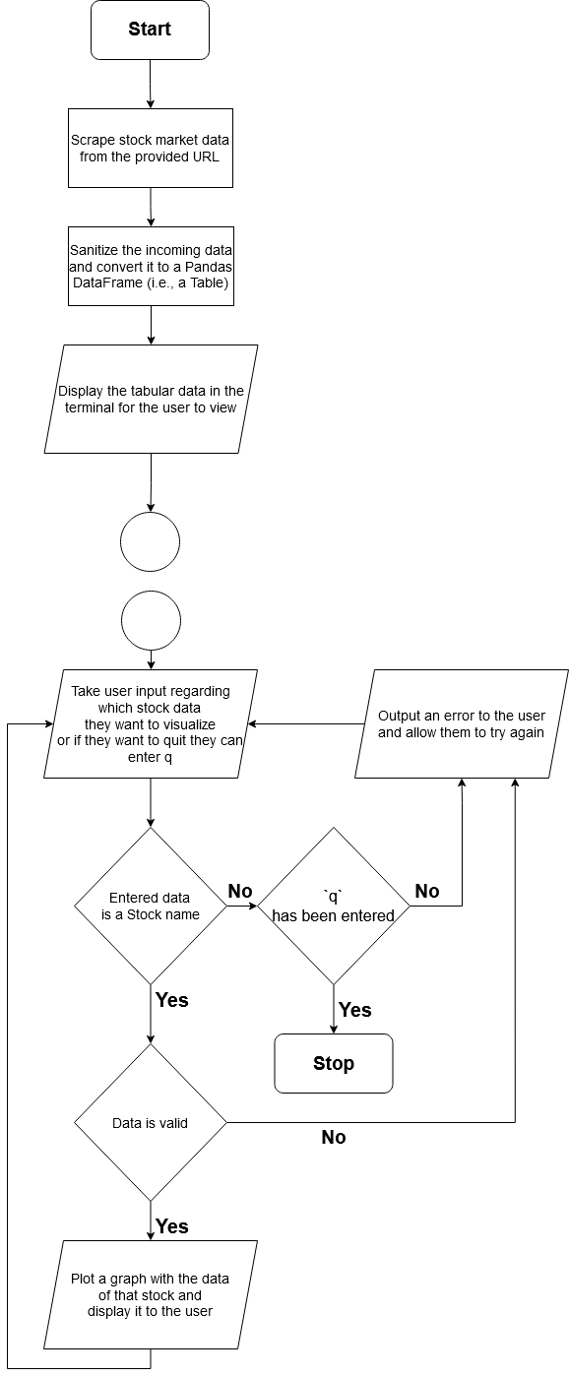
System Architecture
A
A

Slide 5
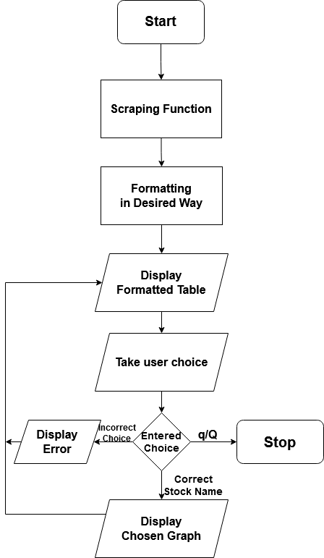
System Architecture
Condensed Version

Slide 6
Features of System
The system is in a clean and well modularized format to increase ease of use.
Due to the modular format of the files and functions, each can be imported and reused independent of the others and thus the code is highly reusable in other projects
It has three main functionalities:
Scraping financial data from a website and outputting it in the form of a Table.
Sanitizing the receiving data by converting numbers from str to float, dates to actual datetime format, reverting scale of numbers, removing unwanted data, etc.
Plotting a graph with the scraped data. The graph is a candlestick graph which is most commonly used for displaying such financial data.

Slide 7
Features of System
The code is very well documented which allows for all the coders to understand each others work very well and also allows new comers to understand the functions, logic and reasoning behind it properly.
The output in the terminal is properly formatted and colored in a standardized manner to allow users to read it the output very easily and make appropriate choices while using the program. It also has good user prompts.
It has features like try and except blocks at the appropriate locations so that it can intercept all errors and provide the user a great experience.
It has testing code that allows us to test the functionality of each individual functions as well as testing the entire system working together. The testing code is also documented appropriately.

Slide 8
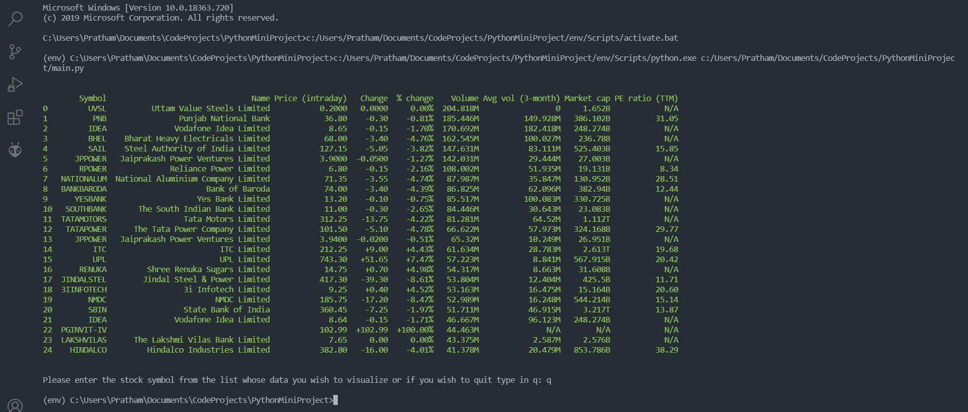
Result

Slide 9
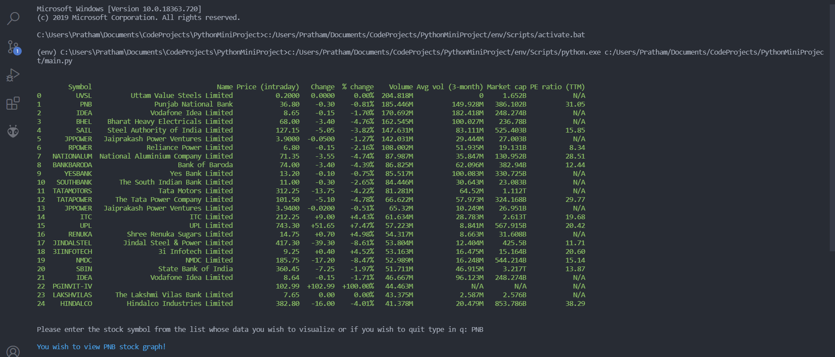
Result

Slide 10
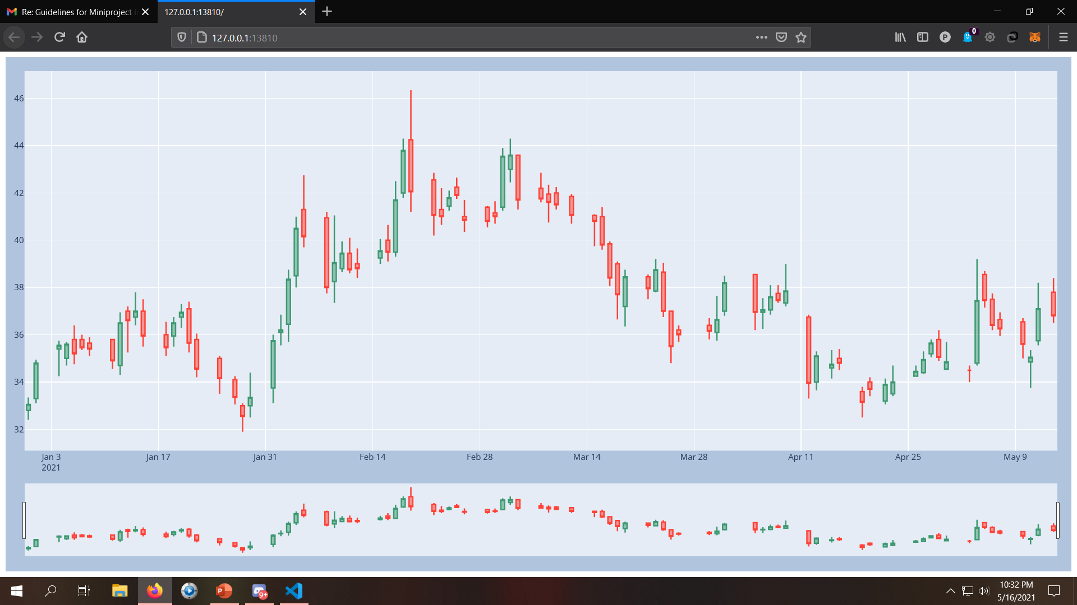
Result

Slide 11
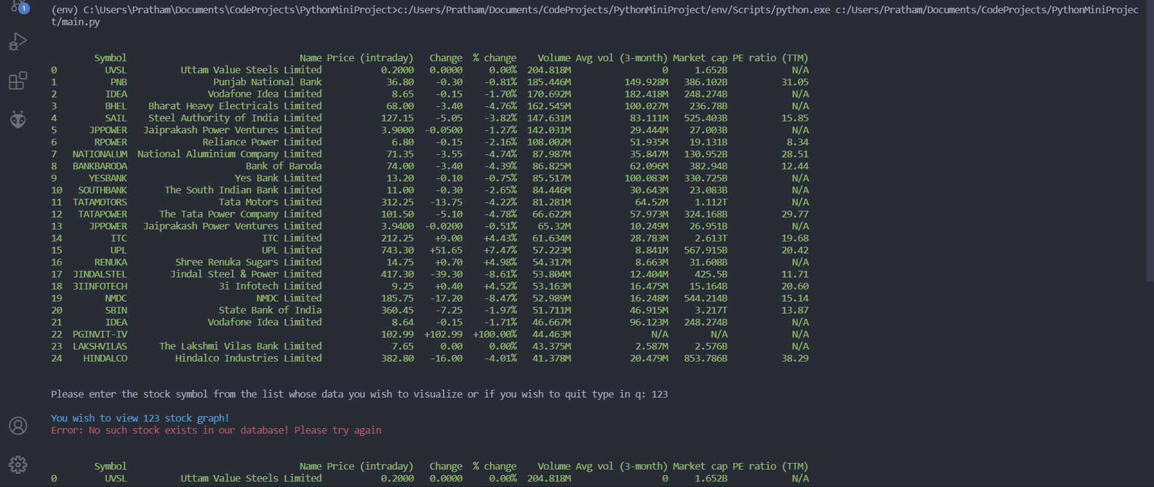
Result

Slide 12
Conclusion
We have successfully been able to create a python program that satisfies our original objective, visualizing stock market data.
It has many salient features as described in the features of designed system section.
We have implemented the functionality of scraping data from desired website and outputting it in a tabular form.
We have implemented the functionality of sanitizing the data by performing various functions on it to get a desirable output.
We have plotted the historical data of the chosen stocks in the form of a candlestick graph.
Lastly and most importantly, we have made it very easy to use the program so that anybody can visualize the data and benefit from it!

Slide 13
References
https://pandas.pydata.org/docs/
https://docs.python-requests.org/en/master/
https://www.crummy.com/software/BeautifulSoup/bs4/doc/
https://plotly.com/python/
https://pypi.org/project/termcolor/
https://in.finance.yahoo.com/?guccounter=1
Project Link:-
https://github.com/Warrior2612/Stock-Market-Data-Visualiser

