Slide 1
Working Memory Graph Terms
Triples(augmentations):
Identifier ^attribuite value
Value: constant or Identifier
Object: elements that share the same first identifier (S1 ^att1 value1 ^att2 value3)

Slide 2
Working Memory Usual Objects
A working memory object usually represents something about the world, such as a block, a wall, a piece of food, or a cell on the board. The individual augmentations represent properties (such as color, size, or weight), or relations with other objects (such as on top of, behind, or inside).

Slide 3
Working Memory Conceptual Objects
Working memory usually also contains objects that are only conceptual things and do not have an identifiable physical existence, such as state s1, which organizes other objects, relations, and properties. The exact representation of objects is up to you, the designer of a Soar program

Slide 4
Working Memory Declaration
Soar does not require any declarations of the possible attributes and constants. In fact, some Soar programs generate new attributes and constant values as they execute. The Soar editing and development tool, VisualSoar, does require declarations for the structure of working memory elements, and those declarations are used to check for errors in your rules but they are not used by Soar when it is executing a program.

Slide 5
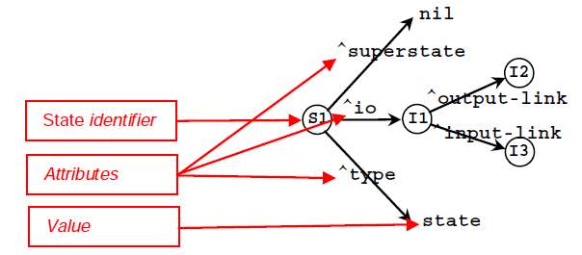
Automatically for every agent

Slide 6


