Slide 1
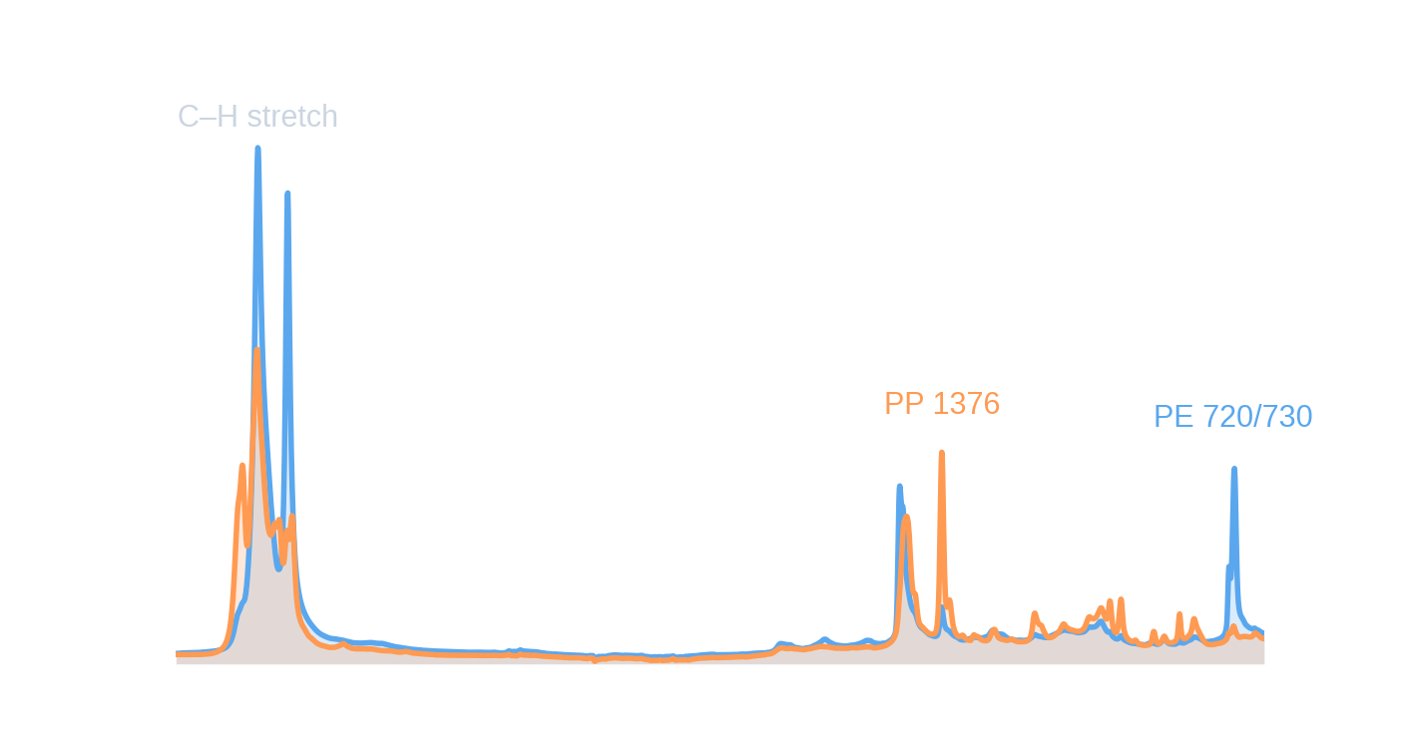
PP vs PE flake identification from FTIR
Validation study, deployed model and web service
Mean ATR-FTIR spectra of the 98 PE and 80 PP flakes: the two polymers differ in a handful of well-known bands.
Polyflow work package · results summary · 2 October 2026
Notes:
Task: classify plastic flakes as PP or PE from ATR-FTIR, test whether colorimeter data helps (especially on black polymers), and deliver a real-time web service. 178 verified flakes, 9 sources.

Slide 2
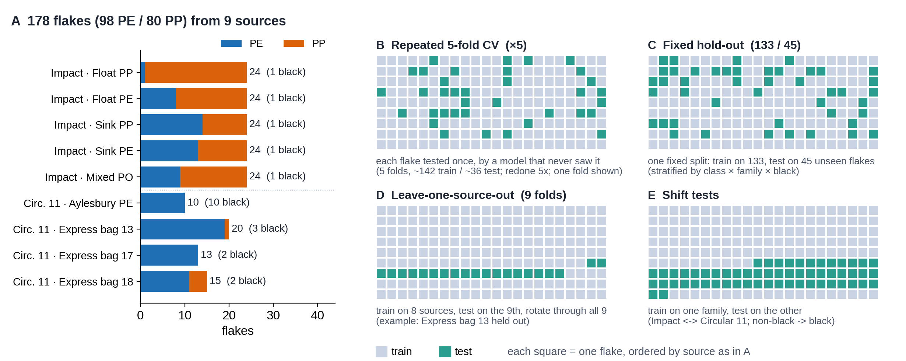
Every test flake is unseen in training: the four protocols differ only in how we split
Test flakes are always unseen
No leakage
Labels = verified last column
B, C: unseen flakes. D, E: unseen flakes from an unseen batch, the harder test.
One spectrum per flake; stratified splits; tuning and calibration only inside the training part.
Folder names are unreliable (‘Float PE’ is 16/24 PP). 8 ambiguous flakes and 1 without spectrum are excluded.
Polyflow · PP/PE FTIR classification
2
Notes:
Key message: in every protocol the flakes being scored were not used to train the model that scores them; the protocols differ only in how flakes are split. In 5-fold CV a new model is trained each round on ~142 flakes and tested on the other ~36, so every flake is tested exactly once. Panel A: 178 PE/PP flakes from 5 Impact plates and 4 Circular-11 batches. All 5 black PP are Impact; all 17 black PE are Circular 11 - a source confound. Protocols: repeated stratified 5-fold CV x5; fixed 133/45 hold-out; leave-one-source-out (9 folds); shift tests (Impact<->Circular 11, non-black -> black).

Slide 3
One preprocessing chain, trained on degraded copies and calibrated: a single 3.4 MB model
TRAINING ONLY · 6 degraded copies per flake
noise ≤ 4 % · blur ≤ 10 cm⁻¹ · gain 0.3–1.3× · baseline tilt · ±8 cm⁻¹ shift. Copies of one flake always stay in the same CV group.
1
2
3
4
5
6
Raw data
Crop
Derivative
Normalise
RBF-SVM
Calibrate
OPUS .0 / .dpt
6,845 points
399–6,999 cm⁻¹
600–1,800 and
2,700–3,100 cm⁻¹
→ 1,658 points
Savitzky–Golay
1st derivative
(window 11)
SNV per spectrum
(gain and baseline
offset removed)
C, γ by grouped CV
on training data
Platt scaling on
out-of-fold scores
→ P(PP)
AT INFERENCE · quality and novelty checks
OUTPUT
PCA reconstruction error flags spectra unlike PE/PP (e.g. Bopp shred) → ‘unreliable’
Weak C–H signal, missing range, coarse sampling or mixed PE+PP signature → ‘review’
PE or PP + probability + status
1.3 ms per spectrum · web UI and CSV export
Benchmarked on the same chain: logistic regression, PLS-DA, linear/RBF SVM, PCA-LDA, kNN, random forest, ExtraTrees, XGBoost, LightGBM, MLP, 1-D CNN, ResNet-1D, Transformer; colour-only and FTIR + colour fusion.
Polyflow · PP/PE FTIR classification
3
Notes:
Preprocessing was chosen by an ablation of 5 regions x 7 chains: every configuration is within 98.9-99.7 %, so the choice is about robustness. Augmentation makes the RBF-SVM invariant to calibration shift (otherwise 11 % at 8 cm-1) and to noise/blur. Calibration and tuning use GroupKFold with groups = original flake so augmented copies never leak.

Slide 4
The selected model is a small kernel SVM; the deep backbones we compared are tiny too
Augmented RBF-SVM
Input
RBF-kernel SVM
Platt scaling
Output
DEPLOYED · 1.3 ms · 3.4 MB
1,658-pt spectrum after SG derivative + SNV
C = 1, γ = 1e-4; 260 support vectors (128 PE / 132 PP)
fitted on out-of-fold scores of original + degraded copies
P(PP), PE/PP call, quality status
Linear baselines
Input
Linear model
Output
logistic regression · PLS-DA
1.1 ms · < 0.2 MB
SNV spectrum, standardised
L2 logistic regression, or PLS-DA with 2–12 components
P(PP) (PLS-DA: thresholded score)
1-D CNN
Input
3 × conv block
Global pooling
Dropout + Linear
23.6k params · 1.6 ms
829 points
Conv k = 9 + BN + GELU + MaxPool; 16 → 32 → 64 ch
mean ‖ max → 128-d vector
→ P(PP)
ResNet-1D
Input
Stem
3 residual blocks
Global avg pool
60.9k params · 1.8 ms
829 points
Conv k = 15, stride 2, 16 ch
16 → 32 → 64 ch (stride 2), k = 7
Dropout + Linear → P(PP)
Transformer
Input
Patch embedding
2 × encoder layer
CLS → LayerNorm
ViT-style · 41.4k params · 1.5 ms
829 points
16-pt patches → 48-d, CLS token, position emb.
4 heads, FFN 96, pre-norm
Linear → P(PP)
Training: SVM and linear models on the preprocessed spectrum (SVM with 6 degraded copies per flake, ≈ 14 s incl. tuning). Deep nets: AdamW, one-cycle LR 2e-3, label smoothing 0.05, fresh augmentation every epoch, 60–80 epochs (≈ 13 s on CPU). Why the SVM: same accuracy as the deep nets, most robust to the stress tests, and no PyTorch needed at serving time.
Polyflow · PP/PE FTIR classification
4
Notes:
All models consume the same preprocessed spectrum (600-1,800 and 2,700-3,100 cm-1, SG 1st derivative, SNV); deep nets use every 2nd point (829 points). Parameter counts and latencies from results/tables/exp9_latency.csv; the SVM hyper-parameters are read from the deployed bundle. Accuracy is identical across these models (slide on backbones), so the choice is about robustness and cost.

Slide 5
We reused Aru's design ideas, not his code: what we kept, extended, changed and dropped
 | Aru's repository (HDPE/LDPE) | Our deployment (PP/PE) | Status
Task | Regression: HDPE % in HDPE/LDPE mixtures | Classification: PP vs PE with a probability | Changed
Preprocessing | SNV → standard scaling; crop wavenumber range; keep every N-th point; fitted on training data only | Same ideas (SNV, crop to two windows, optional decimation, fit on train only) + Savitzky–Golay derivative | Kept + extended
Models | PLSR, PCR, SVR, Ridge, Lasso, RF, GBRT with a small grid search | Same model-zoo + grid-search idea, as classifiers (PLS-DA, SVM, RF …) plus CNN / ResNet / Transformer | Kept + extended
Validation | Grouped CV (replicates of one sample stay together); tuning on the training split only | Kept; added leave-one-source-out, batch-shift and black-flake tests; groups = flake incl. its degraded copies | Kept + extended
Packaging | ModelBundle: model + preprocessing + metadata in one .joblib | One bundle: model + preprocessing + novelty detector + model card; plain importable classes | Kept
Fusion | Late fusion: average of NIR and MIR models | Tested FTIR + colour (early and late): no gain, so not deployed | Tested
Not taken | Zero-pad / chop to force feature length; saved sampling step breaks --validate_only; HDPE-only target | Interpolate onto the fixed native grid; own implementation | Dropped
Aru's shipped model on our flakes: run through his own code it gave outputs outside 0–100 % for every flake (AUC 0.998 as a ranking score), so it could not be reused as a classifier. Our code is written from scratch; nothing was copied.
Polyflow · PP/PE FTIR classification
5
Notes:
Honest summary: the design (preprocess fitted on train, grouped CV, tune on train only, bundle everything in one joblib, model zoo + grid search) comes from reading Aru's repo; the implementation is new. His pad_or_chop would silently zero-pad a mismatched spectrum, which is why we resample onto the fixed grid instead.

Slide 6
Colour does not help: FTIR alone is near-perfect, colour alone does not transfer between batches
What the figure shows
98–100 %
FTIR in all six tests, incl. 22/22 black flakes it never saw in training
10–43 %
colour alone when trained on one batch family and tested on the other: below chance
No gain
from fusion; it is slightly worse (95.6 % hold-out). The deployed model ignores colour
Why: colour mostly encodes the batch. All black PP is from Impact, all black PE from Circular 11.
Polyflow · PP/PE FTIR classification
6
Notes:
FTIR: deployed augmented RBF-SVM. Colour-only: random forest on L*, a*, b*, chroma. Fusion: logistic regression on spectrum + L*a*b* stacked. A predictor that only knows the source scores 75.3 %, the level colour reaches. Within the 22 black flakes colour alone gets 83-90 %, but that is the same confound. A fair test of colour needs black PP and black PE from the same batches.

Slide 7
The strong FTIR models tie on accuracy, so robustness and cost decide the choice
Model | CV | Hold-out | Leave-source-out | Time (ms)
Logistic regression | 99.4 | 100 | 99.4 | 1.1
PLS-DA | 99.4 | 100 | 99.4 | 1.1
RBF-SVM | 99.4 | 100 | 99.4 | 1.1
ExtraTrees | 99.4 | 100 | 99.4 | 11.8
LightGBM | 99.1 | 95.6 | 99.4 | 1.3
1-D CNN (augmented) | 99.4 | 100 | 99.4 | 1.6
ResNet-1D (augmented) | 99.4 | 100 | 99.4 | 1.8
Transformer (augmented) | 99.4 | 97.8 | 99.4 | 1.5
Augmented RBF-SVM (deployed) | 99.4 | 100 | 99.4 | 1.3
Colour-only random forest | 74.6 | 64.4 | 73.0 | –
What the table shows
One error, every model: C11_Exp_Bag_13_A4, labelled PP but spectrally a PE/PP blend.
Accuracy is saturated, so backbone differences (±1 flake) are not meaningful. Boosted trees are weakest on 178 flakes.
Real-time is easy: every model needs 1–2 ms (ExtraTrees 12 ms); the spectrometer, not the model, limits throughput.
So we chose by robustness → next slide.
Accuracy in % (CV = repeated 5-fold), n = 178, hold-out n = 45. Time: one CPU thread, raw spectrum → probability. Augmented = trained with degraded copies.
Polyflow · PP/PE FTIR classification
7
Notes:
Hold-out is 45 flakes, so one flake = 2.2 points; LightGBM 95.6 % = 2 errors. Wilson 95 % CI for the deployed model hold-out 45/45: 92.1-100 %. Not shown: PCA-LDA, kNN, linear SVM, RF, XGBoost, MLP (all in results/tables/benchmark_all_models.csv).

Slide 8
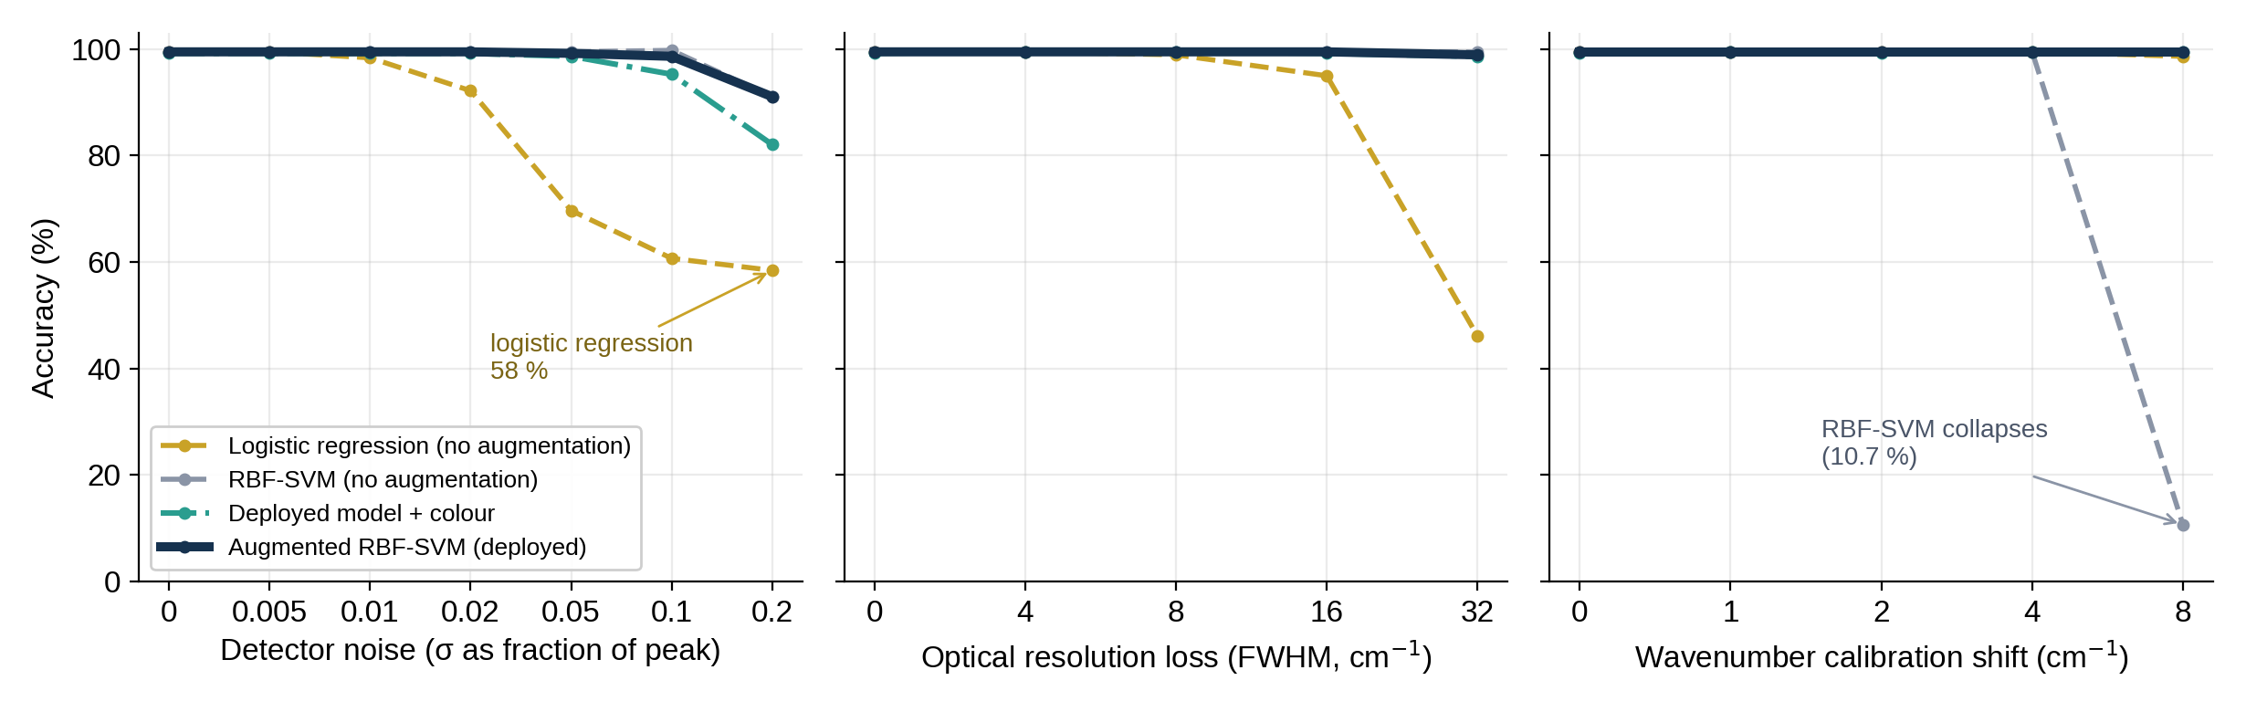
Training on degraded copies removes the weak spots; adding colour does not help
Without augmentation
Deployed augmented model
Colour fusion
RBF-SVM falls to 11 % under a ±8 cm⁻¹ wavenumber shift; logistic regression to 58 % at 20 % noise and 46 % at 32 cm⁻¹ blur.
≥ 99 % up to 5 % noise, 98.9 % at 32 cm⁻¹ blur, 99.4 % at ±8 cm⁻¹ shift and with 50× less signal. 2 % noise ≈ 34× the measured detector noise.
No benefit and slightly worse with noisy spectra (95 % vs 99 % at 10 % noise)
Polyflow · PP/PE FTIR classification
8
Notes:
Models are trained on clean spectra and the held-out fold's spectra are degraded (CV, n=178). Measured detector noise sigma=1.9e-4 A vs peak 0.32 A. Un-augmented ensembles were also worse; ensembles of augmented members match the single augmented SVM but are 2.8x slower.

Slide 9
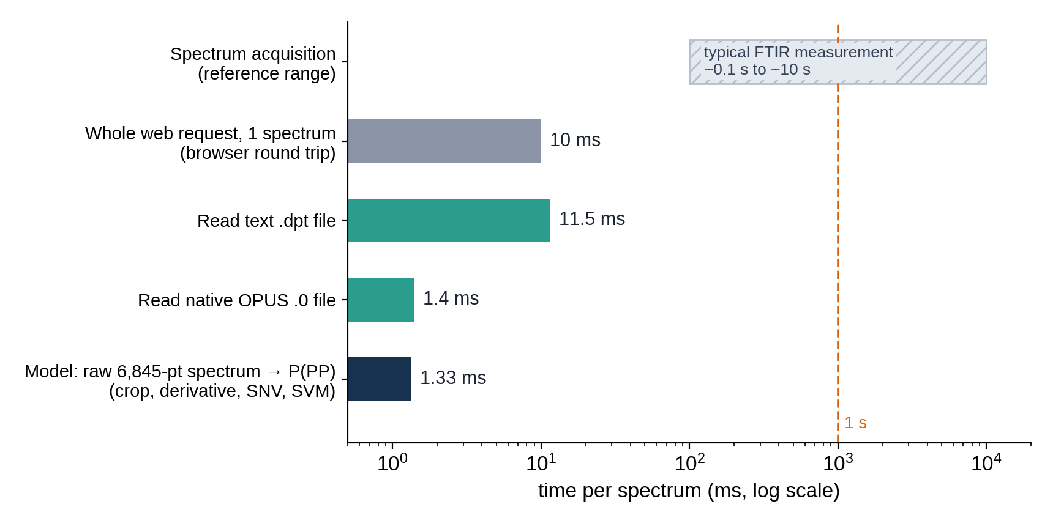
Is ~1 ms real-time? The classifier is not the limiting step; the measurement is
What the figure shows
1.3 ms for the whole model chain (crop, derivative, SNV, SVM) on one CPU thread, no GPU: ≈ 750 spectra/s per thread, ≈ 4,000/s in batch.
Reading the file costs more than the model (1.4 ms native OPUS, 11.5 ms text .dpt); a whole web request is ≈ 10 ms.
A typical FTIR measurement takes far longer (order 0.1–10 s, instrument-dependent, not measured here), so the model never makes the line wait.
Still open: whether this is fast enough for a sorting line depends on the target flakes/s and the spectrometer's scan time. We measured software only, not acquisition, transport or ejection.
Polyflow · PP/PE FTIR classification
9
Notes:
Latency was measured from the raw 6,845-point vector to the probability (median of 200 calls, one thread). The reference range for FTIR acquisition is a general order of magnitude, not a measurement from your instrument. Ask for the target throughput (flakes per second) and the scan settings to give a definite yes/no.

Slide 10
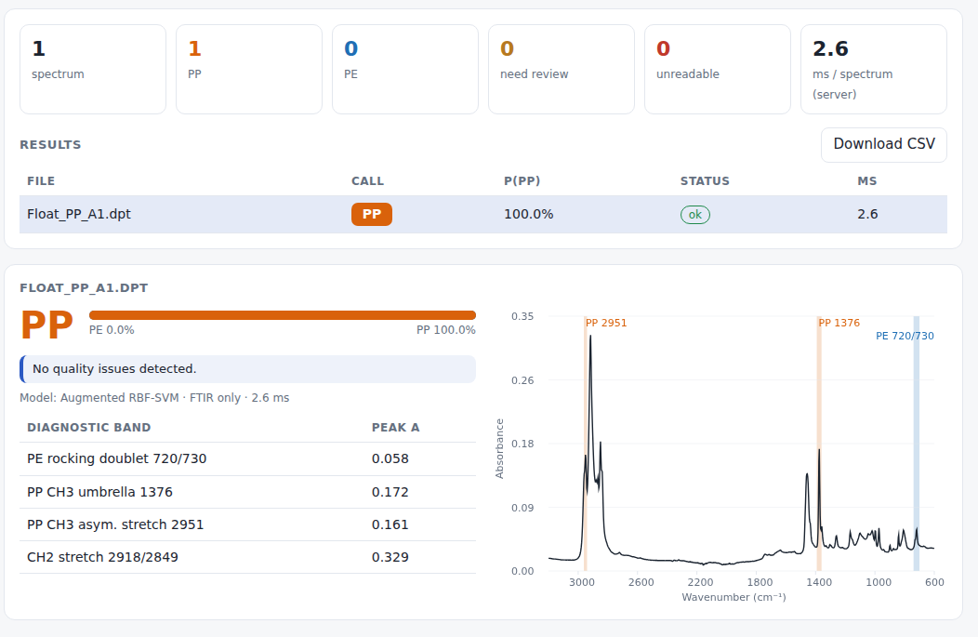
Real time is not the bottleneck; the web service works
1.3 ms
13 points
per spectrum, model only (one CPU thread; ≈ 4,000 per s in batch)
of the C–H stretch band alone still give 99.4 % (leave-source-out)
8 flakes
2 ratios
are enough to reach ≈ 100 % on the hold-out (learning curve)
A720/A1463 and A1376/A1463 give 99.4 %: an interpretable fallback
Web service: drag-and-drop native Bruker .0, .dpt, .csv or .txt; batch upload and CSV export; probability, status and quality flags; no login or HTTPS yet.
Shown: a black PP flake (Impact), classified PP with 100 % probability.
Polyflow · PP/PE FTIR classification
10
Notes:
Latency: median 1.33 ms, p95 1.44 ms (deployed model). Reading a text .dpt costs about 11 ms, native OPUS about 1.4 ms; a whole API call is about 10 ms. Minimal-spectrum and learning-curve results reflect how easy the clean two-class problem is, so treat them as feasibility indications for a cheaper sensor, not as guarantees.

Slide 11
Conclusions
What the evidence supports
What it does not show yet
FTIR alone separates PP from PE: 99.4 % CV, 45/45 hold-out, 99.4 % on unseen batches, 22/22 black flakes.
Colour adds nothing here and mostly encodes the batch; the deployed model is FTIR-only.
Robust and fast: augmented RBF-SVM tolerates noise, blur and ±8 cm⁻¹ shift at 1.3 ms per spectrum.
Delivered: trained model, validation report, and a tested web service for single files and batches.
Labels are library-derived: ‘verified’ equals the Polymerflow ID on every flake. Needs independent truth (DSC / TGA).
Small, easy dataset: 178 flakes, saturated accuracy. The 100 % hold-out is not a blind test; a new batch is.
Black polymers remain open: need black PP and PE from the same batches and low-signal, carbon-black flakes.
Scope: PE vs PP only. Other polymers and blends need a reject class; the Bopp shred is flagged ‘unreliable’.
Bottom line: use the FTIR-only model now; validate it on an independent, harder batch (black, filled, blended) before relying on it for those materials.
Polyflow · PP/PE FTIR classification
11
Notes:
Next steps: (1) independent ground truth for the 'mixed' flakes and a sample of the rest; (2) collect hard cases - black/dark, filled, blends, other polymers, a second instrument; (3) add a reject class; (4) keep FTIR-only until colour is shown to help on batch-balanced black data; (5) auth/HTTPS and instrument integration for deployment.

