Slide 1

C Programing Mini Project:-BlackJack
Teammates
Pranay Joshi 1262252344
Prabhjot Waryah 1262252010

Slide 2
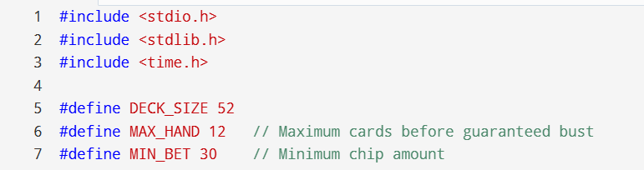
1. Program Setup (Headers & Constants)
• Uses stdio.h, stdlib.h, and time.h libraries.
• DECK_SIZE = 52 defines total cards.
• MAX_HAND = 12 limits maximum cards per hand.
These elements prepare the program for input/output, randomization, and structured gameplay.

Slide 3
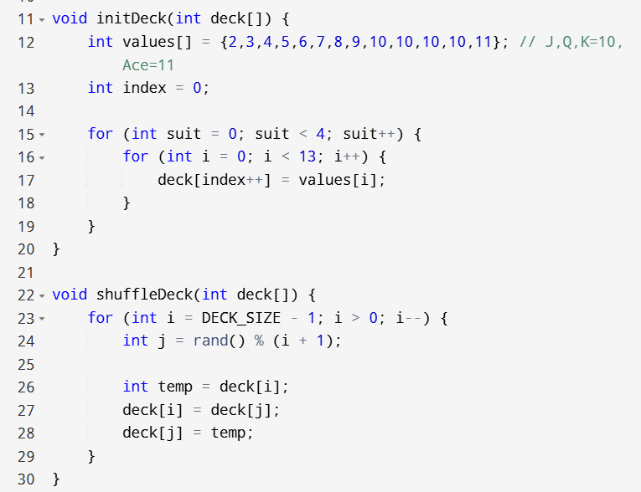
2. Deck Initialization
• initDeck() creates a 52-card deck.
• Face cards (J, Q, K) are assigned value 10.
• Ace is assigned value 11 initially.
• Nested loops repeat values for 4 suits.
This ensures the deck represents a real Blackjack structure.

Slide 4
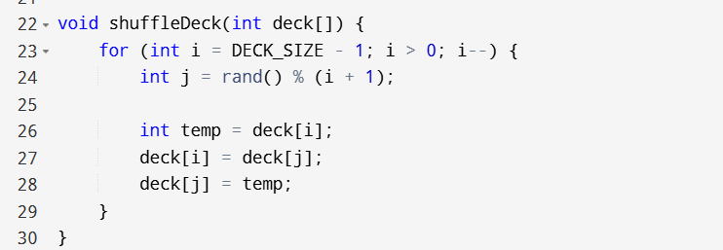
3. Shuffle Logic
• shuffleDeck() randomizes card order.
• Uses Fisher–Yates shuffle algorithm.
• Random swapping ensures fairness.
Each round begins with a freshly shuffled deck.

Slide 5
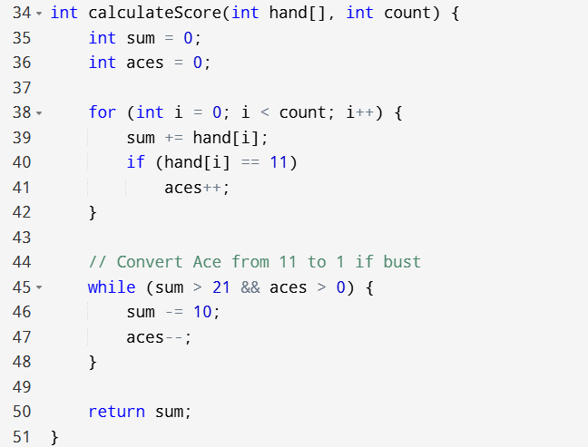
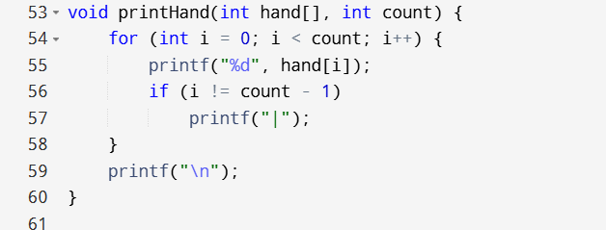
4. Score Calculation & Hand Display
• calculateScore() adds total card values.
• Adjusts Ace from 11 to 1 if total exceeds 21.
• Prevents unnecessary busts.
• printHand() displays cards clearly.
Implements real Blackjack scoring rules.

Slide 6
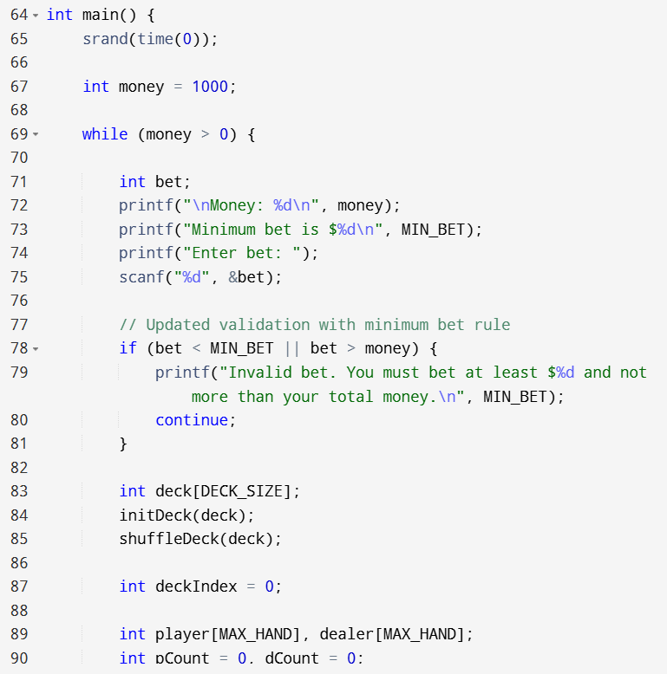
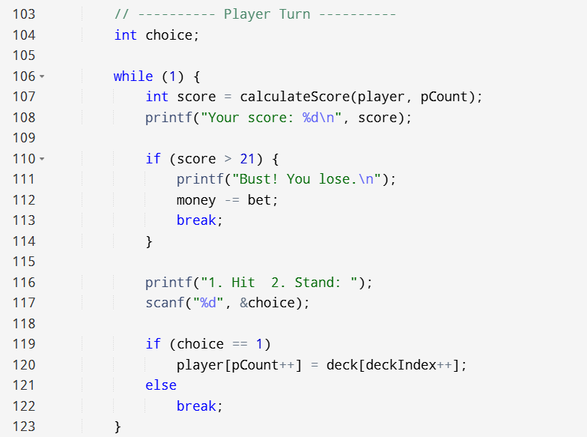
5. Player Turn Logic
• Player receives two initial cards.
• Options: Hit (take card) or Stand (end turn).
• Loop continues until player stands or busts.
• If score > 21 → bet is deducted.
Handles user interaction and decision-making.

Slide 7
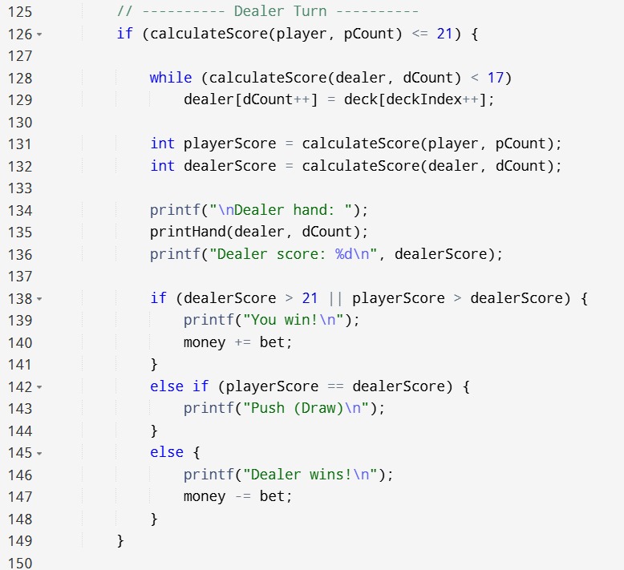
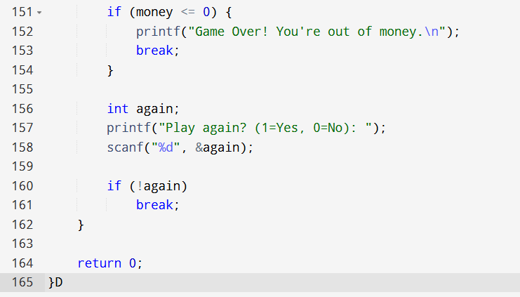
6. Dealer Logic & Betting System
• Dealer draws cards until score ≥ 17.
• Scores are compared to determine winner.
• Player starts with 1000 money units.
• Win → money increases, Lose → money decreases.
• Game continues until money is 0 or player exits.
Demonstrates structured programming and full game flow.

Slide 8
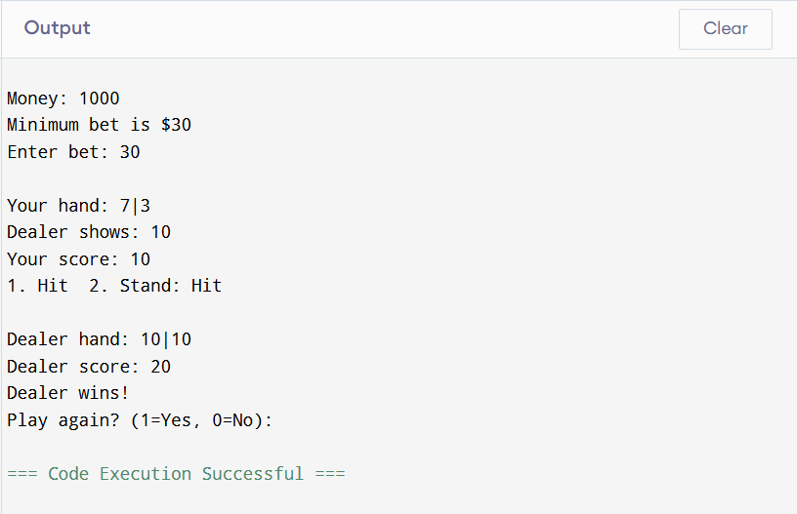
Example

