Slide 1
Dubai Faq Agent
Developed using Lang graph

Slide 2
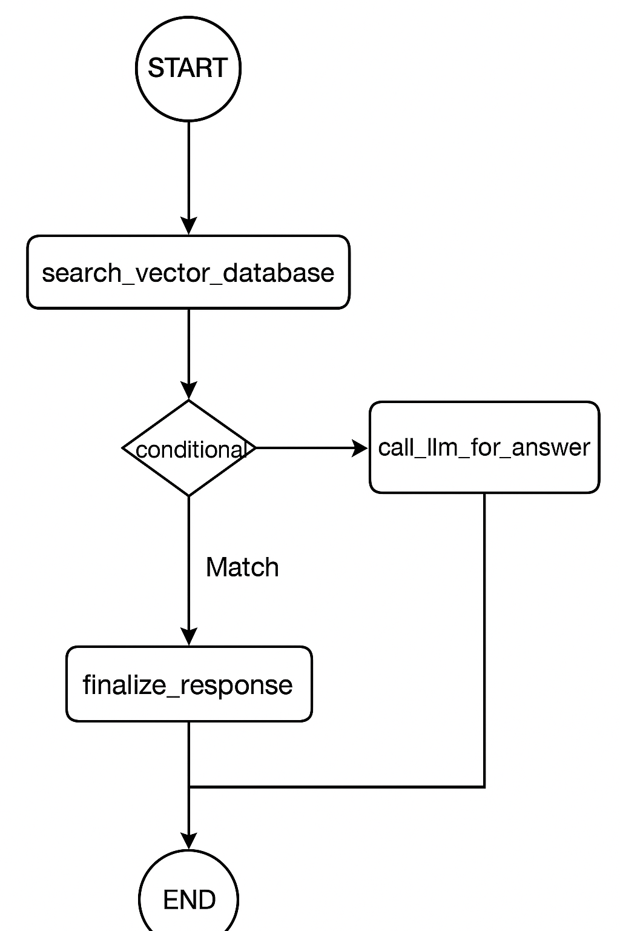
Workflow gRAPh
User asks question

Slide 3
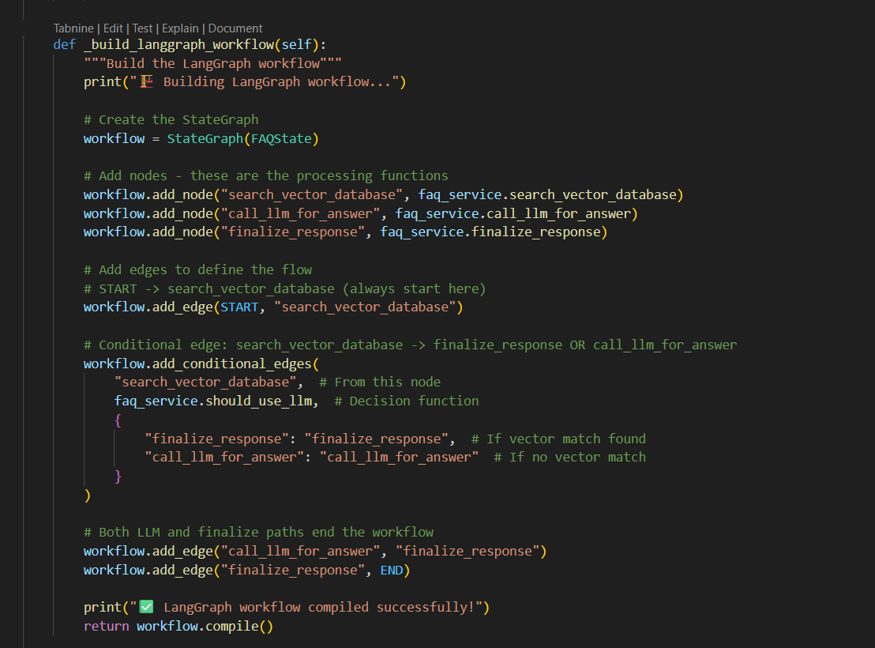
Defining of nodes and edges

Slide 4
Program execution

Slide 5
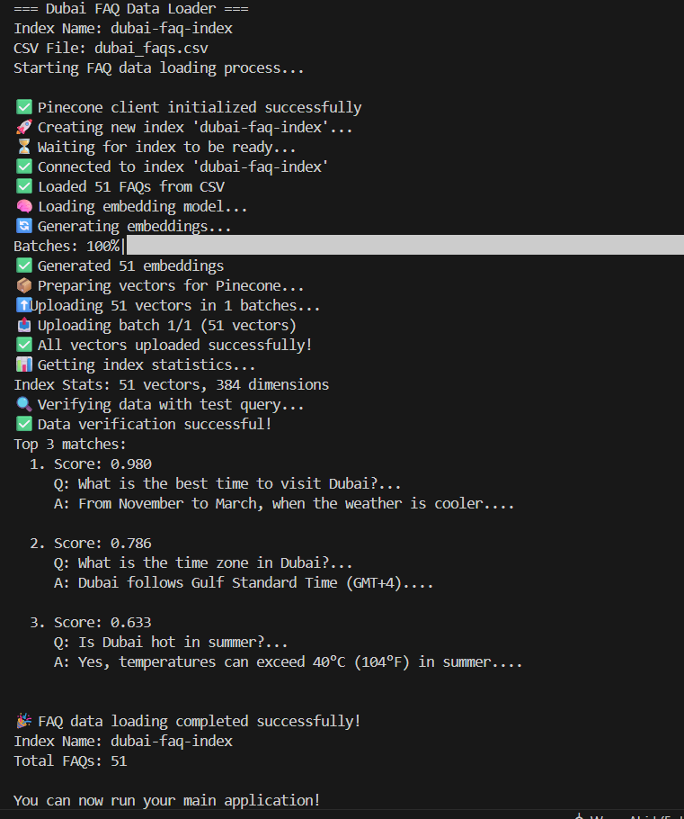
Step 1:
CVS file is read which contains top 50 Dubai FAQ's
Embeddings are made
Stored into pinecone DB

Slide 6
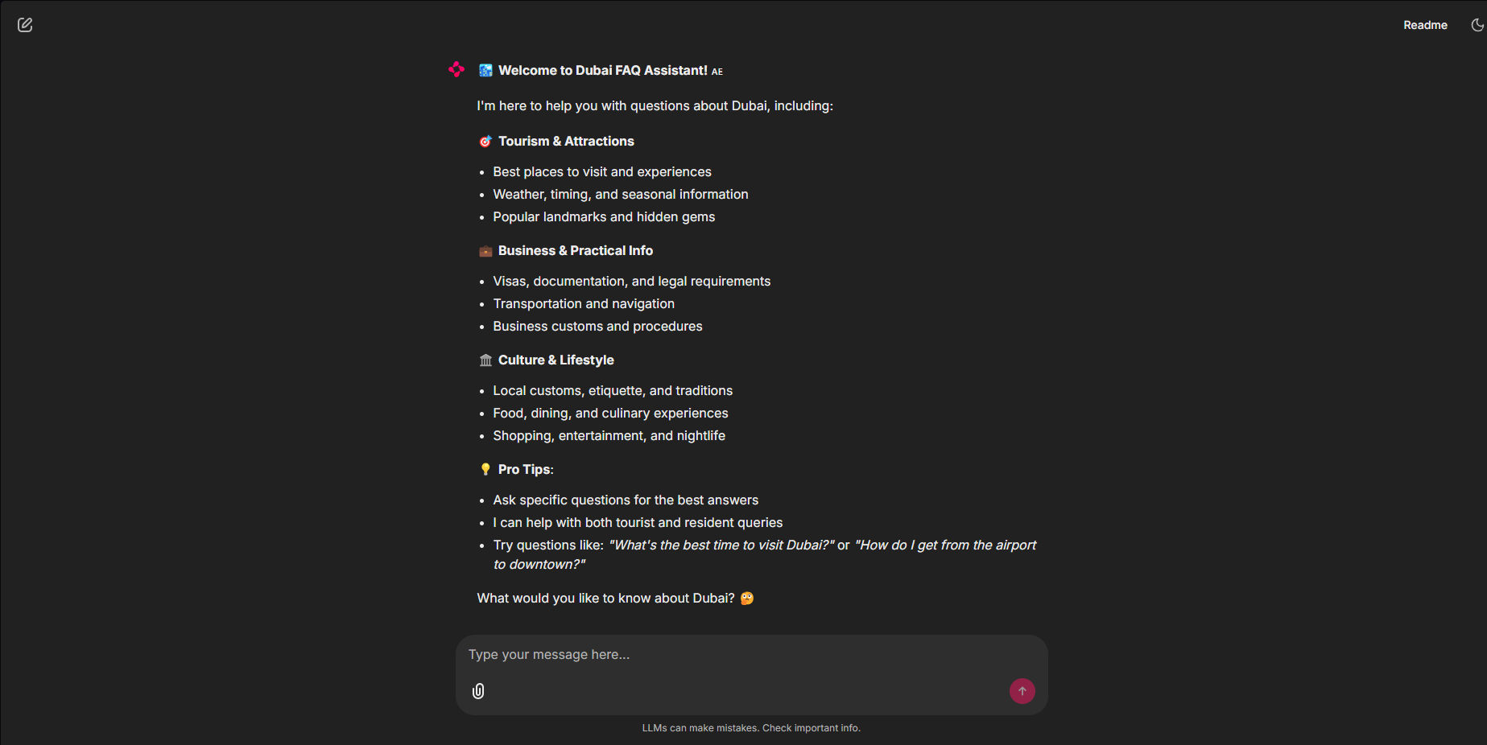
Greeting page

Slide 7
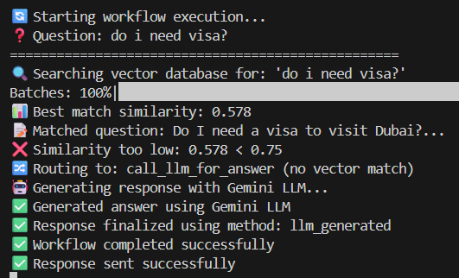
User ask’s a question:

Slide 8
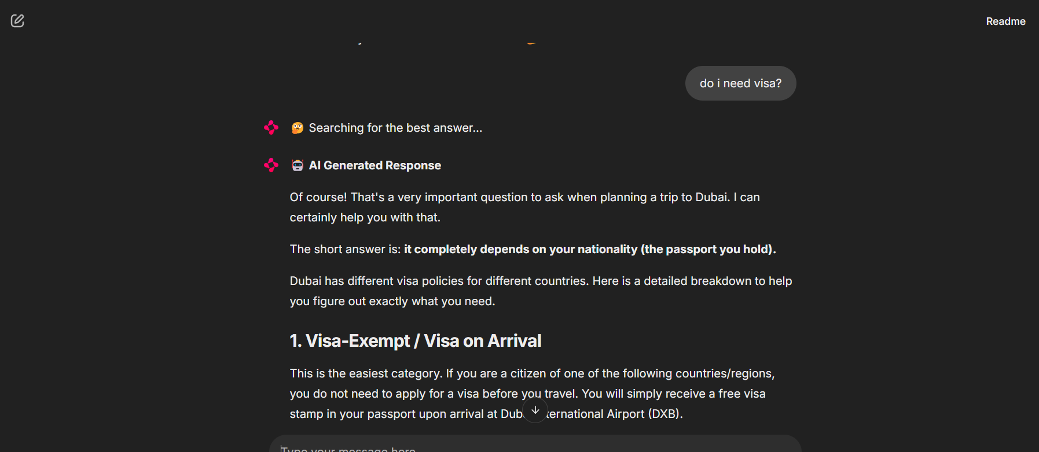
Model’s output

Slide 9
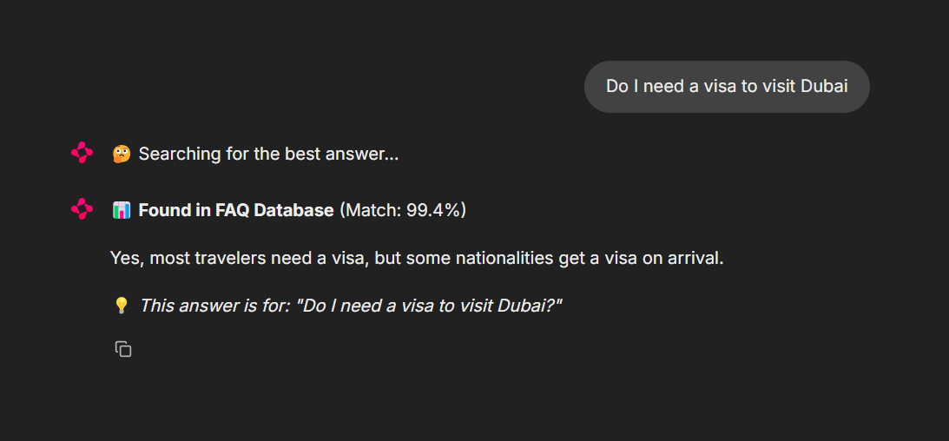
Retrieved Output

