Slide 1
CS 487P Project Report
William Schmid

Slide 2
Google Cloud Platform - BigQuery & CloudSQL
Why GCP?
Cloud systems becoming only more ubiquitous, and I had no experience with any
BigQuery
High levels of parallelization / decentralization when working with the data
Specifically marketed for use with large datasets
CloudSQL
Postgres running on a VM essentially

Slide 3
Benchmarking Goals
Not looking at performance magnitude differences, but how performance decreases as the size of the data being operated on increases
How much of an impact does selectivity have on performance when other variables remain static?
Is BigQuery actually better suited for large data tasks than a traditional solution?

Slide 4
Benchmarking Basics
All tables follow Wisconsin Benchmark schema
No indexes (BigQuery doesn’t support them)
7 execution time measurements for each specification, discard the longest and shortest measurements, and average the remaining measurements to get an average execution time

Slide 5
Benchmark 1: Multi-Way Joins
How will a non-trivial JOIN query scale with table size?
I plan to use the JoinCselASelB query from the paper, which is:
SELECT *
FROM A, B, C
WHERE (A.unique = B.unique)
AND (B.unique = C.unique)
AND (A.unique < X);
Tables A and B will have cardinalities of 50K 500K, 5M, and 50M for each specification of this test
Table C will be 10 times smaller than A and B
X is the cardinality of A divided by 10, so as to provide a selectivity of 10% on the first join
I anticipate BigQuery will have a more linear increase in execution time compared to Cloud SQL, as it is designed to be used on larger datasets

Slide 6
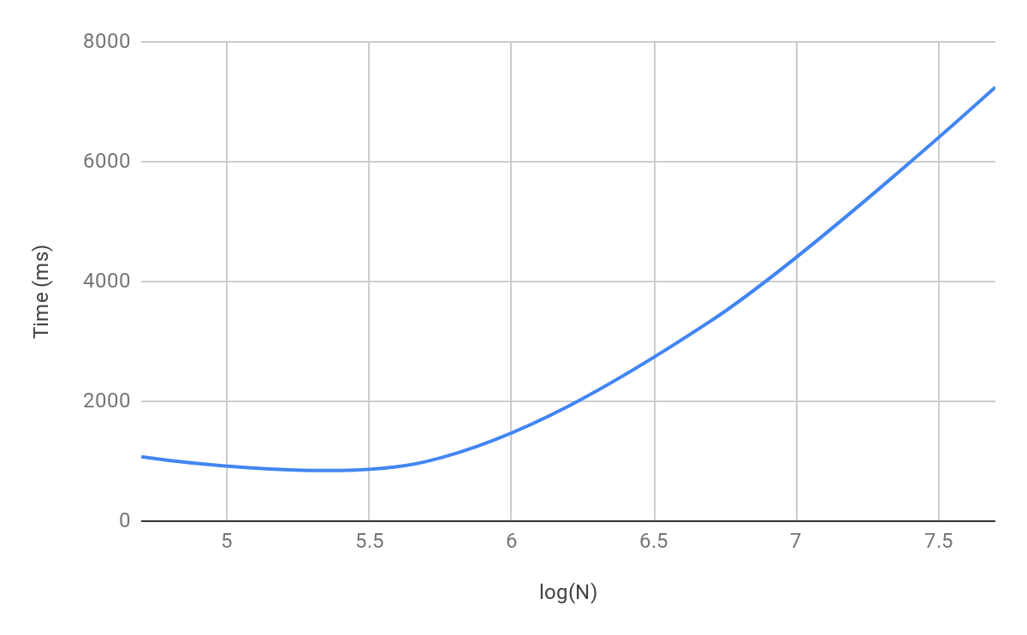
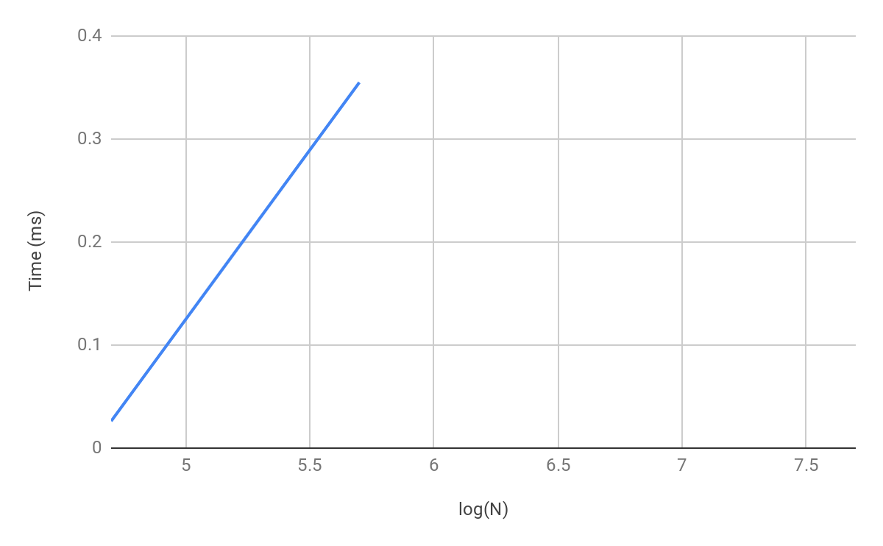
Benchmark 1: Multi-Way Joins
BigQuery
CloudSQL (encountered errors for N > 500K)
N is the cardinality of A/B in the query

Slide 7
Benchmark 1: Multi-Way Joins
CloudSQL couldn’t even execute the query to completion, so at least out of the box, BigQuery is clearly better suited for large multi-way joins
The errors were specifically about reaching the maximum temporary file size in postgres
If errors could be potentially corrected, may be able to draw more meaningful conclusions
As it stands, can’t say much of anything with confidence

Slide 8
Benchmark 2: Join with Varying Selectivity
How will join performance be impacted by selectivity of the join?
Query to be used:
SELECT *
FROM A, B
WHERE (A.unique2 = B.unique2);
Tables A will have a cardinality of 1M for every run
Table B will be either 5K, 10K, 50K to represent selectivities of .5%, 1%, 5%, 10%, and 25% respectively
I again anticipate BigQuery to have a flatter performance curve than Cloud SQL, as it is should theoretically scale to larger selectivities with more ease

Slide 9
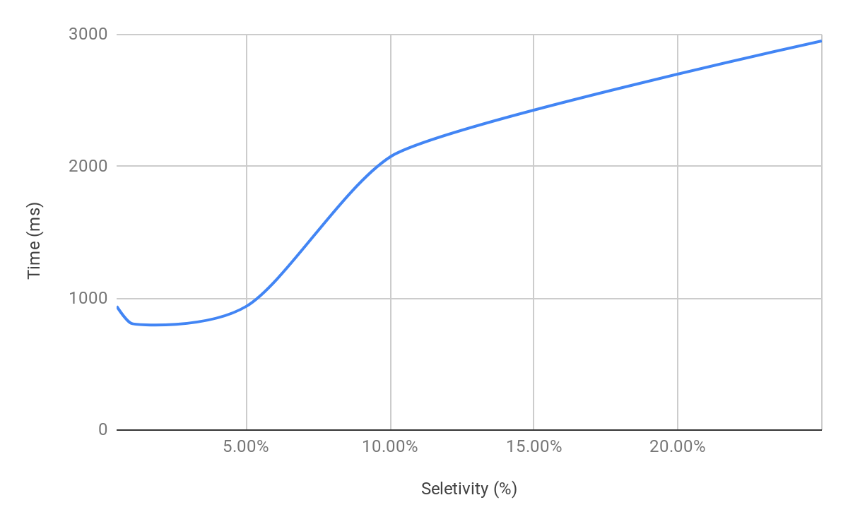
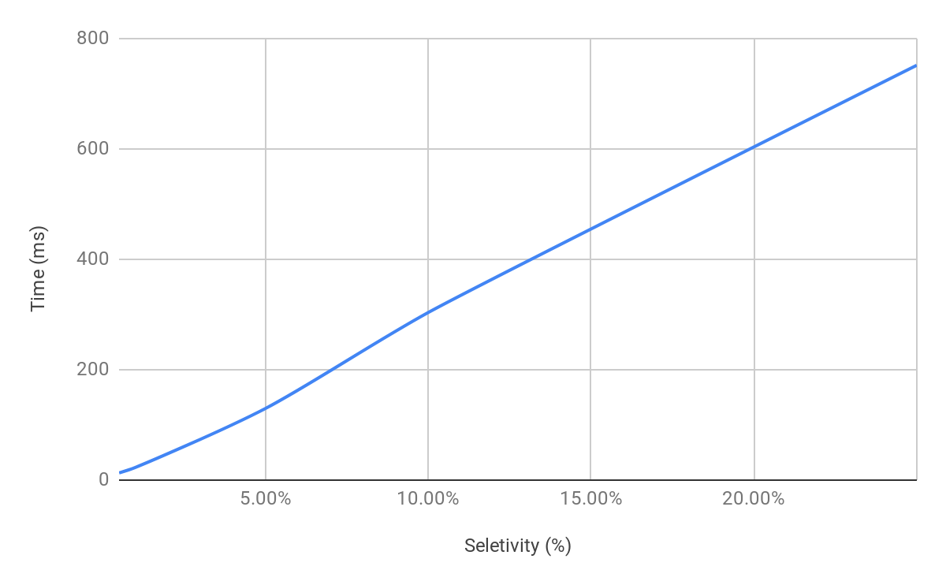
Benchmark 2: Join with Varying Selectivity
BigQuery
CloudSQL

Slide 10
Benchmark 2: Join with Varying Selectivity
CloudSQL maintains a very close to linear relationship with selectivity to performance
BigQuery more uneven, but seems to smooth out to a flatter curve as the selectivity increases
Results seem to match expectations

Slide 11
Benchmark 3: Aggregate Operation
How does performance with each system scale when using an aggregate operator?
Query to be used:
SELECT AVG(unique2)
FROM A;
Tables A will have a cardinality varying from 50K to 50M like Benchmark 1
Like the previous benchmarks, I expect BigQuery to have a relatively smaller increase in execution time compared to Cloud SQL for larger aggregations

Slide 12
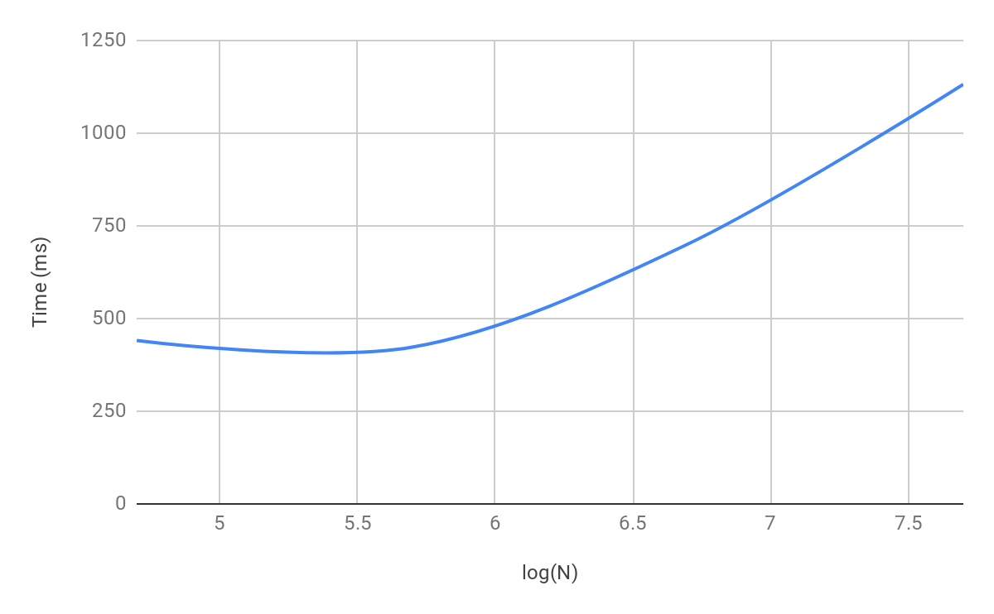
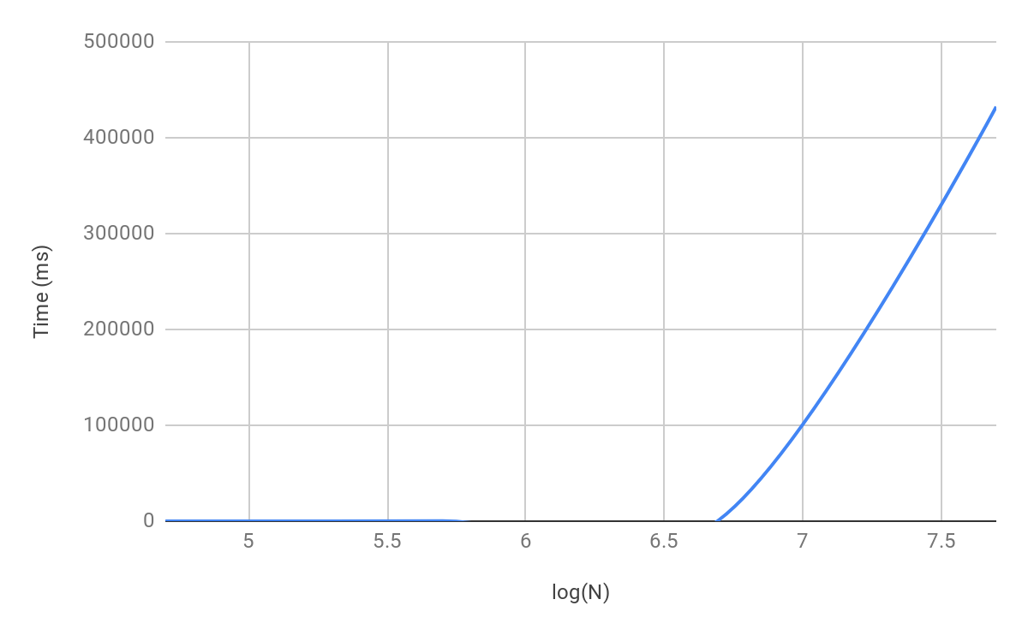
Benchmark 3: Aggregate Operation
BigQuery
CloudSQL
N is the cardinality of A in the query

Slide 13
Benchmark 3: Aggregate Operation
CloudSQL had a dramatic increase in execution time as N grew larger
By contrast, BigQuery scaled extremely well with N (potentially even better than linearly, although it’s hard to tell just from looking at the graph)
The results again matched the expected outcome

Slide 14
Benchmark 4: Selectivity
How will varying selectivity impact the performance of a select operation?
Query to be used:
SELECT *
FROM A
WHERE (unique1 < X);
Table A will have a cardinality of 1M for every run
X will be either 5K, 10K, 50K to represent selectivities of .5%, 1%, 5%, 10%, and 25% respectively
I again anticipate BigQuery to have a flatter performance curve than Cloud SQL, as it is should theoretically scale to larger selectivities with more ease

Slide 15
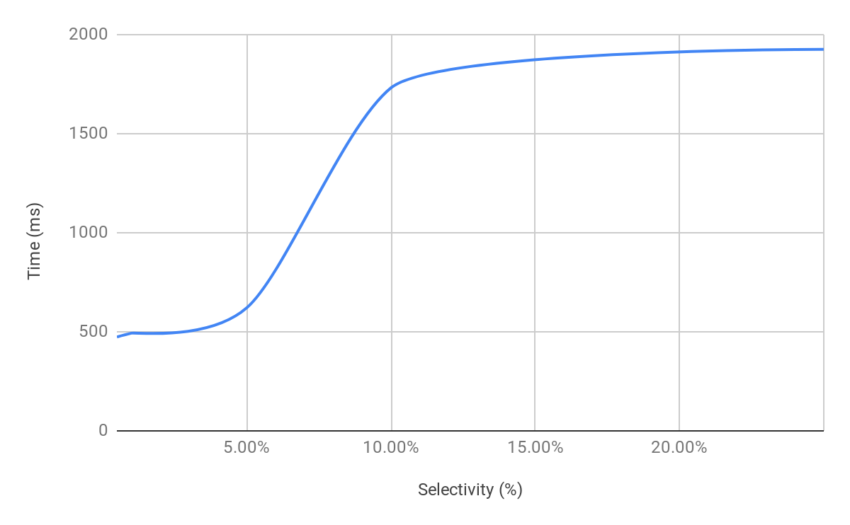
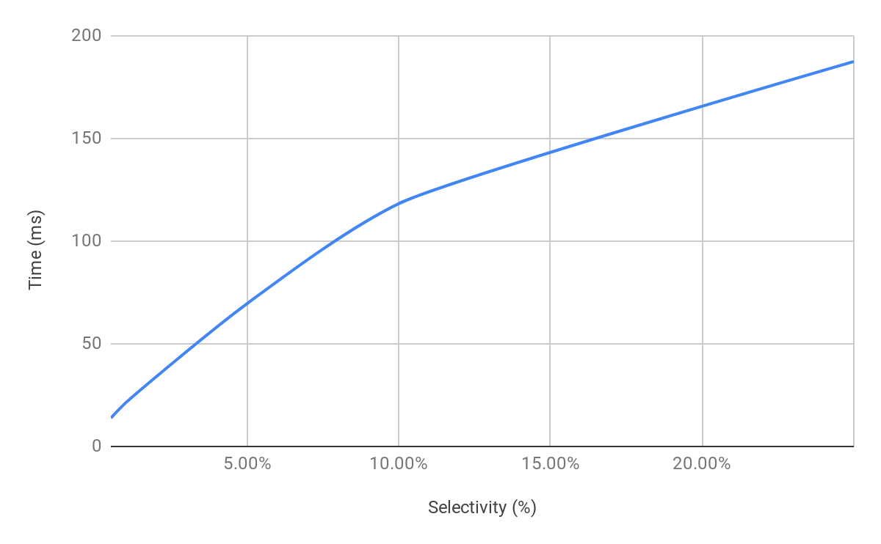
Benchmark 4: Selectivity
BigQuery
CloudSQL

Slide 16
Benchmark 4: Selectivity
Similar to Benchmark 2, CloudSQL has an almost linear performance curve
BigQuery, also as in Benchmark 2, has a curve that flattens out as the selectivity increases
BigQuery demonstrates again that it can work with large amounts of tuples quicker than a traditional DB, and the results of the benchmark are as expected

Slide 17
Conclusions
BigQuery seemed to handle the larger relations with much more ease than CloudSQL
For every benchmark (sans the first which can’t really be used for any analysis), BigQuery had a performance curve that seemed to indicate more flattening out than CloudSQL, which either had a linear relationship or worse
BigQuery also started to have a magnitudinal performance advantage over CloudSQL once the number of tuples being worked with got very high (but this wasn’t really the point of these benchmarks)

Slide 18
Lessons Learned
I learned a ton about navigating the Google Cloud Platform, as well as importing/exporting data between local and cloud systems
I learned the degree to which larger datasets can really become burdensome to performance (especially importing data into CloudSQL…)
I learned that while a product may indeed be better suited for larger amounts of data, it still may be absolutely trounced by a more traditional DB if you aren’t actually working with large amounts of data

