Slide 1

A Network Programming Language
David Walker
Princeton University
Joint work with Nate Foster, Michael J. Freedman, Rob Harrison,
Christopher Monsanto, Mark Reitblatt, Jennifer Rexford, and Alec Story
at Princeton and Cornell Universities

Slide 2

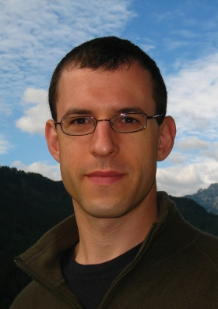






The Team
Nate Foster
Mike Freedman
Rob Harrison
Chris Monsanto
Mark Reitblatt
Jen Rexford
Alec Story

Slide 3

Traditional Networks
Control Plane (software):
Track topology; compute
routes; install forwarding tables
Management:
Monitor traffic
Configure policies
Data Plane (hardware):
Forward, filter, buffer, mark,
rate-limit packets; collect stats

Slide 4
A Recent Idea: (Re)Move the Control Plane?
Move the control plane out of the switch boxes and in to separate, general-purpose computers
Companies buy the forwarding hardware, but implement their own control software
Simpler routers ==> cheaper, more flexible routers
the same hardware box can be a router, a switch, a NAT, a firewall, or some new combination
you don’t have to buy that special million $ load balancer from the networking company
Accelerated innovation
Notes:
router (IP address), switch (MAC address), NAT (IP address and TCP/UDP port), firewall (drop IP addresses, protocol, TCP/UDP port), ... and combinations of them

Slide 5

Controller Machine
Programs running on general-purpose machines implement control and management planes
Monitor network traffic, track topology, decide on routes, install forwarding tables
Data Plane

Slide 6
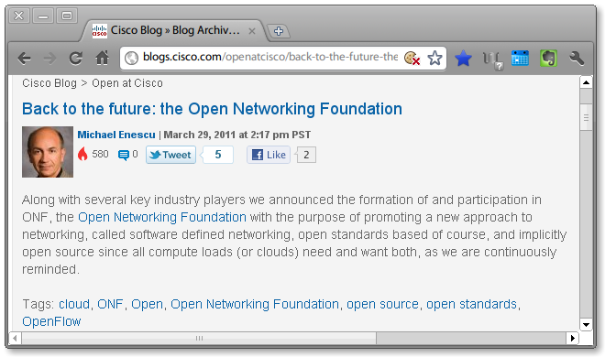
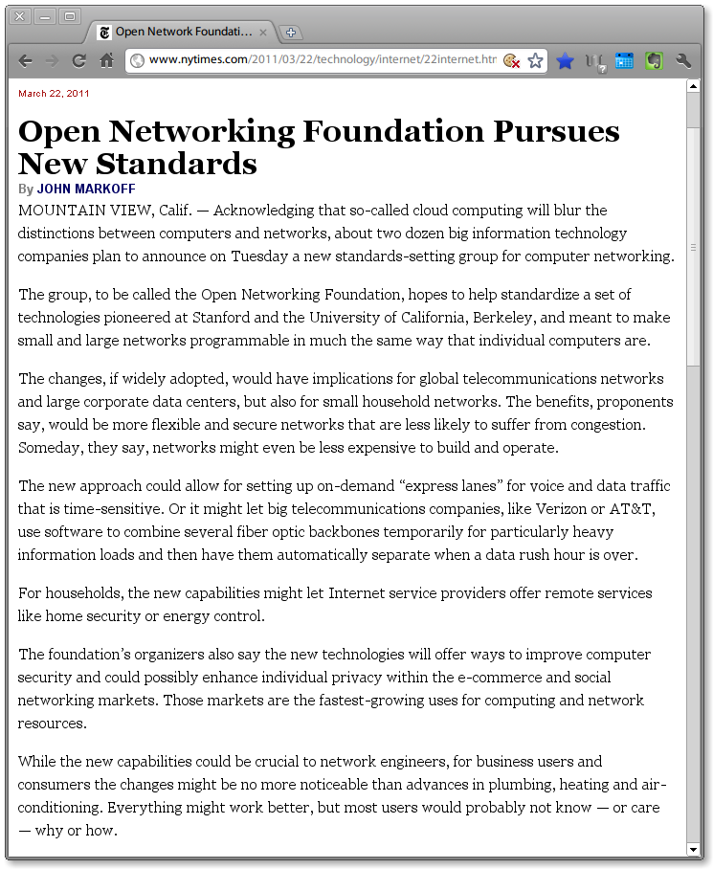
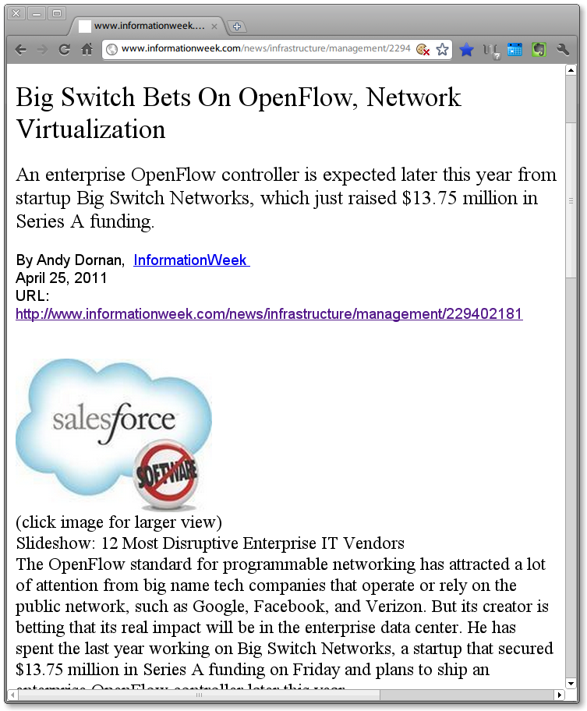
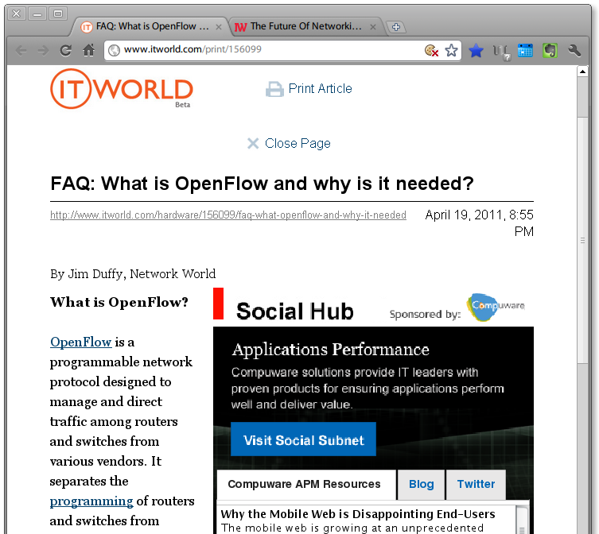
Momentum
New Applications
Seamless host mobility
Network virtualization
Dynamic access control
Energy efficient datacenter management
Web server load balancing
Everyone has signed on:
Microsoft, Google, Cisco, Yahoo, Facebook, …

Slide 7
New Challenges
OpenFlow makes programming networks of switches possible, but doesn’t make it easy
A thin veneer over the switch hardware
A challenging programming problem
Our goals:
Develop language support that facilitates network programming
New abstractions
More modular
More reliable
More secure

Slide 8
This Talk
OpenFlow & NOX in more depth
Existing programming model and problems
Frenetic Language
New abstractions for network programming
Frenetic Run-time System
Implementation strategy and experience

Slide 9
OpenFlow Switches
Flow Table
Packet Header Pattern | Action | Bytes | Packets
01010 | Drop | 200 | 10
010* | Forward(n) | 100 | 3
011* | Controller | 0 | 0
priority

Slide 10
NOX: A Controller Platform
Controller Application
NOX – Controller Platform
Exports Rule-management interface:
Install OpenFlow rule
Uninstall OpenFlow rule
Ask for stats associated with rule
Exports Events:
Packet in
Topology Changes
Controller

Slide 11
OpenFlow Architecture
Controller
Control Messages
Add/remove rules
Network Events
Forwarding table miss
Switches

Slide 12
Problem I: Modular Programming
Controller Application
Routing
Module
Monitoring
Module
R: forward port 1 to port 2
query web traffic?
1
2
R installed
Doesn’t work! Repeater rules too
coarse-grained

Slide 13
Modular Programming: A Different View
Repeater
Repeater/Monitor
def switch_join(switch):
repeater(switch)
def repeater(switch):
pat1 = {in_port:1}
pat2 = {in_port:2}
install(switch,pat1,DEFAULT,None,[output(2)])
install(switch,pat2,DEFAULT,None,[output(1)])
def switch_join(switch)
repeater_monitor(switch)
def repeater_monitor(switch):
pat1 = {in_port:1}
pat2 = {in_port:2}
pat2web = {in_port:2, tp_src:80}
Install(switch, pat1, DEFAULT, None, [output(2)])
install(switch, pat2web, HIGH, None, [output(1)])
install(switch, pat2, DEFAULT, None, [output(1)])
query_stats(switch, pat2web)
def stats_in(switch, xid, pattern, packets, bytes):
print bytes
sleep(30)
query_stats(switch, pattern)
Web Monitor
def monitor(switch):
pat = {in_port:2,tp_src:80}
install(switch, pat, DEFAULT, None, [])
query_stats(switch, pat)
def stats_in(switch, xid, pattern, packets, bytes):
print bytes
sleep(30)
query_stats(switch, pattern)
blue = from repeater
red = from web monitor
green = from neither

Slide 14
Problem II: Network Race Conditions
A challenging chain of events:
Switch
sends packet to controller
Controller
analyzes packet
updates its state
initiates installation of new packet-processing rules
Switch
hasn’t received new rules
sends new packets to controller
Controller
confused
packets in the same flow handled inconsistently
Controller

Slide 15
Problem III: Two-tiered Programming Model
Tricky problem:
Controller activity is driven by packets sent from switches
Efficient applications install rules on switches to forward packets in hardware
Constant questions:
“Is that packet going to come to the controller to trigger my computation?”
“Or is it already being handled invisibly on the switch?”
Controller

Slide 16
Three Problems – One Common Cause
Three problems:
Non-modular programming: Programs can’t be divided into modules for monitoring and forwarding
Network race conditions: The controller sees more events (packets) than it anticipates
Two-tiered programming: Will the controller be able to see the appropriate events given the forward rules installed?
One common cause:
No effective abstractions for reading network state

Slide 17
The Solution
Separate network programming into two parts:
Abstractions for reading network state
Reads should have no effect on forwarding policy
Reads should be able to see every packet
Abstractions for specification of forwarding policy
Forwarding policy must be separated from implementation mechanism
A natural decomposition that mirrors the two fundamental tasks of network management
Monitoring and forwarding

Slide 18
This Talk
OpenFlow & NOX in more depth
Existing programming model and problems
Frenetic Language
New abstractions for network programming
Frenetic Run-time System
Implementation strategy and experience

Slide 19
Frenetic Language
Abstractions for reading network state:
Realized as an integrated network query language
select, filter, group sets of packets or statistics
designed so that most computation can occur on switches in the data plane
Abstractions for specification of forwarding policy:
Realized as a functional stream processing library
generate streams of network policies
transform, split, merge, filter policies & other data streams
Current Implementation:
A set of python libraries on top of NOX

Slide 20
Frenetic Queries
1
2
Goal: measure the total bytes of web traffic arriving on port 2,
every 30 seconds
data to be returned from query
(options: sizes, counts, packets)
filter based on packet headers
(web traffic in on port 2)
def web_query():
return (Select (sizes) *
Where (inport_fp (2) & srcport_fp (80)) *
Every (30))
period: 30 seconds
Key Property: Query semantics independent of other program parts
Notes:
obviously the right thing to do once you’ve found the correct abstraction, but it’s hard to see the sunlight grassy fields from the depths of the foggy marsh. It took us a year.

Slide 21
Frenetic Queries
1
2
Goal: sum the number of packets, per host (ie: mac address),
traveling through port 2, every minute
def host_query():
return (Select (counts) *
Where (inport_fp(2)) *
GroupBy ([srcmac]) *
Every (60))
categorize results by srcmac address

Slide 22
Frenetic Queries
Goal: report the hosts connected to each switch port;
report a host each time it moves from one port to the next
get packets for analysis
def learning_query():
return (Select (packets) *
GroupBy ([srcmac]) *
SplitWhen ([inport]) *
Limit (1))
at most one packet per flow
categorize by srcmac
sub-categorize when the inport changes (the host moves)
Key Property: Query implementation handles network race conditions

Slide 23
Using Queries
Query results, or other streams, are piped in to listeners
def web_query(): …
def host_query(): …
def learning_query(): …
def web_stats():
web_query() >> Print()
def all_stats():
Merge(web_query(), host_query()) >> Print()
Key Property: Queries compose

Slide 24
Frenetic Forwarding Policies
1
2
rule actions
Goal: implement a repeater switch
rules = [Rule(inport_fp(1), [forward(2)]),
Rule(inport_fp(2), [forward(1)])]
def repeater():
return (SwitchJoin() >>
Lift(lambda switch: {switch:rules}))
listen for switch joining the network
packet pattern
(defined over headers)
def main():
repeater() >> register()
construct repeater policy for that switch
Key Property: Policy semantics independent of other queries/policies
register policy with run time

Slide 25
Program Composition
Goal: implement both the stats monitor and the repeater
def main():
repeater() >> register()
all_stats()
Key Property: Queries and policies compose

Slide 26
One More Example
Goal: combine the repeater with a security policy
def filter_ips(ips, policy):
return (subtract_p(policy, {srcips:ips}))
def secure(policy_stream):
return (Pair(bad_ips(), policy_stream) >>
Lift(filter_ips))
def main():
secure(repeater()) >> register()
all_stats()
Key Property: declarative semantics + functional programming = modularity
Notes:
Note: think about complexity of repeatedly iterating through a large list of ips. How to do it better?

Slide 27
This Talk
OpenFlow & NOX in more depth
Existing programming model and problems
Frenetic Language
New abstractions for network programming
Frenetic Run-time System
Implementation strategy and experience

Slide 28
Frenetic System Overview
Frenetic User Program
High-level Language
Integrated query language
Effective support for composition and reuse
Run-time System
Interprets queries, policies
Installs rules
Tracks stats
Handles asynchronous behavior
query,
register policy
query response,
status streams
Frenetic Run-time System
compile policies/
queries,
install rules
manage stats,
filter packets,
process events
NOX

Slide 29
Implementation Options
Rule Granularity
microflow (exact header match)
simpler; more rules generated
wildcard (multiple header match in single rule)
more complex; fewer rules (may be) generated
Rule Installation
reactive (lazy)
first packet of each new flow goes to controller
proactive (eager)
new rules pushed to switches
Frenetic 1.0
Frenetic 2.0

Slide 30
Run-time Activities
Frenetic Program
Register
Policy
NOX
NOX
Install Flow
Packet In
Check Rules
Do Actions
Packet
Frenetic Runtime System
Frenetic Program
NOX
Dataflow in to Runtime
Dataflow out from Runtime
Runtime Module
Runtime Data Structure

Slide 31
Run-time Activities
Frenetic Program
Query
Register
Stats
NOX
NOX
Update Stats
Stats In
Policy
Monitoring Loop
Stats Request
NOX
Install Flow
Packet In
Check Subscribers
Check Rules
Do Actions
Packet
Frenetic Runtime System
Frenetic Program
NOX
Dataflow in to Runtime
Dataflow out from Runtime
Runtime Module
Runtime Data Structure

Slide 32
Run-time Activities
Frenetic Program
Query
Query
Register
Packets
Policy
NOX
NOX
Stats
Update Stats
Stats In
Policy
Monitoring Loop
Stats Request
NOX
Install Flow
Packet In
Check Subscribers
Check Rules
Do Actions
Packet
Packet
Packet
Send Packet
Frenetic Runtime System
Frenetic Program
NOX
Dataflow in to Runtime
Dataflow out from Runtime
Runtime Module
Runtime Data Structure

Slide 33
Preliminary Evaluation
Micro Benchmarks
Coded in Frenetic & Nox
Core Network Applications
Learning Switch
Spanning Tree
Shortest path routing
DHCP server
Centralized ARP server
Generic load balancer
Additional Apps
Memcached query router
Network scanner
DDOS defensive switch

Slide 34
MicroBench: Lines of Code
Lines
of
Code
No monitoring
Web Statistics
Heavy Hitters
Forwarding Policy:
HUB: Floods out other ports
LSW: Learning Switch
Monitoring Policy
Notes:
Heavy hitters: group by mac address.

Slide 35
MicroBench: Controller Traffic
Traffic
to
Controller
(kB)
No monitoring
Heavy Hitters
Web Statistics
Forwarding Policy:
HUB: Floods out other ports
LSW: Learning Switch
Monitoring Policy

Slide 36
Future Work
Performance evaluation & optimization
Measure controller response time & network throughput
Support wildcard rules and proactive rule installation
Parallelism
Program analysis & network invariants
Hosts and Services
Extend queries & controls to end hosts
More abstractions
Virtual network topologies
Network updates with improved semantics

Slide 37
Conclusion: An Analogy
Concern | Assembly Languages |  | Programming Languages
 | x86 | Nox | F#/C#/Java | Frenetic++
Resource Allocation | Move values in to/out of registers | Install, uninstall, reinstall switch rules | Declare program variables | Declare forwarding policy
Resource Tracking | Have I spilled that value? | Will that packet arrive at the controller? | Program variables always accessible | See every packet abstraction
Coordination across program parts | Explicit calling conventions | Globally shared switch state: rules, priorities, counters | Function call boundaries managed automatically | Forwarding policy and query composition managed automatically
Portability | Hardware Dependent | Hardware Dependent | Hardware Independent | Hardware Independent

Slide 38
http://frenetic-lang.org

