Slide 1

ndnSIM: a modular NDN simulator
Introduction and Tutorial
http://ndnsim.net
ndnSIM@lists.cs.ucla.edu
Alex afanasyev
alexander.afanasyev@ucla.edu

Slide 2
Outline
Introduction
  current status
  usage scope
  new additions
  ndnSIM internals
Tutorial
  getting started
  prepare the environment for simulations
    use scratch folder (not recommended)
    use separate repository
  writing basic scenario
    running scenario
    collecting metrics

Slide 3
Introduction
Based on NS-3 network simulator
ndnSIM implements all basic NDN operations
Has modular architecture
  C++ classes for every NDN component
    Face, PIT, FIB, Content store, and Forwarding strategy
Allows combining different implementations of core NDN components
  Different management schemes for PIT
  Different replacement policies for content store
  Different forwarding strategies
Can be easily extended
Easy to use: plug in and experiment

Slide 4
Ultimate Goal
Establishing a common platform to be used by the community for all NDN simulation experimentations
  So that people can compare/replicate results

Slide 5
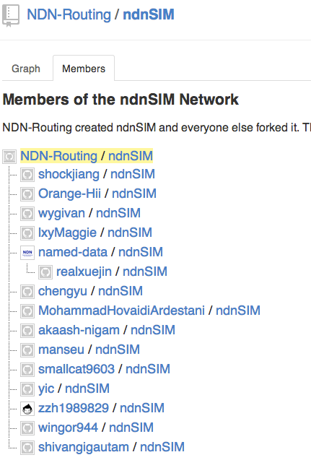
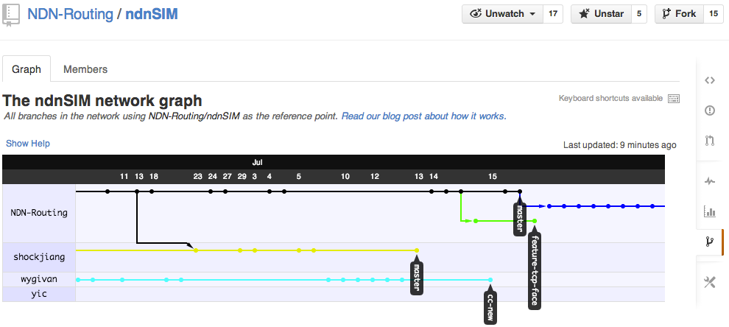
Current status
17 public forks on github
Active development
  new features
  extended API
  usage examples and documentation
A lot of activity on the mailing list

Slide 6
ndnSIM usage scope trends
(based on published papers and mailing list data)
http://ndnsim.net/ndnsim-research-papers.html#research-papers-that-use-ndnsim
  at least 5 published papers (by the early adopters, excluding us) use ndnSIM
Caching-related evaluation
  various caching replacement policies, collaborative caching
Congestion control related
  TCP-like transfers (end-to-end, host-by-host)
  queueing
Mobile and vehicular environment evaluations
DDoS-related evaluations
  interest flooding (us)
  content poisoning
Forwarding strategy experimentation (us)
  behavior in the presence of link failures, prefix black-holing
Application-level evaluations (us)
  exploration of ChronoSync protocol design

Slide 7
Modular ndnSIM structure overview
Applications
NetDevice
(connection to other nodes)
Face (ndn::AppFace,
ndn::ApiFace*)
Face
(ndn::NetDeviceFace)
Core NDN Protocol (ndn::L3Protocol)
ndn::
ContentStore
ndn::Pit
ndn::Fib
ndn::
Forwarding
Strategy
LRU, LFU, Random, with or without evicting stale data,
others
Unbounded, bounded, “Persistent”, “Random” retention policies for PIT entries
BestRoute, Flooding, SmartFlooding, PerOutFaceLimits, PerFibLimits,
others
Notes:
* new addition (explained on next slide)

Slide 8
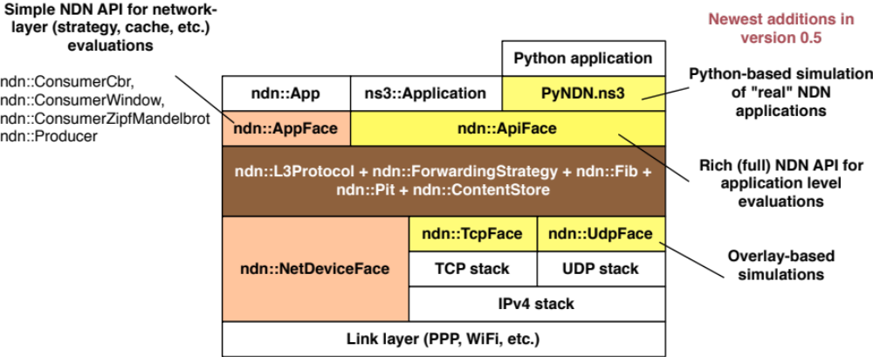
Faces (ndn::Face)
Abstraction from underlying protocols
  callback registration-deregistration
  packet encapsulation
  NEW in version 0.5 selectable pluggable wire format
    optimized/simplified ndnSIM (http://ndnsim.net/ndnsim-packet-formats.html)
    CCNb
Notes:
Callback: functions that are called when an event happens. In ccnx these are called "closures," but callback (my opinion) is much more common and widely used term for that.

Slide 9
New additions in version 0.5 (soon to be released)
Advanced application API
  now it is possible to write full featured applications
    compatible C++ API with NDN.cxx
      https://github.com/named-data/ndn.cxx
    compatible python API with PyNDN
      https://github.com/cawka/PyNDN
  ultimate goal: compile (just run in case of python) real applications inside the simulator
Redesigned/simplified/unified API for Interest and Data packets, Forwarding strategy
  not fully backward compatible, but simple to adapt
Exclude filter support
  other interest selectors may be coming, if requested
Support for overlay-based simulations
  using ndn::TcpFace and ndn::UdpFace
Support for multiple wire format selectable at runtime
  optimized and simplified ndnSIM format
  full-featured (but not too optimal) CCNb format
  other experimental formats

Slide 10
General use of ndnSIM
Define topology
  Manually
  Using various readers (http://ndnsim.net/examples.html#node-grid-example-using-topology-plugin)
Create ndn::StackHelper
  Define ContentStore size and policy
    ns3::ndn::cs::Lru (default size 100), ... Fifo, ... Random
    ns3::ndn::cs::Stats::Lru, ...Fifo, ...Random
    ns3::ndn::cs::Freshness::Lru, ...Fifo, ...Random
  Define Forwarding Strategy
    ns3::ndn::fw::Flooding (default), ...SmartFlooding, ...BestRoute
Set up routes between nodes
  manually
  semi-automatic
Define and assign applications
Collect metrics

Slide 11
Forwarding strategies
Abstraction control all aspect of Interest and Data packet forwarding
  specify where to forward Interest packets
  track data plane performance for Data packets
Available strategies
  Flooding strategy (default)
    Interests will be forwarded to all available faces available for a route (FIB entry). If there are no available GREEN or YELLOW faces, interests is dropped.
  Smart flooding strategy
    If GREEN face is available, Interest will be sent to the highest-ranked GREEN face. If not, Interest will be forwarded to all available faces available for a route (FIB entry)
  Best-Route strategy
    If GREEN face is available, Interest will be sent to the highest-ranked GREEN face. If not, Interest will be forwarded to the highest-ranked YELLOW face.
Easy to write your own strategy or redefine aspects of the existing ones

Slide 12
An initial set of applications
http://ndnsim.net/applications.html
ndn::ConsumerCbr
  generates Interest traffic with predefined frequency
ndn::ConsumerBatches
  generates a specified number of Interests at specified points of simulation
ndn::ConsumerWindow
  very basic approximation of TCP-like transfer
ndn::ConsumerZipfMandelbrot
  (thanks to Xiaoke Jiang) requests contents (names in the requests) following Zipf-Mandelbrot distribution (number of Content frequency Distribution)
ndn::Producer
  Interest-sink application, which replies every incoming Interest with Data packet

Slide 13
Metrics
Packet-level trace helpers
  ndn::L3AggregateTracer
    track aggregate number of forwarded packets
  ndn::L3RateTracer
    track estimated rate (smoothed average) of
      forwarded packets
      “dropped” packets (by the forwarding strategy, not link-layer drops)
      satisfied interests
        overall and per each incoming and outgoing face individually
Content store trace helper
  ndn::CsTracer
    track cache hits and cache misses
App-level trace helpers
  ndn::AppDelayTracer
    simple way to obtain data about for delays between issuing Interest and receiving corresponding Data packet
More info: http://ndnsim.net/metric.html

Slide 14
Some scalability numbers
Memory overhead (on average)
  per simulation node
    Node without any stacks installed: 0.4 Kb
    Node with ndnSIM stack (empty caches and empty PIT): 1.6 Kb
    For reference: Node with IP (IPv4 + IPv6) stack: 5.0 Kb
  per PIT entry: 1.0 Kb
  per CS entry: 0.8 Kb
Processing speed: on single core 2.4 Ghz CPU
  ~100,000 Interests+Data per wall clock second
MPI support of NS-3
  manual network partitioning
  close to linear scaling with number of cores with good partitioning
Notes:
MPI (Message Passing Interface): a standardized method for multi-process multi-host communications (e.g., passing message between processes on the same host, passing messages between processes on different hosts).
In NS-3 there is a module that uses MPI to scale simulations: simulation is loaded (and network topology created) in several processes (same host or different hosts), after which some processes are responsible for packet processing on some nodes, other processes on others. Assignment nodes to processes (network partitioning) is a manual process (at least as of right now). MPI is used to transfer packets between different processes.

Slide 15
FIB population
Manually
Default route
  all interfaces added to default route
  forwarding strategy make a choice
Global routing controller
  calculate SPF
  install a best-route for prefix
Other methods to be added later
  Direct Code Execution based methods
    quagga
    ospfn

Slide 16
Outline
Introduction
Tutorial
  getting started
  prepare the environment for simulations
    use scratch folder (not recommended)
    use separate repository
  writing basic scenario
    running scenario
    collecting metrics
Code from the tutorial can be cloned from github:
https://github.com/cawka/ndnSIM-AsiaFI-tutorial

Slide 17
Getting started
http://ndnsim.net/getting-started.html
Works in OSX, Linux, FreeBSD
  requires boost libraries >= 1.46
    recommended latest version of boost (e.g., 1.54)
  visualizer module need python and various python bindings
Download
  mkdir ndnSIM
  cd ndnSIM
  git clone git://github.com/cawka/ns-3-dev-ndnSIM.git ns-3
  git clone git://github.com/cawka/pybindgen.git pybindgen
  git clone git://github.com/NDN-Routing/ndnSIM.git ns-3/src/ndnSIM
Build
  ./waf configure --enable-examples
Run examples
  ./waf --run=ndn-grid
  ./waf --run=ndn-grid --vis
  other examples: http://ndnsim.net/examples.html

Slide 18
Prepare the environment
Using scratch folder in NS-3 (not recommended)
  one scenario per .cc file
    cd ndnSIM/ns-3
    create scratch/my-scenario.cc
    (./waf)
    ./waf --run my-scenario
  multiple .cc files per scenario
    cd ndnSIM/ns-3
    mkdir scratch/my-scenario
      create scratch/my-scenario/file1.cc
      create scratch/my-scenario/file2.cc
      ...
    (./waf)
    ./waf --run my-scenario
Cons and pros
  cons
    compilation of the scenario could be very slow
    hard to separate simulation code from the simulator code
  pros
    works out-of-the box

Slide 19
Prepare the environment (cont.)
Using separate repository (recommended)
  install ndnSIM and NS-3
    cd ndnSIM/ns-3
    sudo ./waf install
  git clone https://github.com/cawka/ndnSIM-scenario-template my-scenario
  cd my-scenario
  create extensions (any .cc|.h files) in extensions/
    create extensions/my-test-extension.cc
  create scenarios in scenarios/
    create scenarios/my-test-scenario.cc
  ./waf configure --debug
    or just ./waf configure if ndnSIM/NS-3 was compiled in optimized mode
  ./waf
  ./waf --run=my-test-scenario
    or directly: ./build/my-test-scenario
    or ./waf --run my-test-scenario --vis to run visualizer (if installed)
Cons and pros
  cons
    may need certain configuration tricks (refer to README.md)
  pros
    fast compilation
    clear separation of the simulator code from the extensions and scenarios
    easy to make code available for others to reproduce scenarios

Slide 20
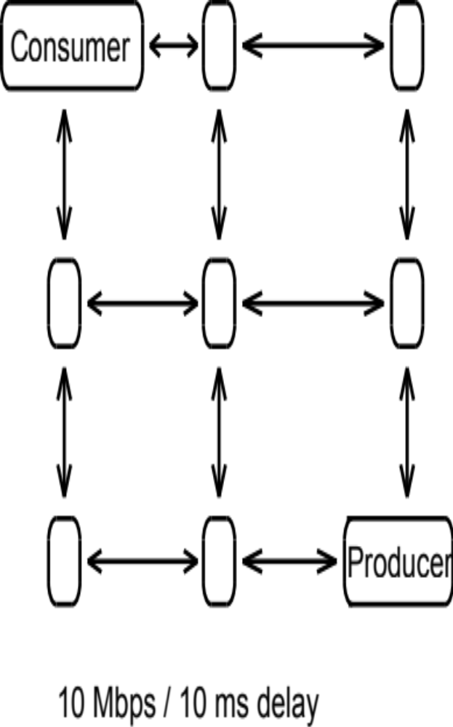
Writing a basic scenario
Simple simulation
  filename
    scenarios/example1.cc (C++)
    scenarios/example1.py (Python)
  Topology
    3x3 grid topology
    10Mbps links / 10ms delays
    One consumer, one producer
  NDN parameters
    Forwarding Strategy for interests: BestRoute
    FIB is computed automatically using global routing controller
    Cache: LRU with 100 items on each node (default)

Slide 21
NS-3 101: Prepare scenario (C++)
Step 1. Include necessary modules
Step 2. Define main function like in any other C++ program
Step 3. Set default parameters for the simulator modules.
For example, define that by default all created p2p links will have 10Mbps bandwidth, 10ms delay and DropTailQueue with 20 packets
Step 4. Allow overriding defaults from command line
Step 5. Define what topology will be simulated.
For example, 3x3 grid topology
Step 6. Create and install networking stacks, install and schedule applications, define metric logging, etc.
Step 7. Define when simulation should be stopped
Final step. Run simulation
#include ”ns3/core-module.h"
#include "ns3/network-module.h"
#include "ns3/point-to-point-module.h"
#include "ns3/point-to-point-grid.h"
#include "ns3/ndnSIM-module.h"
using namespace ns3;
int
main (int argc, char *argv[])
{
  Config::SetDefault ("ns3::PointToPointNetDevice::DataRate", StringValue ("10Mbps"));
  Config::SetDefault ("ns3::PointToPointChannel::Delay", StringValue ("10ms"));
  Config::SetDefault ("ns3::DropTailQueue::MaxPackets", StringValue ("20"));
  CommandLine cmd; cmd.Parse (argc, argv);
  PointToPointHelper p2p;
  PointToPointGridHelper grid (3, 3, p2p);
  grid.BoundingBox(100,100,200,200);
  // scenario meat
  Simulator::Stop (Seconds (20.0));
  Simulator::Run ();
  Simulator::Destroy ();
  return 0;
}

Slide 22
The same scenario can be also written in Python
C++
Python
#include "ns3/core-module.h"
#include "ns3/network-module.h"
#include "ns3/point-to-point-module.h"
#include "ns3/point-to-point-grid.h"
#include "ns3/ndnSIM-module.h”
using namespace ns3;
int
main (int argc, char *argv[])
{
Config::SetDefault ("ns3::PointToPointNetDevice::DataRate", StringValue ("10Mbps"));
Config::SetDefault ("ns3::PointToPointChannel::Delay", StringValue ("10ms"));
Config::SetDefault ("ns3::DropTailQueue::MaxPackets", StringValue ("20"));
CommandLine cmd; cmd.Parse (argc, argv);
PointToPointHelper p2p;
PointToPointGridHelper grid (3, 3, p2p);
grid.BoundingBox(100,100,200,200);
// scenario meat
Simulator::Stop (Seconds (20.0));
Simulator::Run ();
Simulator::Destroy ();
return 0;
}
from ns.core import *
from ns.network import *
from ns.point_to_point import *
from ns.point_to_point_layout import *
from ns.ndnSIM import *
Config.SetDefault ("ns3::PointToPointNetDevice::DataRate", StringValue ("10Mbps"))
Config.SetDefault ("ns3::PointToPointChannel::Delay", StringValue ("10ms"))
Config.SetDefault ("ns3::DropTailQueue::MaxPackets", StringValue ("20"))
import sys; cmd = CommandLine (); cmd.Parse (sys.argv);
p2p = PointToPointHelper ()
grid = PointToPointGridHelper (3,3,p2p)
grid.BoundingBox(100,100,200,200)
# scenario meat
Simulator.Stop (Seconds (20.0))
Simulator.Run ()
Simulator.Destroy ()
# or run using the visualizer
# import visualizer
# visualizer.start ()
Defining scenario in Python is easier and don’t require (re)compilation, but not all features of NS-3 and ndnSIM are available in Python interface.

Slide 23
ndnSIM 101: filling scenario meat (C++)
Step 1. Install NDN stack on all nodes (like starting ccnd on a computer)
Step 2. Define which nodes will run applications
Step 3. “Install” applications on nodes
Step 2. Configure FIB
manually
using global routing controller (shown here)
ndn::StackHelper ndnHelper;
ndnHelper.InstallAll ();
// Getting containers for the consumer/producer
Ptr<Node> producer = grid.GetNode (2, 2);
NodeContainer consumerNodes;
consumerNodes.Add (grid.GetNode (0,0));
ndn::AppHelper cHelper ("ns3::ndn::ConsumerCbr");
cHelper .SetPrefix ("/prefix");
cHelper .SetAttribute ("Frequency", StringValue ("10"));
cHelper .Install (consumerNodes);
ndn::AppHelper pHelper ("ns3::ndn::Producer");
pHelper.SetPrefix ("/prefix");
pHelper.SetAttribute ("PayloadSize", StringValue("1024"));
pHelper.Install (producer);
ndn::GlobalRoutingHelper ndnGlobalRoutingHelper;
ndnGlobalRoutingHelper.InstallAll ();
// Add /prefix origins to ndn::GlobalRouter
ndnGlobalRoutingHelper.AddOrigins (“/prefix”, producer);
// Calculate and install FIBs
ndnGlobalRoutingHelper.CalculateRoutes ();

Slide 24
ndnSIM 101: filling scenario meat (Python)
Step 1. Install NDN stack on all nodes (like starting ccnd on a computer)
Step 2. Define which nodes will run applications
Step 3. “Install” applications on nodes
Step 2. Configure FIB
manually
using global routing controller (shown here)
ndnHelper = ndn.StackHelper ()
ndnHelper.InstallAll ();
# Getting containers for the consumer/producer
producer = grid.GetNode (2, 2)
consumerNodes = NodeContainer ()
consumerNodes.Add (grid.GetNode (0,0))
cHelper = ndn.AppHelper ("ns3::ndn::ConsumerCbr”)
cHelper .SetPrefix ("/prefix”)
cHelper .SetAttribute ("Frequency", StringValue ("10"))
cHelper .Install (consumerNodes)
pHelper = ndn.AppHelper ("ns3::ndn::Producer”)
pHelper.SetPrefix ("/prefix”)
pHelper.SetAttribute ("PayloadSize", StringValue("1024"));
pHelper.Install (producer)
ndnGlobalRoutingHelper = ndn.GlobalRoutingHelper ()
ndnGlobalRoutingHelper.InstallAll ()
# Add /prefix origins to ndn::GlobalRouter
ndnGlobalRoutingHelper.AddOrigins (“/prefix”, producer)
# Calculate and install FIBs
ndnGlobalRoutingHelper.CalculateRoutes ()

Slide 25
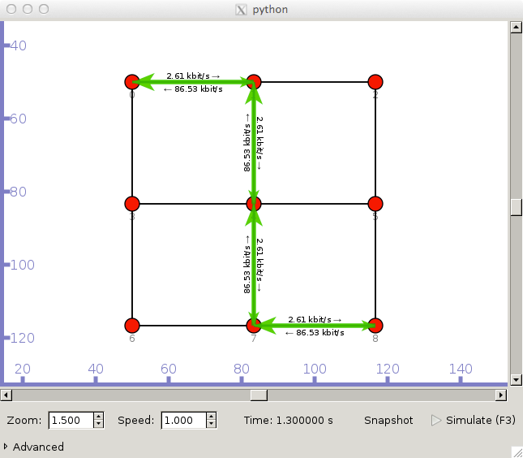
Running the simulation (C++)
Run C++ scenario
  ./waf --run example1
    or ./waf && ./build/example1
    or ./waf --run example1 --vis
Run Python scenario
  python scenarios/example1.py
If in debug mode
  NS_LOG=ndn.fw ./waf --run example1
Result if you followed the steps
Same example is on
http://ndnsim.net
Hint: using right click on a node in visualizer, it is possible to check FIB, PIT, and CS contents on the node during the active simulation

Slide 26
Logging in debug mode
Should be used ONLY for developing/debugging purposes
Actual simulation SHOULD be run in optimized mode
  much faster
  all logging is disabled
Available debug loggings in ndnSIM:
  ndn.L3Protocol, ndn.IpFaceStack
  ndn.Interest, ndn.Data
  ndn.Face, ndn.NetDeviceFace, ndn.AppFace, ndn.ApiFace, ndn.TcpFace, ndn.UdpFace
  ndn.App, ndn.Consumer, ndn.ConsumerBatches, ndn.ConsumerCbr, ndn.ConsumerWindow, ndn.ConsumerZipfMandelbrot, ndn.Producer
  ndn.StackHelper, ndn.AppHelper, ndn.GlobalRoutingHelper, ndn.HeaderHelper, ndn.LinkControlHelper, ndn.IpFacesHelper
  ndn.AppDelayTracer, ndn.CsTracer, ndn.L3RateTracer, ndn.L3AggregateTracer
  ndn.Limits, ndn.Limits.Rate, ndn.Limits.Window, ndn.RttEstimator, ndn.RttMeanDeviation
  ndn.cs.ContentStore, ndn.cs.Fifo, ndn.cs.Fifo::Freshness, ndn.cs.Fifo::LifetimeStats, ndn.cs.Freshness.Fifo, ndn.cs.Freshness.Lfu, ndn.cs.Freshness.Lru, ndn.cs.Freshness.Random, ndn.cs.Lfu, ndn.cs.Lfu::Freshness, ndn.cs.Lfu::LifetimeStats, ndn.cs.Lru, ndn.cs.Lru::Freshness, ndn.cs.Lru::LifetimeStats, ndn.cs.Nocache, ndn.cs.Random, ndn.cs.Random::Freshness, ndn.cs.Random::LifetimeStats, ndn.cs.Stats.Fifo, ndn.cs.Stats.Lfu, ndn.cs.Stats.Lru, ndn.cs.Stats.Random
  ndn.fib.Entry, ndn.fib.FibImpl
  ndn.fw, ndn.fw.BestRoute, ndn.fw.BestRoute.PerOutFaceLimits, ndn.fw.BestRoute.PerOutFaceLimits.PerFibLimits, ndn.fw.Flooding, ndn.fw.Flooding.PerOutFaceLimits, ndn.fw.Flooding.PerOutFaceLimits.PerFibLimits, ndn.fw.GreenYellowRed, ndn.fw.Nacks, ndn.fw.SmartFlooding, ndn.fw.SmartFlooding.PerOutFaceLimits, ndn.fw.SmartFlooding.PerOutFaceLimits.PerFibLimits
  ndn.Pit, ndn.pit.Entry, ndn.pit.Lru, ndn.pit.Lru::AggregateStats, ndn.pit.Persistent, ndn.pit.Persistent::AggregateStats, ndn.pit.PitImpl, ndn.pit.Random, ndn.pit.Random::AggregateStats, ndn.pit.SerializedSize, ndn.pit.SerializedSize::AggregateStats

Slide 27
Logging in debug mode (cont.)
Selecting several several loggings
  NS_LOG=ndn.fw:ndn.fw.BestRoute:ndn.Consumer ./waf --run=example1
Select all loggings (including from the NS-3)
  NS_LOG=* ./waf --run=example1
DO NOT USE LOGGING TO GET METRICS
  use existing tracing helpers or write your own

Slide 28
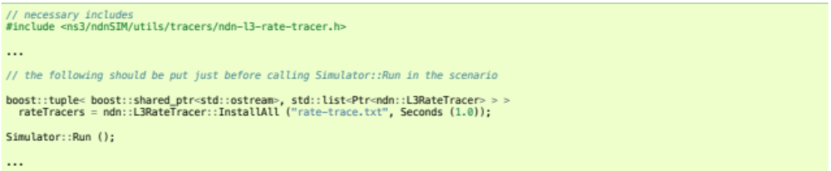
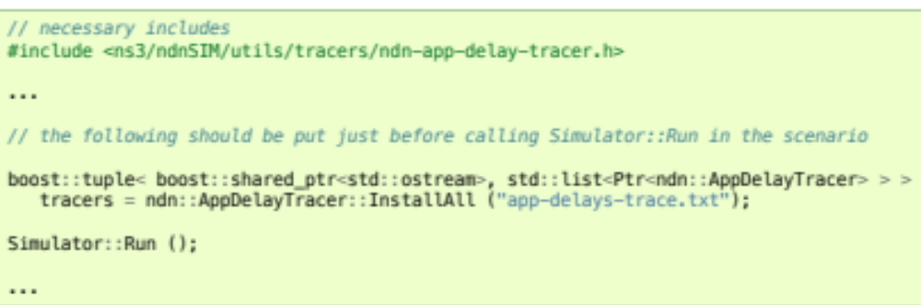
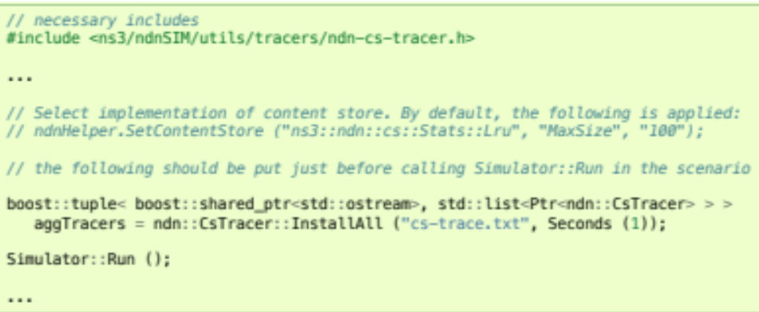
Getting metrics (supported only in C++)
http://ndnsim.net/metric.html
Tracing the rate in bytes and in number of packets of Interest/Data packets forwarded by an NDN node
With the use of ndn::AppDelayTracer it is possible to obtain data about for delays between issuing Interest and receiving corresponding Data packet
With the use of ndn::CsTracer it is possible to obtain statistics of cache hits/cache misses on simulation nodes.

Slide 29
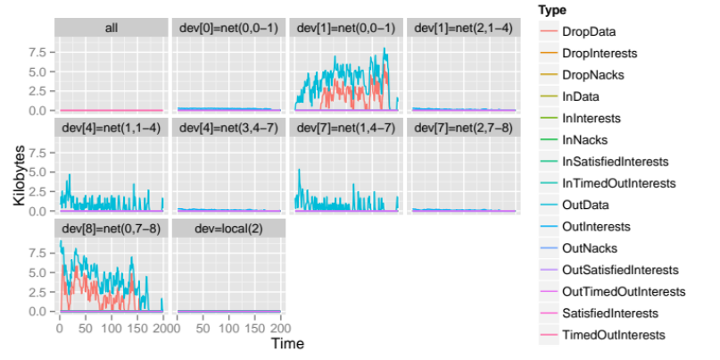
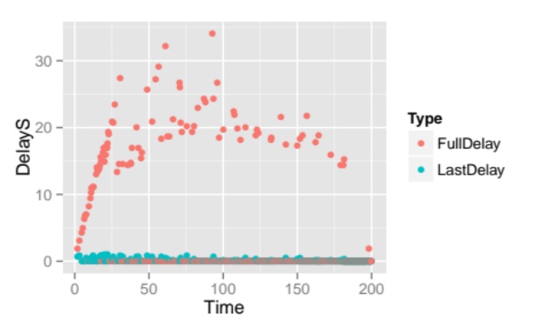
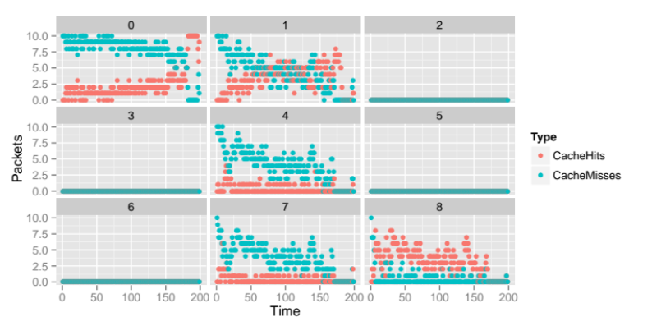
Processing metrics
Resulting rate-trace.txt, app-delays-trace.txt are simple text files that can be easily processed by various apps
  R
  gnuplot
  python graph library and others
Examples with R
  Same scenario, but with small modifications
    Config::SetDefault ("ns3::PointToPointNetDevice::DataRate", StringValue ("20Kbps"));
    ndn::AppHelper cHelper ("ns3::ndn::ConsumerZipfMandelbrot");
  very basic rate-trace.txt procesing
    library (ggplot2)
    data = read.table ("results/rate-trace.txt", header=T)
    ggplot(data, aes(x=Time, y=Kilobytes, color=Type)) + geom_line () + facet_wrap(~ FaceDescr)
  very basic app-delays-trace.txt processing
    library (ggplot2)
    data = read.table ("results/app-delays-trace.txt", header=T)
    ggplot(data, aes(x=Time, y = DelayS, color=Type)) + geom_point ()
  very basic cs-trace.txt processing
    library (ggplot2)
    data = read.table ("results/cs-trace.txt", header=T)
    g = ggplot(data, aes(x=Time, y = Packets, color=Type)) + geom_point () + facet_wrap (~ Node)

Slide 30
Customizing scenarios
Forwarding strategy
Content Store (type and caching replacement/placement policy)
Pending Interest Table

Slide 31
Forwarding strategy
  ndn::StackHelper ndnHelper;
  ndnHelper.SetForwardingStrategy (“ns3::ndn::fw::Flooding”);
Available strategies:
  (default) ns3::ndn::fw::Flooding
  ns3::ndn::fw::BestRoute
  ns3::ndn::fw::SmartFloowing
  ns3::ndn::fw::Flooding::PerOutFaceLimits
  ns3::ndn::fw::Flooding::PerOutFaceLimits::PerFibLimits
  ns3::ndn::fw::BestRoute::PerOutFaceLimits
  ns3::ndn::fw::BestRoute::PerOutFaceLimits::PerFibLimits
  ns3::ndn::fw::SmartFlooding::PerOutFaceLimits
  ns3::ndn::fw::SmartFlooding::PerOutFaceLimits::PerFibLimits

Slide 32
Content Store
Available content stores
  (default) ns3::ndn::cs::Lru
  ns3::ndn::cs::Random
  ns3::ndn::cs::Fifo
  ns3::ndn::cs::Lfu
  ns3::ndn::cs::Nocache
  ns3::ndn::cs::Lru::Freshness
  ns3::ndn::cs::Random::Freshness
  ns3::ndn::cs::Fifo::Freshness
  ns3::ndn::cs::Lfu::Freshness
  ns3::ndn::cs::Lru::LifetimeStats
  ns3::ndn::cs::Random::LifetimeStats
  ns3::ndn::cs::Fifo::LifetimeStats
  ns3::ndn::cs::Lfu::LifetimeStats
  ndn::StackHelper ndnHelper;
  ndnHelper.SetContentStore (“ns3::ndn::cs::Lru”, “MaxSize”, “100”);

Slide 33
Pending Interest Table (PIT)
Each PIT entry stores
  Interest packet itself
  list of incoming faces + associated info
  list of outgoing faces + associated info
  forwarding strategy tags
    e.g., reference to a delayed processing queue
Size of PIT can be limited in simulation scenario
  Available policies for new PIT entry creation:
    (default) persistent (ns3::ndn::pit::Persistent): a new entry will not be created if limit is reached
    LRU (ns3::ndn::pit::LRU): when limit is reached, insertion of a new entry will evict the oldest entry
    Random (ns3::ndn::pit::Random): when limit is reached, insertion will evict a random entry
  ndn::StackHelper ndnHelper;
  ndnHelper.SetPit (“ns3::ndn::pit::Persistent”, “MaxSize”, “100”);

Slide 34
Write your own forwarding strategy
Step 1. Create a standard C++ class and derive it from ndn::ForwardingStrategy, one of the extensions, or one of the existing strategies
Step 2. Extend or re-implement available forwarding strategy events (for the full list refer to http://ndnsim.net/doxygen/):
  OnInterest
  OnData
  WillEraseTimedOutPendingInterest
  AddFace
  RemoveFace
  DidAddFibEntry
  WillRemoveFibEntry
  DidCreatePitEntry
  FailedToCreatePitEntry
  DidReceiveDuplicateInterest
  DidSuppressSimilarInterest
  DidForwardSimilarInterest
  DidExhaustForwardingOptions
  DetectRetransmittedInterest
  WillSatisfyPendingInterest
  DidSendOutData
  DidReceiveSolicitedData
  DidReceiveUnsolicitedData
  ShouldSuppressIncomingInterest
  CanSendOutInterest
  TrySendOutInterest
  DidSendOutInterest
  PropagateInterest
  DoPropagateInterest

Slide 35
Writing a custom forwarding strategy
Basic
  http://ndnsim.net/fw.html#writing-your-own-custom-strategy
Processing forwarding strategy events
  Example
    if we want to perform special logging of all forwarded, timed out, and satisfied Interests
  http://ndnsim.net/fw.html#extending-strategy

Slide 36
Write your own cache policy
Option A:
  create a class derived from ndn::ContentStore, implementing all interface functions
  example
    ndn::cs::NoCache
Option B:
  use C++ templates of ndnSIM
    define “policy traits” (example utils/trie/lru-policy)
      defines what to do
        on insert (e.g., put in front)
        on update (e.g., promote to front)
        on delete (e.g., remove)
        on lookup (e.g., promote to front)
    instantiate cache class with new policy:
      template class ContentStoreImpl<lru_policy_traits>;
    see examples in model/cs/content-store-impl.cc

Slide 37
Writing a custom cache policy
ExamplePolicy
  only every other data packet will be cached
  “promote” Data packet if it is accessed more that twice
  apply LRU cache replacement strategy
Write “policy traits”
  extensions/example-policy.h
  use one of the existing policy traits as a base
    utils/tries/lru-policy.h
“Instantiate” content store with the policy
  create extensions/cs-with-example-policy.cc

Slide 38
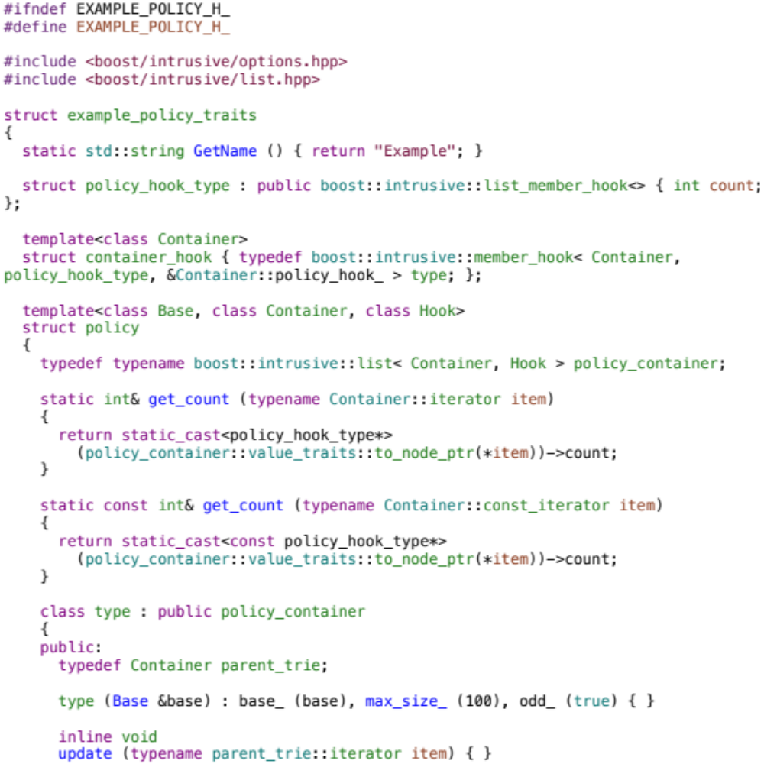
Policy (extensions/example-policy.h) 1/3

Slide 39
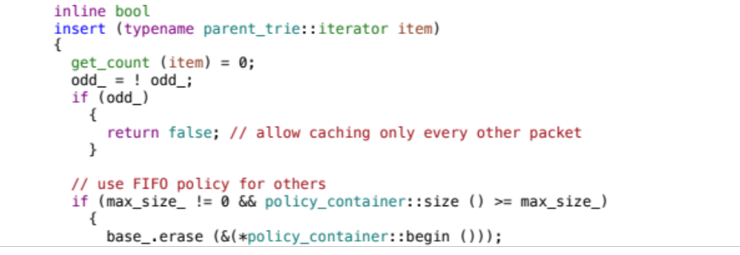
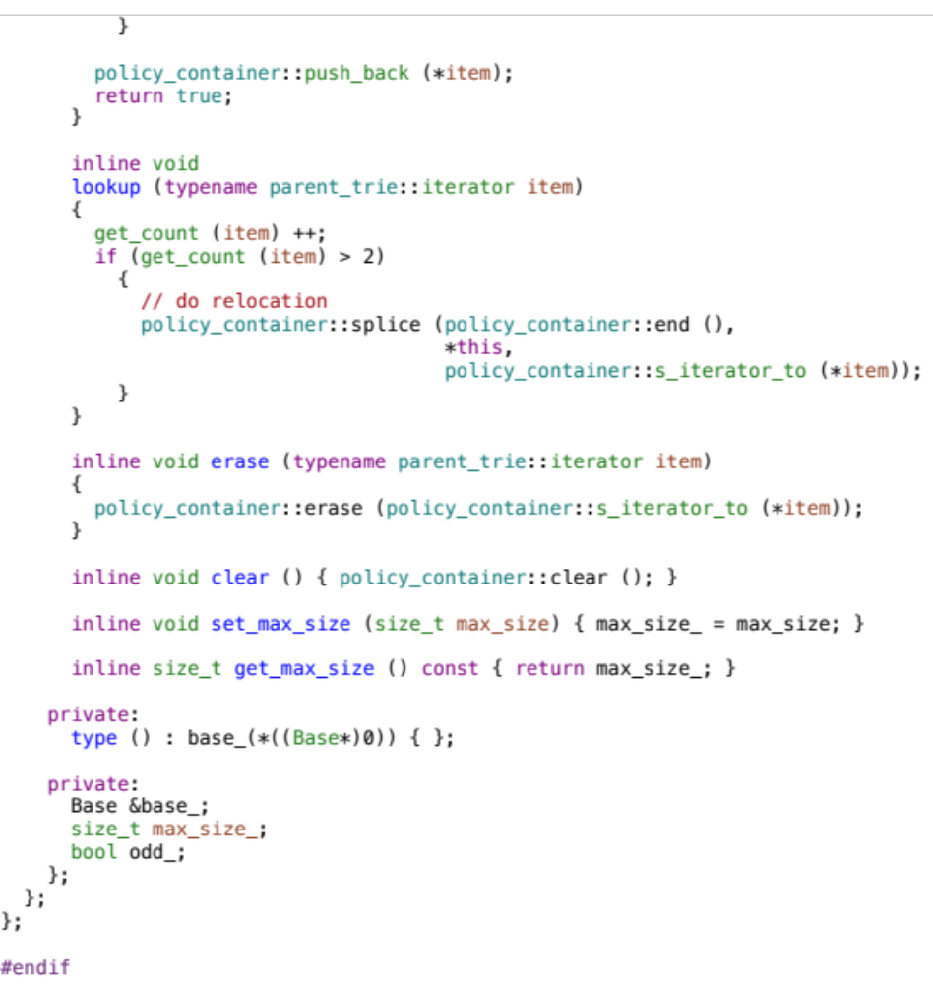
Policy (extensions/example-policy.h) 2/3

Slide 40
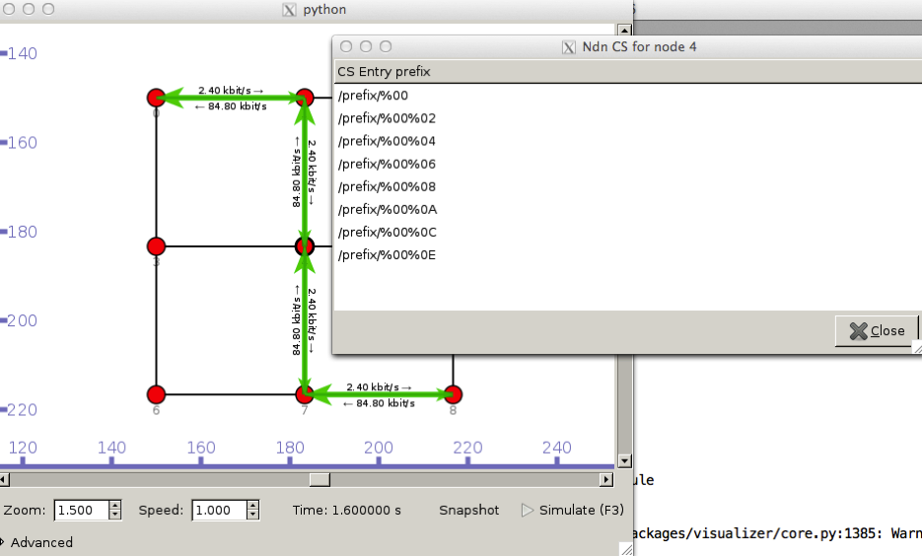
Policy (extensions/example-policy.h) 3/3
See scenarios/example6.cc

Slide 41
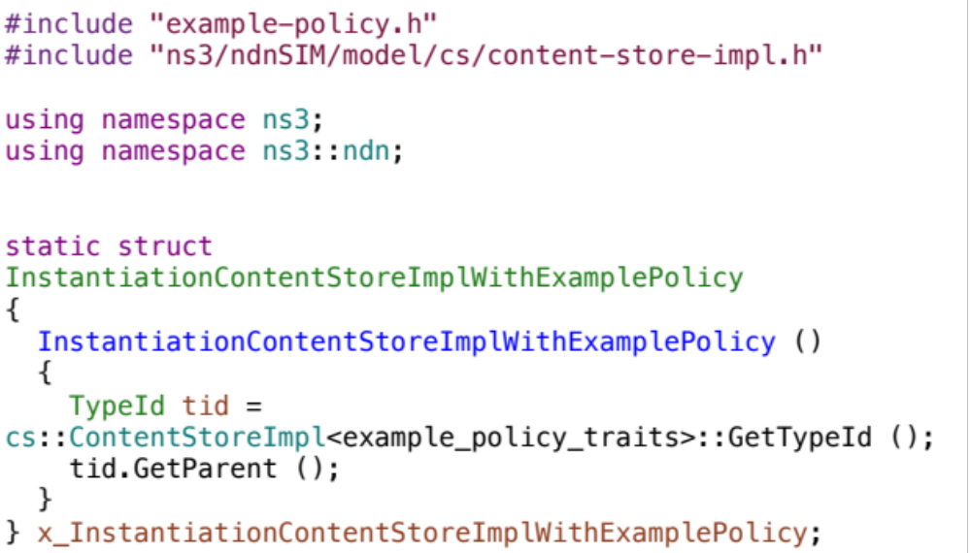
Content Store instantiation (extensions/cs-with-example-policy.cc)

Slide 42
Write your own application (requester)
more http://ndnsim.net/applications.html#custom-applications
Step 1. Create a normal C++ class and derive it from ndn::App
Step 2. Define GetTypeId () function (use templates!)
Needed for NS-3 object system
Step 3. Define actions upon start and stop of the application
Step 4. Implement OnData method to process requested data:
virtual void
OnData (Ptr<const Data> data);
...
class RequesterApp : public App
{
public:
static TypeId GetTypeId ();
RequesterApp ();
virtual ~RequesterApp ();
protected:
// from App
virtual void
StartApplication ()
{
  App::StartApplication ();
  // send packet for example
}
virtual void
StopApplication ()
{
// do cleanup
  App::StopApplication ();
}
};

Slide 43
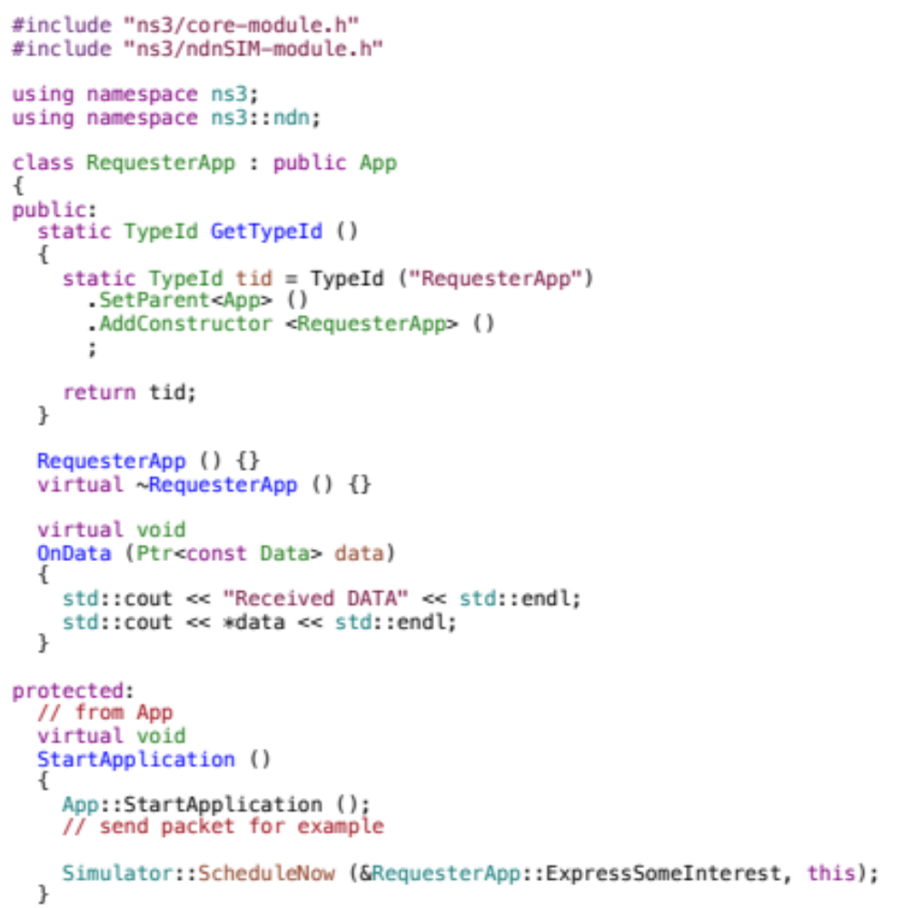
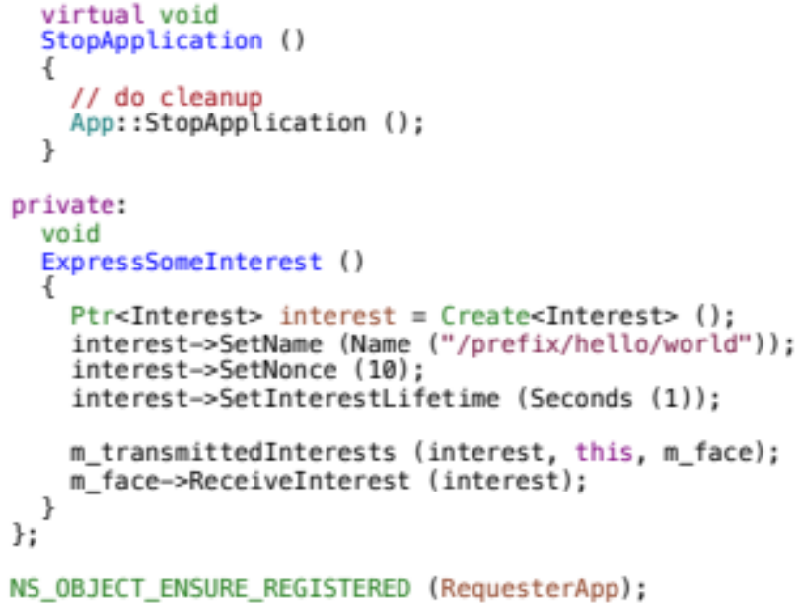
RequesterApp (extensions/requester-app.cc)
See scenarios/example3.cc

Slide 44
Write your own application (producer)
Step 0. Do everything as for the requester app
Step 1. Register prefix in FIB (= set Interest filter) in StartApplication
Step 2. Implement OnInterest to process incoming interests
virtual void
OnInterest (Ptr<const Interest> interest);
void StartApplication ()
{
...
Ptr<Fib> fib = GetNode ()->GetObject<Fib> ();
Ptr<fib::Entry> fibEntry = fib->Add (m_prefix, m_face, 0);
fibEntry->UpdateStatus (m_face, fib::FaceMetric::NDN_FIB_GREEN);
}

Slide 45
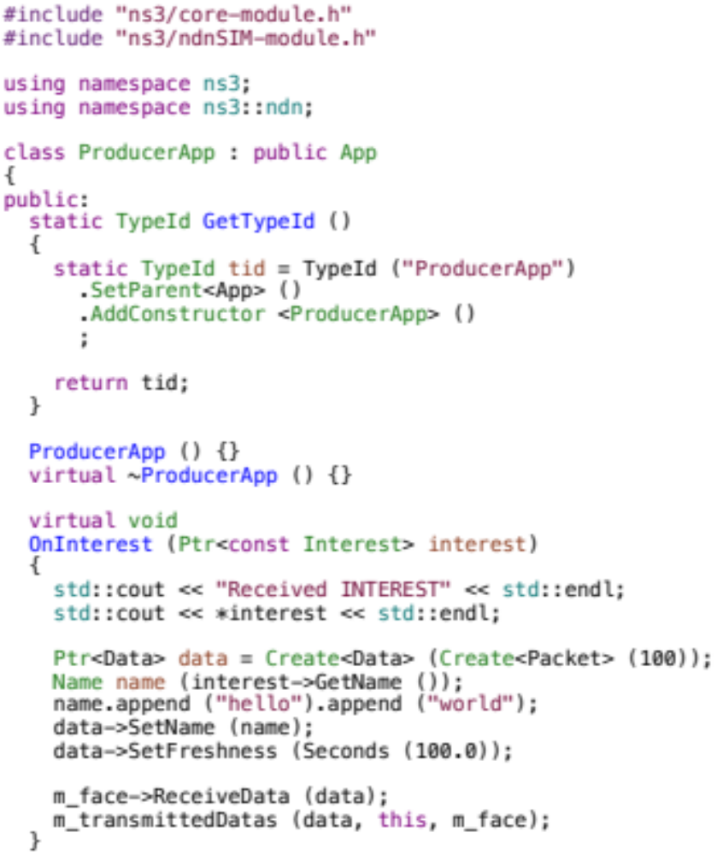
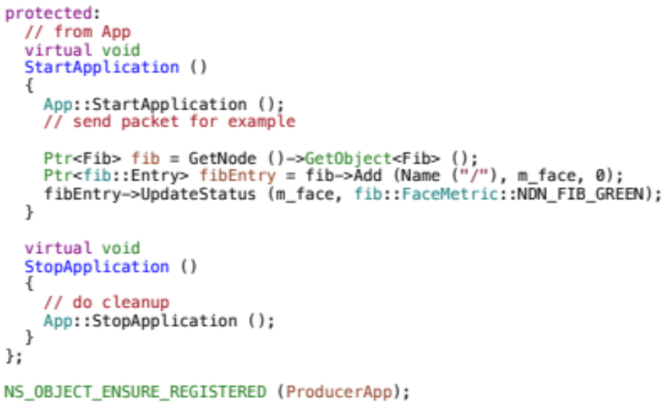
ProducerApp (extensions/producer-app.cc)
See scenarios/example4.cc

Slide 46
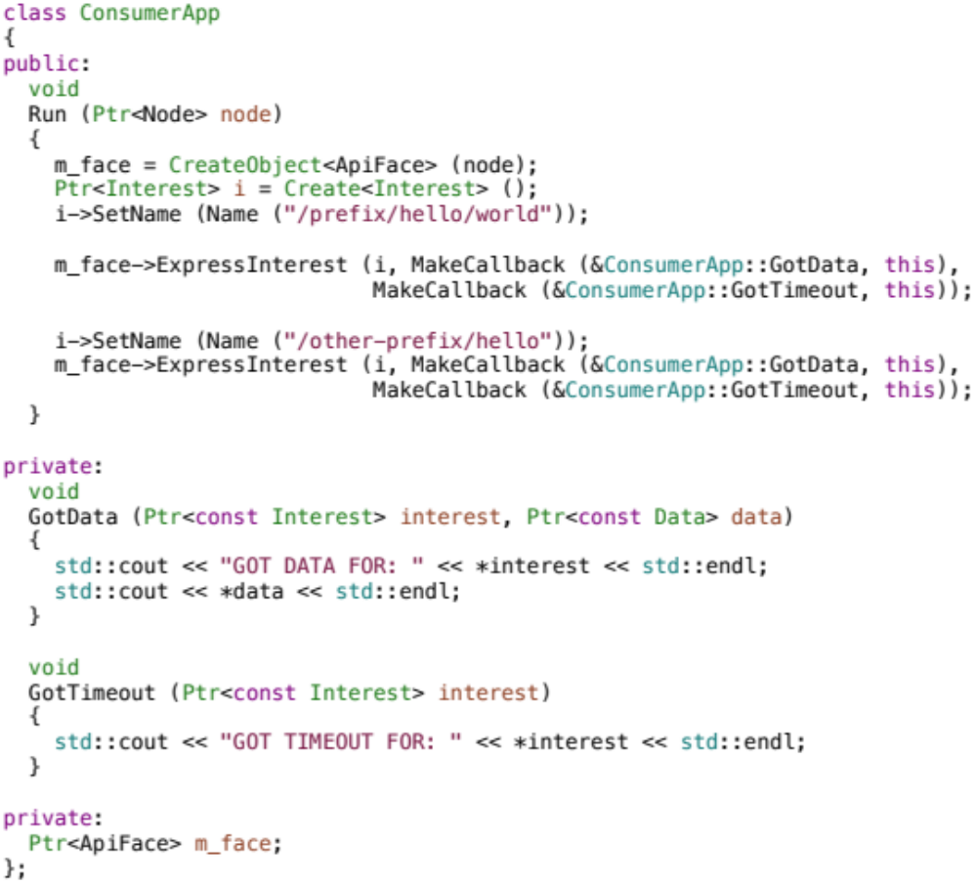
New API to write the same apps (ConsumerApp)
See scenarios/example5.cc

Slide 47
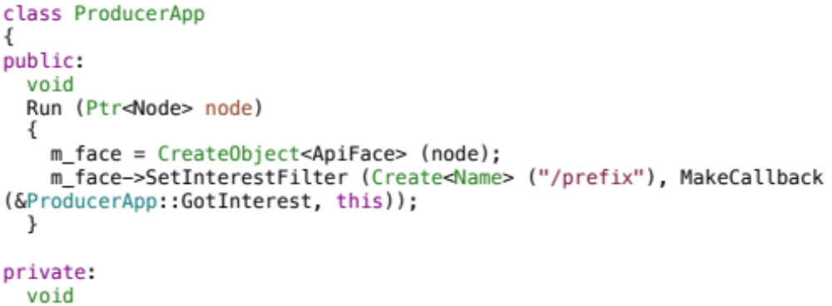
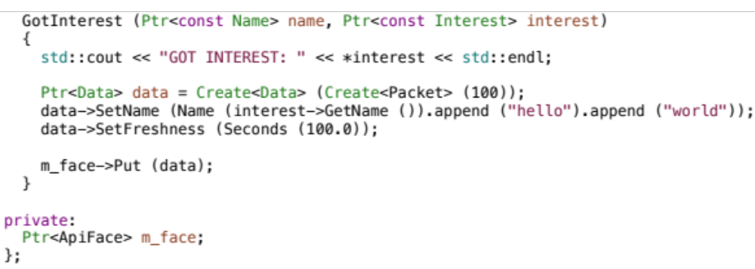
New API to write the same apps (ProducerApp)
See scenarios/example5.cc

Slide 48
NDN experimental extensions
Interest NACKs to enable more intelligent, adaptive forwarding
Congestion control by limiting the number of pending Interests
  per-face
  per-FIB-entry
  per-FIB-entry-per-face
Satisfaction ratio statistics module
  per-face (incoming/outgoing)
  per-prefix
  configurable time granularities
A initial set of simple application modules

Slide 49
Feedback
Try out ndnSIM and let us know your thought/comments/bug reports/new feature requests!
Join our mailing list
  http://www.lists.cs.ucla.edu/mailman/listinfo/ndnsim
Contribute
  issues on Github
    https://github.com/NDN-Routing/ndnSIM/issues?state=open
  fork and create pull requests on Github
  issues in NDN redmine
    http://redmine.named-data.net/projects/ndnsim
http://ndnsim.net

Slide 50
Thanks
Questions?
http://ndnsim.net

