Slide 1

Exploratory Data Analysis on Svarah Dataset
By
Waseem Ahmed
ahmed.Waseem@ufl.edu

Slide 2
Origin of the dataset
Collected Data from 117 speakers across 65 districts in 19 states of India.
Covers 19 out of 22 constitutionally recognized languages.
Contains 9.6 hours of transcribed data.

Slide 3
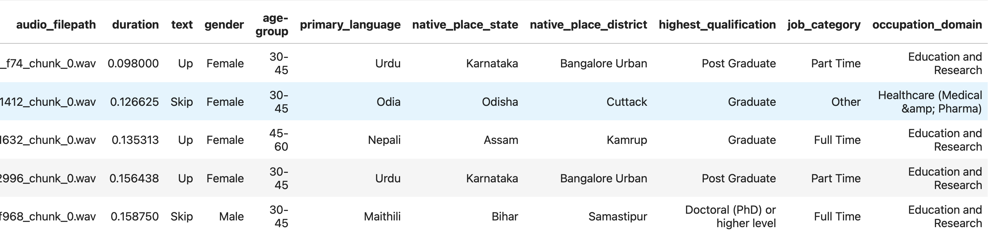
Data Overview

Slide 4
Understanding Data
Graphing Distribution
Graphing Correlation Plots
Graphing Pi Charts
Graphing Cross Tab Bar Charts

Slide 5
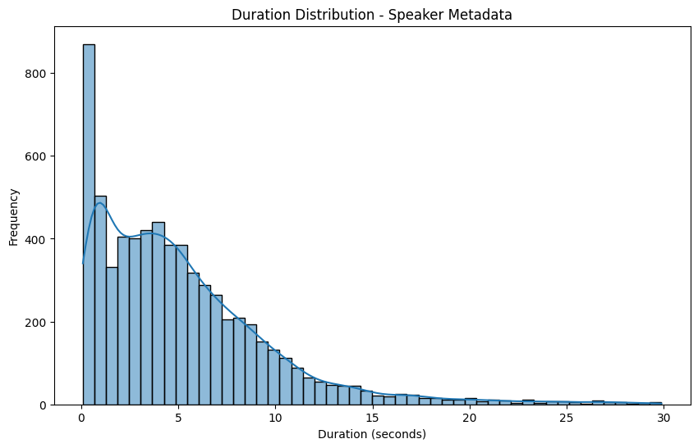
Duration Distribution

Slide 6
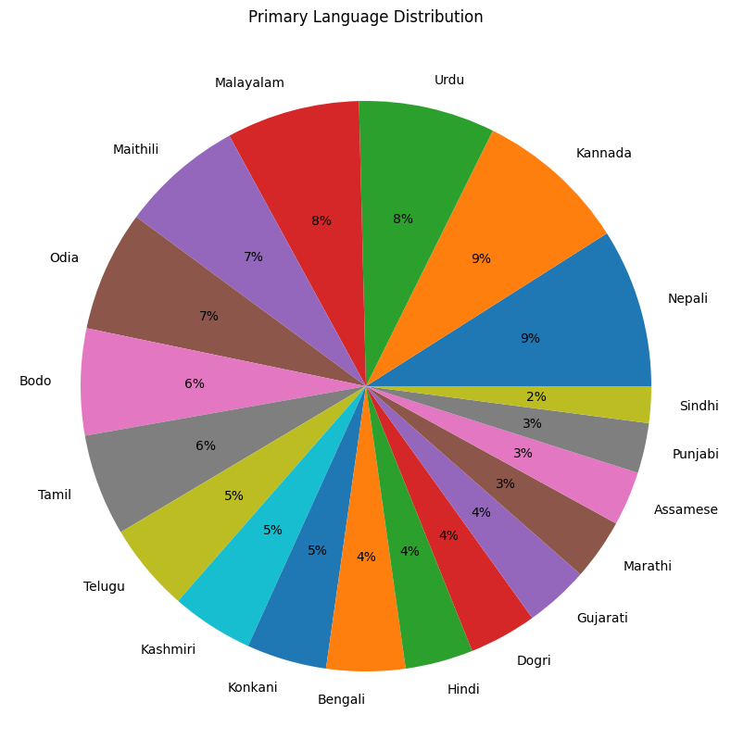
Primary Language Distribution- Pie Chart

Slide 7
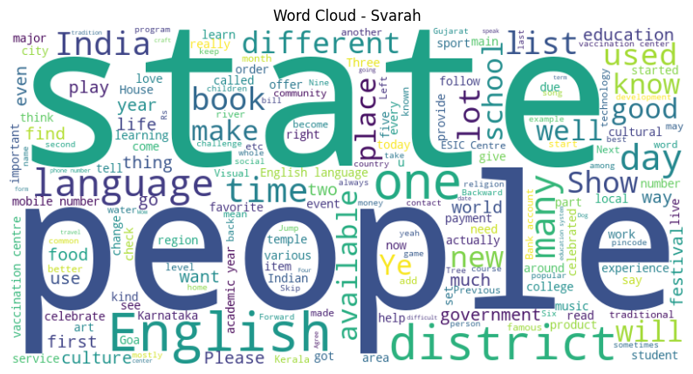
Word Cloud

Slide 8
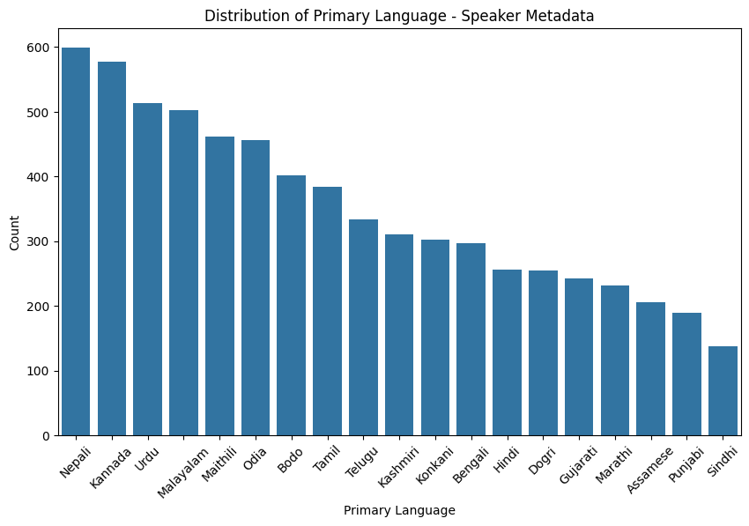
primary language Distribution

Slide 9
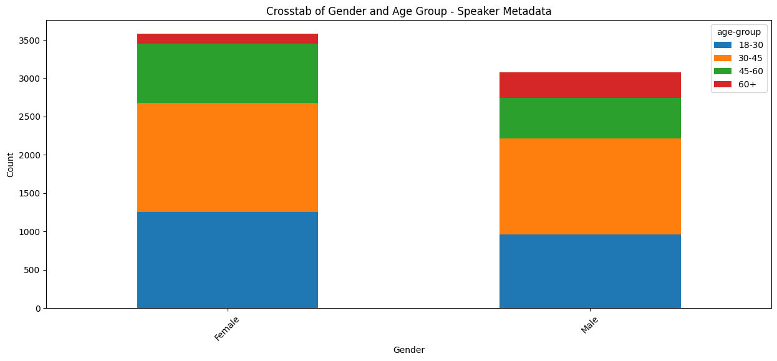
Cross-tabulation - Gender vs. Age Group

Slide 10
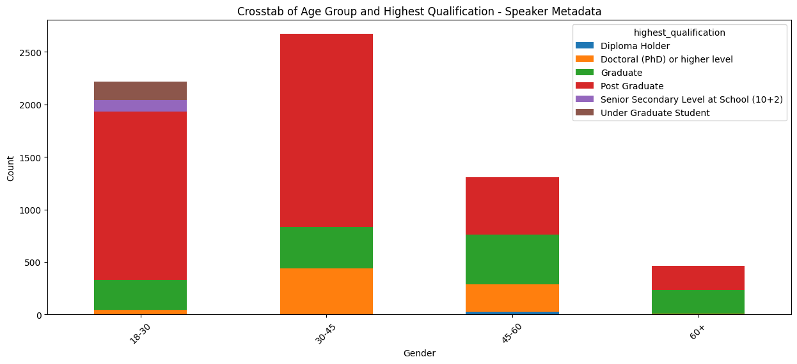
Cross-tabulation - Age Group vs. Highest Qualification

Slide 11
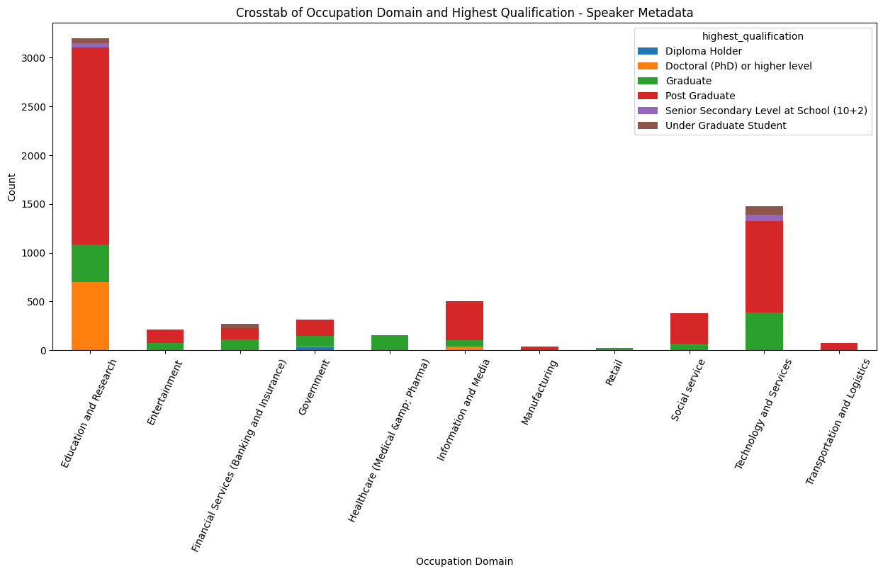
Occupation Domain vs. Highest Qualification

Slide 12
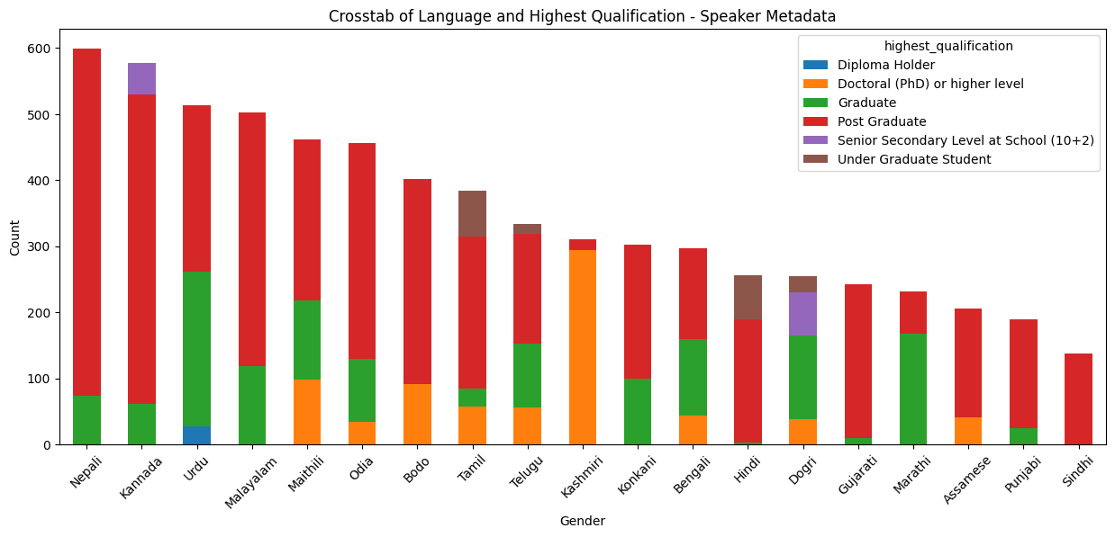
Cross-tabulation -Highest Qualification vs. Primary Language

Slide 13
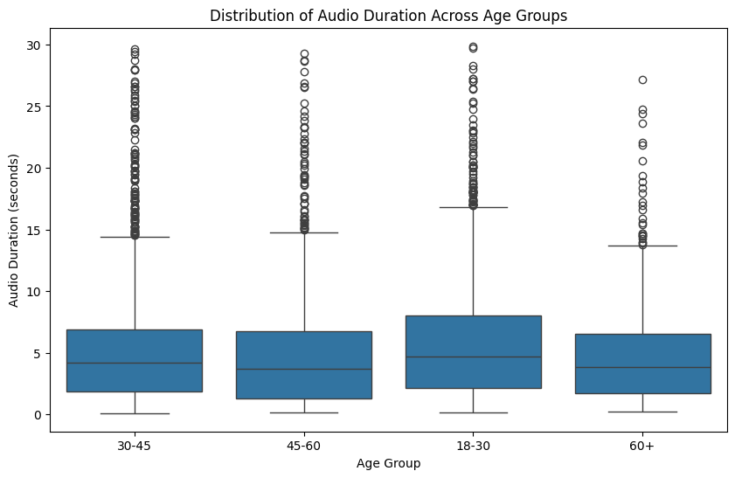
Distribution of Audio Duration Across Age Groups

Slide 14
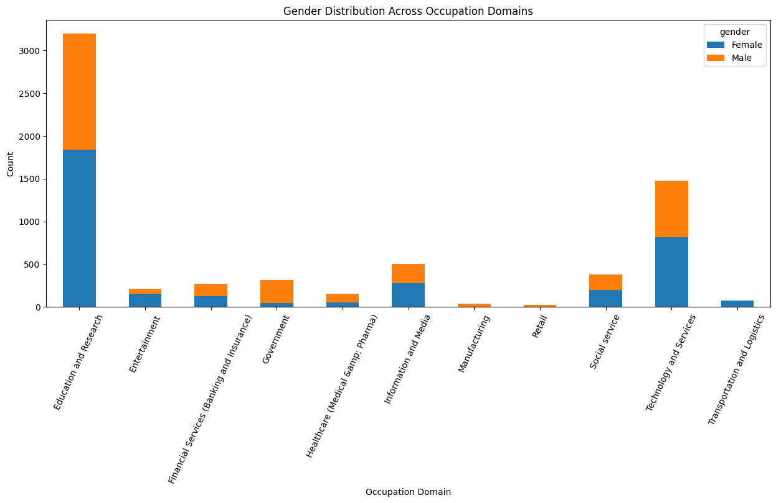
Gender Distribution Across Occupation Domains

Slide 15
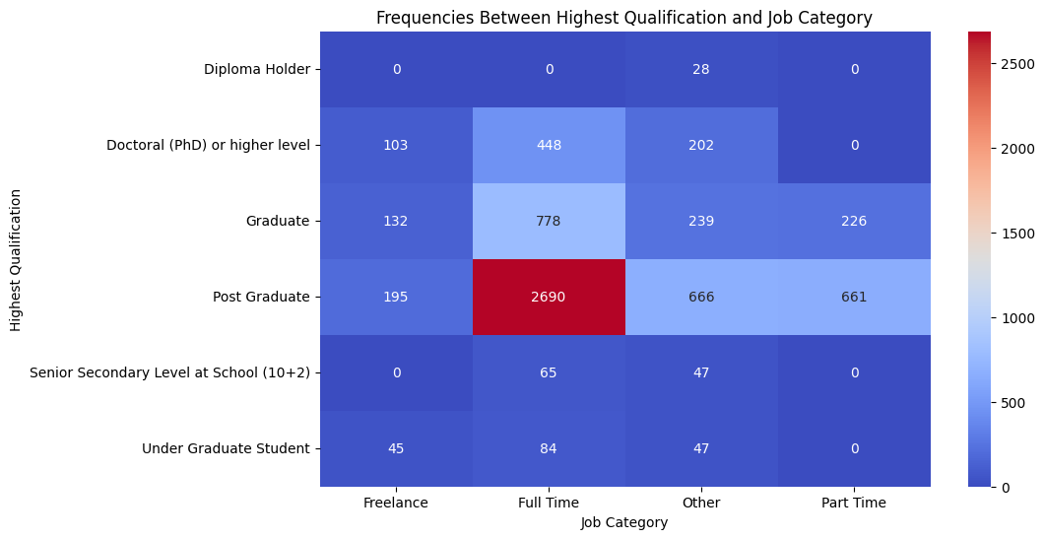
Correlation Between Highest Qualification and Job Category

Slide 16
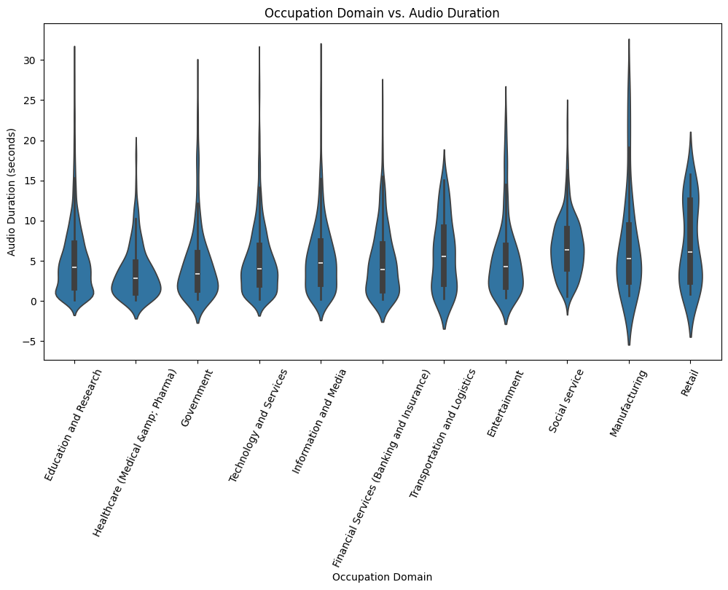
Occupation Domain vs. Audio Duration

Slide 17
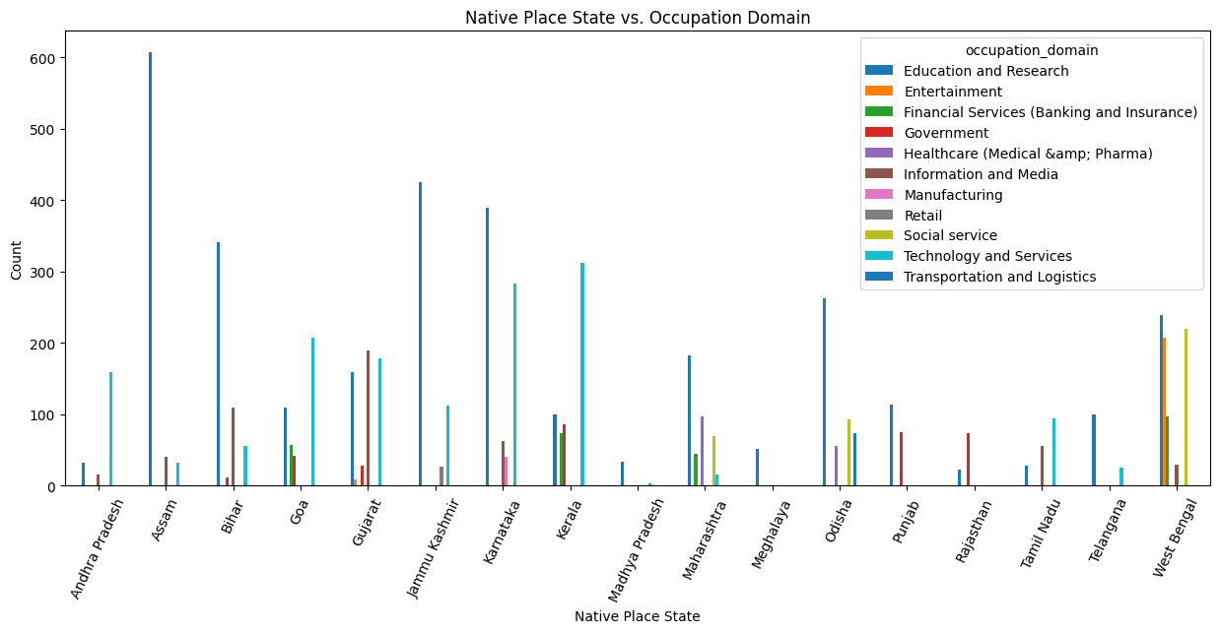
Native Place State vs. Occupation Domain

Slide 18
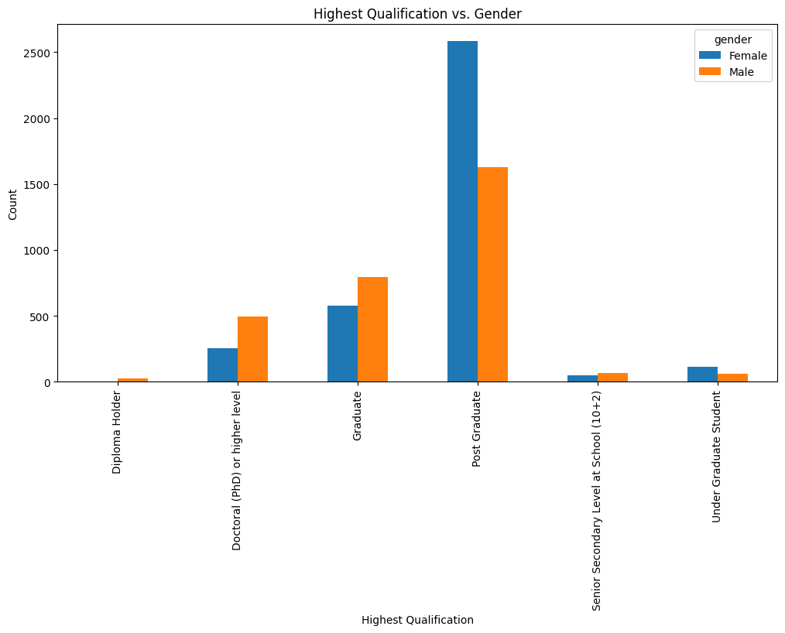
Highest Qualification vs. Gender

Slide 19
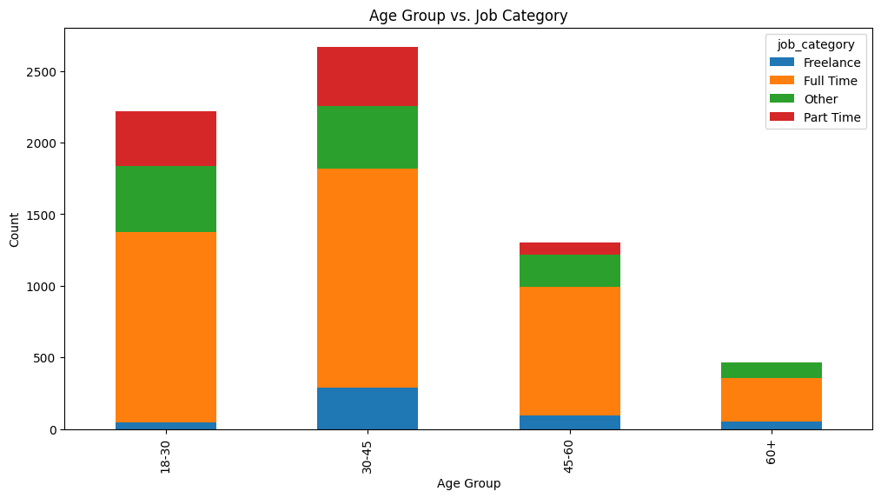
Age Group vs Job Category

Slide 20
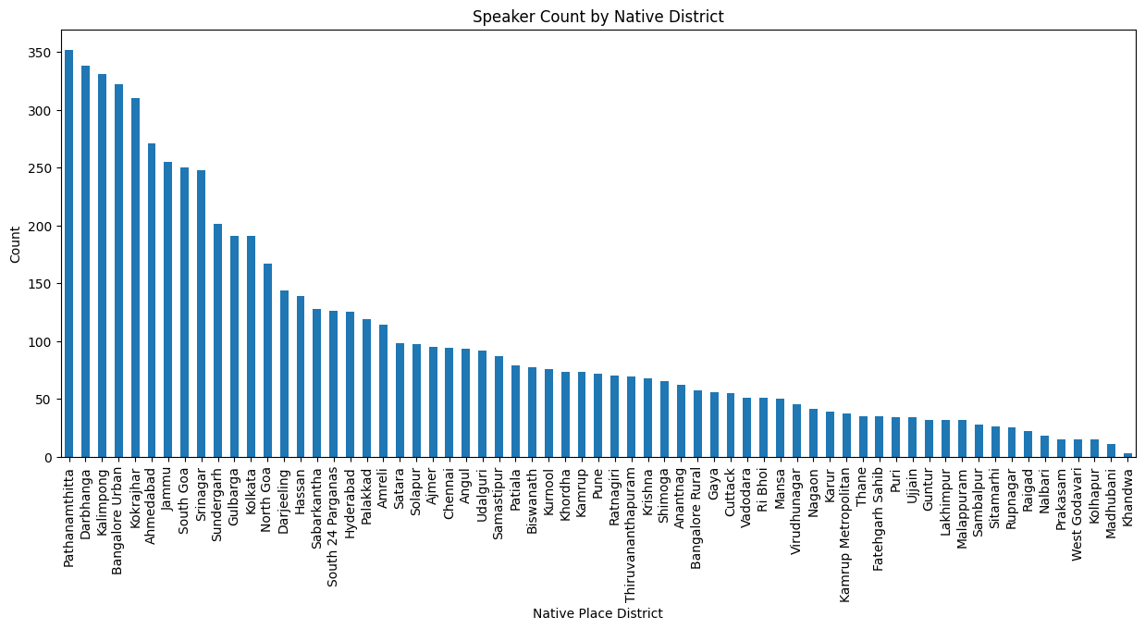
Speaker Count by Native District

Slide 21
Than You

