Slide 1

Preparing Audio Datasets and Their Application to Leading Models
Waseem Ahmed
ahmed.waseem@ufl.edu

Slide 2
Understanding Audio Datasets
Key Components of an Audio Dataset:
• Duration: Length of the audio clip
• Text: Transcription or associated label of the audio
• Demographic metadata: Gender, Age Group, Primary Language, Location, Job Information, etc.

Slide 3
Dataset Analysis
Understanding Metadata in the Dataset:
• Demographic Information: Gender, Age Group, Native Language, Native Place
• Professional Background: Highest Qualification, Job Category, Occupation Domain
• Role of Metadata in Training Models:
• How demographic and occupational metadata might impact speech patterns and model performance
• Importance of considering linguistic diversity (e.g., Urdu, Odia, Nepali)

Slide 4
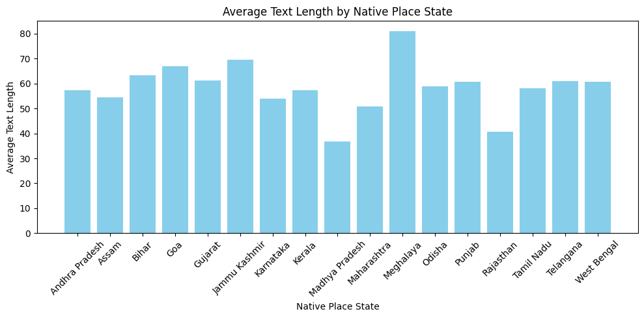
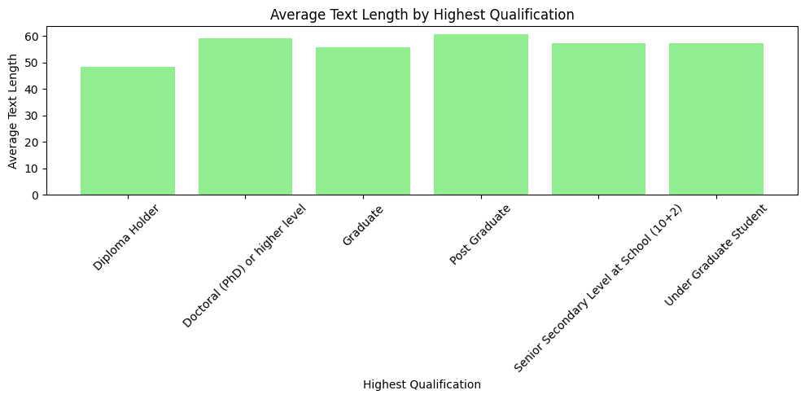
Continued

Slide 5
Preprocessing Audio for Torchaudio
Core Steps in Preprocessing:
• Loading the audio: Using torchaudio.load()
• Resampling: Ensuring a consistent sample rate for all audio clips using torchaudio.transforms.Resample()
• Padding or Trimming: Making sure all audio clips have the same length
• Feature Extraction: Converting raw audio into a numerical format (e.g., spectrogram, Mel-frequency cepstral coefficients (MFCCs))

Slide 6
Text Preprocessing for Audio Datasets
Text Data:
• Handling the transcription of audio (e.g., “Up,” “Skip”)
• Preparing text labels for supervised learning (classification, speech recognition)
Normalization:
• Convert all text to lowercase or apply a consistent format
• Remove special characters and unnecessary punctuation
Handling Class Imbalance:
• Example: If one label (“Up”) appears more frequently than others, how do we address this?

Slide 7
Preparing Metadata for Model Training
Encoding Categorical Data:
• Gender: Encoding gender as binary or categorical (e.g., Female = 0, Male = 1)
• Age Group: One-hot encoding (e.g., 30-45, 45-60)
• Primary Language: Encoding languages for language-specific models
• Job Information: Encoding job category and occupation domain

Slide 8
Example Workflow of Audio Data Preparation
End-to-End Workflow Example:
• Step 1: Load the dataset and audio files
• Step 2: Apply resampling and other preprocessing
• Step 3: Extract features (MFCC or spectrogram)
• Step 4: Encode text and metadata for model training
• Step 5: Input into model for training

Slide 9
What’s Next?
• Understanding how LLM
• Step 2: Apply resampling and other preprocessing
• Step 3: Extract features (MFCC or spectrogram)
• Step 4: Encode text and metadata for model training
• Step 5: Input into model for training

