Slide 1
TaskLink Where Talent Meets Opportunity!
Shayan Salam
Waseem Zahid Laiba Raza

Slide 2

About Us
TaskLink is an online platform that connects clients with freelancers, enabling smooth collaboration on various projects. Our system ensures a streamlined registration process, job postings, and efficient profile management

Slide 3
FUNCTIONAL REQUIREMENTS
The system shall allow users to register as either a client or a freelancer
The system shall authenticate users using a unique email address and password.
The system shall allow clients to post jobs with details such as title, description, budget, category, and deadline
The system shall allow users to create and update their profile, including personal information, skills, portfolio, and work history.
The system shall allow clients to mark a job as completed once the freelancer delivers the work.

Slide 4


NON FUNCTIONAL REQUIREMENTS
PERFORMANCE
SCALABILITY
Response Time Load Handling
System Scaling Resource Efficiency

Slide 5
DESIGN
CLASS DIAGRAM ARCHITECTURE

Slide 6
CLASS DIAGRAM

Slide 7
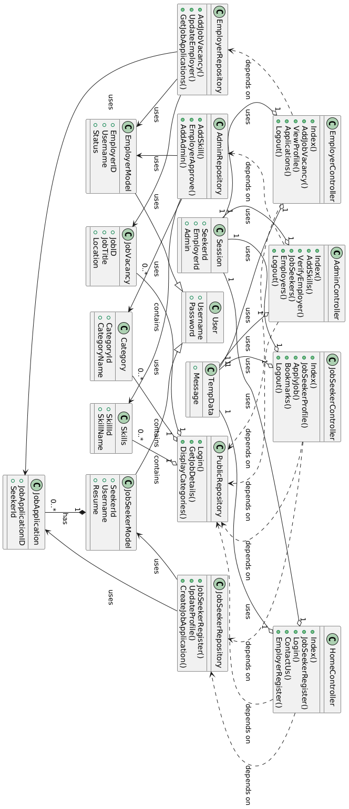

Slide 8
Model-view Controller EFFICIENT & ORGANIZED
ARCHITECTURE

Slide 9
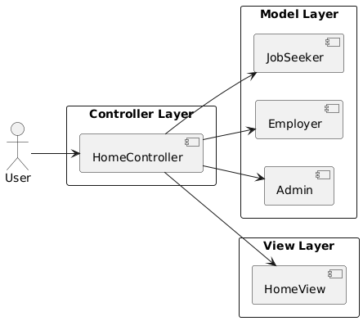

Slide 10
IMPLEMENTATION
SCREENSHOTS

Slide 11
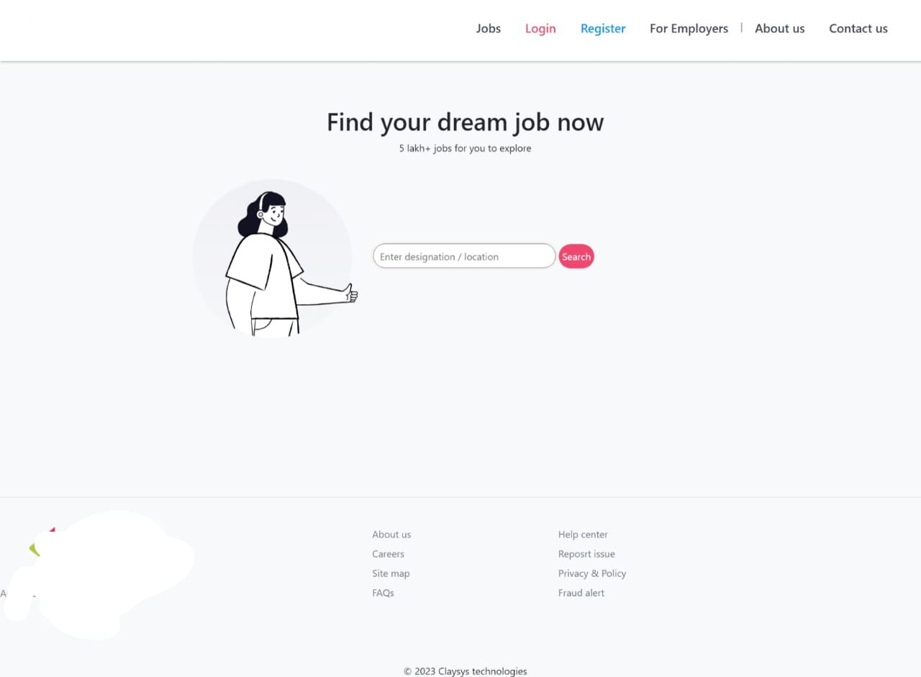

Slide 12
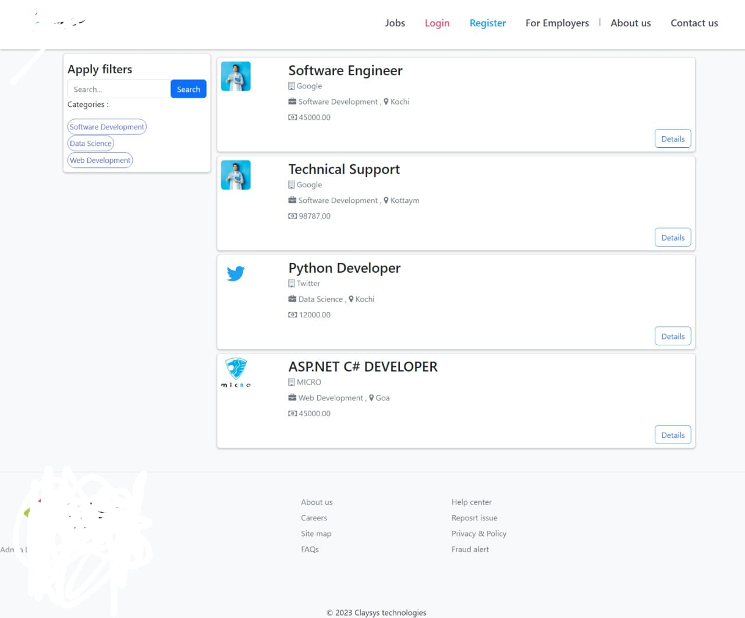

Slide 13
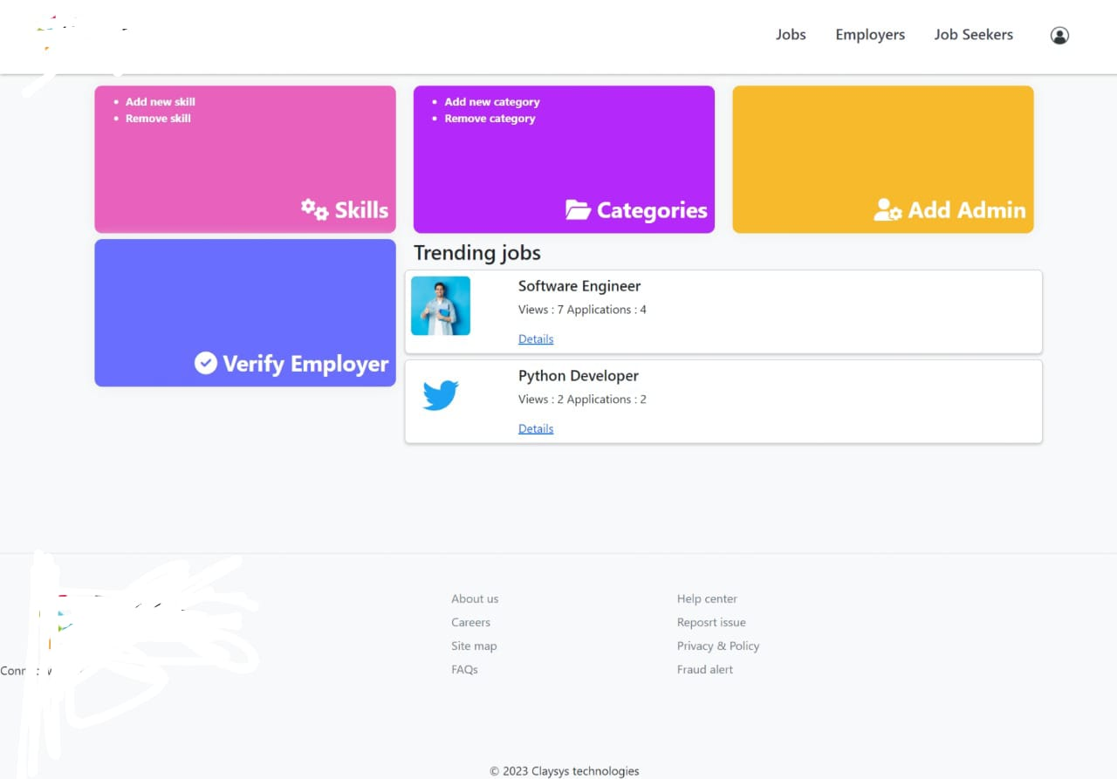

Slide 14
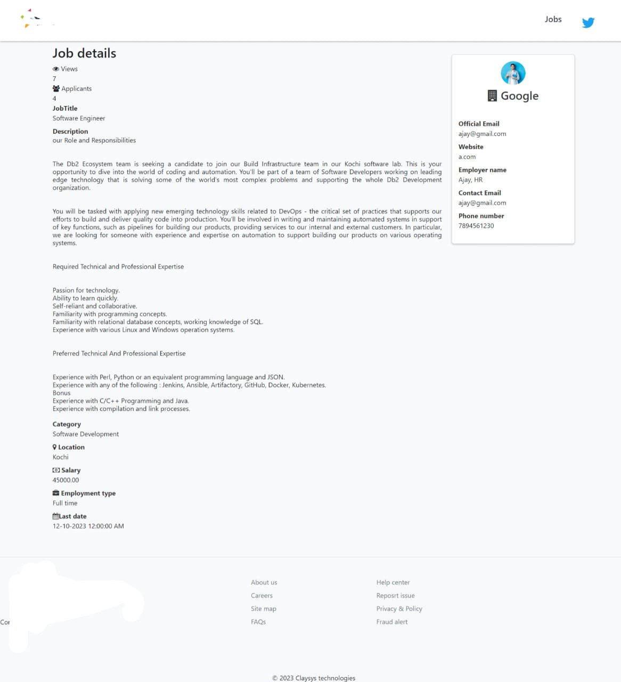

Slide 15
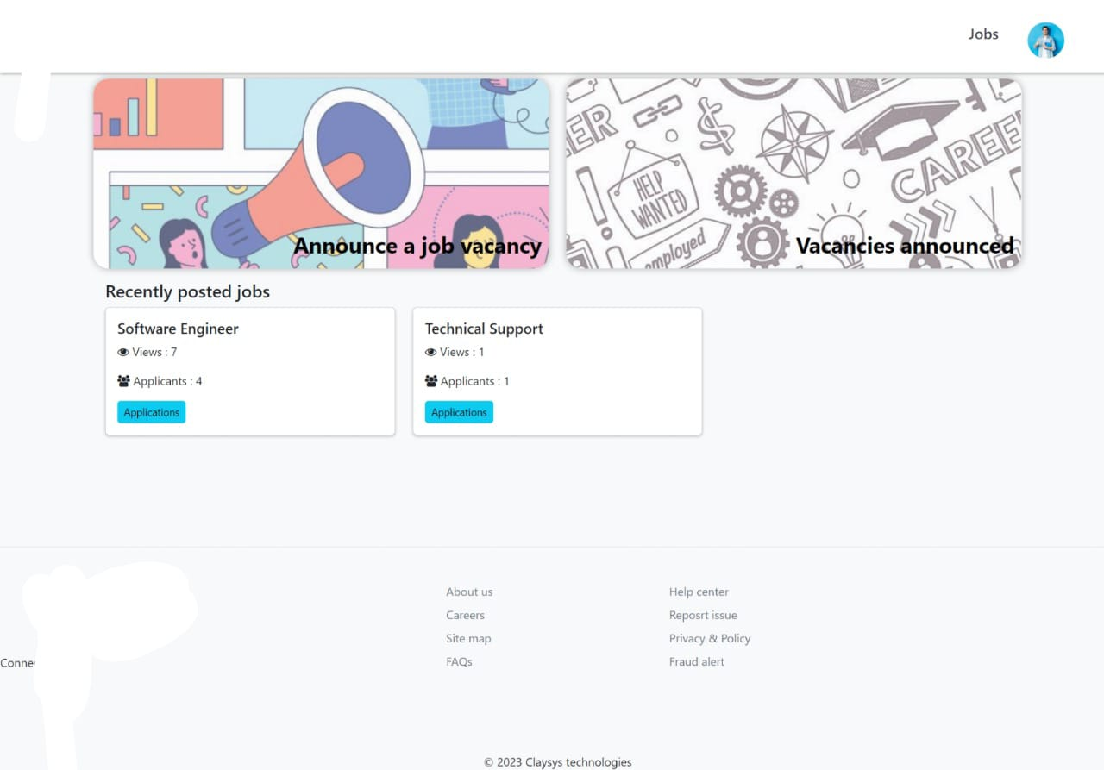

Slide 16
WORK DIVISION
LAIBA
SHAYAN
WASEEM
Project Lead
Developer
Document/Database Specialist

Slide 17

LESSON LEARNT
COMMUNICATION
FLEXIBILITY
CLARITY
ADAPTIBILITY

