Slide 1
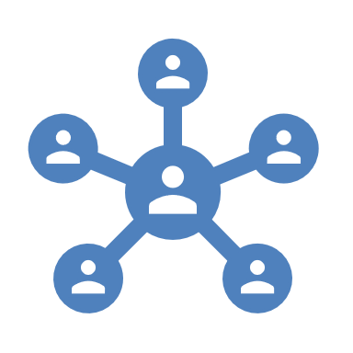
Project Overview & Tech Stack
TalentFlow.AI
Purpose:
A full-stack platform connecting candidates and HRs for job applications, profile management, and recruitment automation.
Key Features:
User authentication (login/register for candidates, HR, admin)
Candidate profile upload & parsing (including CV parsing and online presence extraction)
Job posting and management (HR can post, edit, and manage jobs)
Application management (candidates apply, HR shortlists, admin oversight)
Admin dashboard for system stats, user management, and alerts
Automated matching using LLM (AI) for candidate-job fit
Tech Stack:
Frontend: Next.js, React, MUI, TailwindCSS
Backend: Flask, MongoDB, PyMongo, REST API
AI/LLM: Integration with Groq LLM for smart parsing/matching
Other: Dockerized deployment, ChromaDB for embeddings, NextAuth for authentication

Slide 2

Workflow & User Roles
Candidate:
Registers, uploads CV, profile auto-parsed
Applies to jobs, tracks application status
HR:
Registers, posts jobs, views applicants
Shortlists candidates, updates job status
Admin:
System monitoring, user management
Handles alerts, stats, and critical actions
Workflow:
1. Registration/Login: Secure authentication for all users
2. Profile Management: Candidates upload CVs, system parses and structures data
3. Job Posting: HR posts jobs with detailed requirements
4. Application: Candidates apply, system matches profiles using AI
5. Shortlisting: HR reviews, shortlists, and manages applications
6. Admin Oversight: Admin dashboard for stats, alerts, and user management
Automation & Intelligence:
LLM-powered CV parsing and candidate-job matching
Alerts and logging for system health and security

