Slide 1


Library
Management
System

Slide 2

Team Members
20BCR7138 - Mamidisetti Veera Vardhan
20BCR7140 - Vasireddi Hariprasad
20BCD7137 - Byna Varun
20BCD7147 - Shaik Mohammad Waseem Akram

Slide 3
Agenda
Introduction
Objectives
Methodology
Design of proposed Project
UML Diagrams
Working Model
Results & Discussion
References

Slide 4
Introduction
Library management system is a web based application using PHP and MySQL. This can be used mainly by librarian for managing books, issuing books, and updating all the details about students who have taken books using a computerized system. Students can also use this for logging in and to check the details of books available in library. Only librarian is capable of issuing books and control everything in this software like adding new students, updating details.
This project is being done in PHP and with the help of MySQL database

Slide 5
2. Objectives
To provide better and efficient service to the users.
To make the workload of management in library easy
To make organizing of data and manipulating data easy
To Provide facility for proper monitoring reduce paperwork and provide data security

Slide 6
3. Methodology
The Implementation Methodology is broken into six stages: Requirement analysis, Planning, Modelling, Coding, Testing and Deployment.
Each stage includes a series of segments that are filled with a set of inputs, tools, techniques, and deliverables all building upon one another to move to the next stage.
The methodology contains four modules: Customer details, Farmer details, Product details and Admin details
The methodology also includes built-in sign-off processes to better ensure each party is satisfied throughout the project before moving to the next group of milestones.

Slide 7
4. Design of proposed work
Design phase of software development deals with transforming the clients requirements into a logically working system. Normally, design is performed in the following 2 steps-
1. Primary Design Phase:
In this phase, the system is designed at block level. The blocks are created on the basis of analysis done in a problem identification phase. Different blocks are created for different function emphasis is put on minimizing the information flow between blocks. Thus, all activities which require more interaction are kept in one block.
2. Secondary Design Phase:
In the secondary phase the detailed design of every block is performed

Slide 8
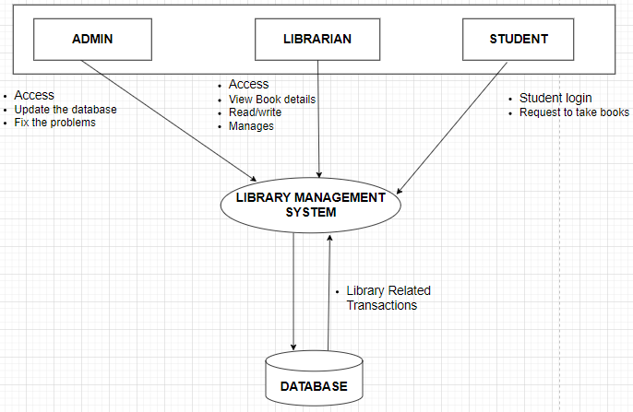
4.1 System Architecture Design

Slide 9
5. UML Diagrams
In this project, we designed different types of UML diagrams. The following are the four different UML diagrams for Library management system
Use Case Diagram: It is a graphical depiction of a user's possible interactions with a system
Class Diagram: It is a type of static structure diagram that describes the structure of a system by showing the system’s classes, their attributes, operations, and the relationships among objects.
Activity Diagram: It provides a view of the behavior of a system by describing the sequence of actions in a process.
Sequence Diagram: It shows process interactions arranged in time sequence in the field of software engineering.

Slide 10
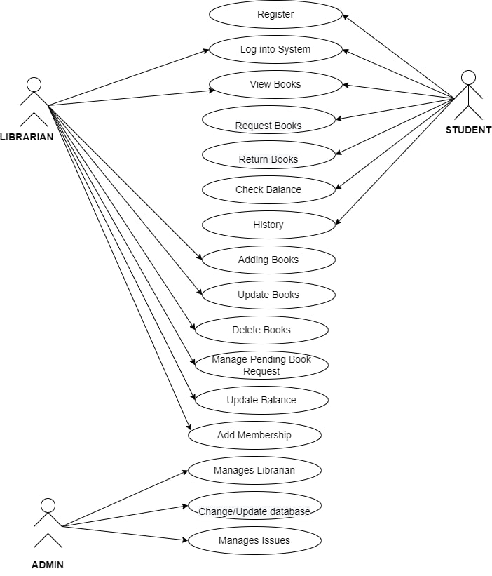
5.1 Use Case Diagram

Slide 11
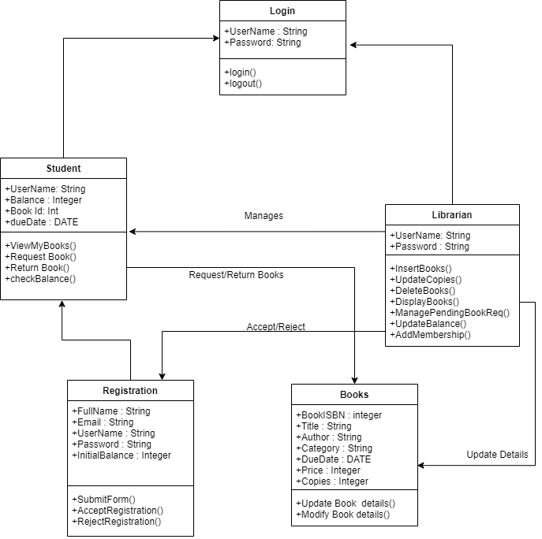
5.2 Class Diagram

Slide 12
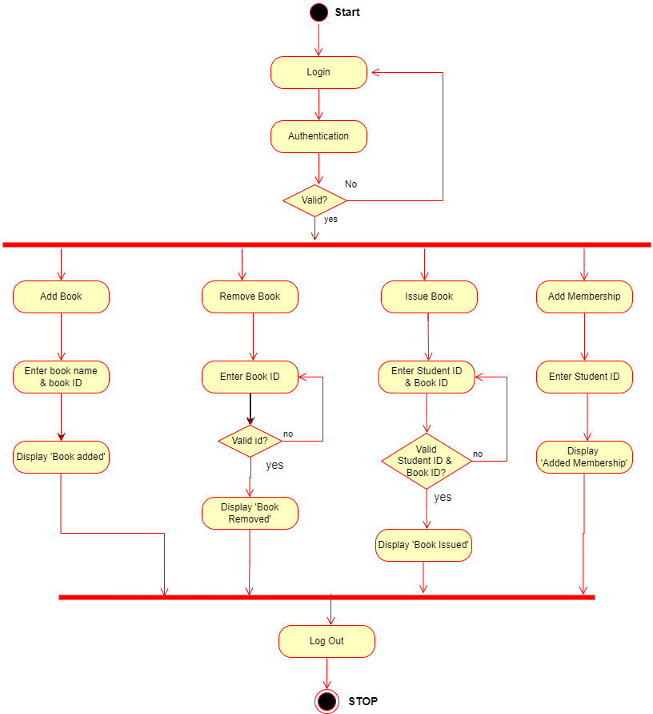
5.3.1 Librarian
Activity Diagram:

Slide 13
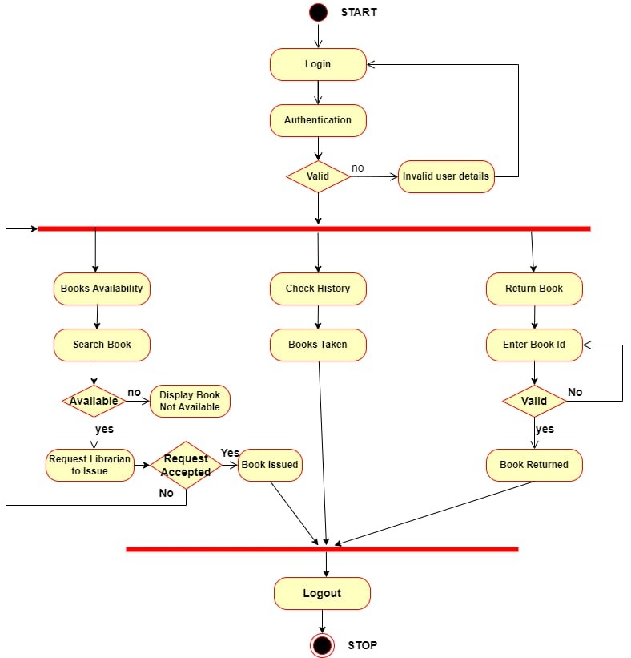
5.3.2 Student
Activity Diagram:

Slide 14
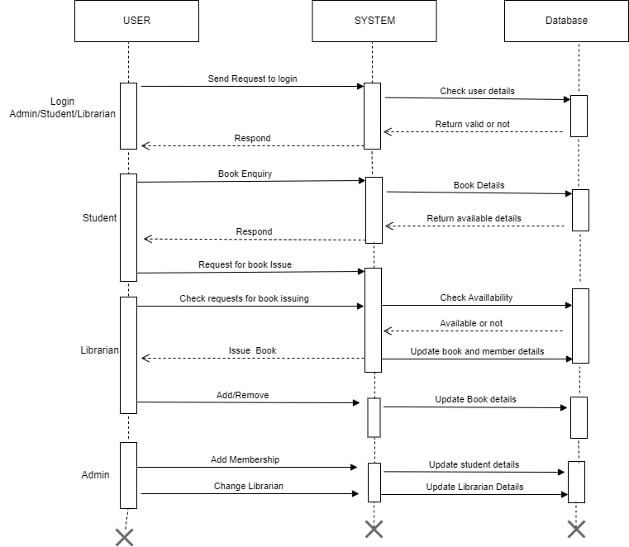
5.4 Sequence
Diagram

Slide 15
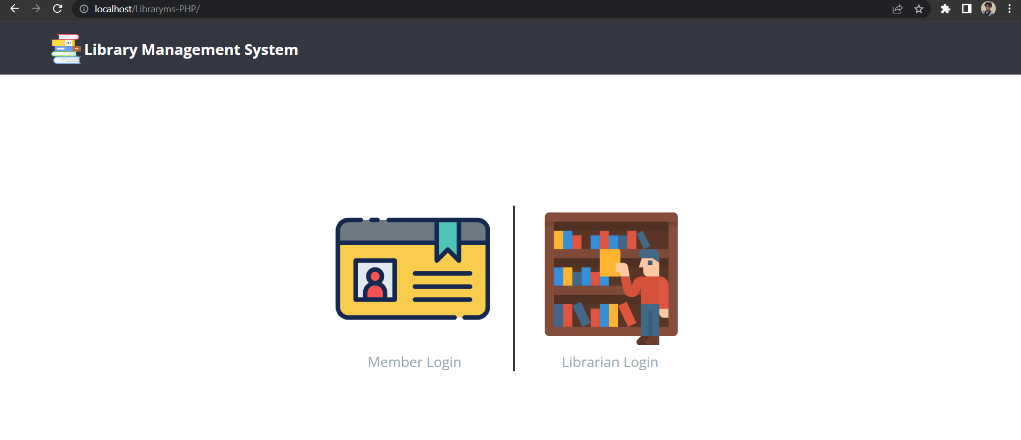
6. Working Model
6.1 Screenshot of Home page

Slide 16
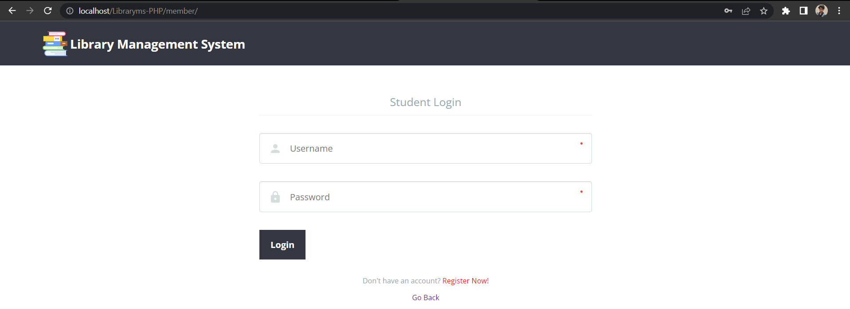
6.2 Screenshot of Student login

Slide 17
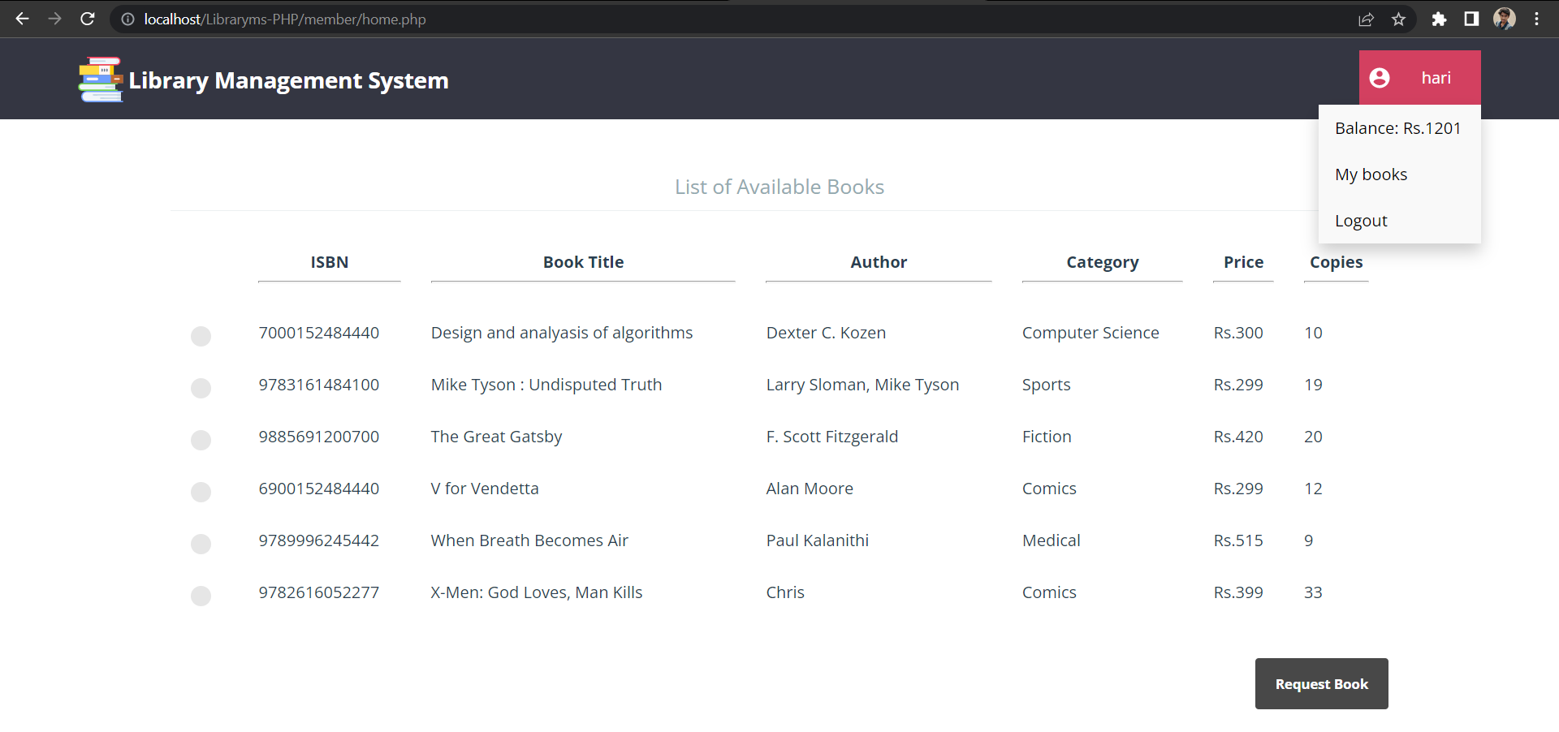
6.3 Screenshot of member after login

Slide 18
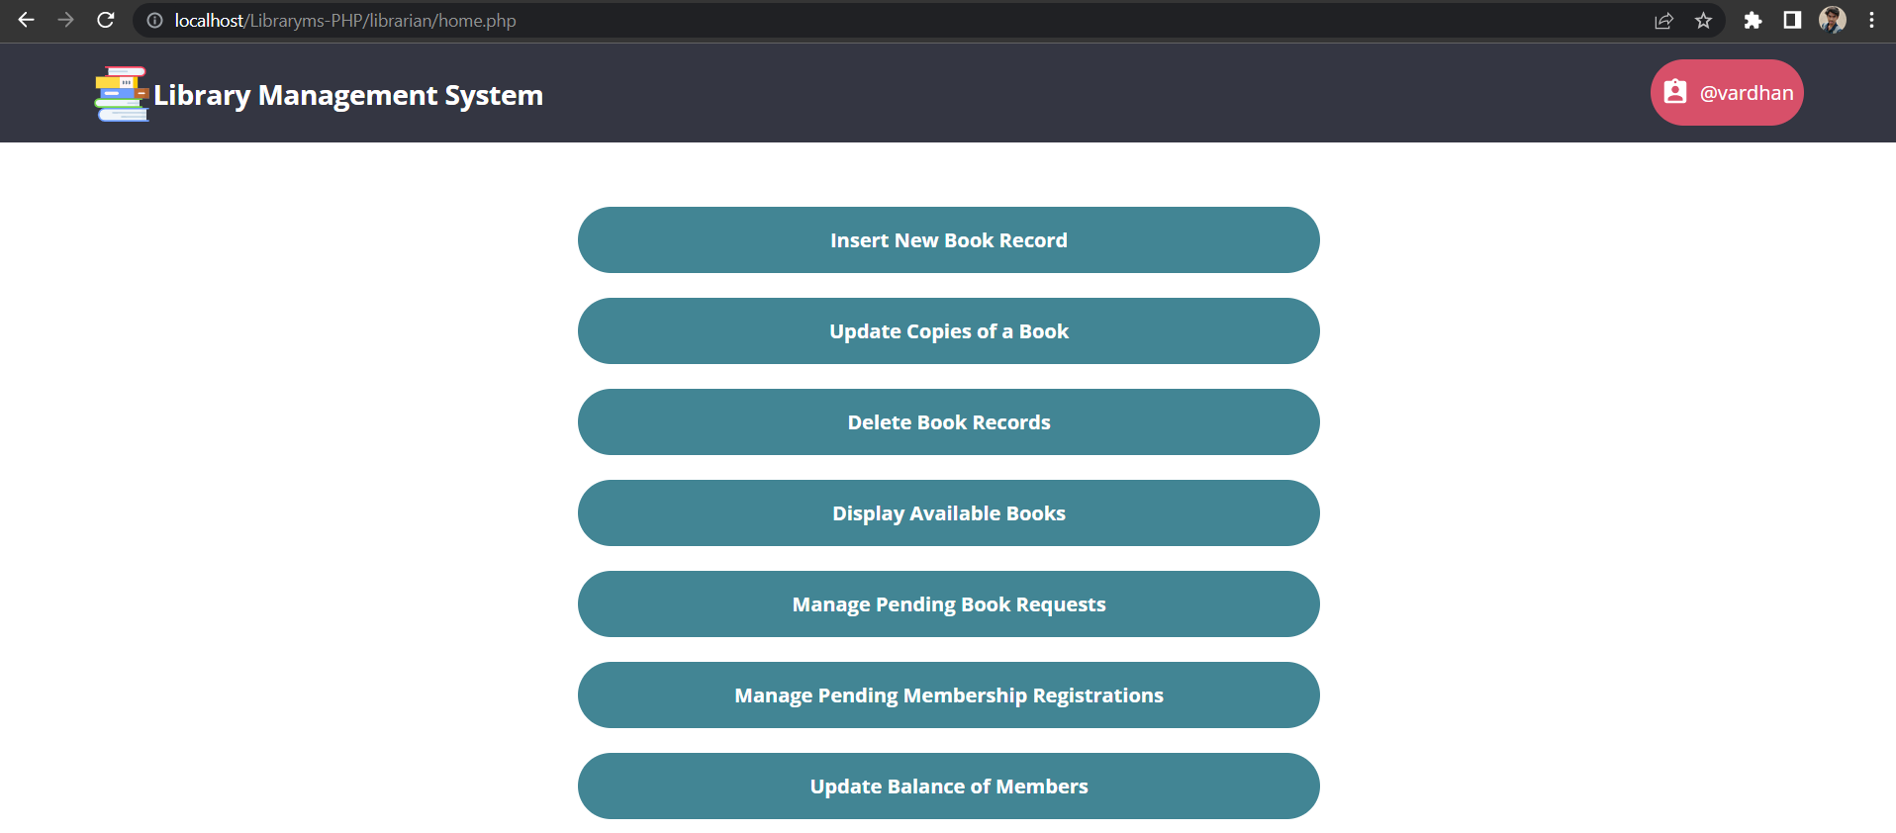
6.4 Screenshot of Admin after login

Slide 19
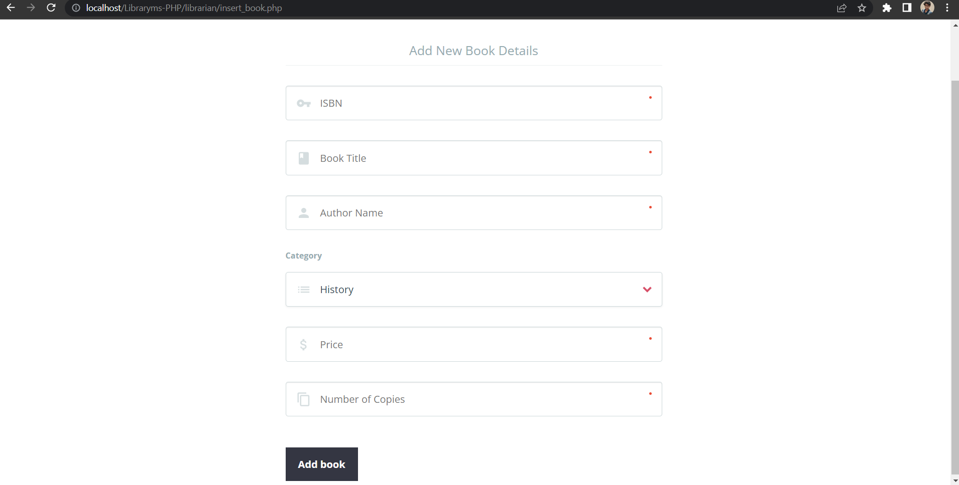
6.5 Screenshot of Add Book

Slide 20
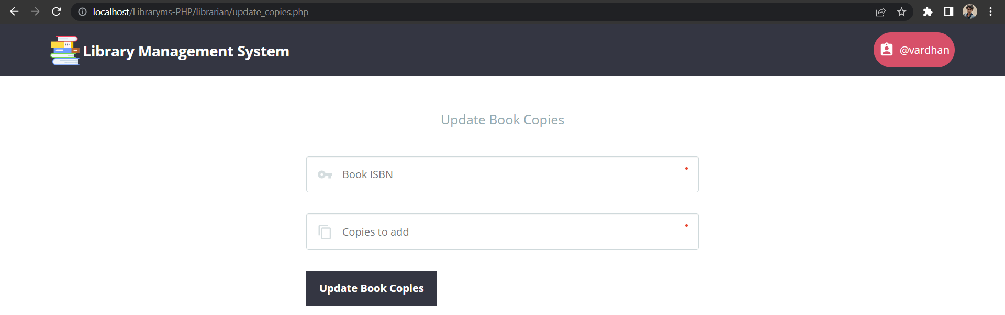
6.6 Screenshot of update Book copies

Slide 21
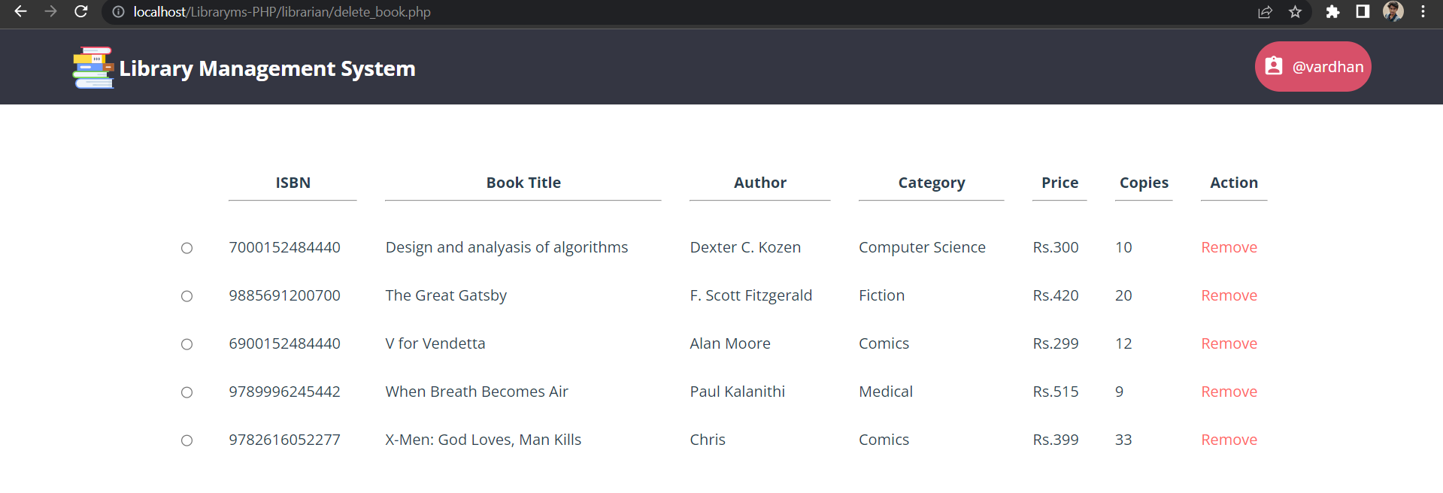
6.7 Screenshot of Book Delete

Slide 22
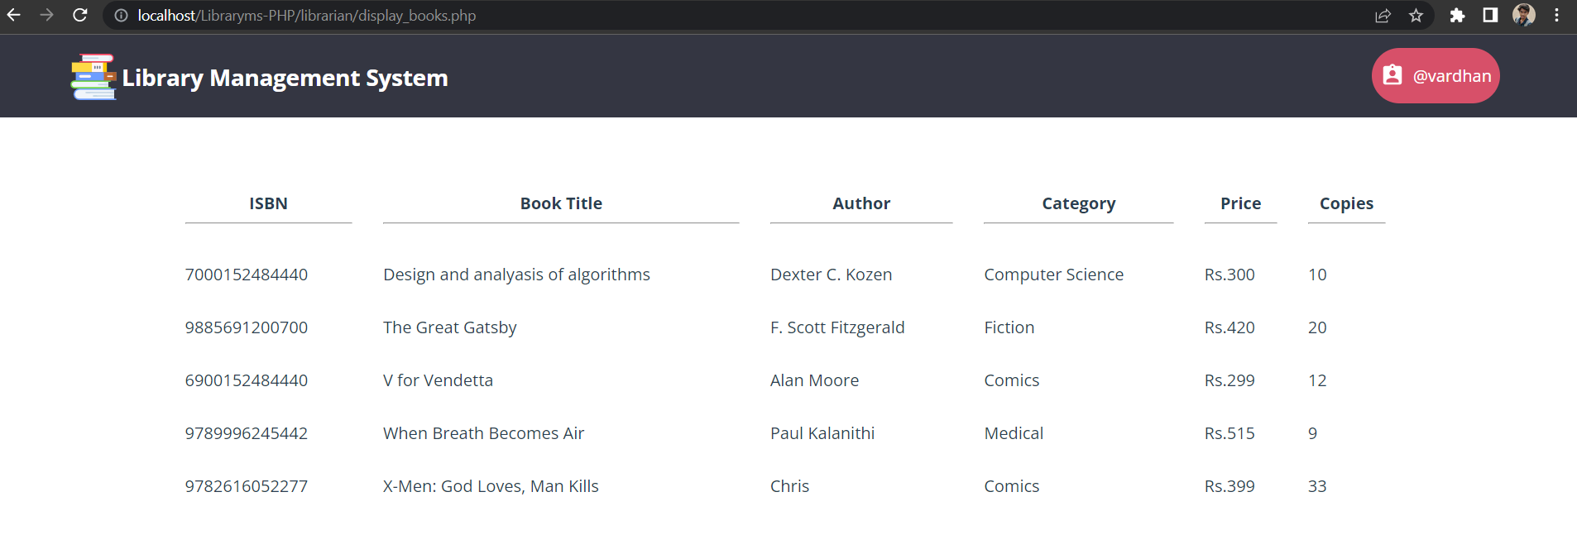
6.8 Screenshot of Books Available

Slide 23
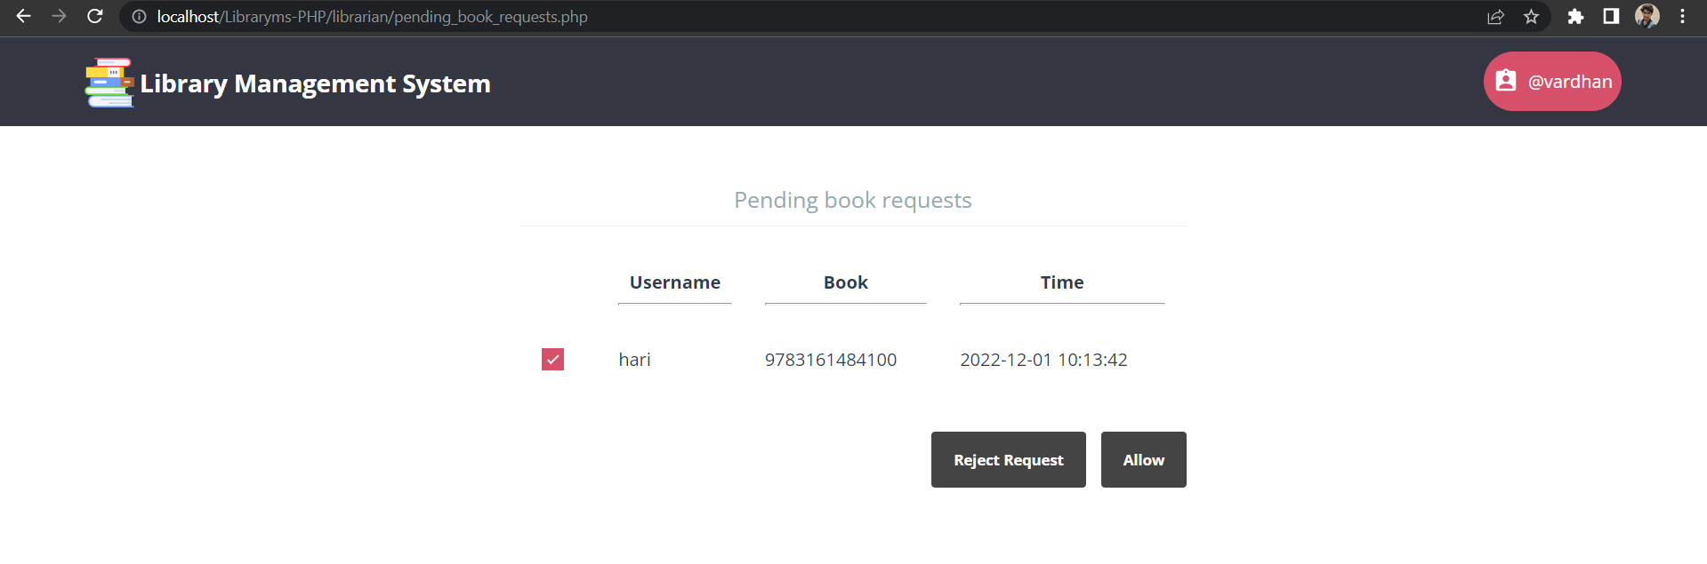
6.9 Screenshot of Pending Book Requests

Slide 24
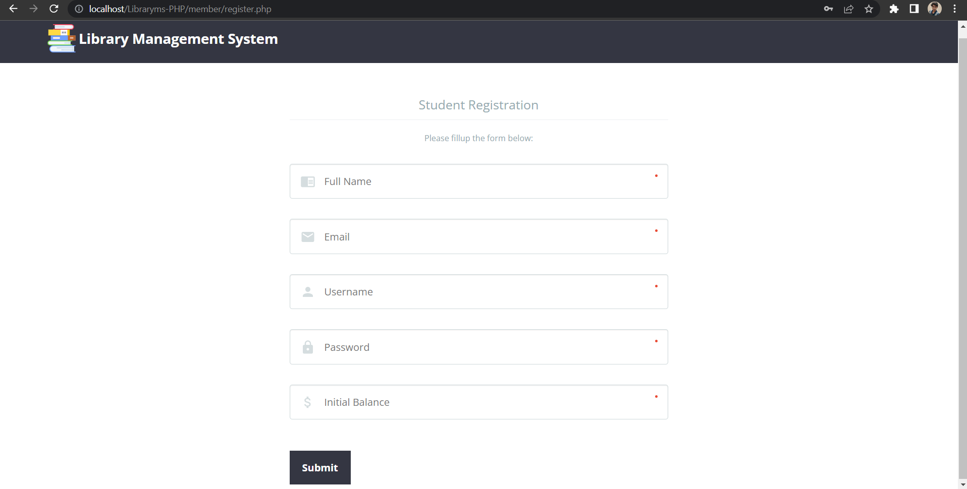
6.10 Screenshot of Student Registration

Slide 25
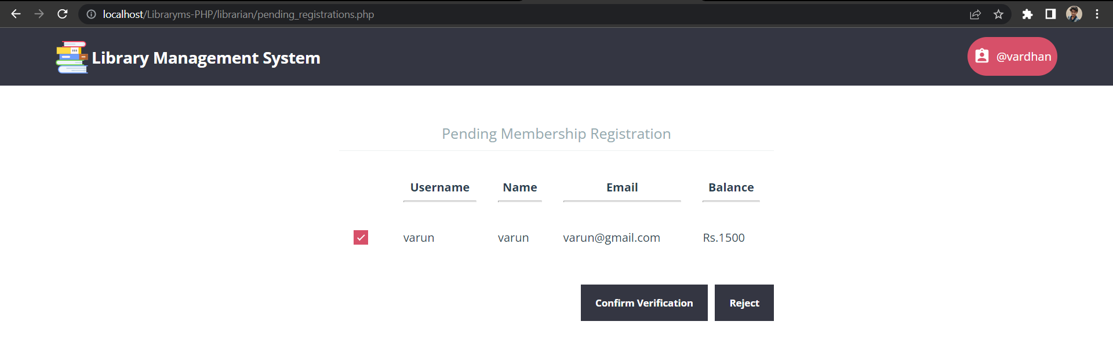
6.11 Screenshot of Pending Registrations

Slide 26
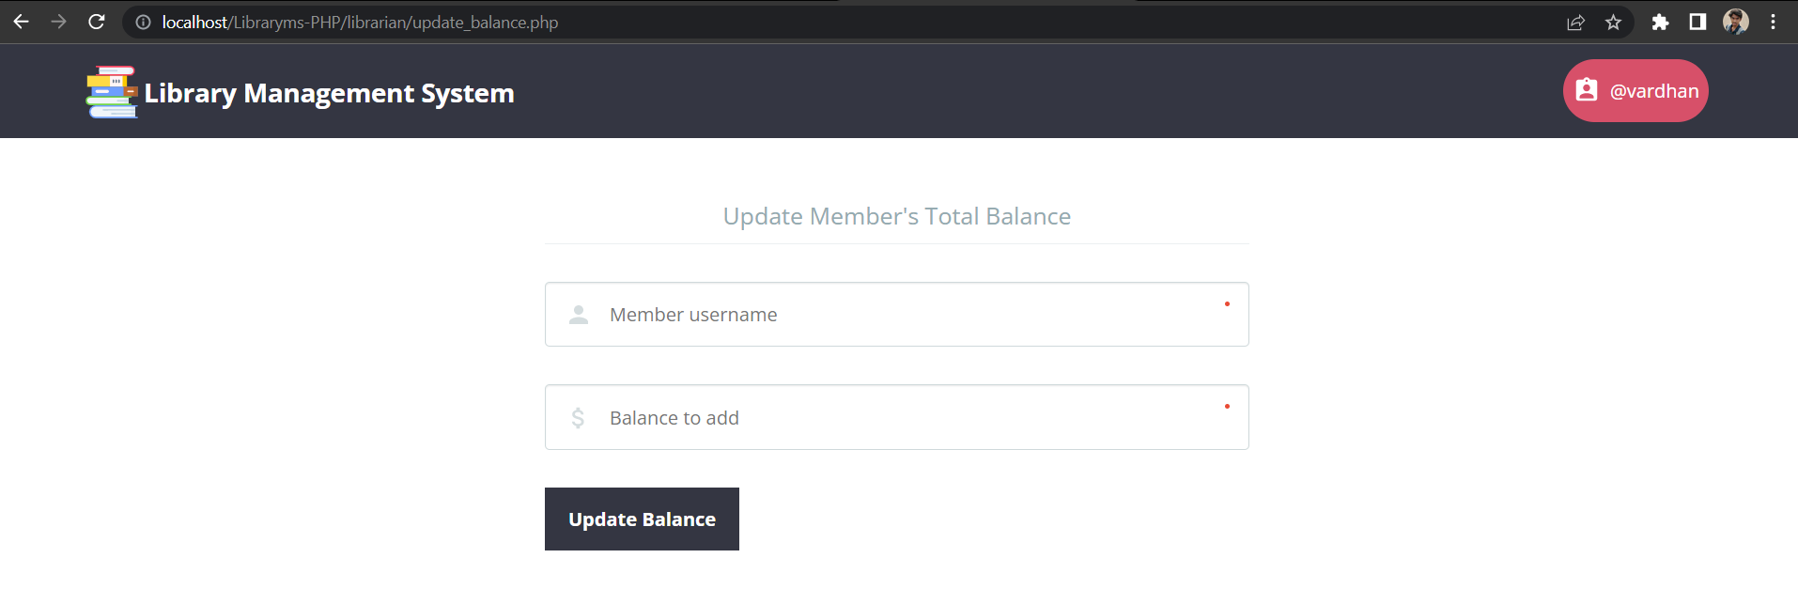
6.12 Screenshot of Balance Update

Slide 27
7. Results and Discussion:
From proper analysis and assessment of the designed system it can be safely concluded that the system is an efficient, usable and reliable Library Management System.
It is working properly and adequately meets the minimum expectations.
It has reduced the workload of librarian
Organizing of data and manipulating data easy

Slide 28
8. References
https://www.tutorialspoint.com/php/php_login_example.htm
https://www.w3schools.com/php/php_sessions.asp
https://www.w3schools.com/php/php_mysql_intro.asp
https://www.w3schools.com/php/php_mysql_create_table.asp
https://www.edureka.co/blog/how-to-run-a-php-program-in-xampp/

Slide 29


