Slide 1
ULTRAVIOLET LIGHT
SUBMITTED TO: PROF VITTORIO SCARANO
SUBMITTED BY: Muhammad Waseem

Slide 2
PROBLEM AREA
UV rays, either from the sun or from artificial sources like tanning beds, can cause sunburn. Exposure to UV rays can cause premature aging of the skin and signs of sun damage such as wrinkles, leathery skin, liver spots. UV rays can also cause eye problems..

Slide 3
PURPOSE
The purpose of this project is to detect and monitor Uv Light rays and monitor those values on an independent platform. By using VEML6070 sensor we can get notified timely which can save our skin from getting harm from uv Light rays.

Slide 4
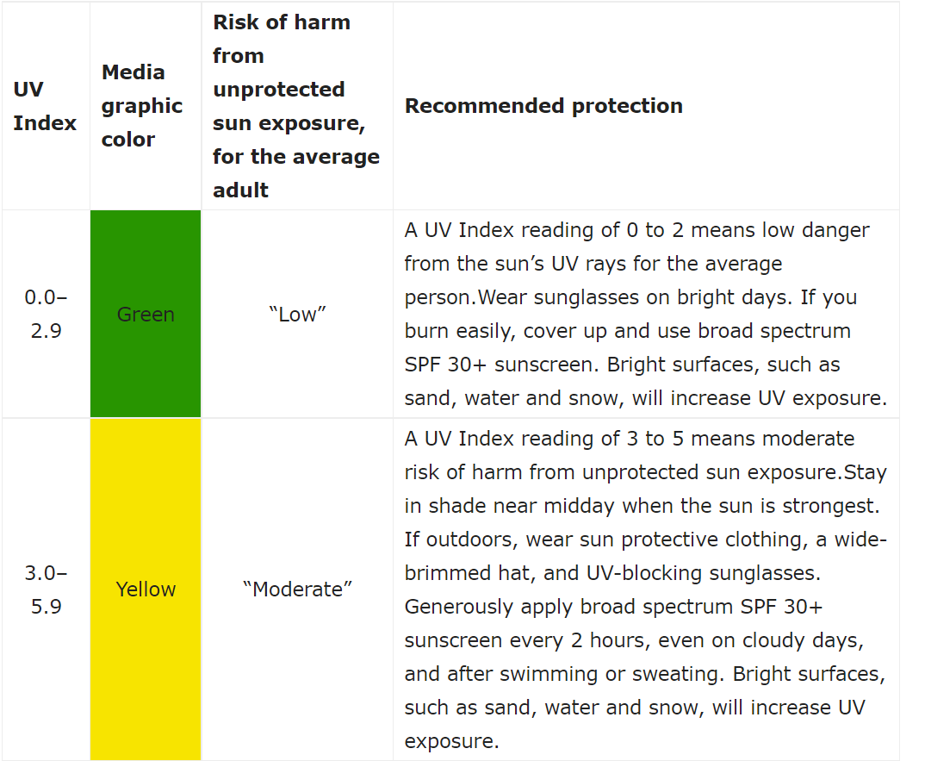
This is the key chart and one of the reasons that a UV index meter is so important

Slide 5
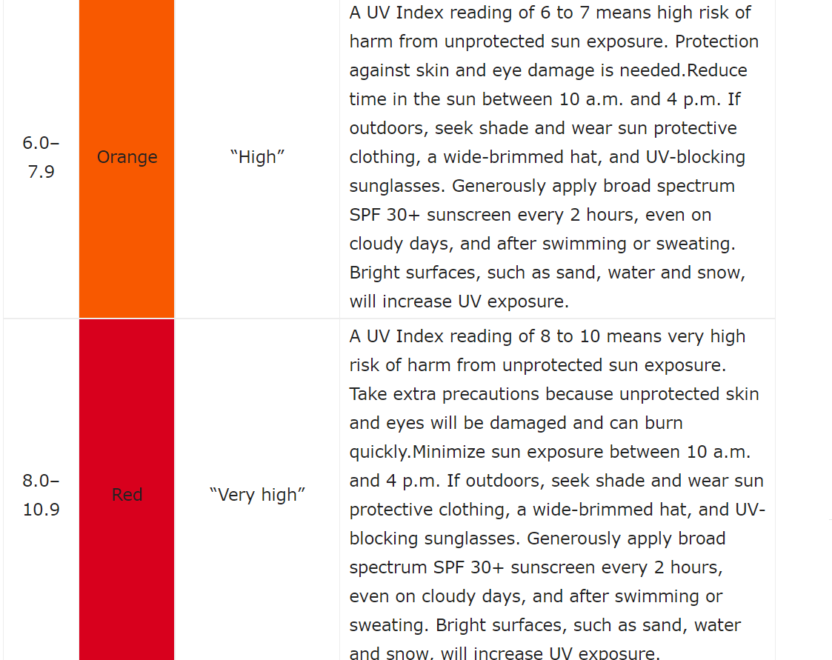
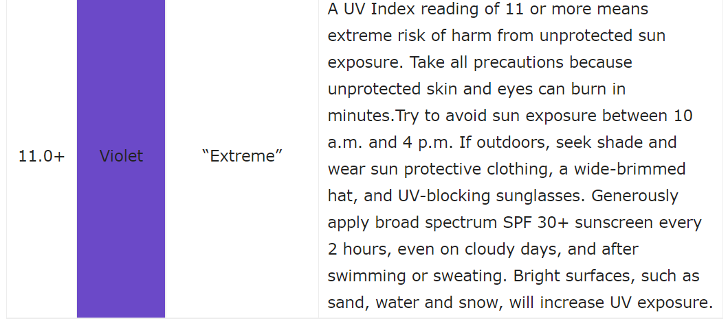

Slide 6
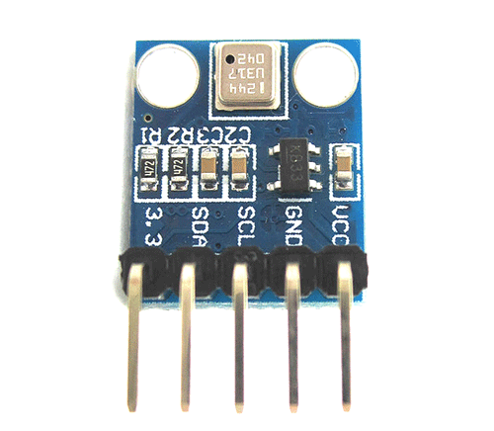
SERVICES AND TOOLS
VEML6070:
This precision sensor is the best low-cost sensing solution for measuring UVLight Rays.!

Slide 7

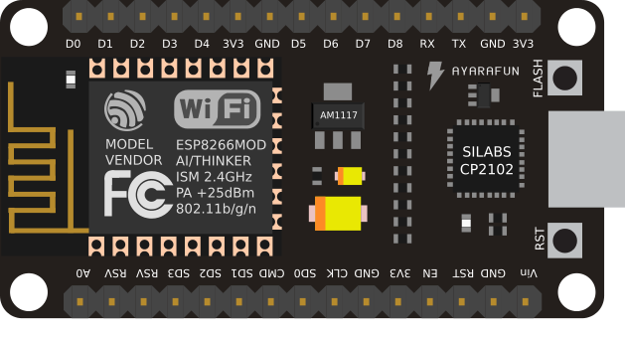
SERVICES & TOOLS CONT…
NodeMcu
is a low-cost open source IoT device that includes firmware, which runs on the ESP8266 Wi-Fi microchip, and hardware based on the ESP-12 module. NodeMCU has 128 KB RAM and 4MB of Flash memory to store data and programs. This device consists of 13 GPIO pins.
RabbitMQ
RabbitMQ is an open-source message-broker software which implements AMQP and has since been extended with a plug-in architecture to support MQTT and other protocols
Nuclio
Nuclio is an open source and managed serverless platform used to minimize development and maintenance overhead and automate the deployment of data-science based application

Slide 8

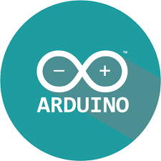
SERVICES & TOOLS CONT…
Docker
Docker is a project open source that automates the process of deployment of applications in software containers.
Arduino
The Arduino Integrated Development Environment is a cross-platform application that is written in functions from C and C++. It is used to write and upload programs to Arduino compatible boards such as NodeMCU.

Slide 9



SERVICES & TOOLS CONT…
MQTIZER is a mobile MQTT client that can connect to any broker which shares the network with your phone, and to any broker on the cloud as well. So to view the on the mobile platform we use MQtizer
MQTLENS is an web app for chrome browser that lets you publish message to an MQTT broker , subscribe to MQTT topics , and receive messages using the chrome web browser
IFTTT If This Then That is a private commercial company that runs services that allow a user to program a response to events in the world.

Slide 10
LIBRARIES
ESP8266
is the library support for the ESP8266 chip to the Arduino environment. It lets us write sketches, using familiar Arduino functions and libraries, and run them directly on NODEMCU
Pubsubclient
Is a client library for MQTT messaging, MQTT is a lightweight messaging protocol ideal for small devices. This library allows you to send and receive MQTT messages.
Adafruit VEML6070
A powerful but easy to use Library for detecting UvLightRays .

Slide 11
IMPLEMENTATION
UBUNTU:
Firstly we install UBUNTU 18.04 on a Virtual Machine.
DOCKER:
Then we install Docker and Docker Compose on the Ubuntu.
NUCLIO:
After Installing docker then we have to install Nuclio serverless platform by using the docker command.

Slide 12
IMPLEMENTATION CONT…
RABBIT MQ: Then we moved to install RabbitMQ by using the given Docker command.
.
ARDUINO IDE: Downloading the Arduino IDE to upload the code to NODEMCU.
LIBRARY INSTALLATION: Installing library for connecting the sensor.

Slide 13
IMPLEMENTATION CONT…
IFTTT: Wehave to make applets on IFTTT webhooks.
.
Than we have to make events on Ifttt applets through webhooks .

Slide 14
IMPLEMENTATION CONT…
Before Uploading the Code we must install MQTT library PUBSUBCLIENT and then we install ESP8266 library for NODEMCU and finally we upload the Code.
.
To generate the queues on RabbitMQ first we deploy the given function on Nuclio by setting IP and triggers.
The deployed function on Nuclio will generate queues on RabbitMQ of the data sensed from the sensor.

Slide 15
IMPLEMENTATION CONT…
MQTIZERTo display the data on SmartPhone we will set the RabbitMQ IP on the app and then it will generate messages on phone
MQTLENS For the MQTT web app we will set the hostname which is our IP and then will generate the messages on the Web App as well

Slide 16
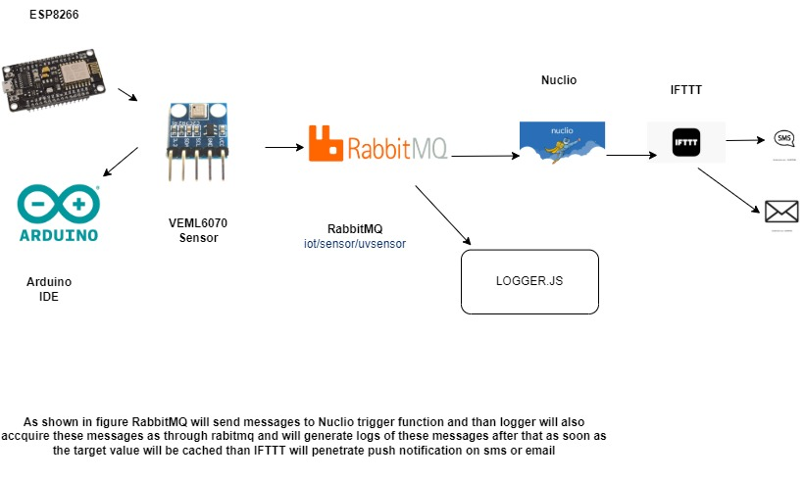
ARCHITECTURE

Slide 17
APPLICATION:
UV Light rays can be used in every perspective of life ,Some examples are :
Automotive (Wheels , Interior Coating)
Medical Products (UV coating in medi al applications).
Label Printing and Printing on packaging.

Slide 18
THANKS!
Any questions?

