Slide 1
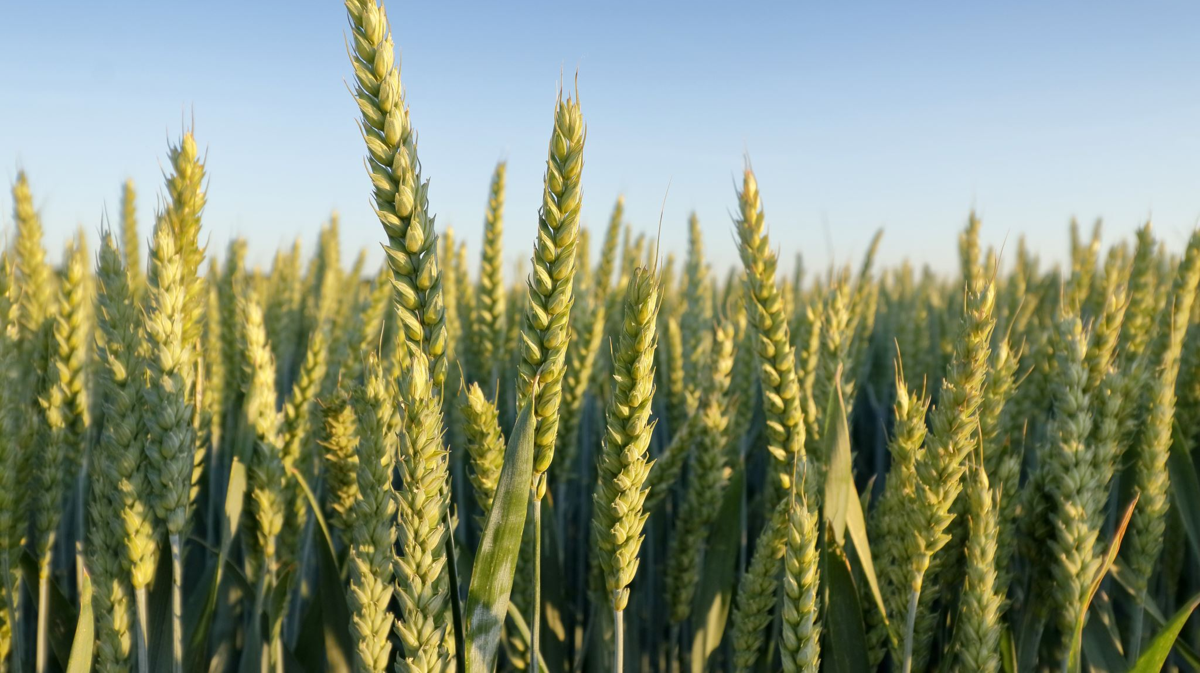
Contribution of ear development to yield stability in winter wheat
Project presentation by Nourian Wasella

Slide 2
Content
Physiology
Hypothesis
Methods
Results
Discussion
Conclusion

Slide 3
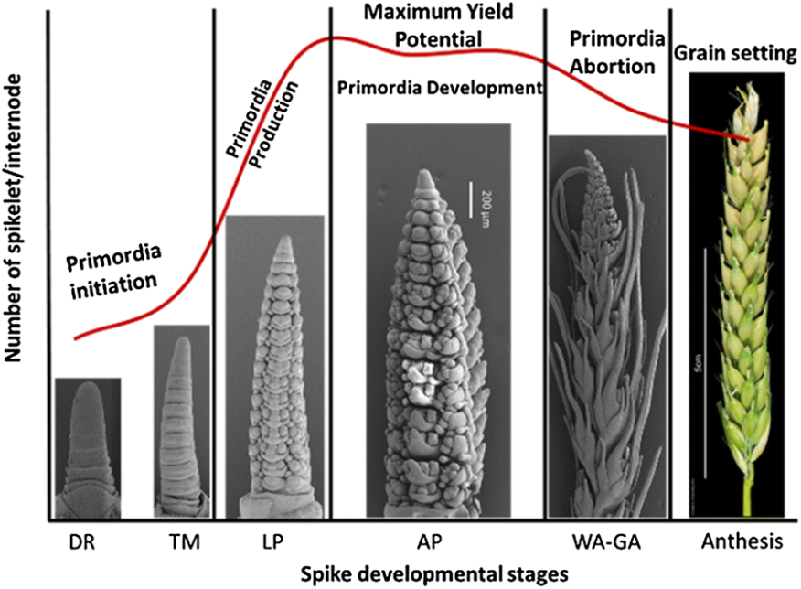
Spike Development (Physiology)
Source: Boussora et al. (2019), [1]

Slide 4
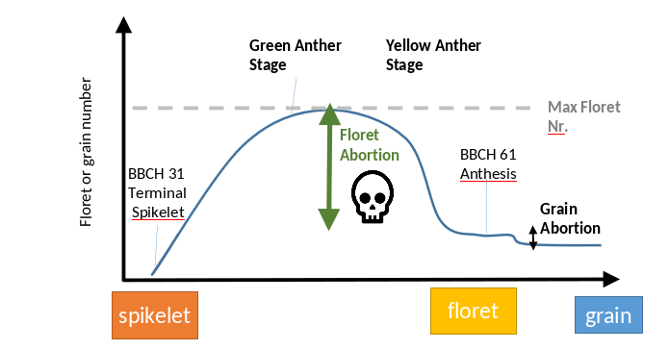
Floret and grain abortion (Physiology)
Source: Tien Cheng Wang (2023), [2]

Slide 5
Sowing Dates
Optimal sowing dates are different for different regions (Ali, Muhammad Anjum et al., 2010, [3])
Early sowing will result in a longer vegetative phase (Gustavo A. et. al, 2021, [4])
This period has very low yield sensitivity
The main goal is to choose a date with minimized stress factors to the plant (Gustavo A. et. al, 2021, [4])

Slide 6
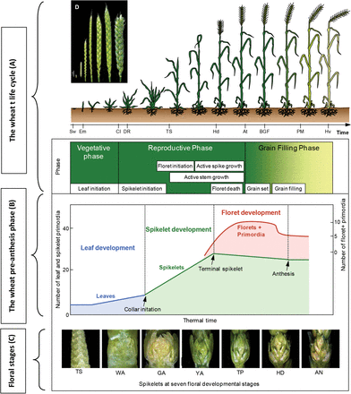
Floret Number
Floret abortion happens before anthesis(Guo, Z. et. al. (2015), [6])
After anthesis there shouldn’t be a difference in floret number between probes taken at different times
Source: Guo, Z. et. al. (2015), [6]

Slide 7
Hypotheses
Treatments with early sowing will have different (a≠b) grain counts compared to those with late sowing
Treatments with early sowing will have different (a≠b) counts of larger and medium grains compared to those with late sowing
Grain setting will be different (a≠b) in treatments with late sowing
There should not be a significant difference (a=b) between floret numbers between batches

Slide 8
Data Structure
plot_id | time_id | date | var | appl | nitrogen
40 | early | 22.10.2020 | Potenzial | Split | 176
42 | late | 05.11.2020 | Potenzial | Split | 176
Two weeks time difference in sowing
Same cultivar (var) and nitrogen application (appl)
Three batches per plot were taken and looked at, at different times and physiological stages
each containing ten ears

Slide 9
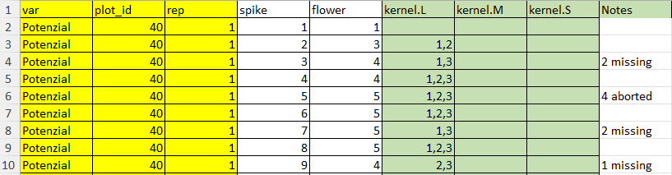
Grain Counting
Variables counted:
Number of Spikes
Number of Flowers
Kernel size and position

Slide 10
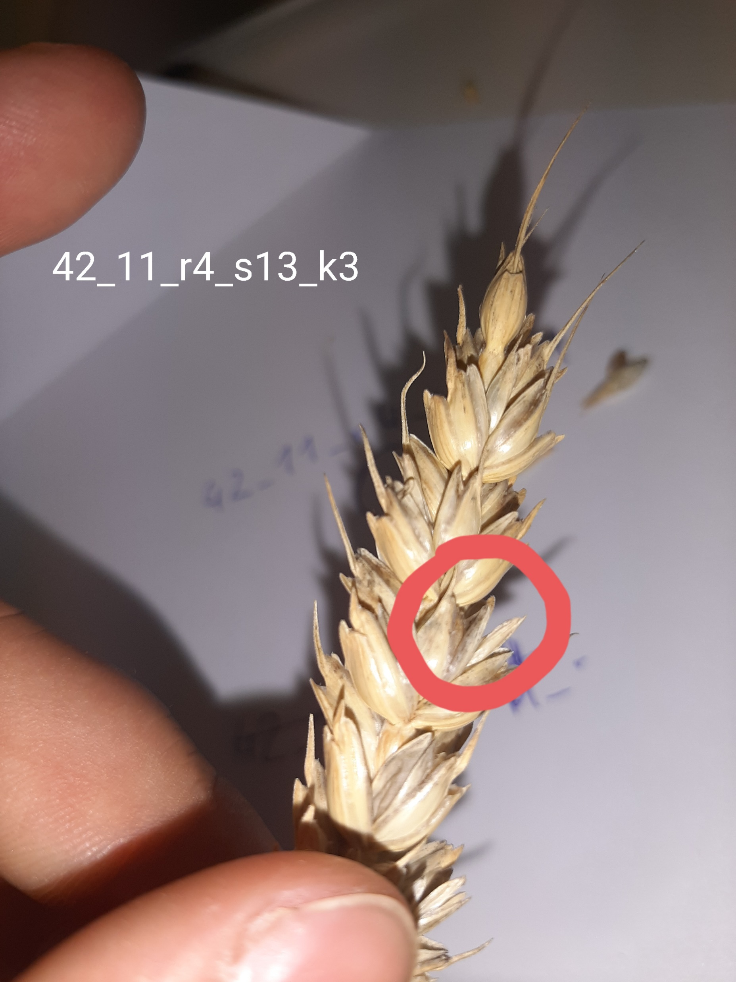
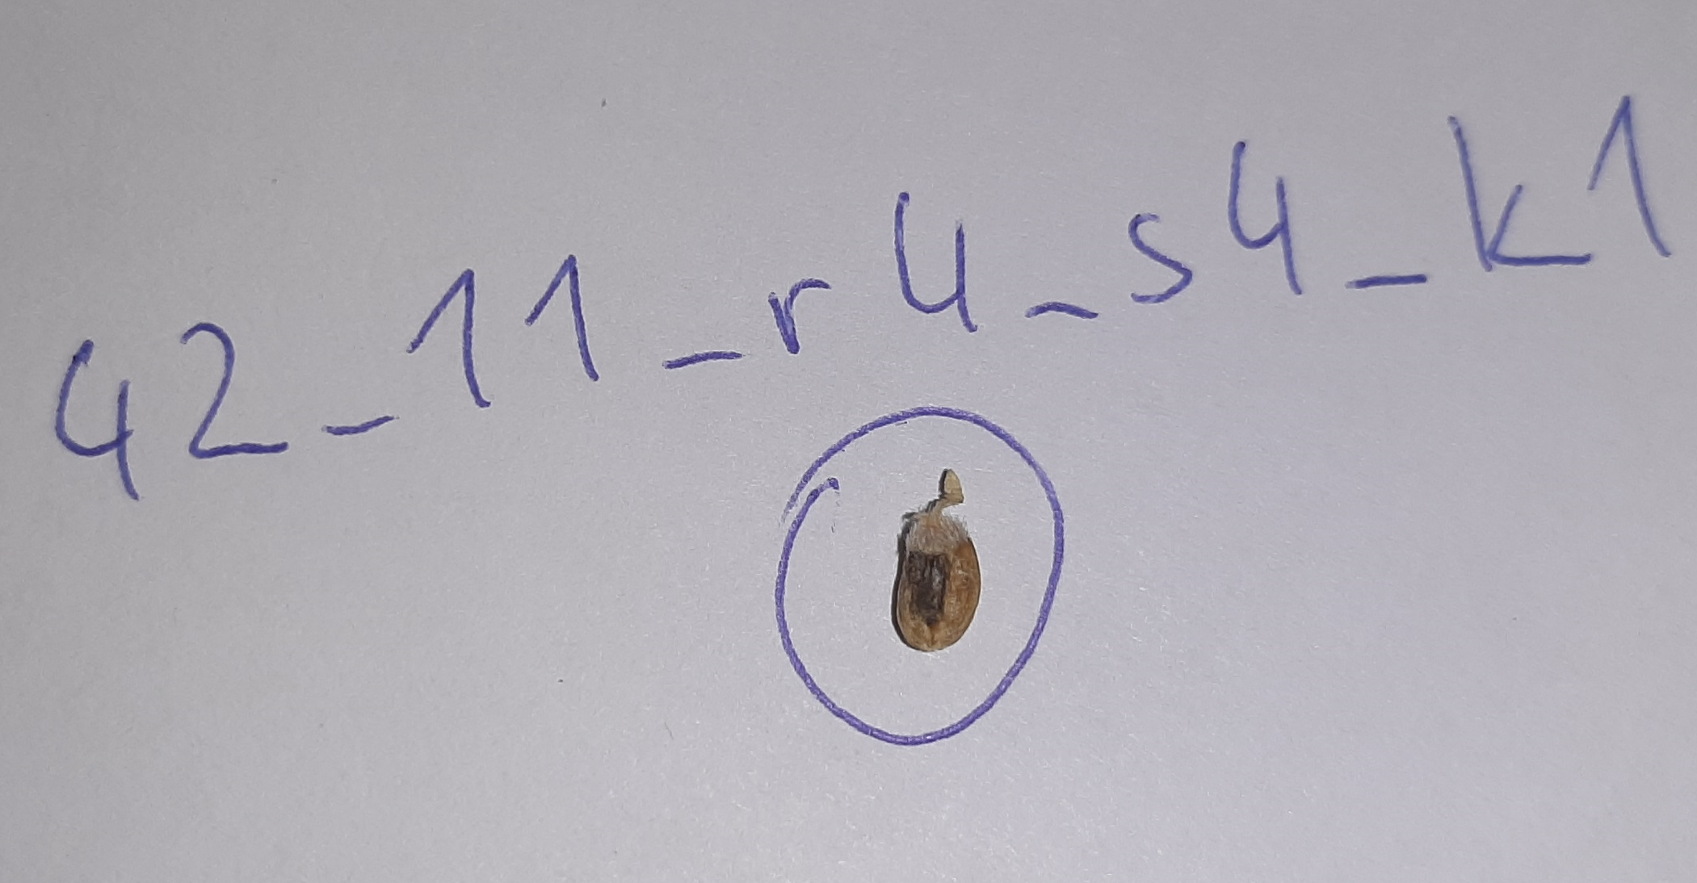
Grain Counting Anomalies

Slide 11
Statistical testing and visualization
For Hypothesis 1-3
Data manipulation with R
Data visualization with R
Boxplots with Scatterpoints
T-tests for significance testing
For Hypothesis 4
Data manipulation with R
Data visualization with R
Line graph
Standard deviations

Slide 12
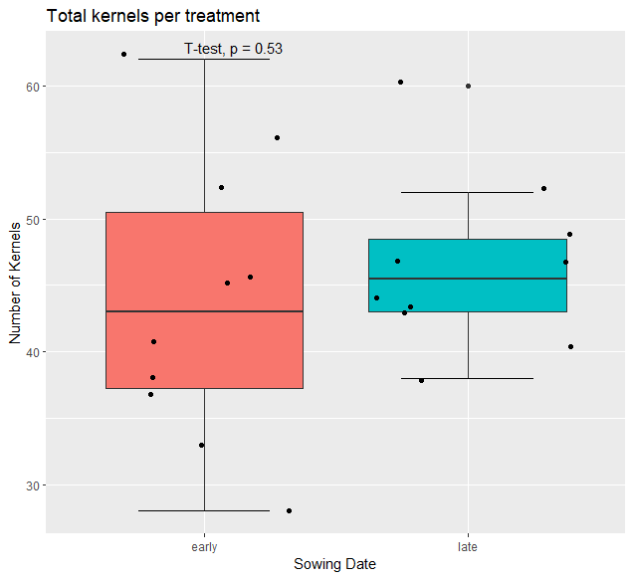
Results (Hypothesis 1)
“Treatments with early sowing will have different (a≠b) grain counts compared to those with late sowing”
No significant difference
Early sowing shows a higher variance

Slide 13
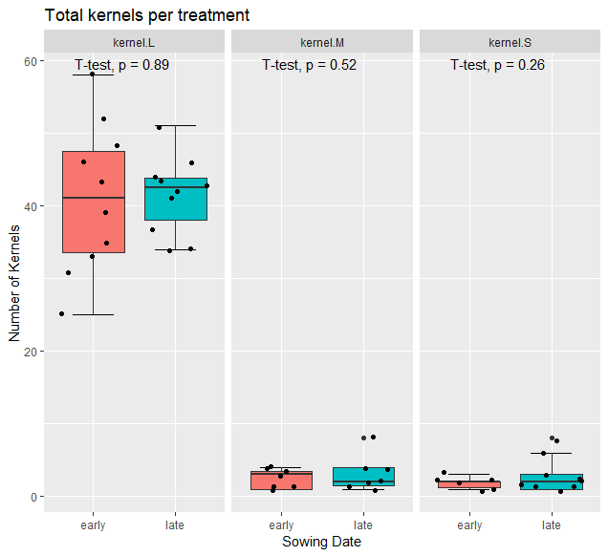
Results (Hypothesis 2)
“Treatments with early sowing will have different (a≠b) counts of larger and medium grains compared to those with late sowing”
No significant difference
Early sowing shows a higher variance in large and small kernels

Slide 14
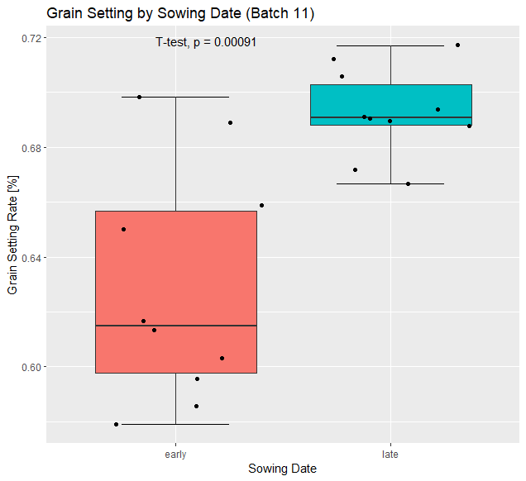
Results (Hypothesis 3)
Grain setting will be different (a≠b) in treatments with late sowing
Significant difference between treatments (a≠b)
Early sowing shows a higher variance

Slide 15
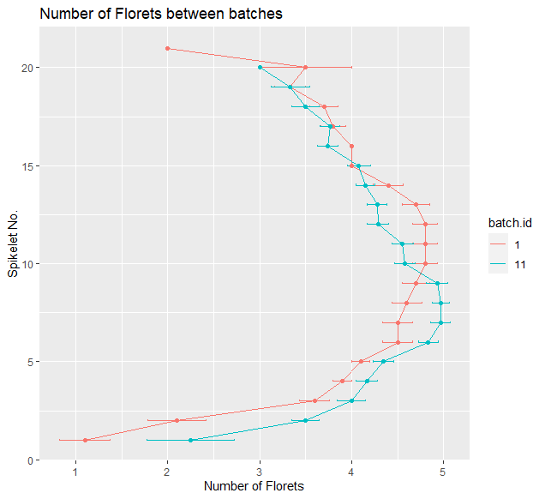
Results (Hypothesis 4)
“There should not be a significant difference (a=b) between floret numbers between batches”
No visible difference
Small sample size

Slide 16

Discussion (Hypotheses 1-2)
Both sowing dates produce similar grain counts
The chosen sowing dates don’t seem to affect the
Differences might show in kernel weight or quality
Yield sensitive period is not affected by sowing dates (Gustavo A. et. al, 2021, [4])
Optimal sowing dates are within a range, so both dates might be optimal (Ali, Muhammad Anjum et al., 2010, [3])
Sowing date influences number of ears rather than the ears themselves (Spink, J. H. et. al. (2000), [9])

Slide 17
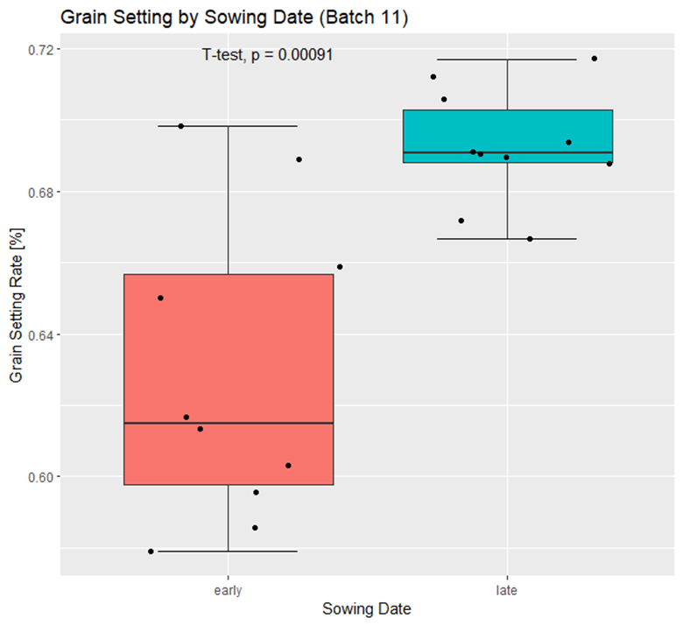
Discussion (Hypothesis 3)
Very small sample size
Might not be representative
Differences might be explained by:
Heat stress
Water stress
Disease and pest pressure
Competition with wheat
Grain setting ≠ yield
Researchers usually look at different variables when they’re comparing sowing dates

Slide 18
Discussion (Hypothesis 4)
Small differences might be due to the small sample size
Differences should be smaller in higher sample sizes
Random effects
Counting errors
Generally, what is expected to be found
Floret abortion happens before anthesis (Guo, Z. et. al. (2015), [6])

Slide 19
Conclusion
Sowing date does not seem to affect the number of kernels, independent of their size
The data collected suggests, that the sowing date influenced the grain setting rate
After anthesis there doesn’t seem to be a difference in floret per spike numbers

Slide 20
References
Boussora, F., Allam, M., Guasmi, F., Ferchichi, A., Rutten, T., Hansson, M., ... & Börner, A. (2019). Spike developmental stages and ABA role in spikelet primordia abortion contribute to the final yield in barley (Hordeum vulgare L.). Botanical Studies, 60(1), 1-11
Tien Chang Wang: B. Sc. Project „Contribution of ear development to yield stability in winter wheat“, 2023, Week 3, Slide 13
Ali, M. A., Ali, M., Sattar, M., & Ali, L. (2010). Sowing date effect on yield of different wheat varieties. J. Agric. Res, 48(2), 157-162.
Slafer, G. A., Savin, R., Pinochet, D., & Calderini, D. F. (2021). Wheat. In Crop physiology case histories for major crops (pp. 98-163). Academic Press.
Fischer, R. A. (2011). Wheat physiology: a review of recent developments. Crop and Pasture Science, 62(2), 95-114.
Guo, Z., Chen, D., & Schnurbusch, T. (2015). Variance components, heritability and correlation analysis of anther and ovary size during the floral development of bread wheat. Journal of Experimental Botany, 66(11), 3099-3111
Koppolu, R., & Schnurbusch, T. (2019). Developmental pathways for shaping spike inflorescence architecture in barley and wheat. Journal of integrative plant biology, 61(3), 278-295
Sakuma, S., & Schnurbusch, T. (2020). Of floral fortune: tinkering with the grain yield potential of cereal crops. New Phytologist, 225(5), 1873-1882.
Spink, J. H., Semere, T., Sparkes, D. L., Whaley, J. M., Foulkes, M. J., Clare, R. W., & Scott, R. K. (2000). Effect of sowing date on the optimum plant density of winter wheat. Annals of applied biology, 137(2), 179-188.
Hyles, J., Bloomfield, M. T., Hunt, J. R., Trethowan, R. M., & Trevaskis, B. (2020). Phenology and related traits for wheat adaptation. Heredity, 125(6), 417-430.
Meier, U. (1997). Growth stages of mono-and dicotyledonous plants. Berlin [etc.]: Blackwell.

