Slide 1
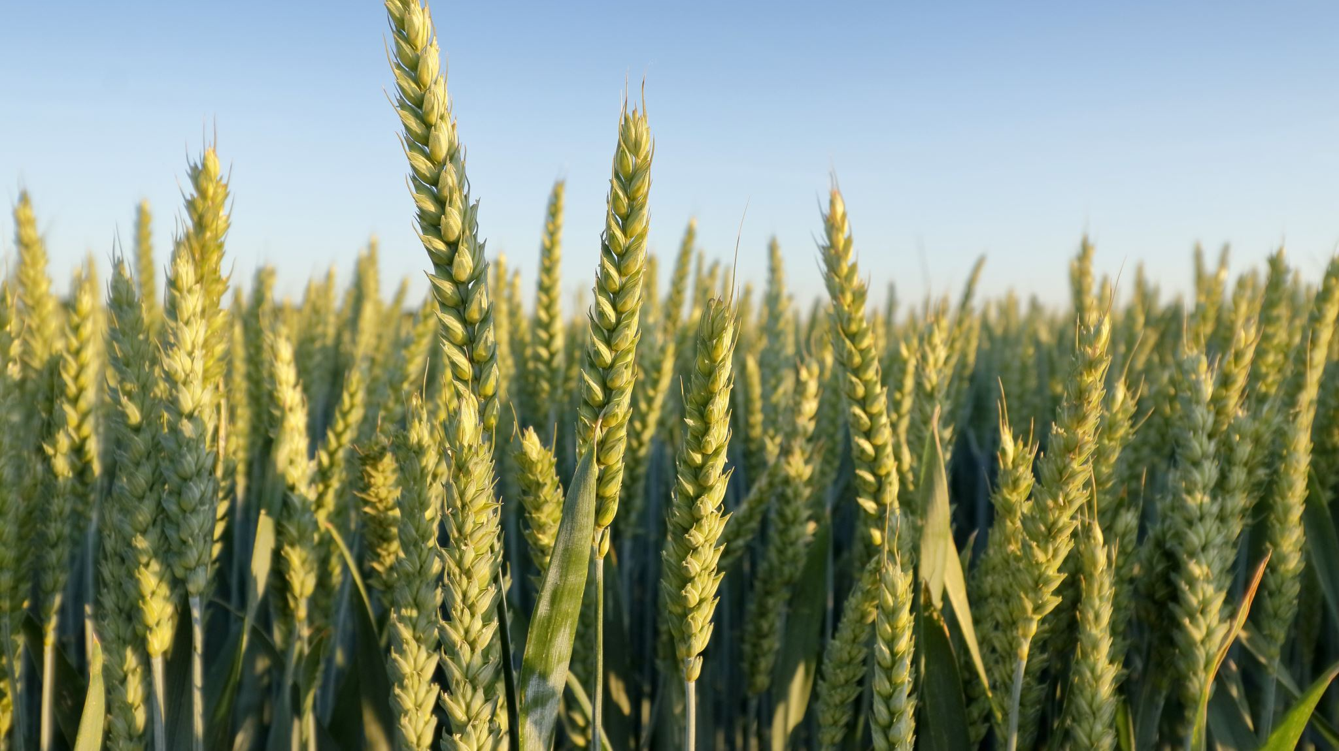
Contribution of ear development to yield stability in winter wheat
Project presentation by Nourian Wasella

Slide 2
Content
Physiology
Hypothesis
Methods
Results
Discussion
Conclusion

Slide 3
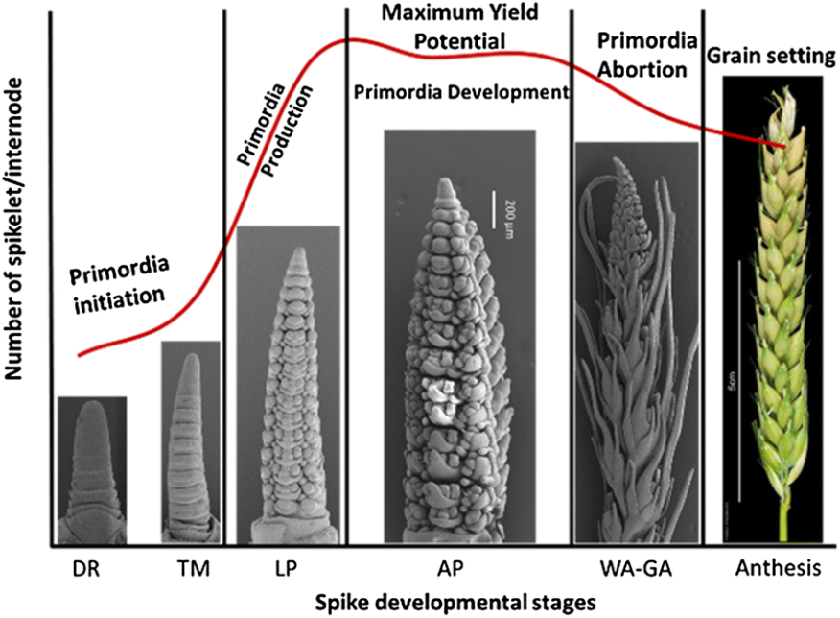
Spike Development (Physiology)
Source: (Boussora et al., 2019)

Slide 4
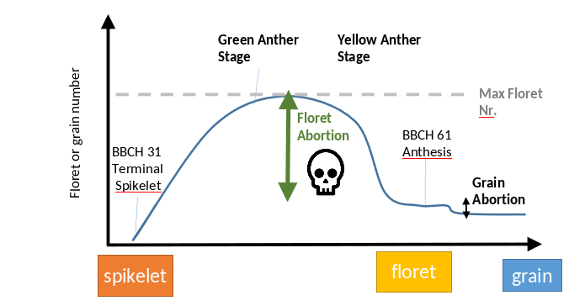
Floret and grain abortion (Physiology)
(Source: Tien Cheng Wang)

Slide 5
Hypotheses
Treatments with early sowing will have higher grain counts compared to those with late sowing
Treatments with early sowing will have higher counts of larger and medium grains compared to those with late sowing
There should not be a significant difference between floret numbers between batches

