Slide 1

BUY BOOKS
Team-3
Anirudh
Harshitha
Pavan​​
Wasil

Slide 2
Problem Statement
Website for buying books online.
Single Page App
Routing
State Management
Responsive web design

Slide 3




Technologies Used
React
React Redux
React Router
Bootstrap5

Slide 4
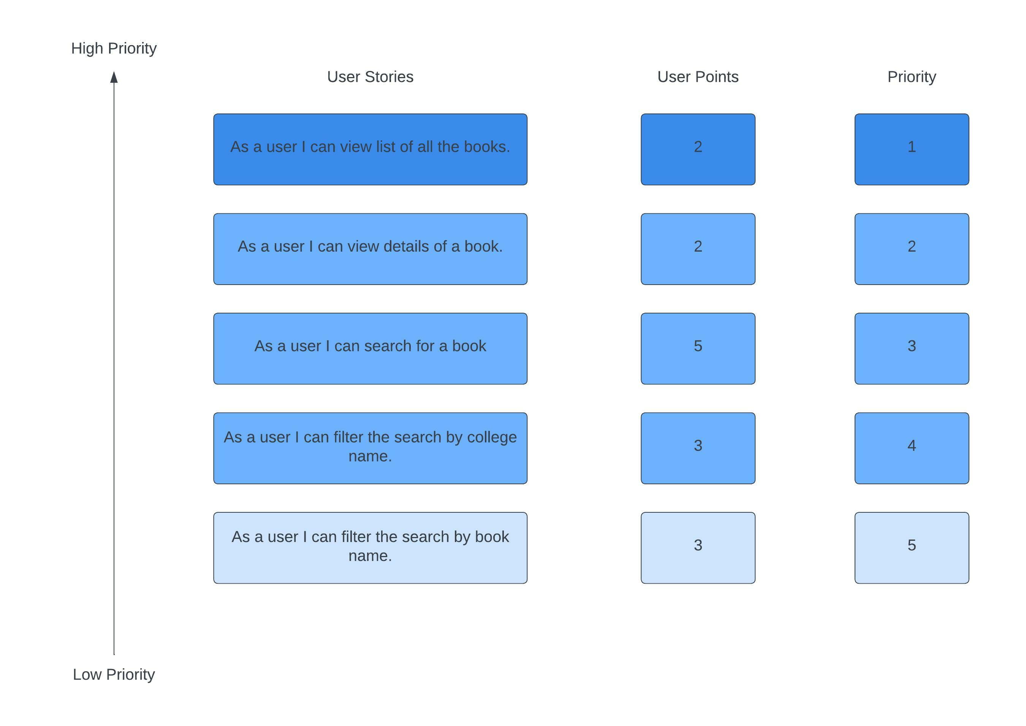
Product Backlog

Slide 5
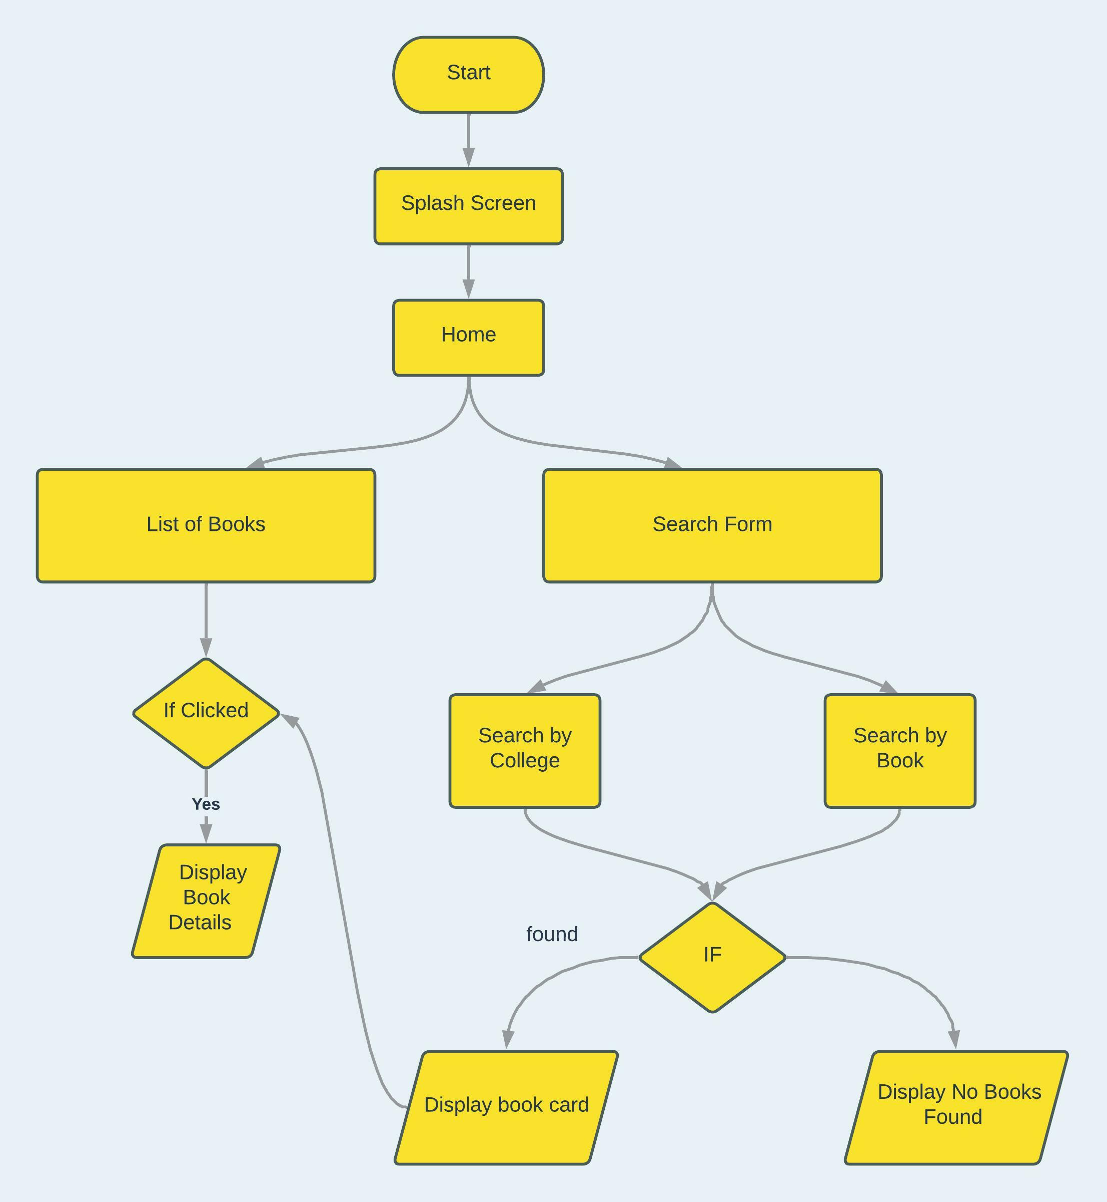
Flowchart

Slide 6
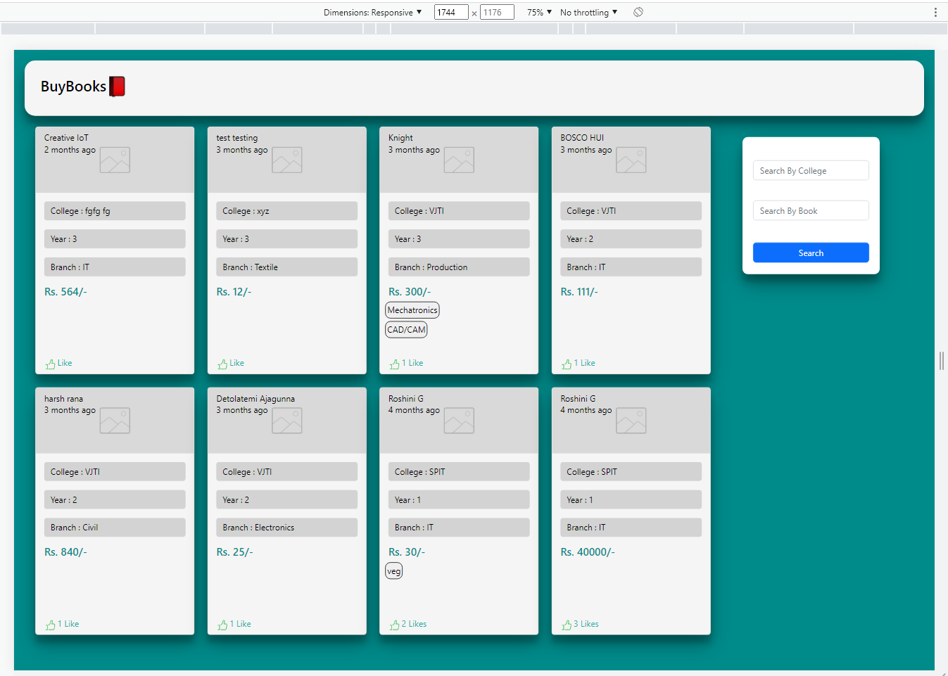
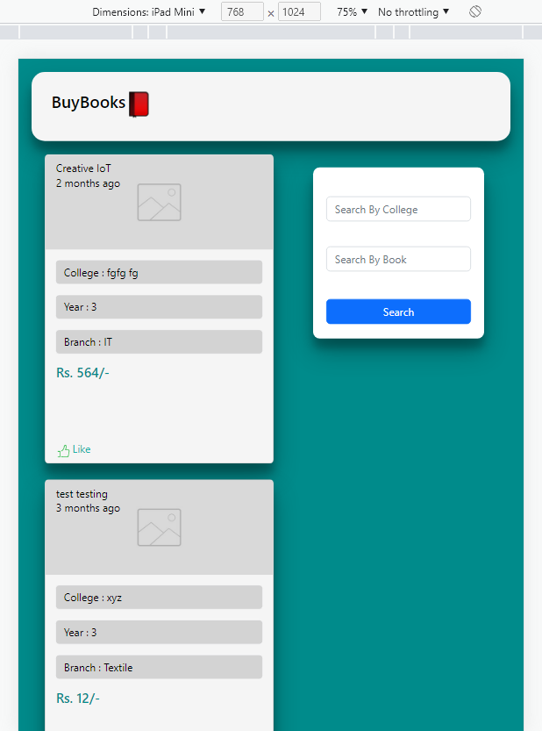
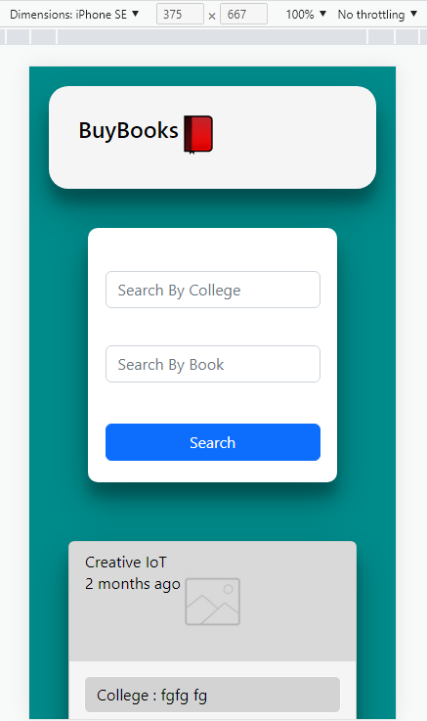
Testing
Test Case 1: Responsive
Desktop Screen
iPad Screen
Mobile Screen

Slide 7
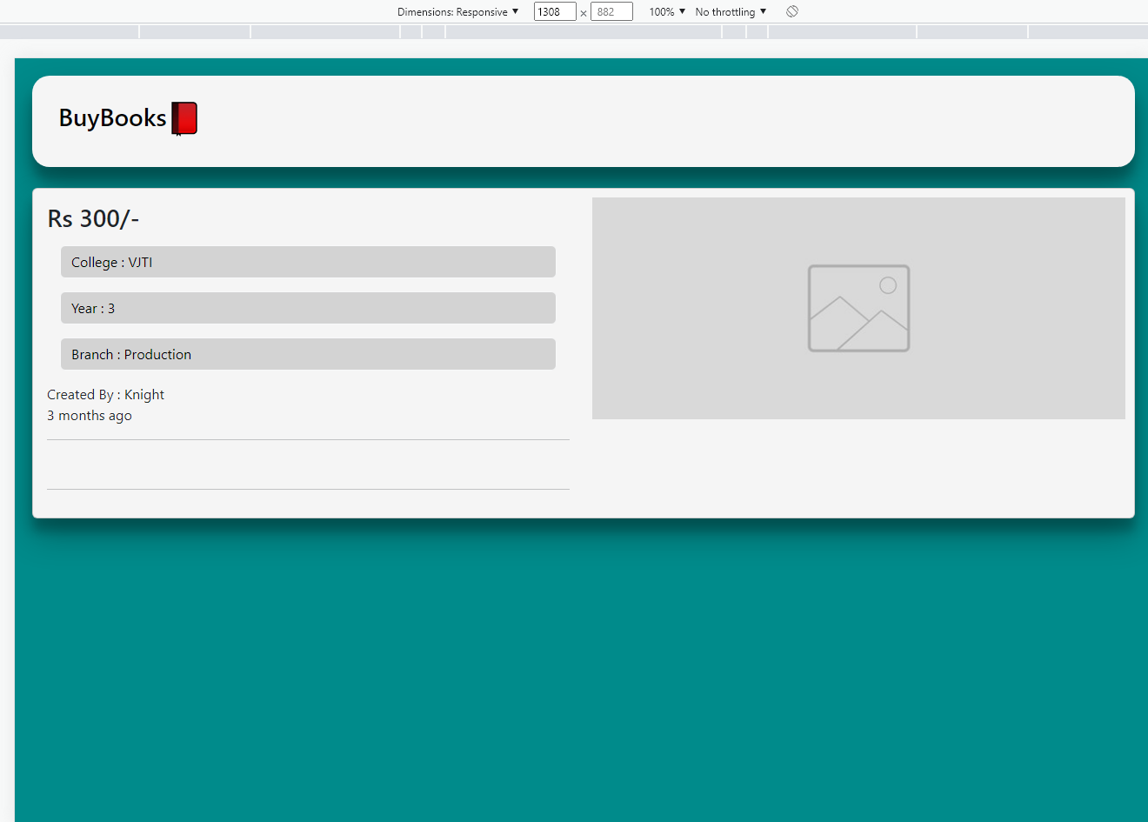
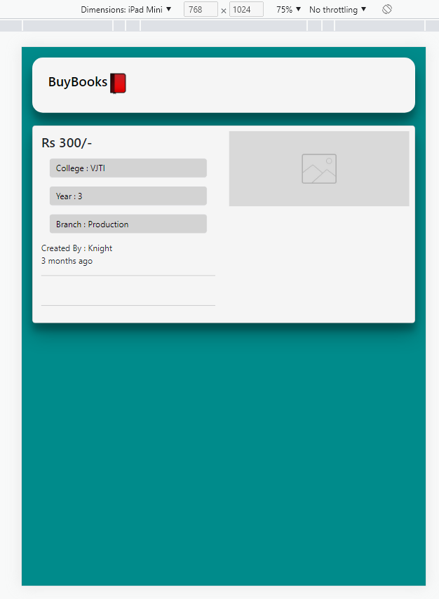
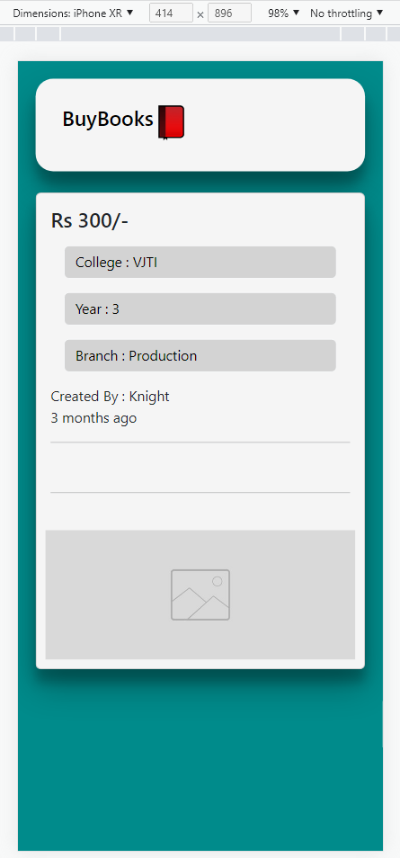
Testing
Test Case 2: Details Page(Responsive)
Desktop View
iPad View
Mobile View

Slide 8
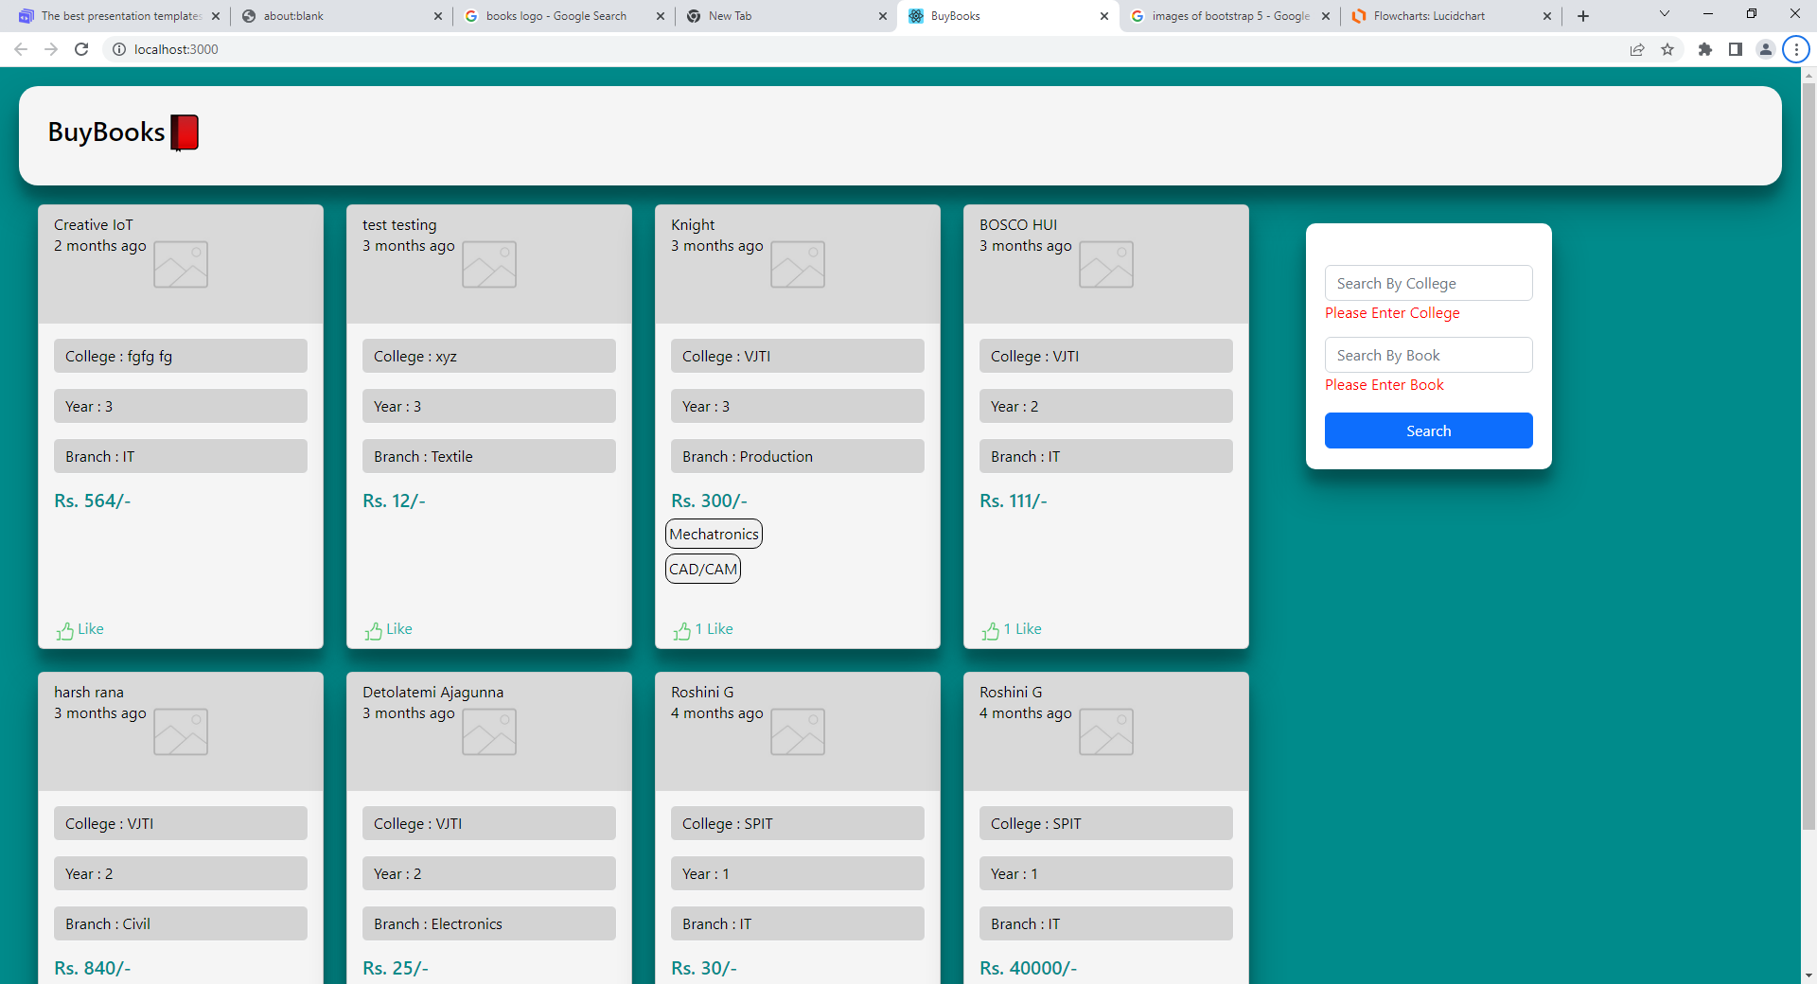
Testing
Test Case 3: Search
Search with empty fields

Slide 9
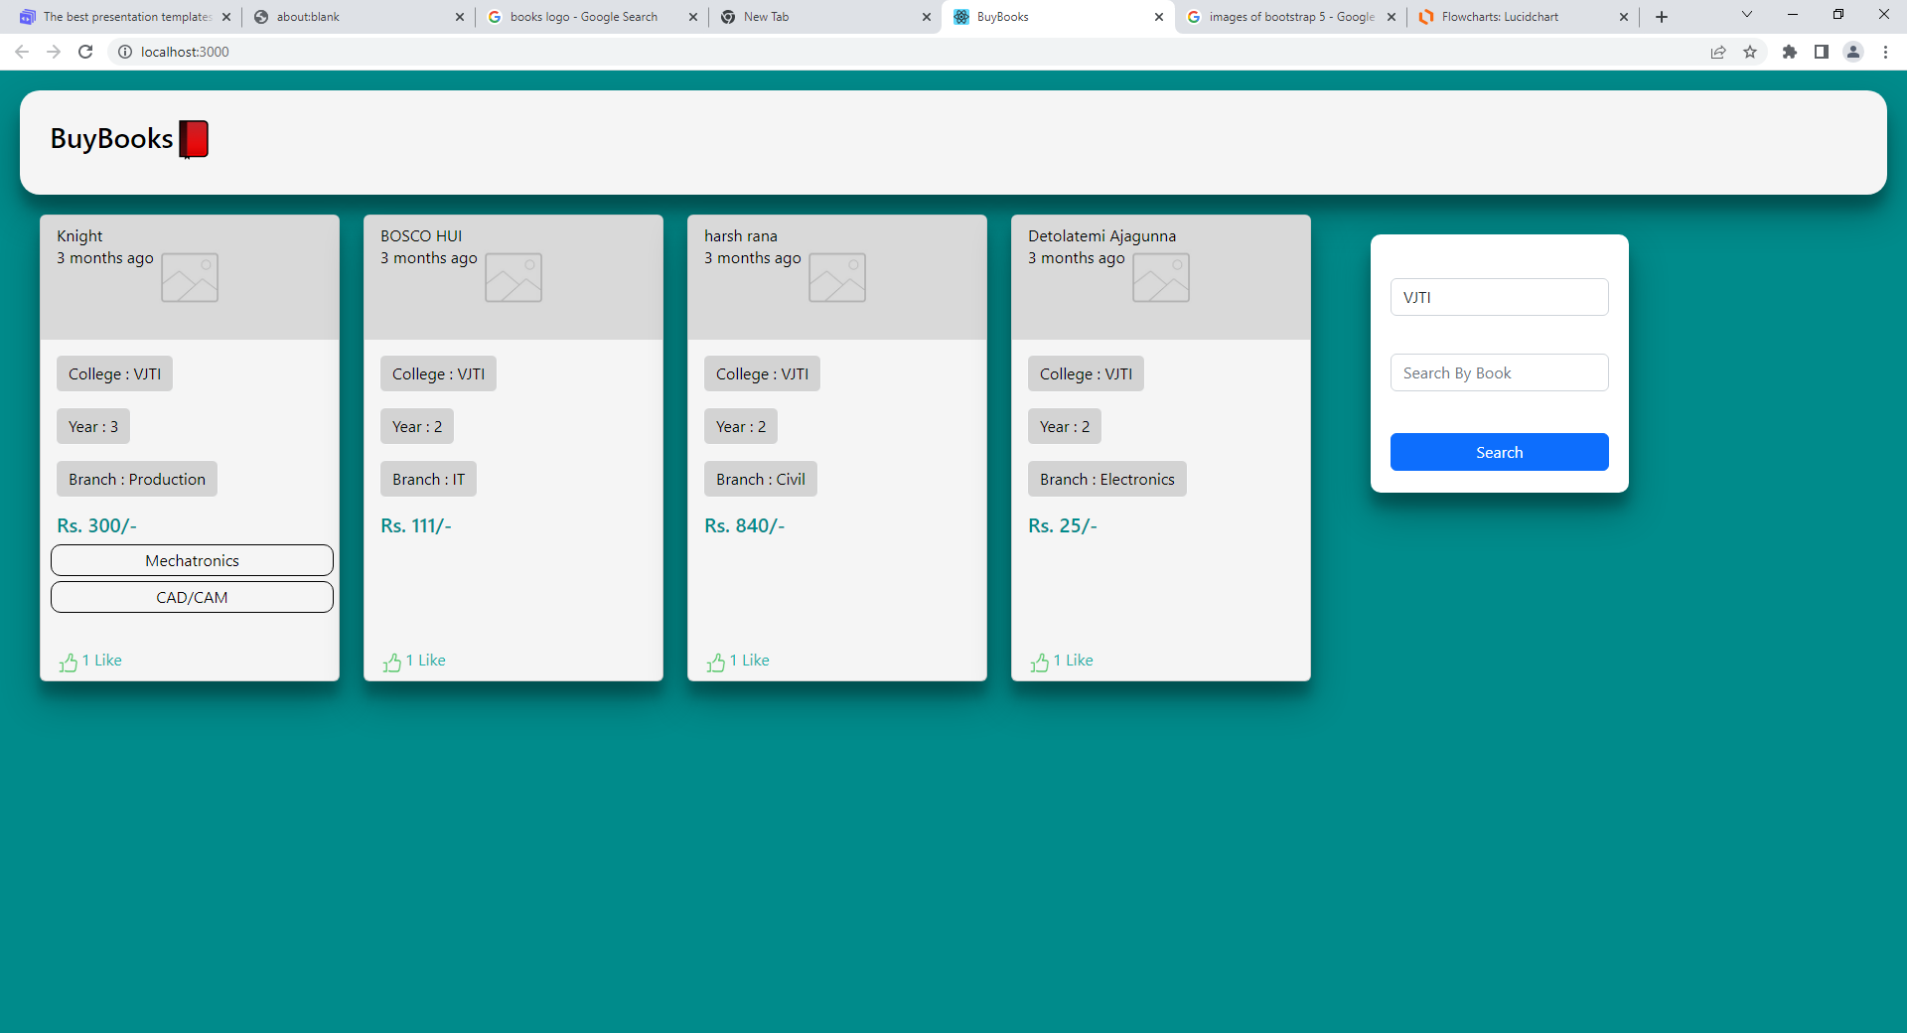
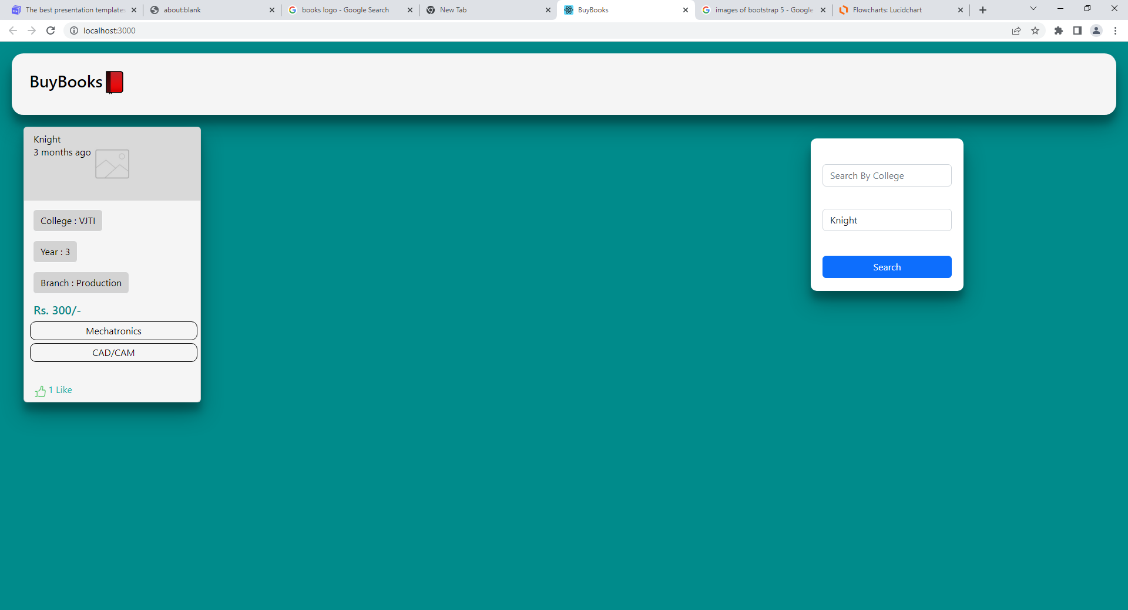
Testing
Test Case 3: Search
Search by College
Search by Book

Slide 10
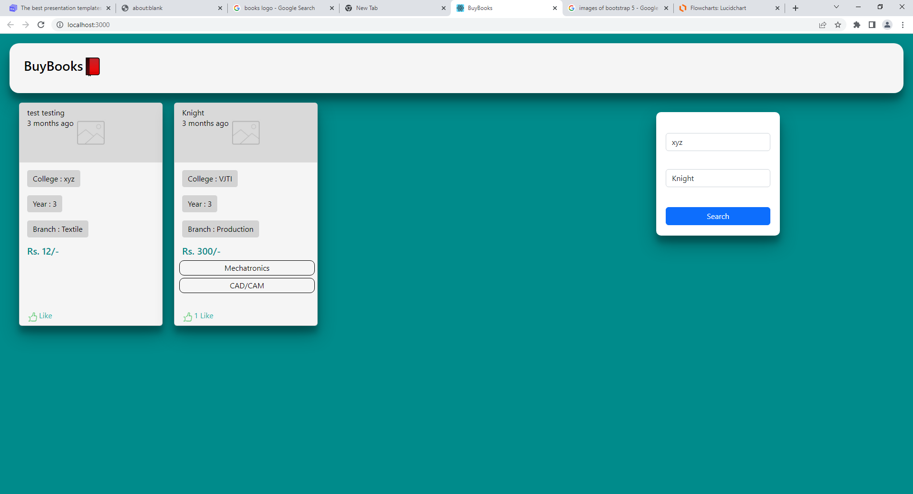
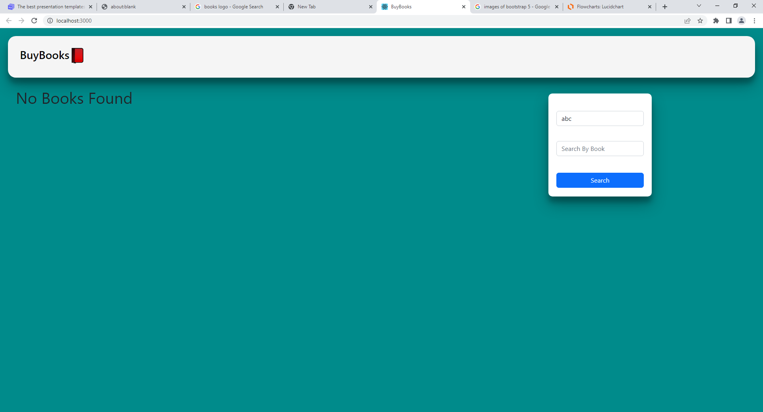
Testing
Test Case 3: Search
Filter Search By Both Fields
If book not found after search

Slide 11
Demo

Slide 12


