Slide 1
TEAM
TECH –TRIO
-LEEVANT RATHOR
-UMED KUMAR
-MD WASIM
Team Members:

Slide 2
Automatic plant irrigation system using waste water for farms.

Slide 3
There is a huge amount of waste water generated in village areas from a wide variety of activities. This waste water can be utilized for crop irrigation purposes. The project involves creation of a system that is automatically able to filter the waste water, making it suitable for irrigating a wide variety of different crops. If required the water can be imbued with certain minerals which would improve the growth of the crops. And then using the filtered water for automatic plant irrigation.

Slide 4
WHY WE NEED THESE-
For facing many problems like :-
Overirrigation
Underirrigation
Farms lands & fields situated miles away from yur home. Extensive travel required , sometimes several times in a day to start or stop the irrigation water pumps.
Land is more , so we need more manpower.
Proper utilization of waste water.

Slide 5
Components:
Arduino uno R3
Ultrasonic Sensor
Submersible water pump
Capacitive soil moisture sensor
Relay module(5 volt)
Boxes and some jumper wires

Slide 6
BLOCK DIAGRAMS

Slide 7
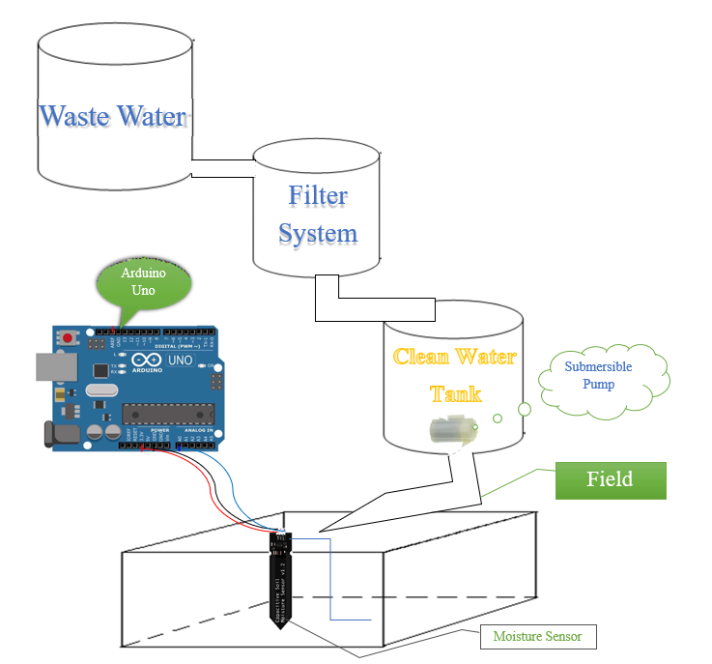
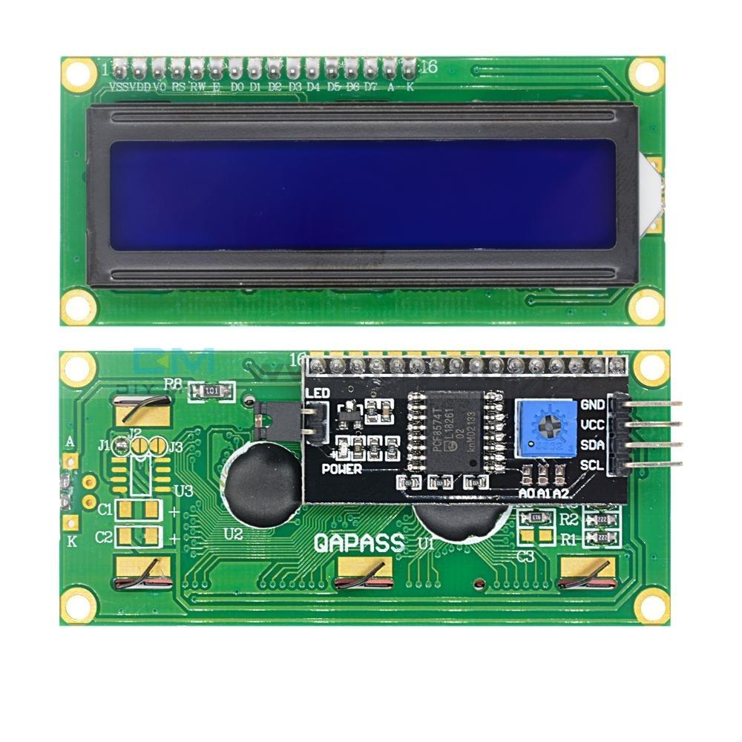
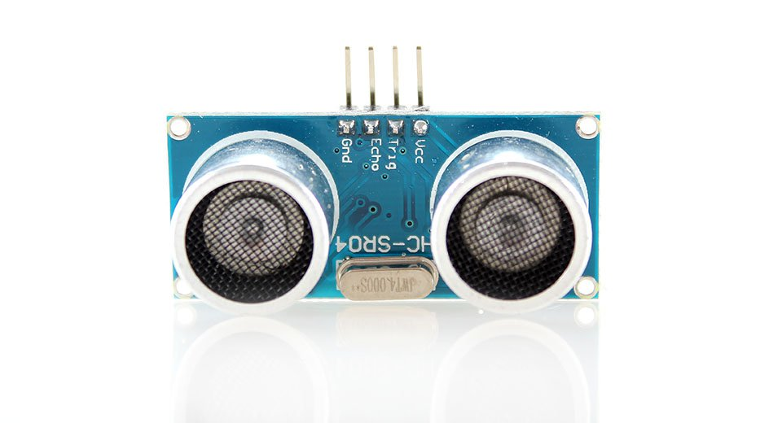

Slide 8
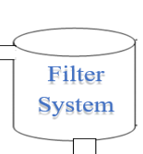
MINERALS AND NUTRIENTS SUITABLE FOR PLANTS AS WELL AS SOIL

Slide 9
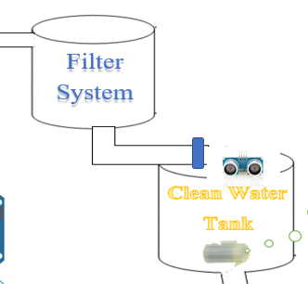
Soil : wet tan<90%
Pump: off open
Soil : dry tank >90%
Pump: off close

Slide 10
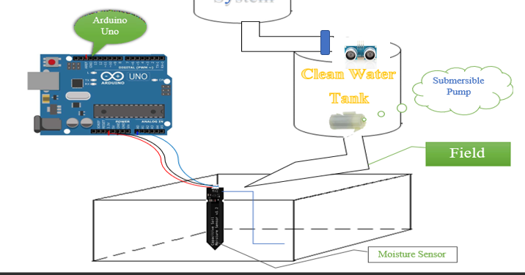

Slide 11
saf
WHEN WATER GET <15% IN SUPPLY TANK
MOTOR WILL BE TURNED OFF AUTOMATICALLY
SAFETY…..

Slide 12
BENEFITS OF THESE PROJECT:-
This makes increase in productivity.
A lot of time can be saved.
Reduce manpower.
Proper use of waste water.
Water saving model because it reduces water consumption.
Work on the principle of once installed and forget for long.
Can irrigate a large amount of land in a single time.

Slide 13

Approx Cost:
₹ 1190

Slide 14
THANK YOU

