Slide 1

Linux

Slide 2
Linux Facts
About 8,50,000 Linux running Android phones are activated every single day
Nearly 7,00,000 TV’s are sold every day which runs on Linux

Slide 3
Linux terminology
Kernel
It is the brain of OS
It controls the hardware and makes hardware interact with the applications

Slide 4
Linux terminology
Filesystem
It is a method of storing and organising files
Different Types of Filesystems Supported by Linux:
Conventional disk filesystems: ext2, ext3, ext4, XFS, Btrfs, JFS, NTFS, etc.
Flash storage filesystems: ubifs, JFFS2, YAFFS, etc.
Database filesystems
Special purpose filesystems: procfs, sysfs, tmpfs, debugfs, etc.

Slide 5
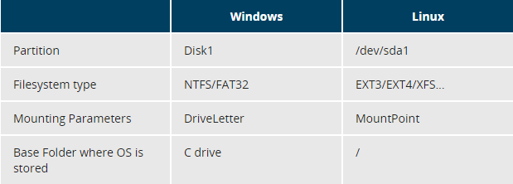
Linux terminology
Partitions and Filesystems
A partition is a logical part of the disk, whereas a filesystem is a method of storing/finding files on a hard disk (usually in a partition).
A comparison between filesystems in Windows and Linux

Slide 6
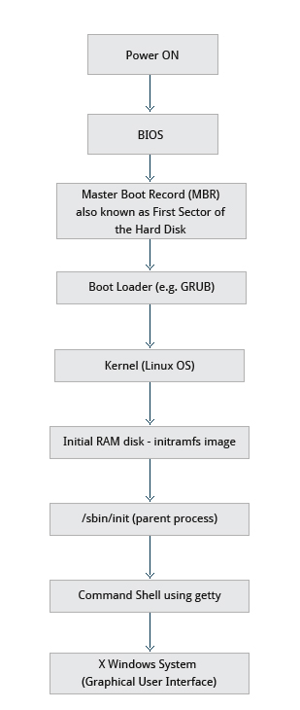
The Boot Process
The Linux boot process is the procedure for initializing the system. It consists of everything that happens from when the computer power is first switched on until the user interface is fully operational.

Slide 7
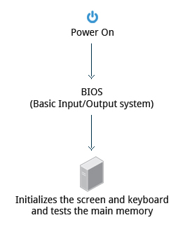
BIOS – The first step
Starting a Linux system involves a number of steps.
When the computer is powered on, the Basic Input/output System (BIOS) initializes the hardware, including the screen and keyboard, and tests the main memory.
This process is also called POST (Power On Self Test).

Slide 8
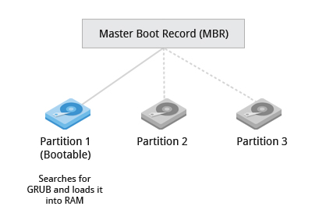
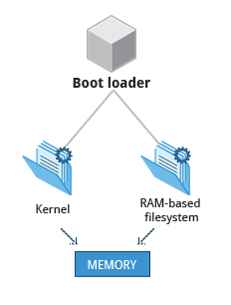
Master Boot Records (MBR) and Boot Loader

Slide 9
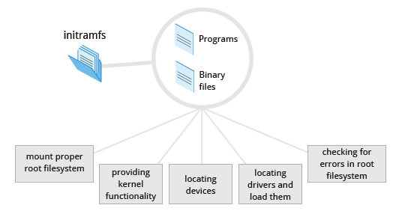
The Initial RAM Disk

Slide 10
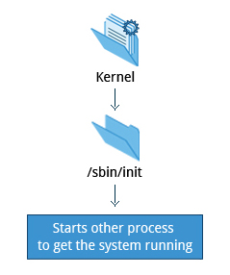
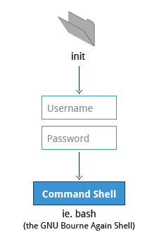
/sbin/init and Services

Slide 11
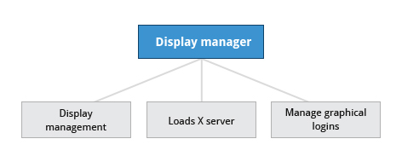
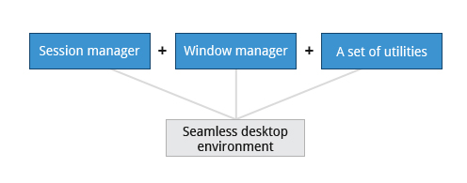
X-Window System

Slide 12
Linux file systems
Understanding Root
/ : root as hierarchy
root : root as user
/root : root directory

Slide 13
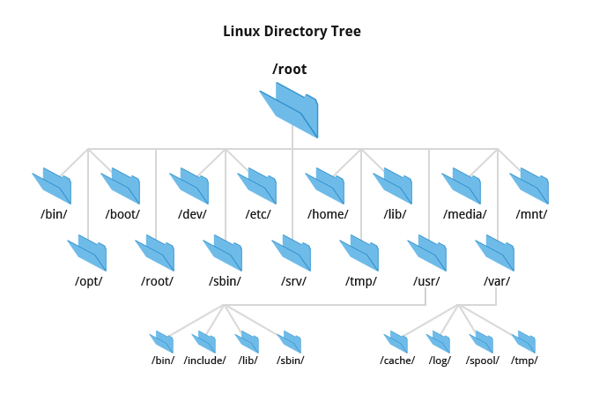

Slide 14
/bin directory contains executable binaries
The /dev directory contains device nodes
The /var directory contains files that are expected to change in size and content as the system is running (varstands for variable) such as the entries in the following directories:
System log files: /var/log
Packages and database files: /var/lib
Print queues: /var/spool
Temp files: /var/tmp
The /etc directory is the home for system configuration files.
The /boot directory contains the few essential files needed to boot the system.

Slide 15
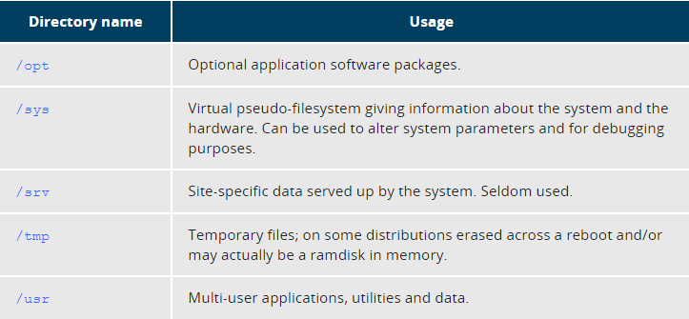

Slide 16
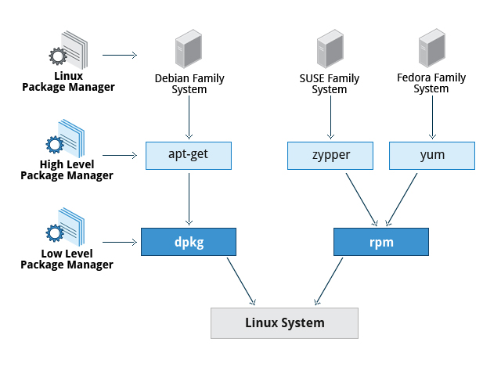
Package Management Systems on Linux

Slide 17
Command Line Operations
Most input lines entered at the shell prompt have three basic elements:
Command
Options
Arguments
The command is the name of the program you are executing. It may be followed by one or more options that modify what the command may do. Arguments specify on what the command will operate on.

Slide 18
Locating applications
$which
Eg : $which diff
$whereis
Eg : $whereis diff
$locate
Eg : $locate diff

Slide 19
Viewing files
$cat – view a file or concatenate
$tac – view file from backwards
$tail – print last 10 lines
$head – print first 10 lines
$touch – create an empty file
$file <name> - will give type of file

Slide 20
$mkdir – create a directory
$rmdir – remove directory*
$mv – rename a file
$rm – remove a file
$rm –f : forcefully remove
$rm –i : interactively remove a file
$rm –rf : recursively remove entire tree structure

Slide 21
User operations
$who : list of users currently logged in
$who –a : detailed info
$whoami : current user
$adduser : adding a user
$deluser : deleting a user
$usermod : modify user account
$addgroup : add a group (Ex - $addgroup <groupname>)
$id <username> : gives details about user
$adduser <un> --ingroup <gn> : adding user to an existing group
$addgroup <un> <gn> : adding existing user to a group
$usermod <un> -g <gn> : modiy group of user
$usermod <un> --gid <gid> : modify gid of user

Slide 22
File ownership
Chown : Used to change user ownership of a file or directory
Eg : $chown <username> <filename>
$chown <username>:<groupname> <filename>
Chgrp : Used to change group ownership
Eg : $chgrp <username/groupname> <filename>

Slide 23
File Permission Modes and chmod
Files have three kinds of permissions: read (r), write (w), execute (x). Rwx. These permissions affect three groups of owners: user/owner (u), group (g), and others (o).
rwx: rwx: rwx u: g: o
Numbers for permissions
4 if read permission is desired.
2 if write permission is desired.
1 if execute permission is desired.

Slide 24
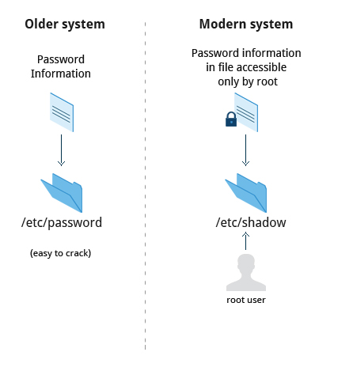
How passwords are stored

Slide 25
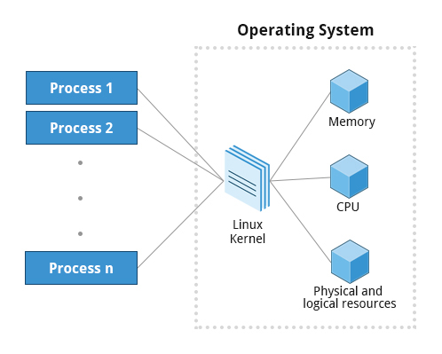
Process
A process is simply an instance of one or more related tasks (threads) executing on your computer.

Slide 26
Commands related to process
ps
Ps –u <username>
Ps –ef
Ps –eLf
Pstree

Slide 27
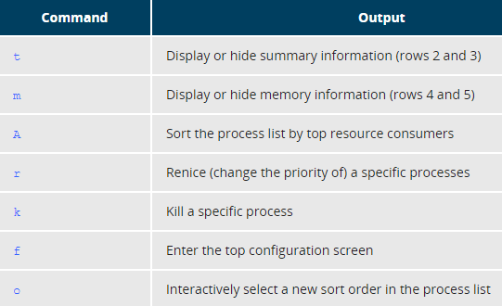
Monitoring process
top
Htop
Commands to alter top

Slide 28
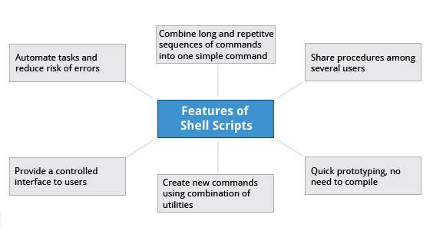
Bash shell scripting Shell – It is a command line interpreter that interprets the commands & instructs OS to perform necessary tasks ($cat /etc/shells : for checking shells)

Slide 29
Simple bash script
$ cat > exscript.sh #!/bin/bash echo "HELLO" echo "WORLD“
Run it as : $ bash exscript.sh
To make script executable change its permissions : chmod +x abc.sh
Now run it as : $./abc.sh

Slide 30
Interactive example
#!/bin/bash # Interactive reading of variables echo "ENTER YOUR NAME" read sname # Display of variable values echo $sname

Slide 31
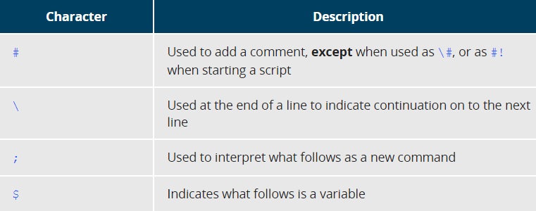
Basic Syntax and Special Characters

Slide 32
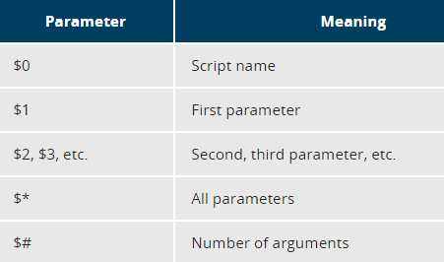
Functions
Eg : display () { echo "This is a sample function" }
Script parameters

Slide 33
Eg:
#!/bin/bash
echo “the name of script is $0”
echo “first parameter is $1”
echo “second parameter is $2”

Slide 34
If statement
if condition then statements else statements fi
Eg:
#!/bin/bash
file=“$1”
if [ -f $file ]; then
echo “$file exists”
else
echo “$file does not exist”
fi

Slide 35
elif statement
elif is same as else-if
Eg:
#!/bin/bash
echo “Enter a number”
read no
if [ $no –eq 100 ]; then
echo “Count is equal to 100”
elif [ $no –gt 100 ]; then
echo “Count is greater than 100”
else
echo “Count is less than 100”
fi

Slide 36
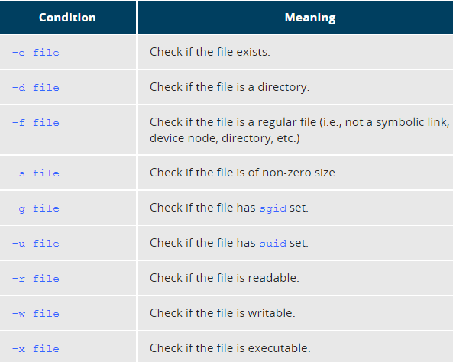

Slide 37
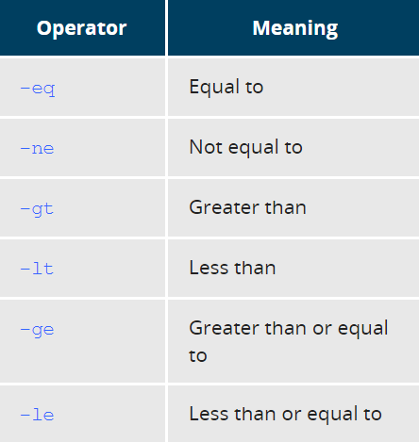

Slide 38
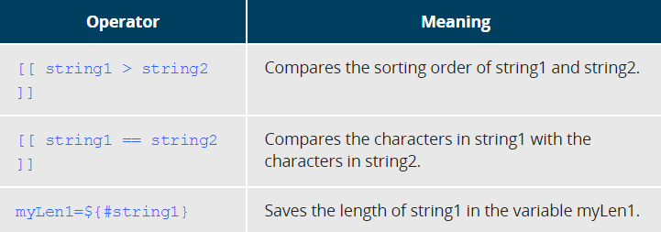
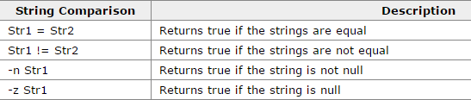

Slide 39
String example
#!/bin/bash
echo “Enter the ipaddress”
read ip
if [ -n $ip ]; then
ping –c 1 $ip
if [ $? –eq 0 ]; then
echo “Machine is giving a ping response”
else
echo “Machine is not giving a ping response”
fi
else
echo “ip is empty”
fi

Slide 40
Script Debuging
Debugging helps you troubleshoot and resolve such errors, and is one of the most important tasks a system administrator performs.
bash –x ./script_file
It can debug only selected parts of a script (if desired) with: set -x # turns on debugging ... set +x # turns off debugging

Slide 41
Cron
Cron is a system daemon used to execute desired tasks (in the background) at designated times.
A crontab file is a simple text file containing a list of commands meant to be run at specified times.
To edit the crontab file enter : $crontab –e
Each line has five time-and-date fields as : minute (0-59), hour (0-23, 0 = midnight), day (1-31), month (1-12), weekday (0-6, 0 = Sunday)
Eg : 04 04 1 1 1 /somedir/somecommand

Slide 42
Cron scripts
#!/bin/bash
echo “Cron ran successfully at : $(date)” >> /tmp/mybackup.log
#!/bin/bash
tar –czf /var/backup/mybup.tar.gz /home/quazi/
echo “Backup performed successfully at : $(date)” >> /var/tmp/bup.log

Slide 43
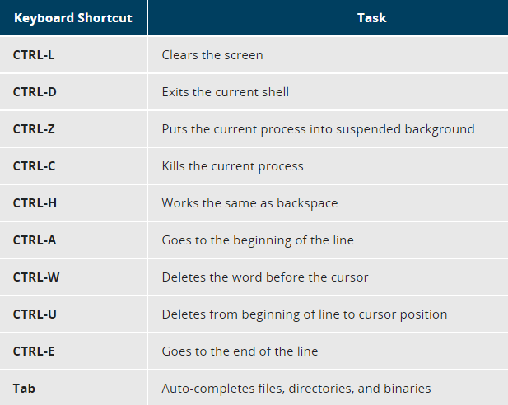

Slide 44

Thank you

