Slide 1

Networks

Slide 2
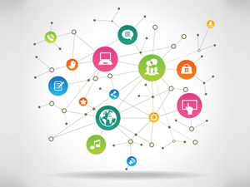
Introduction to Networking
A network is a group of computers and computing devices connected together through communication channels.
The computers connected over a network may be located in the same geographical area or spread across the world.

Slide 3
A network is used to:
Allow the connected devices to communicate with each other.
Enable multiple users to share devices over the network, such as printers and scanners.
Share and manage information across computers easily.

Slide 4
Data communication
Protocol – set of rules that govern data communication.
Without protocol they might be connected but not communicating
Protocol
Protocol
Message
Sender
Reciever

Slide 5
Data flow
Simplex – one way
Eg : keyboard
Utilizes full strength of channel
Half duplex – Can receive and send; but not at same time
Eg : walkie talkie
Full capacity – the one transmitting data
Full duplex – can receive and send at same time
- Eg : telephone

Slide 6
Network criteria
Performance – based on transmit time and receive time
Reliability – no of failures ; ability to recover from failure ; time required to recover from failure
Security – protecting from unauthorised access of data; damage to data

Slide 7
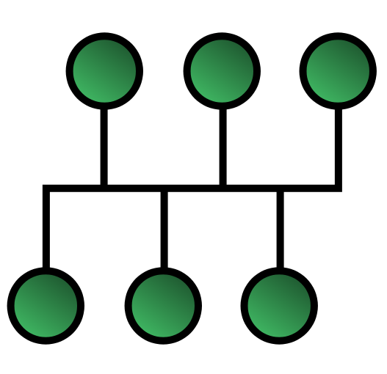
Topologies
Bus Topology – easy installation
- best for small nw
- due to short cable length, no of nodes limited
- bus fails, entire nw fails

Slide 8

Topologies
Star Topology – simple
- failure of one device doesn’t affect the nw
- depends on hub

Slide 9
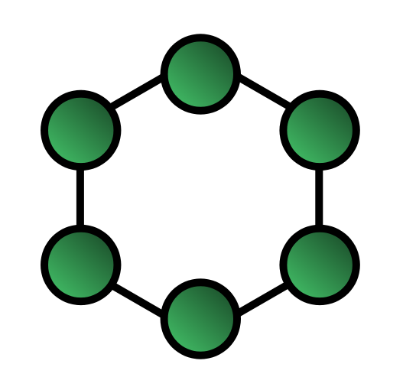
Topologies
Ring Topology – no need of hub
- communications takes place through nodes
- single node fails entire nw fails

Slide 10
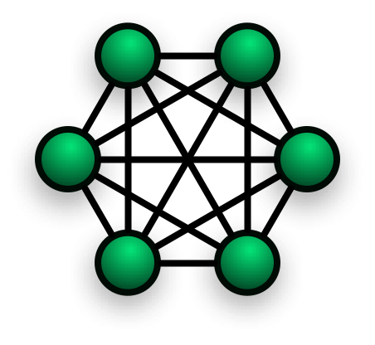
Topologies
Mesh Topology – A dedicated link is provided between each node
High transfer rate
Require large cabling; very expensive
More no of ports

Slide 11
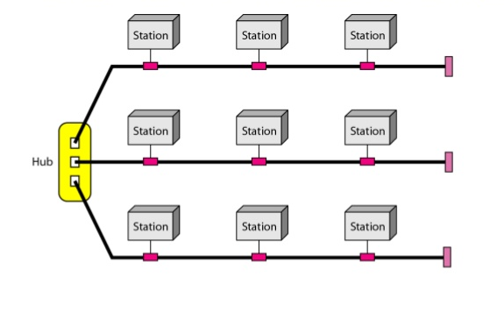
Topologies
Hybrid Topology – Any combination of previous

Slide 12
Categories of network
LAN – privately owned nw
- limited distance of connectivity
- used to share resources (both hw and sw)

Slide 13
Categories of network
WAN – Wide area network
- spans large geographical area
- consists of machines (hosts) connected by communication subnet or just subnet
- hosts are owned by users; subnet by ISP
- work of subnet – carry message from host to host
Subnet
Transmission lines – moves bits ; made of optical fibre, copper wire, radio waves
Switching elements – specialised computers that connect 3 or more transmission lines. Named as - Router

Slide 14
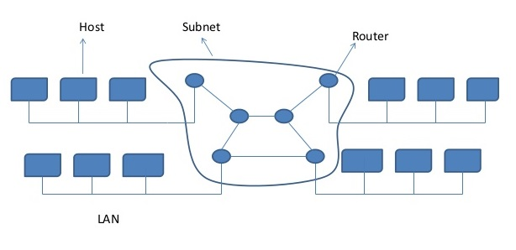

Slide 15
Categories of network
MAN – Metropolitan Area Network
- covers an entire city
- Eg : cable Tv network

Slide 16
Devices
Hub
Bridge
Switch
Router

Slide 17
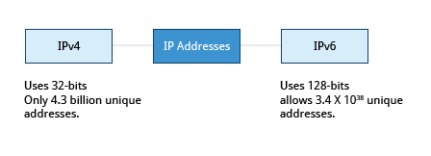
IP Address

Slide 18
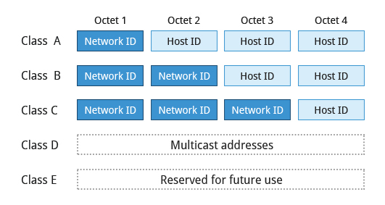
IPv4 Address

Slide 19
Domain Name System
Name resolution : Name Resolution is used to convert numerical IP address values into a human-readable format known as the hostname.
DNS

Slide 20
Commands
$cat /etc/hosts
$host google.com - lookup host using DNS
$nslookup google.com - lookup nameserver interactively
$dig google.com - lookup domain name information from
nameserver
$ping <hostname> - ping is used to check whether or not a machine attached to the network can receive and send data; i.e., it confirms that the remote host is online and is responding.

Slide 21

$route - give routing information
$traceroute <hostname>
$ethtool eth0
nmap
$sudo nmap –A –T4 google.com
$sudo namp -sP 192.168.0.1/24
$tcpdump –i eth0
$iptraf

Slide 22
Points to remember
Public Ip vs Private Ip
Public DNS vs Private DNS

Slide 23
Thank You

