Slide 1
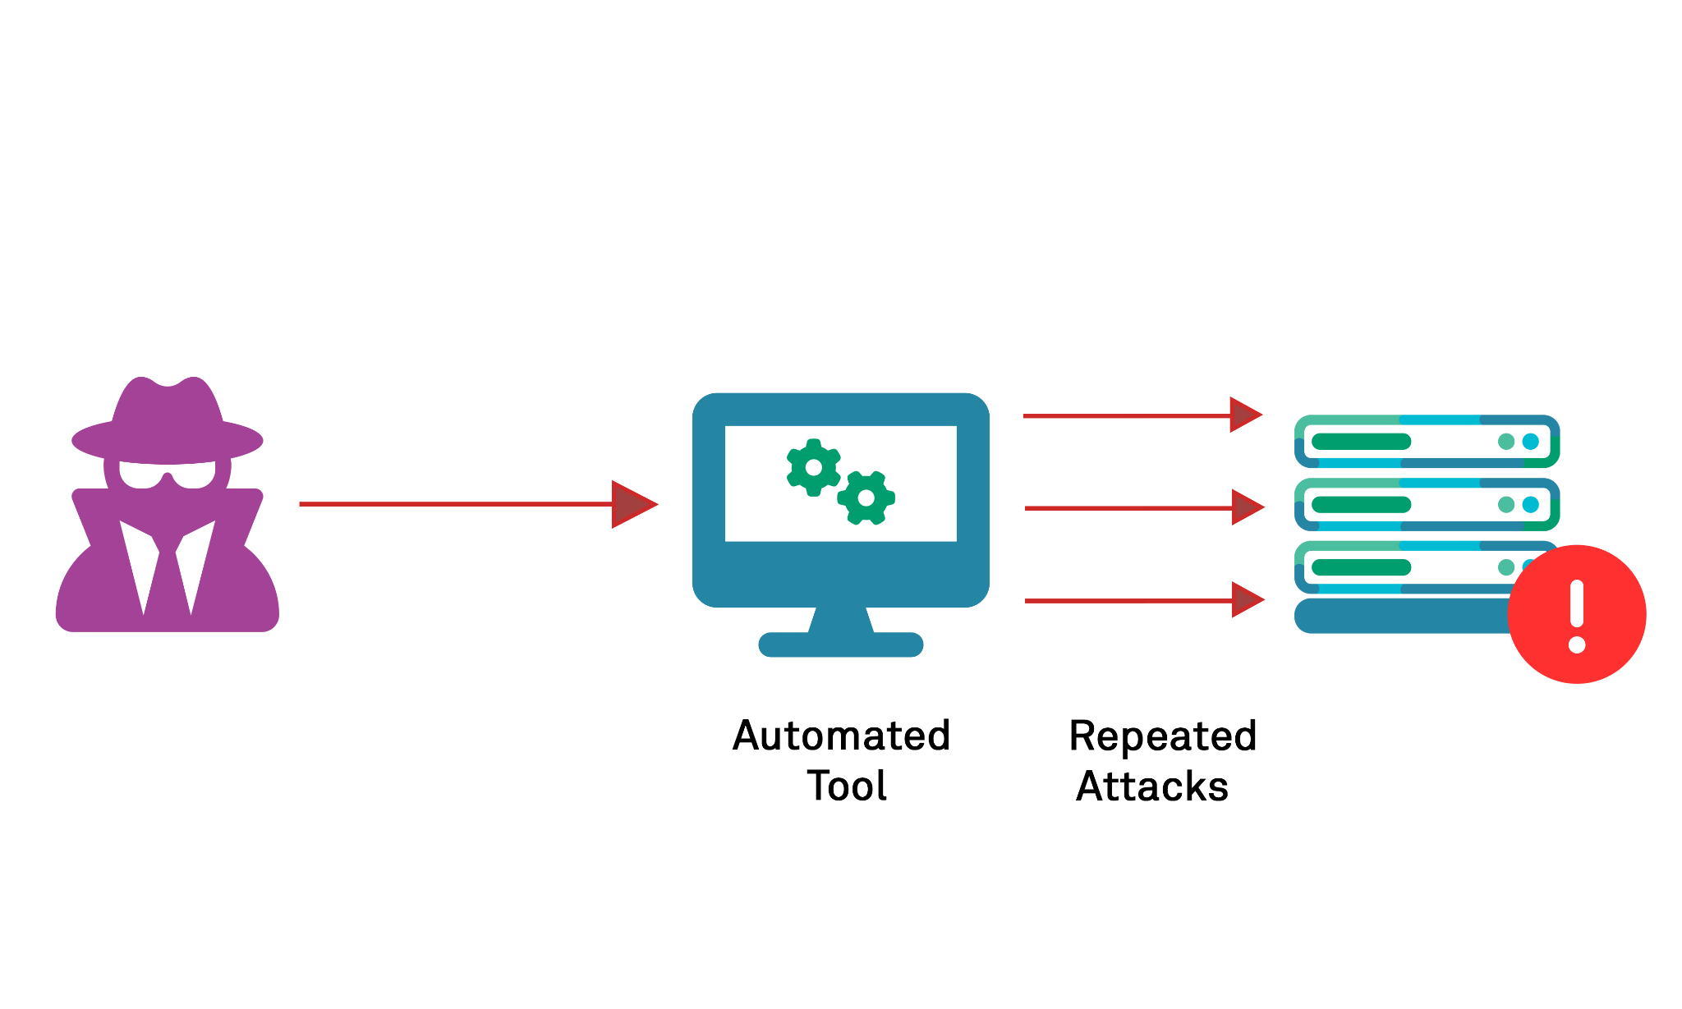
Secure E commerce Group No:9 Brute Force Attack
Yamini 11600655
Raga Sravya Nadella 11600666
Wasim Thonduri 11600575
Eshwar VannemReddy 11596826

Slide 2
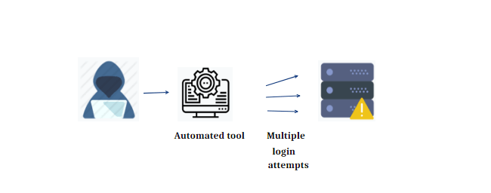
Contents
What is Brute force attack?
How can we Prevent Brute force attack
Car pooling website
Software's used in designing the website
Implementations of Brute force attack
Code snippets
Conclusion
References

Slide 3
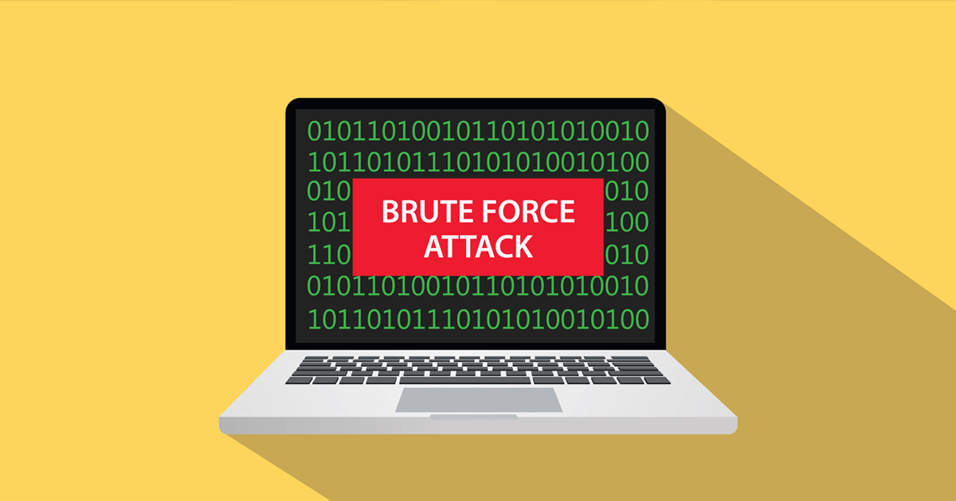
What is Brute force attack?
The brute force attack is a hacking technique that uses trial and error to break encryption keys, passwords, and login information. It is a simple but successful method for gaining unauthorized access to user accounts, business systems, and networks.

Slide 4
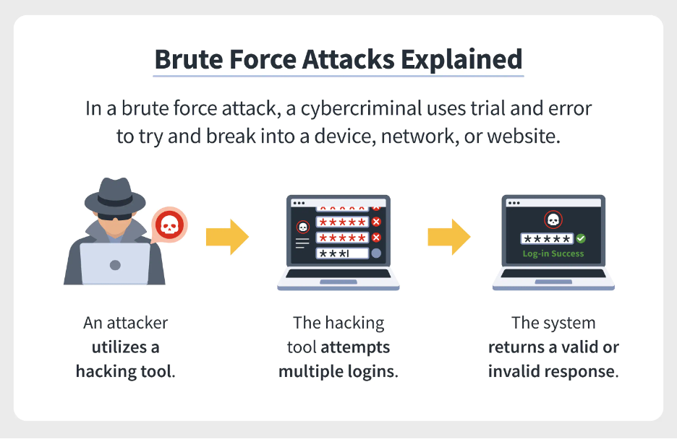

Slide 5
How can we prevent brute force attack?

Slide 6
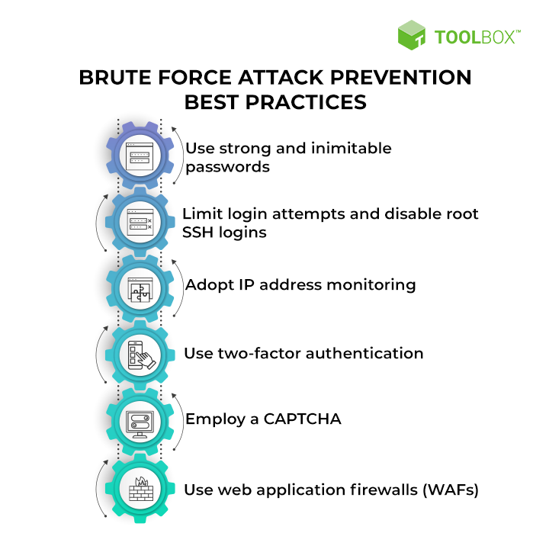

Slide 7
Car pooling website

Slide 8

Software's used in designing the website
PHP
Java Script
CSS
JSON

Slide 9
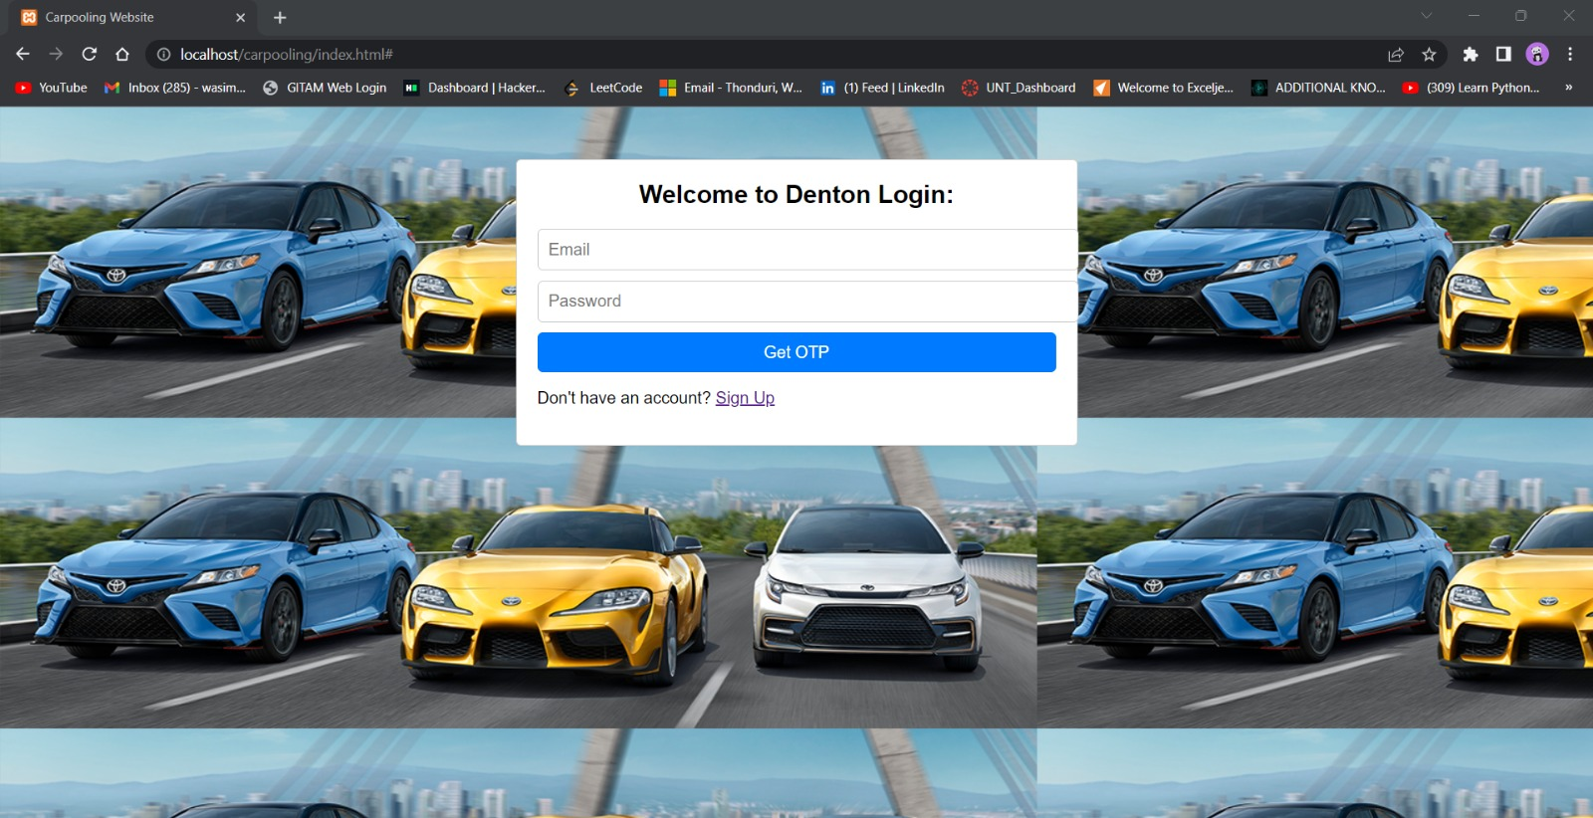

Slide 10
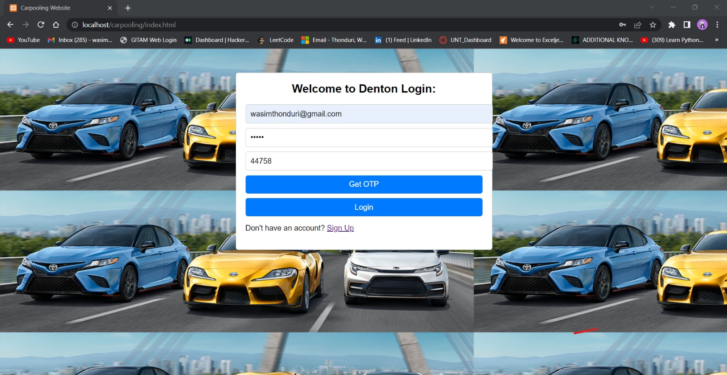

Slide 11
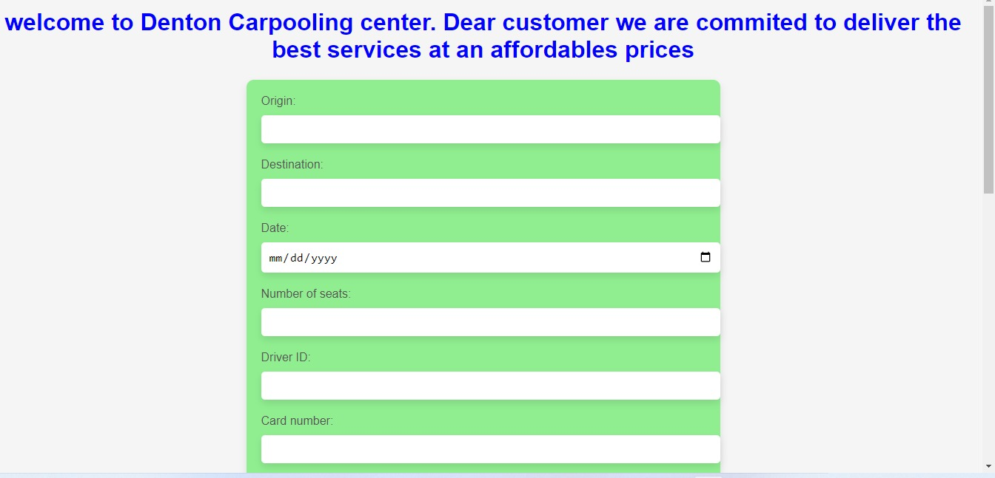

Slide 12
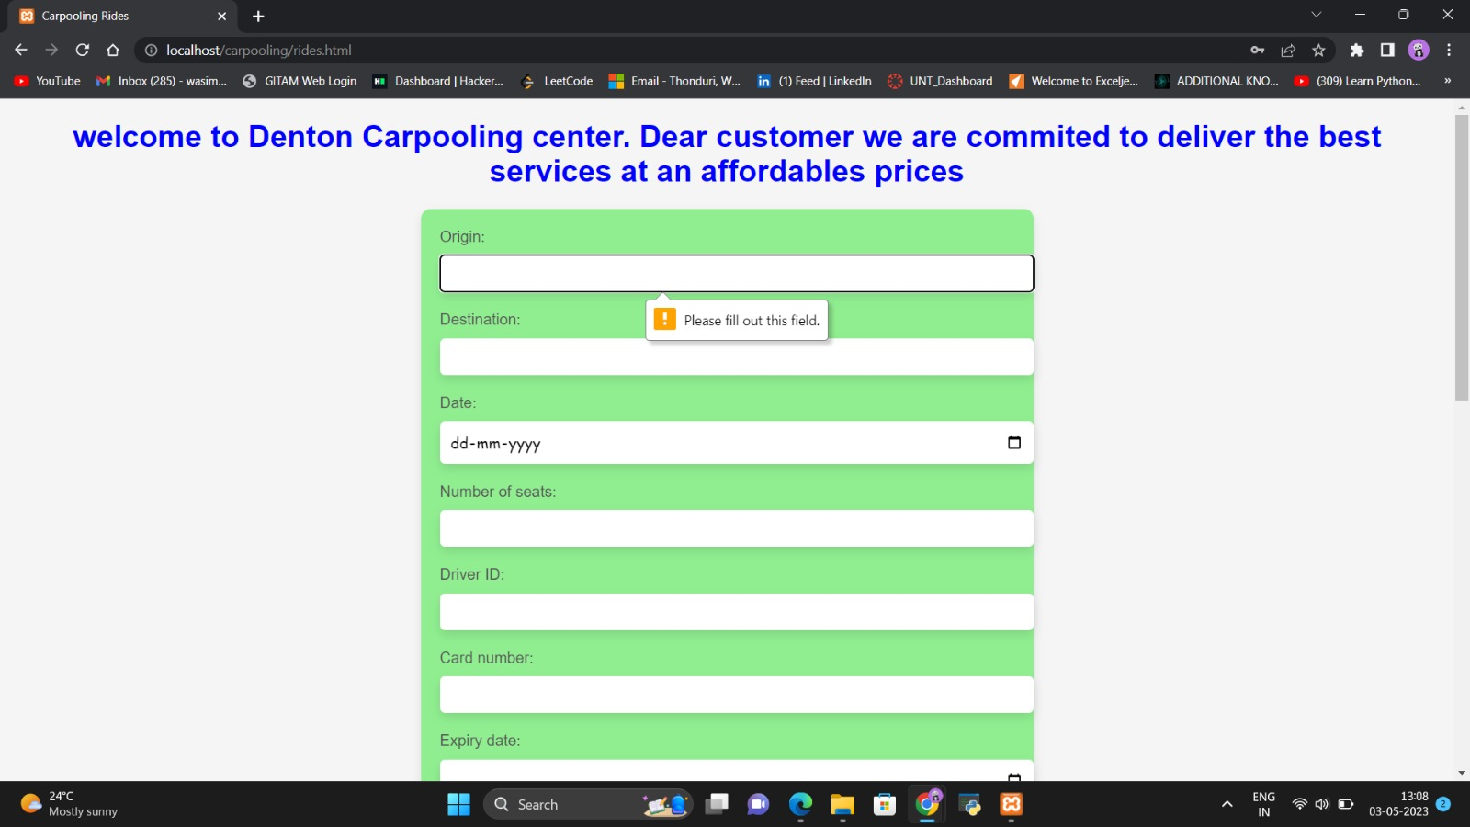

Slide 13
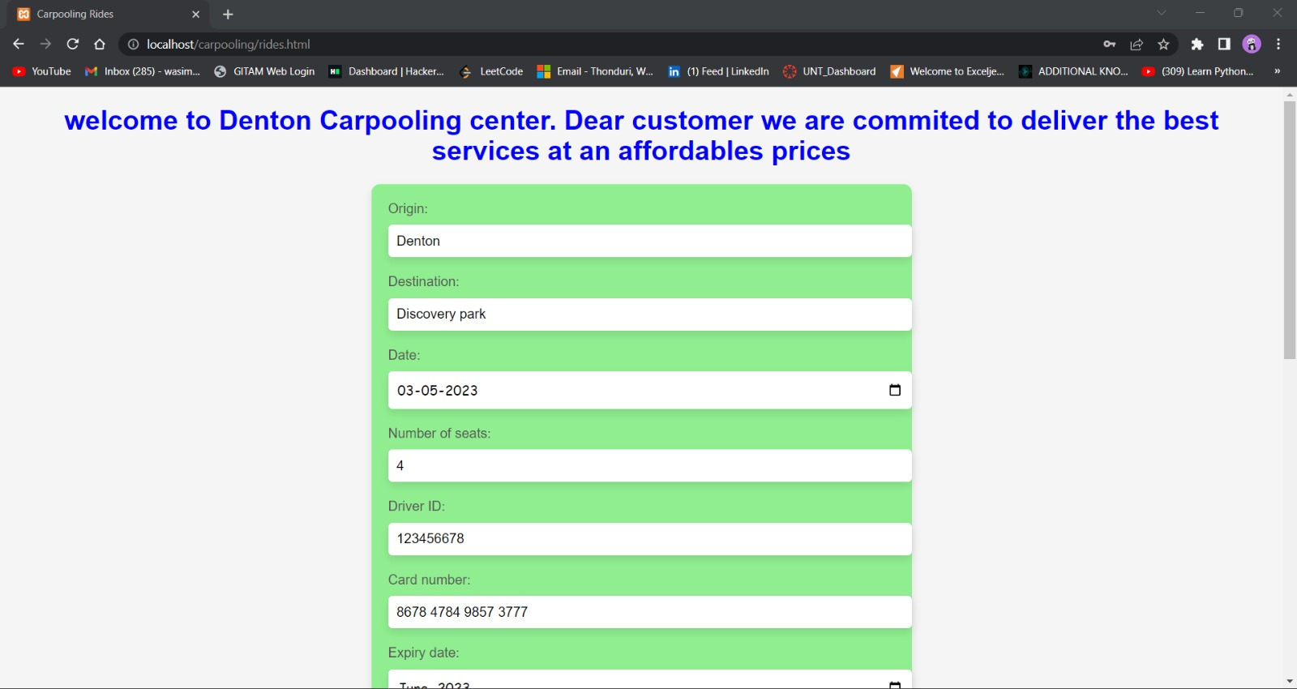

Slide 14
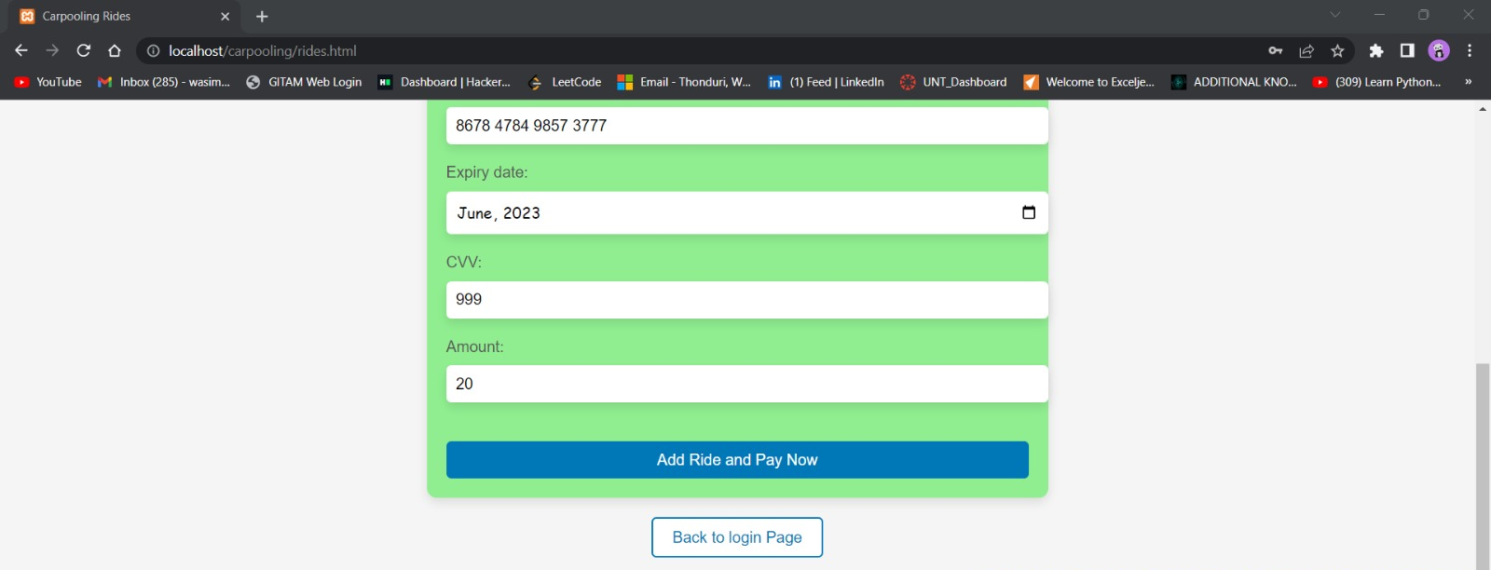

Slide 15
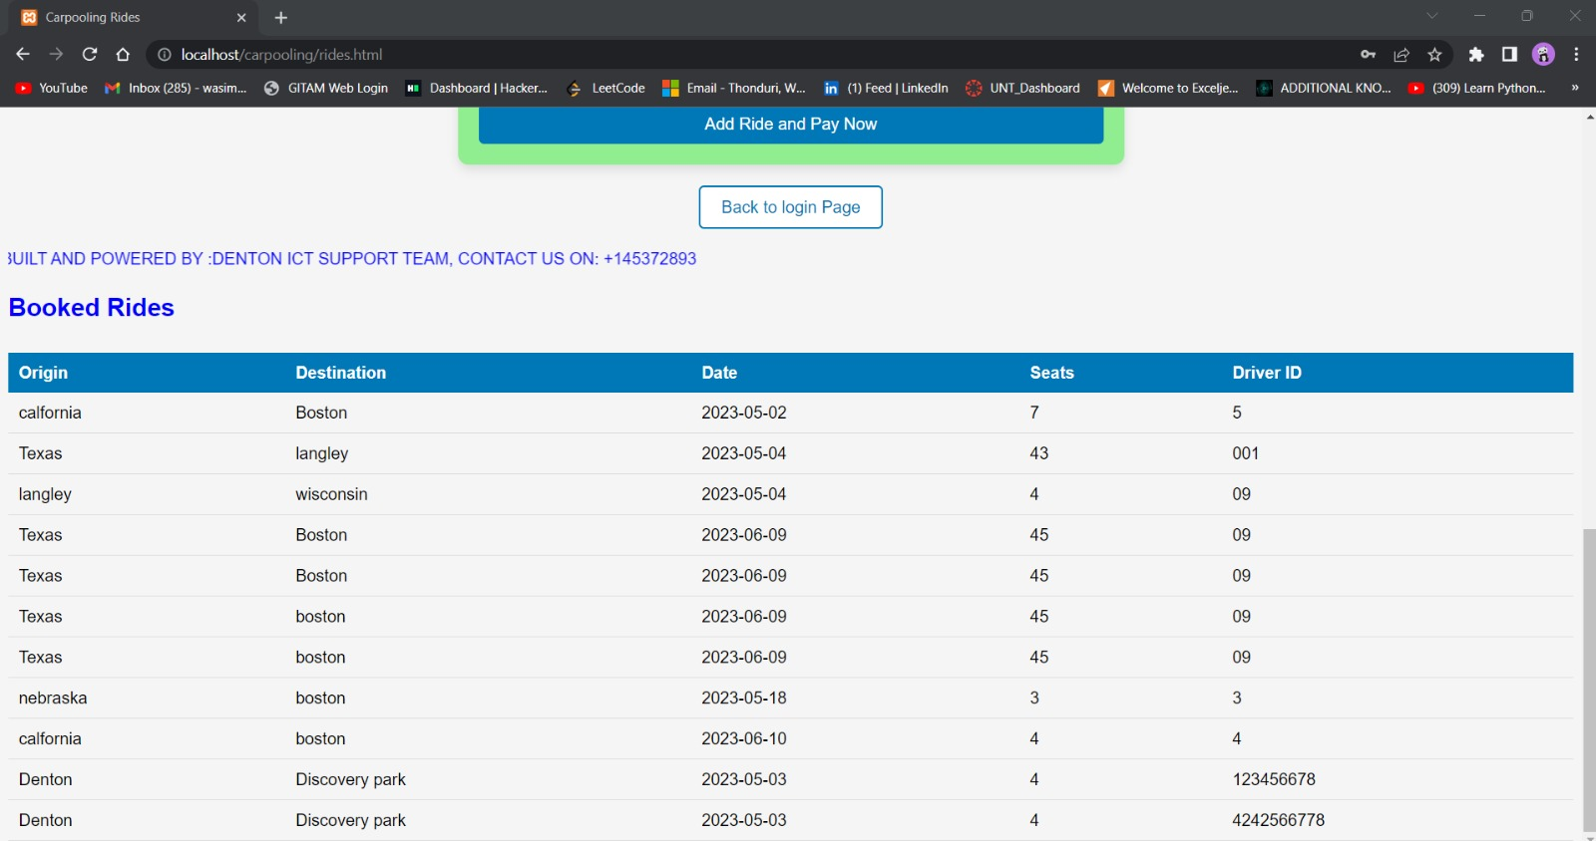

Slide 16
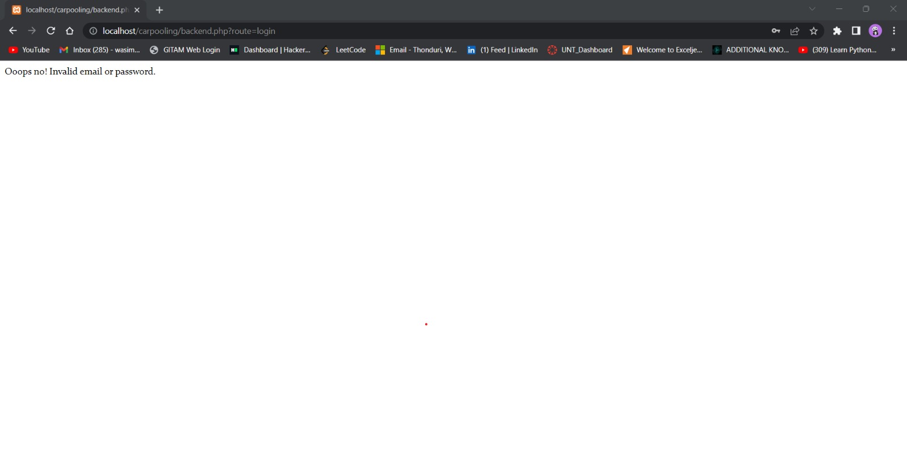

Slide 17
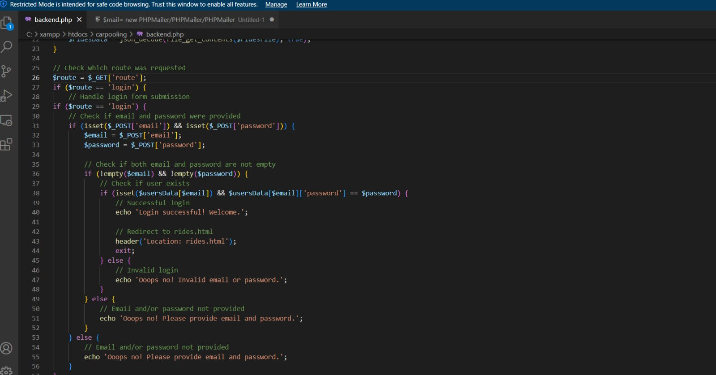
Code snippets

Slide 18
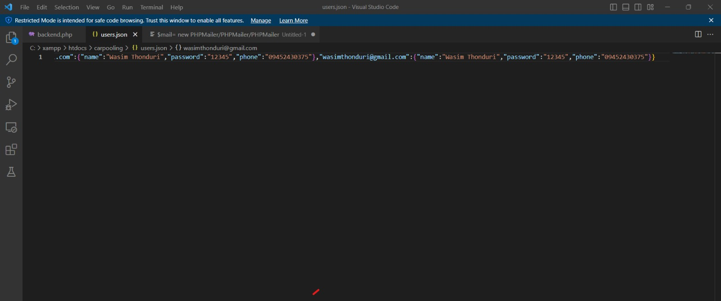

Slide 19
Conclusion
While it may seem like a straightforward approach, brute force attacks can take a significant amount of time and resources to execute successfully. Therefore, it is important to take measures to protect yourself against such attacks, such as using strong and unique passwords, limiting login attempts, and implementing two-factor authentication.

Slide 20
References
https://en.wikipedia.org/wiki/Brute-force_attack
https://www.bleepingcomputer.com/news/microsoft/all-windows-versions-can-now-block-admin-brute-force-attacks/
https://www.crowdstrike.com/cybersecurity-101/brute-force-attacks/

Slide 21
Thank you!

